Slide 1
Total Array Ordering
Jay Foad & Adám Brudzewsky
大道至簡
⍒⍋

Slide 2
Grading
⍋'APL'
1 3 2

Slide 3
Grading
⍋'APL'
1 3 2

Slide 4
Grading
[1,2,3]
⍋'APL'
1 3 2
'A' 'L' 'P' ⍨

Slide 5
Major Cells: Vector
┌→──┐
│APL│
└───┘

Slide 6
Major Cells: Matrix
┌→──┐
↓AAA│
│PPP│
│LLL│
└───┘

Slide 7
Major Cells: Cube
┌→──┐
↓AAA│
│AAA│──┐
│AAA│PP│
└───┘PP│──┐
│PPP│LL│
└───┘LL│
│LLL│
└───┘

Slide 8
Major Cells: mat
┌→─────┐
↓John │
│Roger │
│Adam │
│Morten│
│Jay │
└──────┘

Slide 9
Major Cells: mat ⍋mat
┌→─────┐ 3 5 1 4 2
↓John │
│Roger │
│Adam │
│Morten│
│Jay │
└──────┘

Slide 10
Major Cells: mat ⍋mat
┌→─────┐ 3 5 1 4 2
↓John │
│Roger │
│Adam │
│Morten│
│Jay │
└──────┘

Slide 11
Major Cells: mat mat[⍋mat;]
┌→─────┐ ┌→─────┐
↓John │ ↓Adam │
│Roger │ │Jay │
│Adam │ │John │
│Morten│ │Morten│
│Jay │ │Roger │
└──────┘ └──────┘

Slide 12
Sorting mat[⍋mat;]
{(⊂⍋⍵)⌷⍵} mat

Slide 13
Sorting mat[⍋mat;]
{(⊂⍋⍵)⌷⍵} mat

Slide 14
Sorting mat[⍋mat;]
{(⊂⍒⍵)⌷⍵} mat

Slide 15
Sorting mat[⍋mat;]
Sort ← {(⊂⍋⍵)⌷⍵}

Slide 16
Sorting mat[⍋mat;]
Sort ← {(⊂⍋⍵)⌷⍵}
Sort mat

Slide 17
Sorting mat[⍋mat;]
Sort ← {(⊂⍋⍵)⌷⍵}
Sort mat
Adam
Jay
John
Morten
Roger

Slide 18
Sorting
n ← 'Roger' 'Adam' 'Jay'

Slide 19
Sorting
n ← 'Roger' 'Adam' 'Jay'
Sort n ⍝ 16.0

Slide 20
Sorting
n ← 'Roger' 'Adam' 'Jay'
Sort n ⍝ 16.0
DOMAIN ERROR

Slide 21
Sorting
n ← 'Roger' 'Adam' 'Jay'
Sort n ⍝ 16.0
DOMAIN ERROR
Sort n ⍝ 17.0

Slide 22
Sorting
n ← 'Roger' 'Adam' 'Jay'
Sort n ⍝ 16.0
DOMAIN ERROR
Sort n ⍝ 17.0
┌────┬───┬─────┐
│Adam│Jay│Roger│
└────┴───┴─────┘

Slide 23
⍝ That's all, folks!

Slide 24
Total Array Ordering

Slide 25
History
'Morten'
'Roger '

Slide 26
History
'Morten'
'Roger▉'

Slide 27
History
A ← 'Morten'
B ← 'Roger▉'

Slide 28
History
A ← 'Morten'
B ← 'Roger▉'
⍋ A ,[0.5] B
1 2

Slide 29
History
A ← 'Morten'
B ← 'Roger▉'
⍋ A ,[0.5] B
1 2
'Morten' ≺ 'Roger▉'

Slide 30
Total Array Ordering
some other
≺ ?
array array

Slide 31
Total Array Ordering
How would you order:
⎕ ← 0 'Jay' (2 3⍴'DYALOG') (⍳9)
┌→──────────────────────────────────┐
│ ┌→──┐ ┌→──┐ ┌→────────────────┐ │
│ 0 │Jay│ ↓DYA│ │1 2 3 4 5 6 7 8 9│ │
│ └───┘ │LOG│ └~────────────────┘ │
│ └───┘ │
└∊──────────────────────────────────┘

Slide 32
Total Array Ordering
How would you order:
⎕ ← 0 'Jay' (2 3⍴'DYALOG') (⍳9)
┌→──────────────────────────────────┐
│ ┌→──┐ ┌→──┐ ┌→────────────────┐ │
│ 0 │Jay│ ↓DYA│ │1 2 3 4 5 6 7 8 9│ │
│ └───┘ │LOG│ └~────────────────┘ │
│ └───┘ │
└∊──────────────────────────────────┘

Slide 33
TAO

Slide 34
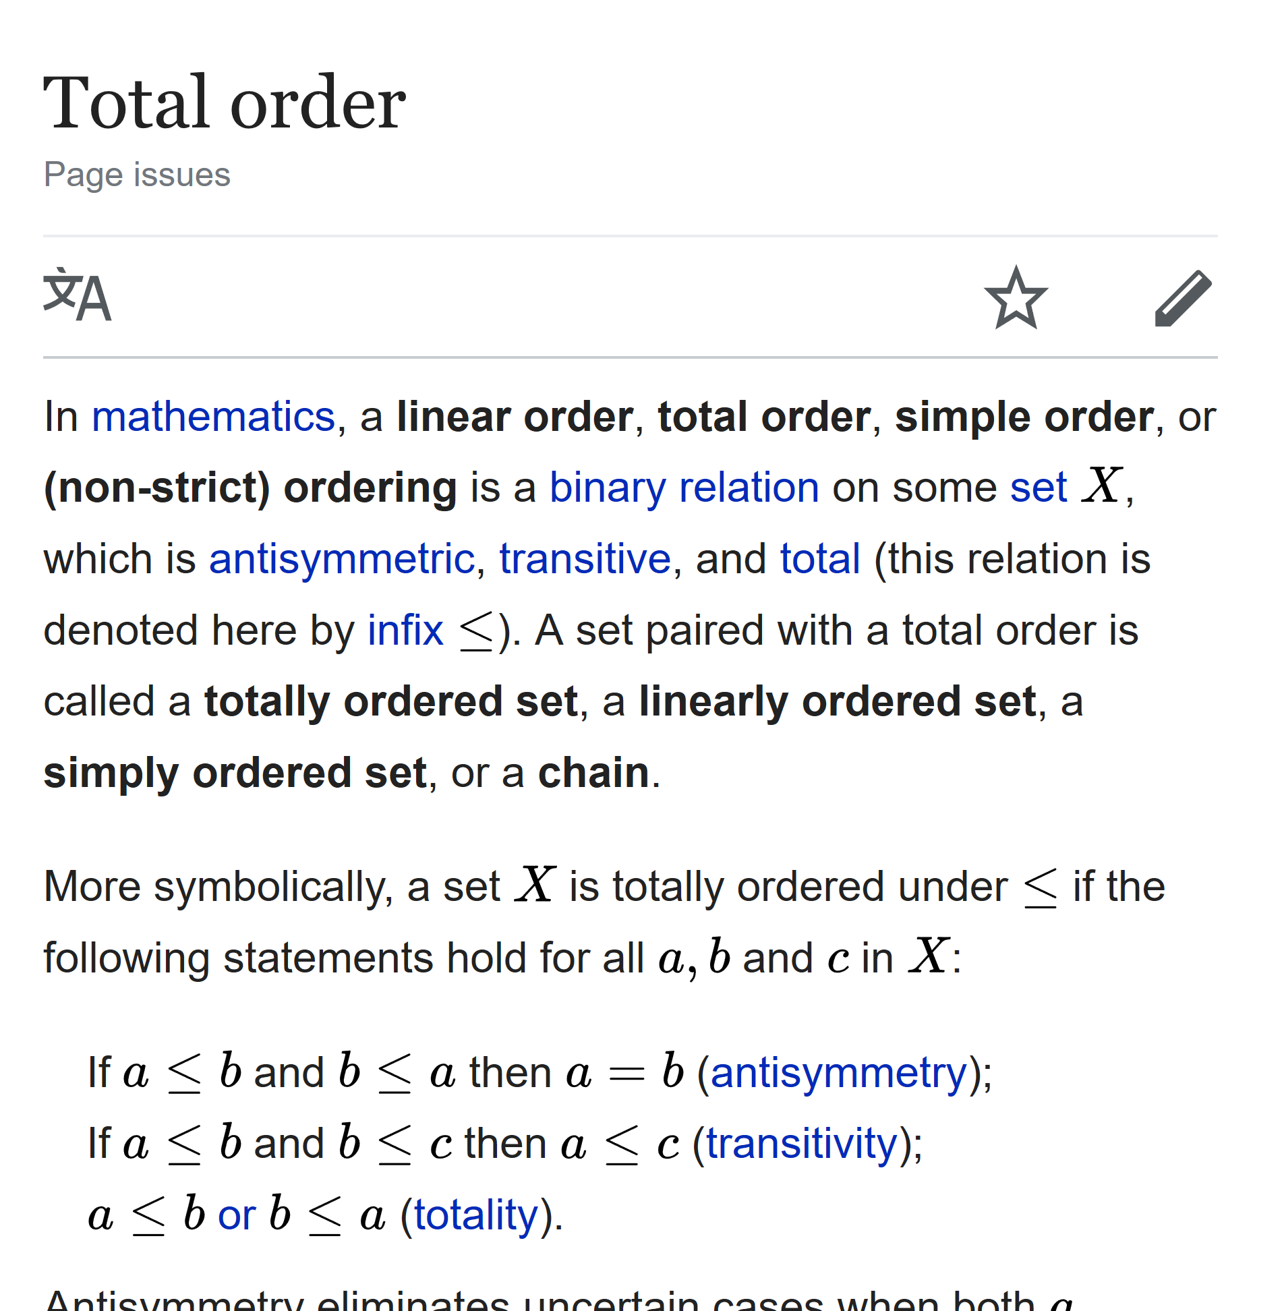
TAO Rules

Slide 35
TAO
some other
≺ ?
array array

Slide 36
TAO
some other
≺ ?
array array

Slide 37
TAO
some other
≺ ?
array array
no refs no refs

Slide 38
TAO Rules

Slide 39
TAO Rules
Compatibility: simple arrays

Slide 40
TAO Rules
Compatibility: simple arrays
Consistency: (⍺≼⍵)∧(⍵≼⍺) ⇔ ⍺=⍵

Slide 41
TAO Rules
Compatibility: simple arrays
Consistency: (⍺≼⍵)∧(⍵≼⍺) ⇔ ⍺=⍵
⍺≡⍵

Slide 42
TAO Rules
Compatibility: simple arrays
Consistency: (⍺≼⍵)∧(⍵≼⍺) ⇔ ⍺=⍵
⍺≡⍵
⍬≢''

Slide 43
TAO Rules: simple scalars

Slide 44
TAO Rules: simple scalars
character vs character: ✓

Slide 45
TAO Rules: simple scalars
character vs character: ✓
real number vs real number: ✓

Slide 46
TAO Rules: simple scalars
character vs character: ✓
real number vs real number: ✓
complex: 1 ≺ 1J1 ≺ 2J¯1 ≺ 2

Slide 47
TAO Rules: simple scalars
character vs character: ✓
real number vs real number: ✓
complex: 1 ≺ 1J1 ≺ 2J¯1 ≺ 2
number vs character: 100 ≺ 'A'

Slide 48
TAO Rules: simple scalars
character vs character: ✓
real number vs real number: ✓
complex: 1 ≺ 1J1 ≺ 2J¯1 ≺ 2
number vs character: 100 ≺ 'A'
null: ⎕NULL ≺ ¯100

Slide 49
TAO Rules: simple scalars
⎕NULL ≺ ¯1 ≺ 0J¯2 ≺ 0 ≺ 0J2 ≺ 1 ≺ 'A'

Slide 50
TAO Rules: same shape

Slide 51
TAO Rules: same shape
┌→───┐ ┌→───┐
│Jay▉│ │John│
└────┘ └────┘

Slide 52
TAO Rules: same shape
┌→───┐ ┌→───┐
│Jay▉│ │John│
└────┘ └────┘

Slide 53
TAO Rules: same shape
┌→───┐ ┌→───┐
│Jay▉│ │John│
└────┘ └────┘
┌→─────────┐ ┌→─────────┐
│ ┌→─┐ │ │ ┌→─┐ │
│ │JF│ 3 1 │ │ │JD│ 2 7 │
│ └──┘ │ │ └──┘ │
└∊─────────┘ └∊─────────┘

Slide 54
TAO Rules: same shape
┌→───┐ ┌→───┐
│Jay▉│ │John│
└────┘ └────┘
┌→─────────┐ ┌→─────────┐
│ ┌→─┐ │ │ ┌→─┐ │
│ │JF│ 3 1 │ │ │JD│ 2 7 │
│ └──┘ │ │ └──┘ │
└∊─────────┘ └∊─────────┘

Slide 55
TAO Rules: different shape
CAN
CAR
CARPENTER
CARPET
CAT

Slide 56
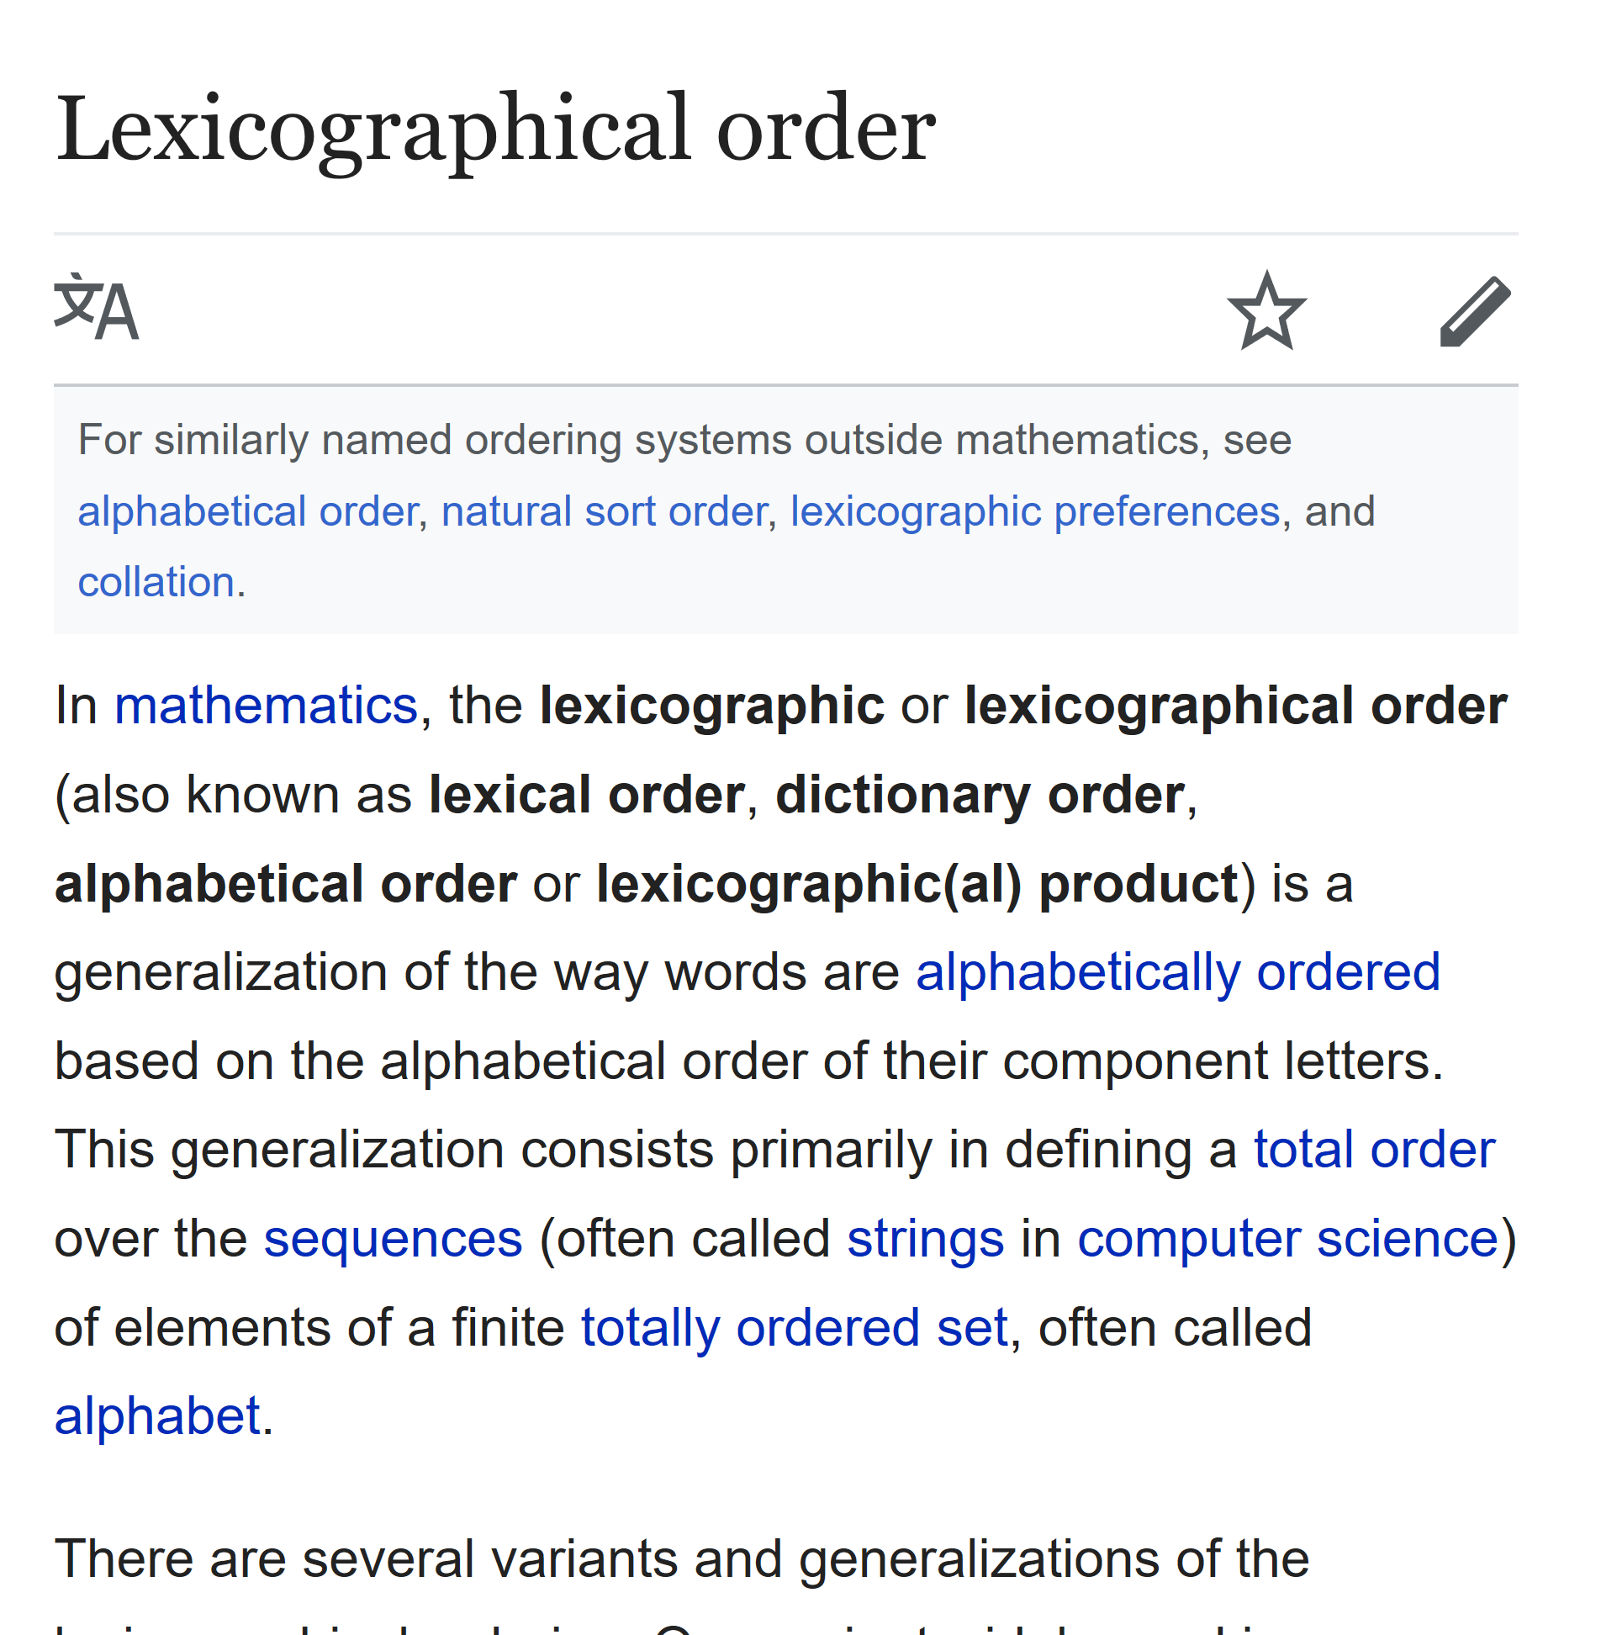
TAO Rules: different shape
CAN
CAR
CARPENTER
CARPET
CAT

Slide 57
TAO Rules: different shape
CAR
CARPENTER

Slide 58
TAO Rules: different shape
CAR
CARPENTER

Slide 59
TAO Rules: different shape
CAR
CARPENTER

Slide 60
TAO Rules: different shape
CAN
CAR
CARPENTER
CARPET
CAT

Slide 61
TAO Rules: different shape
CAN
CAR
CARPENTER
CARPET
CAT

Slide 62
TAO Rules: different shape
↑'CAR' 'CARPENTER'

Slide 63
TAO Rules: different shape
↑'CAR' 'CARPENTER'
CAR▉▉▉▉▉▉
CARPENTER

Slide 64
TAO Rules: different shape
↑'CAR' 'CAR␀␀␀␀␀␀'
CAR▉▉▉▉▉▉
CAR␀␀␀␀␀␀

Slide 65
TAO Rules: different shape
⍋↑'CAR' 'CAR␀␀␀␀␀␀'
2 1

Slide 66
TAO Rules: different shape
⍋↑'CAR' 'CAR␀␀␀␀␀␀'
2 1

Slide 67
TAO Rules: different shape
1 2 3
1 2 3 4

Slide 68
TAO Rules: different shape
¯1 ¯2 ¯3
¯1 ¯2 ¯3 ¯4

Slide 69
TAO Rules: different shape
¯1 ¯2 ¯3
¯1 ¯2 ¯3 ¯4

Slide 70
TAO Rules: different shape
↑(¯1 ¯2 ¯3) (¯1 ¯2 ¯3 ¯4)

Slide 71
TAO Rules: different shape
↑(¯1 ¯2 ¯3) (¯1 ¯2 ¯3 ¯4)
¯1 ¯2 ¯3 0
¯1 ¯2 ¯3 ¯4

Slide 72
TAO Rules: different shape
⍋↑(¯1 ¯2 ¯3) (¯1 ¯2 ¯3 ¯4)

Slide 73
TAO Rules: different shape
⍋↑(¯1 ¯2 ¯3) (¯1 ¯2 ¯3 ¯4)
2 1

Slide 74
TAO Rules: different shape
⍋↑(¯1 ¯2 ¯3) (¯1 ¯2 ¯3 ¯4)
2 1

Slide 75
TAO Rules: different shape
¯∞

Slide 76
TAO Rules: different shape
¯∞ ≺ ⎕NULL ≺ ¯1 ≺ 0J¯2 ≺ 0 ≺ 0J2 ≺ 1 ≺ 'A'

Slide 77
TAO Rules: different shape
CAR¯∞¯∞¯∞¯∞¯∞¯∞
CARPENTER

Slide 78
TAO Rules: different shape
CAR¯∞¯∞¯∞¯∞¯∞¯∞
CARPENTER

Slide 79
TAO Rules: different shape
1 2 1 2 3
1 2 1 2 3
1 2

Slide 80
TAO Rules: different shape
1 2 ¯∞ 1 2 3
1 2 ¯∞ 1 2 3
1 2 ¯∞ ¯∞ ¯∞ ¯∞

Slide 81
TAO Rules: different shape
1 2 ¯∞ 1 2 3
1 2 ¯∞ 1 2 3
1 2 ¯∞ ¯∞ ¯∞ ¯∞

Slide 82
TAO Rules: different shape
1 2 ¯∞ 1 2 3
1 2 ¯∞ 1 2 3
1 2 ¯∞ ¯∞ ¯∞ ¯∞
≺

Slide 83
TAO Rules: different rank
┌→──┐ ┌→────┐
│APL│ ↓Adam │
└───┘ │Jay │
│Roger│
└─────┘

Slide 84
TAO Rules: different rank
┌→──┐ ┌→────┐
↓APL│ ↓Adam │
└───┘ │Jay │
│Roger│
└─────┘

Slide 85
TAO Rules: different rank
┌→────┐ ┌→────┐
↓APL¯∞¯∞│ ↓Adam │
│¯∞¯∞¯∞¯∞¯∞│ │Jay │
│¯∞¯∞¯∞¯∞¯∞│ │Roger│
└─────┘ └─────┘

Slide 86
TAO Rules: different rank
┌→────┐ ┌→────┐
↓APL¯∞¯∞│ ↓Adam │
│¯∞¯∞¯∞¯∞¯∞│ │Jay │
│¯∞¯∞¯∞¯∞¯∞│ │Roger│
└─────┘ └─────┘

Slide 87
TAO Rules: different rank
┌→──┐ ┌→──┐
│APL│ ↓APL│
└───┘ └───┘

Slide 88
TAO Rules: different rank
┌→──┐ ┌→──┐
↓APL│ ↓APL│
└───┘ └───┘

Slide 89
TAO Rules: different rank
┌→──┐ ┌→──┐
│APL│ ↓APL│
└───┘ └───┘
1 2

Slide 90
TAO Rules: different rank
scalar vector
'A' 'APL'
A APL
vector 1-row matrix
3⍴'APL' 1 3⍴'APL'
APL APL

Slide 91
TAO Rules: recap
simple scalars ⎕NULL ≺ nums ≺ chars
same shape item-by-item in ravel order
unequal shape pad with ¯∞
unequal rank prefix shape with 1s

Slide 92
TAO Rules: empty arrays
2 0 0⍴⍬ 0 0 3⍴''

Slide 93
TAO Rules: empty arrays
2 0 0⍴⍬ 0 0 3⍴''

Slide 94
TAO Rules: empty arrays
2 0 0⍴⍬ 0 0 3⍴''
2 0 3⍴⍬ 2 0 3⍴''

Slide 95
TAO Rules: empty arrays
2 0 0⍴⍬ 0 0 3⍴''
⍬ prototypical items ''
or
2 0 0 original shapes 0 0 3
?

Slide 96
TAO Rules: empty arrays
2 0 0⍴⍬ 0 0 3⍴''
⍬ prototypical items ''
2 0 0 original shapes 0 0 3

Slide 97
TAO Rules: empty arrays
2 0 0⍴⍬ 0 0 3⍴⍬
⍬ prototypical items ⍬
2 0 0 original shapes 0 0 3

Slide 98
TAO Rules
simple scalars ⎕NULL ≺ nums ≺ chars
same shape item-by-item in ravel order
unequal shape pad with ¯∞
unequal rank prefix shape with 1s
both empty type then shape

Slide 99
TAO Scope
⍋⍵
⍒⍵
⍺⍸⍵

Slide 100
TAO: a true team effort
Arthur Whitney initial suggestion
Roger Hui TAO of J
John Scholes model: dfns.dyalog.com/n_le.htm
Roger Hui Dyalog implementation
Adám Brudzewsky, Roger Hui, Jay Foad,
John Scholes, Morten Kromberg

Slide 101
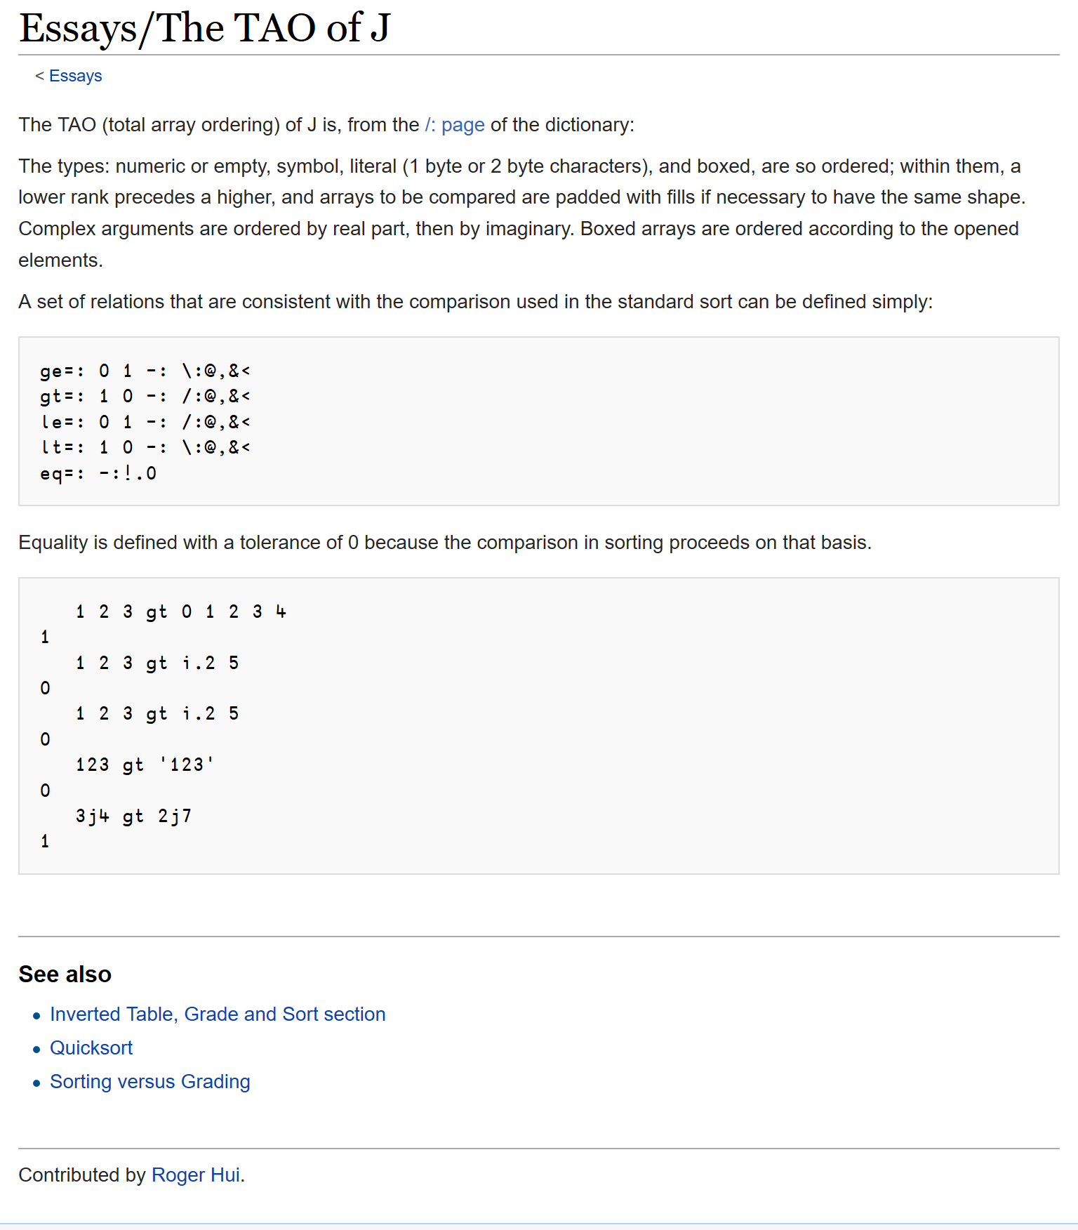
TAO: a true team effort
Arthur Whitney initial suggestion
Roger Hui TAO of J
John Scholes model: dfns.dyalog.com/n_le.htm
Roger Hui Dyalog implementation
Adám Brudzewsky, Roger Hui, Jay Foad,
John Scholes, Morten Kromberg

Slide 102
TAO: a true team effort
Arthur Whitney initial suggestion
Roger Hui TAO of J
John Scholes model: dfns.dyalog.com/n_le.htm
Roger Hui Dyalog implementation
Adám Brudzewsky, Roger Hui, Jay Foad,
John Scholes, Morten Kromberg

Slide 103
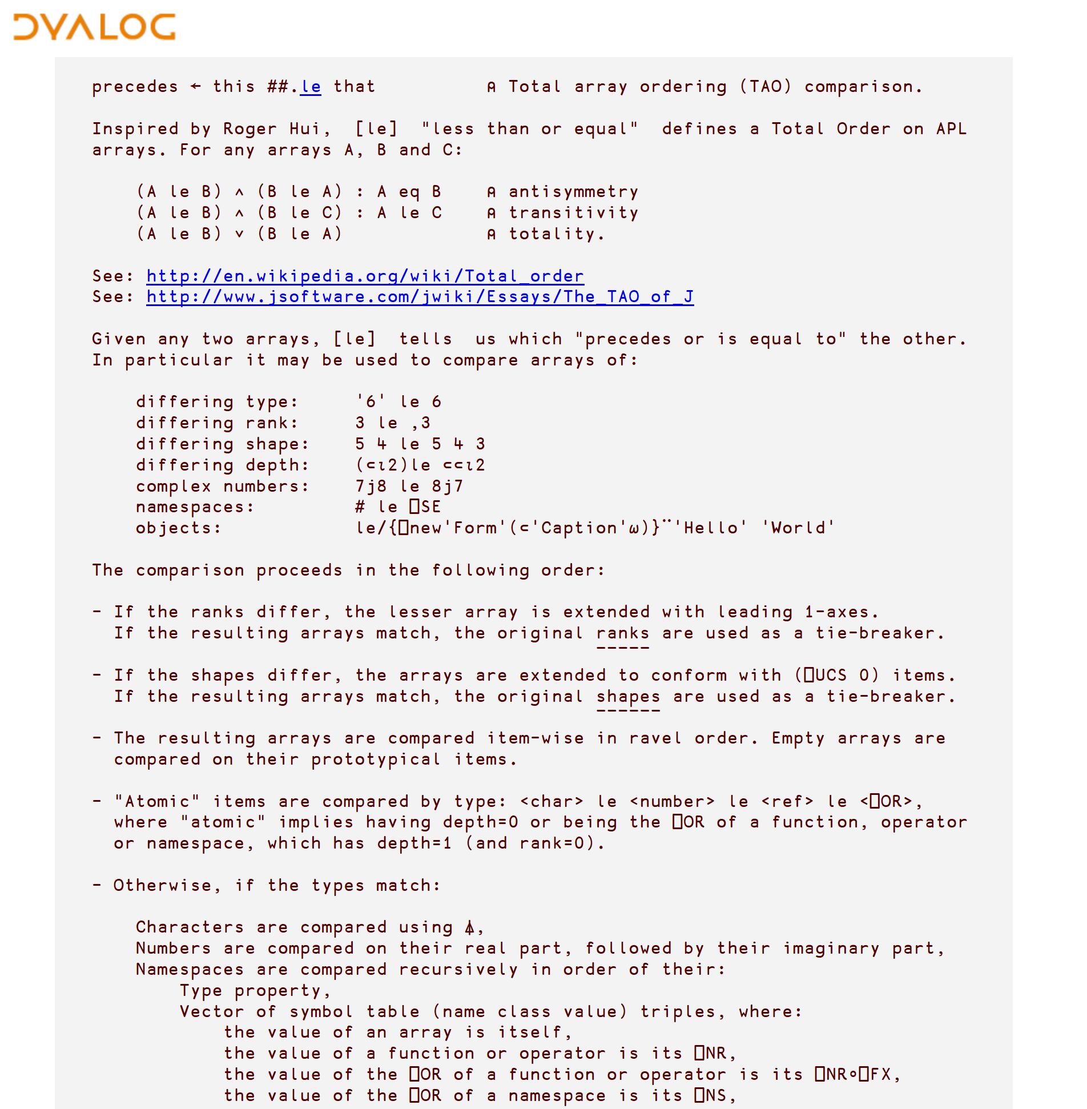
TAO: a true team effort
Arthur Whitney initial suggestion
Roger Hui TAO of J
John Scholes model: dfns.dyalog.com/n_le.htm
Roger Hui Dyalog implementation
Adám Brudzewsky, Roger Hui, Jay Foad,
John Scholes, Morten Kromberg

Slide 104
TAO: a true team effort
Arthur Whitney initial suggestion
Roger Hui TAO of J
John Scholes model: dfns.dyalog.com/n_le.htm
Roger Hui Dyalog implementation
Adám Brudzewsky, Roger Hui, Jay Foad,
John Scholes, Morten Kromberg

Slide 105
Demo
Features coming in version 17.0…

Slide 106
Demo
Phonebook Record Insertion
]load /tao/pb
Sort ← {(⊂⍋⍵)⌷⍵}
Sort pb
pb ← Sort pb
new ← 'Kromberg' 'Morten' 584
pb ⍸ new
(2↑pb)⍪new⍪(2↓pb)
2(↑⍪new⍪↓)pb
Into ← {(⍵⍸⍺)(↑⍪⍺⍪↓)⍵}
new Into pb
Spreadsheet Data Types
ss ← (⎕NEW⊂'Clipboard').Array
Sort ss
ss[⍋ss[;1 3];]
Natural Sorting
)clear
]load /tao/names
Digits ← {⍵∊⎕D}
Digits 'my10b'
CutOffs ← {1,2≠/Digits ⍵}
CutOffs 'my10b'
Parts ← {(CutOffs ⍵)⊂⍵}
Parts 'my10b'
ExecNums ← {∧/Digits ⍵:⍎⍵ ⋄ ⍵}
ExecNums¨Parts 'my10b'
Order ← {⍋ExecNums¨∘Parts¨⍵}
Order names
NatSort ← {(⊂Order ⍵)⌷⍵}
NatSort names
]defs -topdown

Slide 107
Features coming in version 17.0
Grade and Sort any^{no refs} Array
{(⊂⍋⍵}⌷⍵} for all ranks – fast!
⍋⍵ ⍒⍵ ⍺⍸⍵

Slide 108


Webinars on Thursdays at 15:00 UTC
Comment and suggest to webinar@dyalog.com or
@Adám in chat.stackexchange.com/rooms/52405
  April 19 APL Processes and Isolates in the Clouds
  May 17 to be announced
  June 21 to be announced
General APL Questions
stackoverflow.com

