Slide 1
Webinar #10 - 19 April 2017
Isolates in the Cloud

Slide 2
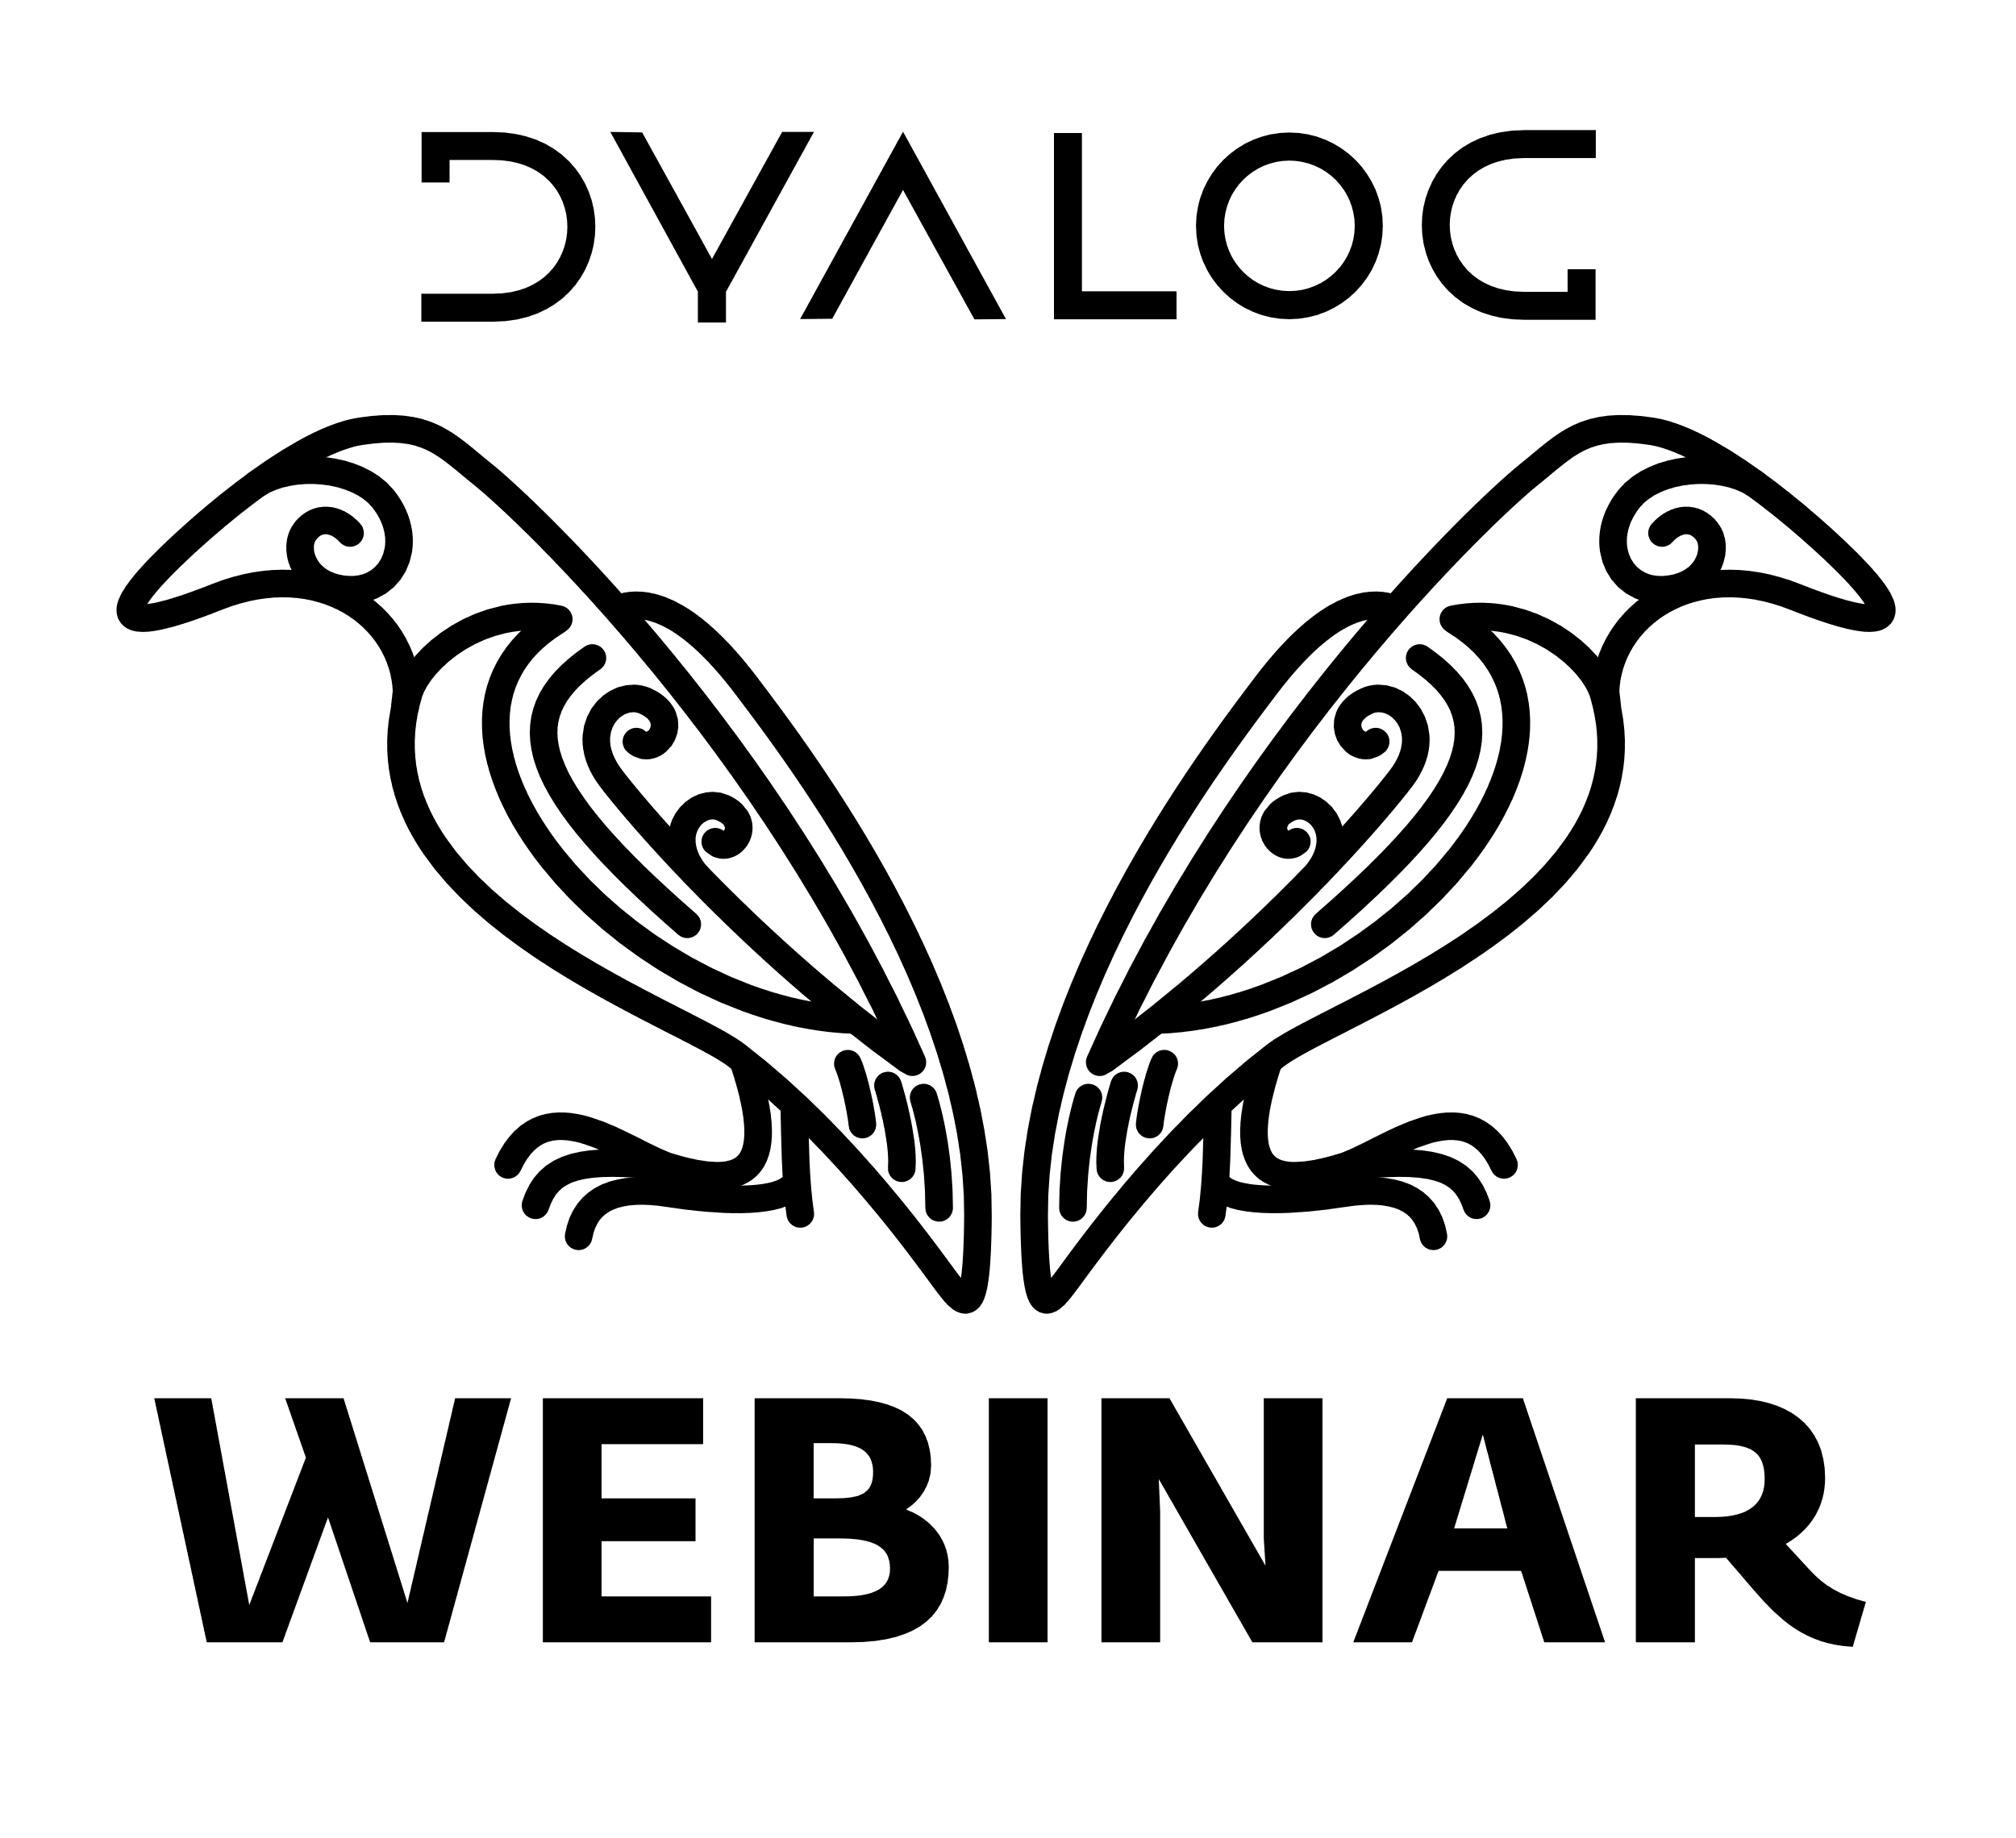
Agenda
Quick introduction to Futures and Isolates
Building and launching a Linux VM
with Dyalog APL on the
Amazon Elastic Compute Cloud (EC2)
Starting 20 VM's and using them as isolate servers
A quick demo of parallel each (ll.EachX in the isolate workspace since 16.0).

Slide 3
Quick Introduction to Isolates
An isolate looks, tastes, and feels
like a namespace, except that
Each isolate appears as an extension of the workspace,
but exists in a separate process.
iss is a 3-element vector of
references to three isolates.
iss←isolate.New¨3⍴⊂''
iss.X←(1 2 3) (4 5) 6
iss.((+⌿ ÷ ≢) X)
2 4.5 6
X←1 2 3
X←6
X←4 5

Slide 4
Isolate Demo

Slide 5
How isolates work
Computers
Dyalog Processes
Namespaces
TCP Sockets
Another Computer
A 2-Core Computer
StartServer 'ip=10.0.0.1'
Isolate
Process 1
A Dyalog
Application
Isolate
Process 1
Isolate 1
1
2
3
4
Isolate 3
Isolate
Process 2
Isolate
Process 2
iss←isolate.New¨4⍴⊂⍬
AddServer '10.0.0.2'
Isolate 2
Isolate 4

Slide 6
Isolate Demo
For more on isolates, see for example
"Parallel Programming in Dyalog APL"
https://dyalog.tv/Dyalog14/?v=JvLWvyG7JEs

Slide 7
Agenda
Quick introduction to isolates
Building and launching a Linux VM
with Dyalog APL on the
Amazon Elastic Compute Cloud (EC2)
Starting 20 VM's and using them as isolate servers
A quick demo of ll.EachX

Slide 8

Create an Amazon Machine Image (AMI)
Select a base AMI with Ubuntu Linux installed
Configure Firewall
Launch the VM
Use WinSCP to copy Dyalog installer
Install Dyalog APL
Use SSH to start Dyalog APL
Connect to it with RIDE
Save the new AMI

Slide 9
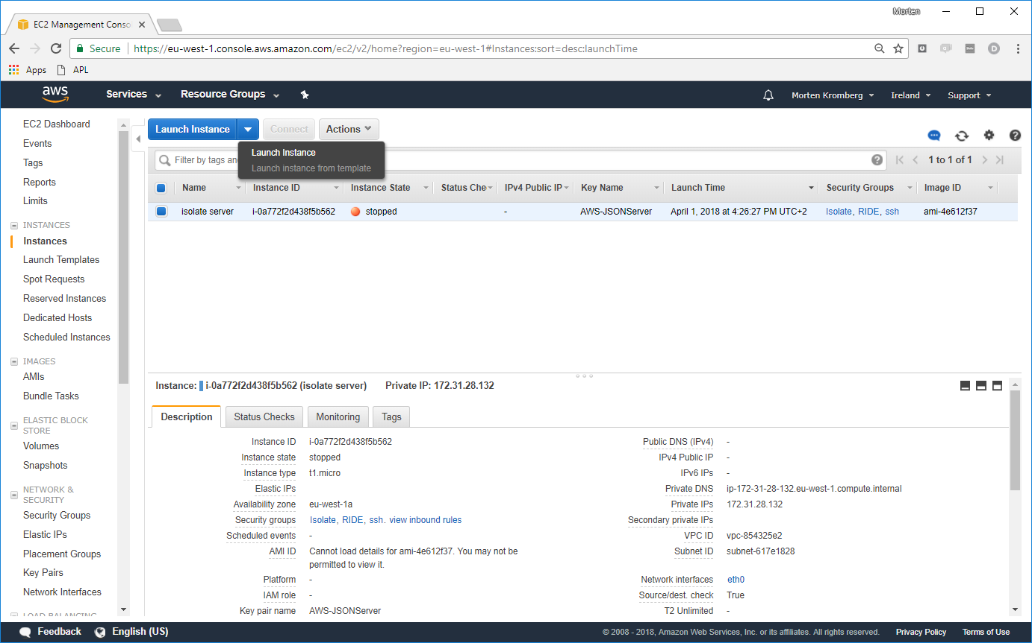

Slide 10
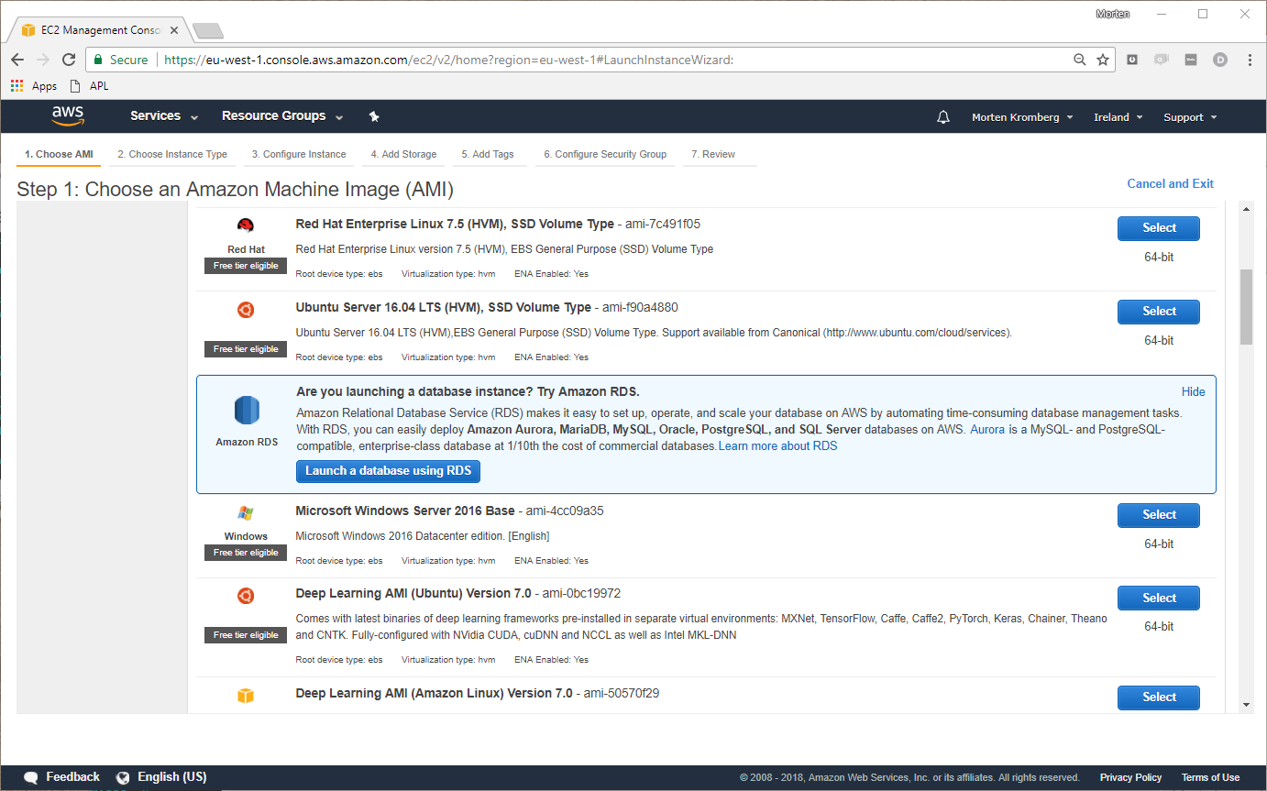

Slide 11
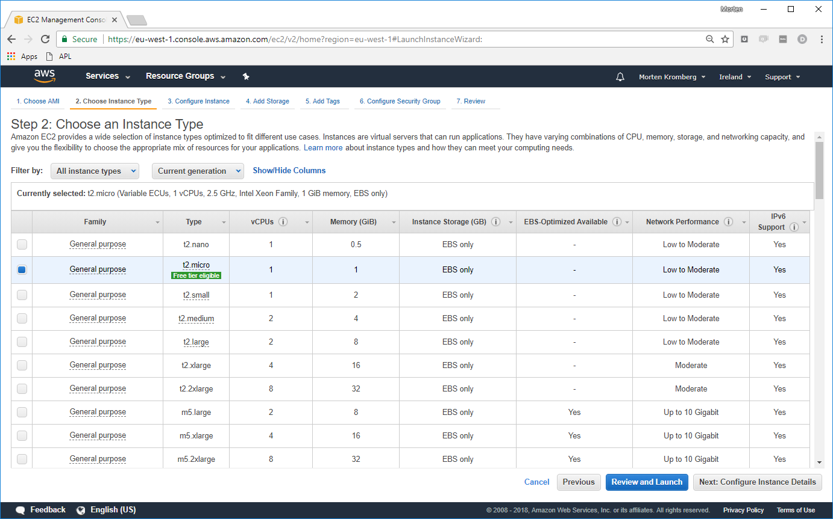

Slide 12
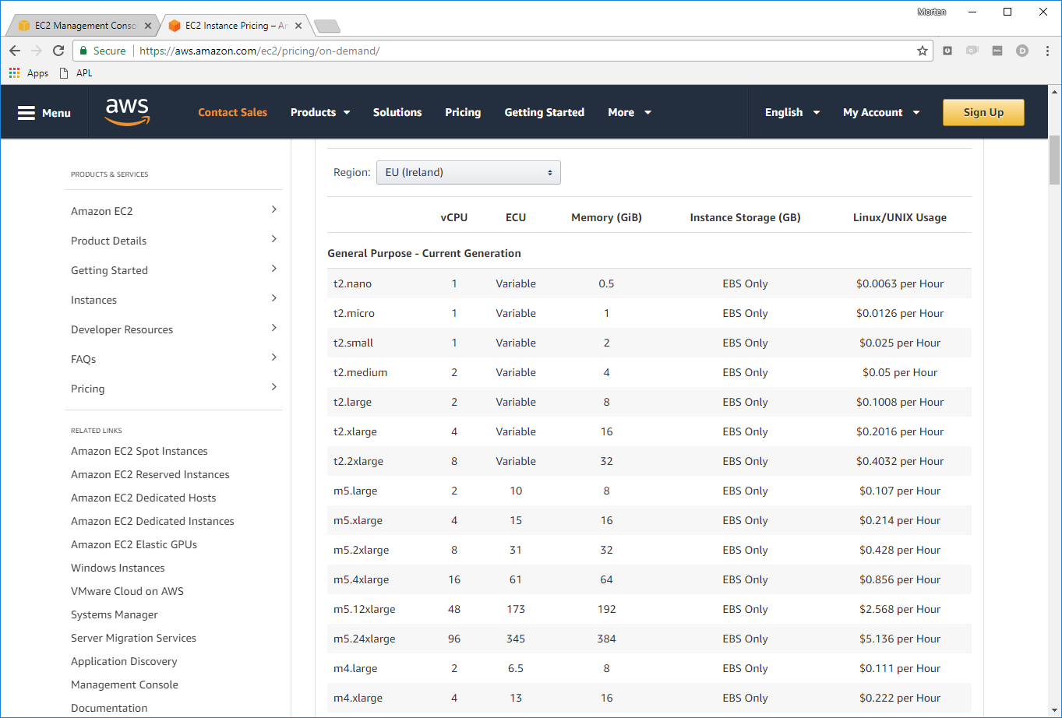

Slide 13
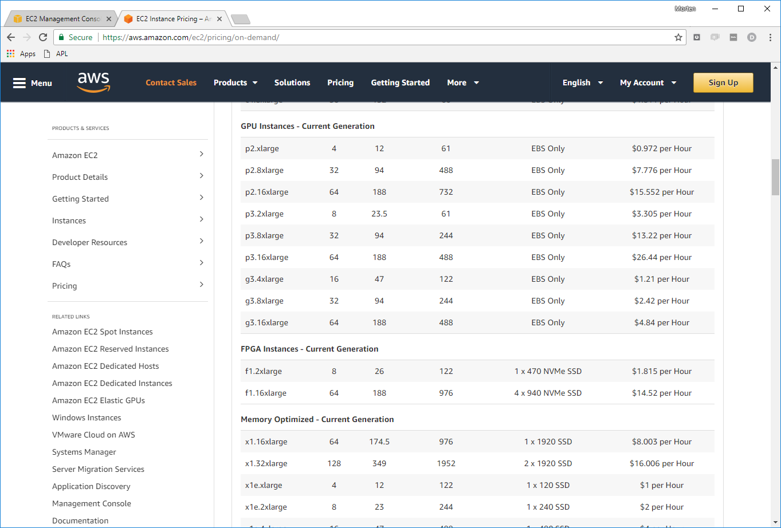

Slide 14
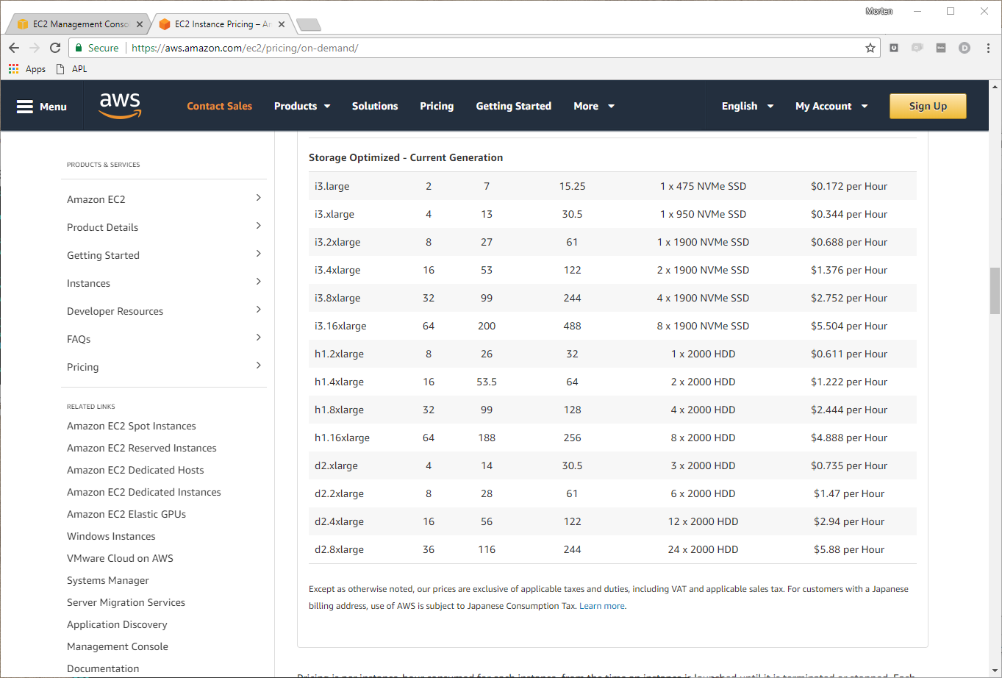

Slide 15
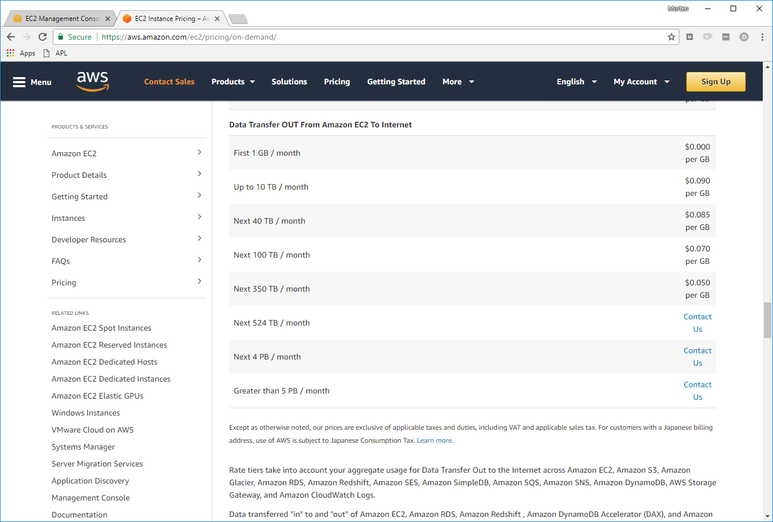

Slide 16
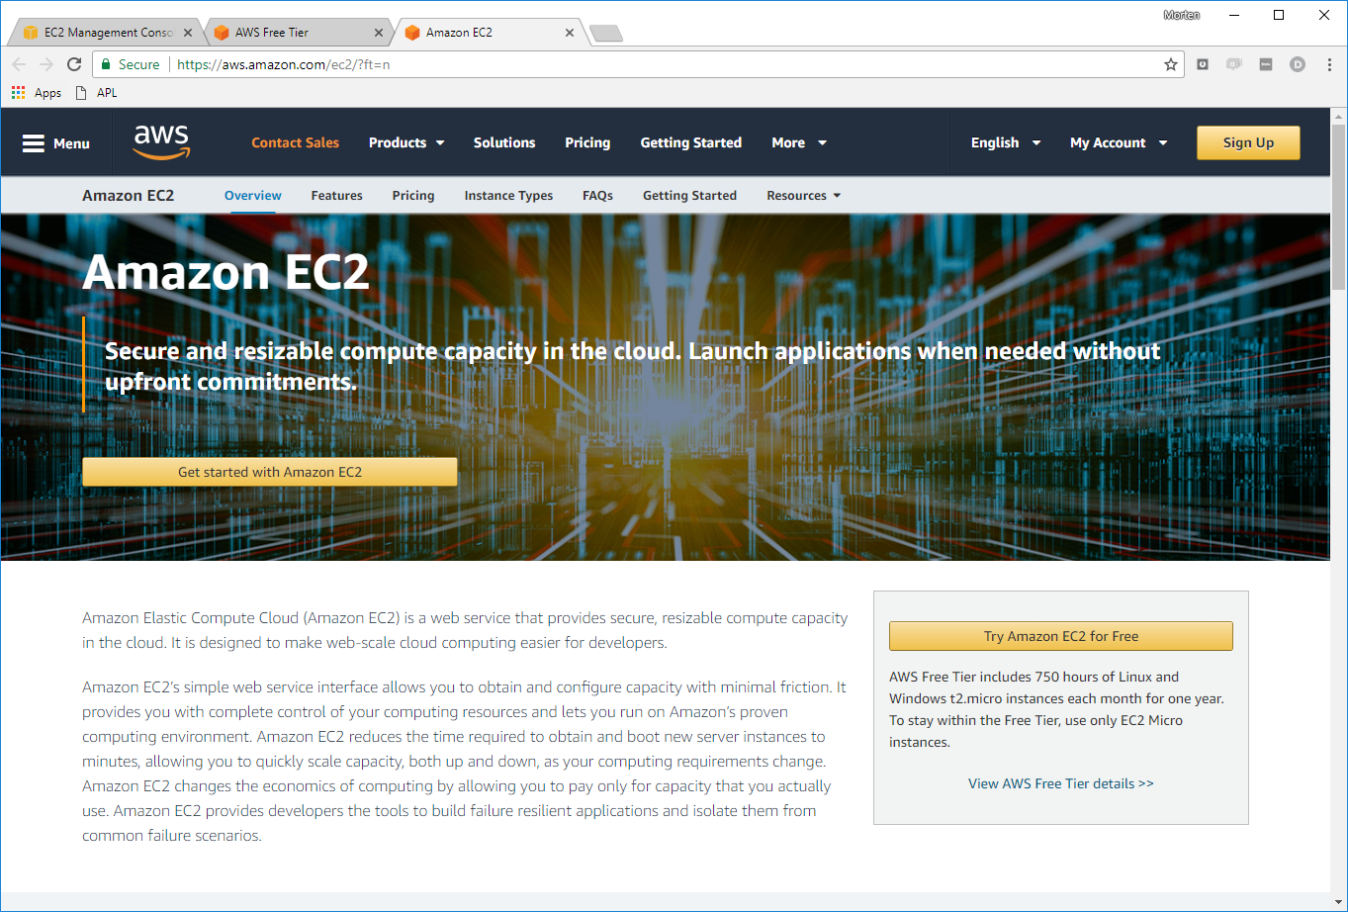
+ Max 20 simultaneous instances

Slide 17
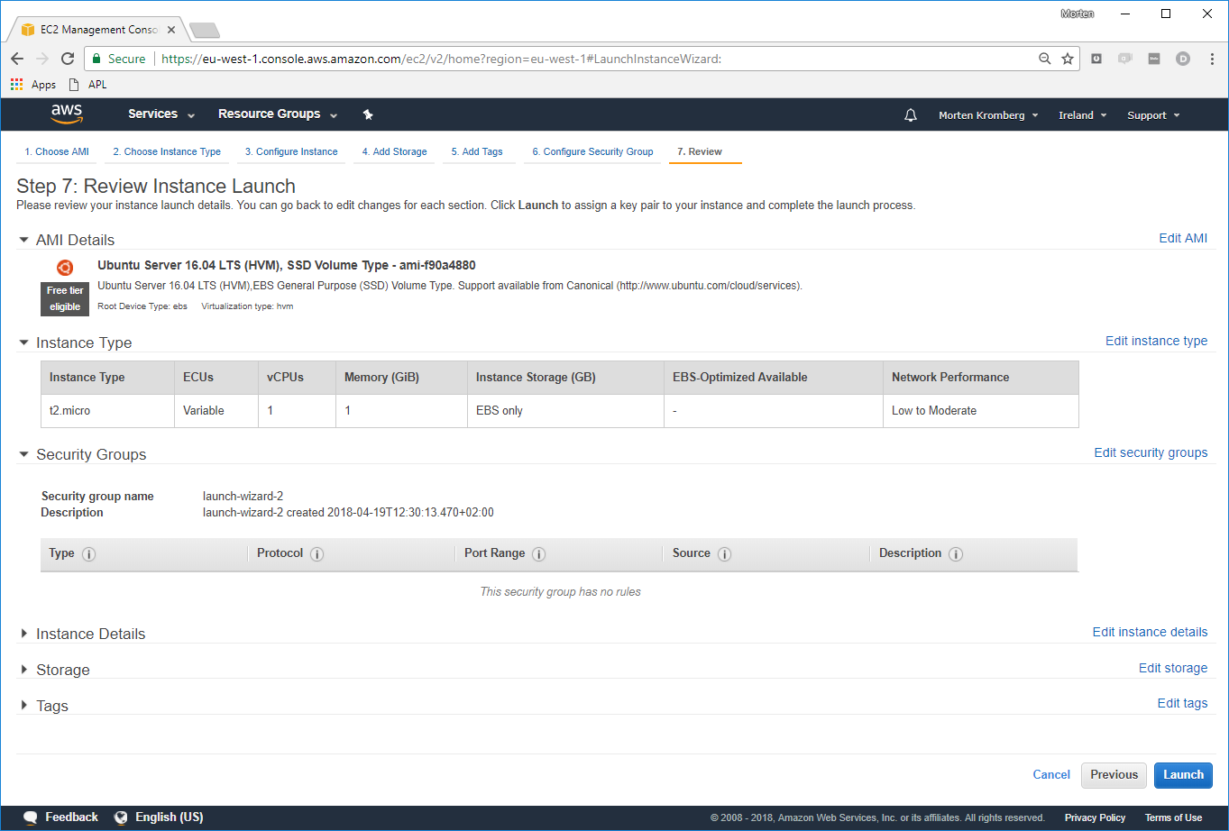

Slide 18
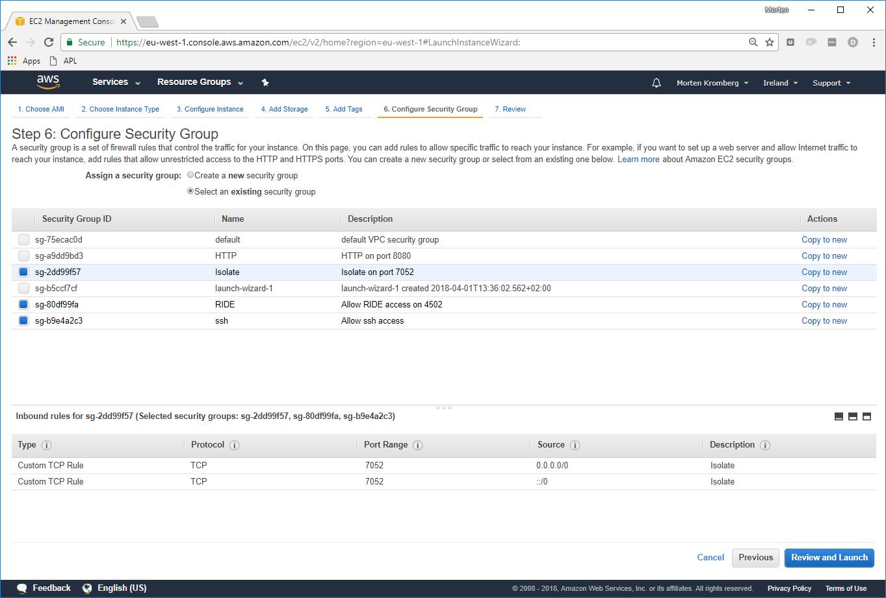

Slide 19
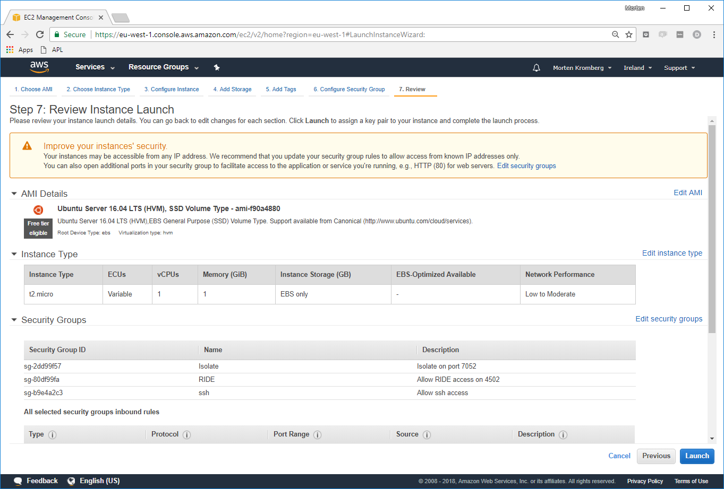

Slide 20
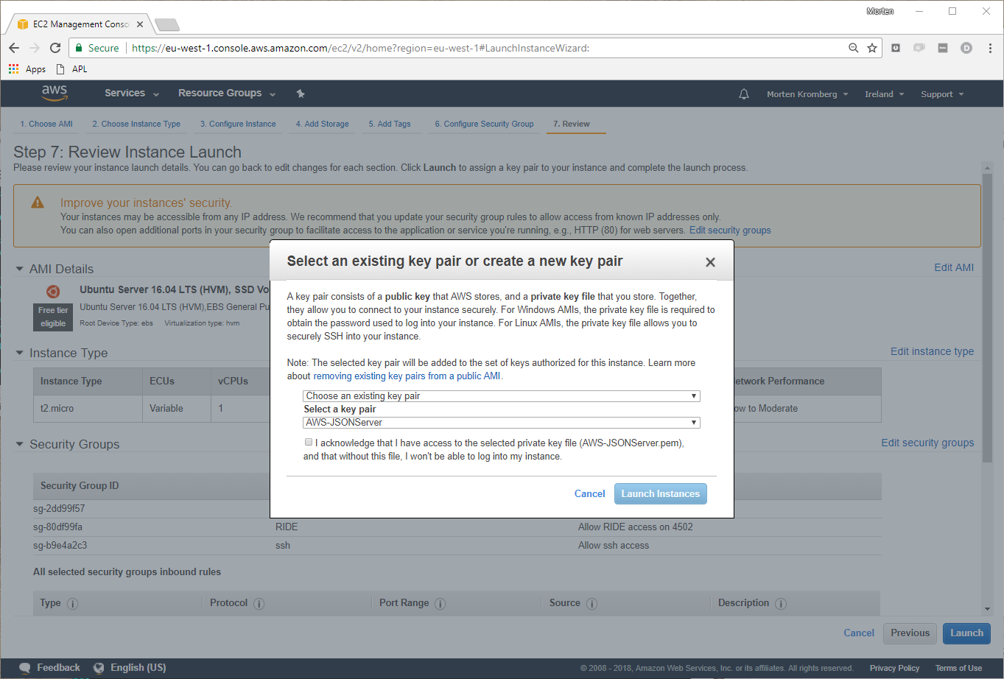

Slide 21
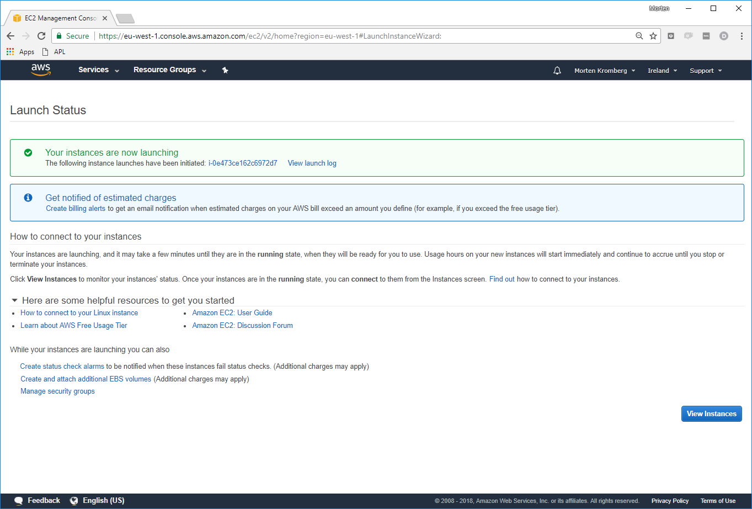

Slide 22
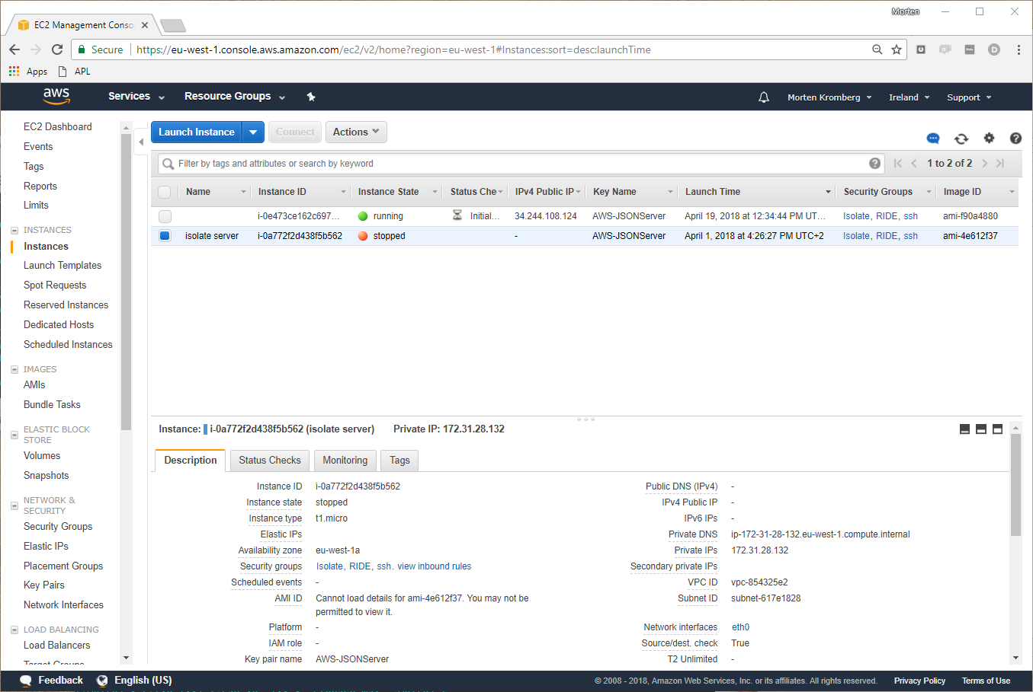

Slide 23
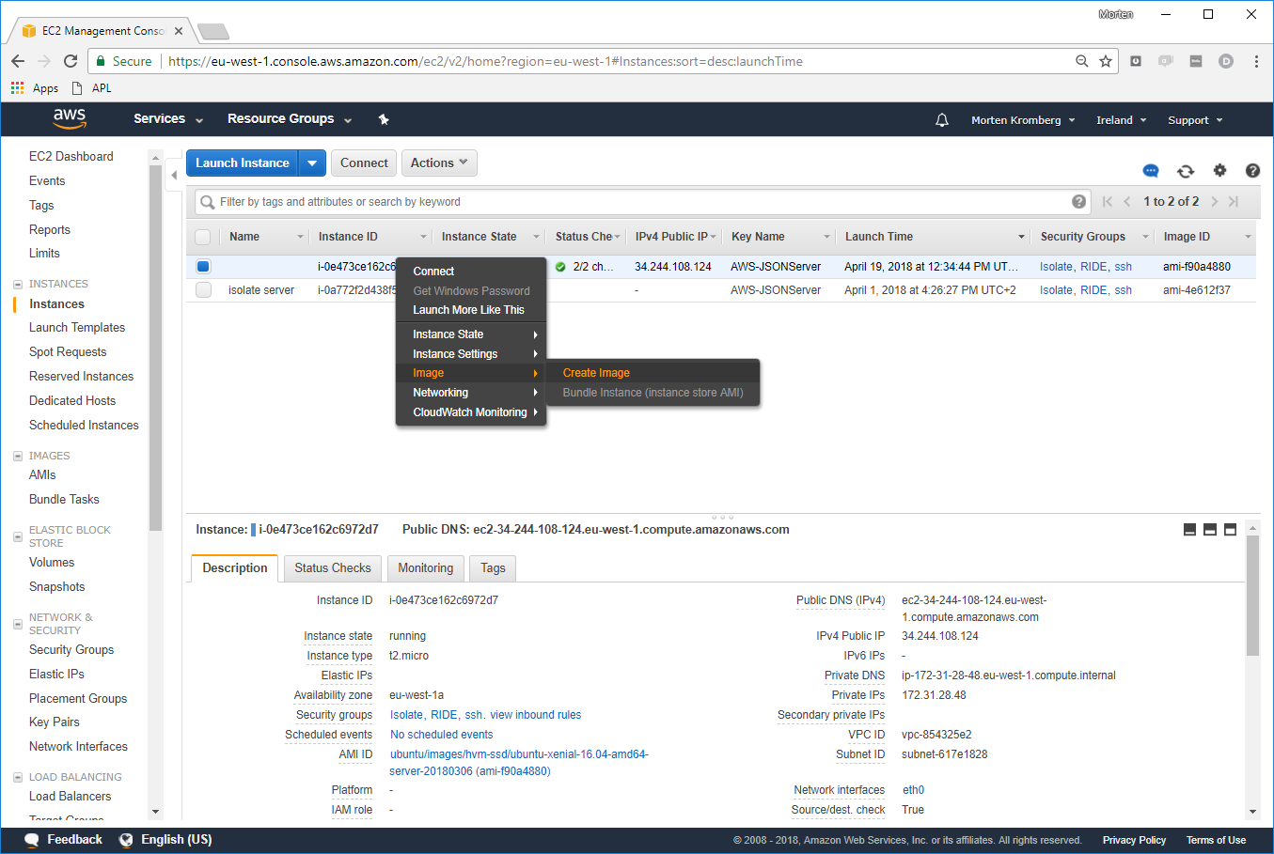

Slide 24
Agenda
Quick introduction to isolates
Building and launching a Linux VM
with Dyalog APL on the
Amazon Elastic Compute Cloud (EC2)
Starting 20 VM's and using them as isolate servers
A quick demo of ll.EachX

Slide 25
Isolates in the Cloud
Computers
Dyalog Processes
Namespaces
SSH Sessions
TCP Sockets
An AWS EC2 Linux VM
A Windows Computer
Another VM
Another VM
Two Per VM
Another VM
StartServer 'ip=81.187.219.129'
Another VM
A Dyalog
Application
Isolate
Process
Isolate
Process
Another VM
Another VM
Another VM
Isolate
Process
Another VM
Another VM
Another VM
Another VM
Another VM
Isolate
Process
Isolate
Process
Another VM
Another VM
Another VM
Another VM
Another VM
1
2
3
4
Another VM
Another VM
Another VM
5
6
7
8
9
10
11
12
13
14
15
16
17
18
19
20
21
22
23
24

Slide 26
Agenda
Quick introduction to isolates
Building and launching a Linux VM
with Dyalog APL on the
Amazon Elastic Compute Cloud (EC2)
Starting 20 VM's and using them as isolate servers
A quick demo of ll.EachX

Slide 27
Summary
Dyalog is creating tools, frameworks and samples
for distributed / cloud computing, including
  APLSSH client to securely start processes on remote machines
  Running Isolates in the Cloud
  Microservice Frameworks (e.g. JSONServer)
  Docker / Container tools
DAAAS (Dyalog APL As A Service) coming soon
  We will publish "premium" AMI's with Dyalog APL,
  JSONServer and MiServer pre-installed
  Pre-build Docker containers with Dyalog installed
  Hardest problem is to decide on pricing
We aim to publish a reference architecture
for scalable services.

Slide 28
Webinar 11
Thursday, May 17th at 15:00 UTC:
Creating and managing your own User Commands

