Slide 1
Thinking in APL: Array-oriented Solutions (Part 1)
Richard Park

Slide 2
Thinking in APL: Array-oriented Solutions
Tool of thought
Language & thought
Primitives
Idioms

Slide 3
Thinking in APL: Array-oriented Solutions
Array as the unit
Direct expression
Techniques
Heuristics

Slide 4

This Webinar
Food for thought
Secret sauce

Slide 5
Notation as a Tool of Thought
Iverson, K.E., 2007.
In ACM Turing award lectures (p. 1979).

Slide 6
Notation as a Tool of Thought
Ease of expressing constructs arising in problems.
Suggestivity.
Ability to subordinate detail.
Economy.
Amenability to formal proofs.

Slide 7
Notation as a Tool of Thought
Design Patterns vs Anti pattern in APL by Aaron W Hsu at FnConf17
https://www.youtube.com/watch?v=v7Mt0GYHU9A

Slide 8
Language as a Tool of Thought
Expression
Suggestivity
Subordination of detail
Economy

Slide 9
Economy
A Conversation with Arthur Whitney (ACM 2009)
Brian Cantrill & Arthur Whitney
AW: … we can remember seven things.
BC: Right. People are able to retain a seven-digit phone number, but it drops off quickly at eight, nine, ten digits.
AW: If you‘re Cantonese, then it’s ten. I have a very good friend, Roger Hui, who implements J. He was born in Hong Kong but grew up in Edmonton as I did. One day I asked him, “Roger, do you do math in English or Cantonese?” He smiled at me and said, “I do it in Cantonese because it‘s faster and it’s completely regular.”

Slide 10
APL Thinking?
The thought process of someone using APL
Primitive functions and operators
Translating natural language algorithm descriptions
Translating pseudo code
Translating code from another
  programming language
Translating mathematical formulae
Specific techniques
Problem solving heuristics

Slide 11
APL Thinking?
The thought process of someone using APL
Primitive functions and operators
Translating natural language algorithm descriptions
Translating pseudo code
Translating code from another
  programming language
Translating mathematical formulae
Specific techniques
Problem solving heuristics

Slide 12
Pragmatism: Array-oriented Solutions?
Array as a unit

Slide 13
Array as a unit
Example: Counting elements
∇ t←Count array;element
[1] t←0
[2] :For element :In array
[3] t+←1
[4] :EndFor
∇

Slide 14
Array as a unit
Example: Counting elements
{⍺←0 ⋄ 0=⍴⍵:⍺ ⋄ (⍺+1)∇1↓⍵}
{+/⍵=⍵}

Slide 15
Array as a unit
Example: Counting elements
{⍺←0 ⋄ 0=⍴⍵:⍺ ⋄ (⍺+1)∇1↓⍵}
{+/⍵=⍵} +/=⍨
≢

Slide 16
Array as a unit
Example: Selection
∇ vowels←JustVowels word
[1] vowels←''
[2] :For letter :In word
[3] :If letter∊'aeiou'
[4] vowels,←letter
[5] :EndIf
[6] :EndFor
∇

Slide 17
Array as a unit
Example: Selection
'aeiou'{(⍵∊⍺)/⍵}word

Slide 18
Array-oriented Solutions
Metzger, R.C., 1981. APL thinking finding array-oriented solutions. ACM SIGAPL APL Quote Quad, 12(1), pp.212-218.
Eisenberg, M. and Peelle, H.A., 1987. APL thinking: examples. ACM SIGAPL APL Quote Quad, 17(4), pp.433-440.

Slide 19
Knowing and using
Primitives
Idioms
Techniques
Heuristics

Slide 20
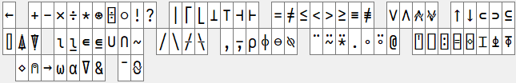
Primitives
Language bar

Slide 21
Idioms
Jul 2nd 16:00 BST aplcart.info turns 1
Adám Brudzewsky demonstrates the various features of APLcart, the largest-ever collection of short APL phrases.
Search: BAA webinar schedule 2020

Slide 22
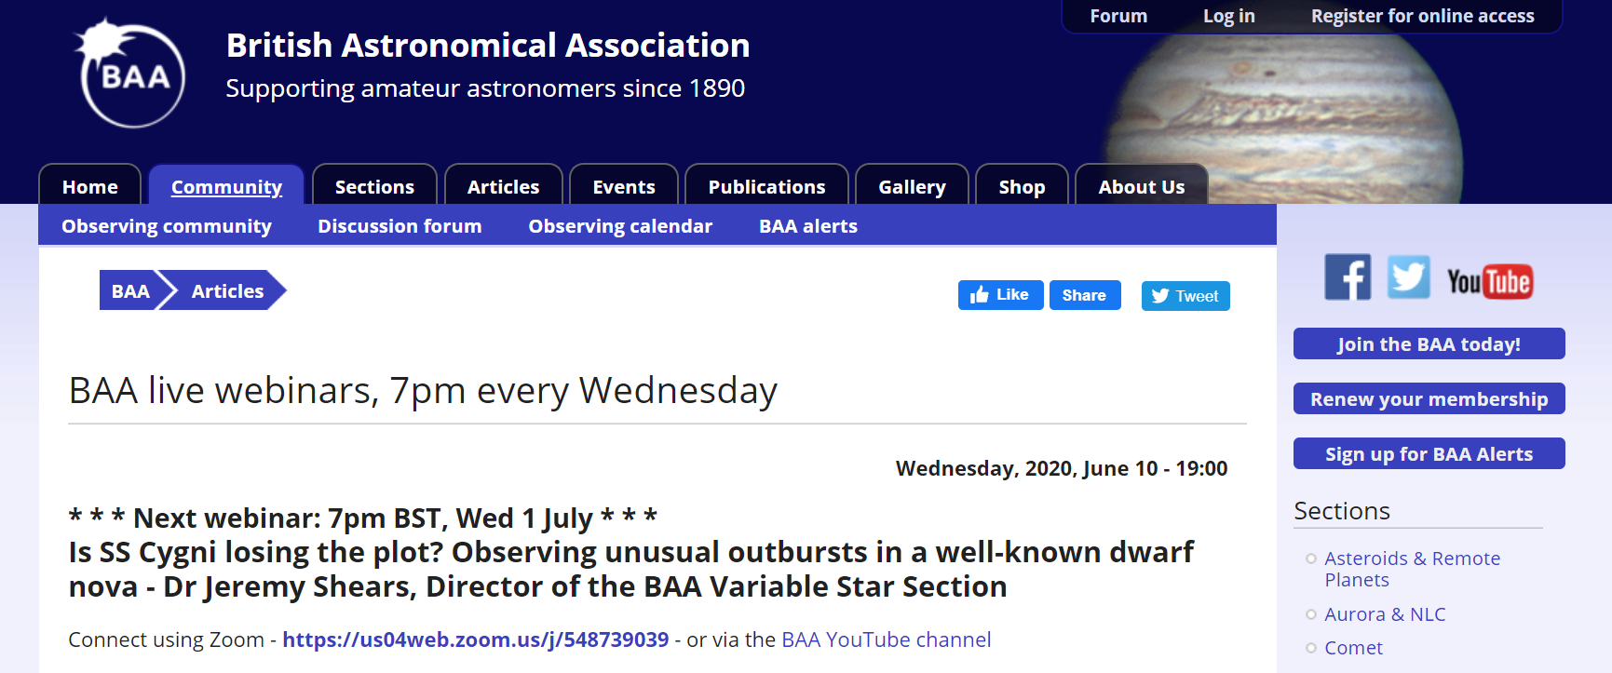

Slide 23
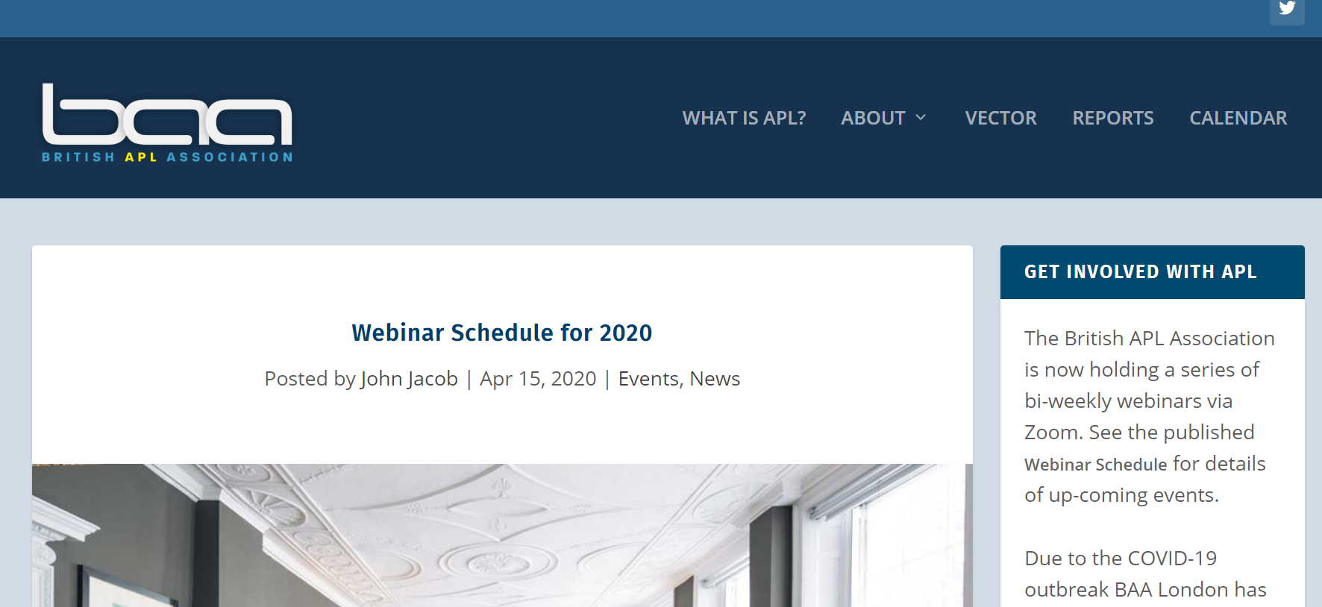

Slide 24
Techniques
{f⌿ ⍺ g ⍵}
{(⍺ f ⍵)⌿⍵}

Slide 25
Heuristics
Metzger, R.C., 1981.
APL thinking finding array-oriented solutions.
ACM SIGAPL APL Quote Quad, 12(1), pp.212-218.

Slide 26
Heuristics
Metzger, R.C., 1981.
APL thinking finding array-oriented solutions.
Value First, Then Shape;
Shape First, Then Value;
Data Transformation;
Loop First;
Think Big;
Function Listing;
Synonym Search.

Slide 27
Value First
Example: To

Slide 28
Value First
3{(⍺-1)↓⍳⍵}7
3 4 5 6 7

Slide 29
Value First
Filtering
3{(⍺≤i)/i←⍳⍵}7
3 4 5 6 7

Slide 30
Shape First
3{(⍺-1)+⍳1+⍵-⍺}7
3 4 5 6 7

Slide 31
Value First
MIota 4 2 3
1 2 3 4 1 2 1 2 3
Miota←{
max←⌈/⍵
i←⍳max
n←((⍴⍵),max)⍴i
(,⍵∘.≥i)/,n
}

Slide 32
Shape First
MIota 4 2 3
1 2 3 4 1 2 1 2 3
Miota2←{
i←(+/⍵)⍴1
i[1++\¯1↓⍵]←1-¯1↓⍵
+\i
}

Slide 33
Shape First
MIota 4 2 3
1 2 3 4 1 2 1 2 3
Miota3←{
i←(+/⍵)⍴1
+\(1-¯1↓⍵)@(1++\¯1↓⍵)⊢i
}

Slide 34
Language as a Tool of Thought
“the computer language you use influences how you understand and solve problems”
- Metzger, R.C., 1981. APL thinking finding array-oriented solutions.

Slide 35
Linguistic Determinism
“the language you use influences how you understand” – me just now
Majid, A., Bowerman, M., Kita, S., Haun, D.B. and Levinson, S.C., 2004. Can language restructure cognition? The case for space. Trends in cognitive sciences, 8(3), pp.108-114.

Slide 36
Linguistic Determinism
Search: Sapir-Whorf Hypothesis
Radiolab Words
Majid, A., Bowerman, M., Kita, S., Haun, D.B. and Levinson, S.C., 2004. Can language restructure cognition? The case for space. Trends in cognitive sciences, 8(3), pp.108-114.

Slide 37
APL Thinking
Metzger, R.C., 1981. APL thinking finding array-oriented solutions.
Eisenberg, M. and Peelle, H.A., 1987. APL thinking: examples. ACM SIGAPL APL Quote Quad, 17(4), pp.433-440.
Eisenberg, M. and Peelle, H.A., 1990. A survey “APL thinking”. ACM SIGAPL APL Quote Quad, 21(2), pp.5-8.
Eisenberg, M. and Peelle, H.A., 1983. APL learning bugs. ACM SIGAPL APL Quote Quad, 13(3), pp.11-16.
Peelle, H.A. and Eisenberg, M., 1985, May. APL teaching bugs. In Proceedings of the international conference on APL: APL and the future (pp. 86-93).
Eisenberg, M. and Peelle, H., 1989, August. APL problem-solving (tutorial session) a tutorial. In Proceedings of the ACM/SIGAPL conference on APL as a tool of thought (session tutorials) (pp. 1-30).
Polivka, R.P., 1984, June. The impact of APL2 on teaching APL. In Proceedings of the international conference on APL (pp. 263-269).

Slide 38
Array-oriented Solutions
Primitives
Idioms
Techniques
Heuristics

Slide 39
Next Week
Jul 2nd 16:00 BST aplcart.info turns 1
Adám Brudzewsky demonstrates the various features of APLcart, the largest-ever collection of short APL phrases.
Search: BAA webinar schedule 2020

Slide 40
Next Dyalog Webinar
Jul 9th 16:00 BST
Adám presents
Language Features of Dyalog version 18.0 in Depth (part 3)

