Slide 1
Presenting TryAPL v3
Richard Park

Slide 2
TryAPL: New in Version 3
Open source: github.com/dyalog/tryapl
Open API
Off-the-shelf technologies
APL-style "session"
Multi-line functions
Download and upload "workspaces"
Share without interference
Touch-screen friendly
Dark mode

Slide 3
History
Dyalog '12 (Elsinore), The Story of TryAPL:
dyalog.tv/Dyalog12/?v=9AMj77tuDAg

Slide 4
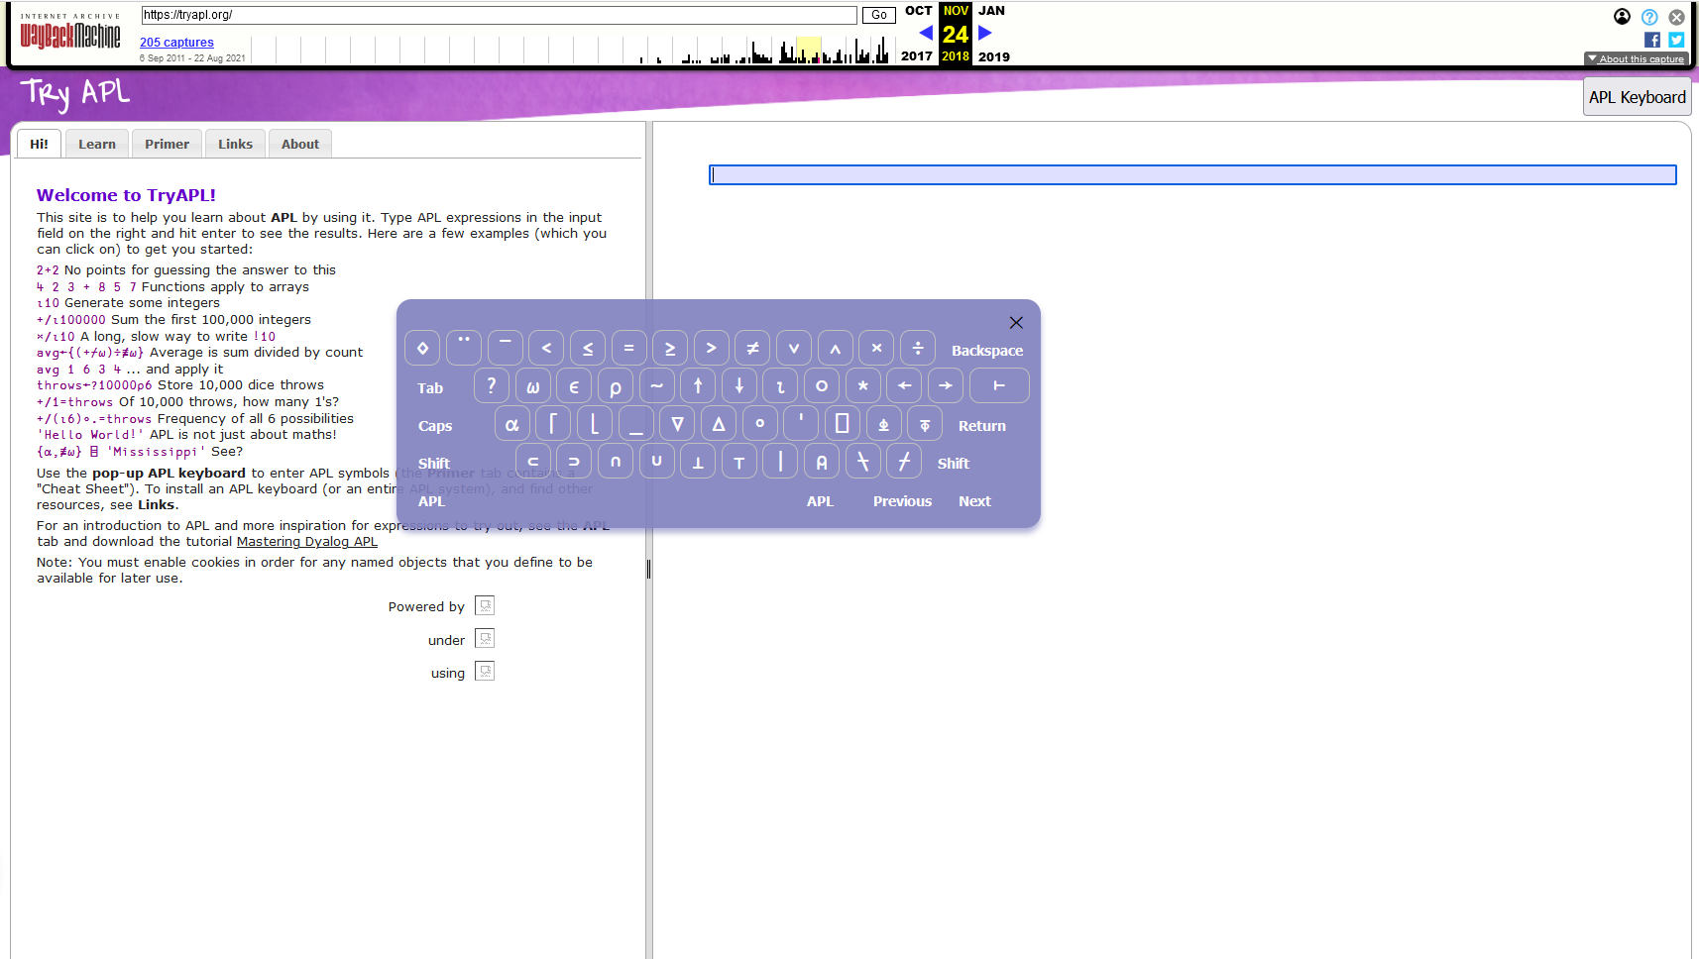

Slide 5
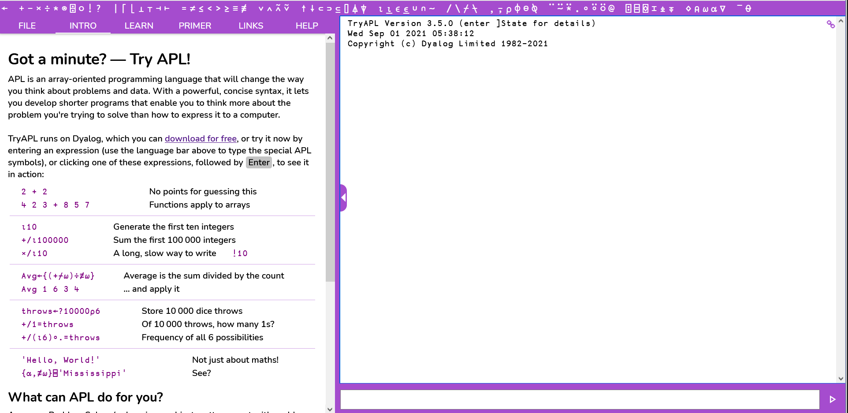

Slide 6
Now Open Source
github.com/dyalog/tryapl

Slide 7
Backend
github.com/dyalog/Jarvis
github.com/abrudz/dyalog-safe-exec

Slide 8
Linux and macOS:
$ dyalog LOAD=/path/to/TAE.apln
Microsoft Windows Powershell
PS $Env:LOAD="TAE.apln"
PS &dyalog

Slide 9
Info
apl.wiki/TryAPL

Slide 10
TryAPL: New in Version 3
Open source: github.com/dyalog/tryapl
Open API
Off-the-shelf technologies
APL-style "session"
Multi-line functions
Download and upload "workspaces"
Share without interference
Touch-screen friendly
Dark mode

Slide 11
New features in version 4
You tell us!
tryapl@dyalog.com
github.com/dyalog/tryapl

Slide 12
Coming Up: September
britishaplassociation.org/webinar-schedule-2021
9th
23rd
apl.wiki/campfire
26th

Slide 13
Next Webinar: 30th September
Error Handling - Part 5
with Adám Brudzewsky
dyalog.tv

