Slide 1
Pragmatic Functional
and Parallel Programming
in Dyalog APL
Morten Kromberg, CXO Dyalog Ltd
Chuo University, Tokyo
July 6th, 2016

Slide 2
Agenda
50-Year-Old Constructs for Parallel Programing: a Brief Introduction to APL
Some recent additions of
parallel and asynchronous extensions
to the Dyalog APL dialect of APL
A very short demo - if I don't talk too much

Slide 3









A Programming Language (for Math)
a×b
Mat1 +.× Mat2
Problems:
- Wide variety of syntactical forms
- Strange and inconsistent precedence rules
- Things get worse when you deal with matrices
See http://www.jsoftware.com/papers/EvalOrder.htm
*x
f g x
x÷y
(3○x)*2
b⍟a
+/4×⍳6
a*÷n
×/4×⍳6

Slide 4
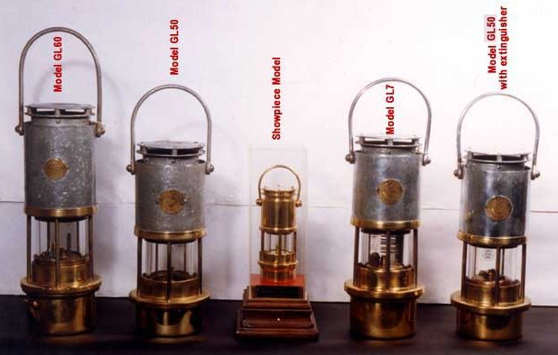
Comments
The ”lamp” symbol (⍝) indicates the beginning of a comment:
2×3 ⍝ two times three
6

Slide 5
“Scalar” Functions
1 2 3 + 4 5 6 ⍝ addition
5 7 9
10 20 30 > 25 ⍝ greater than
0 0 1
1 2 3 ⌈ 3 2 1 ⍝ maximum
3 2 3
? 6 6 6 6 ⍝ "roll"
4 3 5 4
⍝ Below: 10 times a 2x3 matrix
⍝ containing the integers from 1 to 6
10 × 2 3 ⍴ ⍳ 6
10 20 30
40 50 60

Slide 6
Order of Execution
No "precedence", only one rule: as f g x in mathematics
f g x ←→ f(g(x))
Each function takes as its right argument the result of the entire expression to its right.
Good APL can be read from left to right by an experienced programmer, but as a beginner you may need to break it down.
10 × 2 3 ⍴ ⍳ 6
Let's experiment at https://tryapl.org:
https://tryapl.org/?a=10%20%D7%202%203%20%u2374%20%u2373%206&run

Slide 7
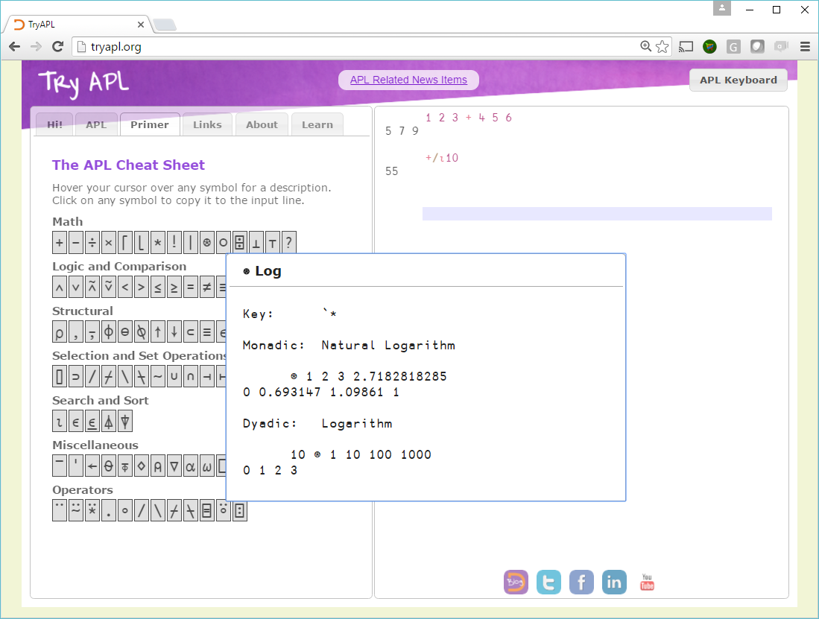

Slide 8
Reduction (f/ or f⌿ or f/[n])
mat ← 3 4 ⍴ ⍳12
×/mat
1 | 2 | 3 | 4
5 | 6 | 7 | 8
9 | 10 | 11 | 12
24
1680
11880
×⌿mat
45 | 120 | 231 | 384

Slide 9
Scan (f\ or f⍀ or f\[n])
mat ← 3 4 ⍴ ⍳12
+\mat
1 | 2 | 3 | 4
5 | 6 | 7 | 8
9 | 10 | 11 | 12
1 | 3 | 6 | 10
5 | 11 | 18 | 26
9 | 19 | 30 | 42
+⍀mat
1 | 2 | 3 | 4
6 | 8 | 10 | 12
15 | 18 | 21 | 12

Slide 10






Outer Product (∘.f)
⍺f⍵ for all combinations of items from left & right
vec1 ∘.x vec2
1 | 2
10 | 100 | 1000

Slide 11
Inner Product (f.g)
f/ row g col for all combinations of rows left, cols right.
m1
m2
1 | 2 | 0
¯1 | 0 | 3
¯1 | 1
0 | 2
¯1 | 0
m1 +.× m2
+/ 1 2 0 × 1 2 0
¯1 | 5
¯2 | ¯1
(+.× is the regular “dot product”)

Slide 12
Inner Product (f.g)
m1
m2
1 | 2 | 0
¯1 | 0 | 3
¯1 | 1
0 | 2
¯1 | 0
m1 +.= m2
+/ 1 2 0 = 1 2 0
0 | 3
2 | 0
(+.= is “count of matches”)

Slide 13
Selected "Mixed" Functions 1/4
mat ← 3 4 ⍴ ⍳12
Rotate: ⌽ ⊖ and ⌽[n]
2 0 ¯1⌽mat
1 | 2 | 3 | 4
5 | 6 | 7 | 8
9 | 10 | 11 | 12
3 | 4 | 1 | 2
5 | 6 | 7 | 8
12 | 9 | 10 | 11
0 1 0 ¯1⊖mat
1 | 6 | 3 | 12
5 | 10 | 7 | 4
9 | 2 | 11 | 8

Slide 14
Selected Mixed Functions 2/4
Take ↑ and Drop ↓
mat ← 3 4 ⍴ ⍳12
¯2 2↑mat
1 | 2 | 3 | 4
5 | 6 | 7 | 8
9 | 10 | 11 | 12
5 | 6
9 | 10
1↓mat
5 | 6 | 7 | 8
9 | 10 | 11 | 12

Slide 15
Selected Mixed Functions 3/4
Transpose ⍉
mat ← 3 4 ⍴ ⍳12
⍉mat
1 | 2 | 3 | 4
5 | 6 | 7 | 8
9 | 10 | 11 | 12
1 | 5 | 9
2 | 6 | 10
3 | 7 | 11
4 | 8 | 12
1 1⍉mat
1 | 6 | 11

Slide 16
Selected Mixed Functions 4/4
IndexOf ⍳
3 1 4 1 5 9 ⍳ 1 2 3
2 7 1
Grade (Up) ⍋
⍋3 1 4 1 5 9
2 4 1 3 5 6
{⍵[⍋⍵]}3 1 4 1 5 9 ⍝ index by grade
1 1 3 4 5 9
Membership ∊
'HELLO WORLD'∊'AEIOU'
0 1 0 0 1 0 0 1 0 0 0

Slide 17
Look Ma, No Loops!
The fact that map is implicit, and indexing can be done using arrays, encourages ”switch free” logic. Your data structure acts as a ”control structure”:
Example | Comments
data←2 7 15 60 data ⌈ 5 5 7 15 60 | if data[i]>5 then data[i] else 5
data + data ∊ 3 7 15 2 8 16 60 | Increment where data[i] is in [3,7,15].
(x × mask) + y × ~mask | If mask[i] then x else y
ages←'child' 'young' '20s' 'old' ages[1⌈4⌊ ⌈data÷10] child child young old | “bucketing”
NB: This stuff is *really* easy for a compiler to parallelise

Slide 18
Summary: Basic [Parallel] Forms
The following forms have existed since the beginning:
Scalar functions:
+-×÷| *⍟ ⌈⌊
<≤=≥>≠
∧∨ ⍲⍱ ~
○! ?(roll)
Reduction: /⌿ and Scan: \⍀
Outer Product: ∘.f
Inner Product (rows-left vs cols-right): f.g and ⊥
“Mixed”: ⌹⊤ ⍴,↑↓ ⍳∊⍒⍋ ⌽⍉⊖ ?(deal)

Slide 19
User-defined Functions
Lambdas, aka “dfns” provide a lexically scoped, functional form of functions in APL.
Alternative to procedural style of coding from 1966 APL.
plusdouble←{⍺+2×⍵} ⍝ left arg + two times right
fibonacci←{ ⍝ Tail-recursive Fibonacci.
⍺←0 1 ⍝ Default left argument
⍵=0: ⍬⍴⍺ ⍝ If ⍵=0, return 1st item of ⍺
(1↓⍺,+/⍺) ∇ ⍵-1 ⍝ Tail recursion
}

Slide 20
Summary: Syntax of APL
Syntactical Form | Example | Result
array | 1 3.1415 1.2E18
function argument | ⍳ 6 | 1 2 3 4 5 6
left-arg function right-arg | 1 2 3 × 1 10 100 1 plusdouble 2 3 | 1 20 300 5 7
operand operator | ×/ 1 2 3 4 5 6 2 +/ 1 2 3 4 5 6 plusdouble/1 2 3 | 720 3 5 7 9 11 17
left-opnd operator right-opnd | 1 0 2 +.× 1 2 3 | 7
array[indices] | 'ABCDEF'[2 5 5 6] | BEEF
Notes:
Demo “Syntaxes”

Slide 21
1982: Nested Arrays
APL2: Any item of an array can be another array
Scalar functions “pervade”:
(1 2 3) 10 × (4 5 6) (7 (8 9))
┌───────┬──────────┐
│4 10 18│┌──┬─────┐│
│ ││70│80 90││
│ │└──┴─────┘│
└───────┴──────────┘

Slide 22
Each Operator (¨)
The “Each” operator ¨ maps “non-scalar” functions.
For example, +/ reduces vectors so:
+/ (4 5 6) (7 8 9) ⍝ ←→ (4 5 6)+(7 8 9)
11 13 15
+/¨ (plus reduce each) will sum each top-level item:
+/¨ (4 5 6) (7 8 9) ⍝ ←→ (4+5+6) (7+8+9)
15 24

Slide 23
Recent Extensions
Modern APL has introduced additional high-order functions and combinators:
Function trains (f + g)
Power (⍣) applies a function repeatedly
Rank (⍤) breaks arguments into sub-arrays of specified ranks
Key (⌸) uses values found in one argument to partition another
Stencil (⌺) applies a function to ”neighborhoods” of each item of an array
Function application using such operators can be highly optimised and parallelised by compilers (AND interpreters).

Slide 24
“Function Trains”
“Atop”: (f g)
⍺ (f g) ⍵ ←→ f (⍺ g ⍵)
10000 (? ⍴) 6 ⍝ Roll 10000 dice w/out 10000 element temp array
“Fork”: (f g h)
(f g h) ⍵ ←→ (f ⍵) g (h ⍵)
(f + h) ⍵ ←→ (f ⍵) + (h ⍵)
(+⌿ ÷ ≢) ⍵ ←→ (+⌿⍵) ÷ (≢ ⍵) ⍝ mean is sum ÷ count
⍺ (f g h) ⍵ ←→ (⍺f⍵) g (⍺h⍵)
1 (+ , -) 0.1 ⍝ (1+0.1),(1-0.1) or 1 ± 0.1
1.1 0.9
Tines of a fork can be computed in parallel, and
Trains allow creation of more efficiently parallelisable units

Slide 25
Power Operator
Apply a function a fixed number of times, or until the right operand function tells you to stop.
2 (+ ⍣ 3) 3 ⍝ Add 2 three times
9
twice←⍣2 ⍝ Bind one operand;
2 +twice 3 ⍝ twice is a monadic opr
7
({1+÷⍵}⍣≡)1 ⍝ … until f^{n} ≡ f^{n-1}
1.618033989

Slide 26
Rank Operator (1 of 2)
mat (x⍤1 0) vec
Multiplication with left rank 1 (vectors), right rank 0 (scalars)
1 | 2 | 3
4 | 5 | 6
10 | 100
×
10
20
30
400
500
600

Slide 27
Rank Operator (2 of 2)
mat ← 2 2 4 ⍴ ⍳16
1 | 2 | 3 | 4
5 | 6 | 7 | 8
((+⌿ ÷ ≢)⍤2) mat ⍝ avg cols
3 | 4 | 5 | 6
11 | 12 | 13 | 14
9 | 10 | 11 | 12
13 | 14 | 15 | 16
(+⌿ ÷ ≢) mat ⍝ average along 1st dimension
5 | 6 | 7 | 8
9 | 10 | 11 | 12
((+⌿ ÷ ≢)⍤1) mat ⍝ avg rows
2.5 | 6.5
10.5 | 14.5

Slide 28
Key (⌸)
Apply operand function to items corresponding to unique keys.
keys← 'red' 'blue' 'red' 'red' 'blue'
values← 10 20 30 40 50
keys {⍺ ⍵}⌸ values ⍝ Group by key
┌────┬────────┐
│red │10 30 40│
├────┼────────┤
│blue│20 50 │
└────┴────────┘
keys {⍺,+/⍵}⌸ values ⍝ Sum items by key
┌────┬──┐
│red │80│
├────┼──┤
│blue│70│
└────┴──┘

Slide 29
Stencil (⌺)
“Stencil” applies function operand to each item of an array – and selected neighbours:
⊢ 1 2 3 ⍝ ⊢ is “same”: identity function
1 2 3
(⊢ ⌺ 3) 1 2 3 ⍝ Window Size = 3
0 1 2
1 2 3
2 3 0
Neighbors Items
⍝ A classical ”blur” stencil can be expressed as:
({ .25 .5 .25 +.× ⍵} ⌺ 3) 0 10 0 0 10 0
2.5 5 2.5 2.5 5 2.5

Slide 30
John Conway’s Game of Life
Computing the next generation:
Any live cell with fewer than two live neighbours dies, as if caused by under-population.
Any live cell with two or three live neighbours lives on to the next generation.
Any live cell with more than three live neighbours dies, as if by over-population.
Any dead cell with exactly three live neighbours becomes a live cell, as if by reproduction.
life←{↑1 ⍵∨.∧3 4=+/,¯1 0 1∘.⊖¯1 0 1∘.⌽⊂⍵}
life←{↑1 ⍵∨.∧3 4=⊂{+/,⍵} ⌺ 3 3⊢⍵}

Slide 31
Life is a Convolution
life←{↑1 ⍵∨.∧3 4=⊂{+/,⍵} ⌺ 3 3⊢⍵} ⍝ Stencil Life
⎕←edges←∘.⌈⍨2 1 2 ⍝ Neighbors weighted 2, centre = 1
2 2 2
2 1 2
2 2 2
If there are two or three neighbours for a live cell, the edge-weighted sum of the 3x3 tile around the cell will be (1+2+2) or (1+2+2+2). If there are three neighbours for an empty cell (birth), the sum will be (2+2+2). So:
⎕←good←5 6 7∊⍨⍳18 ⍝ Index Origin Zero
0 0 0 0 0 1 1 1 0 0 0 0 0 0 0 0 0 0
And now life is a super-optimisable parallel stencil calculation:
life←{good[{+/,⍵×edges} ⌺ 3 3⊢⍵]}

Slide 32
Neural Networks
APL is a direct notation for expressing the math at the core of artificial neural networks. For example, the following function applies a sigmoid function to the output of a collection of sigmoid neurons:
sn←{÷1+*-⍺+.×⍵}
⍺ contains neuron weights (rows are neurons, one col per input)
⍵ is an array of input stimuli (row are inputs, one col per “case”).
This applies the computation as a stencil of size 7 7, to an input matrix:
img←{÷1+*-weights+.×,⍵} ⌺ 7 7⊢⍵}

Slide 33
Parallel Functional Forms in APL
Parallel Forms
f (map often implicit)
f¨ (each: explicit map)
f.g (inner product)
f⍤n (rank: map sub-arrays)
f⌸ (key: ”group by”)
f⌺sz (stencil: map to
neighborhoods)
Sometimes Parallelizable ...
f/ (reduction)
f\ (scan)
f⍣n (apply n times or until fixpoint)

Slide 34
Objects in APL: Dot is Parallel
APL ”Namespaces” are dynamic objects:
life←⎕NS '' ⍝ Create an empty namespace
life.meaning←42 ⍝ Create variable within it
(altlife←⎕NS '').meaning←321 ⍝ Another one
universes←life,altlife ⍝ Array of namespaces
≢universes ⍝ How many items?
2
universes.meaning ⍝ Parallel universes
42 321

Slide 35
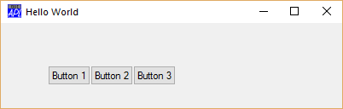
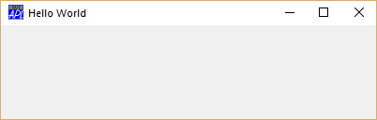
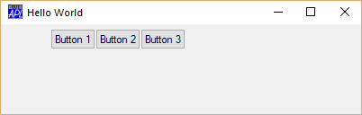
Class-based Objects
F←⎕NEW'Form' (('Caption' 'Hello World')
('Coord' 'Pixel')('Size'(100 400)))
F.(B1 B2 B3)←F.⎕NEW¨{'Button'
(('Caption'('Button ',⍕⍵))('Posn'(5+50×0 ⍵)))}¨1 2 3
F.(B1 B2 B3).(Caption Posn)
┌───────────────┬────────────────┬────────────────┐
│┌────────┬────┐│┌────────┬─────┐│┌────────┬─────┐│
││Button 1│5 55│││Button 2│5 105│││Button 3│5 155││
│└────────┴────┘│└────────┴─────┘│└────────┴─────┘│
└───────────────┴────────────────┴────────────────┘
F.(B1 B2 B3).(Posn[1]←50)

Slide 36
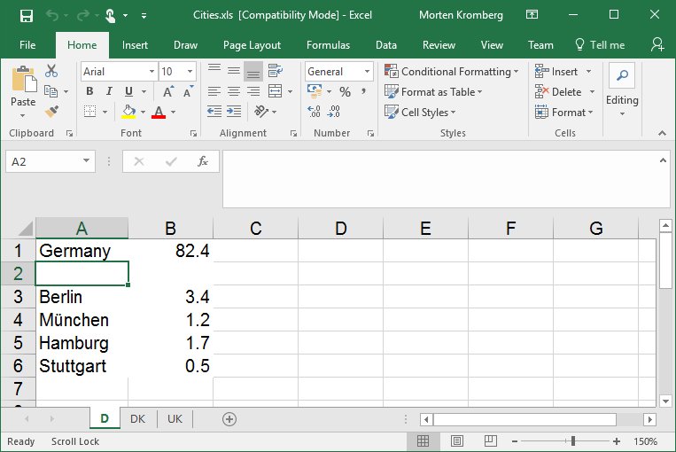
More Arrays of Objects
XL←⎕NEW 'OleClient' (⊂'ClassName' 'Excel.Application')
cities←XL.Workbooks.Open ⊂'c:\...\cities.xls'
sheets←⌷cities.Sheets ⍝ Sheets collection as an array
sheets.Name
┌─┬──┬──┐
│D│DK│UK│
└─┴──┴──┘
sheets.UsedRange.Value2
┌──────────────────┬───────────────────┬───────────────────────┐
│┌─────────┬──────┐│┌──────────┬──────┐│┌──────────────┬──────┐│
││Germany │82.4 │││Denmark │5.4 │││United Kingdom│60.2 ││
│├─────────┼──────┤│├──────────┼──────┤│├──────────────┼──────┤│
││Berlin │3.4 │││Copenhagen│2 │││London │7 ││
│├─────────┼──────┤│├──────────┼──────┤│├──────────────┼──────┤│
││München │1.2 │││Helsingør │0.03 │││Birmingham │1 ││
│├─────────┼──────┤│└──────────┴──────┘│├──────────────┼──────┤│
││Stuttgart│0.5 ││ ││Basingstoke │0.1 ││
│└─────────┴──────┘│ │└──────────────┴──────┘│
└──────────────────┴───────────────────┴───────────────────────┘

Slide 37
Parallel Execution of APL
Use vector instructions (SSE etc)
Multithread primitives
  Done some scalar dyadic functions
  Need to look at operators and trains
Compile to Parallel Hardware
  Aaron Hsu at Indiana University: co-dfns compiler
  HyperFit / University of Copenhagen: APL to Futhark
  Bernecky / Scholz @ Herriot Watt: Single Assignment C
Introduce Asynchronous Features into Language
  Futures and Isolates

Slide 38
Compilers
Compiler projects are very exciting and will make APL competitive in new areas
  Image manipulation
  Fluid dynamics-style applications
But not all applications are ”data parallel”
And compilers sometimes put unpleasant constraints on the users ☺

Slide 39
Interpreter Needs Help...
APL is SIMD at the core
But parallelising sequences of SIMD instructions is hard
  We have parallel cores, but they don’t have parallel access to memory
The user has the knowledge which is hard to deduce throught static analysis of APL:
  Array size vs number of parallel threads
  Side effects (or lack thereof)
(S)he can help make decisions on when to fork and collect
Conclusion: We need new language features to allow the user to express optionally asynchronous parts of algorithms

Slide 40
Futures and Isolates
Goal: Allow the APL user to explicitly express parallelism / asynchronicty in a natural way
In the interpreter, futures and isolates enable coarse-grained task parallelism
  Tasks with a duration of at least 100ms
In a compiler, futures can be used to express fine-grained data parallelism

Slide 41
Isolates
An Isolate tastes, smells, looks like a Dyalog namespace, except that...
Expressions executed in the isolate run in a separate process from the main interpreter thread (”in parallel”)

Slide 42
Isolate Example
I3←isolate.New¨3⍴⊂''
I3.X←(1 2 3)(4 5)6
I3.({(+⌿⍵)÷≢⍵}X)
2 4.5 6
X←1 2 3
X←6
X←4 5

Slide 43
Futures
The result of an expression executed in an Isolate is a Future
Futures can be passed as arguments to functions without blocking
Structural functions can work on arrays containing futures without blocking
Primitives which need to reference the value will block

Slide 44
The Parallel Operator
Monadic operator parallel (∥) derives a function which:
creates an empty isolate
executes the operand inside the isolate
returns a future (and discards the isolate when no longer needed)
sums←{+/⍳⍵}∥¨⍳100 ⍝ returns 100 futures - IMMEDIATELY
≢sums ⍝ structural functions do not ”realize” futures
100
≢partitions←(100⍴25↑1)⊂sums ⍝ Partitioned Enclose
4
≢¨partitions ⍝ 4 groups, each containing 25 futures
25 25 25 25
+/ +/∥¨partitions ⍝ 4 parallel +/’es
171700
(We used 1+4+100 parallel threads to compute the end result)

Slide 45
Deterministic Parallelism
Inserting or removing Parallel operators does not change the meaning of the code. Thus, parallelism does not interfere with the notation.
sums←{+/⍳⍵}∥¨⍳100
partitions←(100⍴25↑1)⊂sums
+/+/∥¨partitions
171700
sums←{+/⍳⍵} ¨⍳100
partitions←(100⍴25↑1)⊂sums
+/+/ ¨partitions
171700
(as long as your functions have no side effects)
(… and there are no errors)

Slide 46
The Model Implementation
Futures are fully implemented in the Dyalog interpreters from v14.0 (2014) onwards
The creation and management of isolates is still modelled using APL code, most importantly:
Proposed Primitive Construct | Name in Current Model | Comment
¤ | ø | New Isolate
∥ | II | Parallel
∥¨ | IÏ | Parallel Each

Slide 47
Demo

Slide 48
Fun with Isolates ☺!
Example: Start an isolate server on each of two Raspberry Pi-controlled robots, then under Windows/Linux/Mac:
{isolate.AddServer '192.168.0.',⍕⍵}¨100 101
bots←ø¨ bot bot ⍝ clone bot driver API
500 bots.Drive (45 0)(0 45)
This means: call the Drive function on each bot in parallel,
With a left argument of 500ms
With right arg of (45 0) for first and (0 45) for 2nd bot (power settings for right and left wheels)

Slide 49
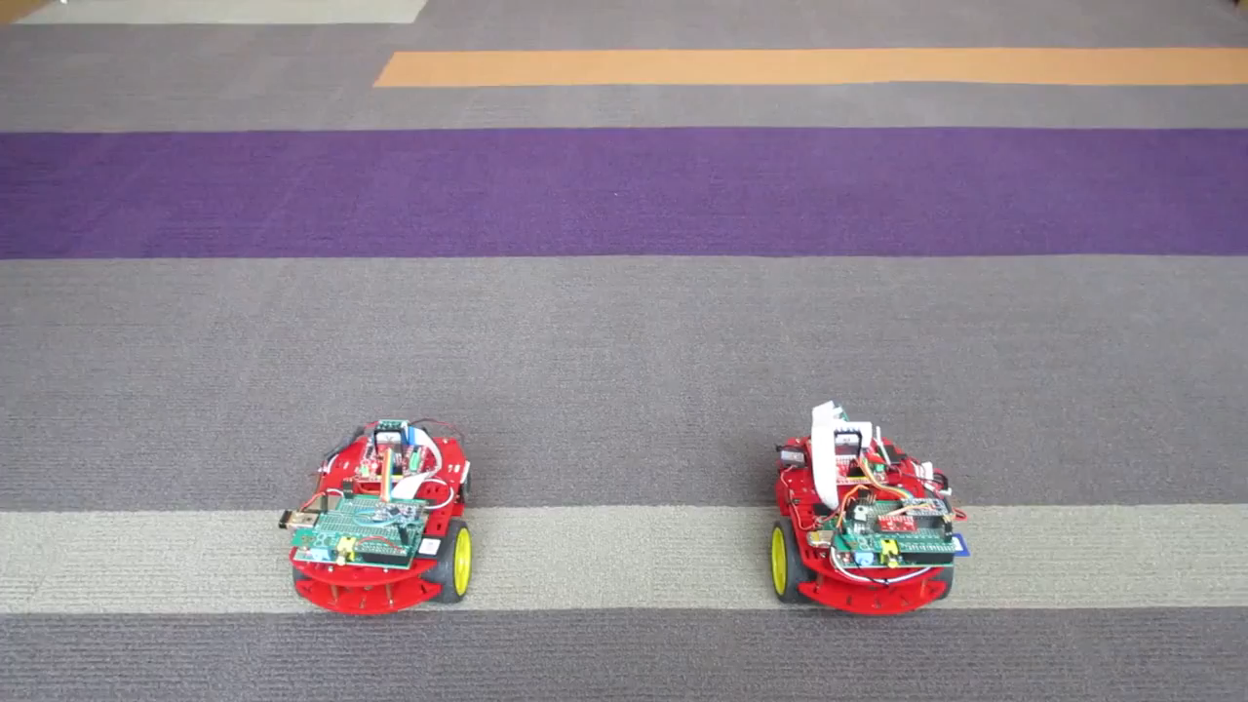
Dancing Robots

Slide 50
Selected Customers
KCI Corp (US)
  Budgeting and Planning
Carlisle Group (US)
  Collateral and Securitization for Global Capital Markets
CompuGroupMedical (Sweden)
  Worlds Largest “Patient Record” system: 40,000 users and 2.5 million patients records at largest hospital in Scandinavia
ExxonMobil (US)
  Optimizes the “Cracking” of Petroluem Products using APL
SimCorp (DK), APL Italiana (I), Fiserv Investment Services (US), Infostroy Ltd (Russia)
  Leaders in various markets for Asset Management Systems
A Finnish game company

Slide 51

Infostroy

Slide 52

SimCorp

Slide 53
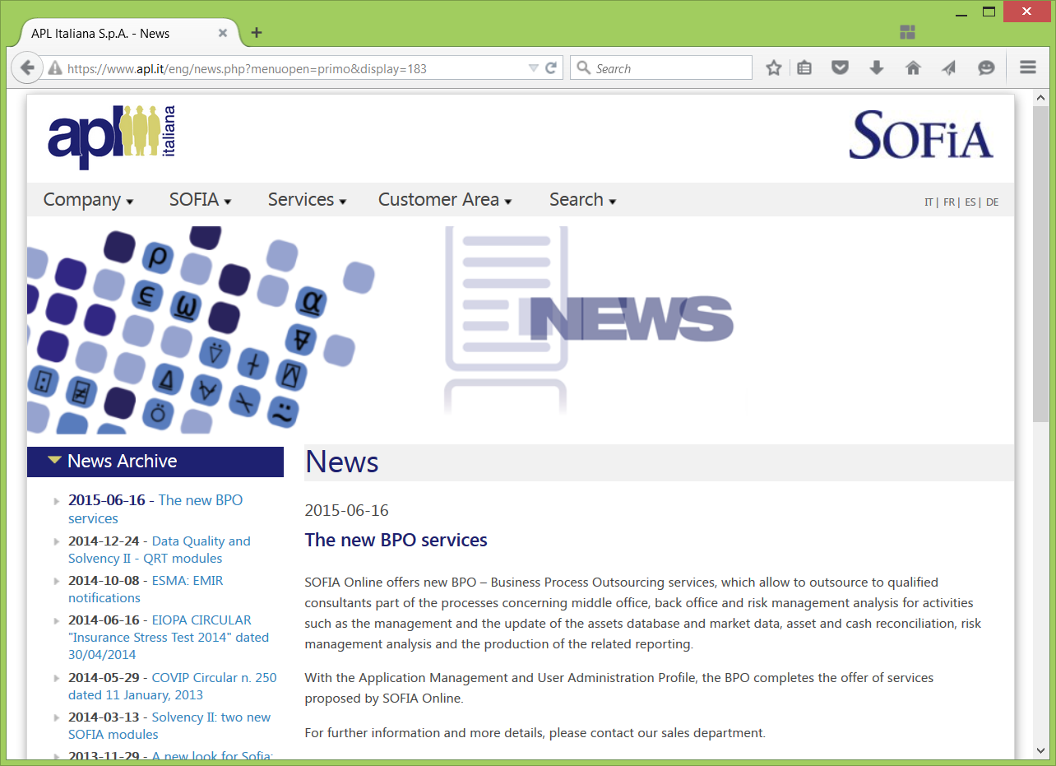
APLIT

Slide 54
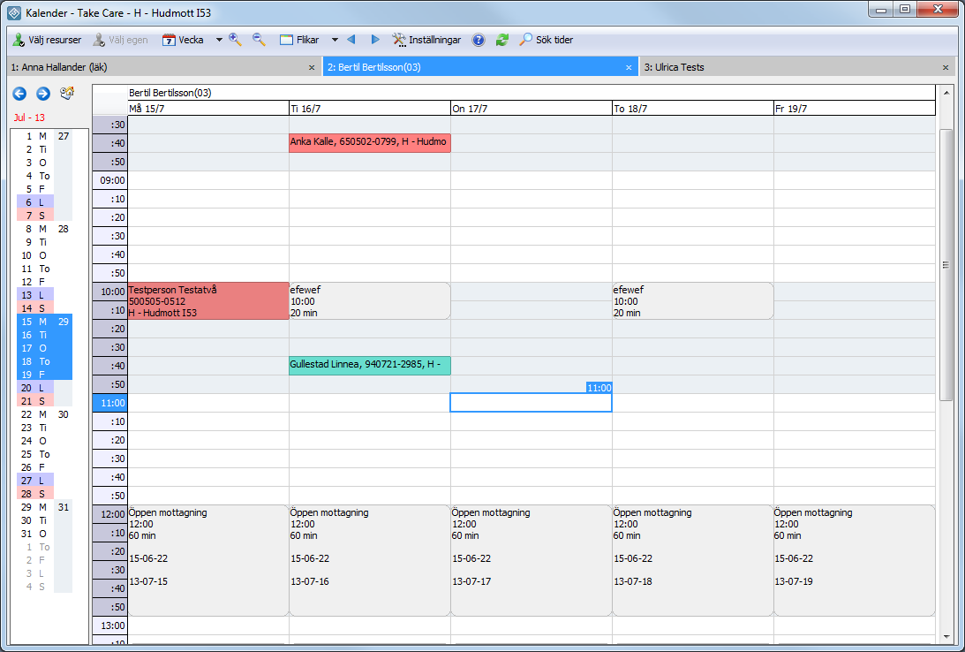
CGM TakeCare
Patient Journal System

Slide 55
Any Questions
?
Prefix: Roll (scalar) - Integer in range 1 to ⍵:
? 6 6 6 6
4 3 4 2
Infix: Deal – deal ⍺ items from range 1 to ⍵:
5 ? 6
2 5 1 4 6
Selfie: Permutation:
?⍨ 6
3 1 4 2 6 5

Slide 56
Resources
Supporting documentation and materials online:
Interactive APL Session on line:
  http://tryapl.org (see the "resources" tab)
Online Help and Manuals
  http://help.dyalog.com
  http://docs.dyalog.com
Introduction to Dyalog APL by Bernard Legrand
  http://http://www.dyalog.com/mastering-dyalog-apl.htm
Google: Try for example
  https://www.google.com/?q=dyalog+apl+power+operator

