Slide 1
Migrating APL+Win
Applications
Morten Kromberg, CTO

Slide 2
A New Wave of Migrants
Dyalog APL was created by Dyadic Systems Ltd, when the mainframe consulting business started to die (1981)
Most current users of Dyalog APL migrated from SHARP APL, IBM APL2, APL+Win, or APLX (or DEC APLSF, or …)
Waves of migrants
  ”Death” of mainframes and minicomputers (1980's)
  Superior support for Windows GUI (1990's)
  Now, "the cloud" (& a few more mainframes being shut down)

Slide 3
From APL2
Relatively straightforward
A few language differences
  Each (¨) on empty arrays
  Format by example
User Interfaces and file I/O are usually already handled by simple cover-functions and can be emulated “easily”
Linux or Windows apps may be making external DLL calls
Notes:
*

Slide 4
Recent / Active APL2 Migrations
Insurance company
  No UI, manipulates text and Excel files
  Handled by European Consulting Partner
Sandvik (Sweden) – in progress: Mainframe APL2 direct to Docker Containers and HTML/svg
  Handled by Tiamatica in Malmö (Gilgamesh Athoraya)
BIG Jewellers: Windows
  Handled by Mark Wolfson @ BIG "with a little help"

Slide 5
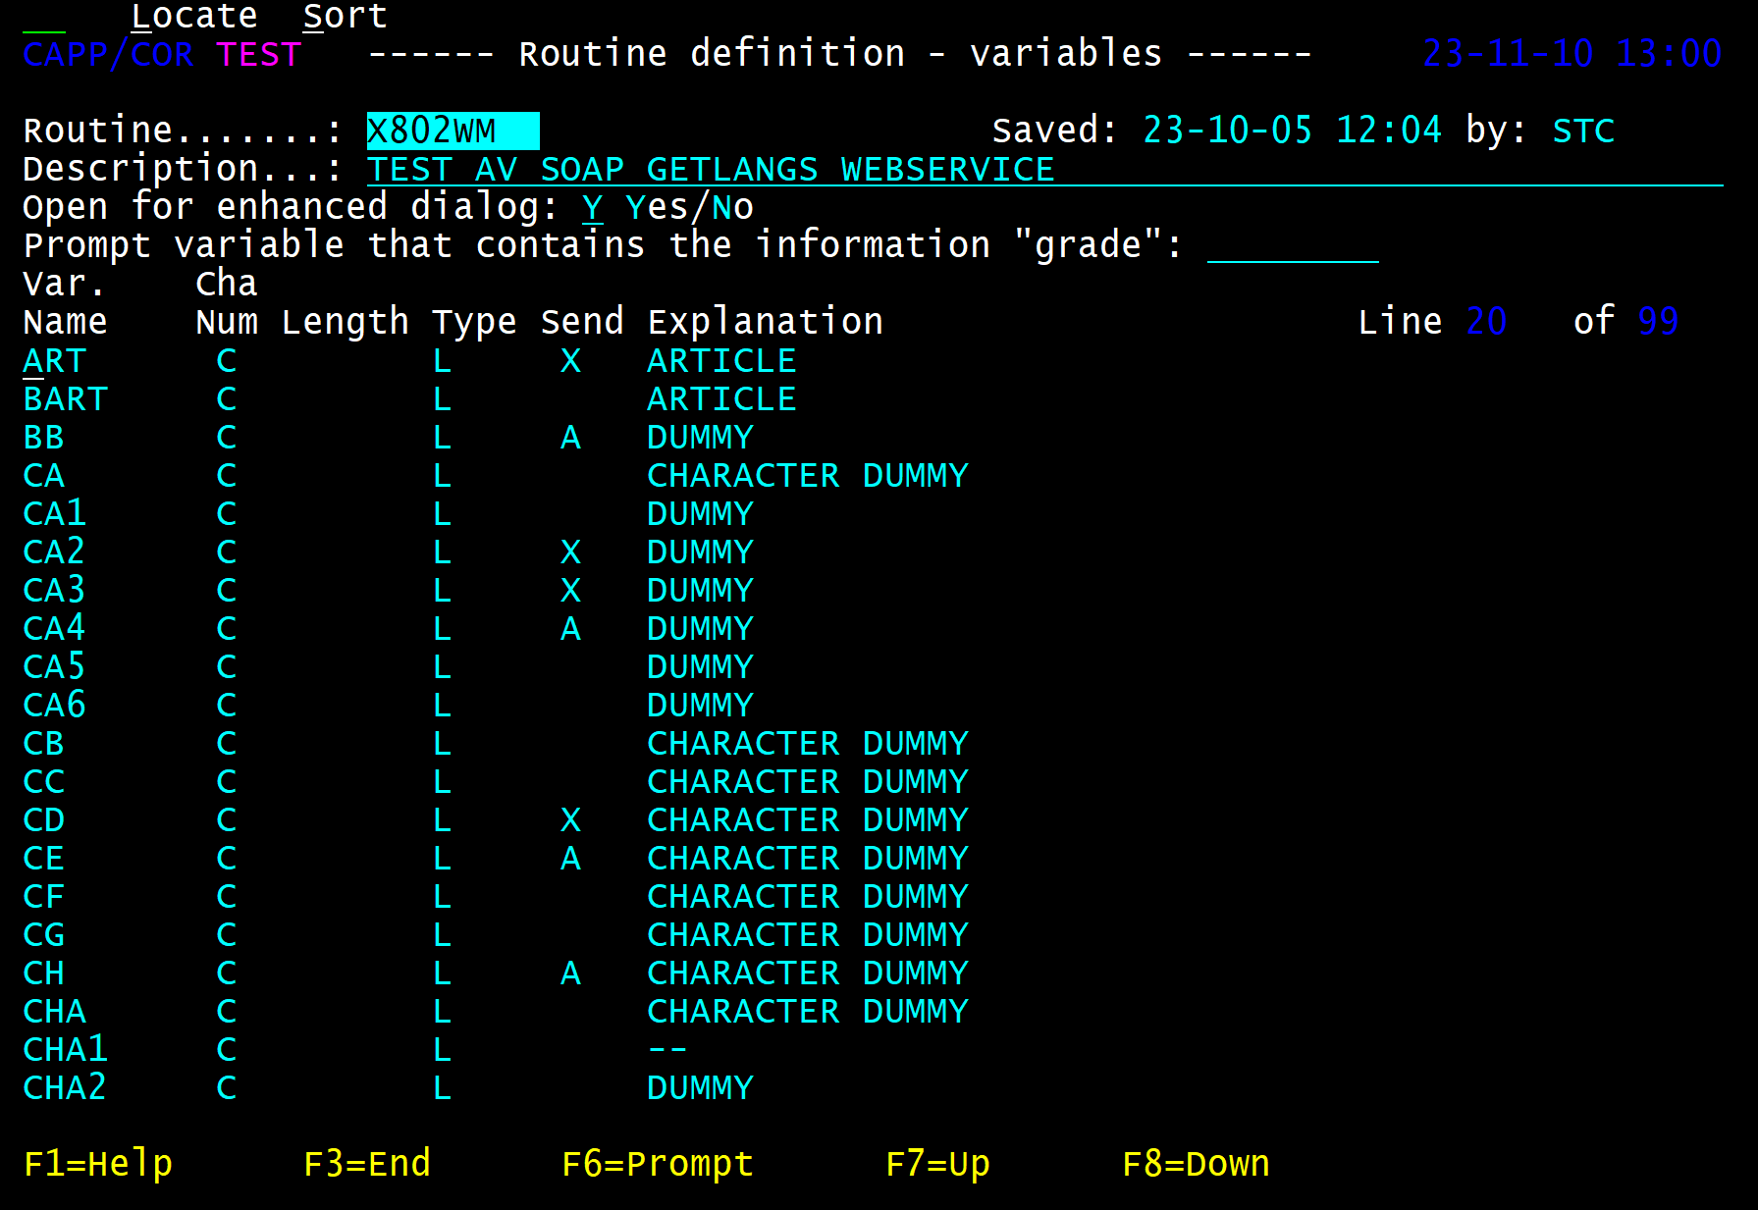
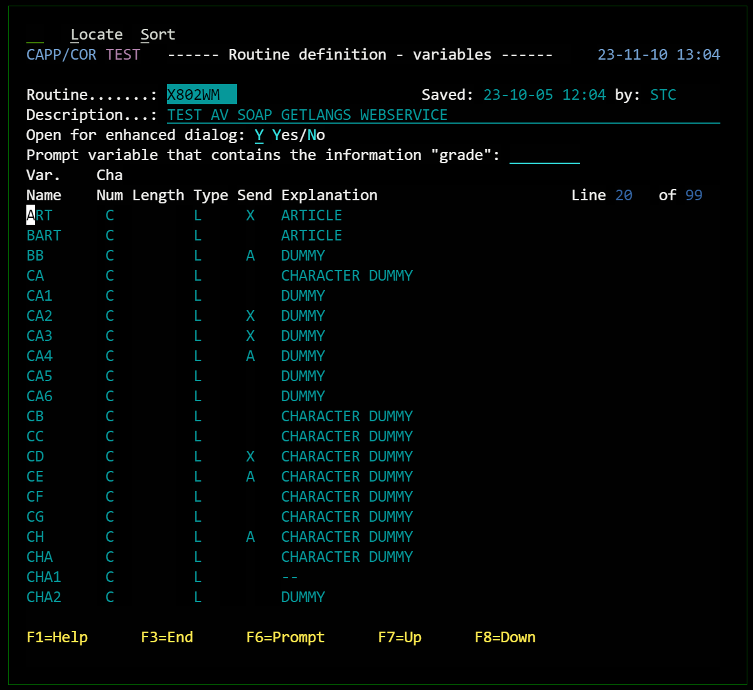
Migrated APL2 Mainframe UI

Slide 6

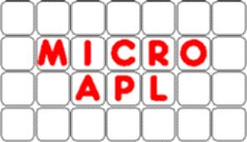
From APL+Win or MicroAPL APLX
Same language differences as APL2, plus:
System functions & control structures not found in Dyalog APL
Double quotes ("Don't do this!")
Graphical User Interfaces

Slide 7
Recent / Active APL+Win Migrations
Two European Insurance companies
  One with GUI, completely rewritten in Dyalog APL, the other a pure service converted to Jarvis in Linux containers
  Handled by a European consulting partner
METSIM® - in progress
  Migration being handled by Dyalog
  Will be used to develop tools to automate migration, including the Graphical User Interface
More under discussion

Slide 8
Migrating APL+Win Applications

Slide 9
Step 1: Export Source Code
APL Workspace Transfer format is a standard agreed by APL vendors before 1980
Most APL systems provide user or system commands IN and OUT to read and write this format
The APL+Win user command ]OUT creates a file in Transfer Format:
]OUT /tmp/out ➔ /tmp/out.ATF
Notes:
*

Slide 10
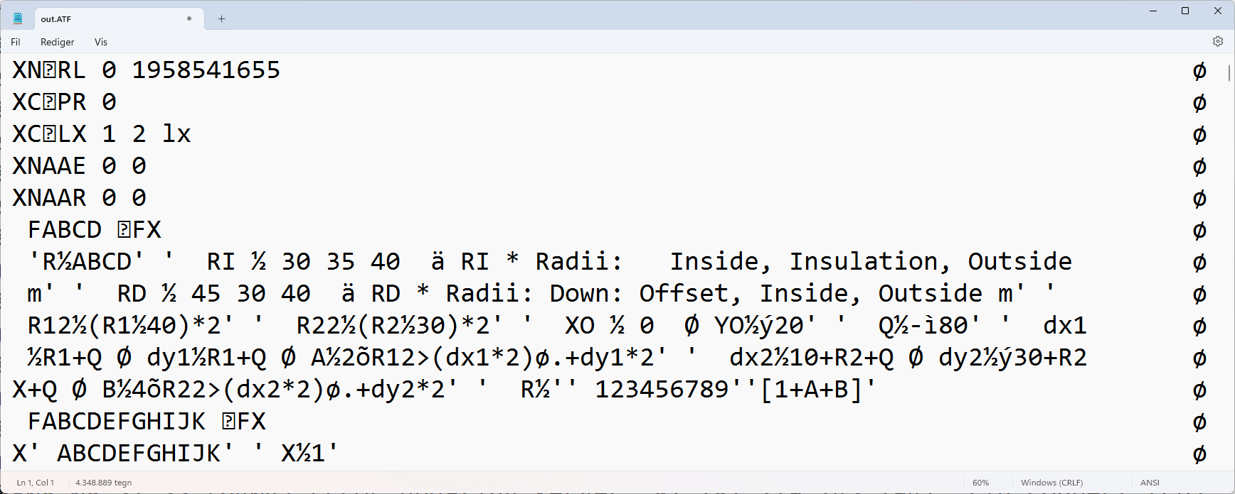
Step 1 – Export Source Code
Result of ]OUT /tmp/out:

Slide 11
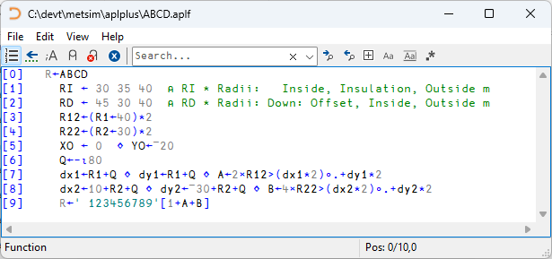
Step 2: Create Text Source
Our new ]IN command can create text source files
]IN /tmp/out.ATF -outdir=/path/aplplus -apl=APLPLUS
Notes:
*

Slide 12
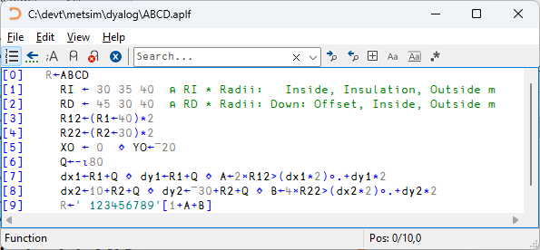
Step 3: Automatic Conversion
Apply automated transformations to the original source
]todyalog /path/aplplus /path/dyalog A2K
Notes:
*

Slide 13
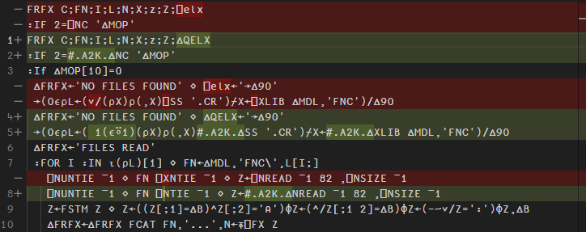
Automatic Substitutions
Many Thanks to VS Code!

Slide 14
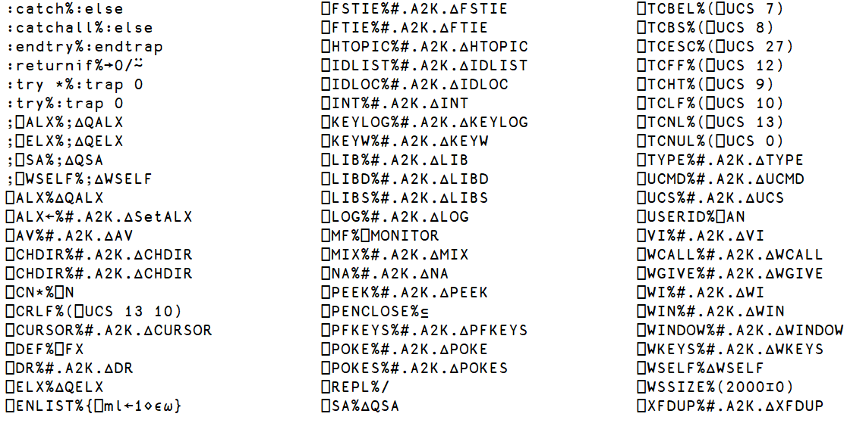
atfmap.txt

Slide 15
System Functions Emulated
⎕XLIB => #.A2K.∆XLIB
R←∆XLIB X
X,←'*'↓⍨≢X
:If 0∊⍴R←↑⊃⎕NINFO⍠1⊢X
:If ∨/'?*'∊X
R←0 0⍴' '
:Else
'XFHOST ERROR FindFirstFile 1 0 3 The system cannot find the path specified.'
⎕SIGNAL 22
:EndIf
:Else
R←R[⍋R;]
:EndIf

Slide 16
Manual Steps

Slide 17
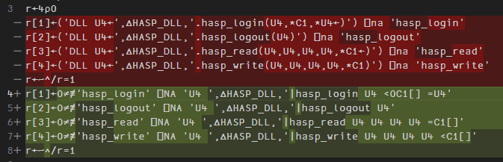
Foreign Function Calls
Mechanical manual translation
We *may* add automated conversion

Slide 18
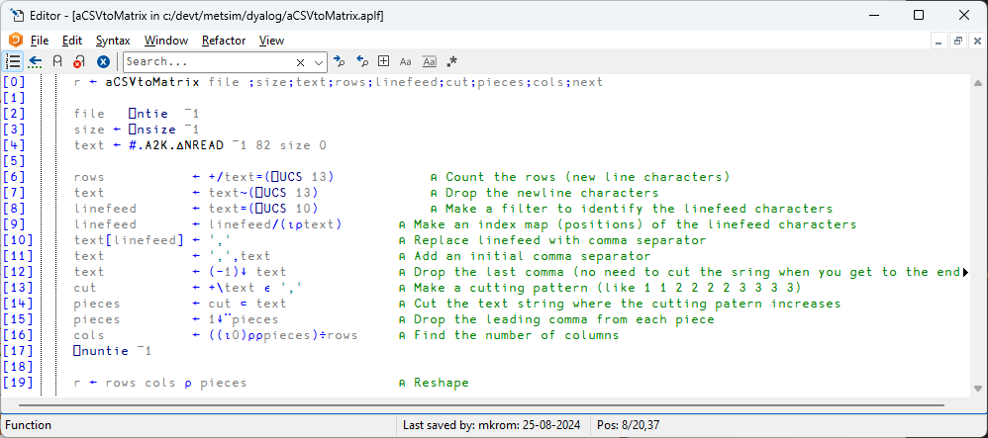
CSV files
⎕CSV

Slide 19
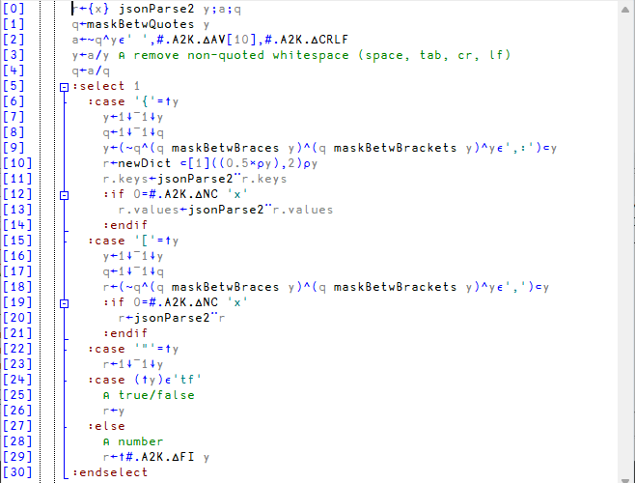
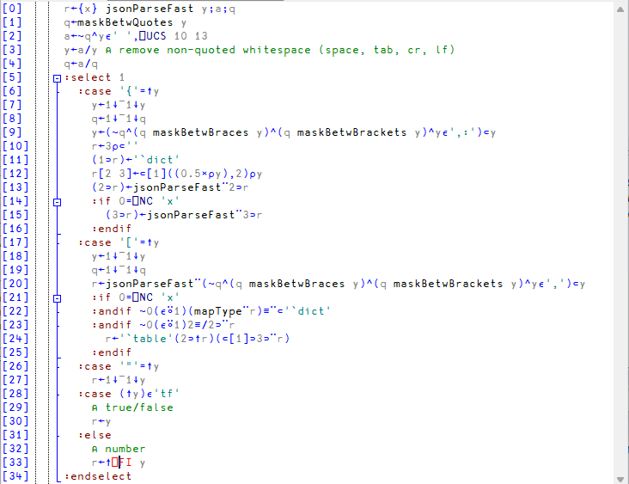
⎕JSON

Slide 20
Component Files
Emulations of ⎕F* system functions which can read and write APL+Win component files directly
  Uses an APL+Win runtime application and binary SCAR format via TCP sockets
Allows parallel operation of old + new versions of the application code
Component files can be migrated gradually
Notes:
*

Slide 21
The Hard Part
Graphical User Interfaces
⎕WI

Slide 22
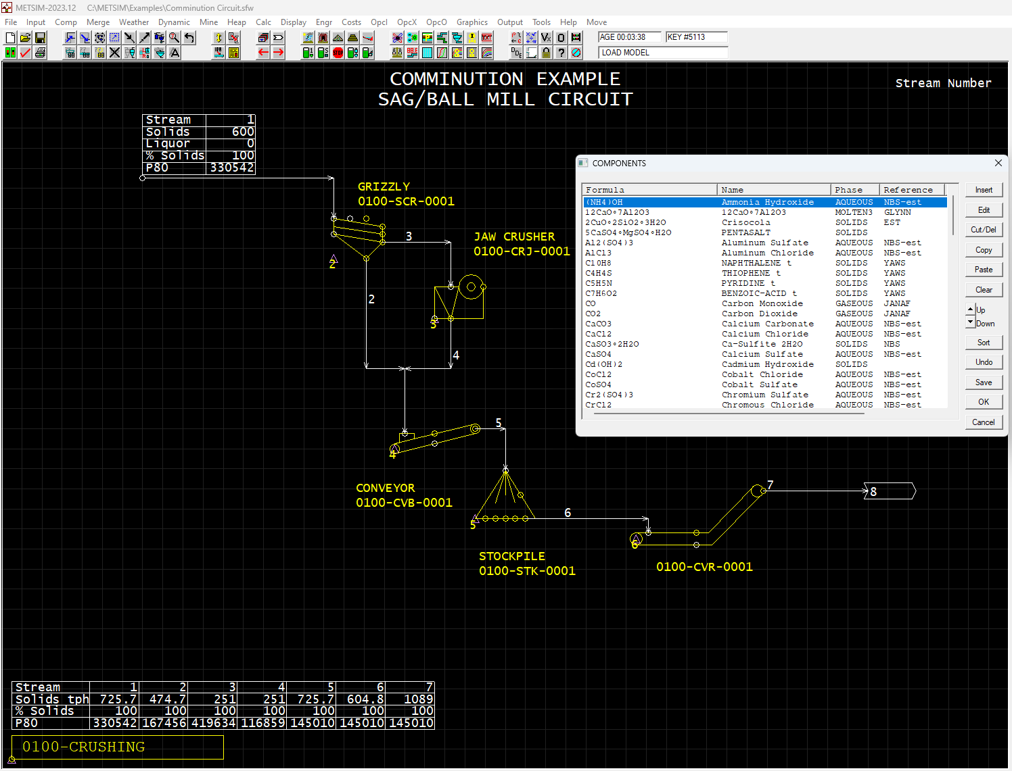
Demo

Slide 23
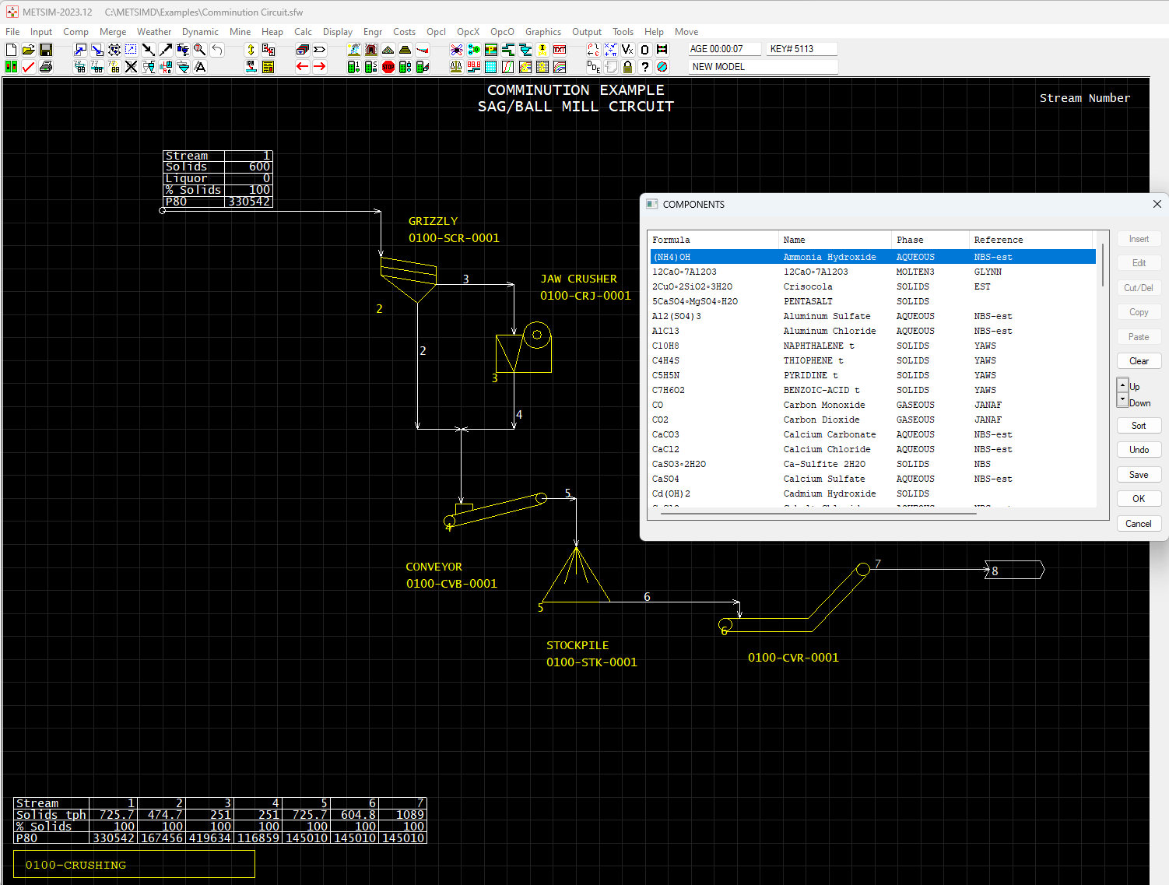

Slide 24
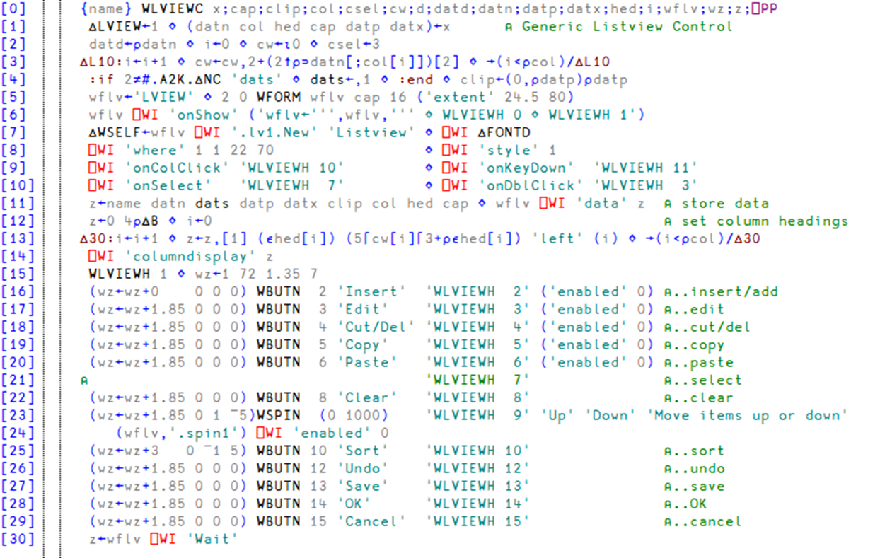

Slide 25
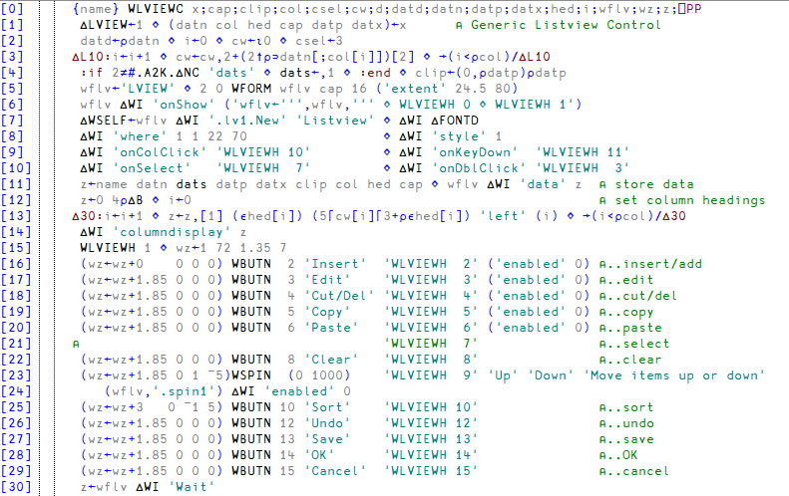
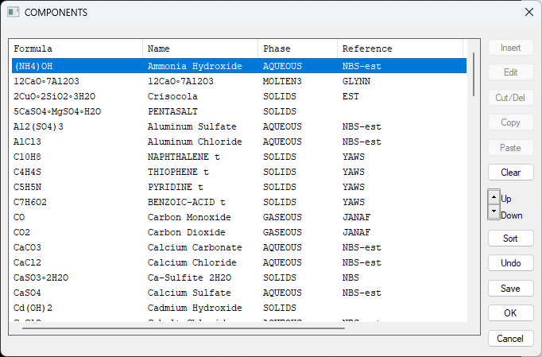

Slide 26
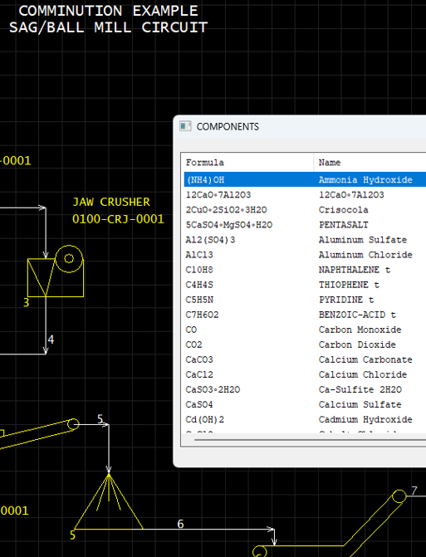
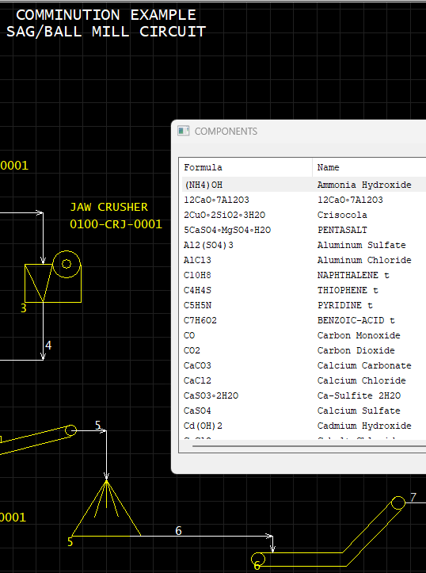

Slide 27
∆WI Status November 2024
Some Support
No Support (yet)
button imagelist picture
check label richedit
combo list scroll
edit listview* selector
form menu spinner
frame page timer
activecontrol mdiform status
activeobject media toolbox
commandbar option trackbar
commandbutton printer tree
datetime progress
grid
* listview since Dyalog'24

Slide 28
Declaration of Intent
We have hired two new APL developers in 2024
METSIM® migration complete expected early 2025
Our partners in Germany, USA and Sweden are gaining experience of migrations

Slide 29
Declaration of Intent
We will produce a document enumerating differences and documenting emulation functions
All migration tools and documentation will be
free and open source
We *may* also decide to add new features to Dyalog v20.0
  For example :LeaveIf

Slide 30
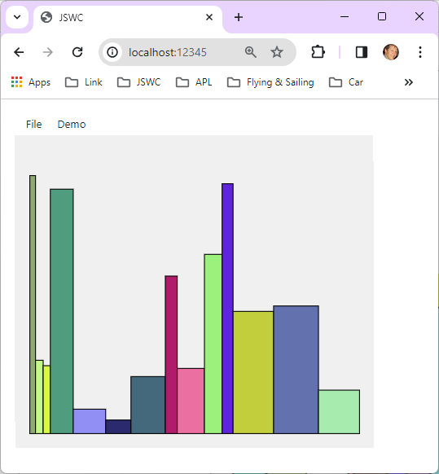
EWC + ∆WI =
From APL+Win
direct to
the Cloud

