Slide 1
Migrating Win32 GUI to other Environments
(EWC)
Morten Kromberg, CTO (& APL Developer)
Neil Kirsopp, JS (& APL) Developer

Slide 2
Why EWC?
1. Protect existing investments
Since 1990, ⎕WC has made it possible for domain experts to be ”full stack” developers
⎕WC is perhaps the most important
reason why Dyalog has been successful
⎕WC is is restricted to the Microsoft Windows desktop, which is fading

Slide 3
Why EWC?
2. Build New Applications
EWC can easily be extended with JavaScript libraries
Potential migration path for existing code to ”responsive” layout
  Replace Posn/Size with Flex CSS
"EWC is a uniquely interactive web development environment"

Slide 4
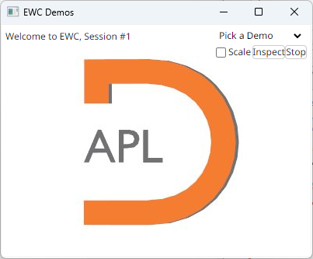
demo.Run 'Desktop'

Slide 5
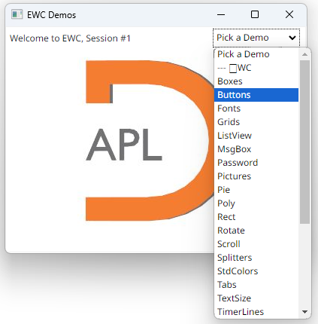
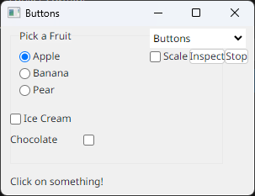

Slide 6
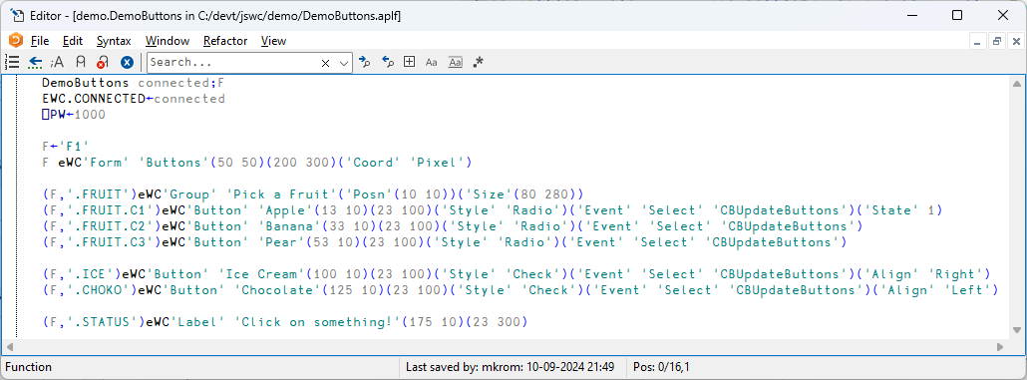

Slide 7
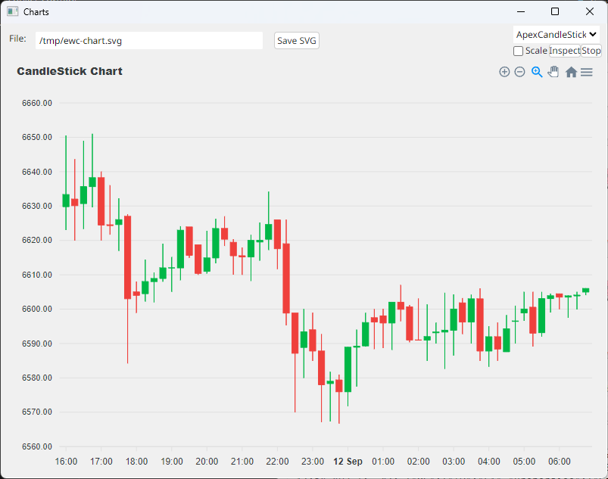
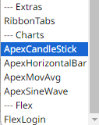
The Demo Application
Demos of
Extensions

Slide 8
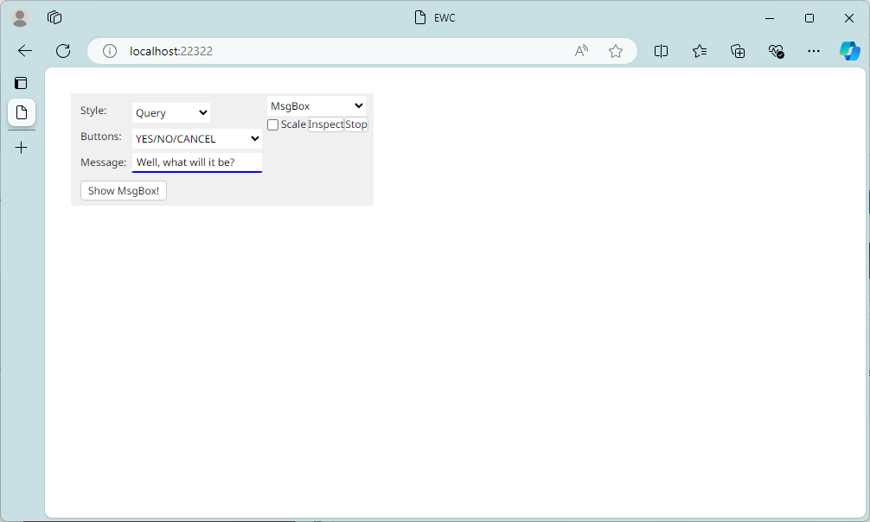
demo.Run 'Browser'

Slide 9
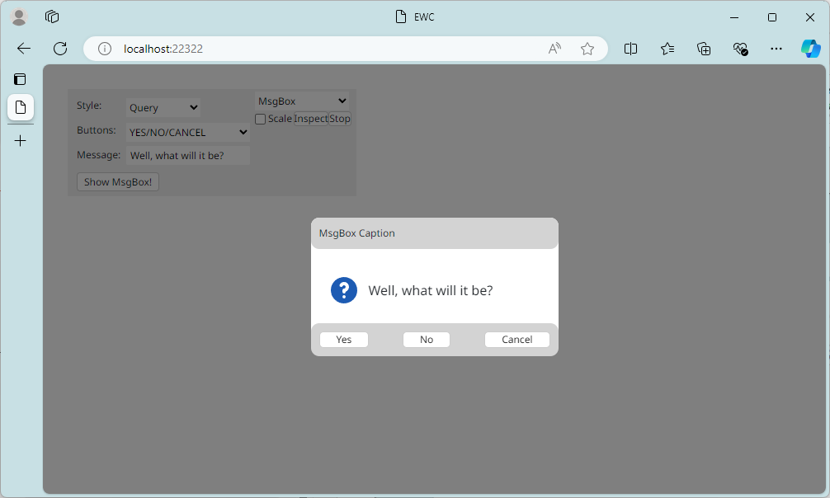

Slide 10
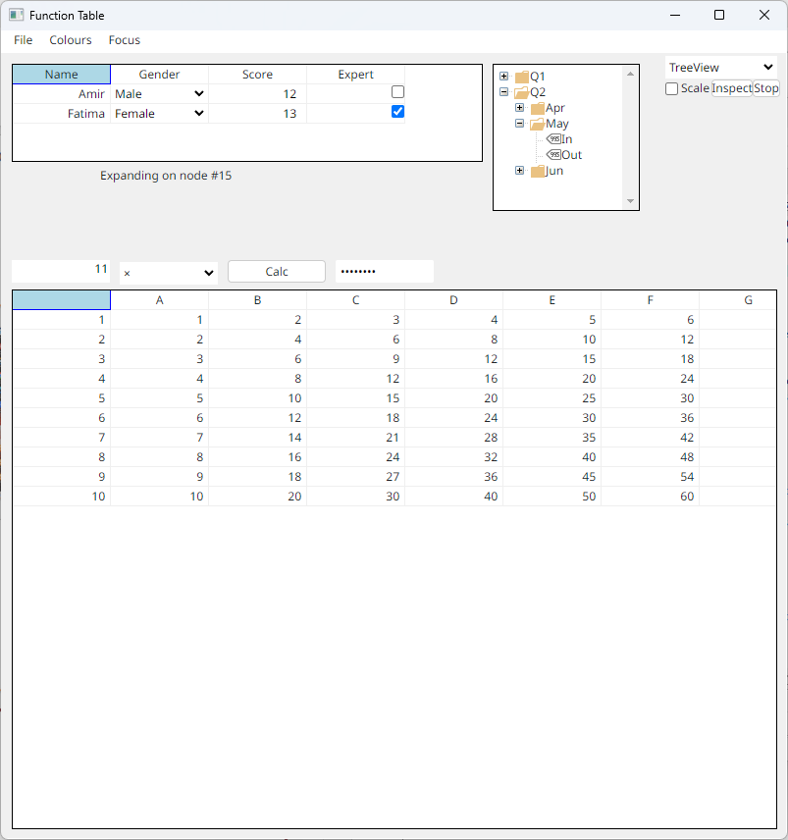
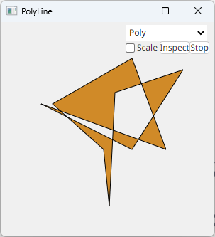
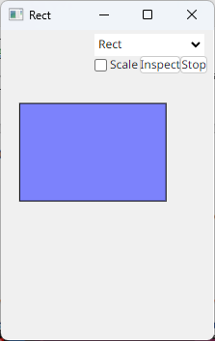

Slide 11
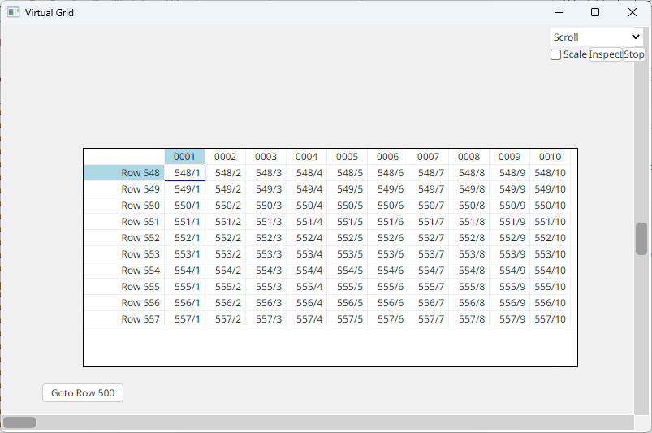

Slide 12
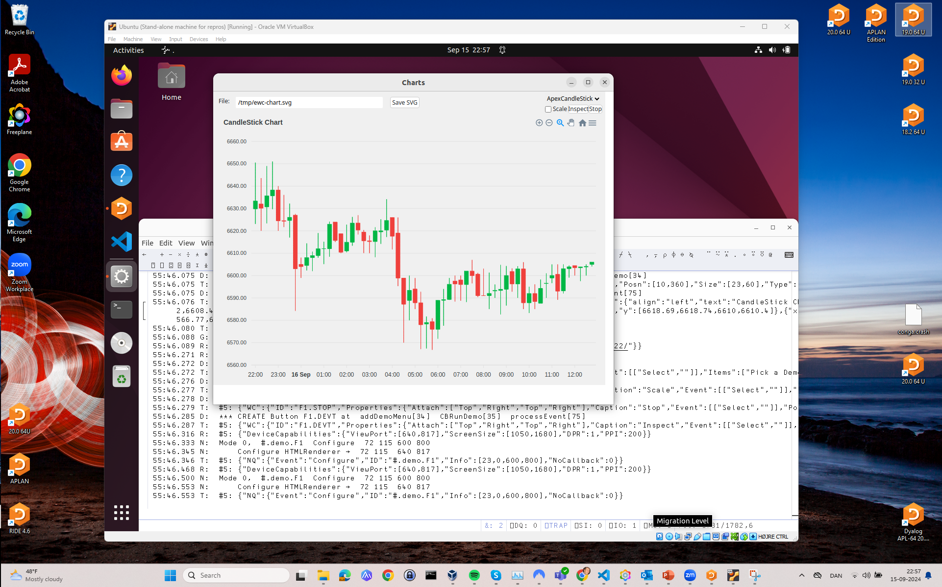
We will document how to create your own extensions

Slide 13
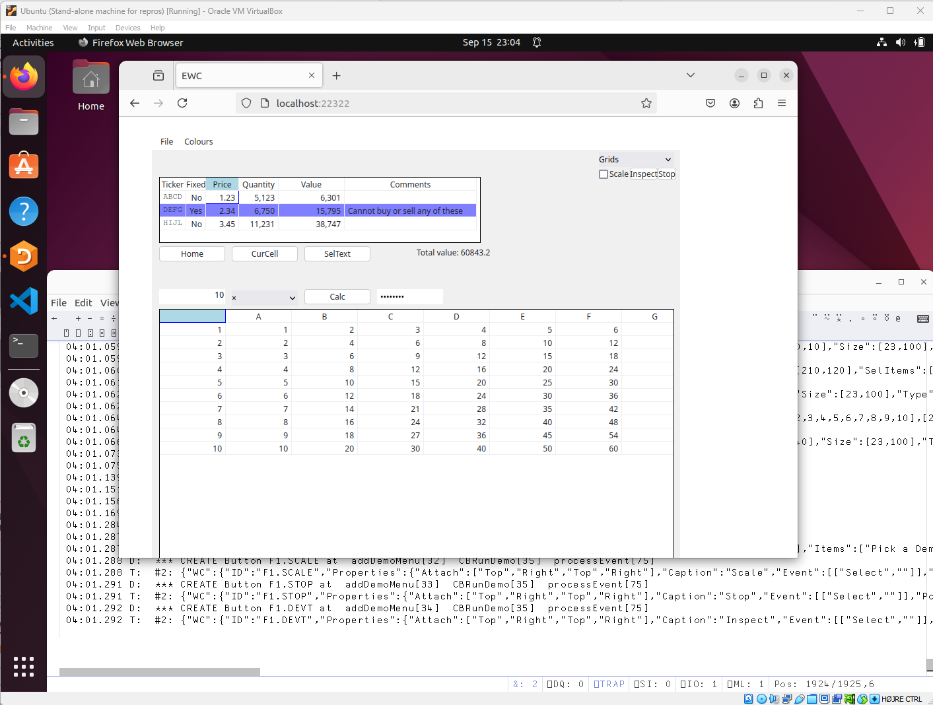

Slide 14
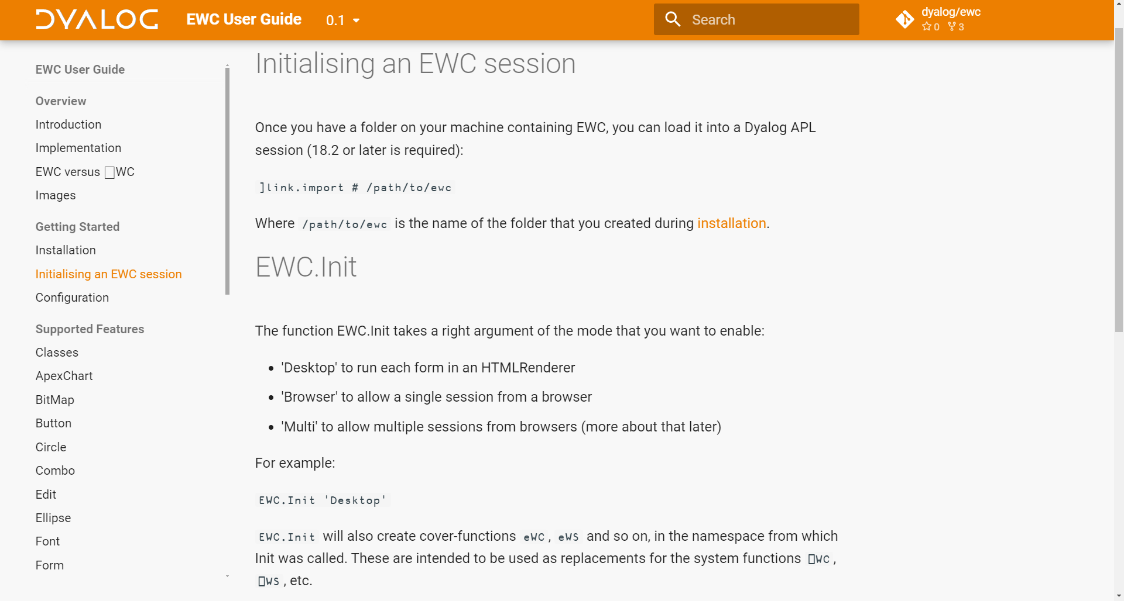

Slide 15
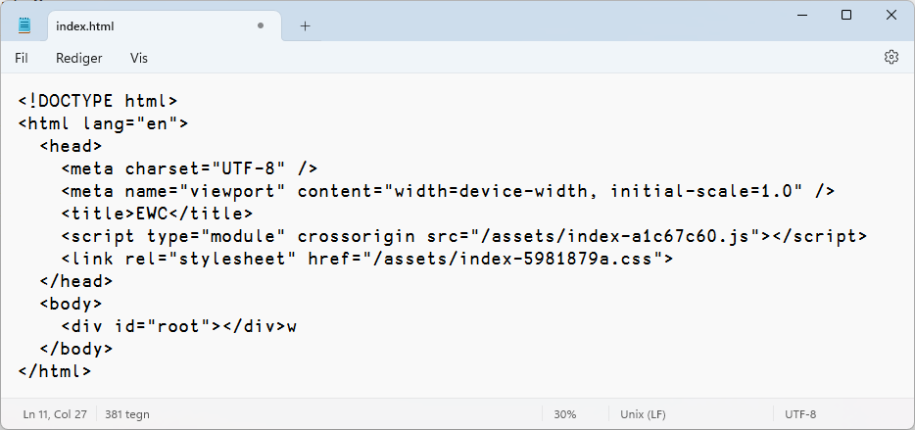
How Does it Work?
Conga server is created listening on port 22322
HTMLRenderer or Web Browser launched at
http://localhost:22322/index.html

Slide 16

Browser or HTMLRenderer
EWC
Namespace
WebSocket
JS / React
Application
'F1.STATUS' eWC 'Label' 'Click on something!' (175 10) (23 300)
➔ {"WC":{"ID":"F1.STATUS",
"Properties":{"Caption":"Click on something!",
"Posn":[175,10],"Size":[23,300],"Type":"Label"}}}

Slide 17
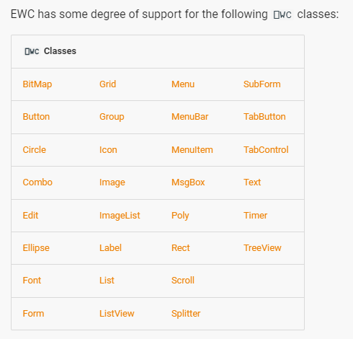
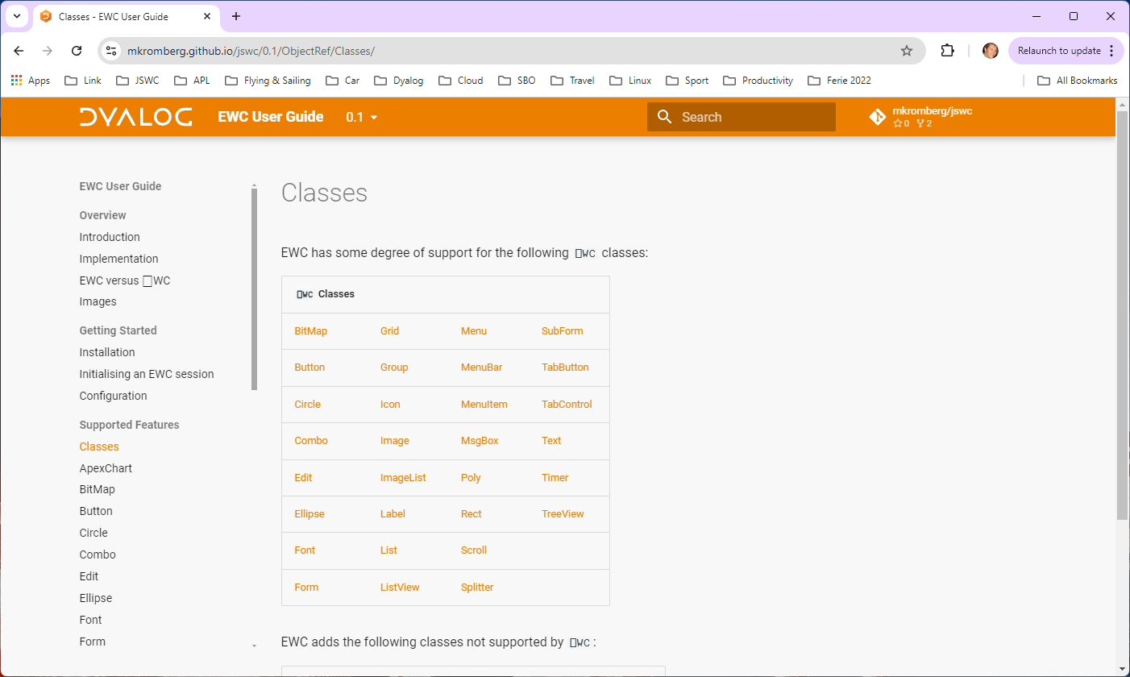
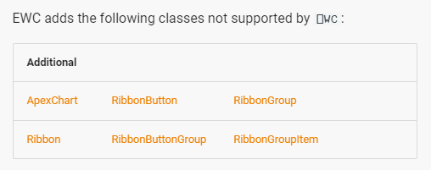

Slide 18
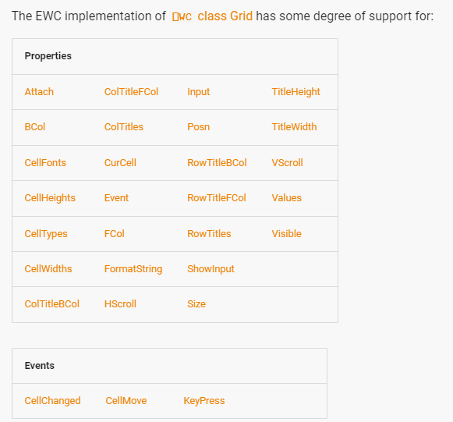
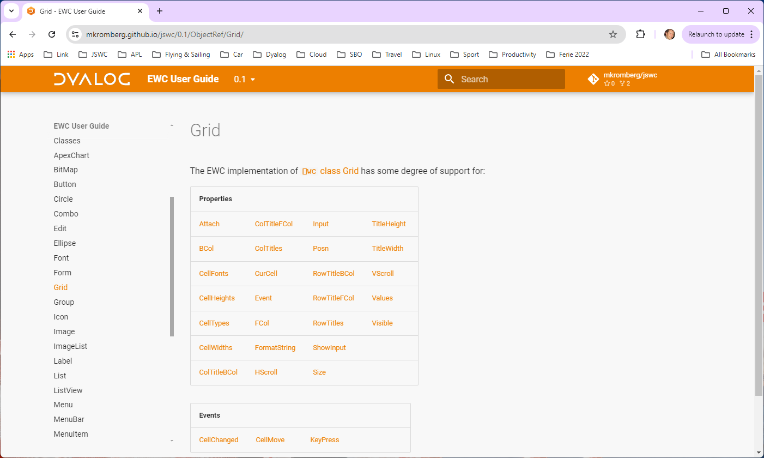
Being added as
applications
need them.

Slide 19
Significant Limitations
Limited set of Classes & Props
Coord Pixel only
No direct assignment and reference to properties –
must use ⎕WS / ⎕WG
No creation using ⎕NEW
Images and ImageLists are handled differently (better!)
Validation and Error Messages weaker / different
⎕NQ may not behave exactly as under Windows

Slide 20
Significant Limitations
Limited set of Classes & Props
Coord Pixel only
No direct assignment and reference to properties –
must use ⎕WS / ⎕WG
No creation using ⎕NEW
Images and ImageLists are handled differently (better!)
Validation and Error Messages weaker / different
⎕NQ may not behave exactly as under Windows

Slide 21
Handling Unsupported Features
EWC tries to "ignore" use of missing features
Get something up and running
  Then modify your code or ask Dyalog to add support
If you try to create an instance of an unsupported class
FOO[7] 'W0' eWC 'Widget' 'Hello World' ('Size' (300 400))
40:32.702 W: *** Warning: at FOO[7] - WC W0 - unsupported class "widget"
The following still creates a form, ignoring the unsupported feature:
FOO[7] 'F0' eWC 'Form' 'Hello World' ('Size' (300 400)) ('Dockable' 1)
38:58.307 W: *** Warning: at FOO[7] - Unsupported on form: Dockable

Slide 22
Extensions
Ribbon family of controls
ApexCharts
”Flex” instead of Posn + Size
DIY Extensions
(KendoUI)

Slide 23
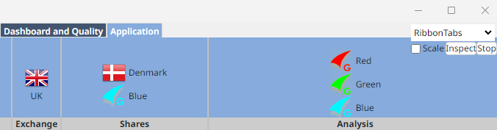
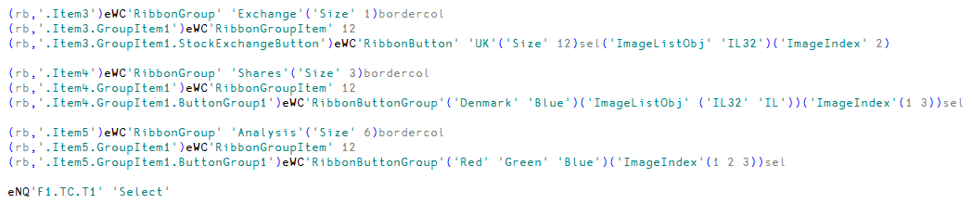
Ribbons

Slide 24
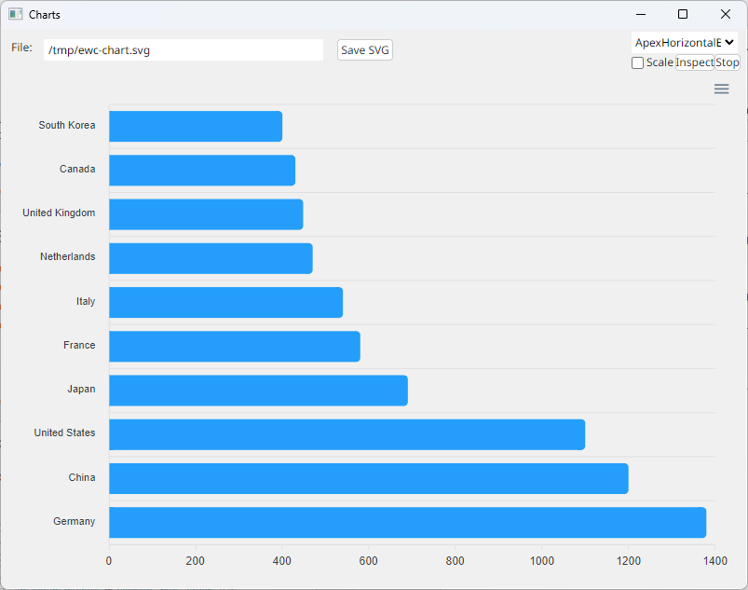
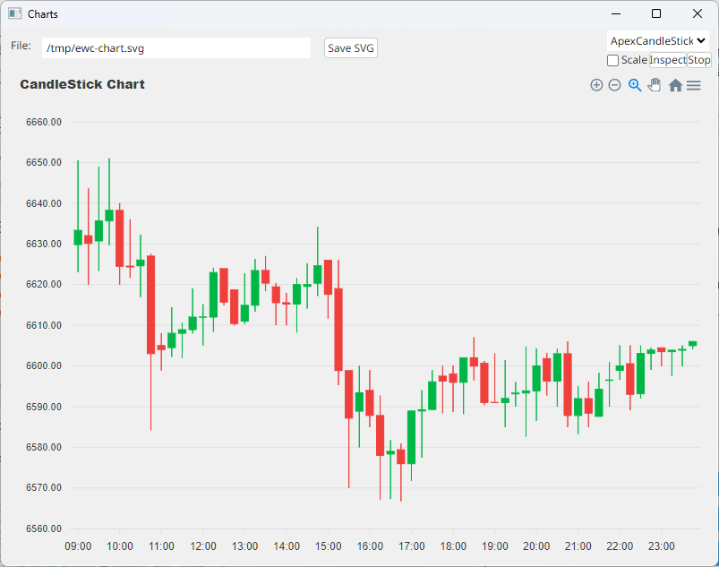
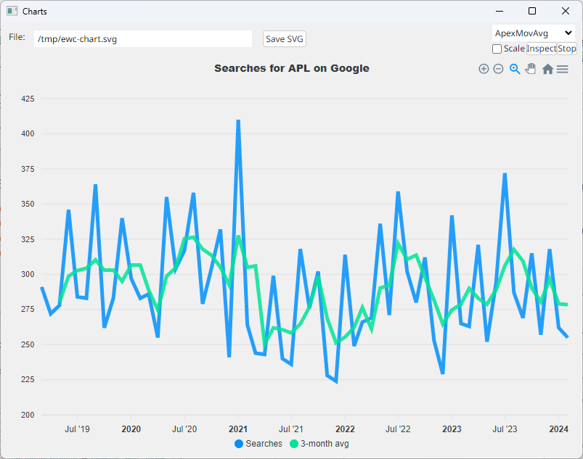
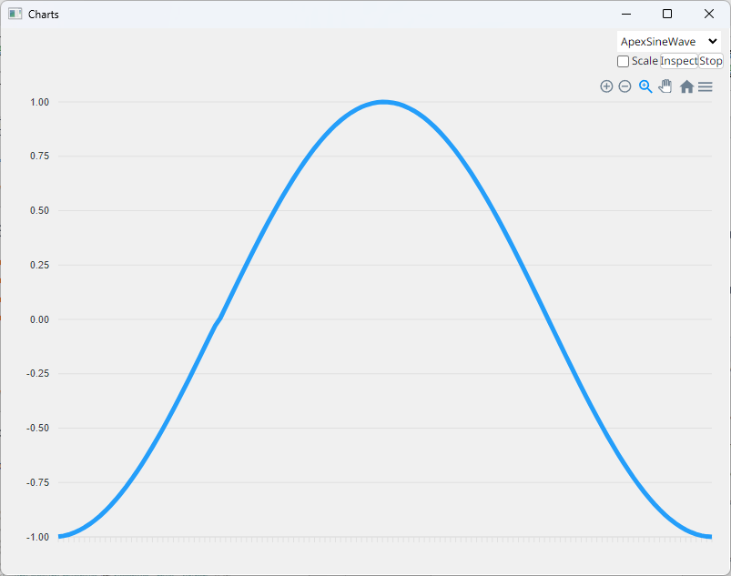
ApexCharts – Four Demos

Slide 25
ApexCharts Design
Options are passed straight through
(JSON string or APL namespace)
Series can be in several APL-friendly formats:

Slide 26
ApexCharts SVG Property
The SVG property allows us to retrieve the SVG for the chart
Use ApexCharts in an invisible HTMLRenderer to generate charts
≢svg←'F1.BAR' eWG 'SVG'
29820
4 80⍴svg
<svg id="SvgjsSvg1006" width="780" height="540" xmlns="http://www.w3.org/2000/sv
g" version="1.1" xmlns:xlink="http://www.w3.org/1999/xlink" xmlns:svgjs="http://
svgjs.dev" class="apexcharts-svg" xmlns:data="ApexChartsNS" transform="translate
(0, 0)" style="background: transparent;"><foreignObject x="0" y="0" width="780"

Slide 27
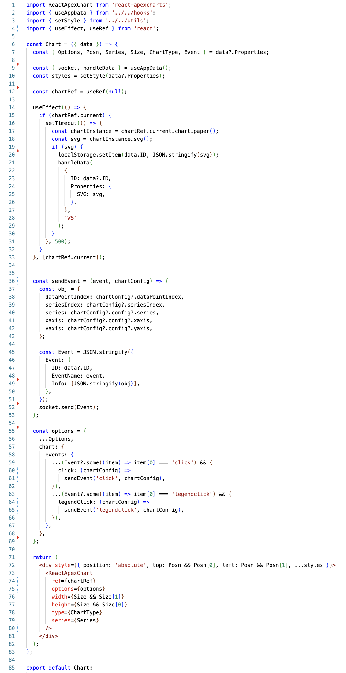
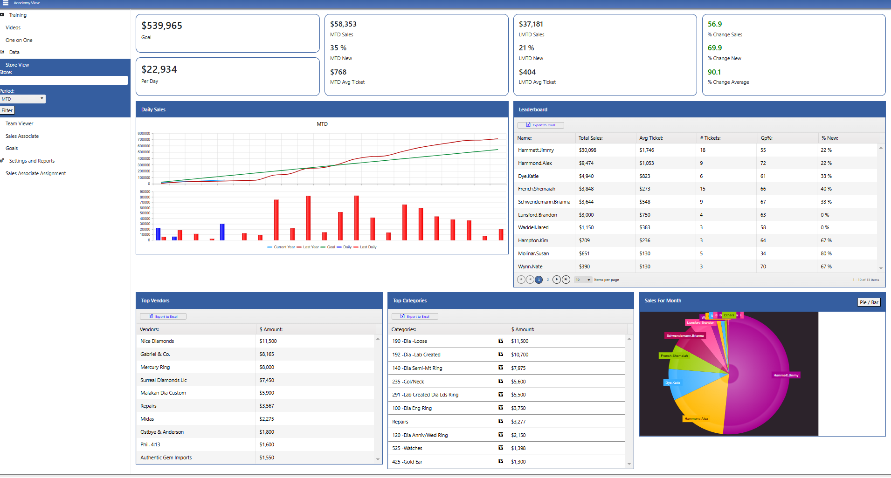
Extending EWC
Slide from Neil on what JS was needed to add ApexCharts will be here

Slide 28
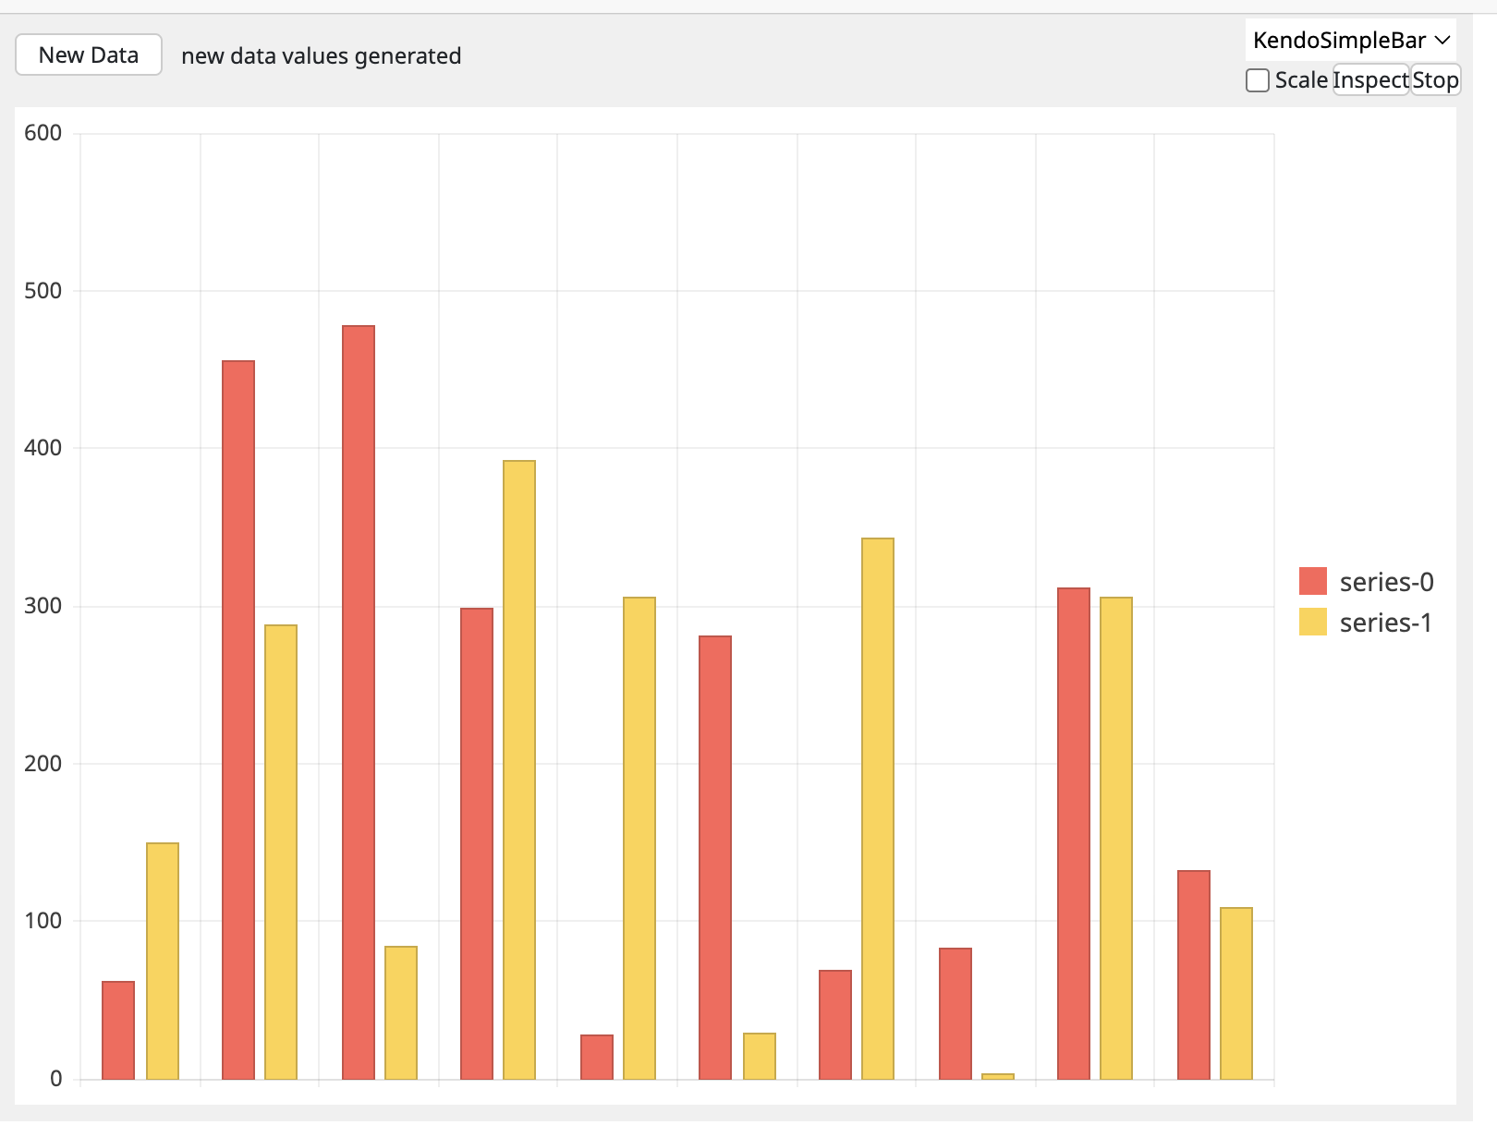
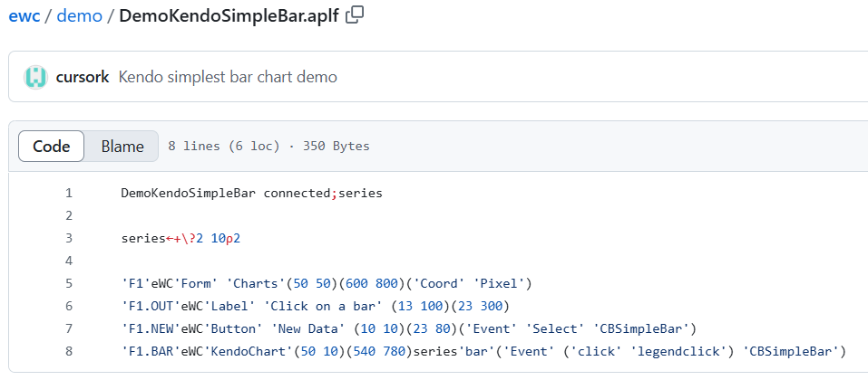

Slide 29
Flex – Instead of Posn & Size
Still VERY experimental – Feedback Please!
The Flex property can be set on containers
  'Flex' 'fill'
  Form should fill the available space (Forms only)
  'Flex' 'row'
  Stack controls horizontally (Any container object)
  'Flex' 'column'
  No comment
By default, 'fill' sets column orientation
CSS property allows you to add additional CSS styling

Slide 30

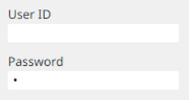
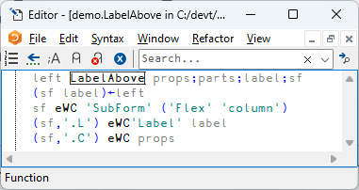
SubForm = "StackPanel"
A Subform with Flex becomes a "StackPanel"

Slide 31
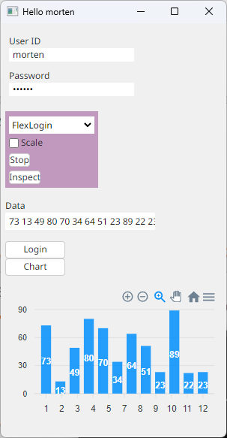
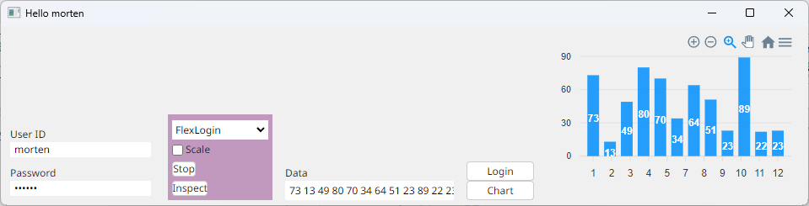
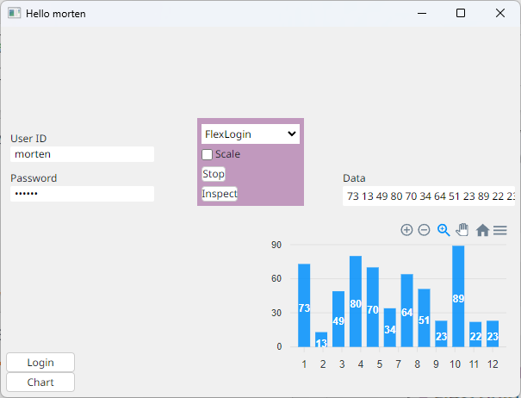

Slide 32
Multi User Mode
Intended for multi-user applications.
EWC.Init 'Multi'
Must be called from a namespace which contains a function names Initialise
Initialise MUST create and eDQ a Form (and demo.Run will do this)
This namespace will be cloned for each new Browser connection, and Initialise will be called on a new thread
Notice each user is suspended in ∆DQ in a namespace named demo_n.
demo.Run 'Multi'
(two sessions connect)
)si
· · #.EWC.∆DQ[42]
· · #.demo_1.Initialise[13]
· &5
· · #.EWC.∆DQ[42]
· · #.demo_2.Initialise[13]
· &6
· [#.EWC.[LIB]] #.EWC.Conga.LIB.Wait[8]
· [#.EWC.[wss]] #.EWC.wss.Listen[2]
· #.EWC.wss.Start[14]
&4

Slide 33
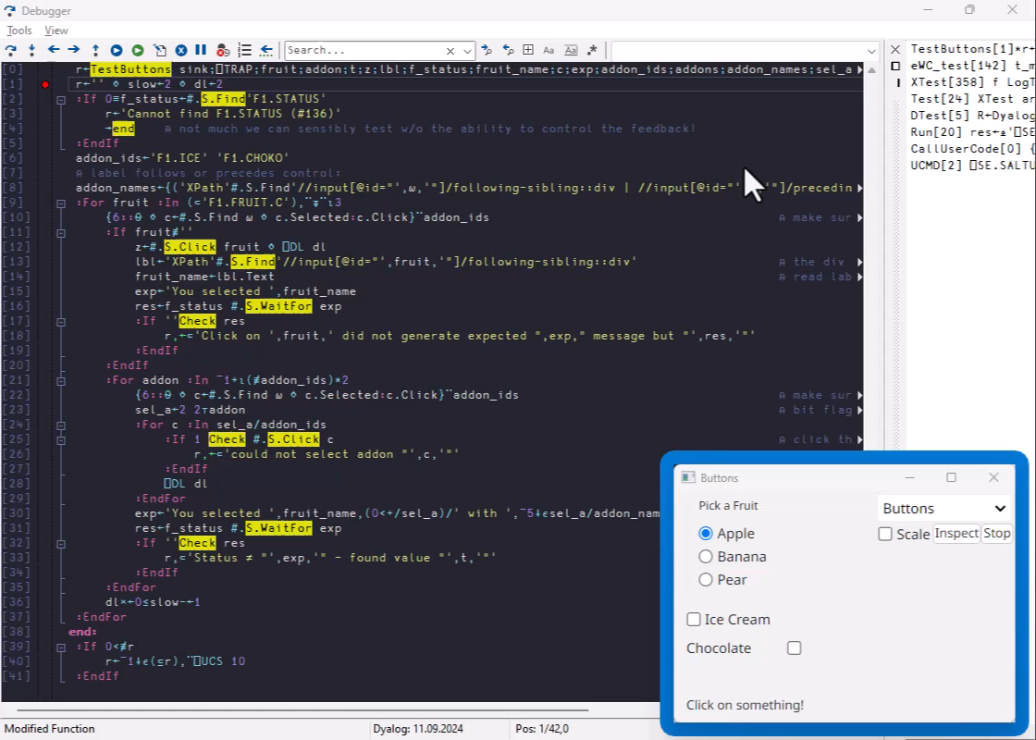
GUI Testing using Selenium

Slide 34
Current Status
Current selection of features is being driven by the needs of two launch customers...

Slide 35
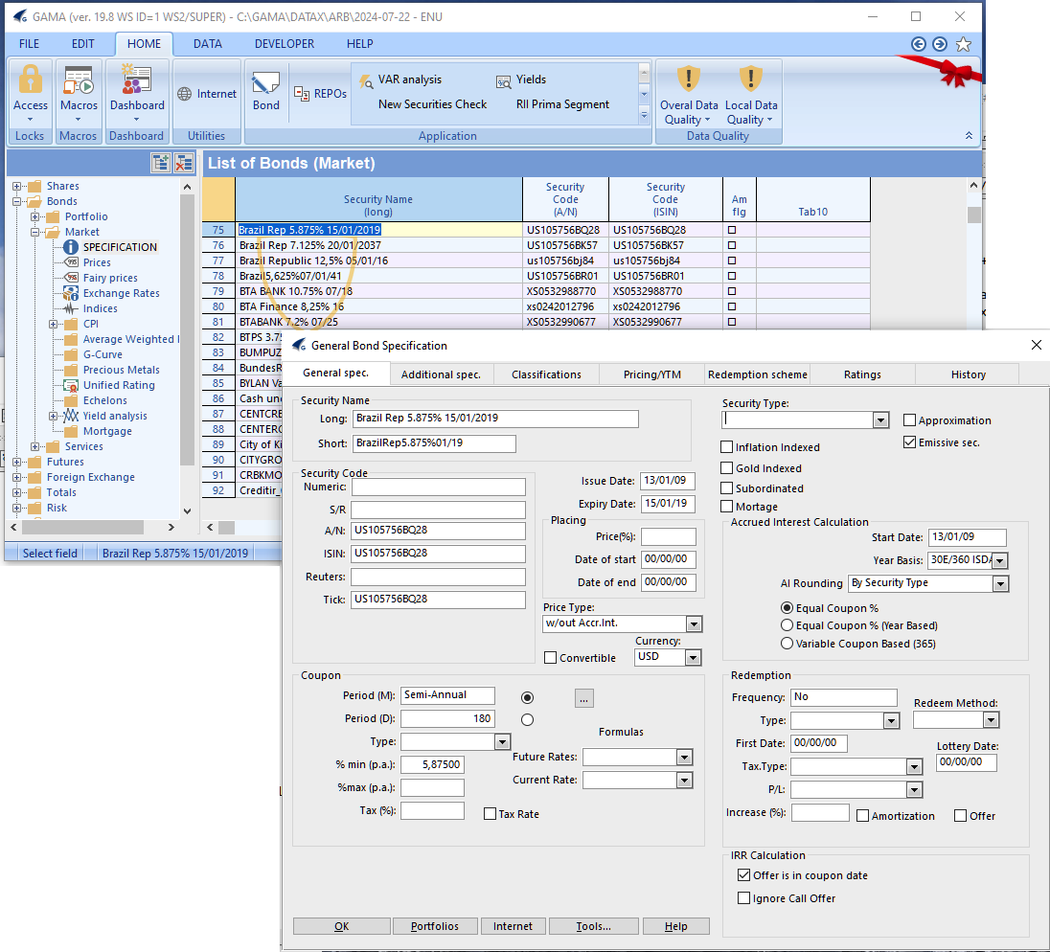

Slide 36
Extending EWC
Slide from Neil on what JS was needed to add ApexCharts will be here

Slide 37
EWC Status, Continued
Initial prototype built using external contractor
Now we have Neil full-time
Free and Open Source
  We will document how to create your own extensions
We expect to add features quickly this winter
  Send us sample apps / tell us what you need!

Slide 38
Thank You!

Slide 39
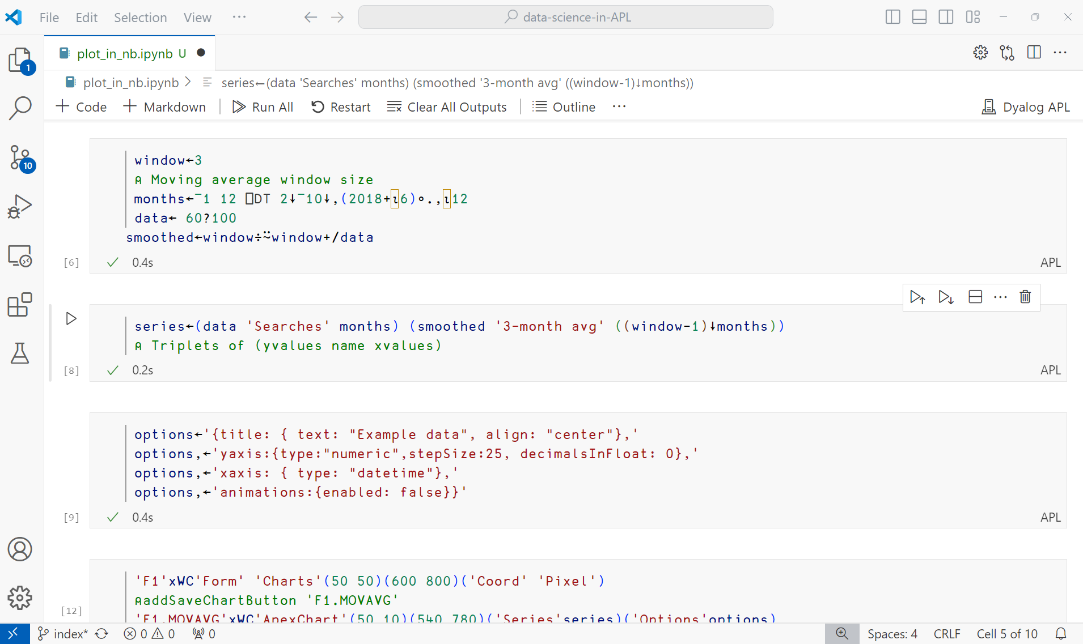

Slide 40
