Slide 1
News from Dyalog
Stine Kromberg, CEO
Morten Kromberg, CTO

Slide 2
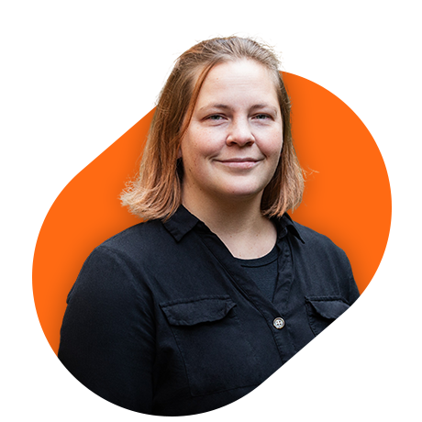
A New Face at the Helm
Stine Kromberg
MSc in Business Administration and Information Systems
Grew up with APL – but not an APL’er
Officially 4.5 years with Dyalog
10 months as CEO

Slide 3

Future of Dyalog
[Many] New faces
Same direction, same values!
First support current users
Build the tools and support for new users
Help train the next generation of users

Slide 4


The Challenge and the Forge
– for new and current developers

Slide 5

Road Map - 2023

Slide 6

Road Map - 2024

Slide 7
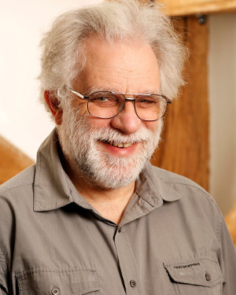
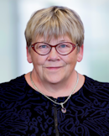
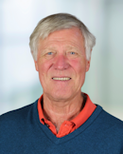
Retired
Geoff Streeter
Gitte Christensen
Peter Donnelly
U17 (29/11): Let's Put the Future Behind Us (Panel Discussion)

Slide 8
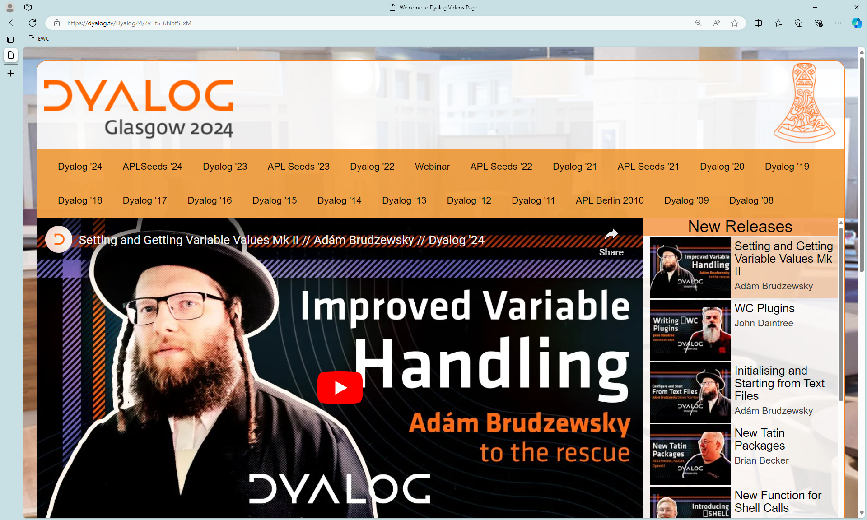
Go to https://dyalog.tv !

Slide 9
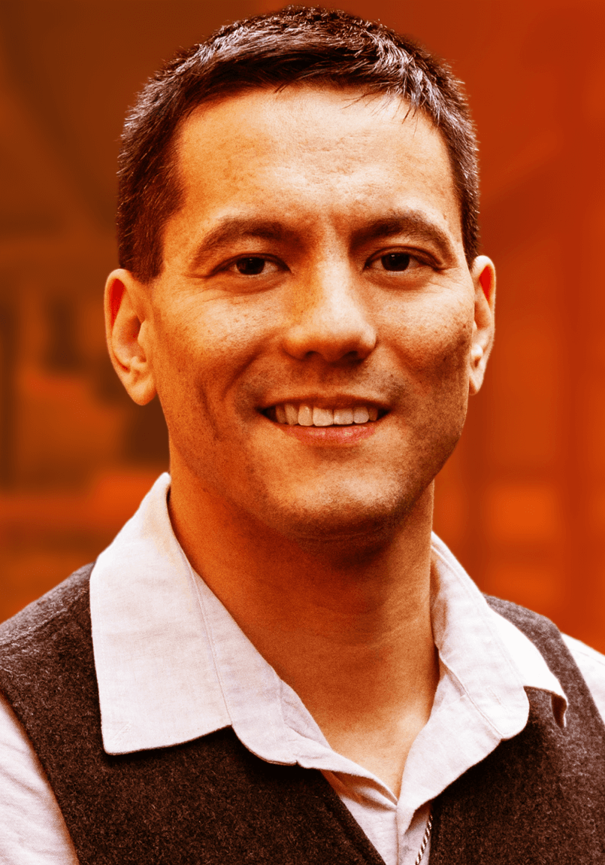
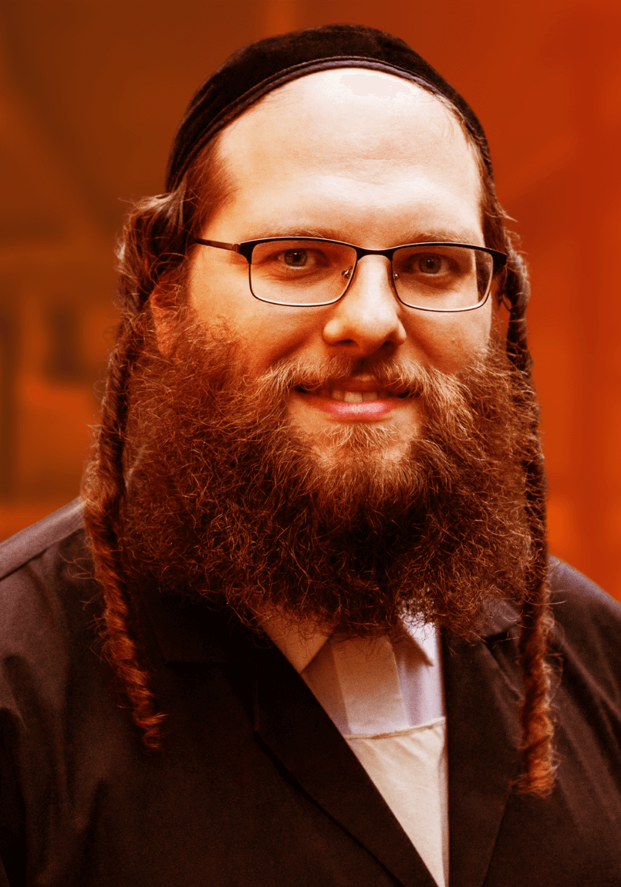


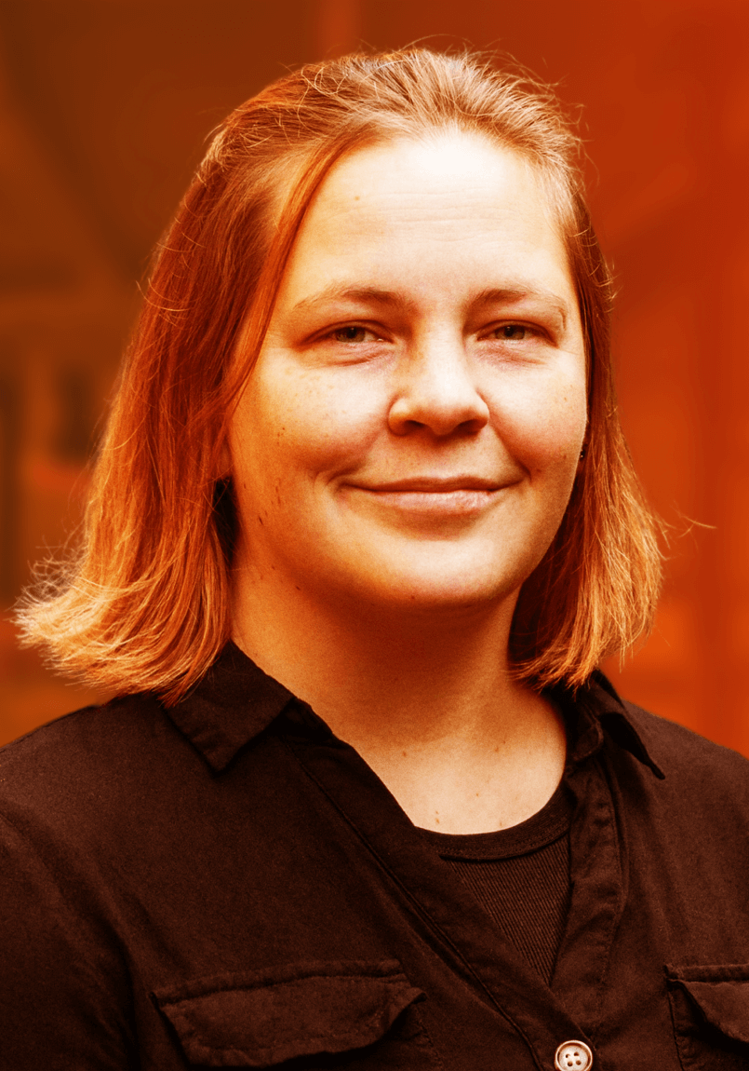
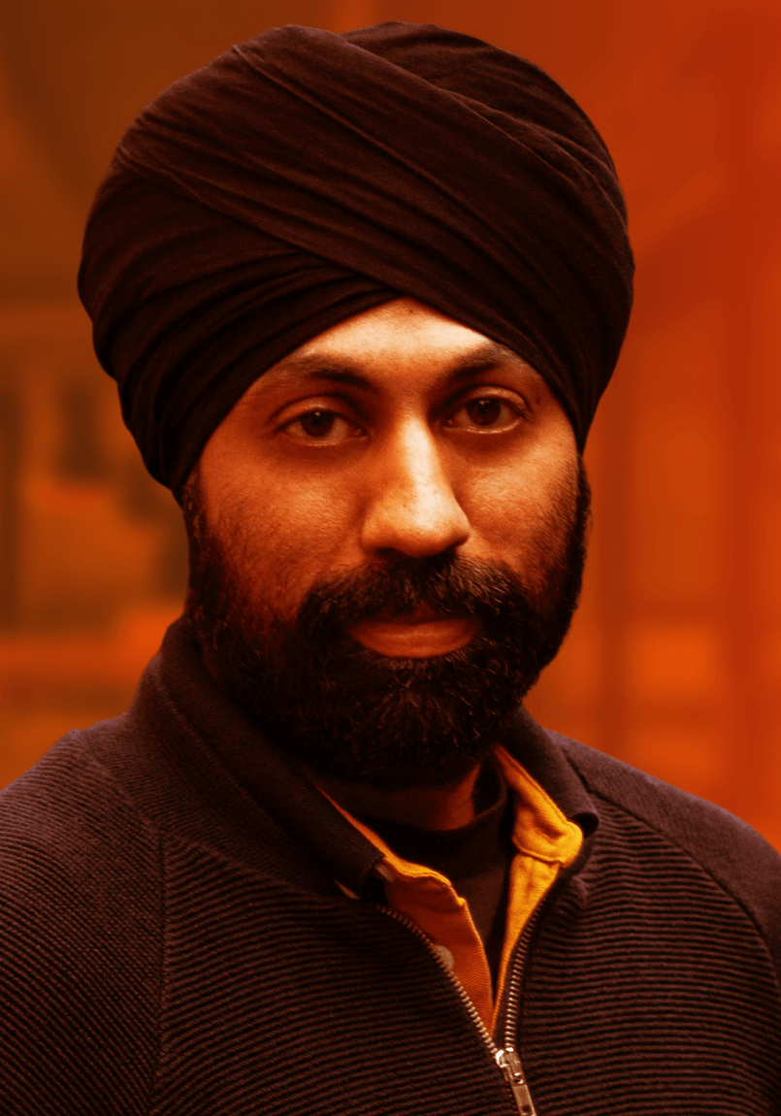
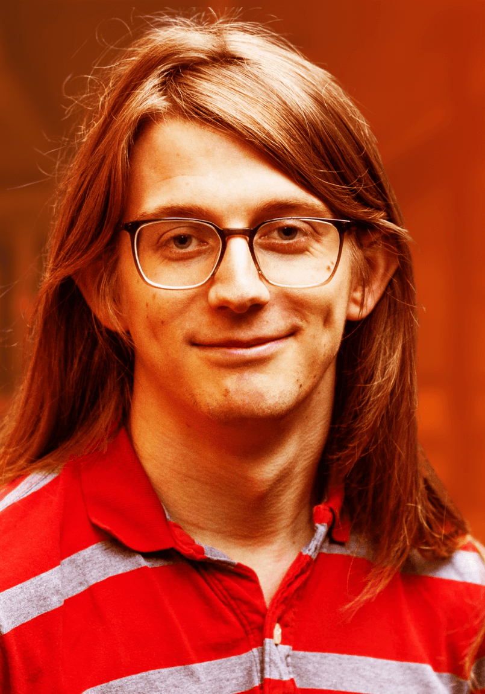
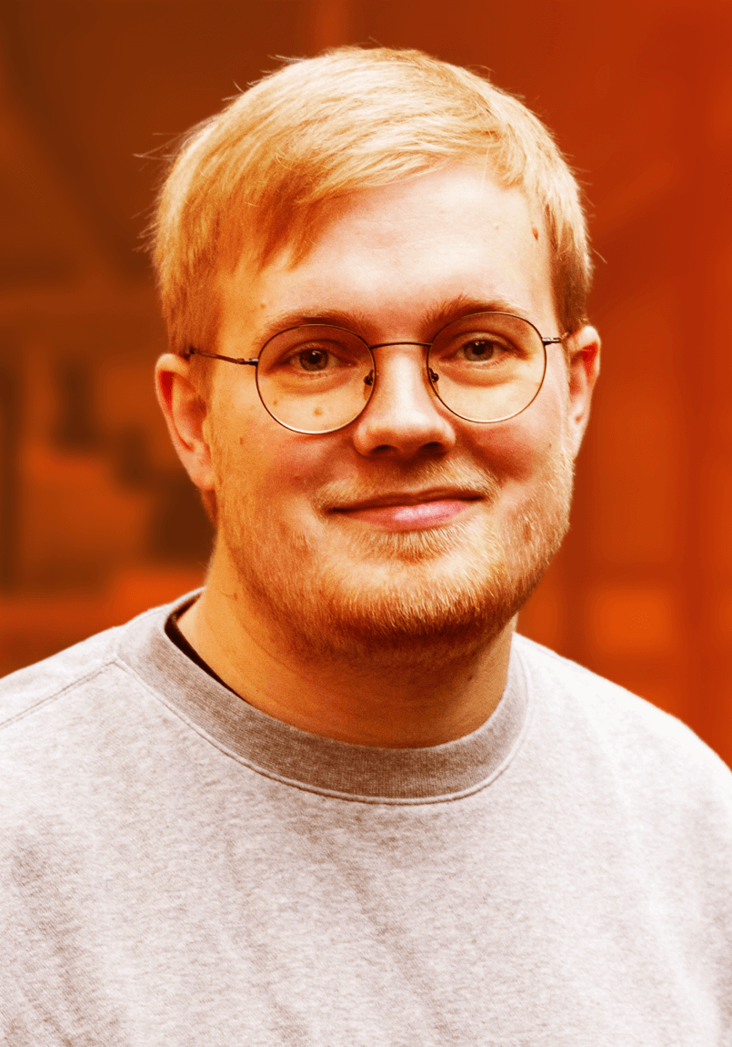
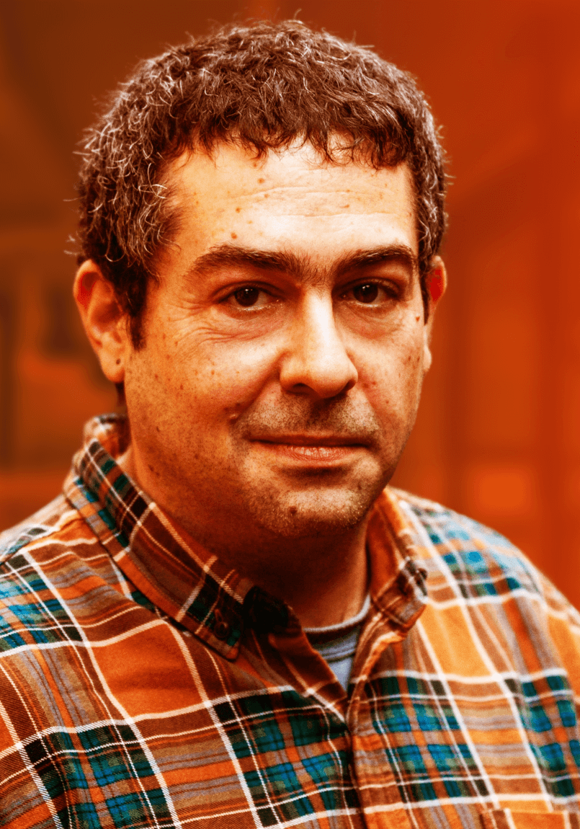




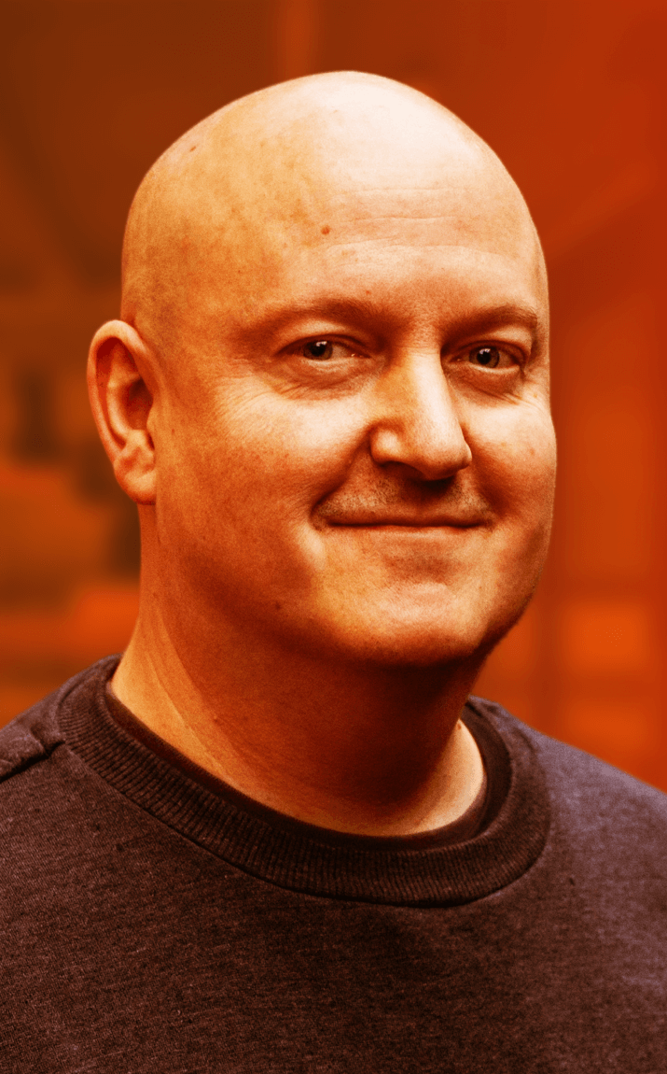
Dyalog – The Next Generation
2010-2021
2022
U18 (29/11): The New Breed Plugs In
(Panel Discussion)
2023

Slide 10
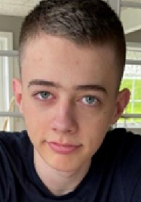
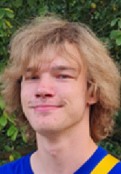
Dyalog – The Next Generation
2024 Summer Interns
U03 next week: raylib-apl (Brian Ellingsgaard)
U07 tomorrow: Climbing Trees and Catching Bugs (Asher Harvey-Smith)

Slide 11

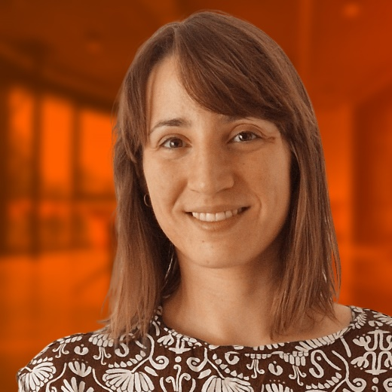



Slide 12
Karl Holt
(February, Århus, DK)
Karl is a member of the APL Tools Group
and an APL Consultant
Karl is working on the emulator for
APL+Win GUI (⎕WI)
Tomorrow, Here: Migrating APL+Win GUI

Slide 13

Brandon Wilson
(July, 昭和村 / Shōwa, Japan)
Brandon is heading up our Static Analysis project
Working with Aaron Hsu to enhance the co-dfns compiler to support the project
D06 (22/11): Static Analysis of APL in APL
D14 (22/11): Data Parallel Proof Verification in APL

Slide 14
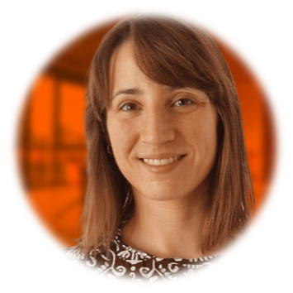
Martina Crippa
(August, Copenhagen)
Martina is a member of the APL Tools group and a Consultant
Martina also works in C++
Her first projects are a Kafka interface (C++) and the Dyalog File Server (APL)
Kafka is an Event Streaming Platform
(message queue)

Slide 15
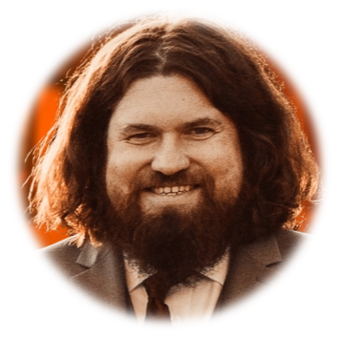
Neil Kirsopp
(Gunzenhausen, Bavaria)
Tomorrow, Here: Migrating GUI to the Cloud
Neil is a JavaScript developer (amongst many things)
Also an APL enthusiast
He will work on enhancing EWC, and also take over RIDE development
... and look at a VS Code / Emacs plugin

Slide 16
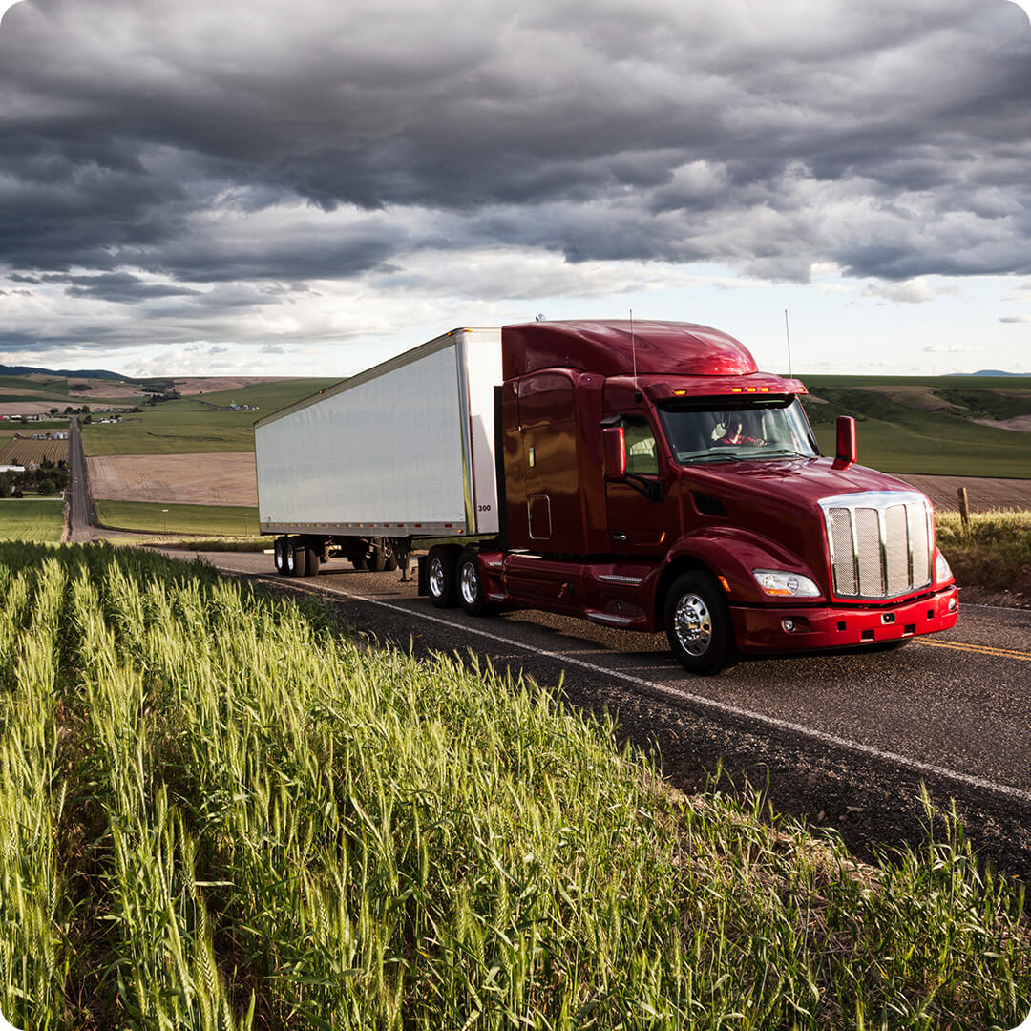
Big Things Heading Your Way
Array Notation
Set & Get Variables
Token-by-Token Debugging
Everywhere WC
Reverse Compose

Slide 17
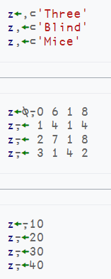
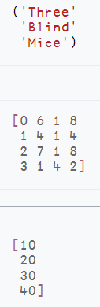
Array Notation
≡
≡
≡

Slide 18
Namespace Notation
person←(first: 'Max' ⋄ last: 'Mustermann')
person.last,', ',person.first
Mustermann, Max
person.(first,' ',last)
Max Mustermann
D03: Array Notation: A Journey of Discovery (John Daintree)

Slide 19
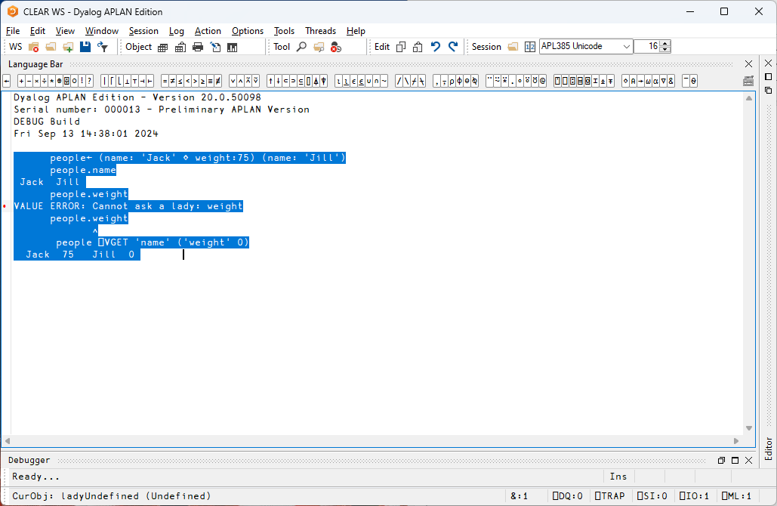
people← (name: 'Jack' ⋄ weight:75) (name: 'Jill')
people.name
Jack Jill
people.weight
VALUE ERROR: Undefined name: weight
people.weight
∧
people ⎕VGET 'name' ('weight' 50)
Jack 75 Jill 50
people[1].⎕VGET ¯2
name Jack weight 75

Slide 20
Set and Get Variables
Get:
[source] ⎕VGET 'Name' ('Height' ¯1) ⍝ Values w/optional defaults
Name List with Values:
(names values)←[source] ⎕VGET 2 ⍝ Name Matrix and values
pairs←[source] ⎕VGET ¯2 ⍝ (Name Value) Pairs
Set:
ref←[target] ⎕VSET ('First' 'Lieschen')('Last' 'Müller')
ref←[target] ⎕VSET (2 5⍴'FirstLast ')('Max' 'Munstermann')
D04: Setting and Getting Variables (Adam Brudzewsky)

Slide 21
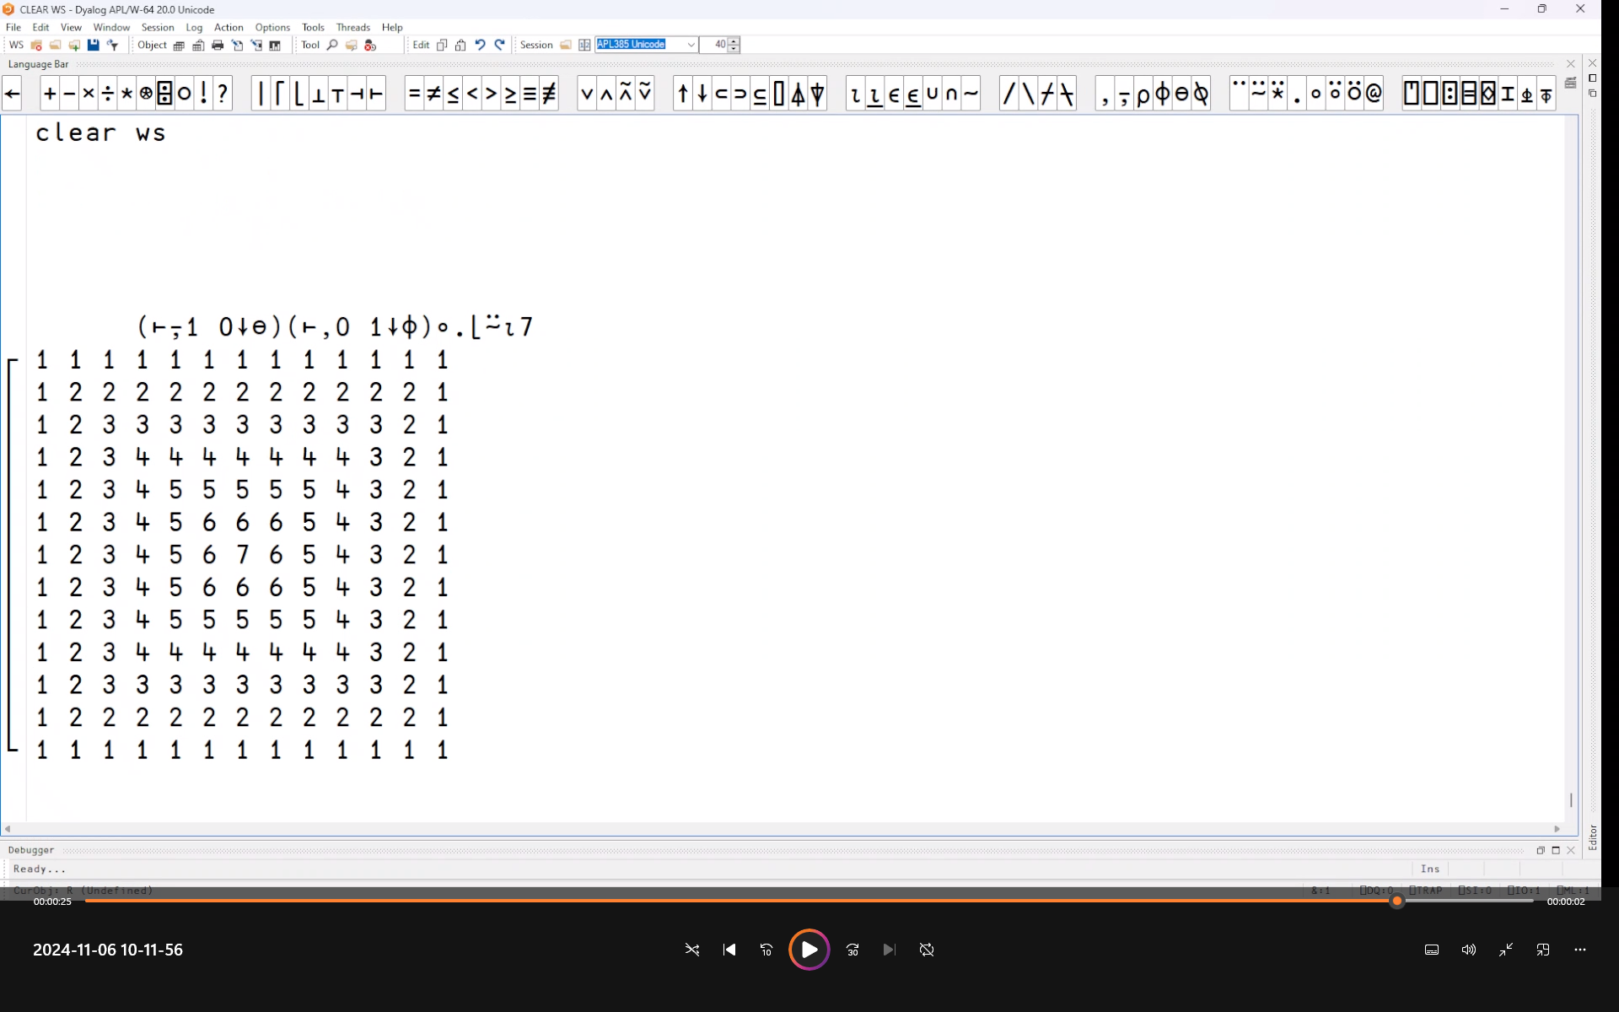
Token by Token Debugging

Slide 22
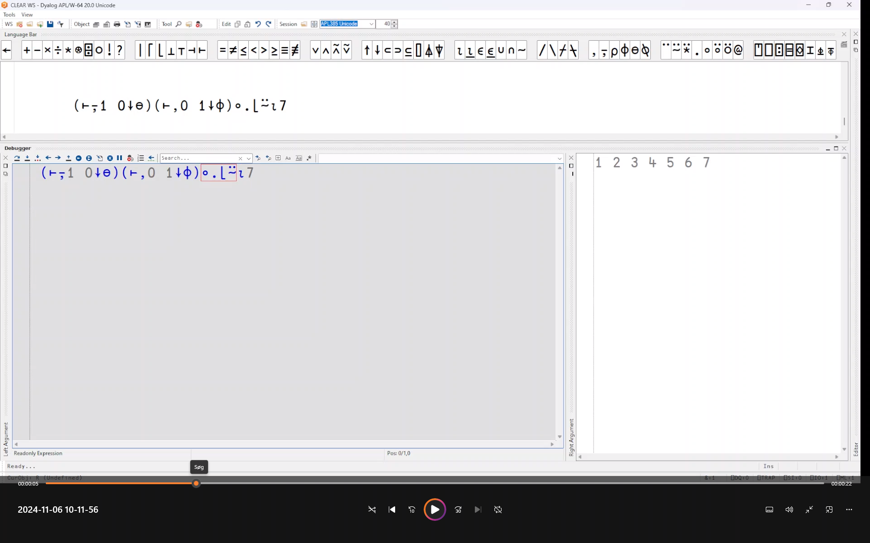

Slide 23
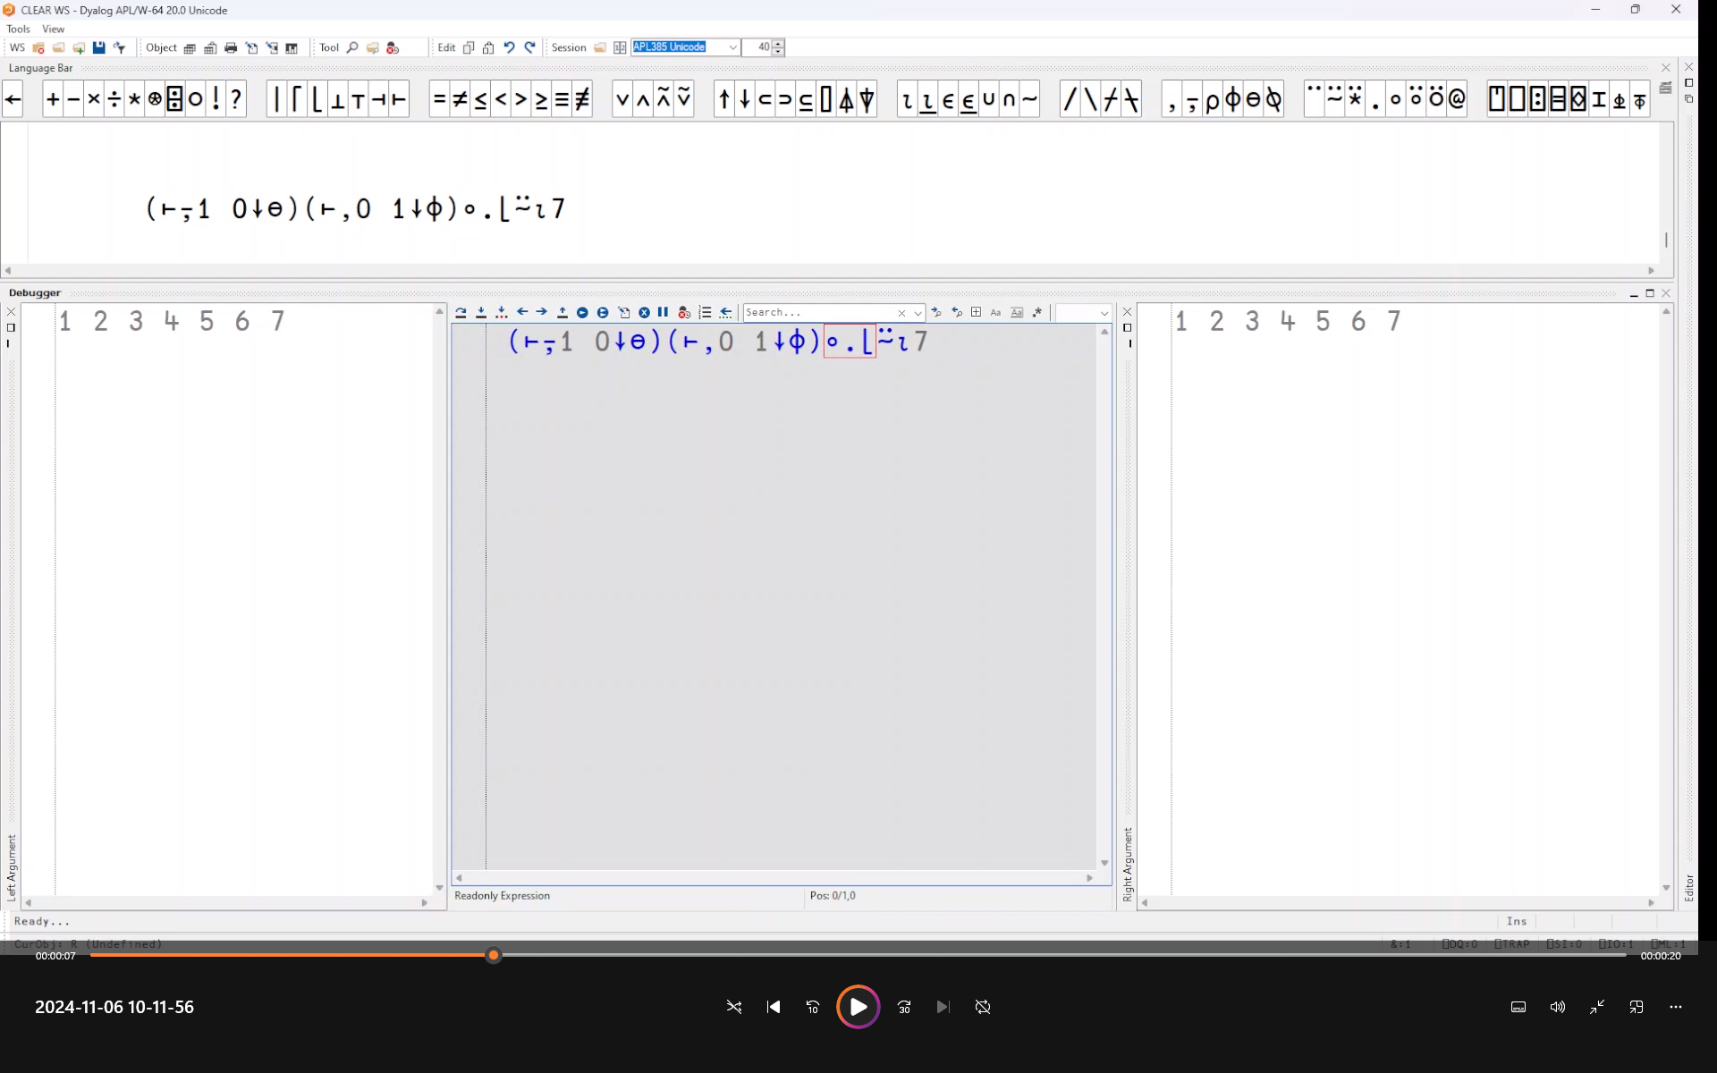

Slide 24
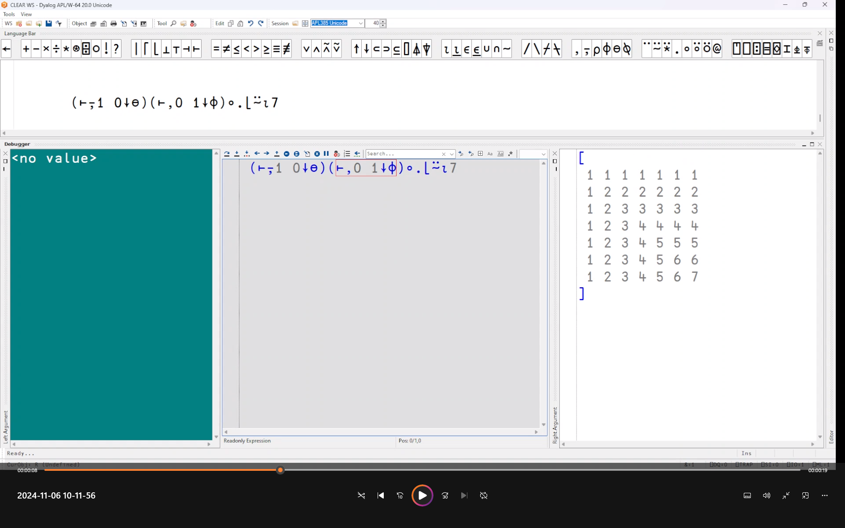

Slide 25


Slide 26
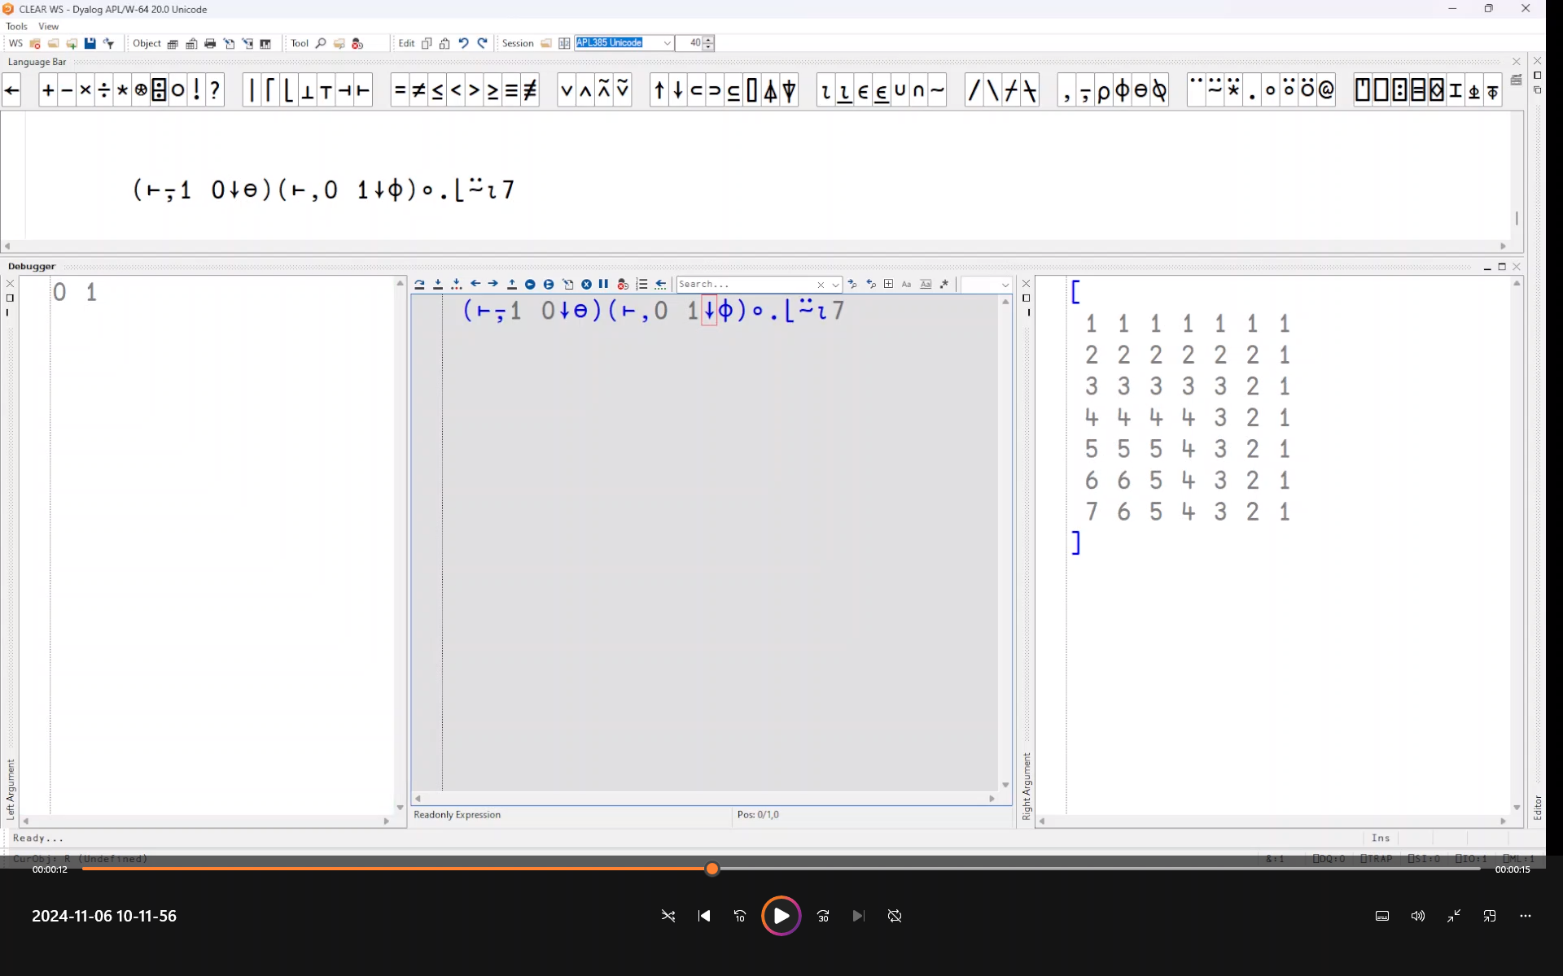

Slide 27


Slide 28
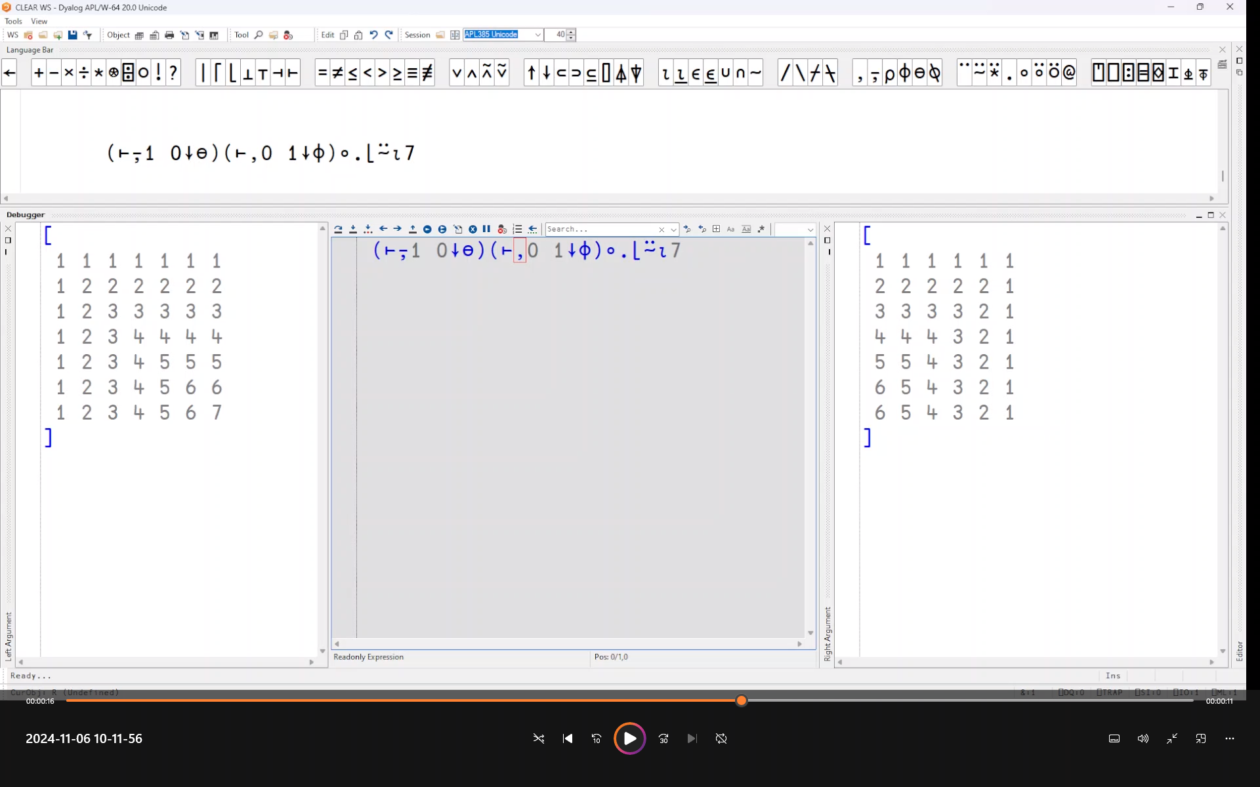

Slide 29
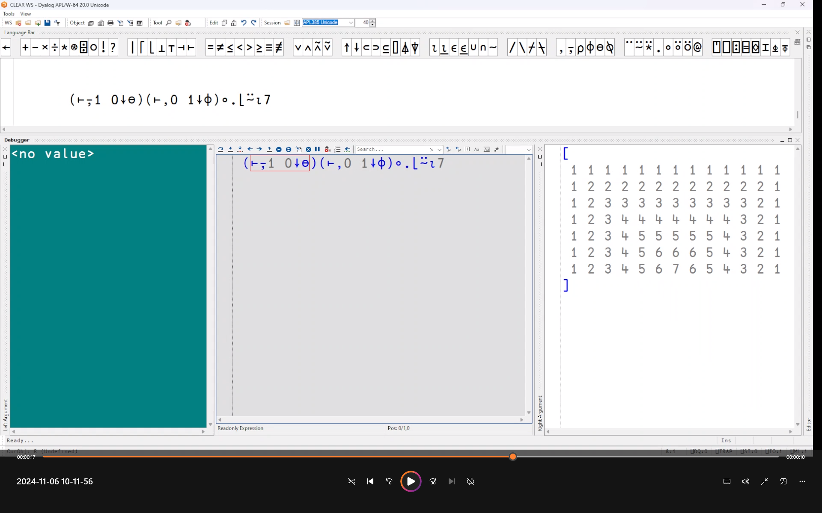

Slide 30
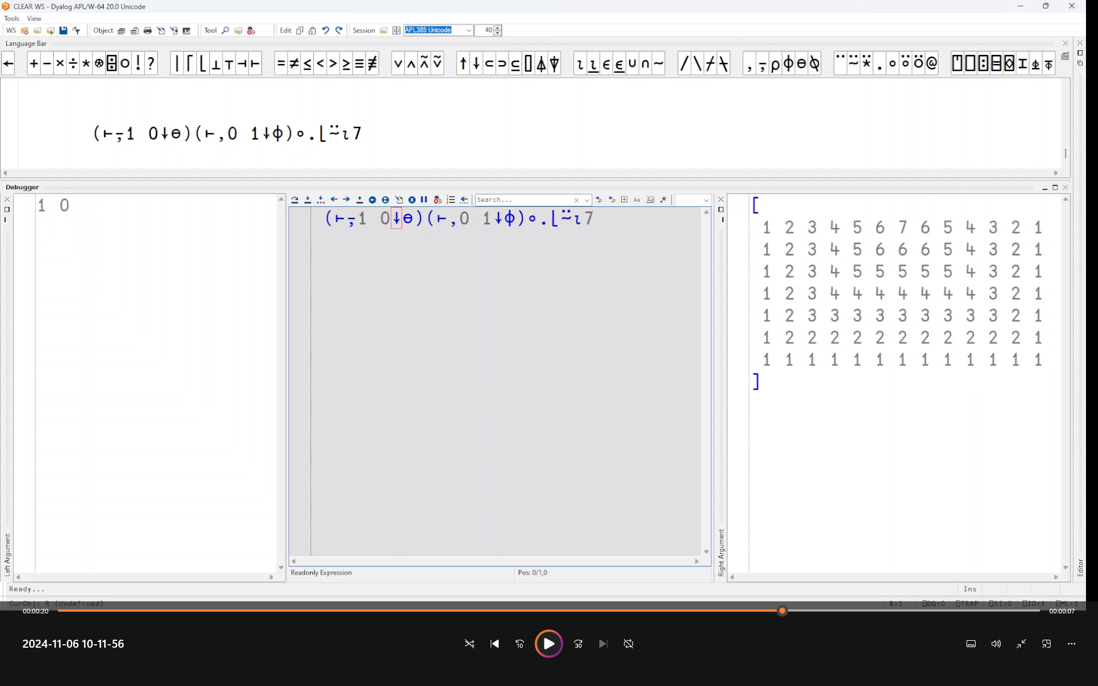
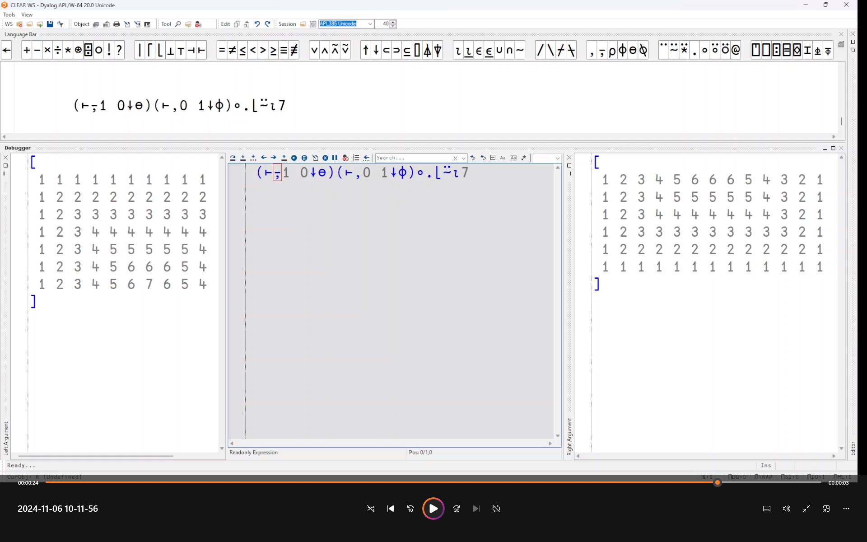

Slide 32
EWC – "Everywhere" WC
A JavaScript emulation of Dyalog's Win32 wrappers (⎕WC, ⎕WG, ⎕WS …)
"Everywhere" means
  Windows, Linux, macOS Desktops
  Dyalog APL on any platform acting as a Web Server
    Adds IBM AIX, Raspberry Pi

Slide 33
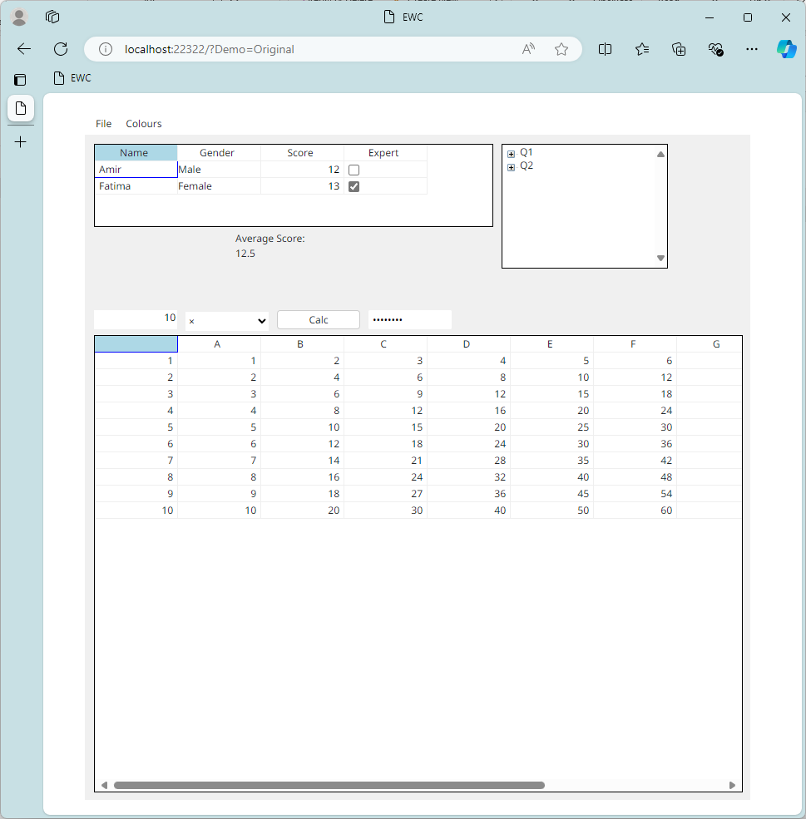
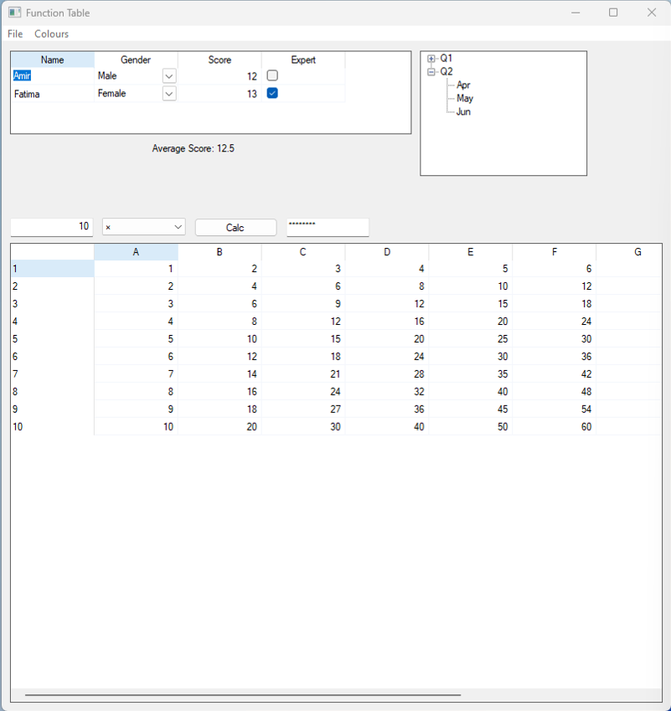
⎕WC↓
EWC→

Slide 34
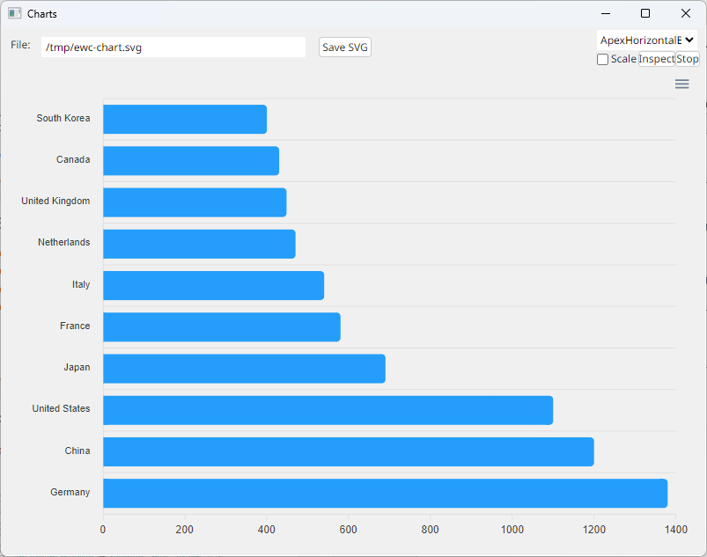
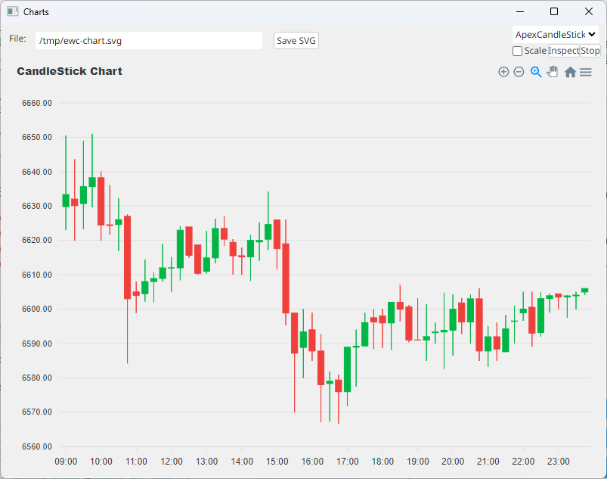
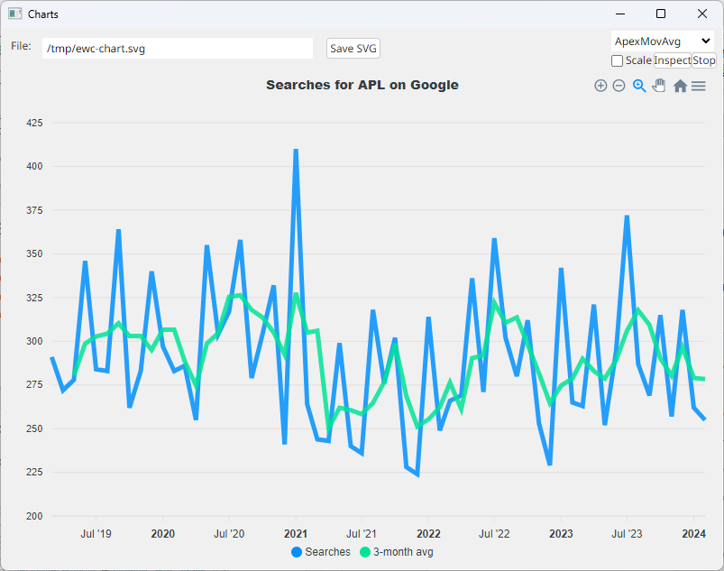
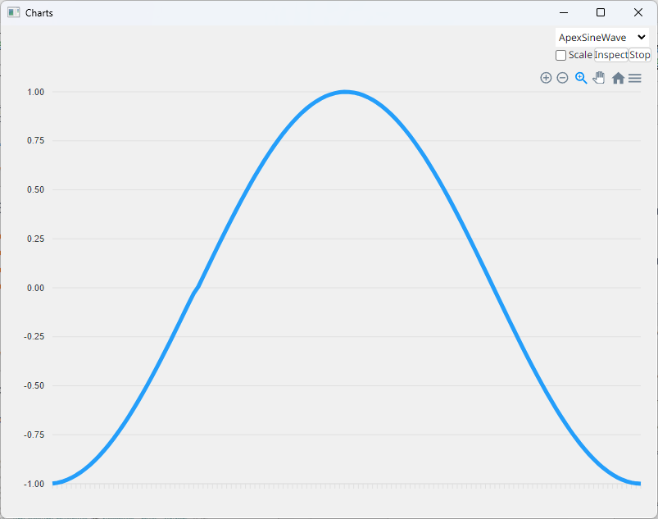
+ ApexCharts

Slide 35
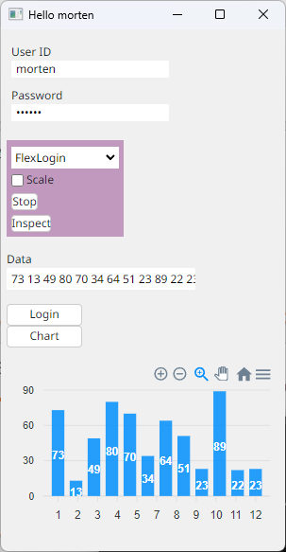
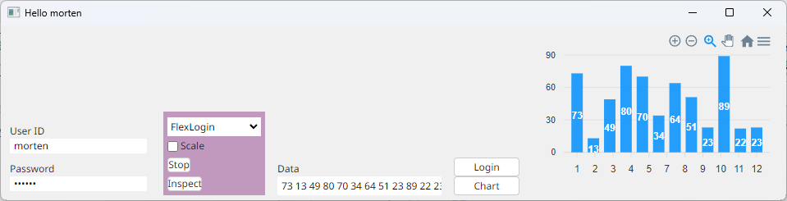
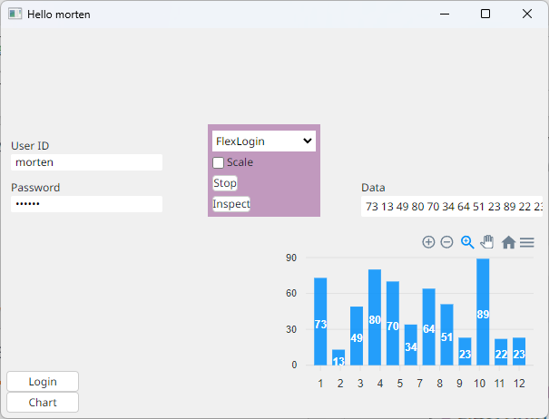
+ Flex
Layout

Slide 36
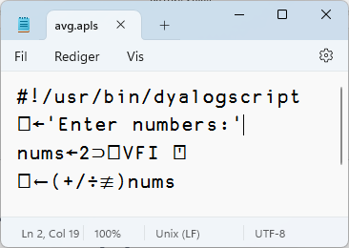
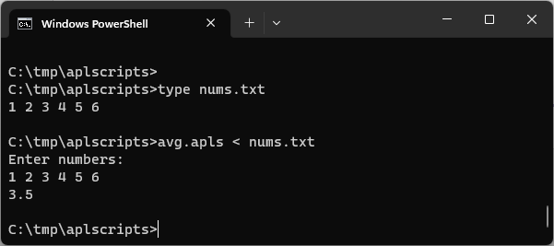
Script Support
#! (hash bang) scripting
Script engine is critical for new users
Makes "Continuous Integration" easier
Still a bit of a prototype in v19.0
Will be improved in v20.0
  Need to be able to
  debug scripts via RIDE

Slide 37
Behind / Reverse Compose
Dyadic: ⍺ f⍛g ⍵ ⬅➔ (f ⍺) g ⍵
10⍳⍛∊2 3 5 8 ⍝ (⍳10)∊2 3 5 8
0 1 1 0 1 0 0 1 0 0

Slide 38
Behind / Reverse Compose
Monadic: f⍛g ⍵ ⬅➔ (f ⍵) g ⍵
f←5∘< ⍝ Predicate function
f⍛⌿ 2 7 1 8 2 8 ⍝ Filter by f
7 8 8
⌈/⍛= 2 7 1 8 2 8 3 ⍝ Max behind Equal
0 0 0 1 0 1 0

Slide 39

Tatin
D11: New Tatin Packages (Brian Becker)
Package manager for Dyalog APL
(A tasty way to package APLs)
2023
2024
]z←tatin.listPackages
{⍺,≢⍵}⌸{(¯1+⍵⍳'-')↑⍵}¨3↓z[;1]
aplteam 42
davin 4
dyalog 2
]z←tatin.listPackages
{⍺,≢⍵}⌸{(¯1+⍵⍳'-')↑⍵}¨3↓z[;1]
aplteam 44
davin 4
dyalog 5 ⍝ 150% growth!
¯2↑z
dyalog-HttpCommand 1
dyalog-Jarvis 1
¯5↑z
dyalog-APLProcess 1
dyalog-HttpCommand 1
dyalog-Jarvis 1
dyalog-NuGet 1
dyalog-OpenAI 1

Slide 40
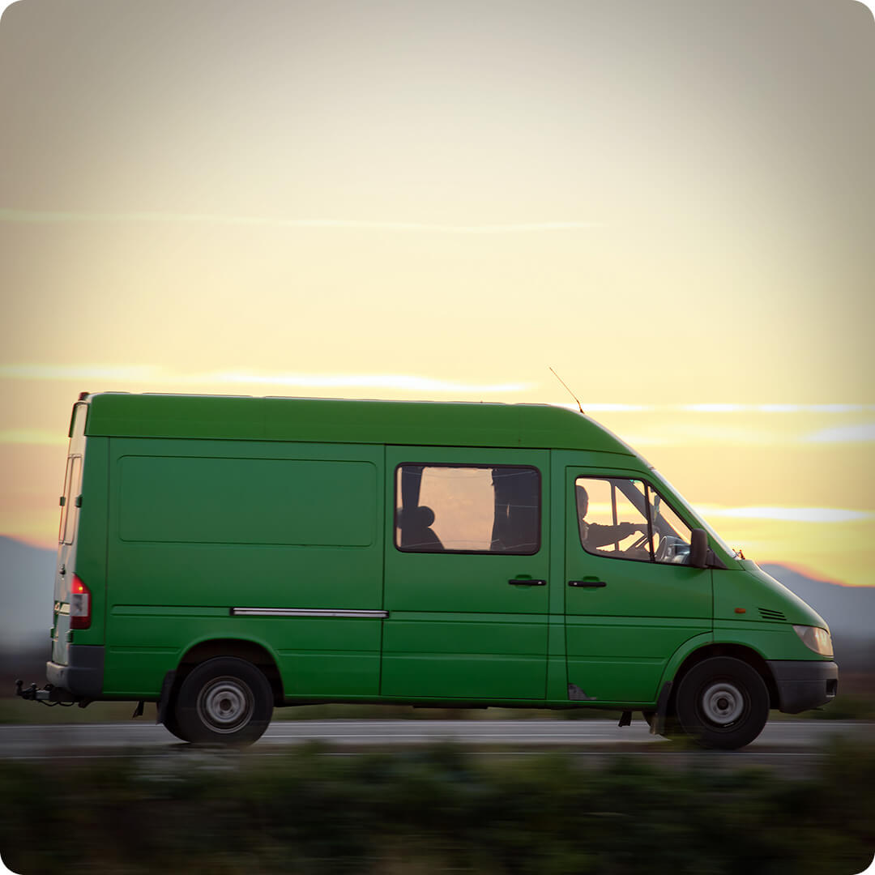
Medium Things on The Way
New Shell System Function
.NET Bridge Enhancements
HTMLRenderer Enhancements
Static Analysis of APL Code
Health Monitor
HTMLRenderer Enhancements

Slide 41
⎕SHELL to replace complement ⎕SH
Invoke OS commands from APL
Interruptible
Optionally return data as an asynchronous stream
Manage stdin, stdout & stderr (& other streams) independently
Handle variety of data encodings
D12: New Function for Shell Calls (Peter Mikkelsen)

Slide 42

.NET Bridge Enhancements
The v19.0 bridge to .NET 6/7/8 is now equivalent to the Framework bridge
New features will ONLY target the new .NET versions (8+):
  Generics, Delegates
  Async Methods (probably not v20.0)

Slide 43

Static Analysis of APL Code
Static Analysis of application code is seen as a required "best practice" by some corporations
We are building a prototype of a tool which will
  Detect vulnerabilities and other bad practices
  "Lint" APL Code
This tool will initially be licensed separately
A free "community edition" may follow
D06 (22/11): Static Analysis of APL in APL (Brandon Wilson)
D13 (22/11): Co-dfns Roadmap and Updates (Aaron Hsu)

Slide 44
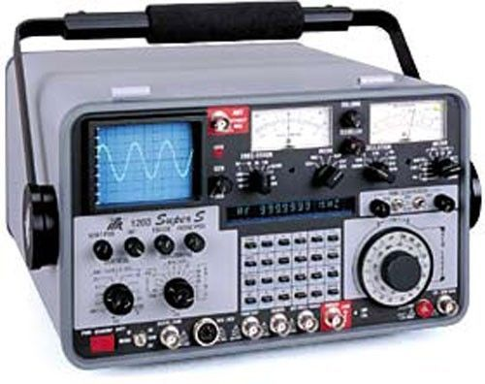
Health Monitor
Version 19.0 contains a prototype. Ideas for v20.0 include:
Complete feature to find last known location of a "hanging" interpreter
Sending signals to interrupt or terminate tasks
Discoverability: allow APL process to broadcast services that it provides
Switch ⎕PROFILE on and off; collect data
Possibly add OpenTelemetry data feed

Slide 45
HTMLRenderer Enhancements
The HTMLRenderer continues to grow in importance
File Upload
Modal HTMLRenderer Windows
More control over "Chrome"
  The EWC project will accelerate the evolution of the HTMLRenderer (more tomorrow)

Slide 46

Small Things
⎕NINFO w/Callbacks
Set File Attributes using ⎕NATTRIBUTES
Unicode decomposition / normal forms

Slide 47
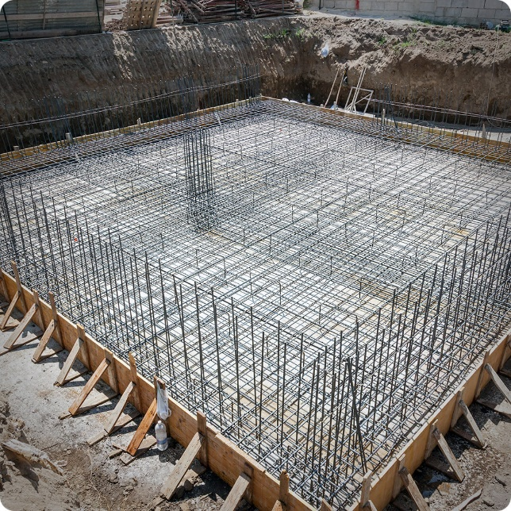
Laying New Foundations
⎕WC Plugin Mechanism
Relax Interpreter Limits
Artificial Intelligence

Slide 48
An Open [Source] Plugin Architecture
A modern replacement for Auxiliary Processors
  Uses Direct Workspace Access (DWA) for high performance
  Accessible via ⎕WC / ⎕NEW
Make interpreter extensions open source, eg.
  HTMLRenderer, Conga (our TCP platform)
  Cryptographic Library
Many of these are interfaces to open source components
Dyalog APL
Conga
HTML
Renderer
GnuTLS
Chromium
Embedded
Framework

Slide 49
Plugin Architecture Benefits
Allow users to move faster
  Adopt new versions of Chromium or OpenSSL
Make the Dyalog community more inclusive
  Allow users to contribute to our eco-system
Users can develop and share new extensions
Makes our encryption tools transparent and verifyable
  ➔ Easier to comply with FOSS licence constraints
Dyalog APL
Conga
HTML
Renderer
GnuTLS
Chromium
Embedded
Framework
D05: WC Plugins (John Daintree)

Slide 50
Relax Interpreter Limits
We plan to relax limitations in the interpreter, like:
Max Rank (15)
Number of tokens in a line (4,095)
Number of token types
(and many more)

Slide 51
Relax Limits – Why Now?
We need more token types for new primitives, new control structures, array notation, …
Migrants to Dyalog have functions with >9,999 lines ☺☹
Challenge: Structure has not changed for decades
  (except adding new types like Unicode and Complex Numbers)
Must avoid "big bang" data conversion
  Different versions of APL must share data
  (Restore & use archived component files)
D16: Interpreter Limits (John Daintree)

Slide 52
Artificial Intelligence
Research Into:
OpenAI interface (Tatin Package)
Using "Language Models" to search our Documentation
Are Language Models good enough for a meaningful "APL Co-Pilot?"
  (at least for newcomers to APL)

Slide 53
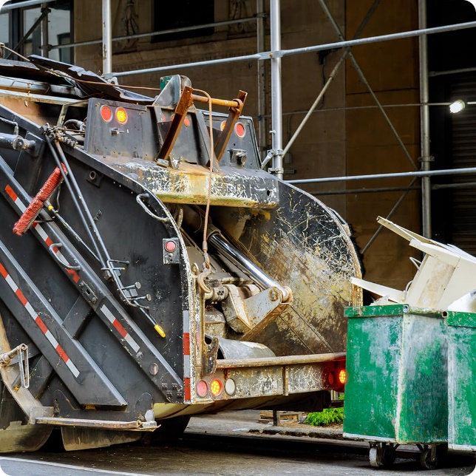
Tidying Up
PCRE 10.x
  Upgrade ⎕R & ⎕S to use latest PCRE
Documentation Format

Slide 54

Documentation
help.dyalog.com and "core" documentation will be produced using MkDocs on GitHub
Anyone (including you) can raise "issues"
  Or even submit "Pull requests"
  You CAN still email docs@ or support@
Some tools already use MkDocs…

Slide 55
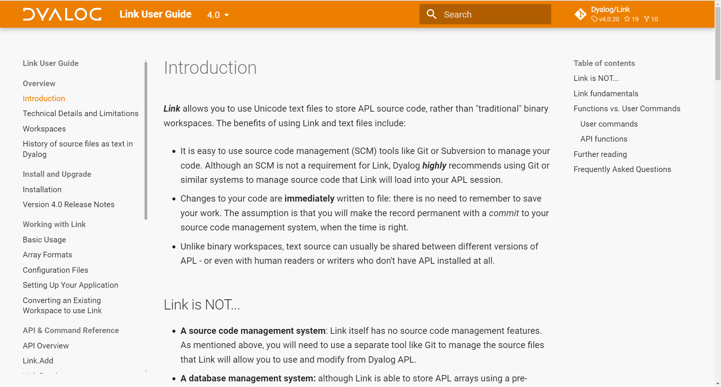

Slide 56
Documentation: Why change?
Easier to contribute
  Internally and externally (and Pete has retired)
Open formats, platform agnostic tools
Better search
Human-friendly, predictable URLs, like
  https://docs.dyalog.com/20.0/object-reference/properties/depth/

Slide 57
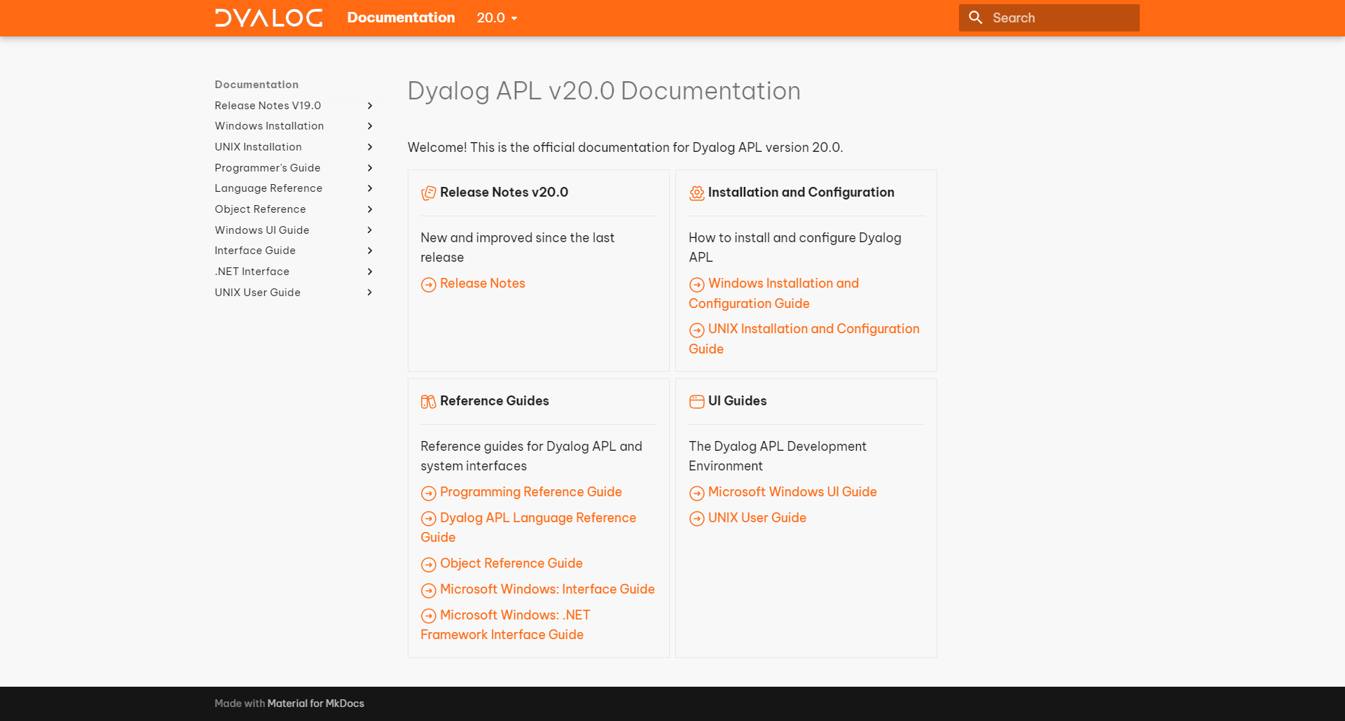

Slide 58
Other Stuff
Link v4.1
Kafka Interface
Telemetry
BSIMM Audit
Isolates connect back to server
  (Docker containers)
Performance
  Set functions
  NSs kept alive by children
  Garbage Collector
Exhaustive Primitive Tests
64-bit ARM support
  (Pi & AWS Image)
New Mac installer
Directory naming
Keyboard layouts
Platform Features

Slide 59
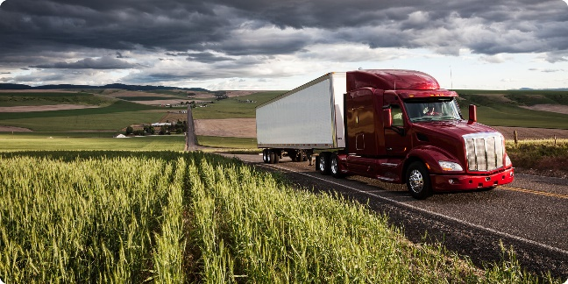
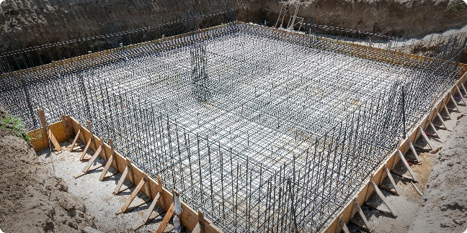
Big Things
Array Notation
Set & Get Variables
Token-by-Token Tracing
Everywhere WC
Script Support
Reverse Compose
New Foundations
⎕WC Plugin Mechanism
  Open-source more components
  HTMLRenderer, Conga, Crypto Library
Relax Interpreter Limits
New UCMD mechanism

Slide 60
Thank You!

