Slide 1

OpenAI Demo
Morten Kromberg, CTO
(Code and examples by Brian Becker)

Slide 2

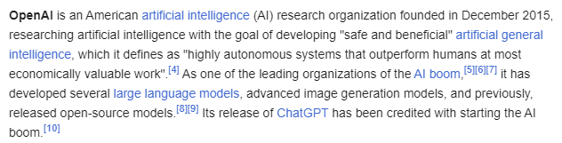
What is OpenAI?
Wikipedia says:

Slide 3

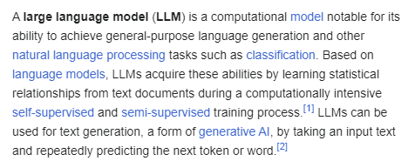
What is an LLM?
Wikipedia says:

Slide 4
Getting Started
Follow the instructions at
https://platform.openai.com/docs/quickstart
You need an API Key
Do not store it in code, and do not lose it!
  I store it in an environment variable
You will need to pay some money
  (I paid $10 + VAT)

Slide 5
The OpenAI Class
Written by Brian Becker in the last month
Will soon move to separate repository github.com/dyalog/openai
Demonstrates
  Chat with LLM
  Audio Manipulation
  Image Creation

Slide 6
General Usage
3 sub-classes, Audio, Chat and Image, each of which has methods that will create an instance:
Create an instance of the endpoint with most common parameters. Example:
i←OpenAI.Image.Create parameters
Set any additional parameters if needed
Run: r←i.Run
If ~ r.IsOK
  Check r.Data

Slide 7
z.IsOK
0
⎕json z.Data
{"error":{"code":"insufficient_quota",
"message":"You exceeded your current quota,
please check your plan and billing details.
For more information on this error, read the docs:
https://platform.openai.com/docs/guides/error-codes/api-errors.",
"param":null,"type":"insufficient_quota"}}
Translation: Please Enter Your Credit Card #

Slide 8
Chat.Completion
"Completion" means continue a conversion with an "Assistant"
i←OpenAI.Chat.Completion System User
or i←OpenAI.Chat.Completion System
or i←OpenAI.Chat.Completion ''
System describes the assistant.
User is the user's initial input.
i←OpenAI.Chat.Completion 'you are a sarcastic assistant' 'how much is 2+2'

Slide 9
OpenAI.Audio Methods
Method | Description | Constructor Arguments
Speech | Create Audio | Text OutFile Voice
Transcription | Create Text from Audio | AudioFile OutFile
Translate | Translate Audio to English | AudioFile OutFile

Slide 10

Audio Examples
txt←'Suomi on kaunis maa, ja ihmiset ovat hyvin ystävällisiä.'
s←OpenAI.Audio.Speech txt
s.OutFile←'/tmp/finnish.wav' 1 ⍝ 1 specifies to overwrite
s.Run.IsOK
]open c:\tmp\finnish.wav
ts←OpenAI.Audio.Transcription '/tmp/finnish.wav'
ts.Run.IsOK
ts.Response.Data.text
Suomi on kaunis maa ja ihmiset hyvin ystävällisiä.
tl←OpenAI.Audio.Translation '/tmp/finnish.wav'
tl.Run.IsOK
tl.Response.Data.text
Finland is a beautiful country and people are very friendly.

Slide 11
OpenAI.Image Methods
Method | Description | Constructor Arguments
Create | Create Image | prompt OutFile style
Edit | Modify Image | ImageFile prompt
Vary | Create variants of Image | ImageFile n
Prompt inspiration used by the AI to generate or modify the image
style 'vivid' (the default) or 'natural'
n the number of images to generate from 1 (the default) to 10
response_format 'url' (the default, valid for 60 mins) or 'b64_json'
size '256x256', '512x512', or '1024x1024' (the default)

Slide 12
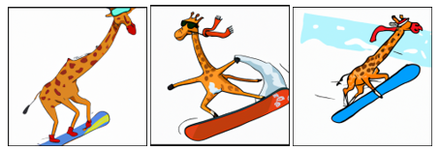
Image Example
i←OpenAI.Image.Create 'a giraffe snowboarding'
i.size←'512x512'
i.n←3
i.Run.IsOK
i.Show

