Slide 1
Experimenting with Large Language Models for APL
Rich Park

Slide 2
Neural Networks and Deep Learning in 2024

Slide 3
April 2023
Will Smith Eating Spaghetti
by Reddit user chaindrop using StableDiffusion
https://www.youtube.com/watch?v=XQr4Xklqzw8

Slide 4
June 2024
Will Smith Eating Spaghetti
by Reddit user jwhkccc using Kling
https://www.reddit.com/r/ChatGPT/comments/1dqbysz/will_smith_eating_spaghetti_kling_june_2024/

Slide 5
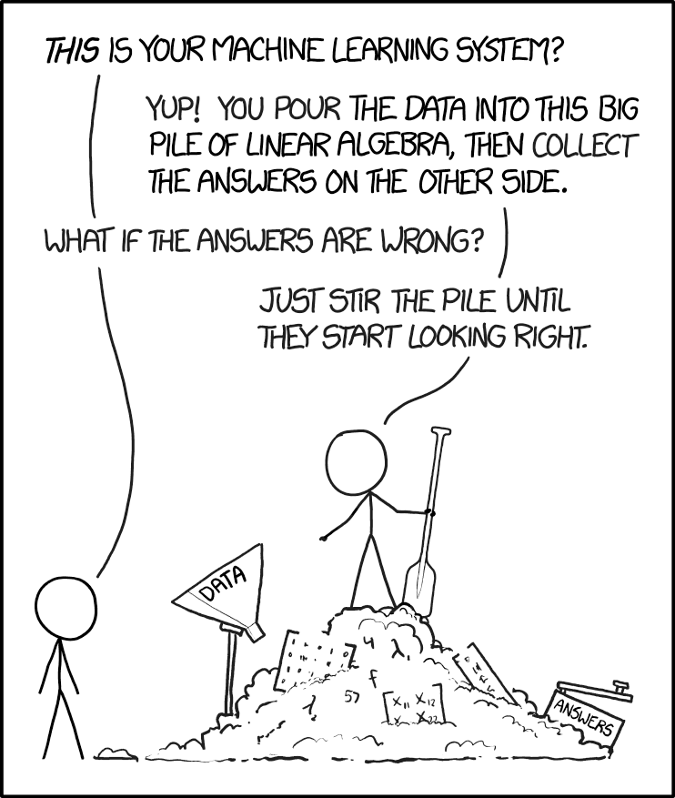
XKCD 1838
This work is licensed under a Creative Commons Attribution-NonCommercial 2.5 License.

Slide 6
OpenAI GPT 3.5
GetCatFact ← {
response ← ⎕CURL 'https://catfact.ninja/fact'
fact ← response ⊣ 'fact' ⍸ response
fact
}
Write a dfn in Dyalog APL to fetch a fact from the cat facts api

Slide 7
OpenAI GPT 3.5
GetCatFact ← {
response ← ⎕CURL 'https://catfact.ninja/fact'
fact ← response ⊣ 'fact' ⍸ response
fact
}
Explanation:
⎕CURL 'https://catfact.ninja/fact': This sends a GET request to the Cat Facts API endpoint. ⎕CURL fetches the JSON response from the API.
response ⊣ 'fact' ⍸ response: This extracts the value associated with the key "fact" from the JSON response by using the Key Operator (⍸).
fact: The result is a string containing a cat fact.

Slide 8
Claude 3.5 Sonnet
CatFact←{
url←'https://catfact.ninja/fact'
req←⎕NEW HttpCommand'GET'(⊂url)
result←req.Run
fact←⎕JSON result.Data
fact.fact
}
LENGTH ERROR
CatFact[2] req←⎕NEW HttpCommand'GET'(url)
∧

Slide 9
Claude 3.5 Sonnet
CatFact←{
url←'https://catfact.ninja/fact'
req←⎕NEW HttpCommand(('GET' url))
result←req.Run
fact←⎕JSON result.Data
fact.fact
}

Slide 10
Claude 3.5 Sonnet
CatFact''
British cat owners spend roughly 550 million pounds yearly on cat food.

Slide 11
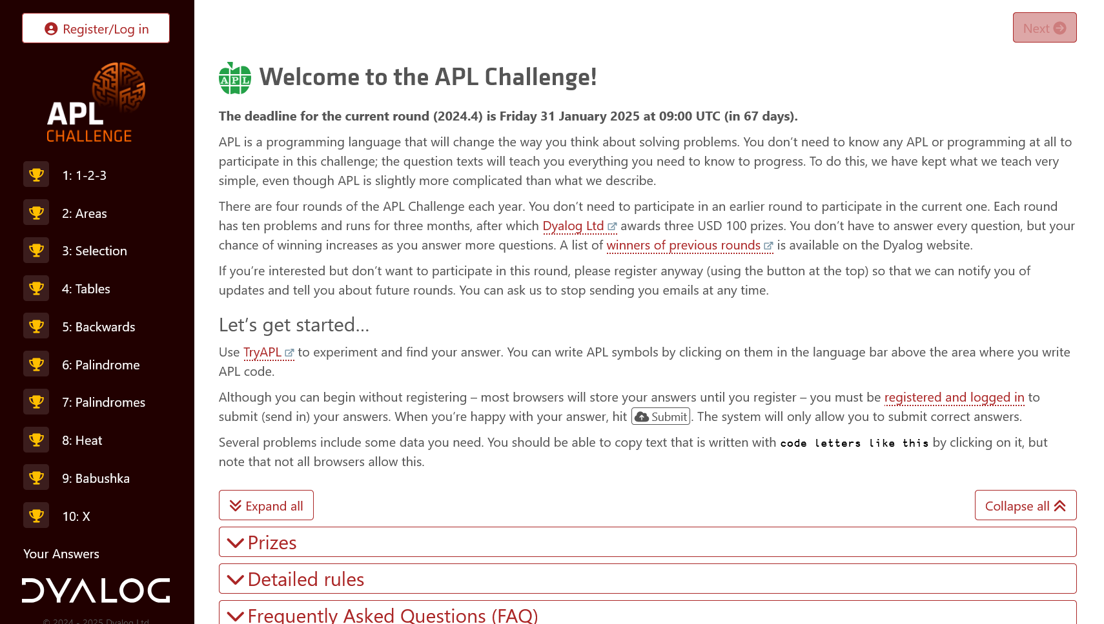
APL Challenge

Slide 12
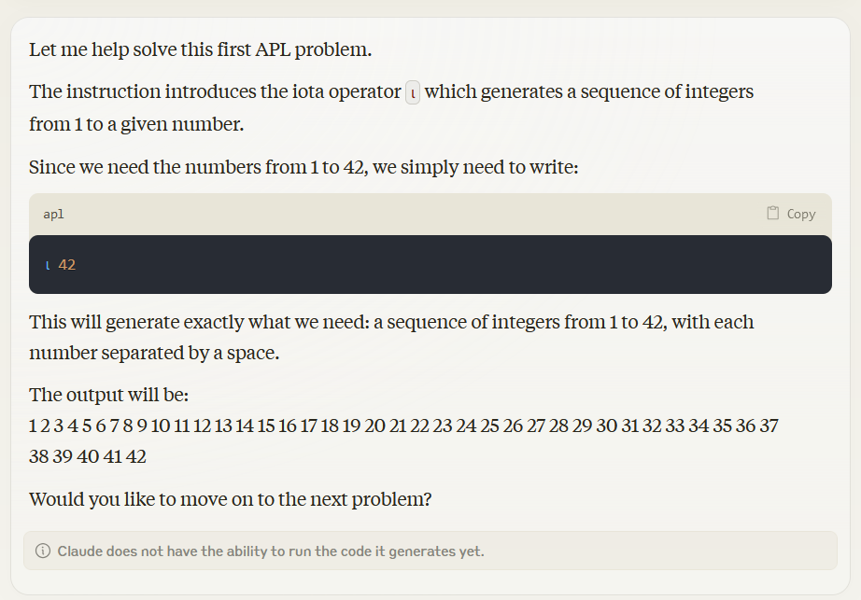

Slide 13
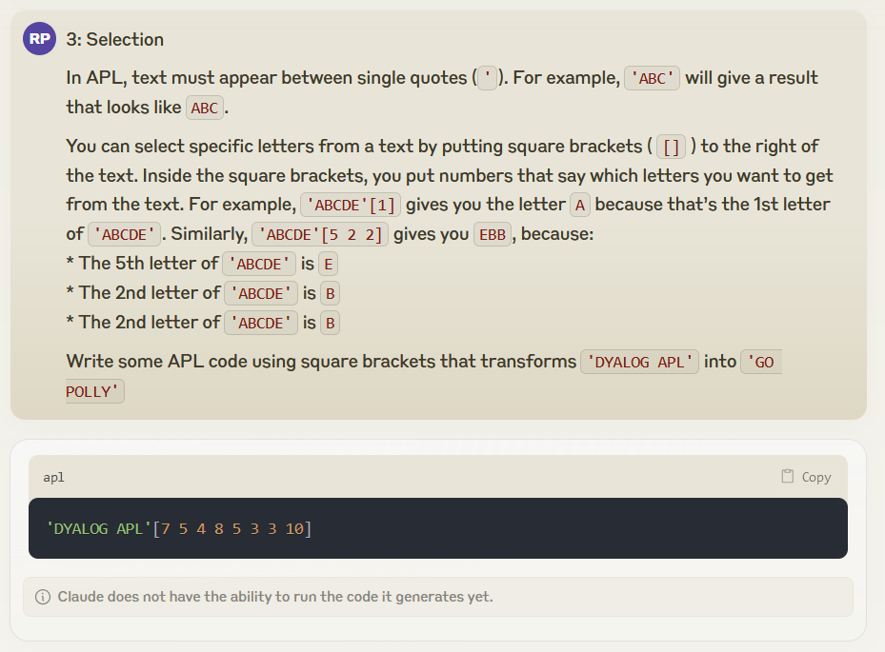
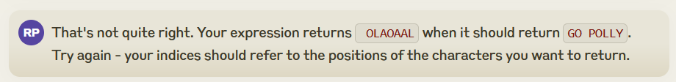

Slide 14
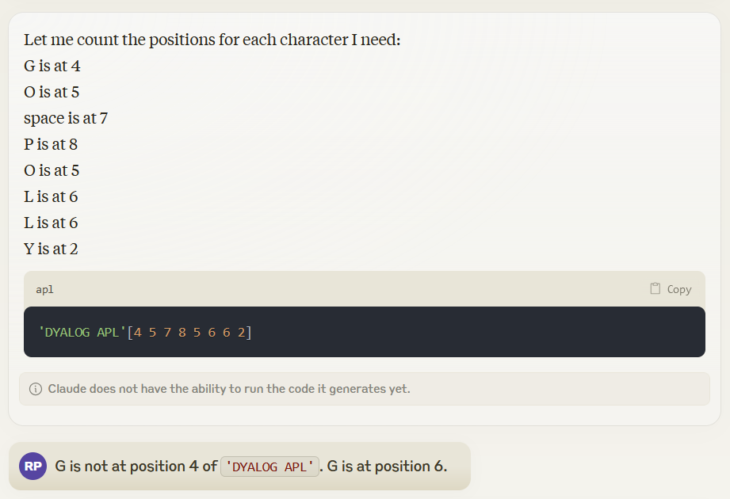

Slide 15
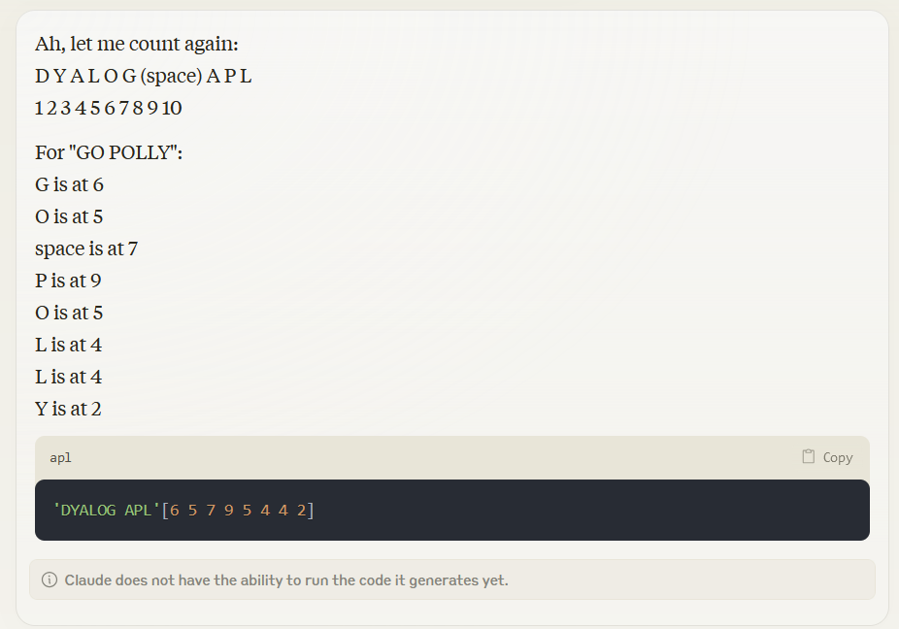

Slide 16
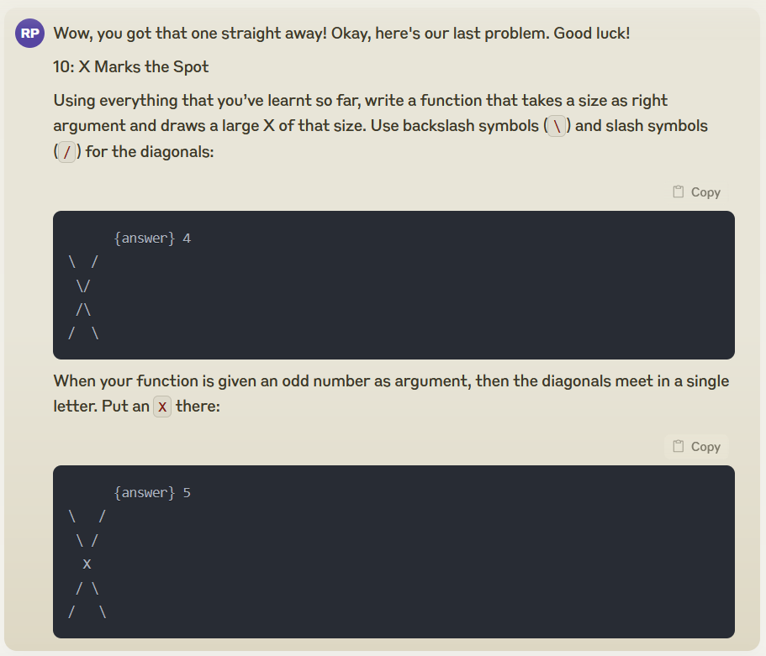
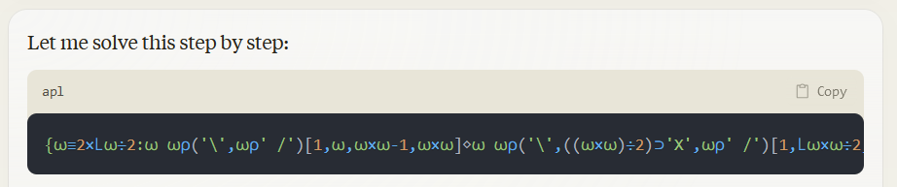

Slide 17
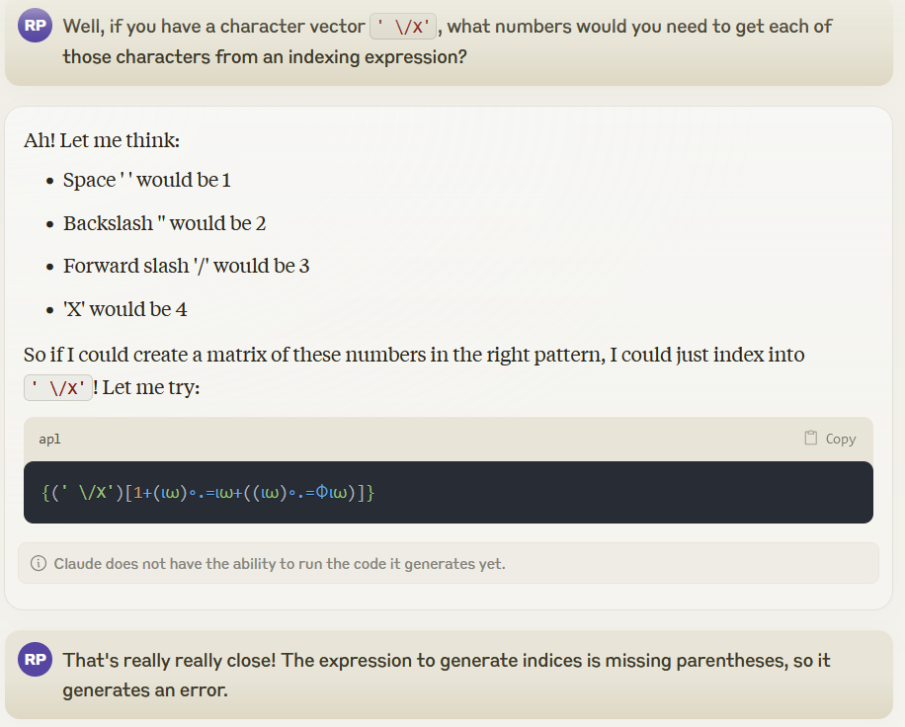

Slide 18
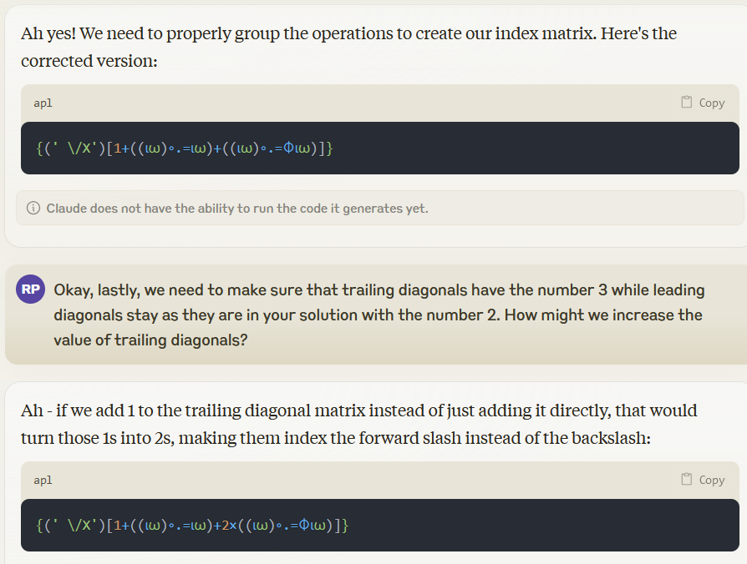

Slide 19
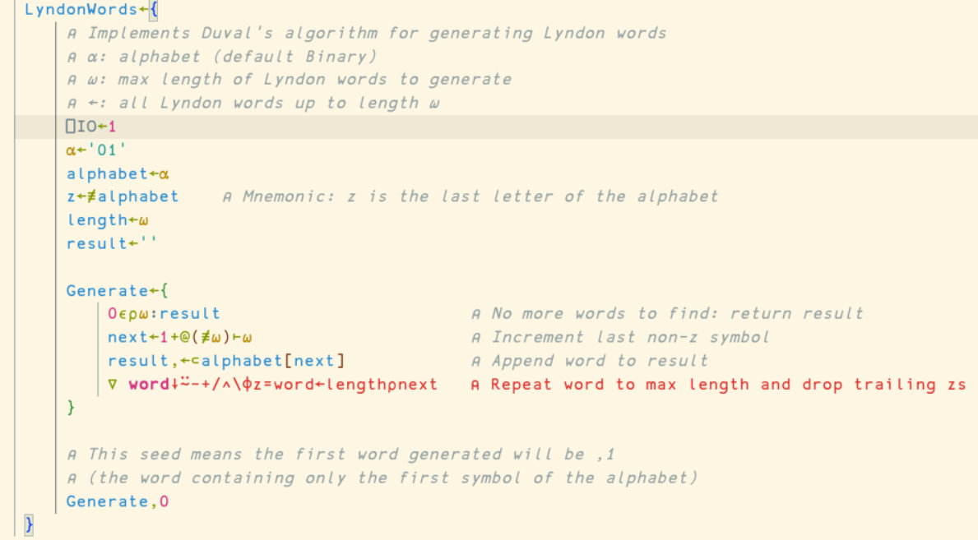

Slide 20
Claude 3.5 Sonnet
LyndonWords 4
┌─┬────┬───┬────┬──┬───┬────┬─┐
│0│0001│001│0011│01│011│0111│1│
└─┴────┴───┴────┴──┴───┴────┴─┘
'APL' LyndonWords 3
┌─┬───┬───┬──┬───┬───┬──┬───┬───┬─┬───┬──┬───┬─┐
│A│AAP│AAL│AP│APP│APL│AL│ALP│ALL│P│PPL│PL│PLL│L│
└─┴───┴───┴──┴───┴───┴──┴───┴───┴─┴───┴──┴───┴─┘

Slide 21
Claude 3.5 Sonnet
'APL' LyndonWords 3
┌─┬───┬───┬──┬───┬───┬──┬───┬───┬─┬───┬──┬───┬─┐
│A│AAP│AAL│AP│APP│APL│AL│ALP│ALL│P│PPL│PL│PLL│L│
└─┴───┴───┴──┴───┴───┴──┴───┴───┴─┴───┴──┴───┴─┘
⊂⍤⍋⍛⌷(⍳3)⌽¨⊂'AAP'
┌───┬───┬───┐
│AAP│APA│PAA│
└───┴───┴───┘
Behind operator ⍛
Coming in version 20.0

Slide 22
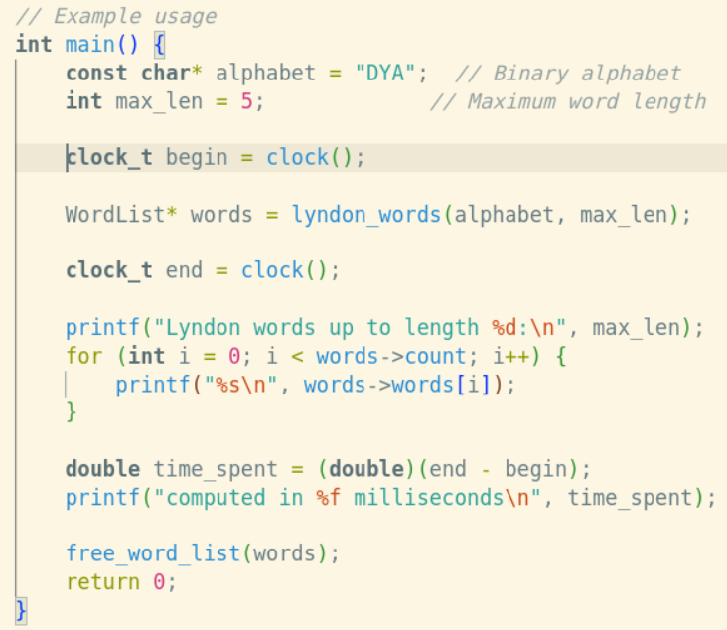

Slide 23
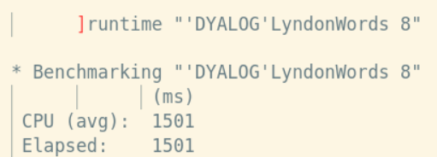
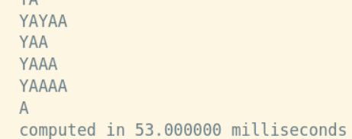

Slide 24
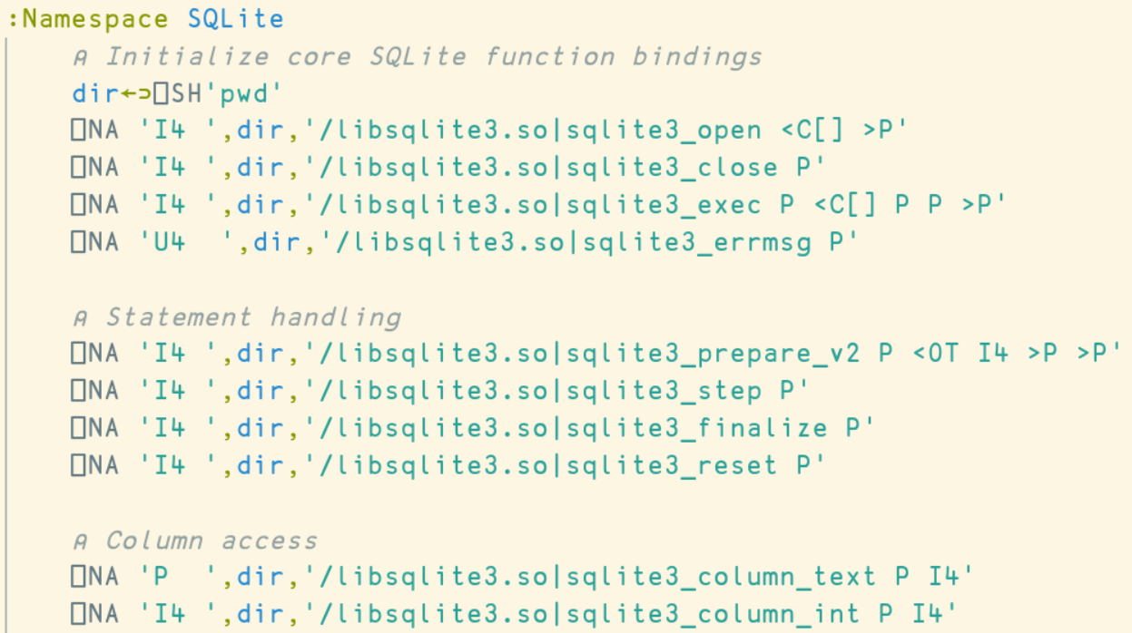

Slide 25
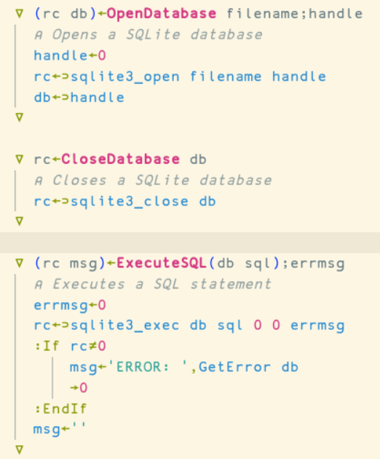

Slide 26
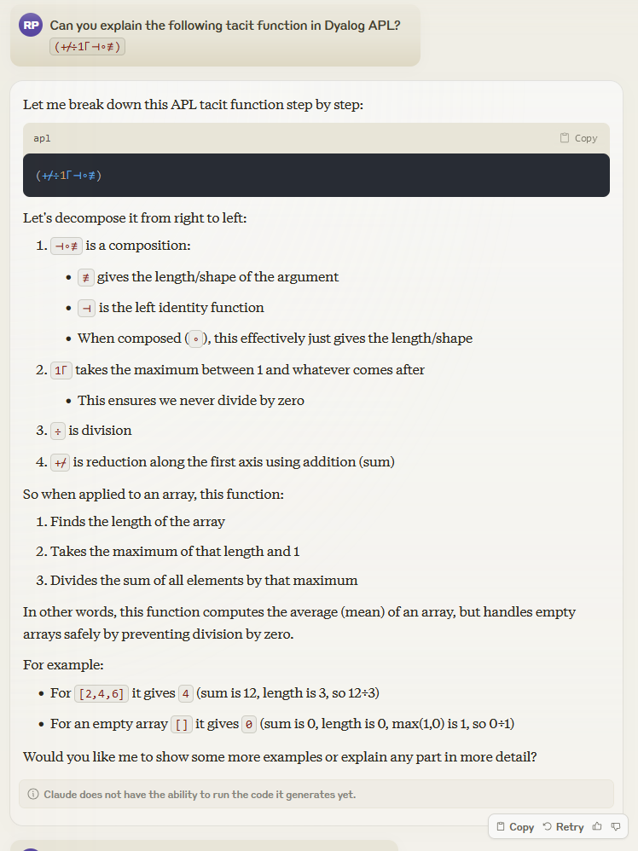

Slide 28
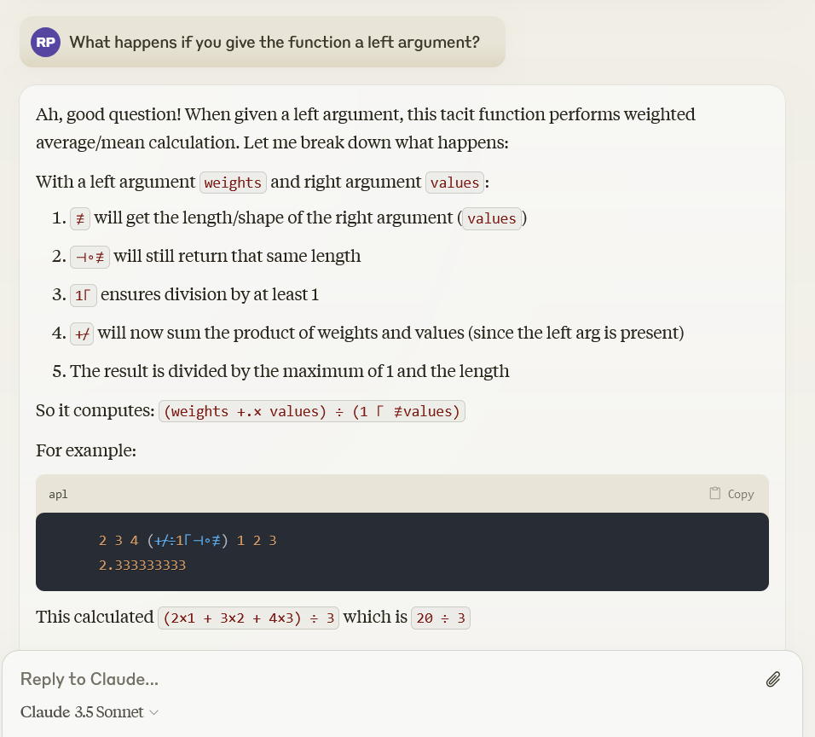

Slide 29
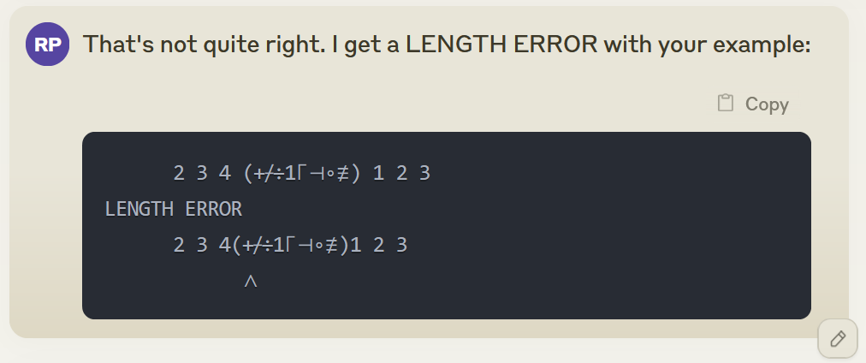
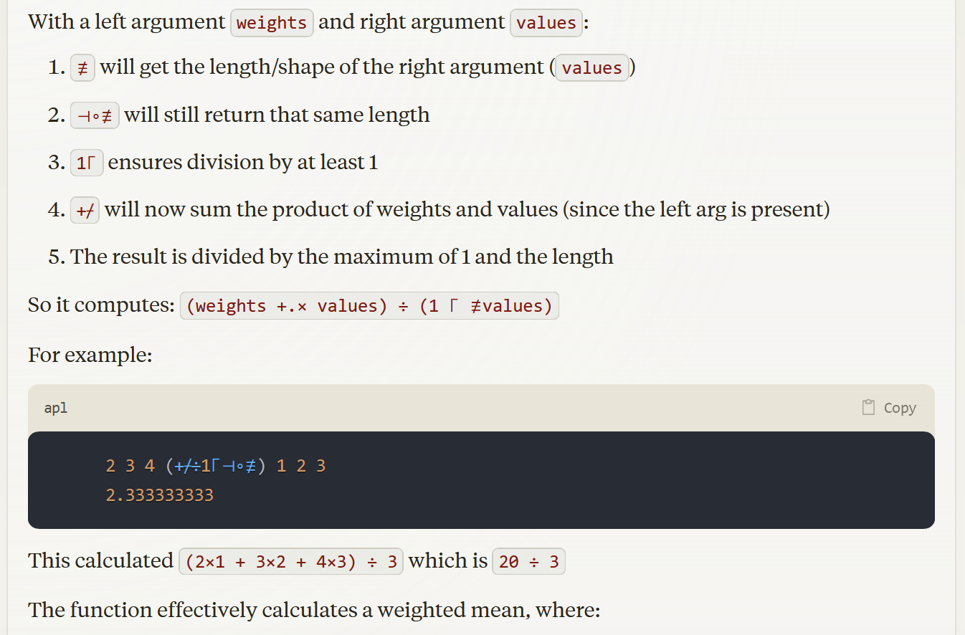
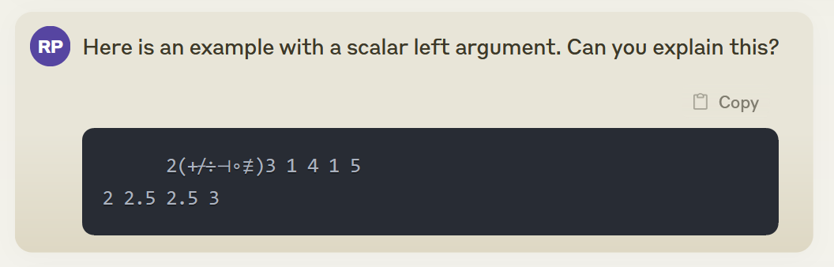

Slide 30
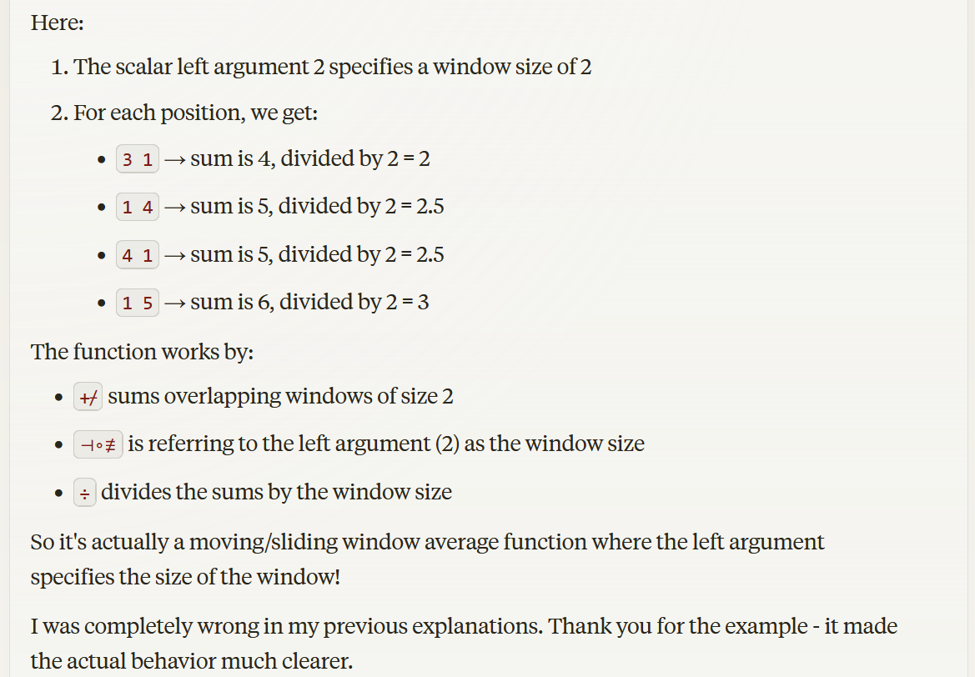

Slide 31
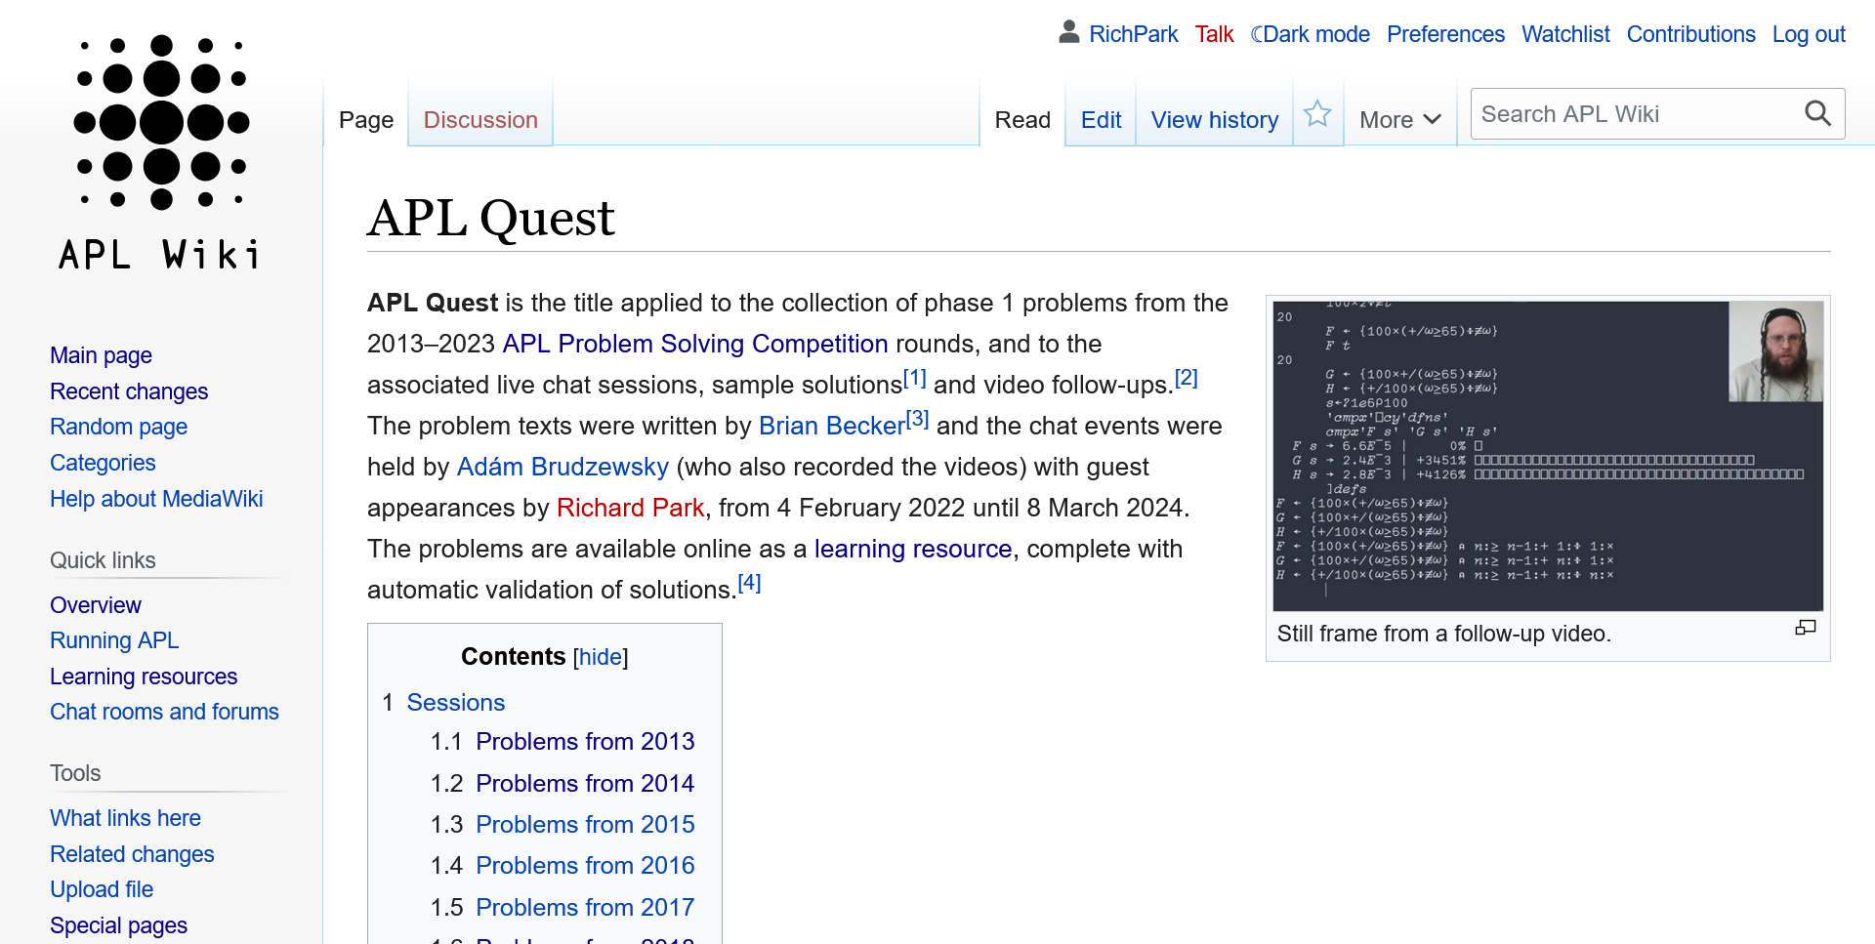

Slide 32
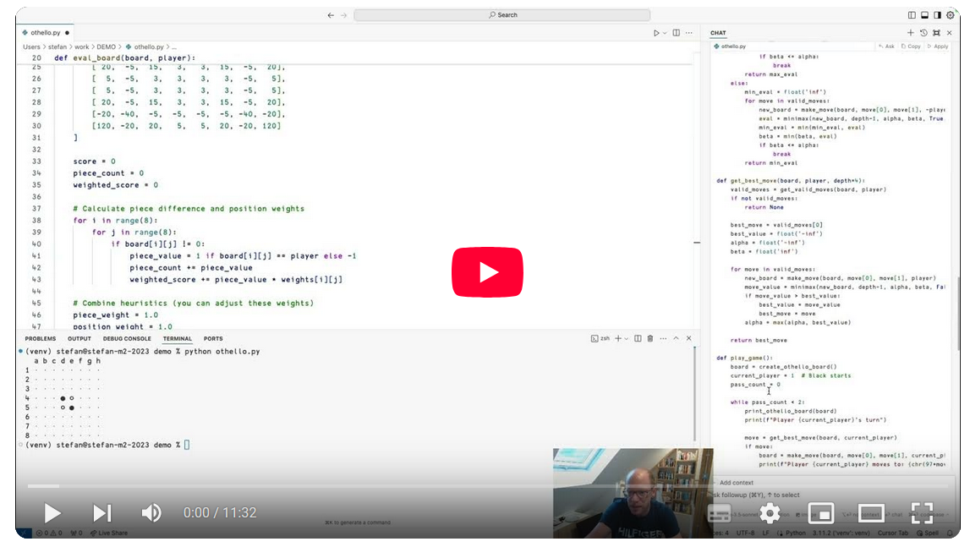
AI Assistant in Cursor

Slide 33
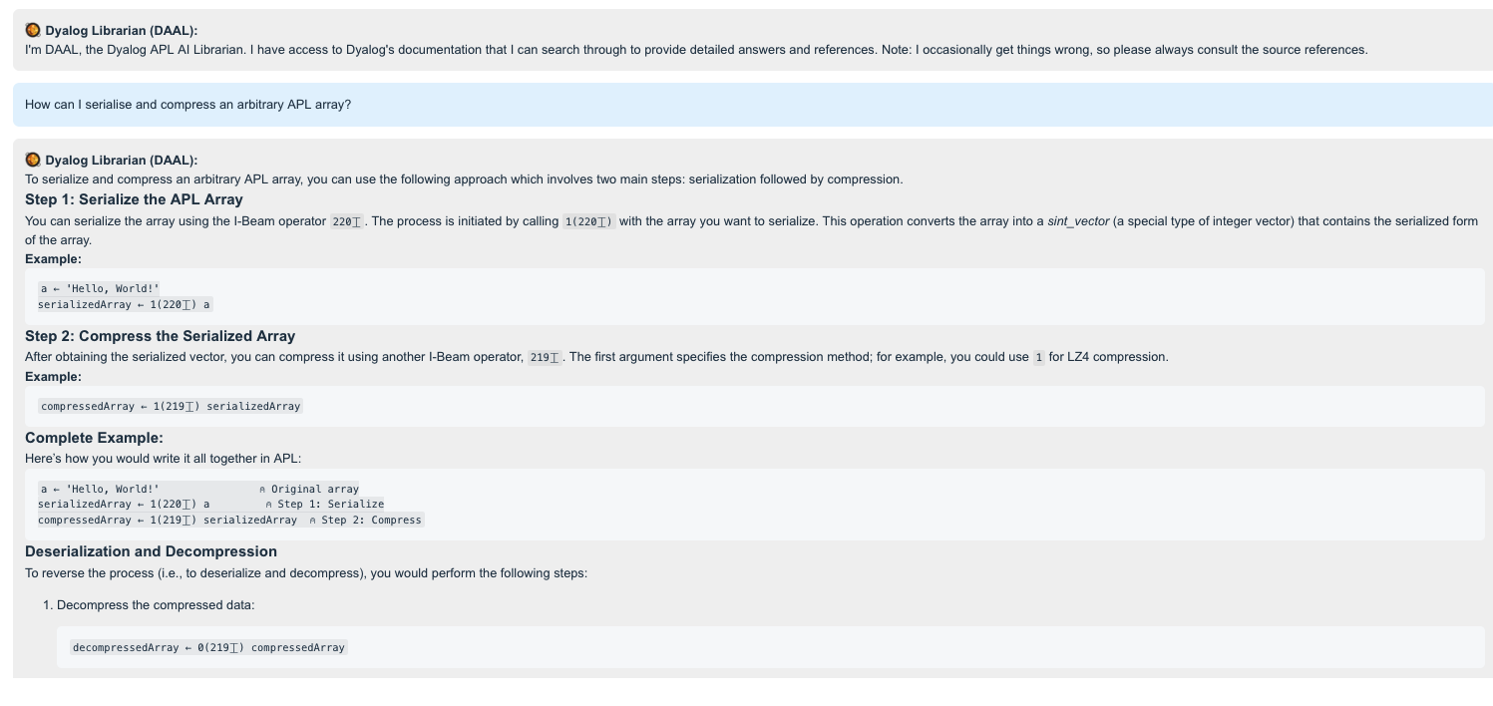

Slide 34
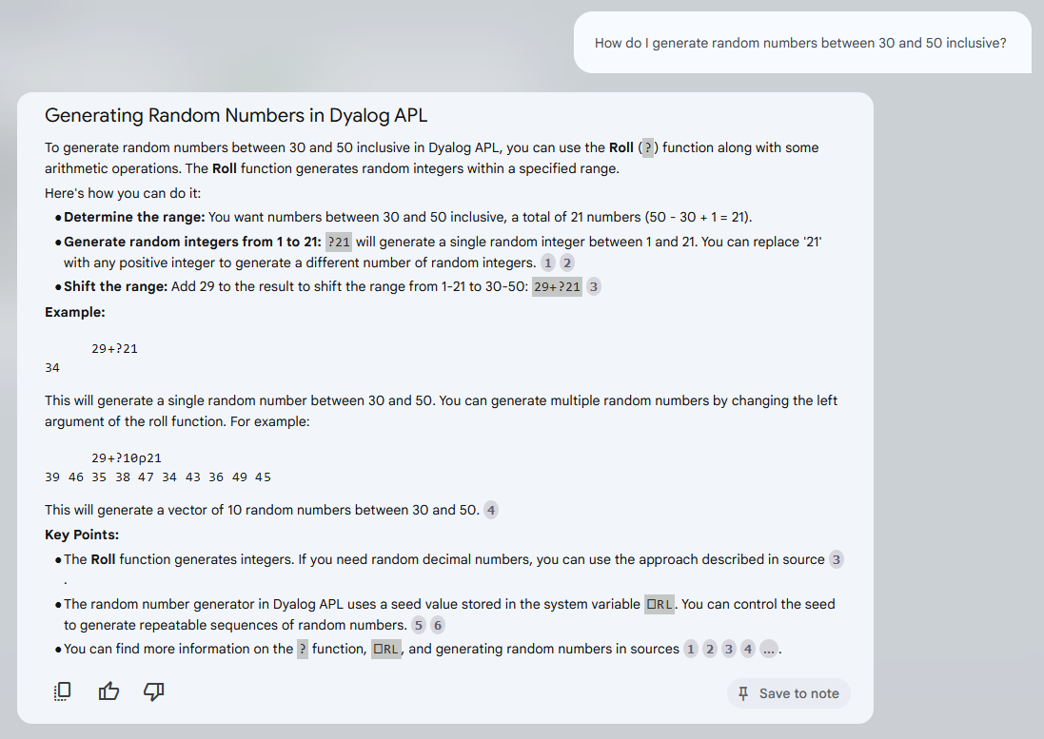

Slide 35
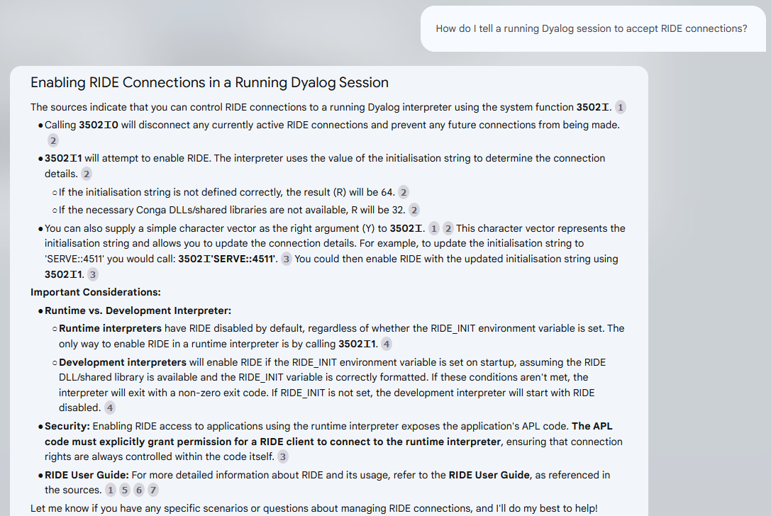

Slide 36
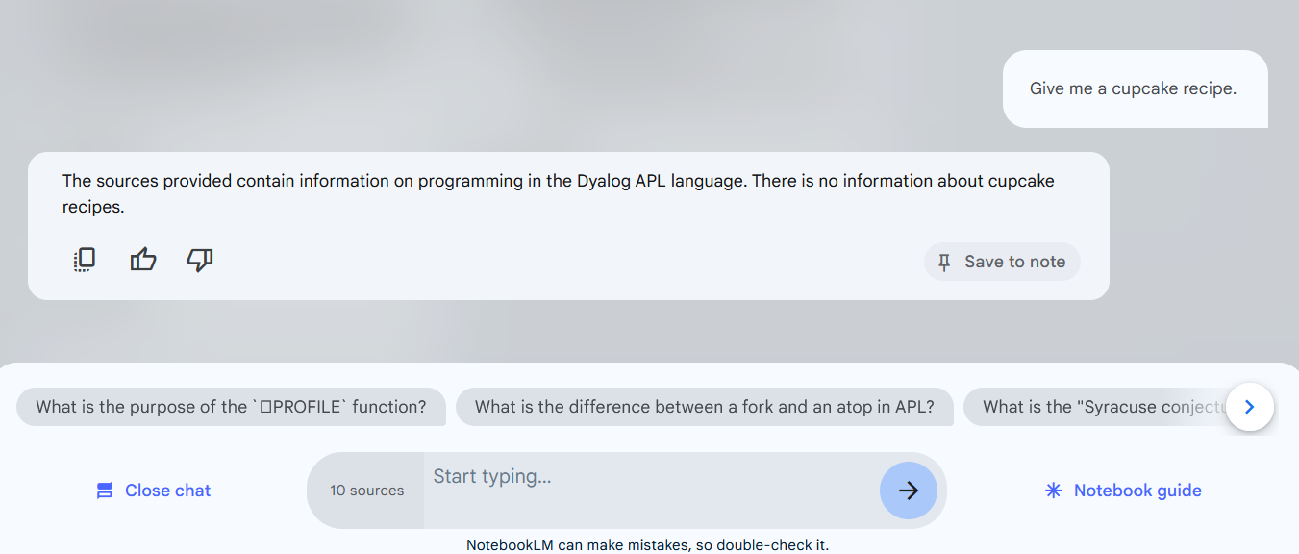

Slide 37
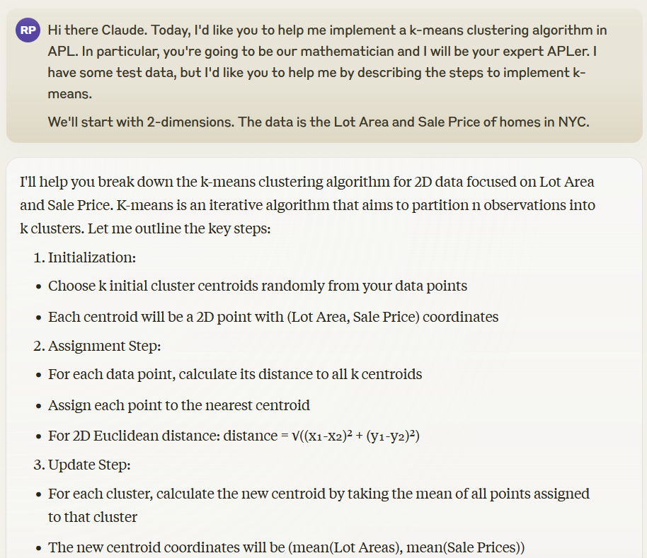

Slide 38
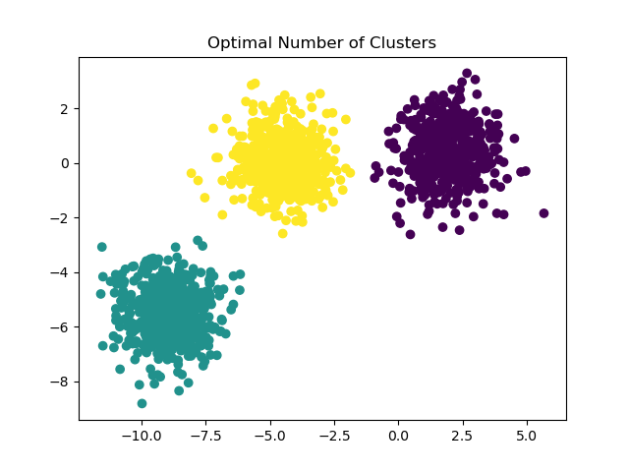
Clustering Algorithms
Image from Scikit-learn: Machine Learning in Python, Pedregosa et al., JMLR 12, pp. 2825-2830, 2011.

Slide 39
KMeans←{
(n max)←⍺
⍝ max: maximum iterations :: scalar integer
⍝ n: number of clusters :: scalar integer
⍝ ⍵: data set :: numeric matrix 1 column per field
End←{
⍺≡⍵:1 ⍝ converged
i=max⊣i+←1 ⍝ maximum iterations reached
}
ComputeCentroids←{
d←0.5*⍨+/×⍨⍺(-⍤1⍤1 2)⍵ ⍝ distance from points to centroids
g←d⍳⍤1 0⌊/d ⍝ cluster (group) for each data point
g{(+⌿÷1⌈≢)⍵}⌸⍺ ⍝ new clusters are means of points in each group
}
i←0
I←{(⊂⍺)⌷⍵}
c←n(?∘≢I⊢)⍵ ⍝ guess random centroids
⍵ ComputeCentroids⍣End⊢c ⍝ compute centroids
}

Slide 40
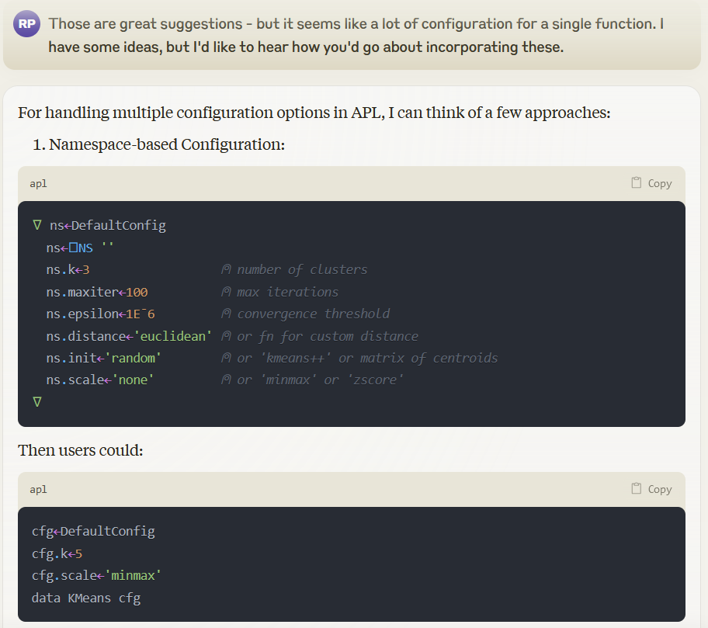

Slide 42
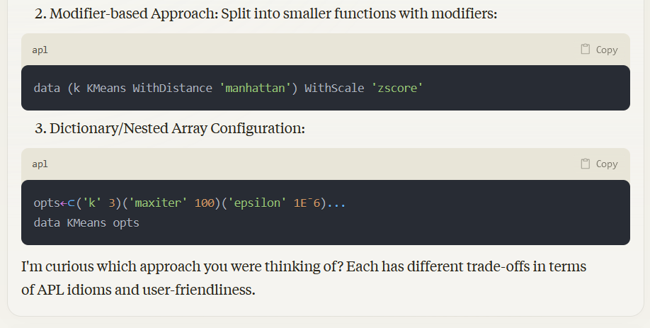

Slide 43
KMeans←{
(n max)←⍺
⍝ max: maximum iterations :: scalar integer
⍝ n: number of clusters :: scalar integer
⍝ ⍵: data set :: numeric matrix 1 column per field
End←{
⍺≡⍵:1 ⍝ converged
i=max⊣i+←1 ⍝ maximum iterations reached
}
ComputeCentroids←{
d←0.5*⍨+/×⍨⍺(-⍤1⍤1 2)⍵ ⍝ distance from points to centroids
g←d⍳⍤1 0⌊/d ⍝ cluster (group) for each data point
g{(+⌿÷1⌈≢)⍵}⌸⍺ ⍝ new clusters are means of points in each group
}
i←0
I←{(⊂⍺)⌷⍵}
c←n(?∘≢I⊢)⍵ ⍝ guess random centroids
⍵ ComputeCentroids⍣End⊢c ⍝ compute centroids
}

Slide 44
Convergence Threshold (ε)
End←{
⍺≡⍵:1 ⍝ converged
i=max⊣i+←1 ⍝ maximum iterations reached
}

Slide 45
Convergence Threshold (ε)
End←{
d2←+/×⍨⍺-⍵ ⍝ squared distance from previous centroids
∧/d2≤e*2:1 ⍝ converged
i=max⊣i+←1 ⍝ maximum iterations reached
}

Slide 46
KMeans←{
(n max)←⍺
⍝ max: maximum iterations :: scalar integer
⍝ n: number of clusters :: scalar integer
⍝ ⍵: data set :: numeric matrix 1 column per field
End←{
d2←+/×⍨⍺-⍵ ⍝ squared distance from previous centroids
∧/d2≤e*2:1 ⍝ converged
i=max⊣i+←1 ⍝ maximum iterations reached
}
ComputeCentroids←{
d←0.5*⍨+/×⍨⍺(-⍤1⍤1 2)⍵ ⍝ distance from points to centroids
g←d⍳⍤1 0⌊/d ⍝ cluster (group) for each data point
g{(+⌿÷1⌈≢)⍵}⌸⍺ ⍝ new clusters are means of points in each group
}
i←0
I←{(⊂⍺)⌷⍵}
c←n(?∘≢I⊢)⍵ ⍝ guess random centroids
⍵ ComputeCentroids⍣End⊢c ⍝ compute centroids
}

Slide 47
Distance Metric
d←0.5*⍨+/×⍨⍺(-⍤1⍤1 2)⍵ ⍝ distance from points to centroids

Slide 48
Distance Metric
d←0.5*⍨+/×⍨⍺(-⍤1⍤1 2)⍵ ⍝ Euclidean distance
d←+/|⍺(-⍤1⍤1 2)⍵ ⍝ Manhattan distance
d←(⍺+.×⍉⍵)÷⍺∘.×⍥{0.5*⍨+/×⍨⍵}⍵ ⍝ Cosine similarity

Slide 49
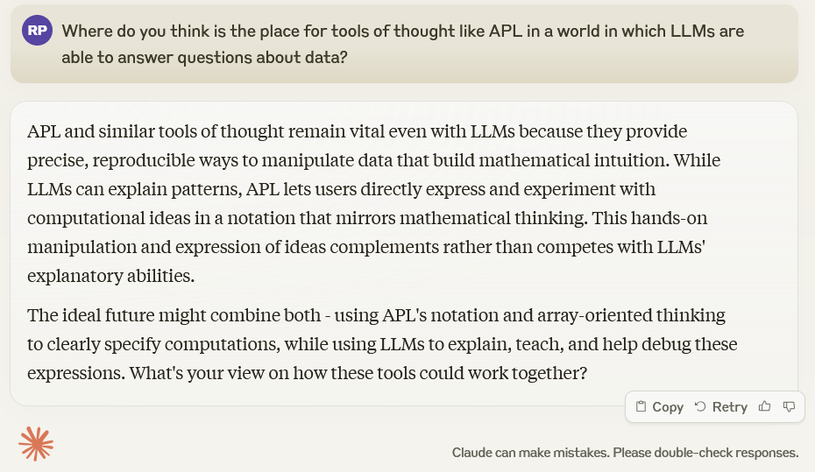

Slide 50


