Slide 1
Dyalog version 20.0 & ⎕SHELL
Peter Mikkelsen

Slide 2
Introduction
A quick look at Dyalog version 20.0
Overview of ⎕SHELL
  "An improved version of ⎕SH/⎕CMD, with more control over a lot of things"
  This part is a re-run of a presentation done at Dyalog'24
  The recording exists online

Slide 3
Dyalog Version 20.0
Expected to be released later this year
Contains a handful of new features
  Inline tracing
  Behind operator ⍛
  Array notation
  ⎕VGET and ⎕VSET
  ⎕SHELL
  (the list is not complete)

Slide 4
Version 20.0: Inline tracing
An extension to the tracer
  Possible to step through the execution of individual primitives
  Examination of intermediate results
  Very helpful when working with tacit code
  Ctrl-Alt-Enter

Slide 5
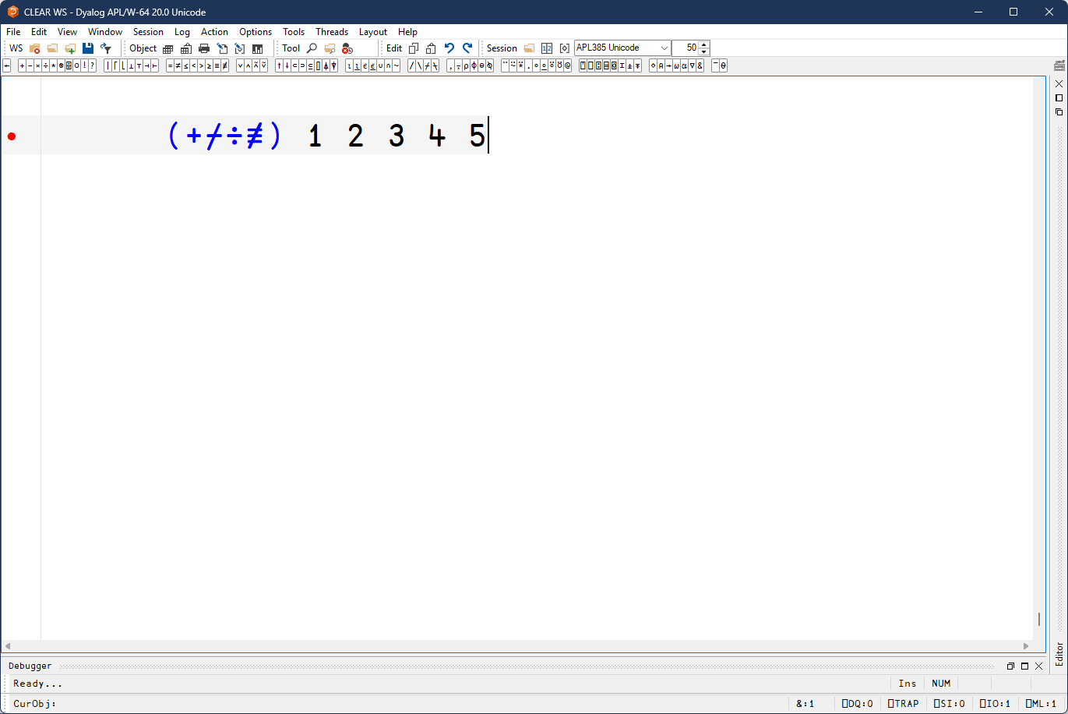
Version 20.0: Inline tracing

Slide 6
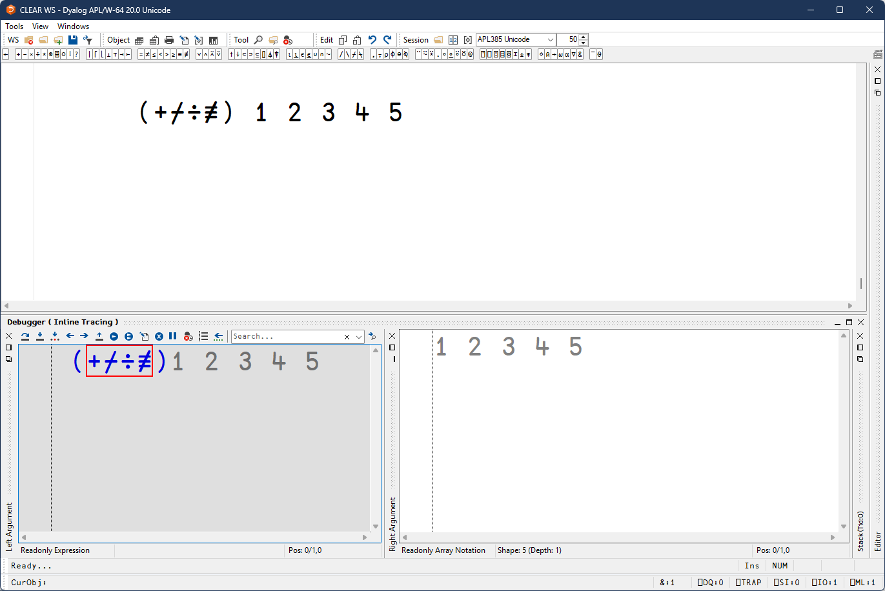
Version 20.0: Inline tracing

Slide 7
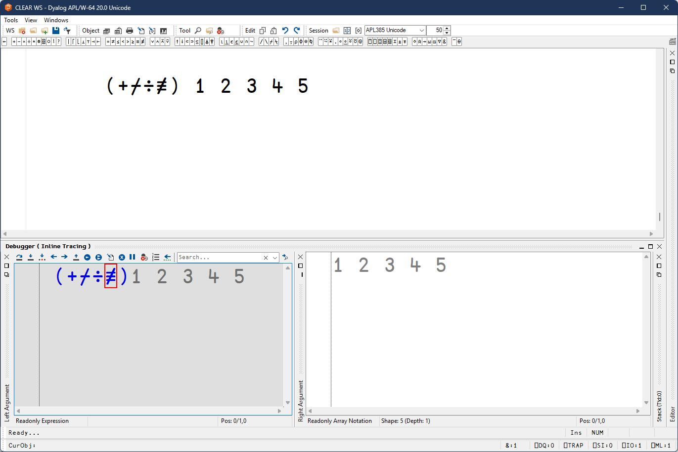
Version 20.0: Inline tracing

Slide 8
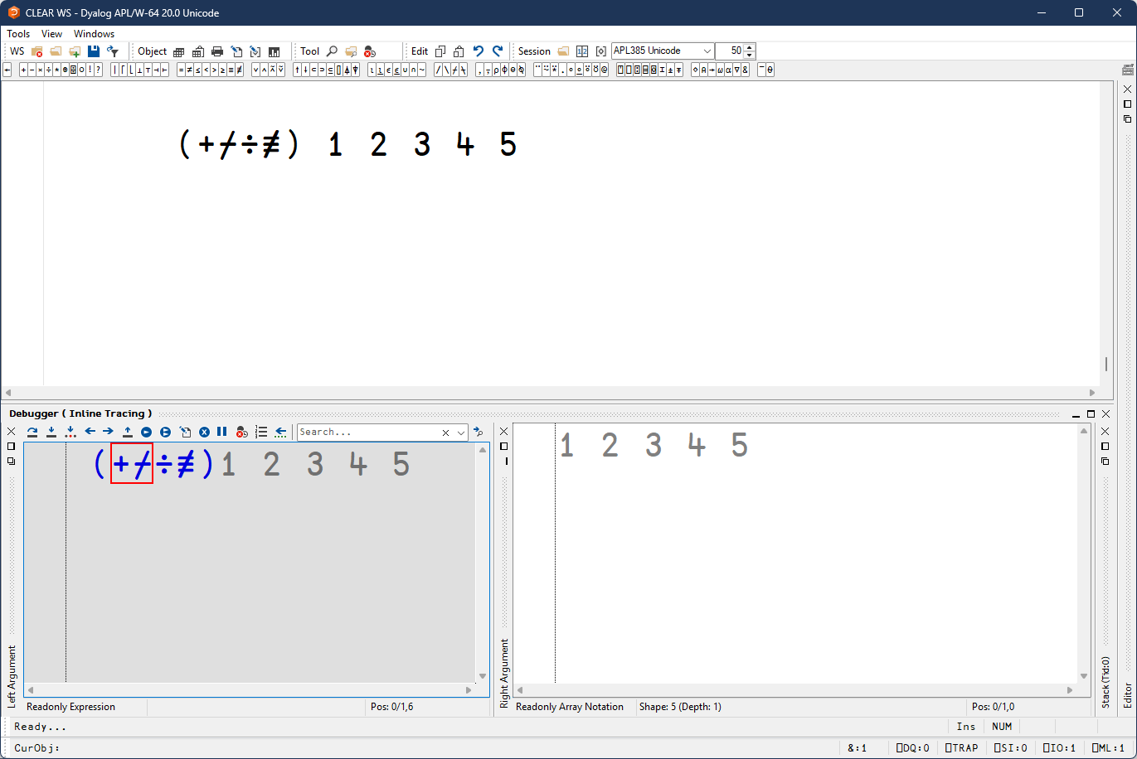
Version 20.0: Inline tracing

Slide 9
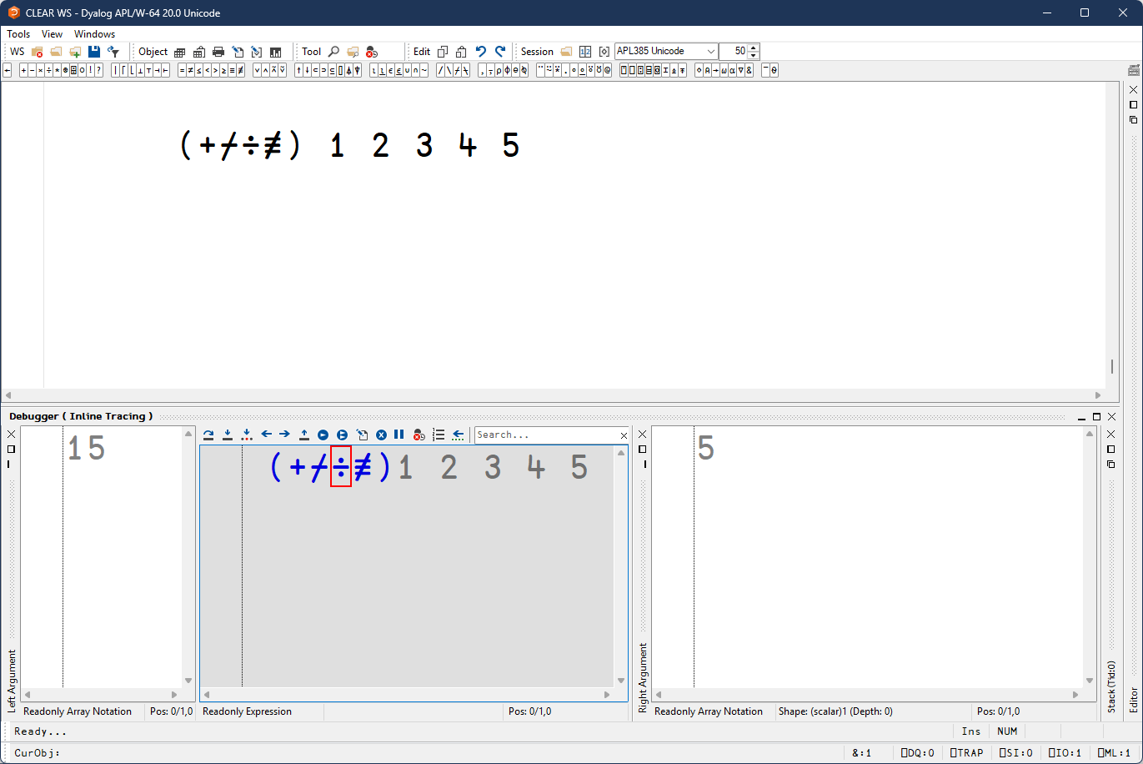
Version 20.0: Inline tracing

Slide 10
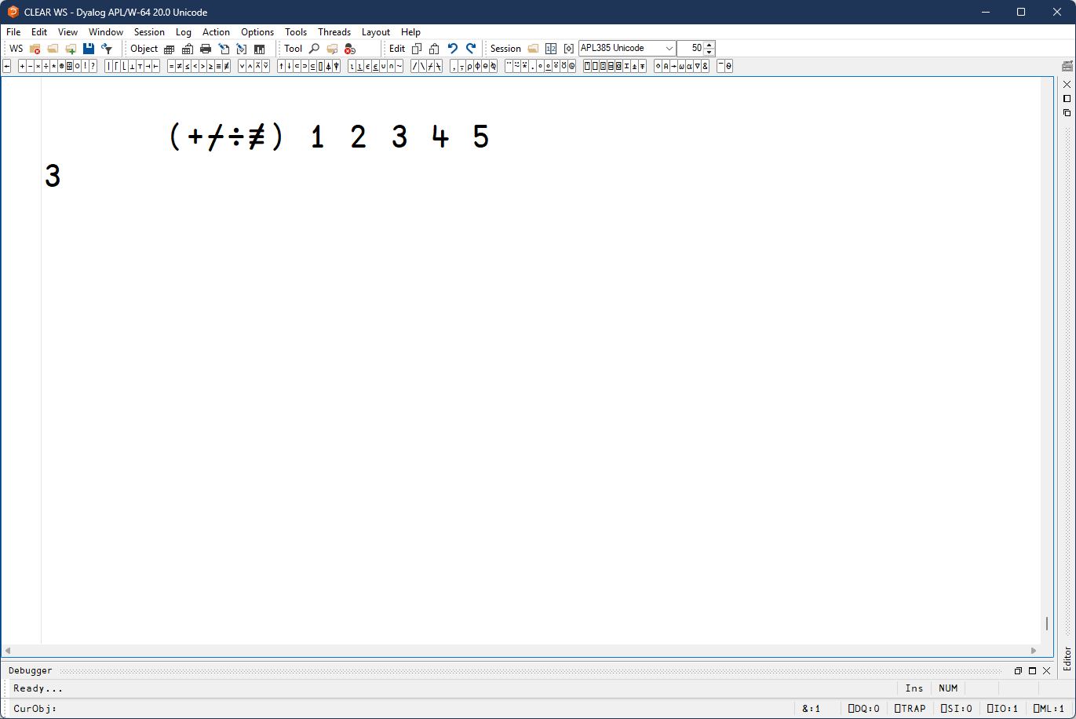
Version 20.0: Inline tracing

Slide 11
Version 20.0: Behind operator ⍛
A new composition operator
f⍛g Y is equivalent to (f Y) g Y
  ⌽⍛≡ ⍝ Is it a palindrome?
X f⍛g Y is equivalent to (f X) g Y
  -⍛↓ ⍝ Drop from the right
Mostly useful if you write tacit code
Ctrl-Shift-f

Slide 12
Version 20.0: Array notation
A new way of writing arrays and namespaces
Items are separated by ⋄ or newlines

Slide 13
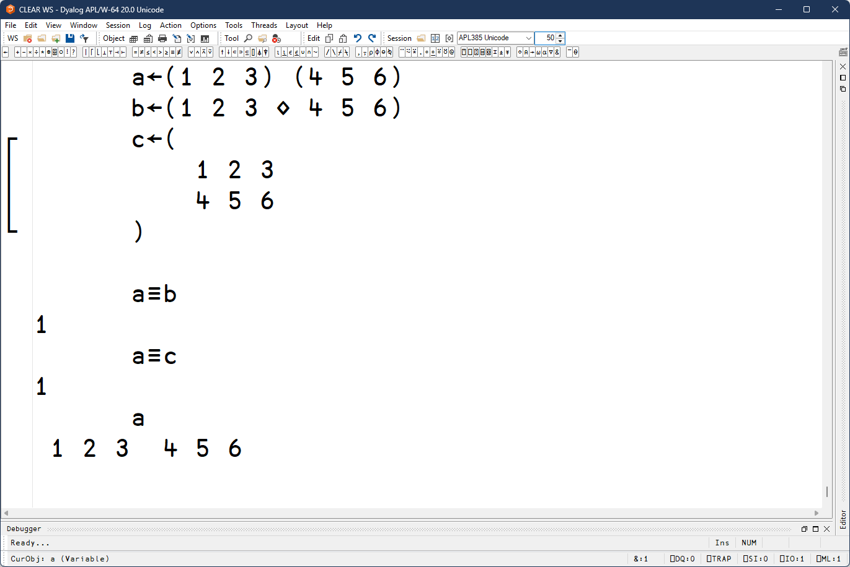
Version 20.0: Array notation: vectors

Slide 14
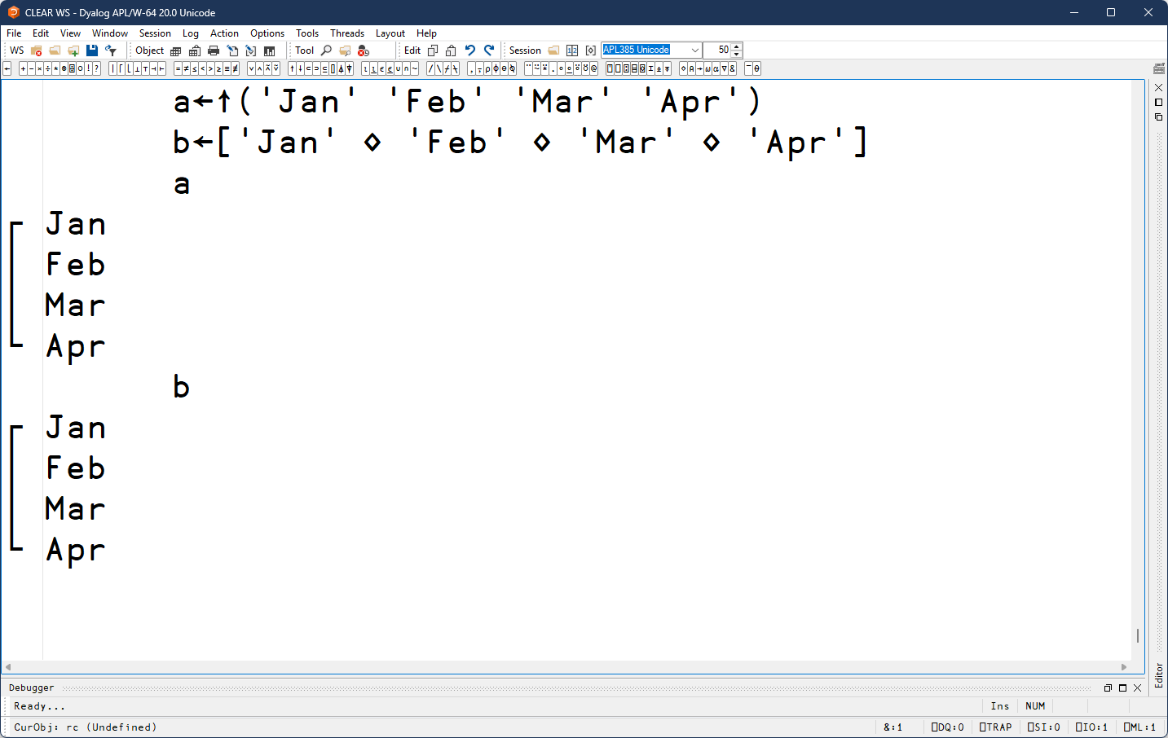
Version 20.0: Array notation: high-rank

Slide 15
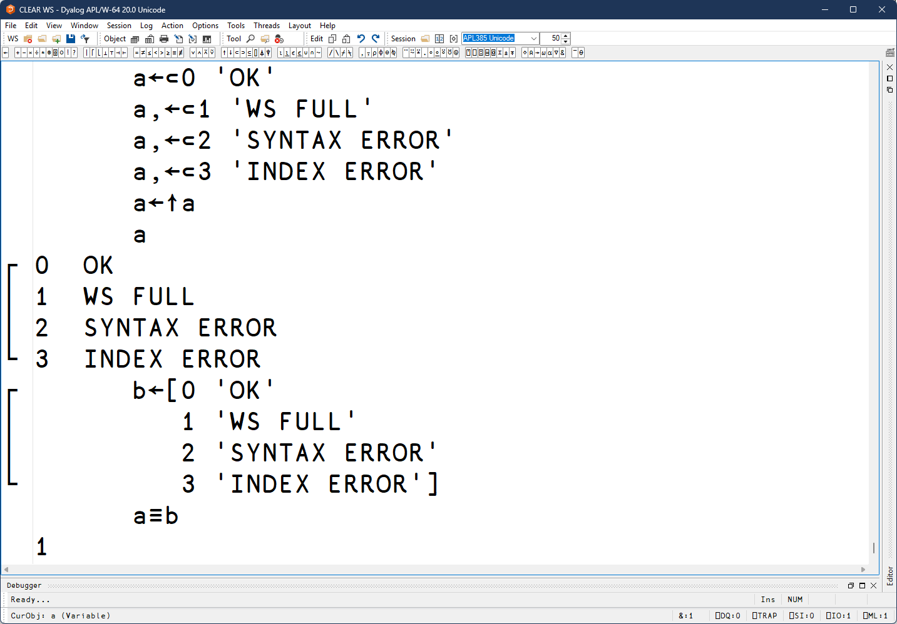
Version 20.0: Array notation: high-rank

Slide 16
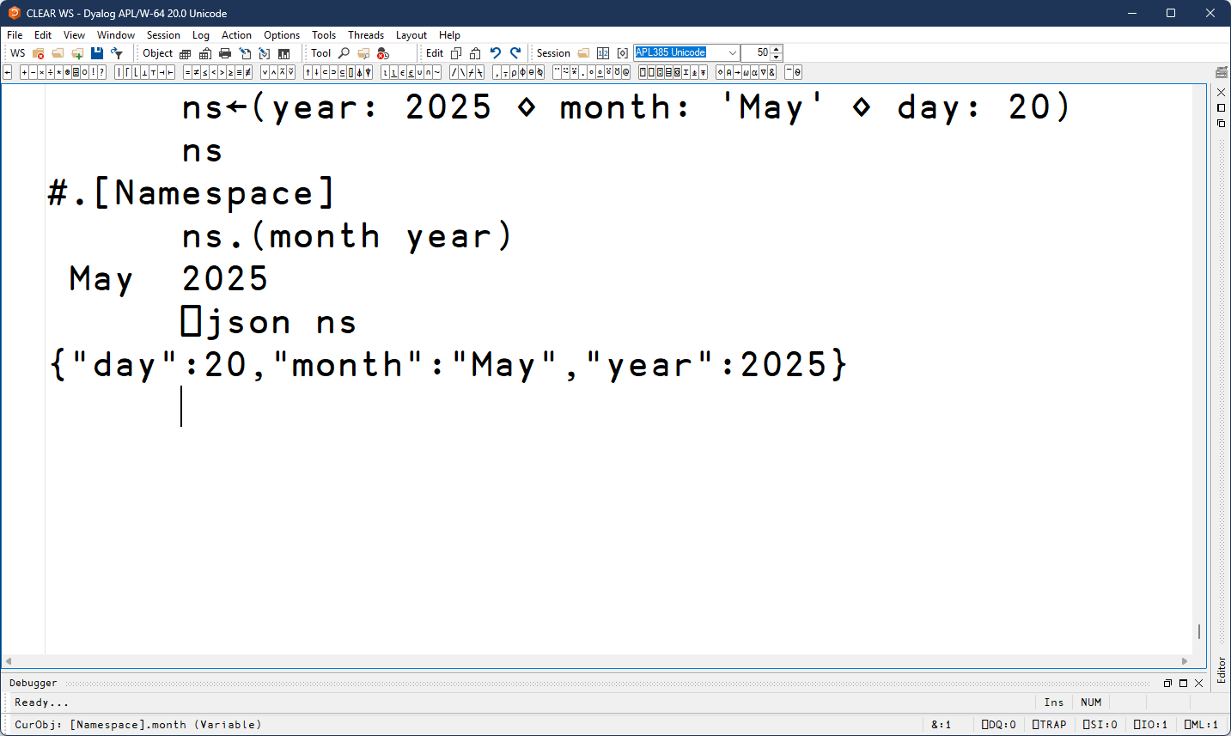
Version 20.0: Array notation: namespaces

Slide 17



Version 20.0: Array notation: namespaces

Slide 18
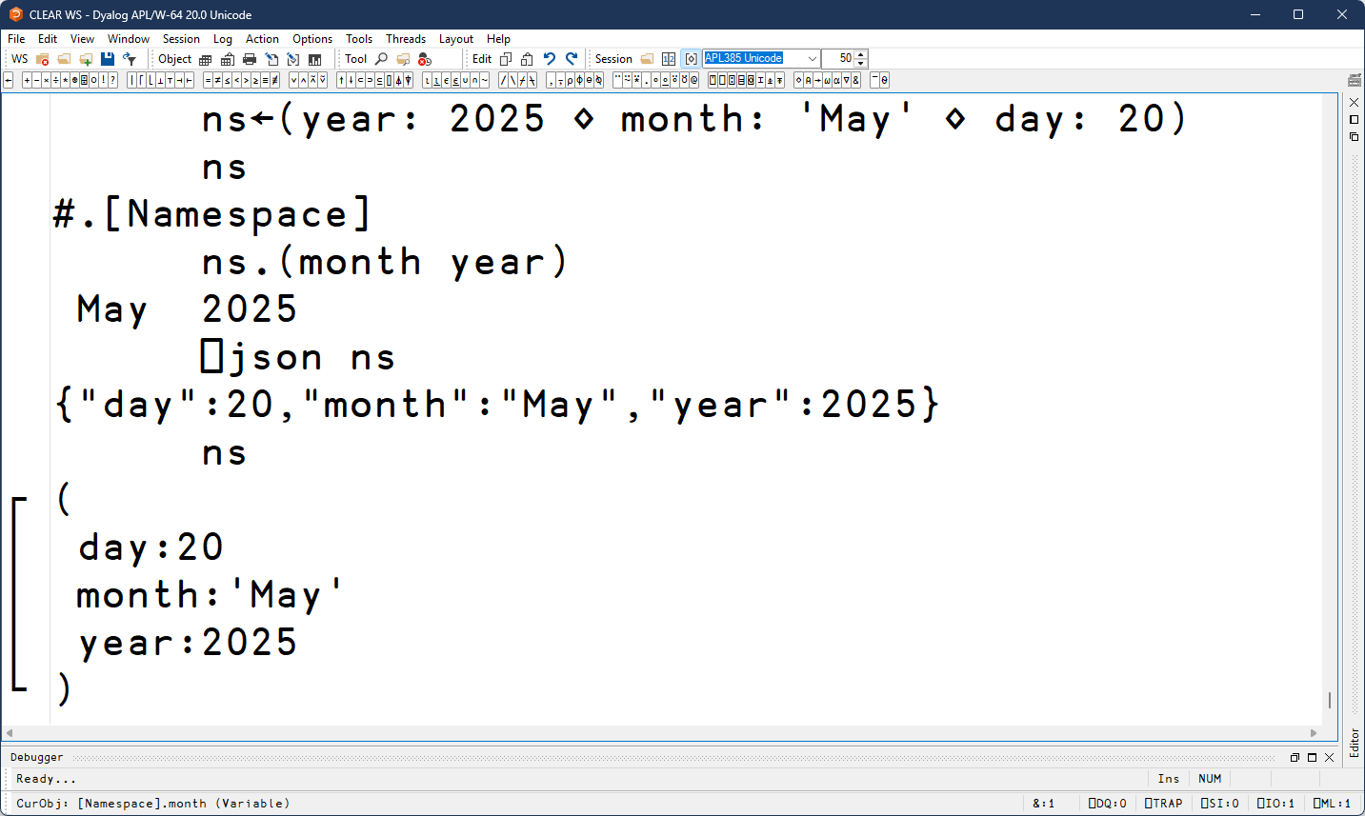


Version 20.0: Array notation: namespaces

Slide 19
Version 20.0: ⎕VGET and ⎕VSET
System functions which make it possible to set and get values of variables by name
  Without the use of ⍎ which can be dangerous
  With the possibility of providing a default value
  In a number of namespaces at once
  Very useful for looking up data in external data sources where some data is missing, such as JSON from a web API

Slide 20
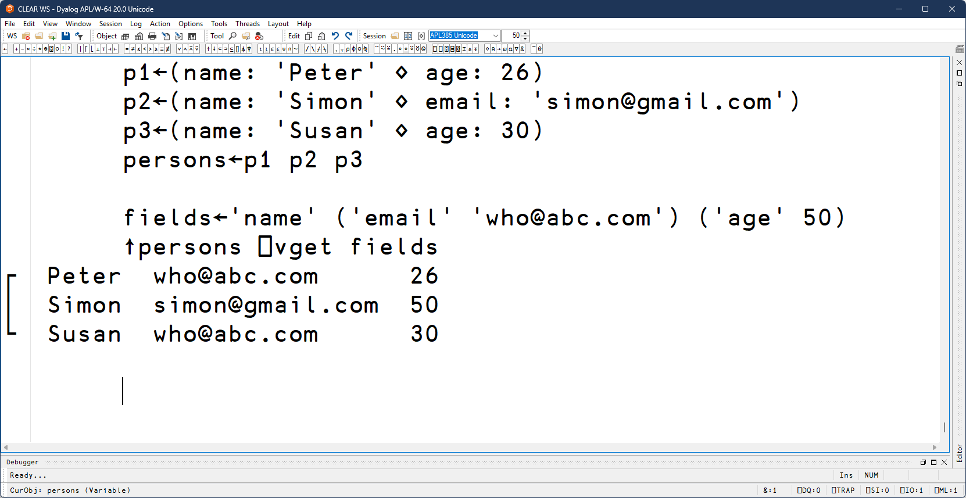
Version 20.0: ⎕VGET and ⎕VSET

Slide 21
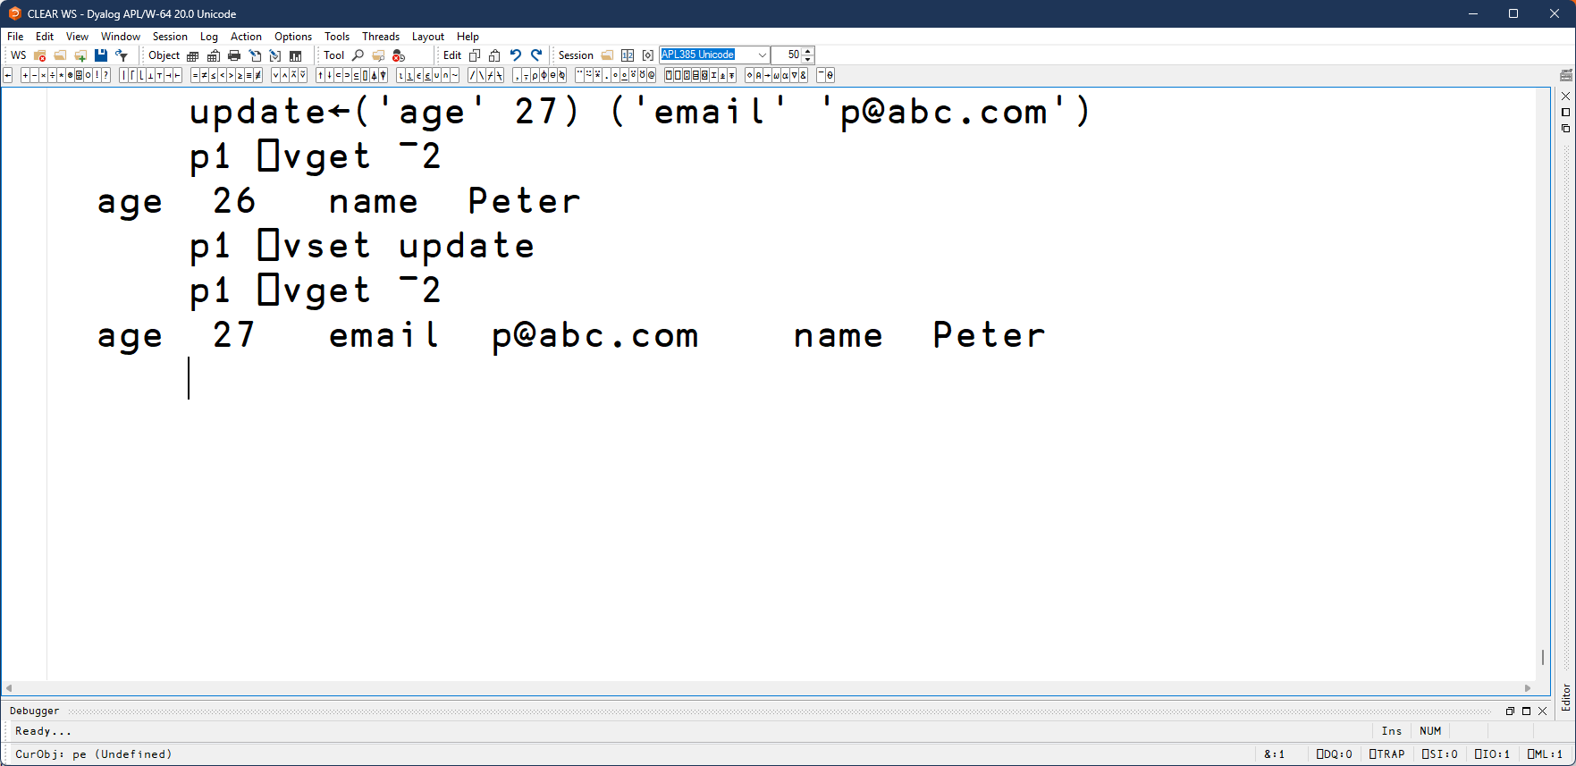
Version 20.0: ⎕VGET and ⎕VSET

Slide 22
Version 20.0: ⎕SHELL
The rest of the presentation ☺

Slide 23
Why provide an alternative to ⎕SH?
Short version: ⎕SH makes too many choices for us
  If we disagree, there is no way to change them
Examples:
  Always picks up standard output as lines of text with specific encoding
  Assumes non-zero exit codes are always bad
  Blocks all other thread while it waits
Difficult to extend ⎕SH enough, without breaking changes

Slide 24
⎕SHELL overview
Monadic system function R←⎕SHELL cmd
  'Command arg1 arg2' - run via system shell
  'Command' 'arg1' 'arg2' - execute command directly
Supports many variant options to change the defaults
Result is a five-element nested vector
  (StreamData StreamIds ExitCode ExitReason Pid)
  More complicated, but ⊃⊃⎕SHELL is almost equivalent

Slide 25
A look at the result
StreamData and StreamIds
  Vectors of the same length
⎕SHELL can collect output from different "streams"
  Controllable via variant options
Each collected stream has its number in StreamIds
Data at the corresponding position of StreamData
  Default is to redirect stderr (2) to stdout (1), and collect stdout

Slide 26
A look at the result
ExitCode and ExitReason
  Integers that tells us why ⎕SHELL stopped
ExitReasons:
  0: normal exit. ExitCode is the exit code
  1: terminated by signal. ExitCode is the negated signal number
  2: ⎕SHELL timed out. ExitCode is always ¯1006
  3: ⎕SHELL interrupted. Exitcode is always ¯1002

Slide 27
A look at the result
Pid
  Process ID if the child process is still running
This is only relevant when ExitReason is 2 or 3
Additional cleanup might be required to get rid of the process
  Some I-beams will be provided to help with that

Slide 28
Demo
Let’s have a quick look in the session
(Screenshots of the demo)

Slide 29
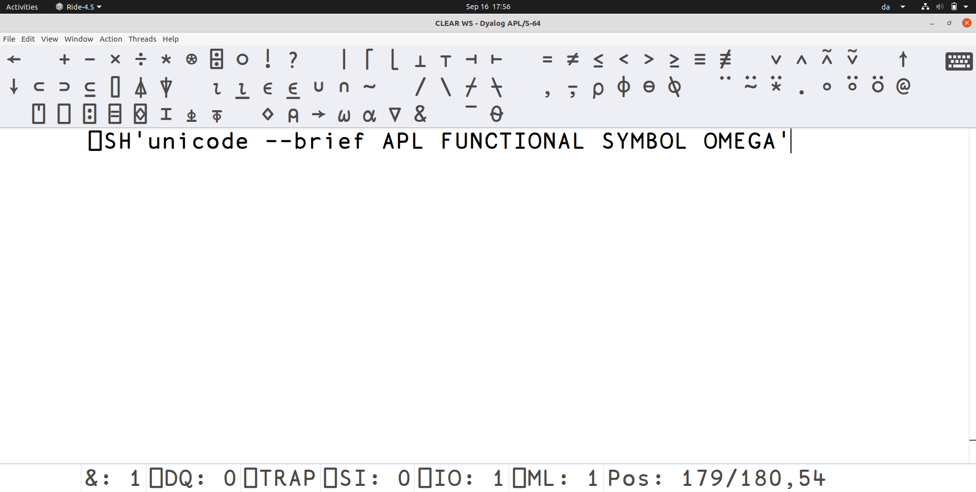

Slide 30
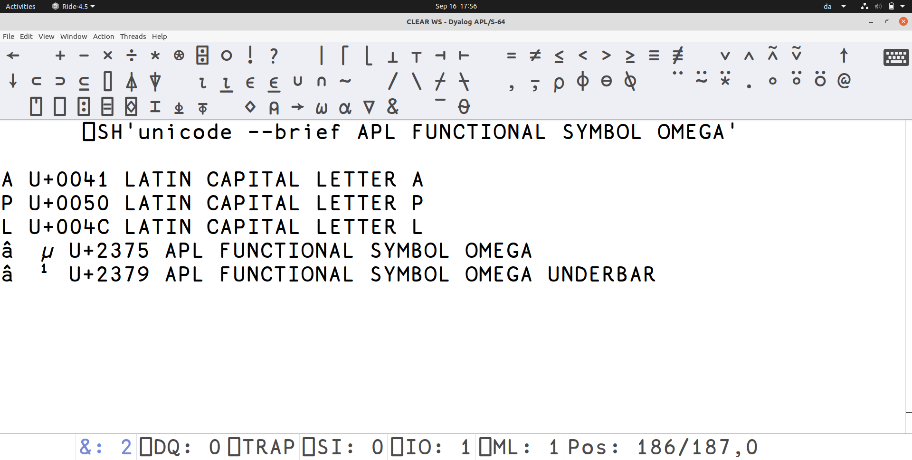

Slide 31
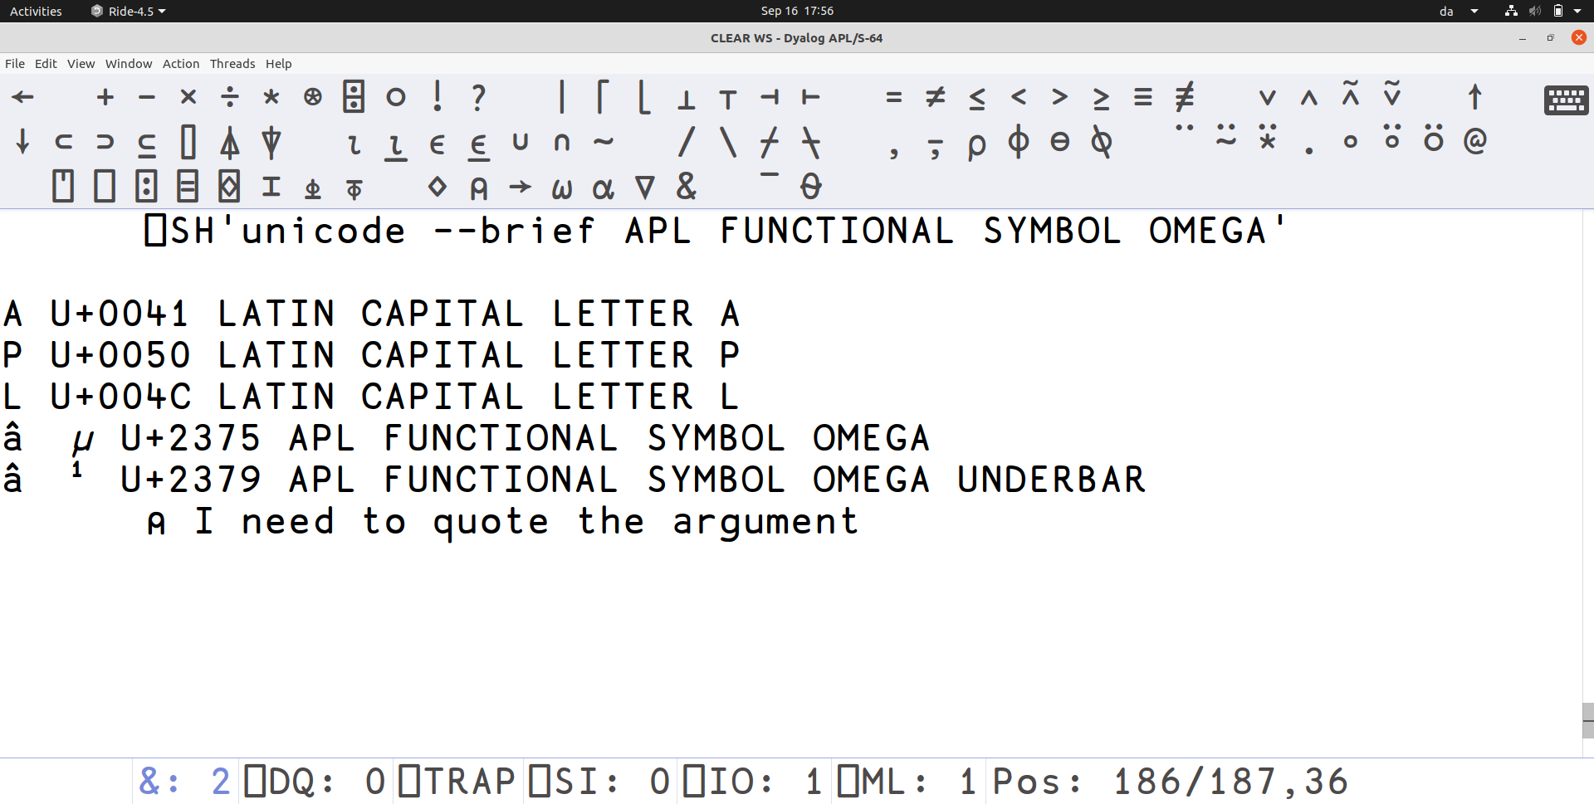

Slide 32
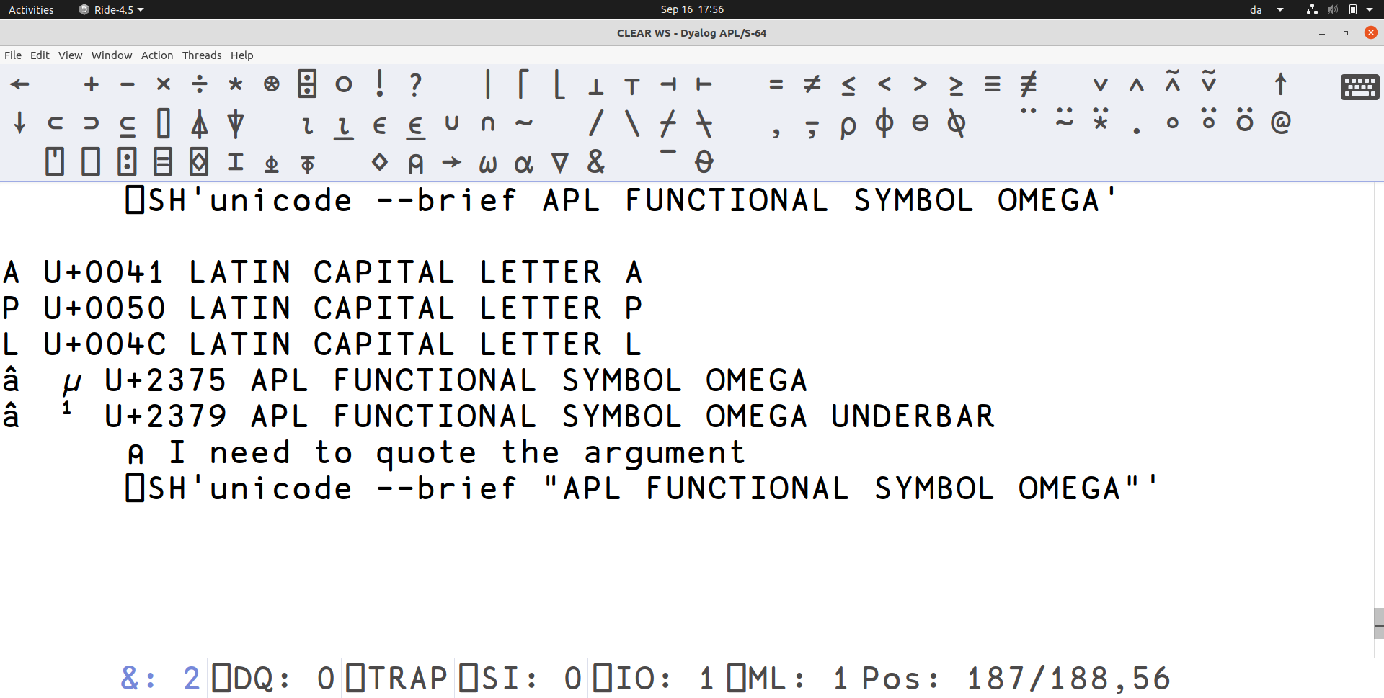

Slide 33
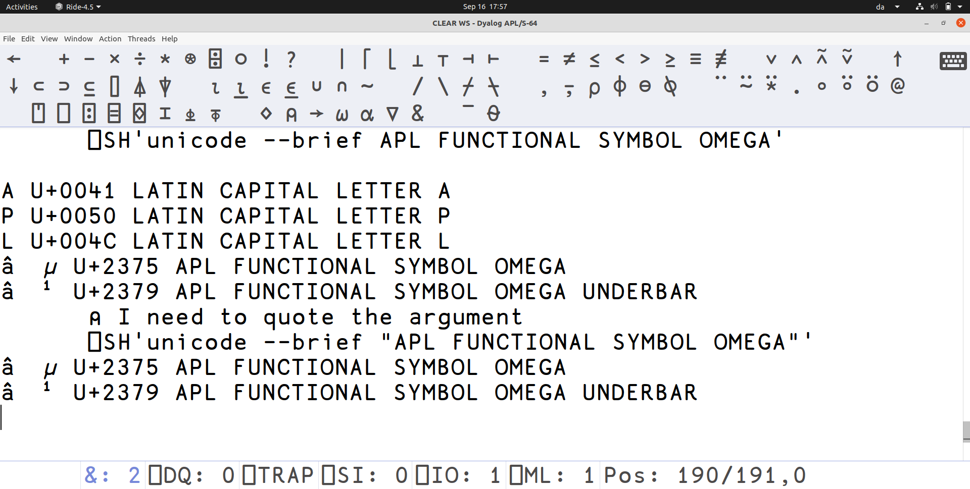

Slide 34
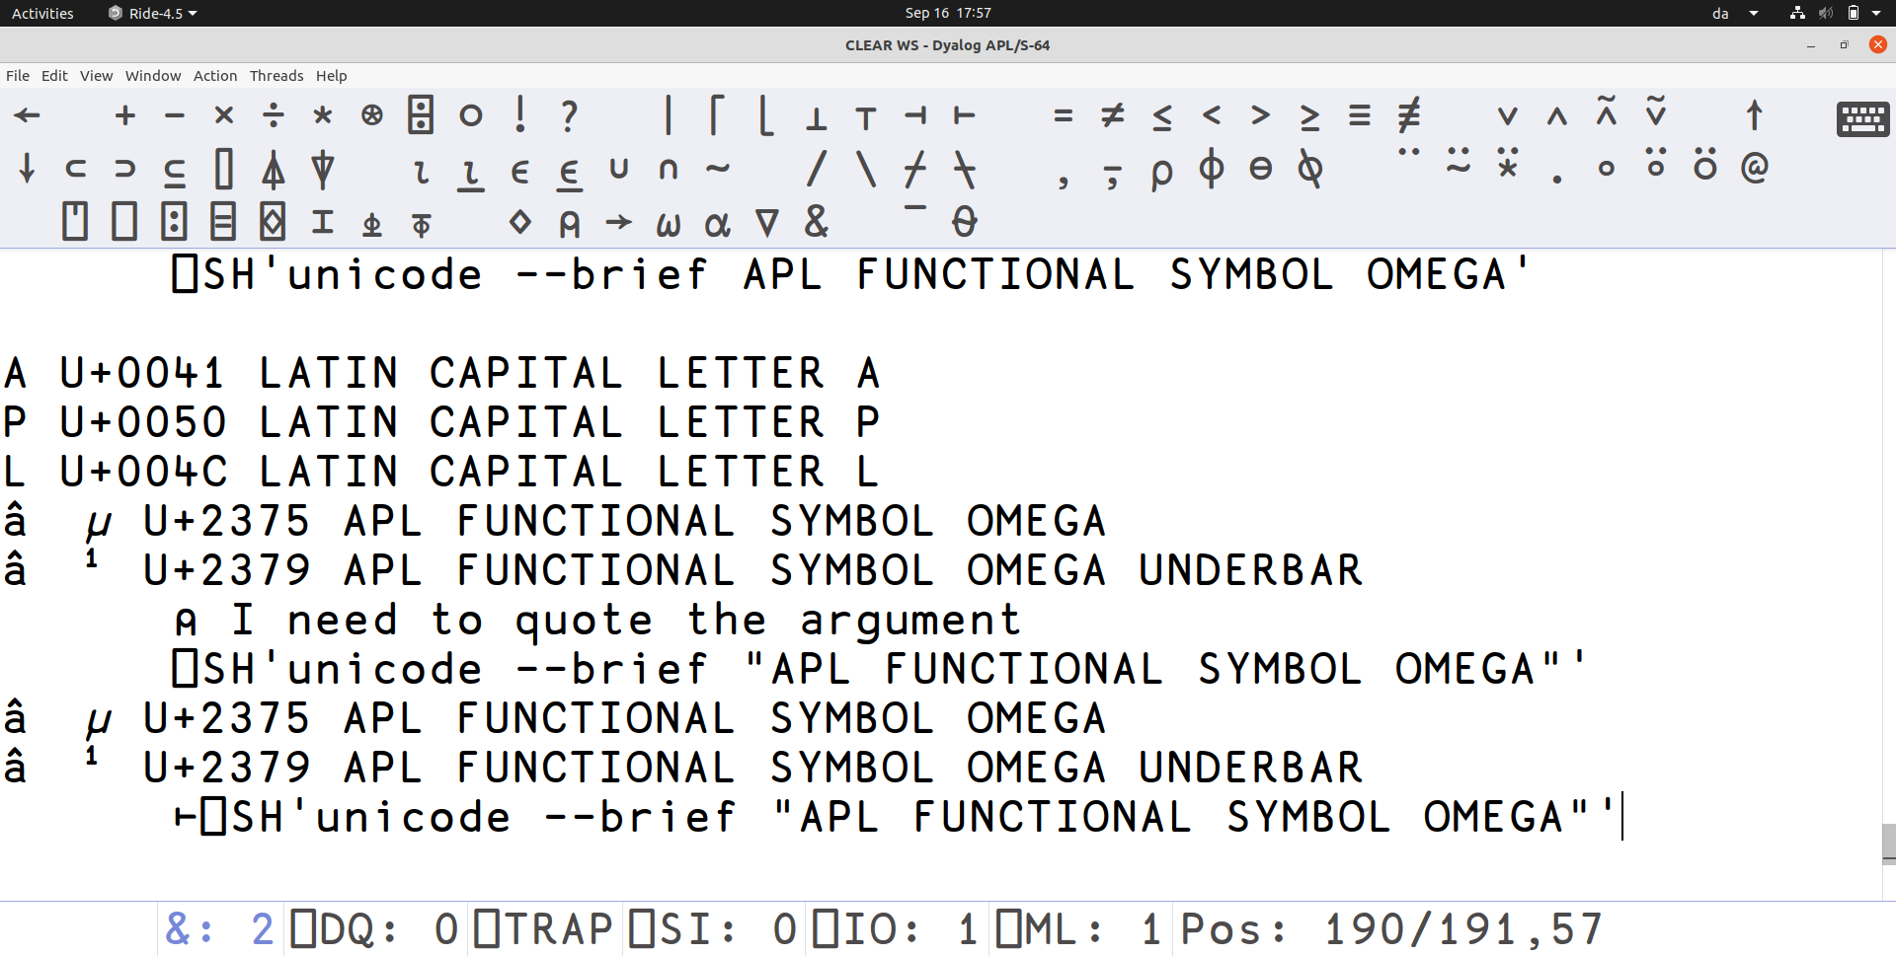

Slide 35
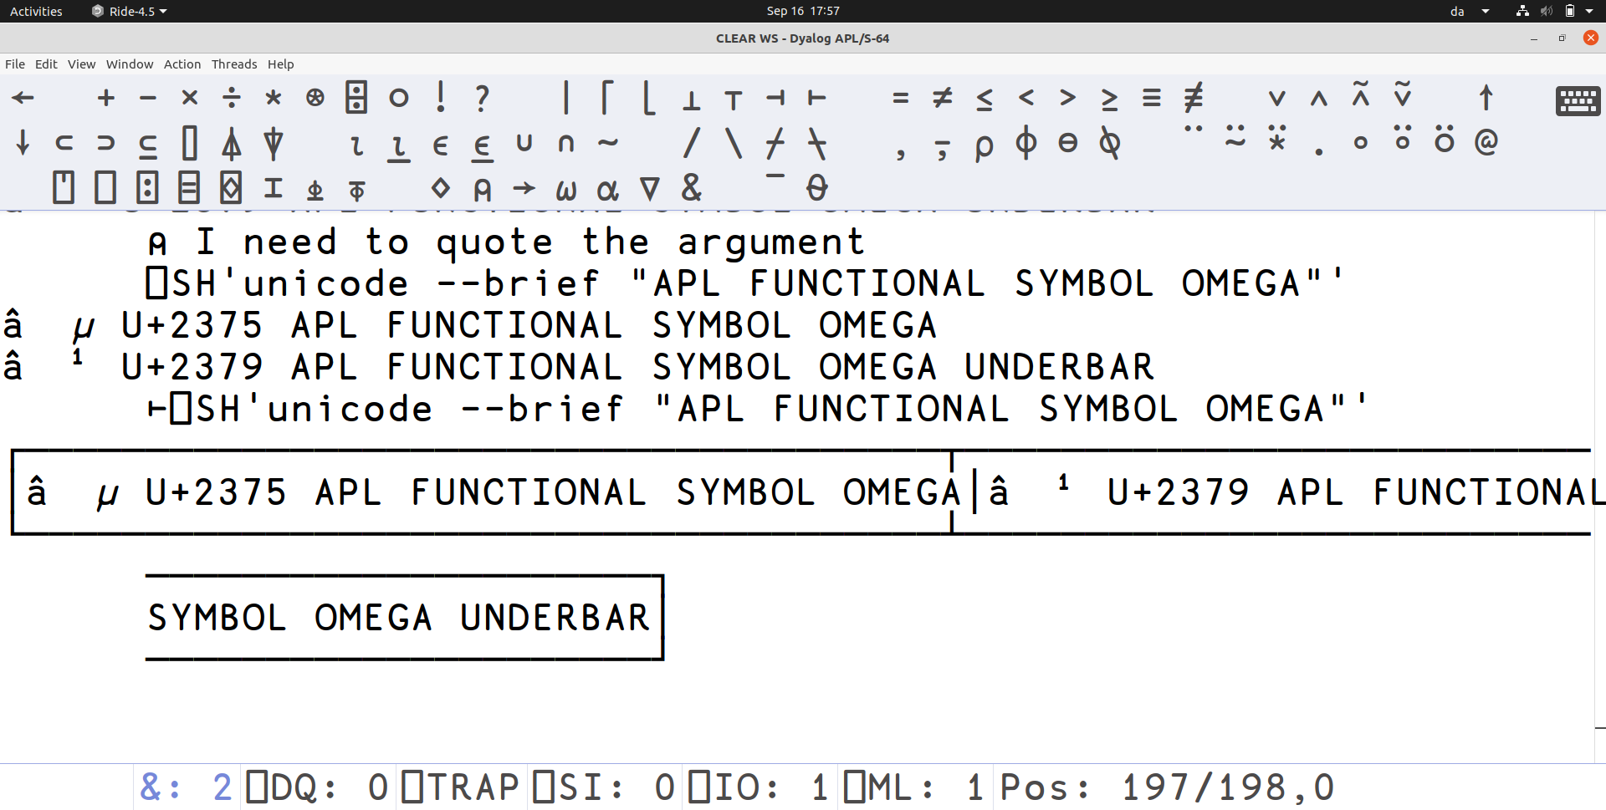

Slide 36
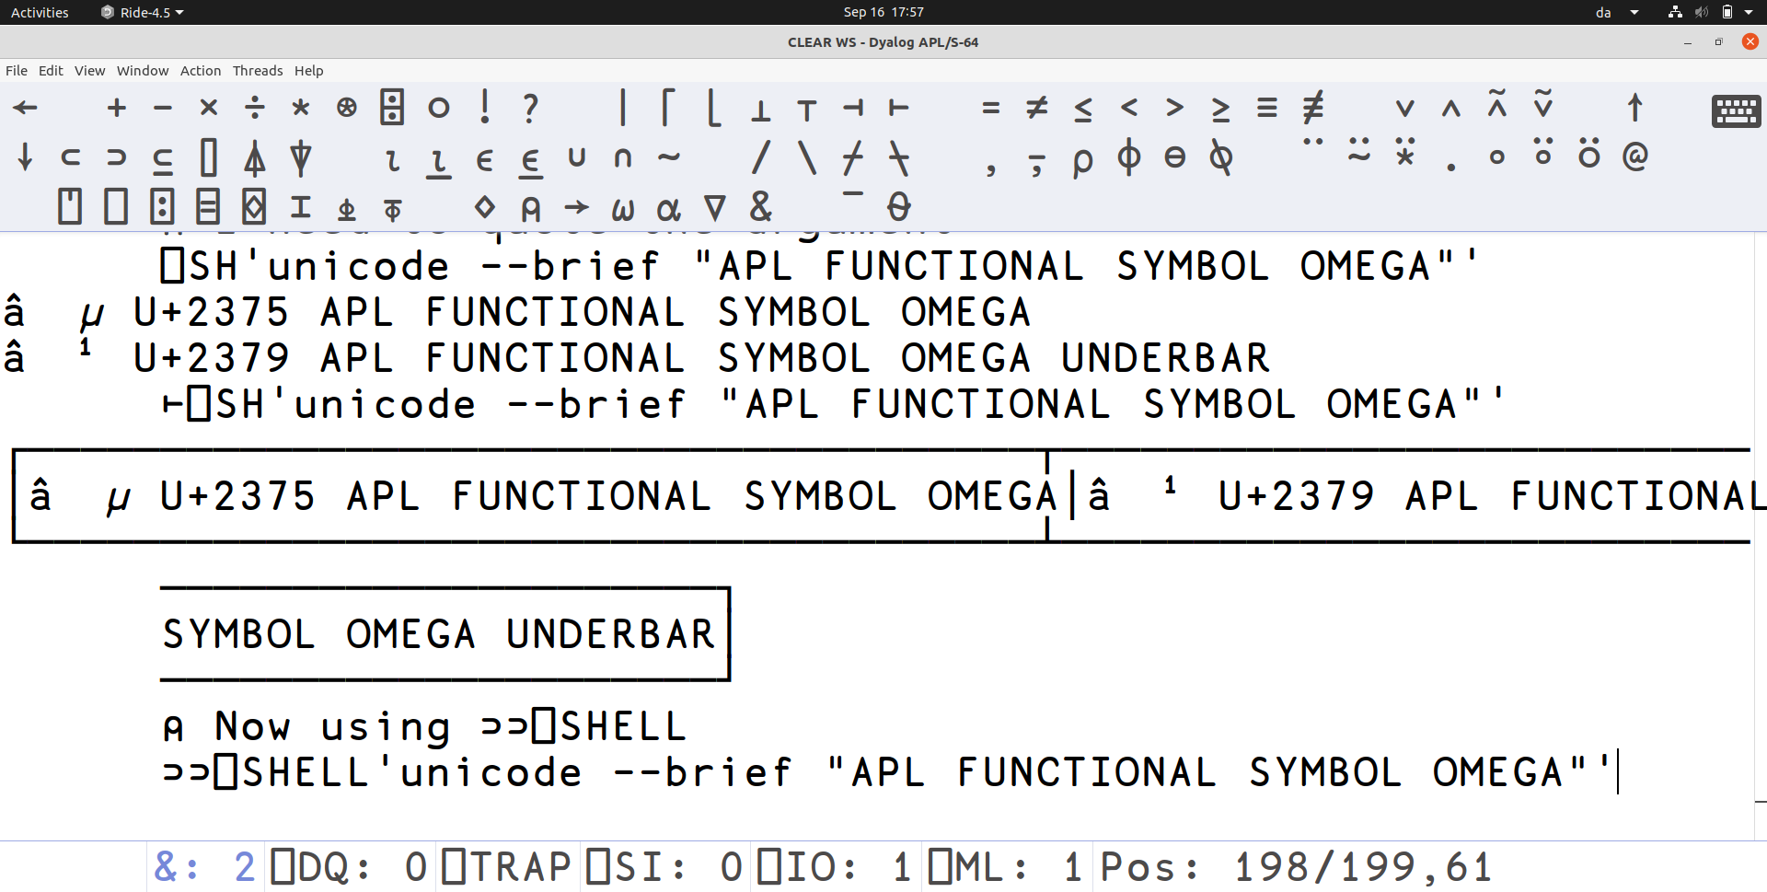

Slide 37
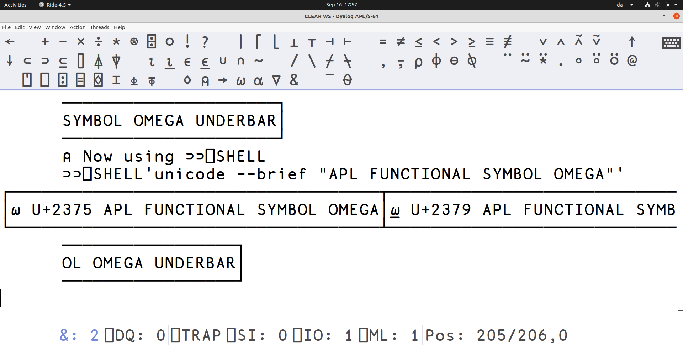

Slide 38
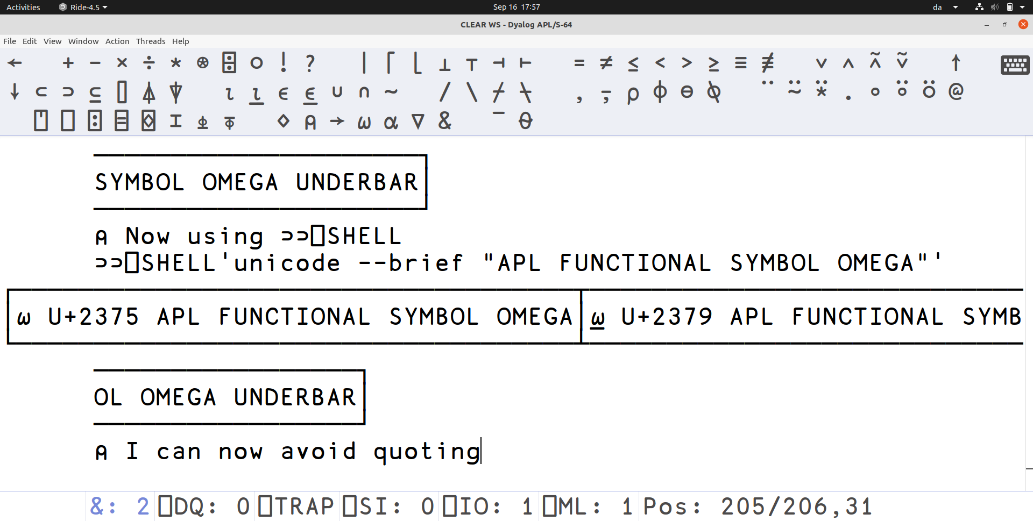

Slide 39
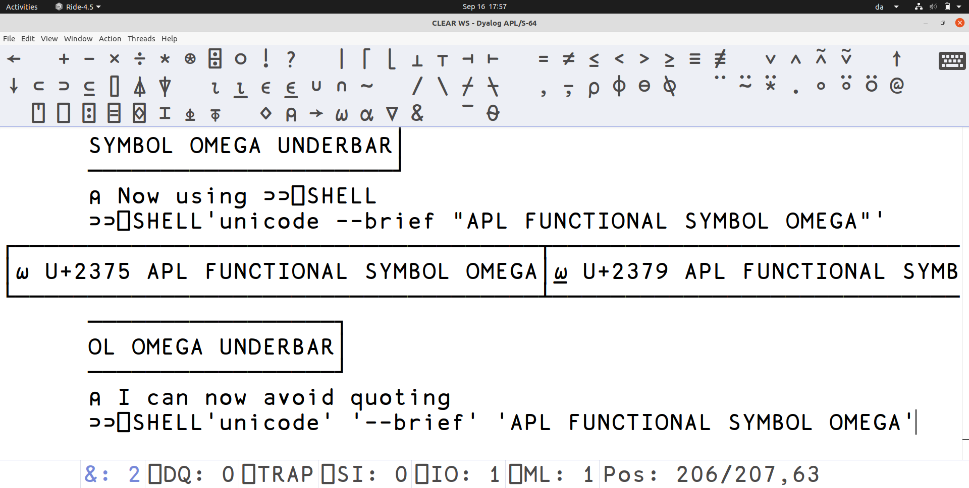

Slide 40
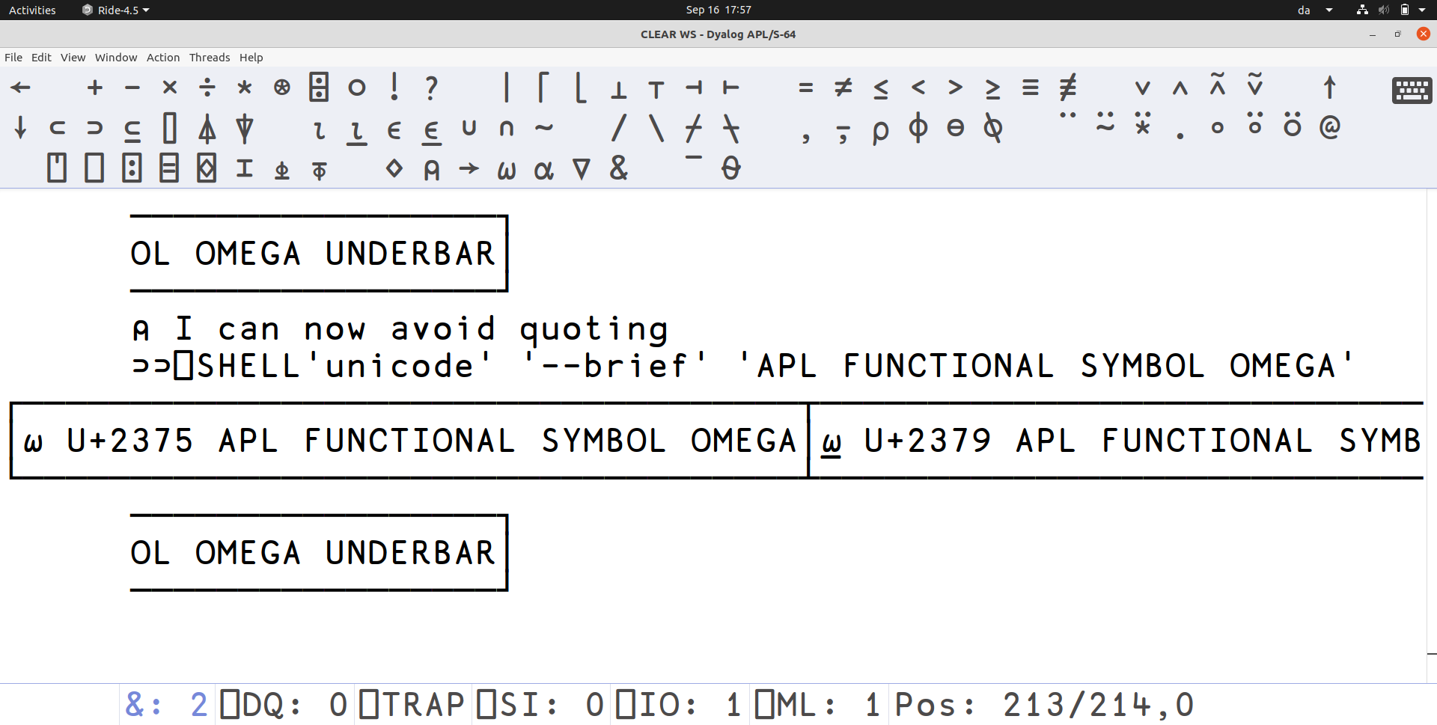

Slide 41
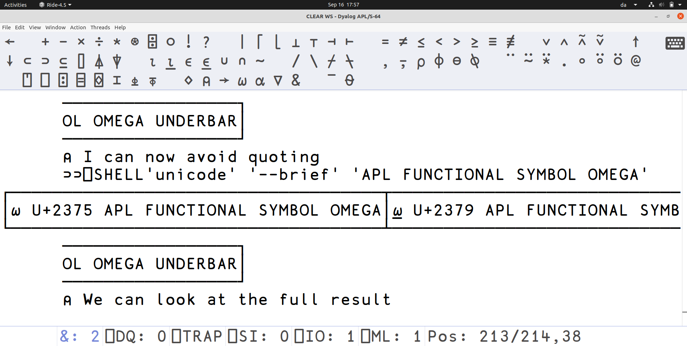

Slide 42
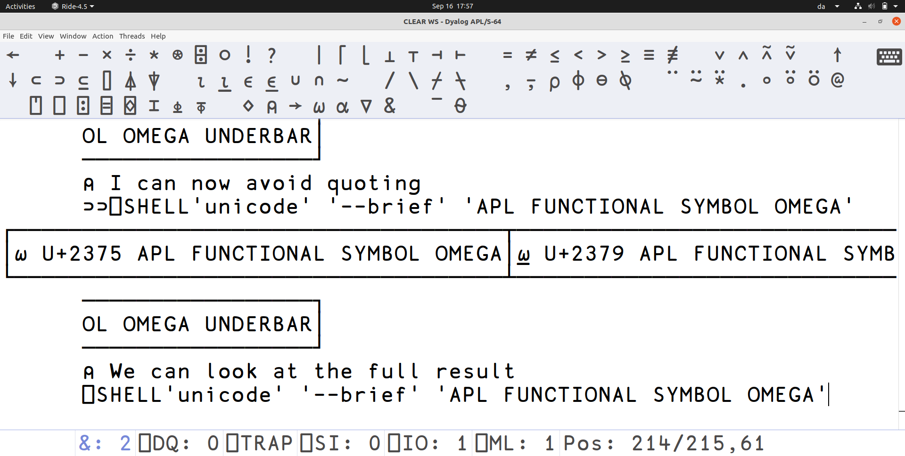

Slide 43
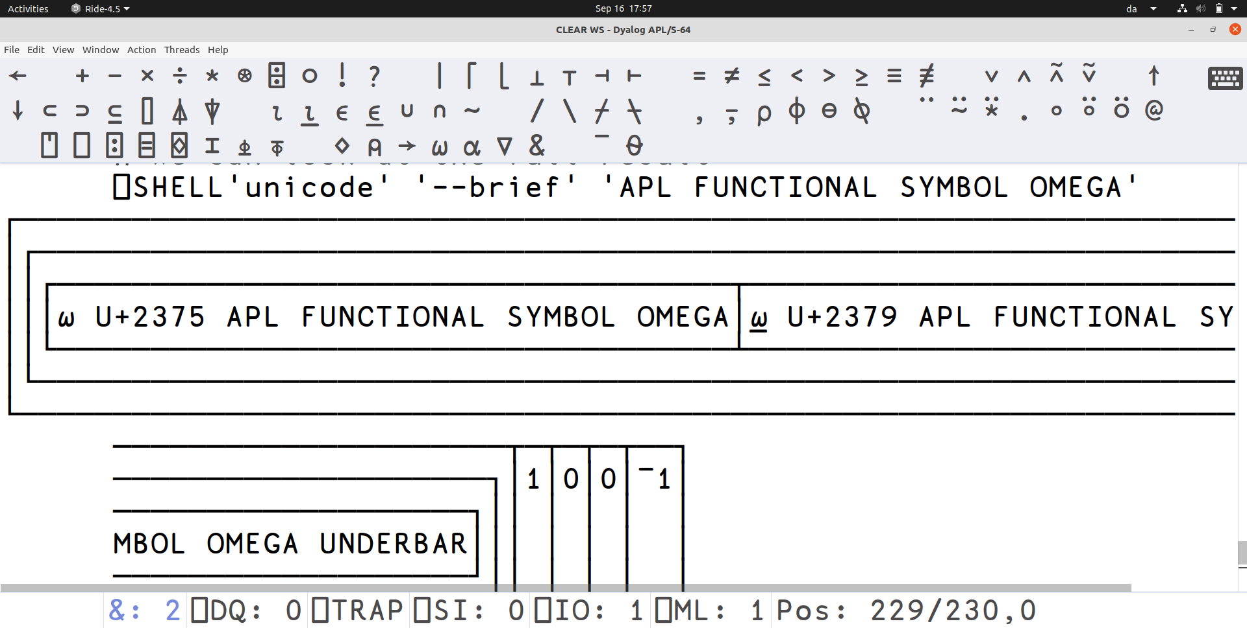

Slide 44
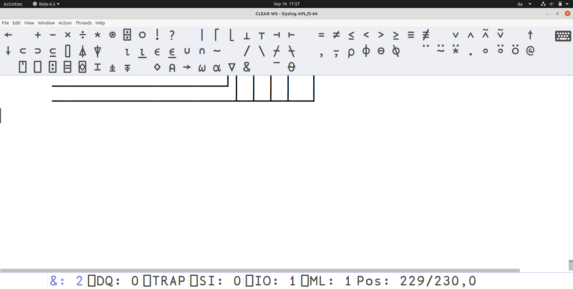

Slide 45
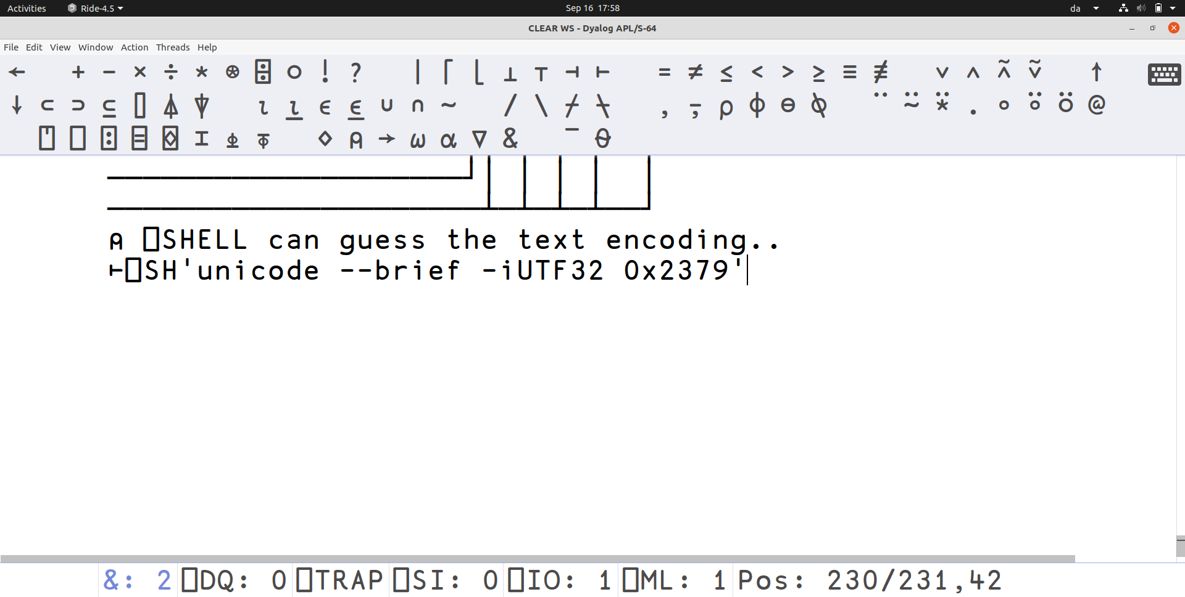

Slide 46
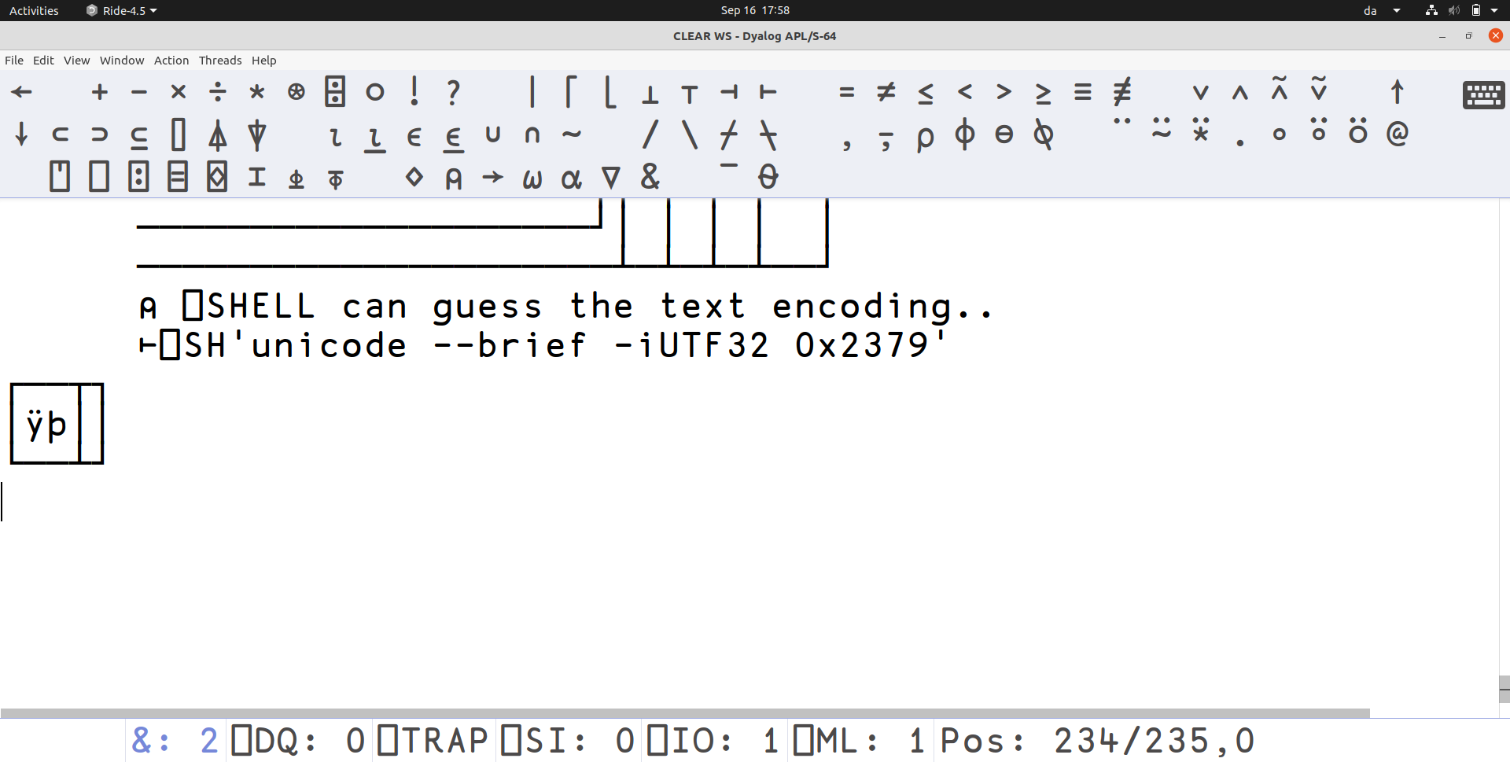

Slide 47
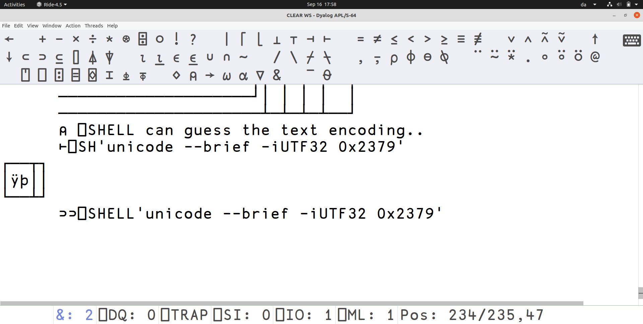

Slide 48
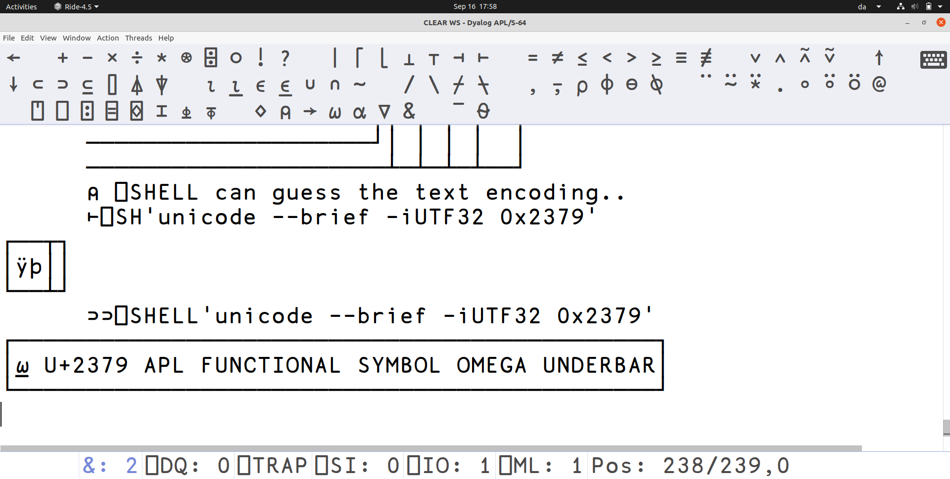

Slide 49
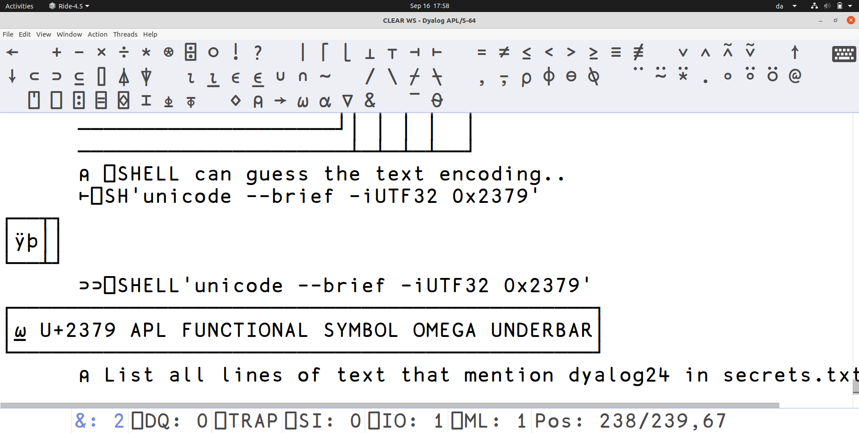

Slide 50
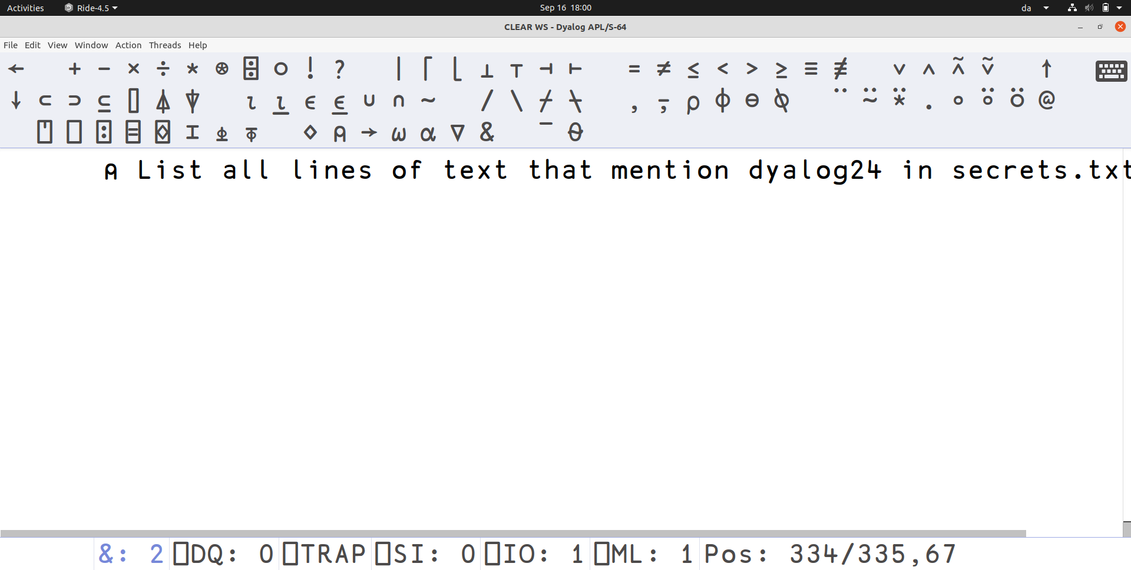

Slide 51
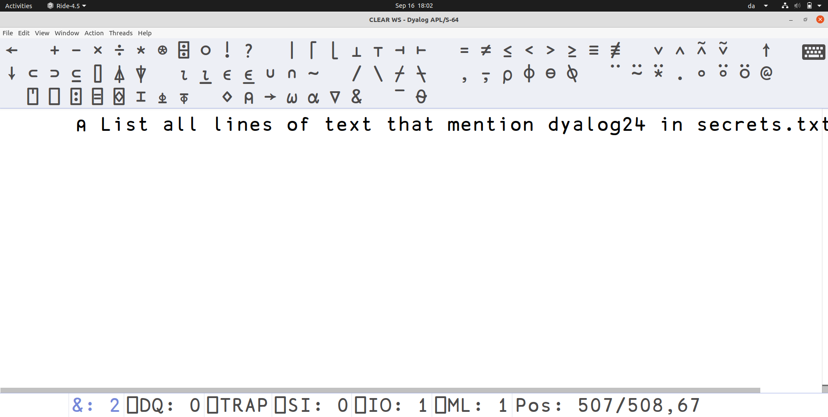

Slide 52
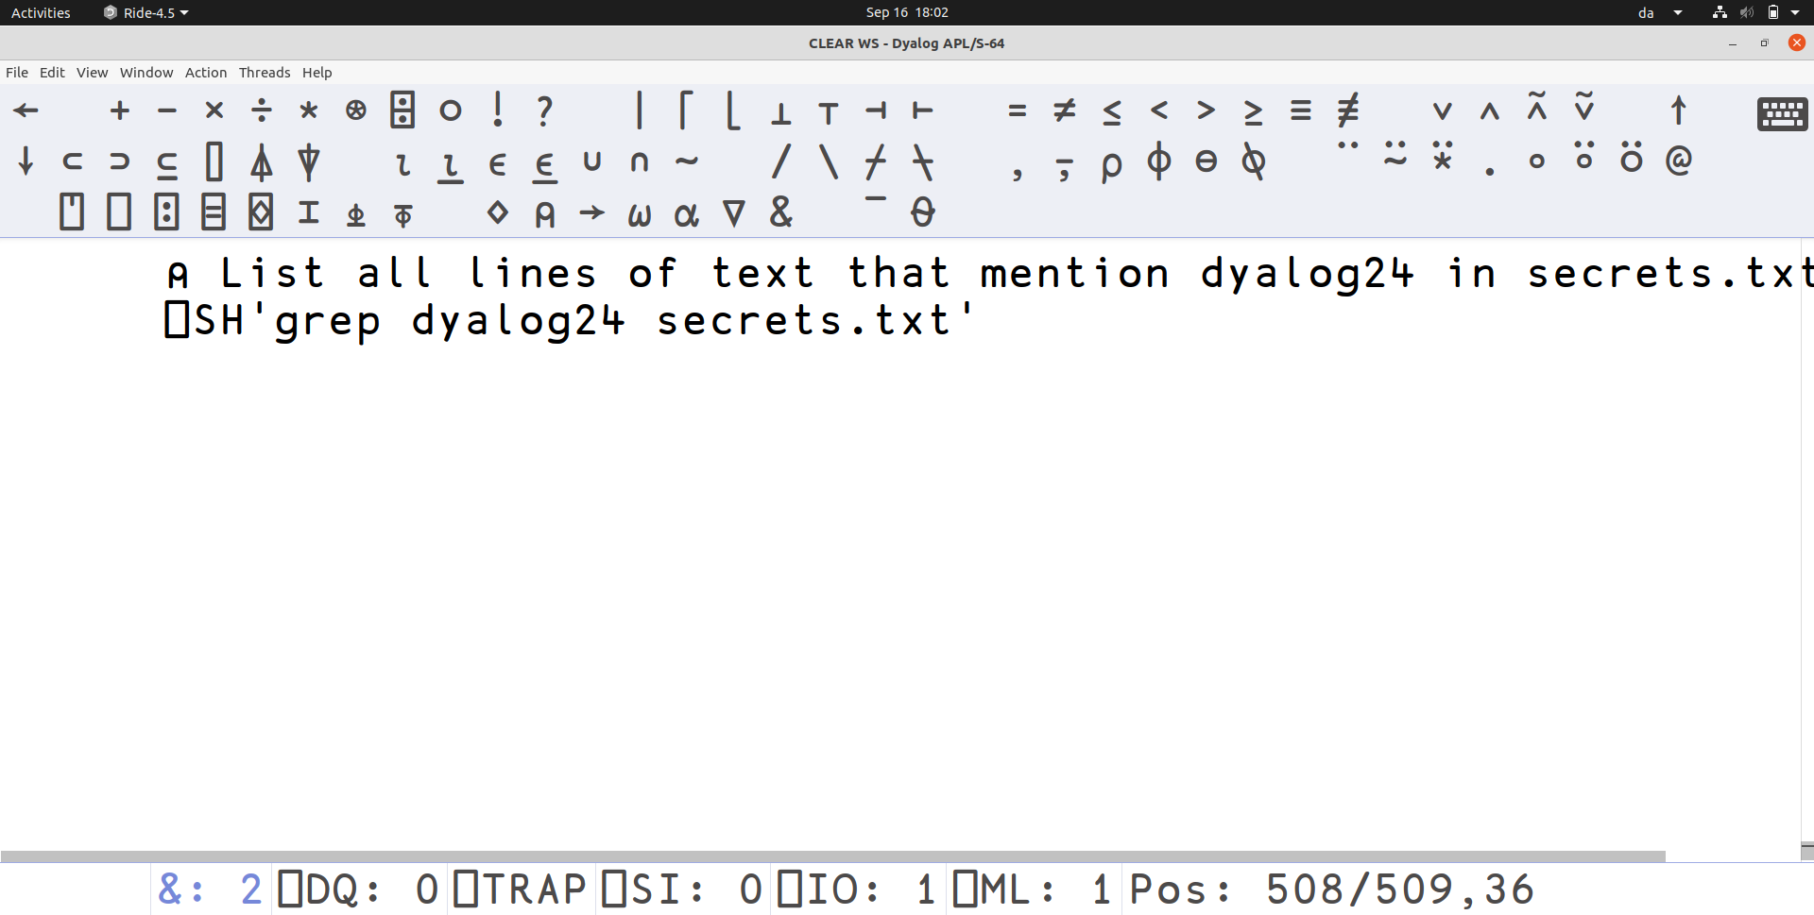

Slide 53
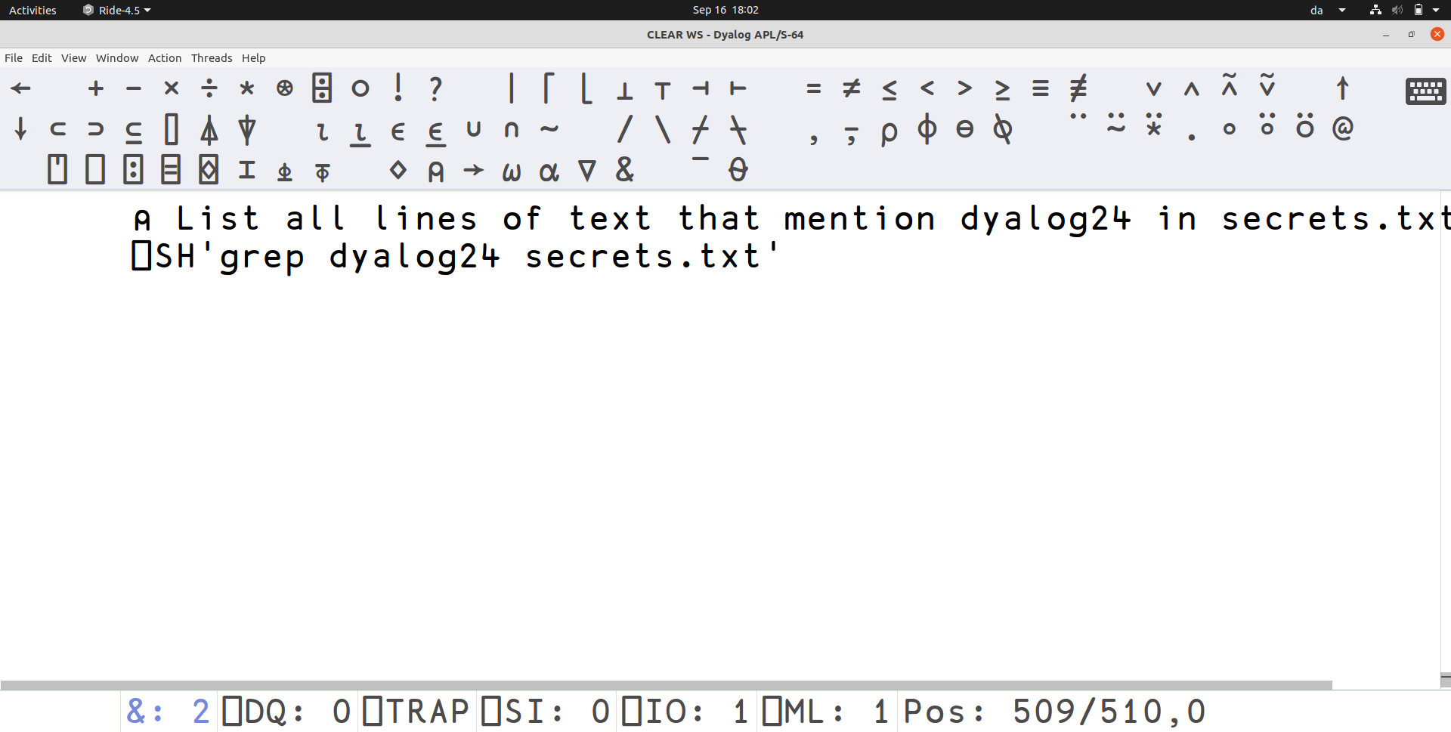

Slide 54
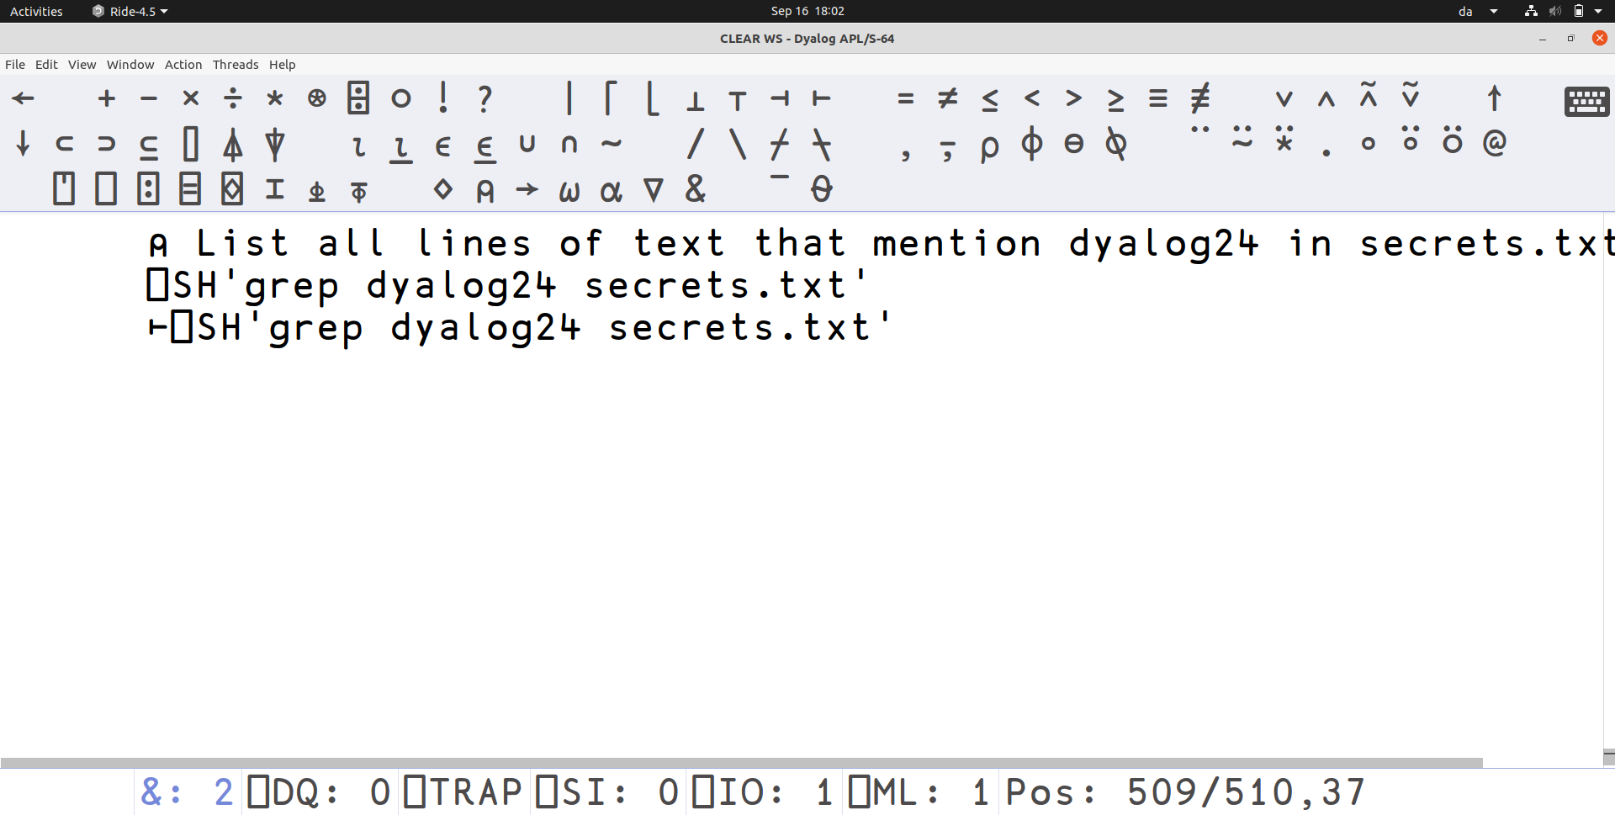

Slide 55
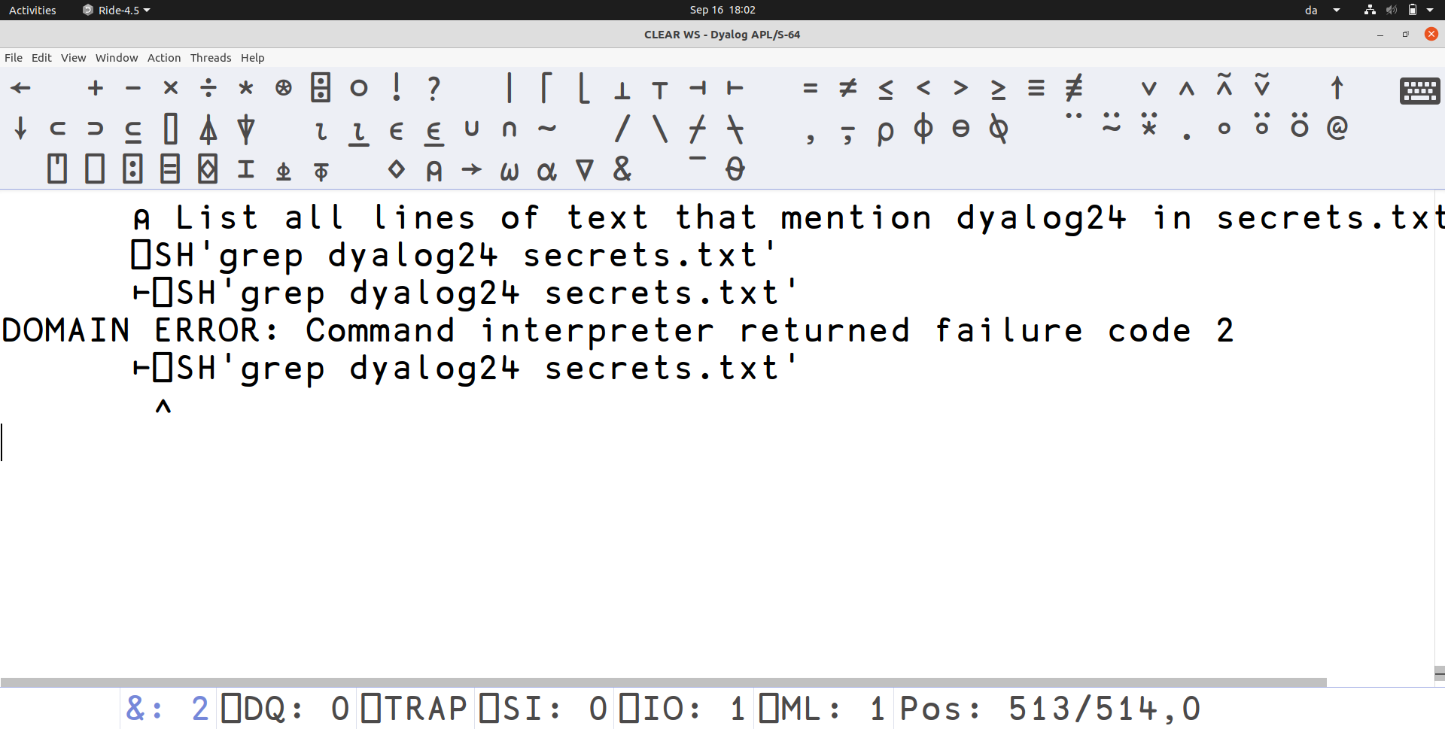

Slide 56
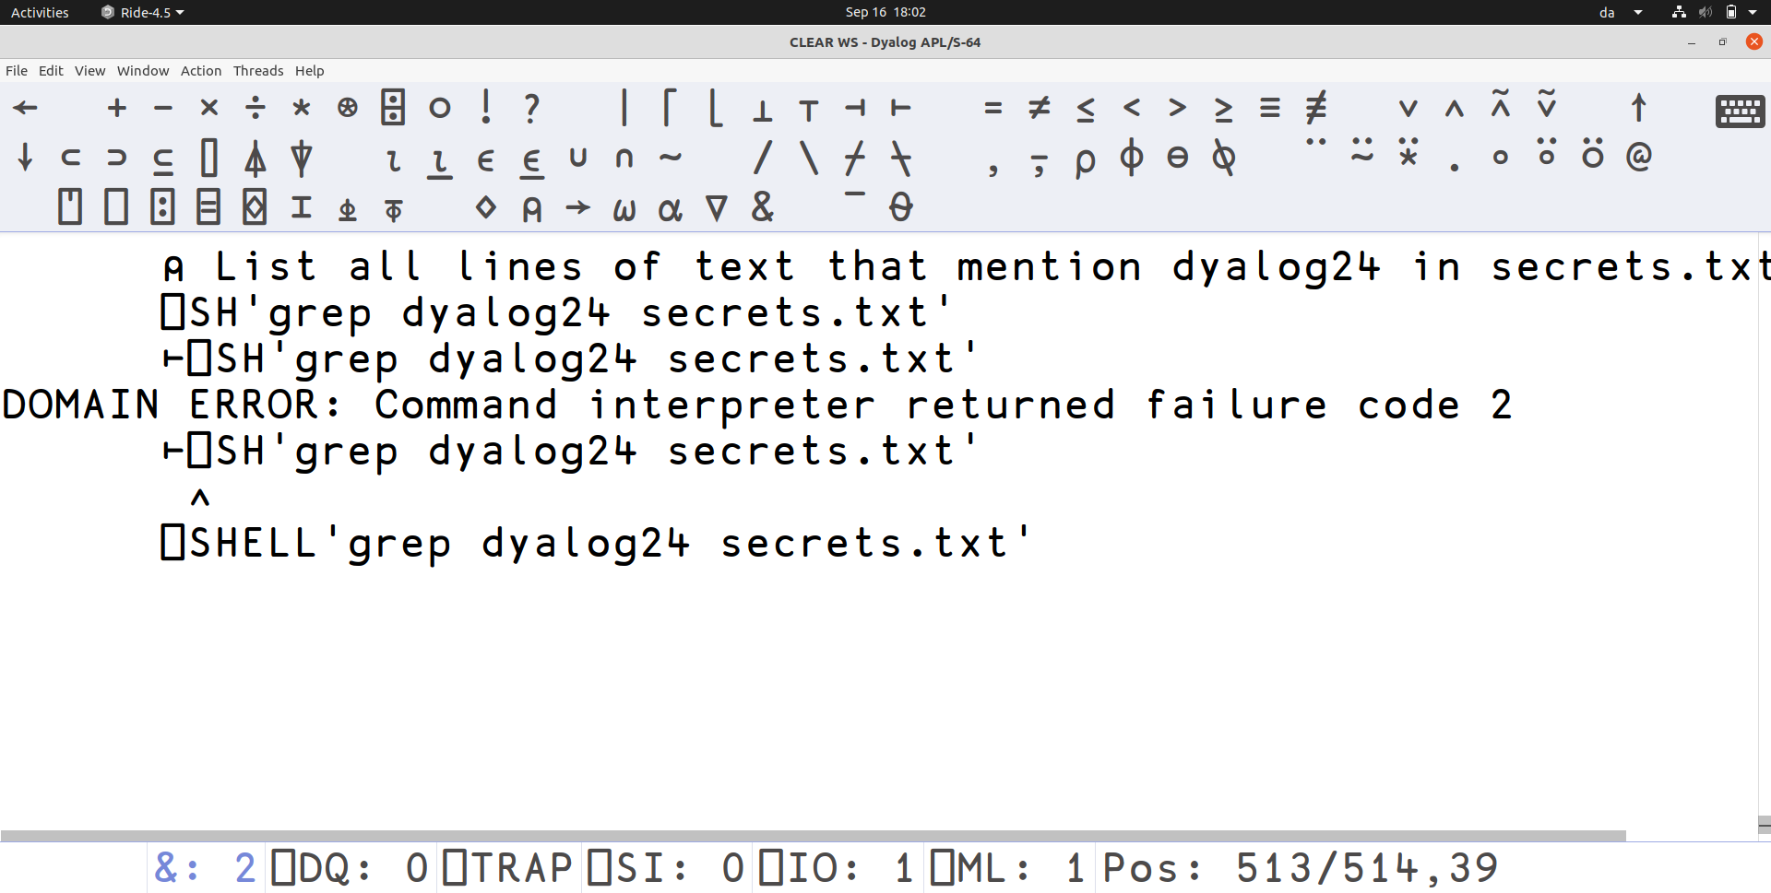

Slide 57
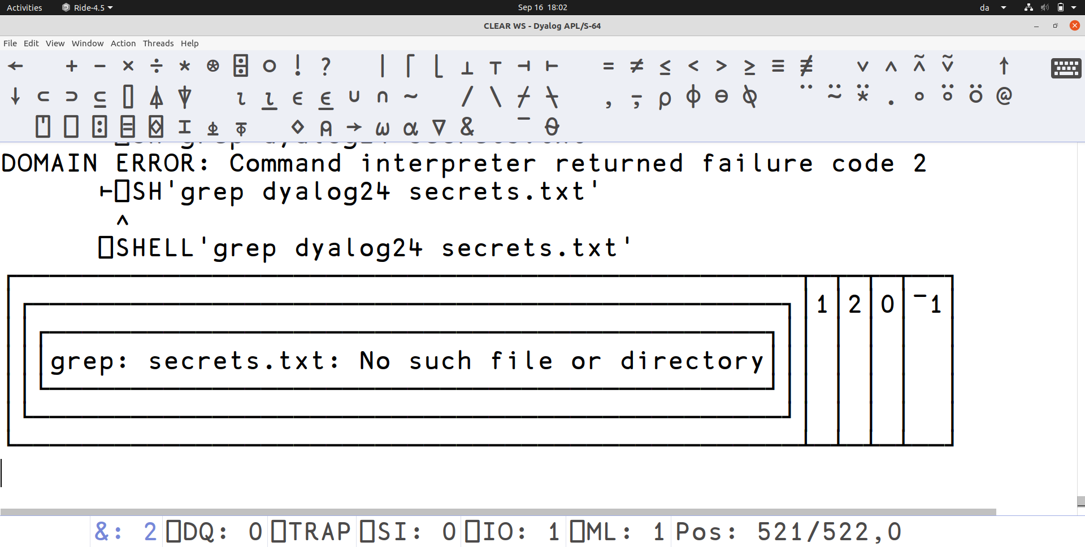

Slide 58
Overview of the variant options
Many variant options
Typical usage won’t require much, if any at all

Slide 59
⍠'WorkingDir' path
Simply changes the working directory of the child process
By default, the same as the interpreter

Slide 60
⍠'InheritEnv' bool
Every process has a set of environment variables
By default, inherits the set from the interpreter

Slide 61
⍠'Env' namesAndValues
Allows the user to add/set additional environment variables
  Overwrites any inherited values
Examples:
  Provide configuration options
  Set an API key
2 column matrix or name-value pairs

Slide 62
⍠'Shell' shellSpec
Makes it possible to use another shell than powershell or /bin/sh
  Only relevant when right argument is simple
Examples:
  '/bin/bash' '-c'
  'CMD.EXE' '/C'

Slide 63
⍠'ExitCheck' bool
⎕SH checks the exit code and produce domain error if non-zero
In ⎕SHELL that is optional
  Makes it possible to deal with non-zero exits and still get the output produced
  Much easier figure out what went wrong when the error messages aren’t lost

Slide 64
⍠'Timeout' milliseconds
Some programs finish "quickly"
Some might hang or take a very long time
Set a timeout and cause the ⎕SHELL call to return after a while
  No TIMEOUT error
  Data collected so far is available

Slide 65
⍠'Signal' number
⎕SHELL can stop before the child process
Child process potentially still running
Requires cleanup
Automatically send a signal to the child process
  SIGTERM by default
  On windows we don’t have signals, but 9 (SIGKILL) calls TerminateProcess
  Often the child process dies on own

Slide 66
⍠'Window' mode
⎕CMD on windows supports specifying initial window mode
  Hidden, Maximized …
  Done via a nested right argument
Exactly the same thing
  Variant option because right argument means something else

Slide 67
⍠'Output' redirections
Which output streams to collect, and what to do with the data
Default is to collect stdout as text, and redirect stderr to stdout
2-column matrix or vector of streamId-target pairs
Quite a few possible targets

Slide 68
⍠'Output' redirections
('Stream' StreamNum) or just StreamNum
('File' TieNum) or just TieNum
('File' FilePath)
('Array' DataType)
('Array' TextEncoding) or just 'Array'
'Null'

Slide 69
⍠'Output' redirections
('Callback' Fn EncodingOrType)
('Callback' Fn)
  Whenever data is produced, run a callback function to deal with it
Fn is name of function, or (FnName LeftArg)
Callback passed a namespace with information
Data does not show up in the ⎕SHELL result value

Slide 70
⍠'Input' redirections
Controls what the child process sees when it tries to read from its input streams
By default, only stdin is setup, such that the child process gets no data
2-column matrix or vector of streamId-source pairs

Slide 71
⍠'Input' redirections
('File' TieNum) or just TieNum
('File' FilePath)
('Array' Data Type)
('Array' TextData Encoding)
('Array' TextData Encoding Newline)
'Null'

Slide 72
⍠'Input' redirections
('Token' tokenNumber)
All the other sources required all data to be specified before running ⎕SHELL
Send additional data:
  ('Array' …) ⎕TPUT tokenNumber
Tell ⎕SHELL that no more data will appear:
  ⎕TPUT tokenNumber

Slide 73
Default redirections
⎕SHELL always sets up redirections for the three standard streams if not explicitly setup
Input:
  0 'Null'
Output:
  2 ('Stream' 1)
  1 'Array'

Slide 74
Demo
How to use ⎕SHELL to run python3
Some variant options will be used

Slide 75
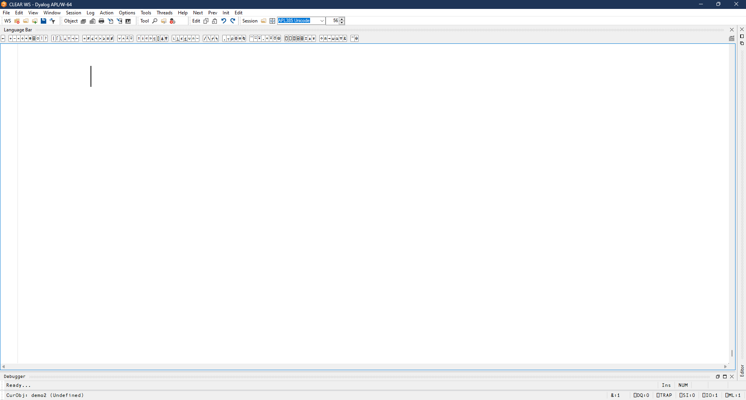

Slide 76
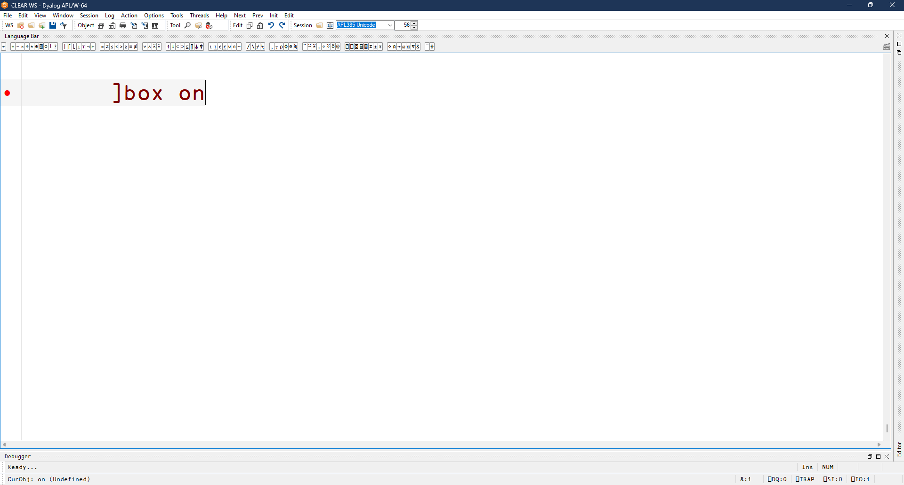

Slide 77
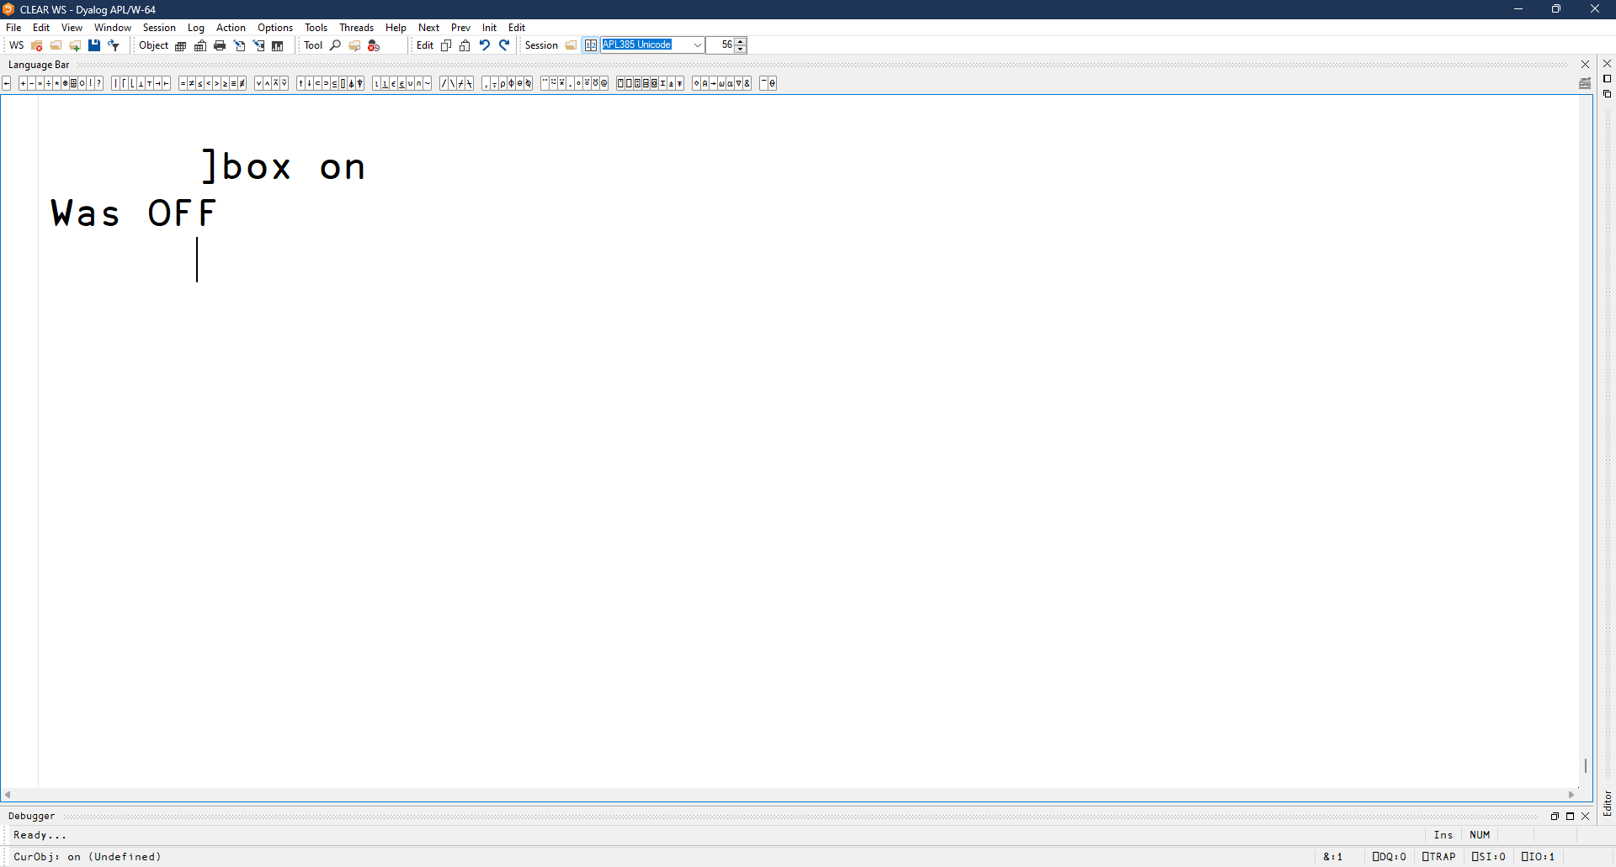

Slide 78
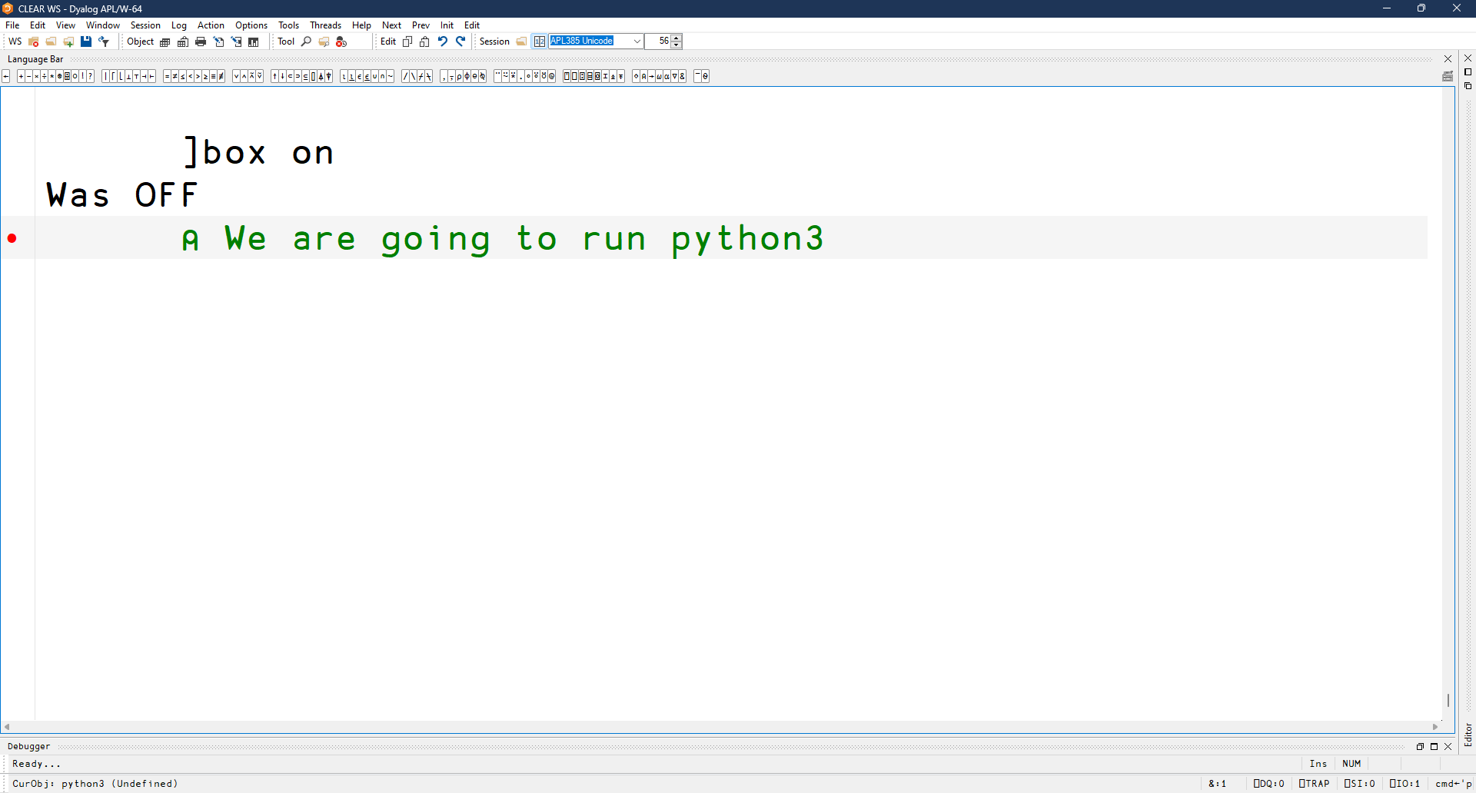

Slide 79
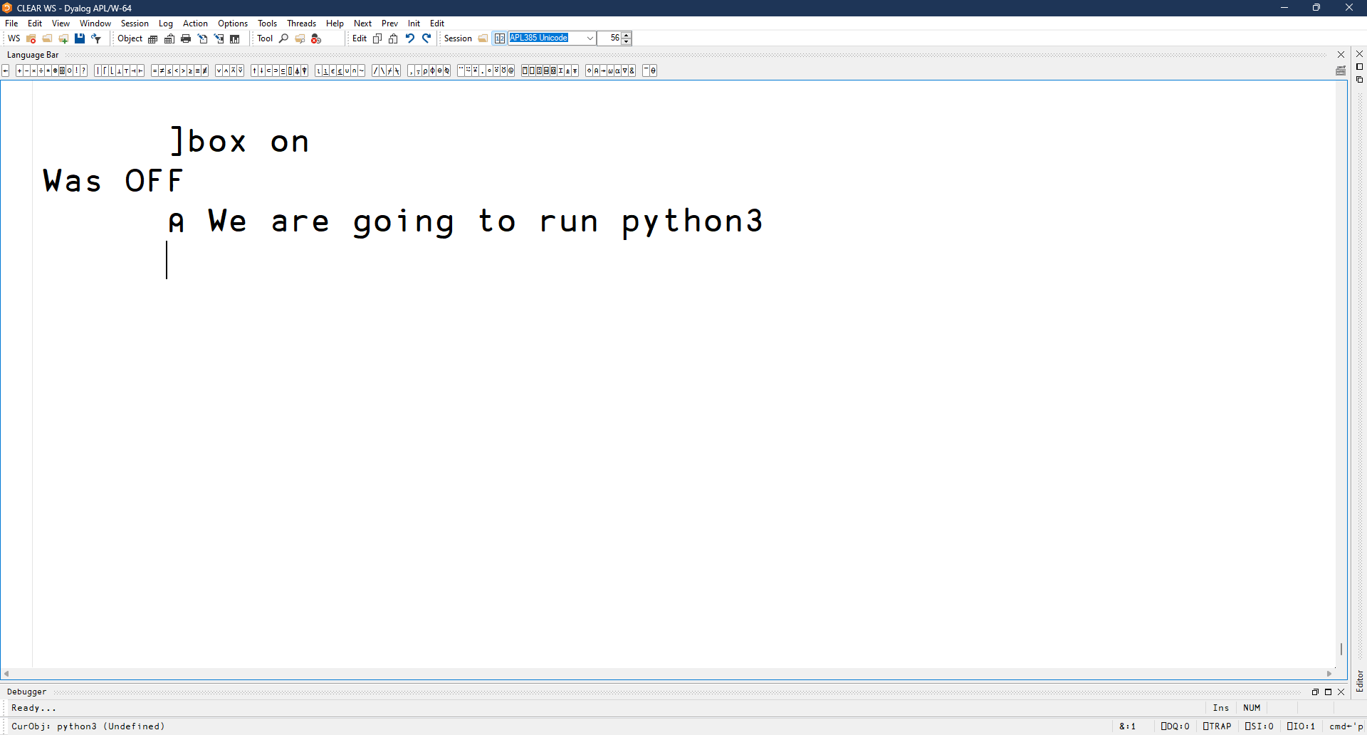

Slide 80
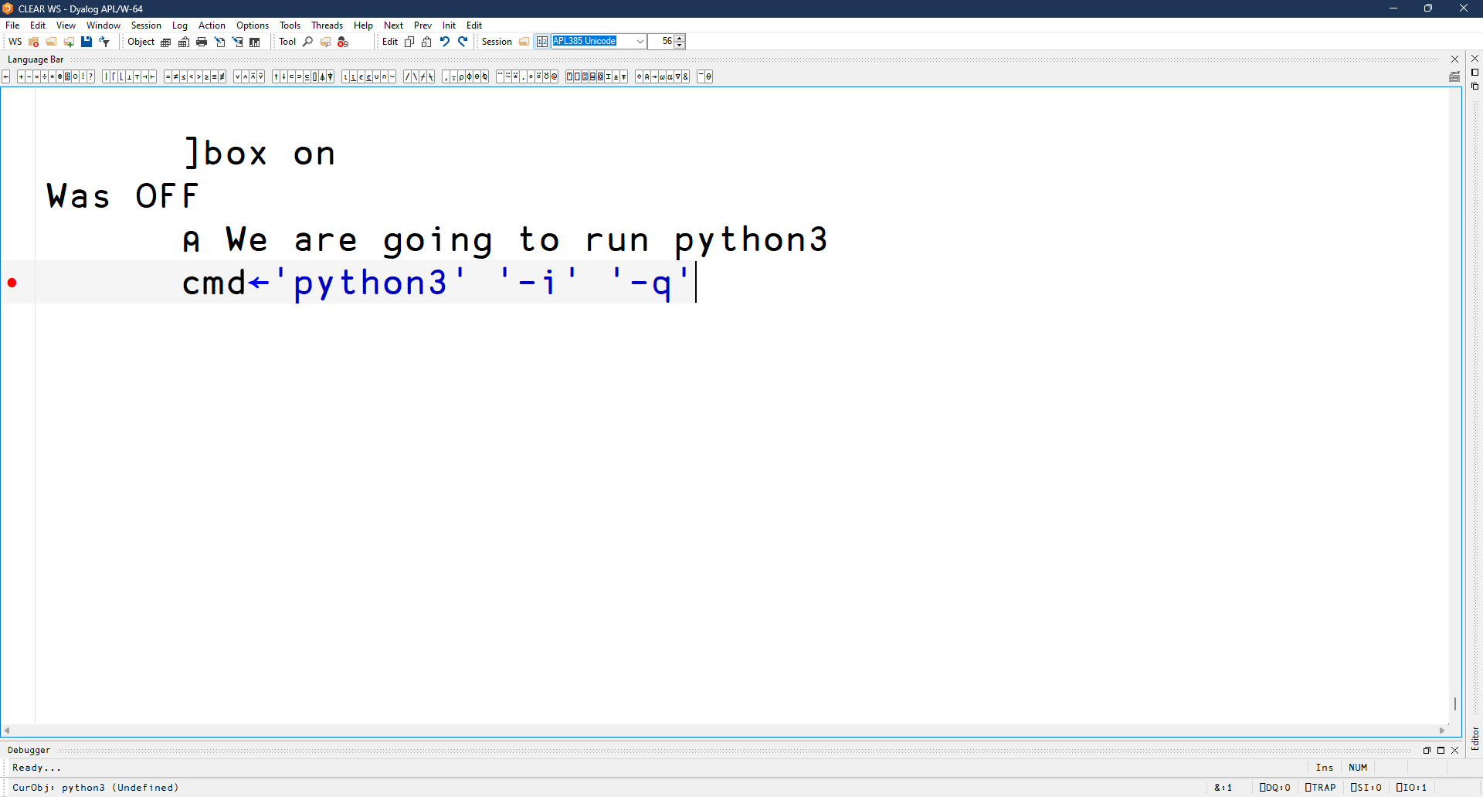

Slide 81
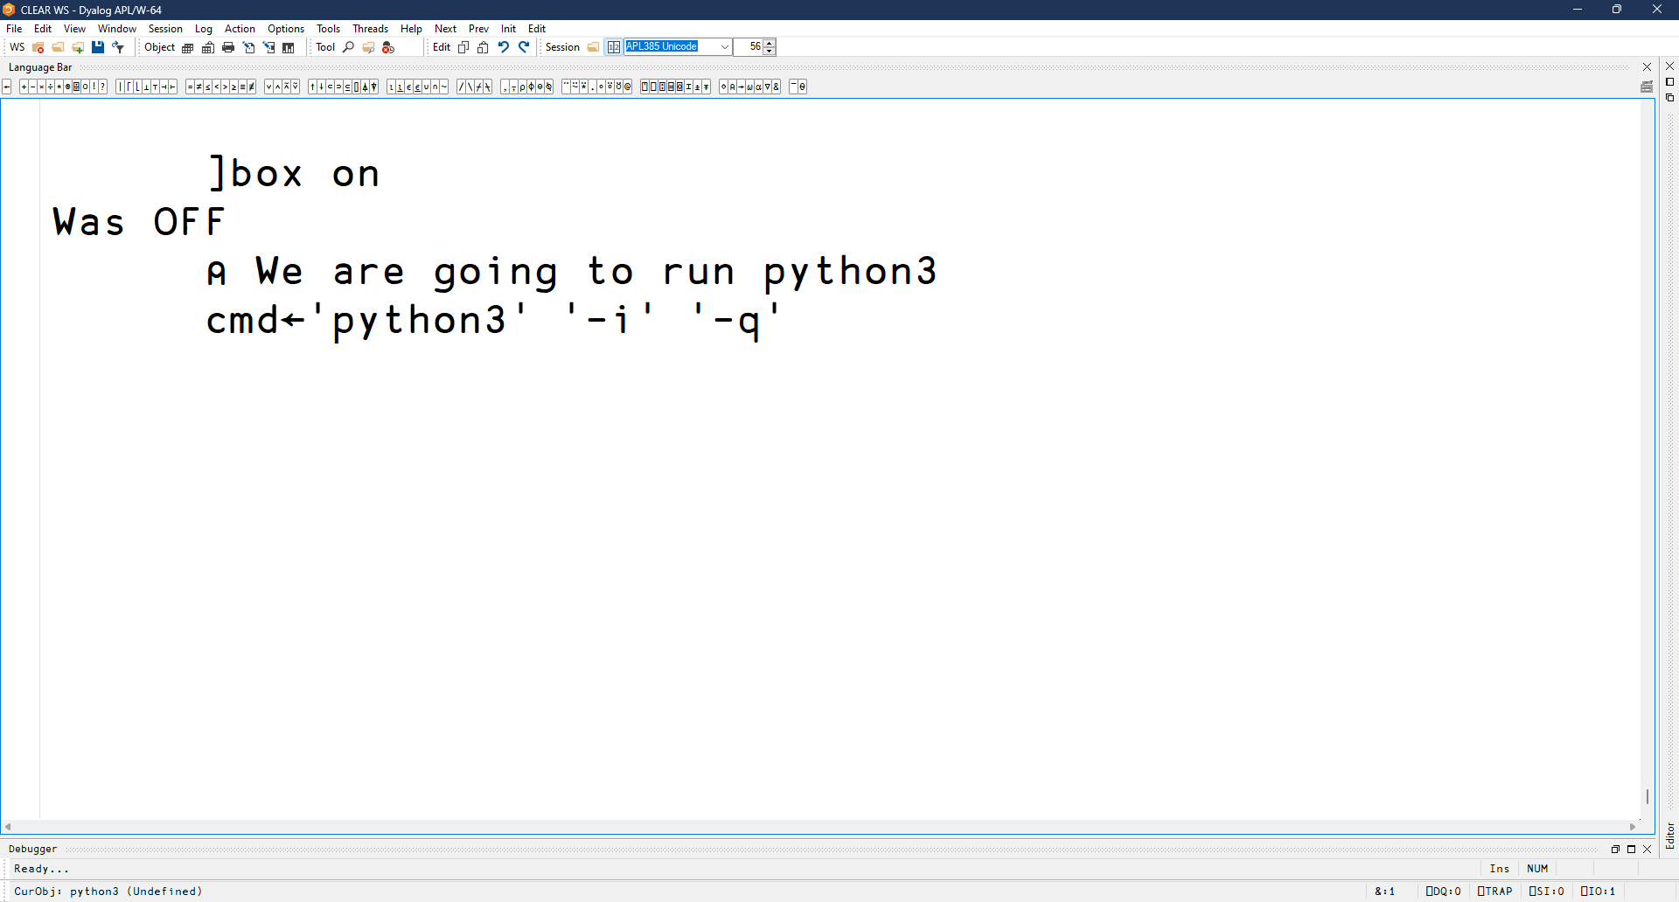

Slide 82
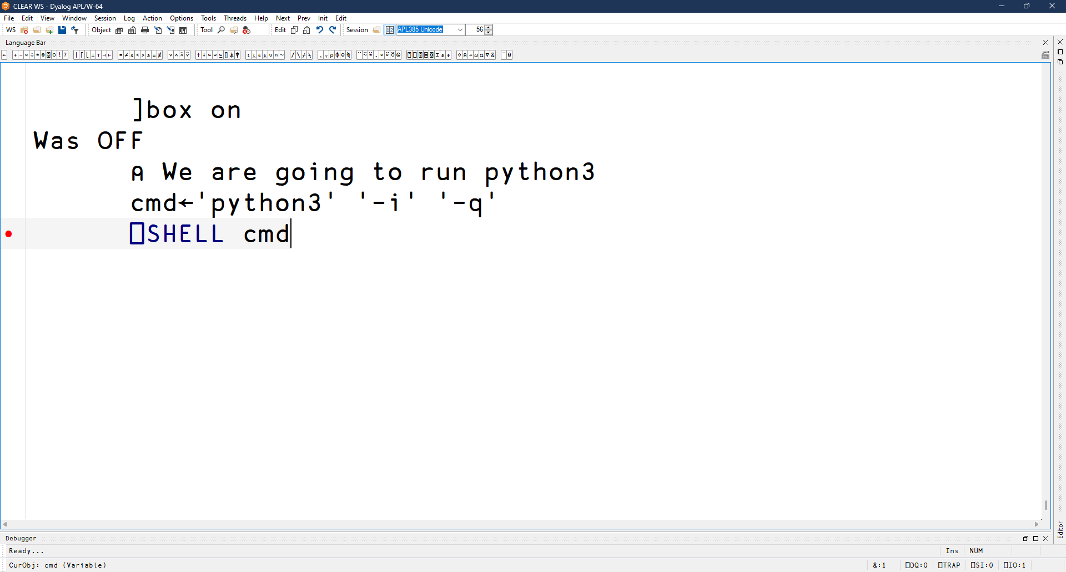

Slide 83


Slide 84


Slide 85


Slide 86


Slide 87


Slide 88


Slide 89


Slide 90


Slide 91


Slide 92


Slide 93


Slide 94


Slide 95


Slide 96


Slide 97


Slide 98


Slide 99


Slide 100


Slide 101


Slide 102


Slide 103


Slide 104


Slide 105


Slide 106


Slide 107


Slide 108


Slide 109


Slide 110


Slide 111


Slide 112


Slide 113


Slide 114


Slide 115


Slide 116


Slide 117


Slide 118


Slide 119


Slide 120


Slide 121


Slide 122


Slide 123


Slide 124


Slide 125


Slide 126


Slide 127


Slide 128


Slide 129


Slide 130


Slide 131


Slide 132


Slide 133


Slide 134


Slide 135


Slide 136


Slide 137


Slide 138


Slide 139


Slide 140


Slide 141


Slide 142


Slide 143


Slide 144


Slide 145


Slide 146


Slide 147


Slide 148


Slide 149


Slide 150


Slide 151


Slide 152


Slide 153


Slide 154


Slide 155


Slide 156


Slide 157


Slide 158


Slide 159


Slide 160
End of demo
This is of course only an example
Wrap it up in a class
  p←⎕NEW python
  …
⎕SHELL is designed not to have a specific use-case in mind

Slide 161
Summary
Lots of new stuff in version 20.0
Including ⎕SHELL, which we took a deeper look at
Now is a good time for questions

