Slide 1

News from Dyalog
Morten Kromberg, CTO

Slide 2
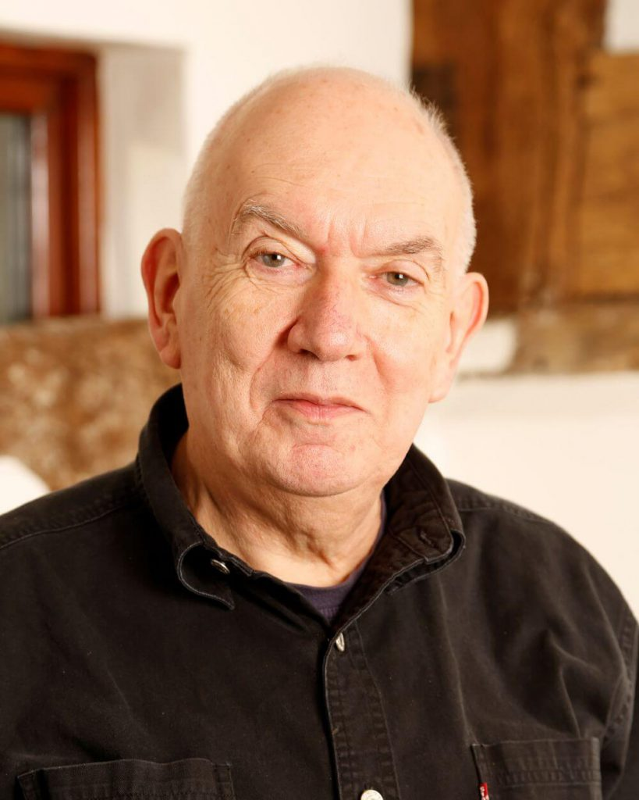

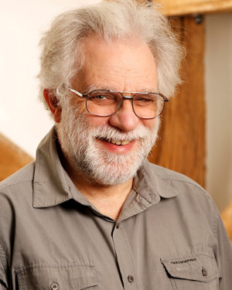
We Stand on the Shoulders of Giants
John Scholes (1948-2019)
Roger Hui (1953-2021)
Geoff Streeter (retired 2023)
https://rogerhui.rip https://johnscholes.rip

Slide 3
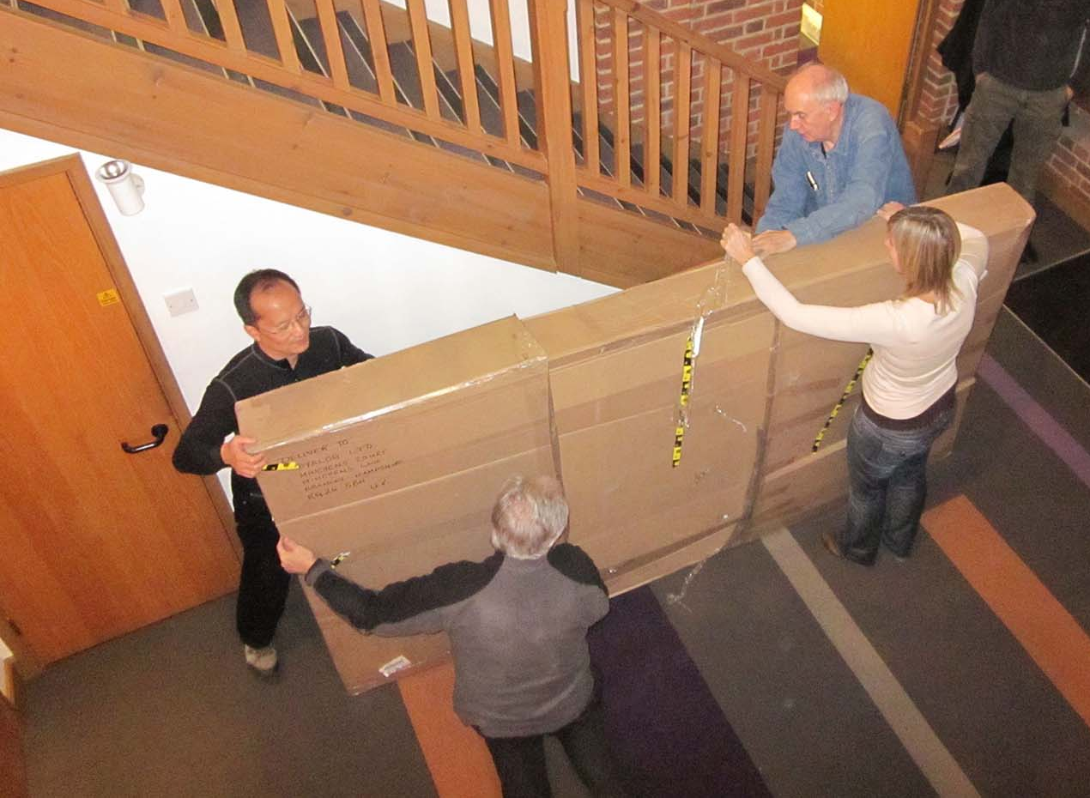
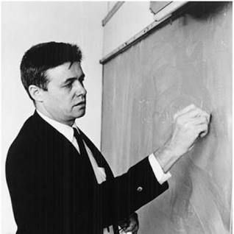
Ken Iverson's Blackboard
arrives in Bramley (2010)

Slide 4
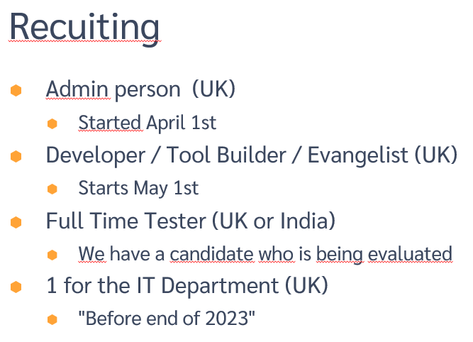
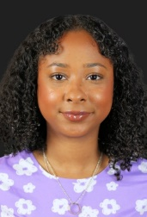
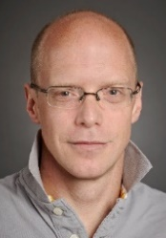


From my SWEDAPL'23 Presentation
Jada
Stefan
Aarush
Bangalore
Abs

Slide 5
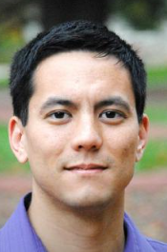






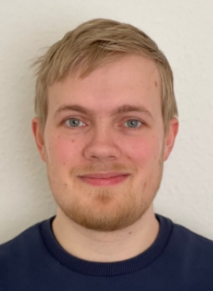
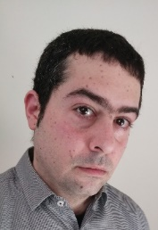




Dyalog – The Next Generation
2010-2021
2022
2023
Mike
Karl
2024
2023 Summer Interns

Slide 6


Our 2nd Employee to Retire
Gitte Christensen
The CEO has retired!
Kirstine Kromberg
Long Live the New CEO!

Slide 7
Under Gitte's Reign …
Headcount and Turnover Quadrupled Quintupled
  Headcount now ~26 full time equivalents
  Steadily increasing R&D budget
  First generation of interpreter developers retired;
  Second productive; Third recruited
  Largest sustained investment in APL technology in history

Slide 8
Under Gitte's Reign…
Trading Profit in every year since 2005. Sources:
  Growing partnerships with major customers
  Increasing share of APL market ("unfortunately" accelerating)
  A small number of completely new APL systems (so far)
Manoevering towards re-launching APL as a modern tool for prototyping and rapid application development

Slide 9
Financial Status
Owners | 2008 | 2018 | Present
SimCorp (Denmark) | 32.33% | 40% | 24%
APL Italiana (Italy) | 32.33%
Management & Employees | 35.33% | 60% | 76%
Ownership
  24% owned by SimCorp (which acquired APL Italiana, and was then itself acquired by Deutsche Börse)
  76% owned by management and employees
Revenue steadily increasing:
Profitable every year
since acquisition in 2005
5-year period | Growth
2017-2023 | 35%
2012-2017 | 8%
2007-2012 | 57%

Slide 10
News from the Evangelism Front
Aaron Hsu
co-dfns
compiler
Adam Brudzewsky
Here, There and
Everywhere
Rich Park
Media, Training
and "Outreach"
Stefan Kruger
Lead Technical
Writer
Jesús López
Metallurgist
(embedded
evangelist)

Slide 11
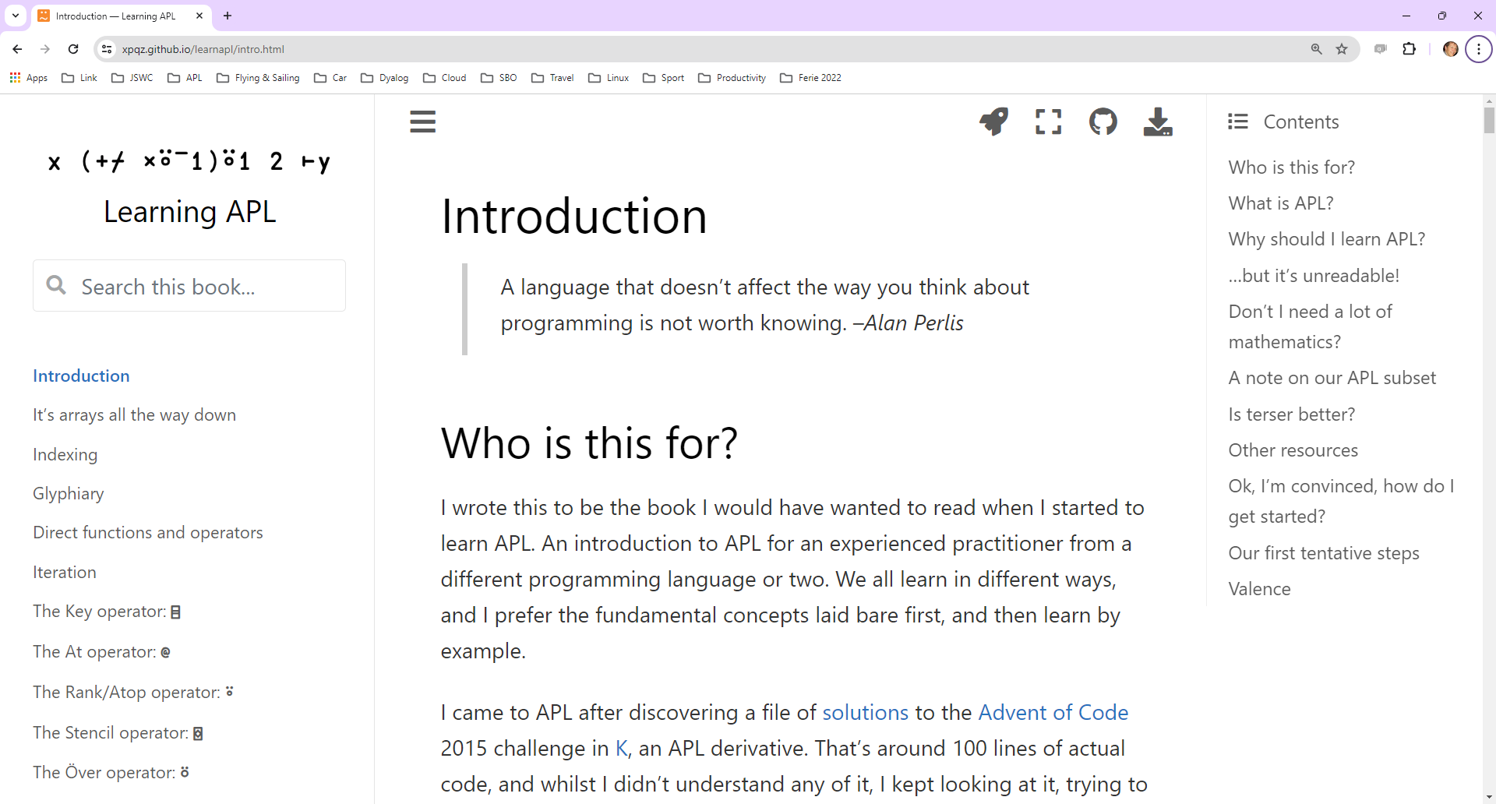
Stefan
Kruger

Slide 12
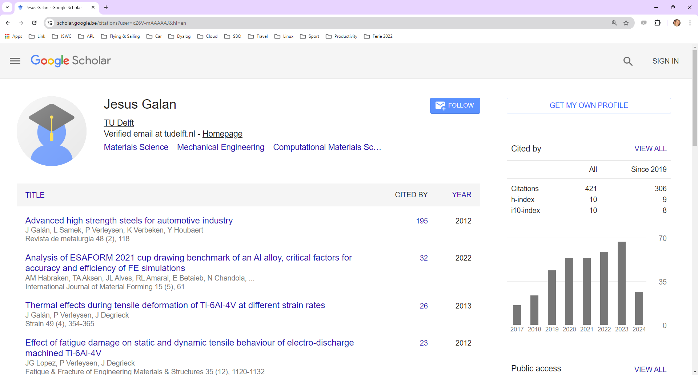
Jesús Galan López

Slide 13
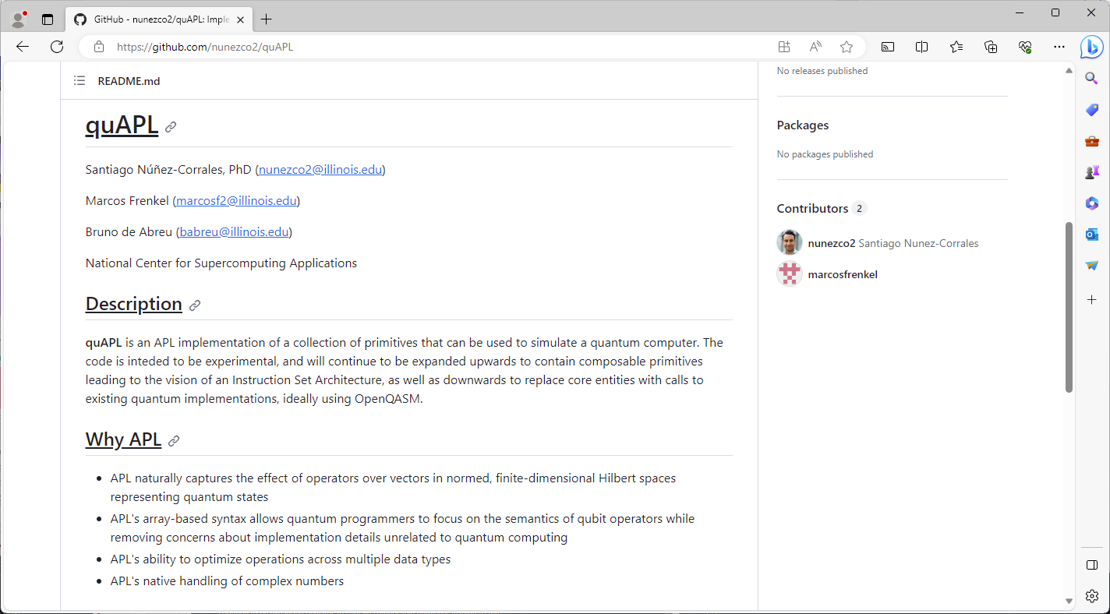
Talk at Dyalog'24

Slide 14
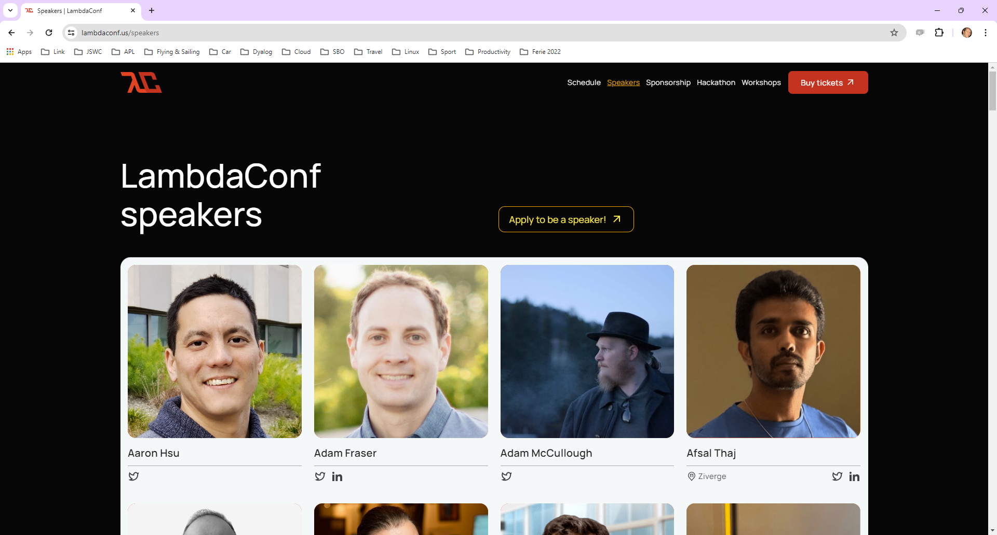

Slide 15
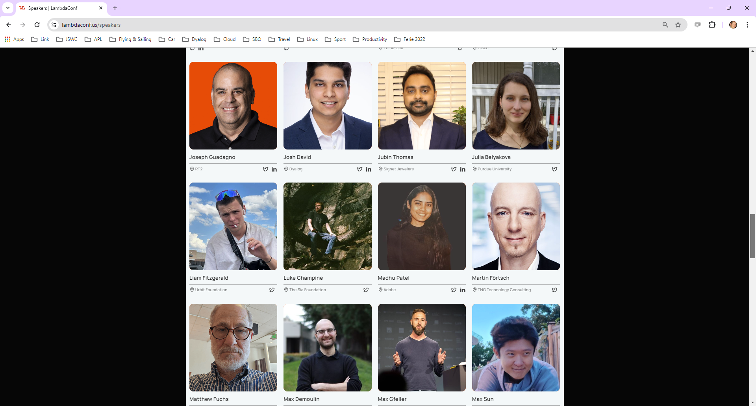

Slide 16
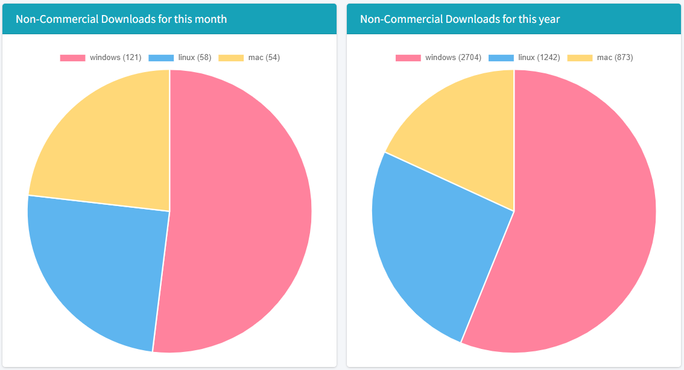
Non-Commercial Downloads
(snapshot September 18th, 2023)

Slide 17
Mortens Favourite v19.0 Features
Things that Morten has actually used since release …

Slide 18



Source Code Management
Productivity
& IDE
Link 4.0 was included with v19.0. Highlights include:
  Link a single namespace or class file
  Default to current namespace if no namespace specified
  Configuration files
  Support for simple text vectors, vectors of text vectors, and character matrices in simple text files (rather than using array notation)
The Cider project manager and the Tatin package manager will be bundled with v19.0
Dyalog is starting to distribute tools as Tatin packages
Link
(source)
Cider
(projects)
Tatin
(packages)

Slide 19
Tatin and Cider included…
Dyalog APL/W Version 19.0.49074
Serial number: 000013
Tue Apr 16 13:34:28 2024
]tools.activate all
Rebuilding user command cache... done
Restart APL to complete activation.
cmddir set to: …;C:/…/Dyalog APL 19.0 Unicode Files/SessionExtensions/CiderTatin
]tatin.loadPackages dyalog-Jarvis
1 package loaded into #
ij←⎕NEW Jarvis
ij.⎕nl -2
AcceptFrom AllowFormData AllowGETs AppCloseFn AppInitFn AuthenticateFn …
… SessionUseCookie UseZip ValidateRequestFn WaitTimeout ZipLevel

Slide 20
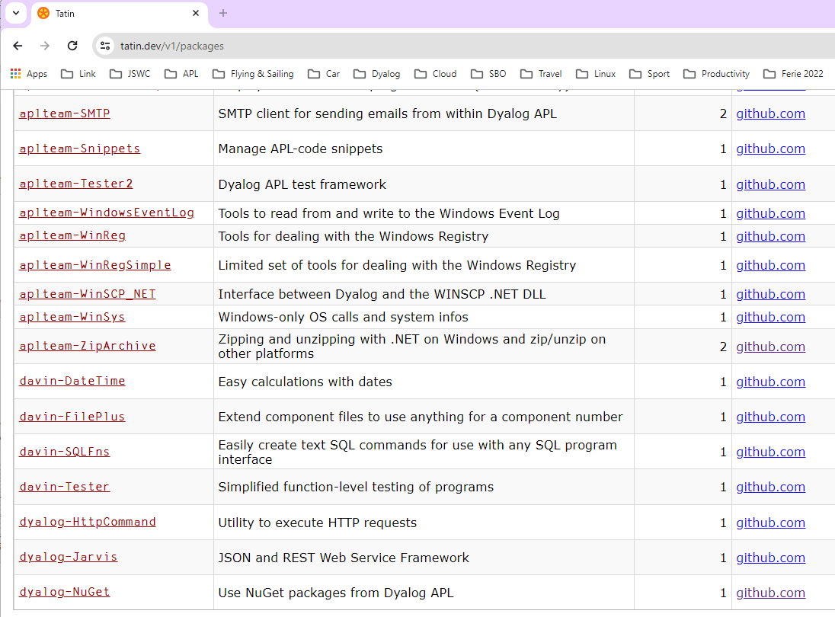


Slide 21
The NuGet Tool…
NuGet is the .NET Package Manager.

Slide 22
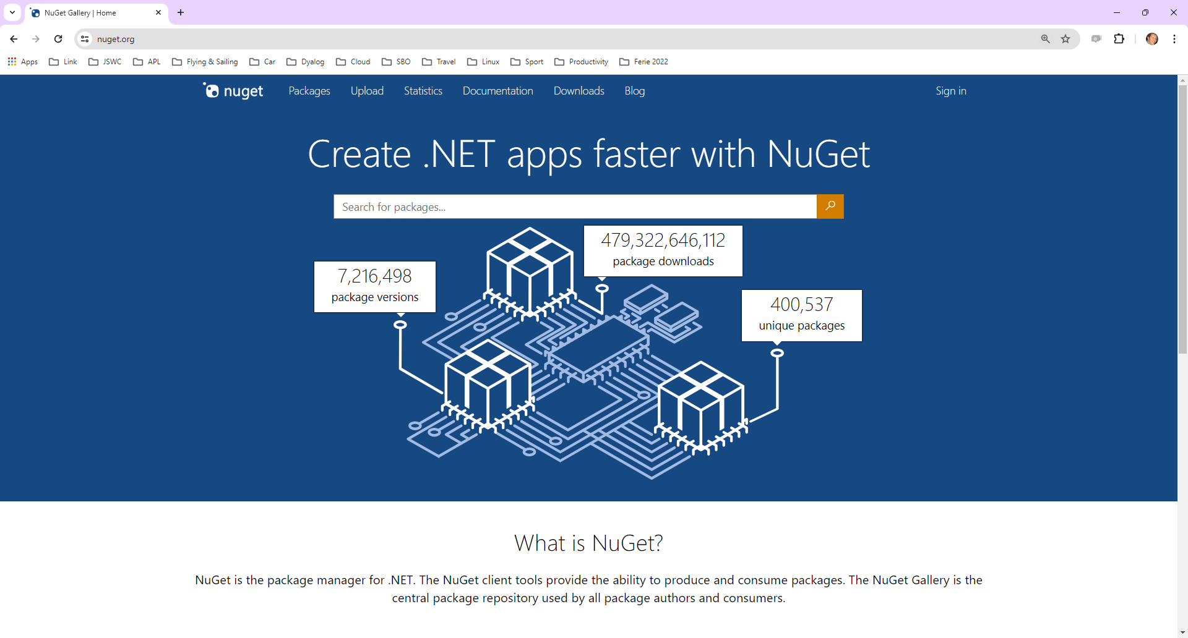

Slide 23
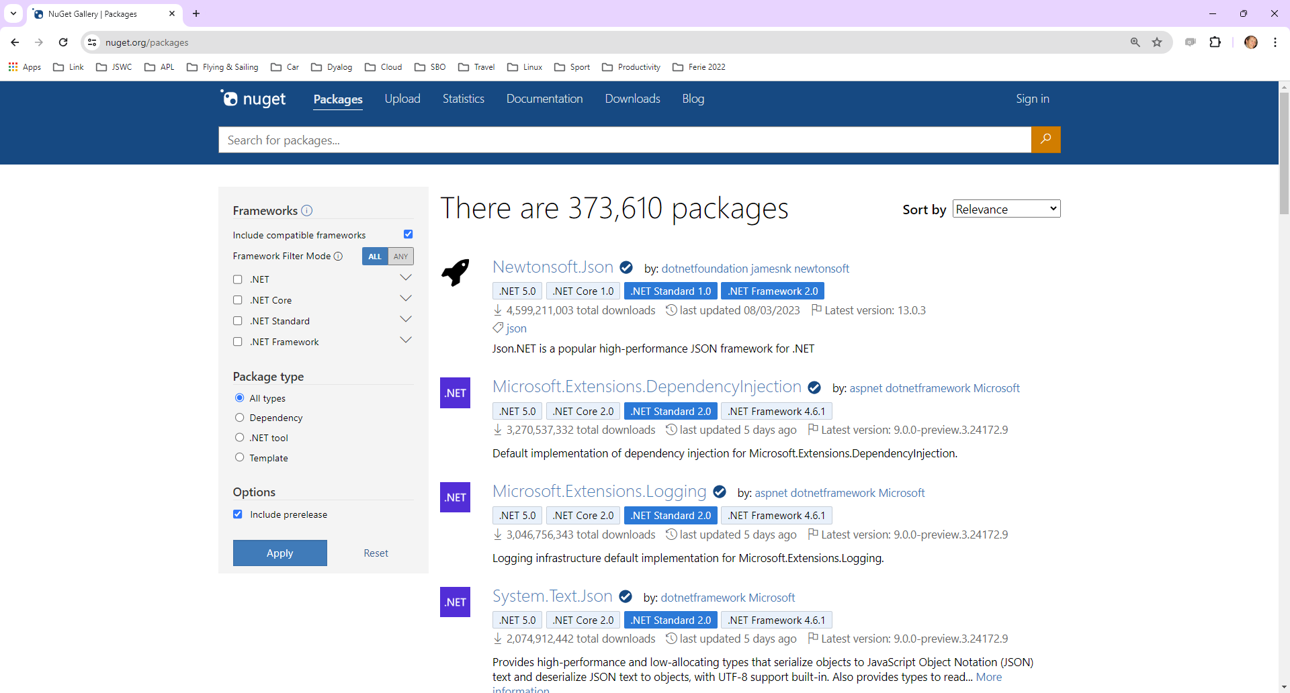

Slide 24
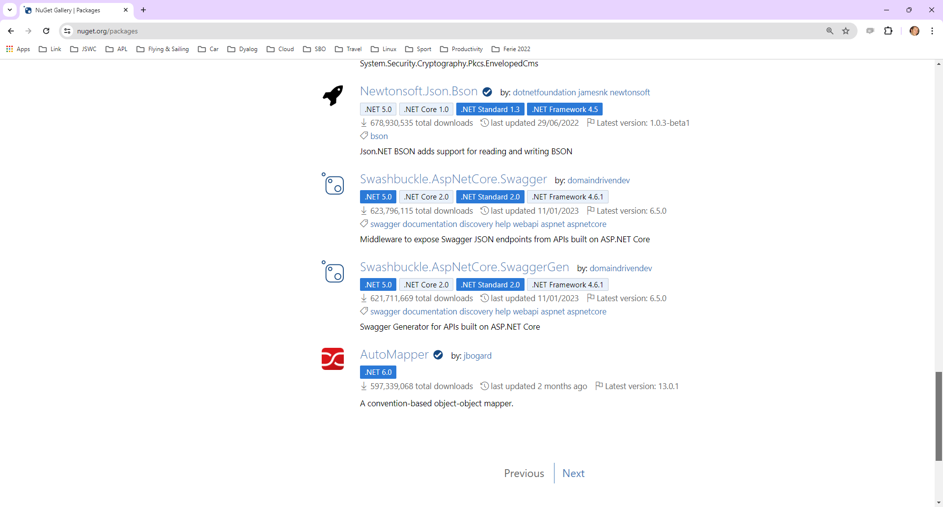

Slide 25
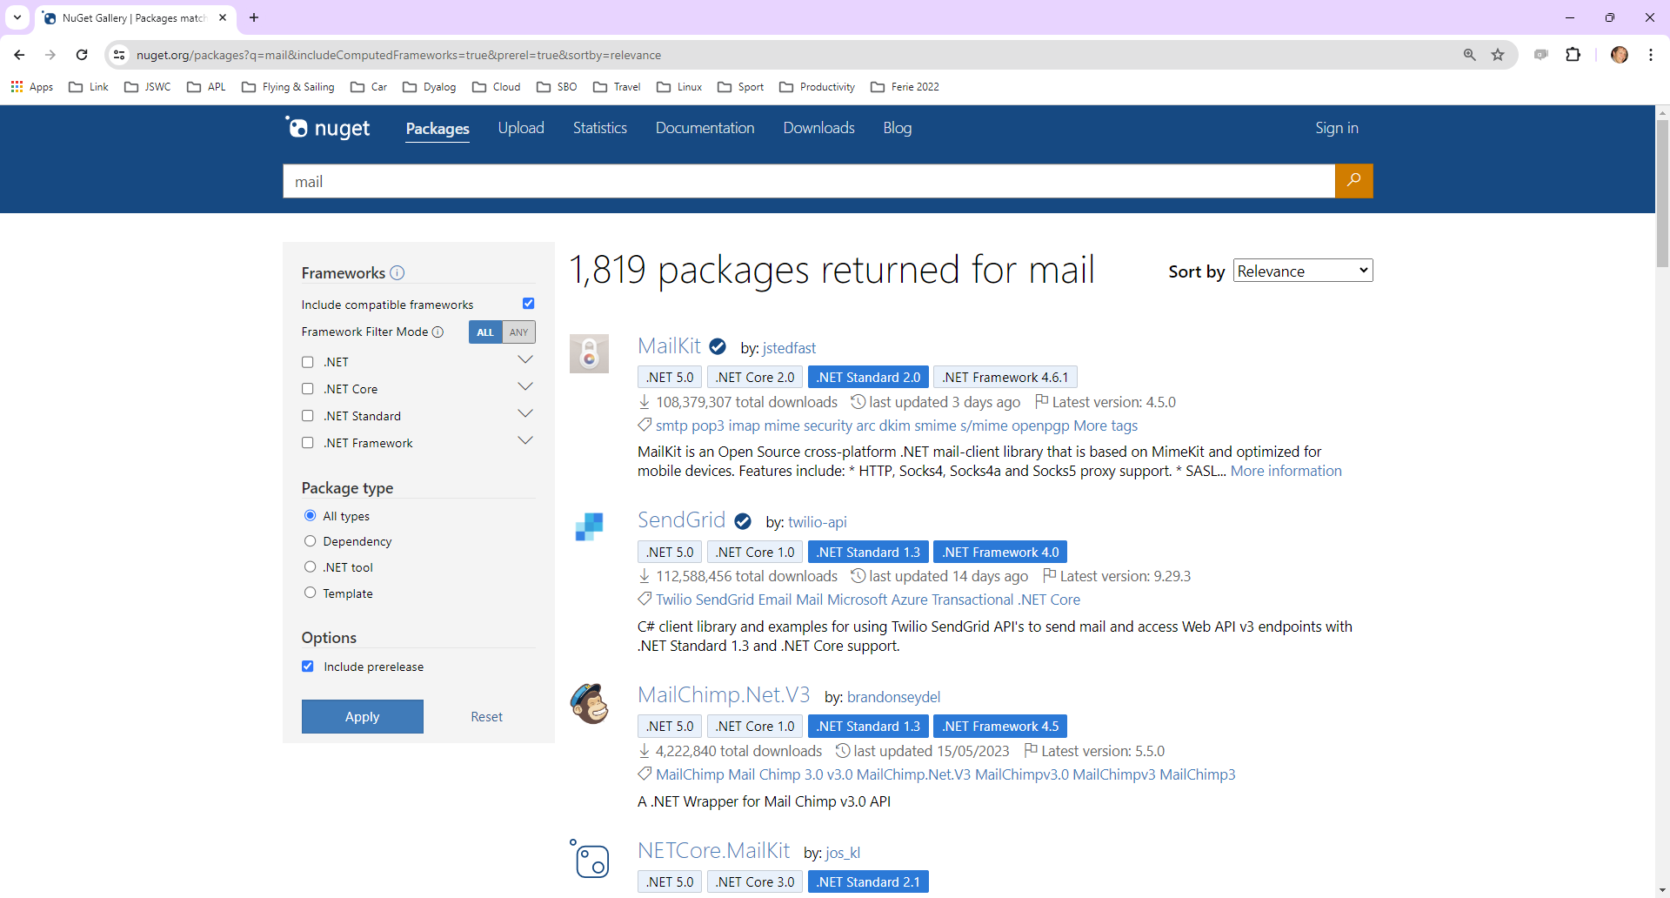

Slide 26
The NuGet Tool…
Let's try MailKit….
]tatin.loadpackages dyalog-nuget
1 package loaded into #
]link.import c:\devt\nuget\APLSource\Tests
Imported: #.Tests ← c:\devt\nuget\APLSource\Tests
Tests.test 'mailkit' ⍝ Trace me

Slide 27
Cider Project Manager
Cider uses Link to manage source code in a folder…
Along with any packages that it uses
  Tatin and Nuget both supported
(I have not had cause to use Cider)

Slide 28
Token Allocation
JSWC needs a token for each thread doing DQ or NQ:
allocateTokens;z;t;i
t←'JSWC Synchronisation'
:Trap 2 ⍝ ⎕TALLOC will SYNTAX ERROR in v18.2
z←↑⎕TALLOC 0 ⍝ List all allocated ranges
:If (≢z)≥i←z[;2]⍳⊂t ⍝ Do we already have a range?
TOKENRANGE←z[i;1] ⍝ Yes: use it
:Else
TOKENRANGE←⎕TALLOC 1 t ⍝ No: Allocate a range
:EndIf
TOKENSTEP←10*-⌈10⍟MAXSESSIONS+1 ⍝ e.g. step by 0.001 if MAXSESSIONS is 100
(WG_TOKENBASE DQ_TOKENBASE)←TOKENRANGE+0.1 0.2 ⍝ Start at n.101 and n.2.01
:Else ⍝ Version 18.2 or earlier
TOKENSTEP←1 ⍝ Step by 1, and separate the ranges out
(WG_TOKENBASE DQ_TOKENBASE)←(0 1×1+MAXSESSIONS)+30⊥⎕A⍳'JSWC' ⍝ Think of a number
:EndTrap

Slide 29
Multiple Session Log Files
Before v19.0, the default would be for all Dyalog processes to use the same log file
This sometimes caused loss of useful log file data
In the worst case, rare crashes when two processes tried to update the file at the same time
  (typically when starting or stoppping many processes at once)
Version 19.0 locks the log file and subsequent processes will open or create a new one

Slide 30
Log Files - Intended Usage Pattern
Users who always start the same set of interpreters at the start of a working session
  Development
  Test
  Prod
… will get the same log files each day
Alternatively, create shortcuts without * in the log file name

Slide 31
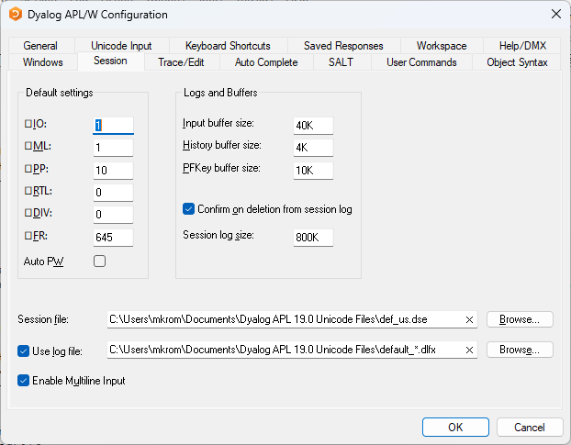
Multiple Session Log Files…

Slide 32
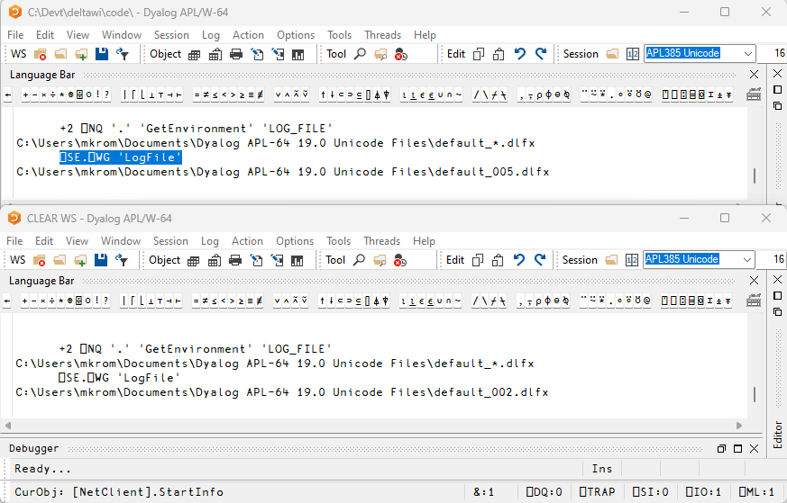

Slide 33
)ed foo[123]
In version 19.0, if you add a line number after the a name, the editor will open on that line

Slide 34
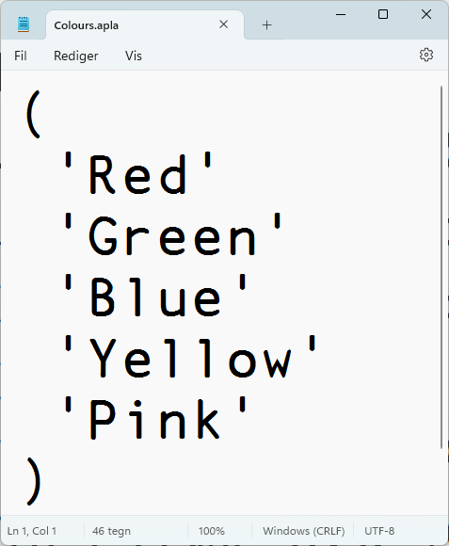
Arrays in "Plain" Text Files
Some character data doesn't map nicely to APL Array Notation:
  Simple character vectors
  Simple character matrices
  Vectors of character vectors
Link v4.0 adds experimental support for storing such arrays in "plain" format

Slide 35
–text=aplan (default)
)ns MyApp
#.MyApp
#.MyApp.Colours←'Red' 'Green' 'Blue' 'Yellow' 'Pink'
]link.create MyApp c:\tmp\myapp -arrays
Linked: #.MyApp ←→ c:\tmp\myapp [directory was created]
]open c:\tmp\myapp\Colours.apla
c:\tmp\myapp\Colours.apla

Slide 36
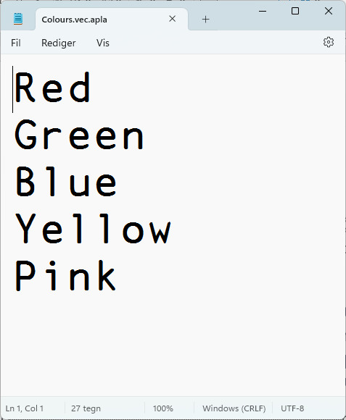
–text=plain
)ns MyApp
#.MyApp
#.MyApp.Colours←'Red' 'Green' 'Blue' 'Yellow' 'Pink'
]link.create MyApp c:\tmp\myapp –arrays –text=plain
Linked: #.MyApp ←→ c:\tmp\myapp [directory was created]
]open c:\tmp\myapp\Colours.apla
c:\tmp\myapp\Colours.apla

Slide 37
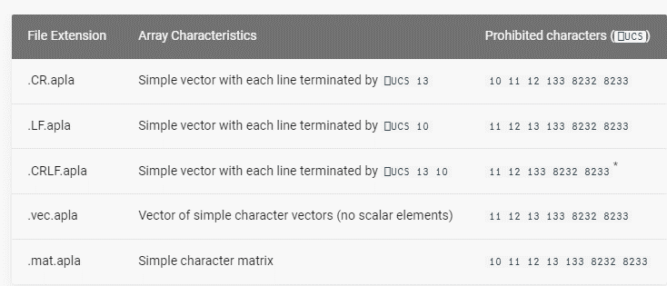
text=plain is experimental
Design may be refined in next release cycle

Slide 38

v19.0 .NET Bridge
Adds support for .NET 6, 7, 8 …
  Tested with 6.0 & 8.0
  Configured for 8.0 by default
  Also full support for 4.8 (aka ".NET Framework")
Can export APL code as .NET assemblies
  Will allow embedding APL code in .NET frameworks like ASP.NET Core, etc
.NET 8.0 is the
Long Term Support
version (LTS)

Slide 39


Service Orientation
A rapidly increasing proportion of new APL code is delivered as services
Jarvis wraps APL code as HTTP/JSON or RESTful services on any platform
  https://github.com/dyalog/jarvis
Off-the-shelf docker containers containing Dyalog APL (optionally with Jarvis)
HttpCommand is our HTTP client
HTTP(s) / JSON

Slide 40
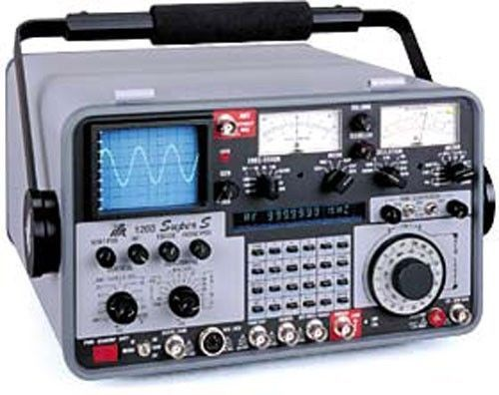
Health Monitor
Installing &
Managing
Experimental TCP-based monitor:
Interpreter can broadcast regular updates on (e.g.):
  CPU consumption, Memory statistics
  )SI stack and Error information
Notifications on
  untrapped errors
  ws compaction
Exact execution location is available as an option
(with runtime cost)
Also broadcasts details of how to connect Remote IDE if that is possible

Slide 41
Health Monitor Example
["PollFacts",{"Facts":["AccountInformation","Workspace","ThreadCount"],"Interval":5000,"UID":"1 1"}]
["Facts",
{"Facts": [ {
"ID": 2, "Name": "AccountInformation",
"Value": {
"ComputeTime": 438,
"ConnectTime": 46973,
"KeyingTime": 0,
"UserIdentification": 0
}},{
"ID": 3, "Name": "Workspace",
"Value": {
"Allocation": 33882064,
"AllocationHWM": 33882064,
"Available": 2144207480,
"Compactions": 2,
"FreePockets": 186682,
"GarbageCollections": 0,
"GarbagePockets": 0,
"Sediment": 2120,
"Used": 3276168,
"UsedPockets": 23209,
"WSID": "CLEAR WS"
}},{
"ID": 6, "Name": "ThreadCount",
"Value": {
"Suspended": 1,
"Total": 2
}}
],
"Interval": 5000,
"UID": "1 1"
}]

Slide 42

  HTMLRenderer updates
Productivity
& IDE
New features include:
AllowContextMenu
ExecuteJavascript
Get/SetZoomLevel
IsLoading + LoadEnd event

Slide 43
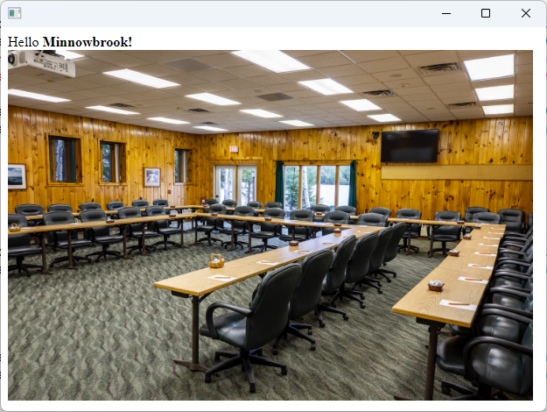
HTMLRenderer – what's that?
pic←'https://minnowbrook.org/wp-content/uploads/2022/04/
Screen-Shot-2022-04-18-at-2.24.30-PM.png'
'MyForm' ⎕WC 'HTMLRenderer' ('Hello <b>Minnowbrook!</b><br/>
<img src="',pic,'" height=400 width=600>')
Chromium
Embedded
Framework
(CEF)

Slide 44
  HTMLRenderer updates
Productivity
& IDE
New features include:
AllowContextMenu
ExecuteJavascript
Get/SetZoomLevel
IsLoading + LoadEnd event

Slide 45
Sketch of Version 20.0 (Q2/2025)
Transferred from v19.0
Resume Optimisation Work
.NET Bridge "enhancements"
  Support "Generic" methods & classes
More HTMLRenderer improvements
Health Monitor
Script Engine Support
⎕NATTRIBUTES
Next Set of Projects
Relax Interpreter Limits
Array Notation
Token-by-token Debugging
Query Platform Features
New "Shell" System Command
Open-Source HTMLRenderer & Conga
JavaScript emulation of ⎕WC

Slide 46
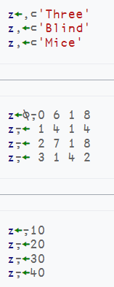
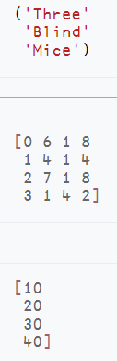
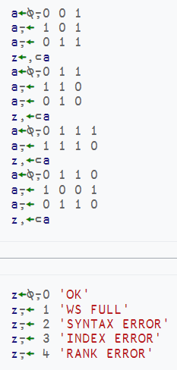
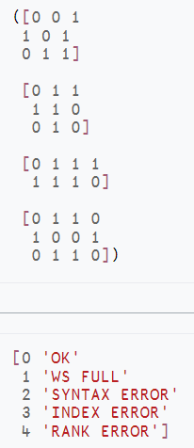
Array Notation
https://aplwiki.com/wiki/Array_notation

Slide 47
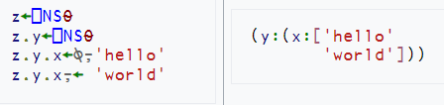
Array Notation
Public proposal published
  https://aplwiki.com/wiki/Array_notation
APL model exists in Link since v3.0 and
⎕SE.Dyalog.Array.Serialise|Deserialise
Will be integrated with interpreter in v20.0

Slide 48
Get and Set values without Execute
Working with data where the names of variables are held in an array
A common requirement when writing tools
Should have been done 20 years ago

Slide 49
⎕NG: Name Get
FirstName←'Jill' ⋄ Age←32 ⍝ Some data
⎕NG 'Age' 'FirstName' ⍝ Avoid ⍎
32 Jill
⎕NG ('Age' 0) ('LastName' 'Unknown')
⍝ (Name Default) pairs
32 Unknown
⍝ Left argument can be a namespace reference

Slide 50
⎕NS: Name Set
⎕NS ('FirstName' 'Jill') ('Age' 32)
⍝ (Name Value) pairs
⍝ But what if you have a vector of values?
⎕NS (↑'FirstName' 'Age') ('Jill' 32)
⍝ (Matrix of Names) (Vector of Values)
⍝ Left argument can be a namespace reference

Slide 51


Slide 52
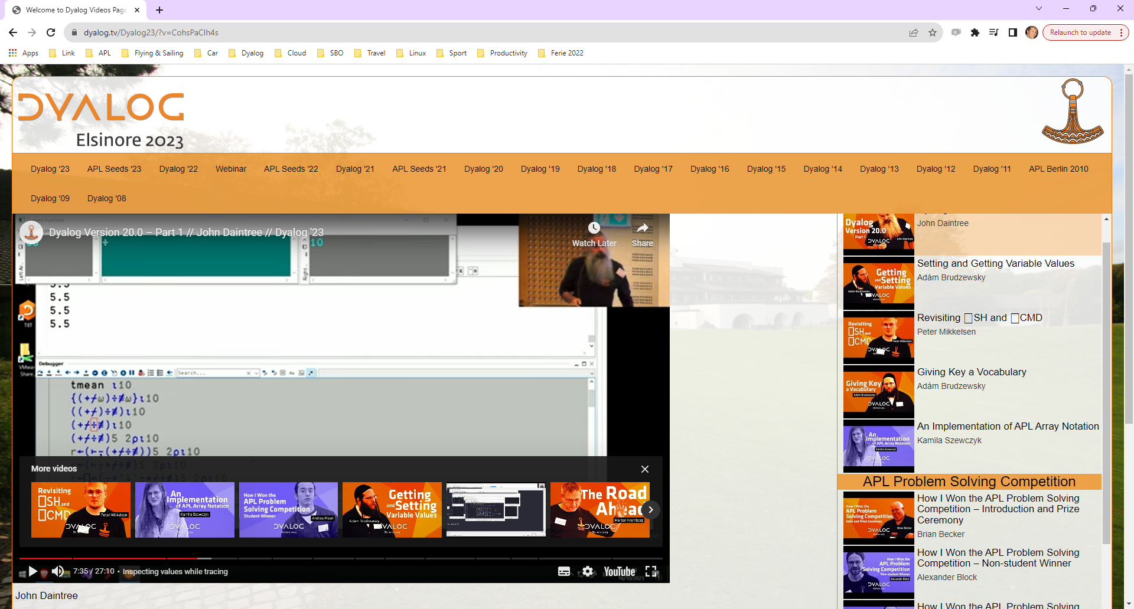
Token by Token Debugging

Slide 53
.NET Bridge Enhancements
The v19.0 bridge to .NET 6/7/8 is roughly on par with the Framework bridge
In v20.0, the new bridge may move ahead, adding:
  Generics
  Delegates
  Async
Some of these will only be designed / modelled in v20

Slide 54
HTMLRenderer Enhancements
Suggested:
File Upload
Modal HTMLRenderer Windows
More control over "Chrome"
Other changes driven by JSWC project

Slide 55
HTMLRenderer & Conga "Open Source"
Allow users to compile own versions of "plugins" and make pull requests
  Allow users to move a bit faster when Dyalog is slow to e.g. use a new version of Chromium
  Help grow the community by open sourcing more things
This might include the Dyalog Cryptographic Library and user-defined plugins
A modern replacement for Auxiliary Processors
Conga may also be loaded and initialised at startup, avoiding current issues with initialisation

Slide 56
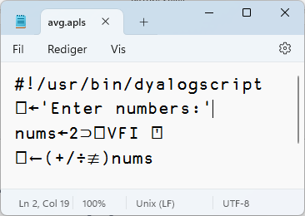
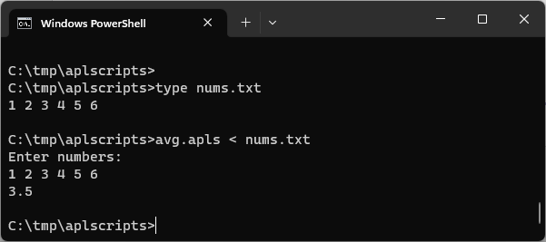
Script-Engine Support
#! (hash bang) scripting
We think the script engine is
critical for attracting new users
Still a bit of a prototype
  Will be hardened for v20.0
  Need to be able to
  debug scripts via RIDE

Slide 57
Easy Web Creator - EWC
A JavaScript emulation of our Win32 layer (⎕WC, ⎕WG, ⎕WS …)
Still mostly referred to as JSWC (JavaScript Window Create)

Slide 58
Demo of JSWC

Slide 59
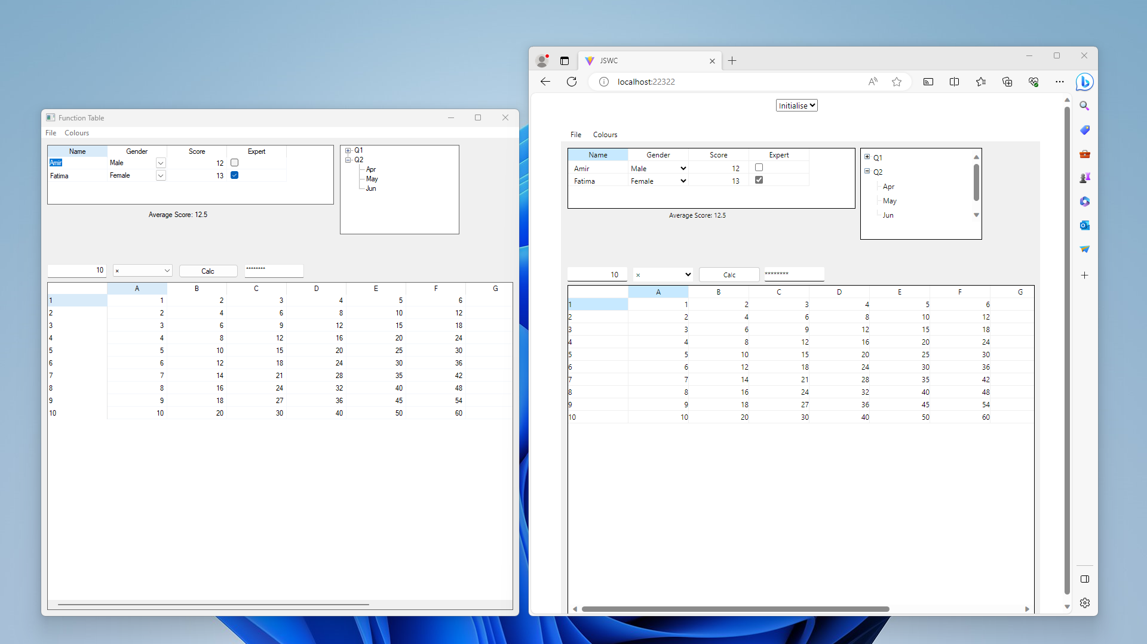
JavaScript ⎕WC

Slide 60
EWC also Open Source
Both the server-side APL code and the client-side JavaScript
Users will be able to create their own widgets
We are planning

Slide 61
Automated Testing w/ Selenium
One important benefit of HTML rendering is that Selenium can be used for automated testing

Slide 62
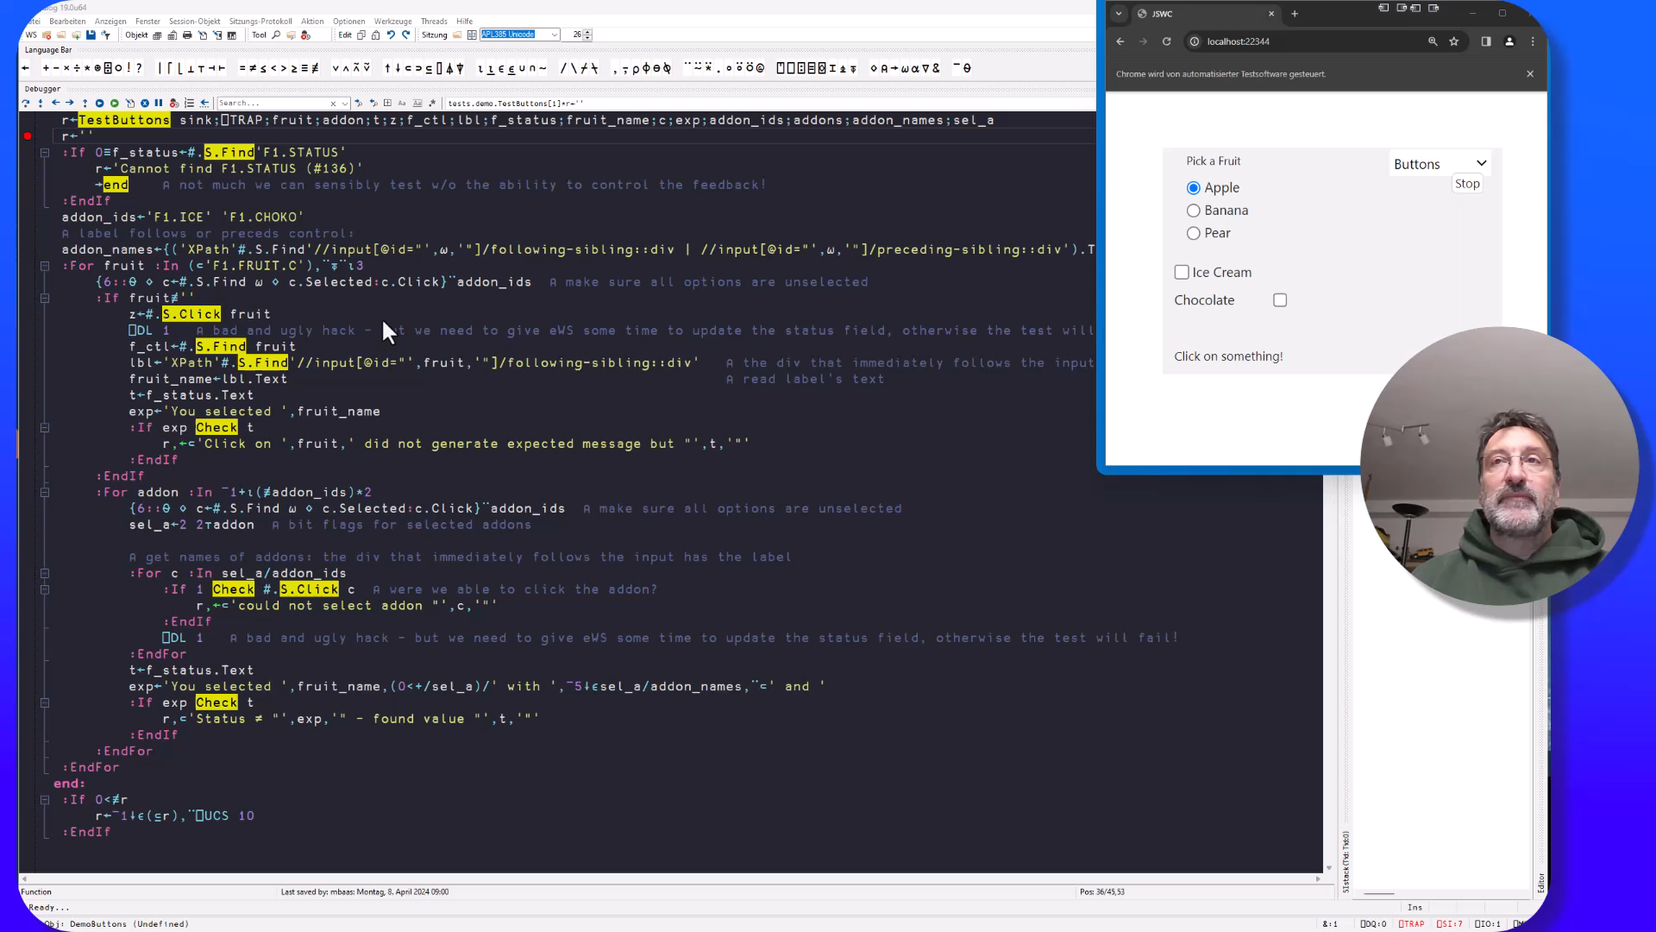

Slide 63
Health Monitor
Version 19.0 contains a prototype. Ideas for v20.0 include:
Add feature to find last known location of a "hanging" interpreter
Sending signals to interrupt or terminate tasks
Discoverability: allow APL process to broadcast services that it provides
Switch ⎕PROFILE on and off; collect data

Slide 64
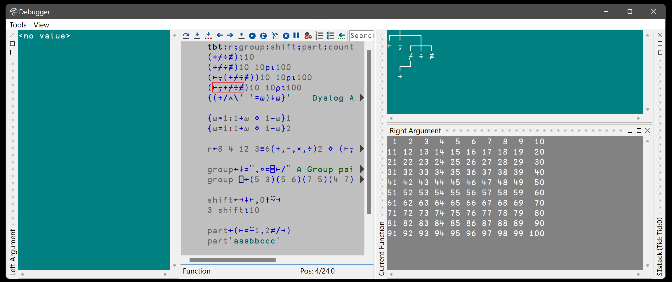
Token-by-token Debugging
See John's presentations at Dyalog'22 – and Dyalog'23

Slide 65
Static Analysis of APL Code
Static Analysis of application code is seen as a required "best practice" by some corporations
We are building a prototype of a tool which will
  Detect vulnerabilities
  "Lint" APL Code
  Compute readability and other metrics
This tool will initially be licensed separately
A free "community edition" may follow

Slide 66
⎕SHELL to replace existing ⎕SH
Invoke OS commands from APL
Interruptible
Optionally return data as an asynchronous Stream
Manage stdin, stdout & stderr independently
Handle variety of data encodings

Slide 67
No New Primitives in v20.0
There is a small set of APL primitives that are "missing"
See Adam Brudzewsky's presentation "Filling the Core Language Gaps" at Dyalog'22
These were expected in v20
However, we are going to spend the time relaxing limitations in the interpreter
  Max Rank, # of lines in a function, tokens on a line, more primitives, …
New primitives will appear in v21

Slide 68
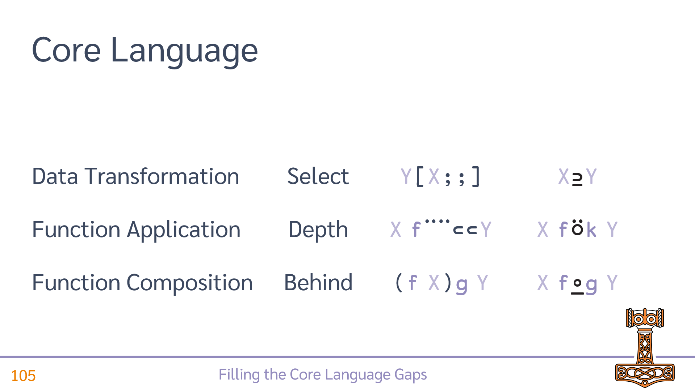
Possible New Primitives

Slide 69
What about…
HTTP2
Kafka

Slide 70
Sketch of Version 20.0 (Q2/2025)
Transferred from v19.0
Resume Optimisation Work
.NET Bridge "enhancements"
  Support "Generic" methods & classes
More HTMLRenderer improvements
Health Monitor
Script Engine Support
⎕NATTRIBUTES
Next Set of Projects
Relax Interpreter Limits
Array Notation
Token-by-token Debugging
Query Platform Features
New "Shell" System Command
Open-Source HTMLRenderer & Conga
JavaScript emulation of ⎕WC

