Slide 1
What are we producing?
Riskflow provides the financial logic in the form of a DLL (Digital Linked Library) that is exposed via the .Net framework.
This can run on local devices as well as be exposed as a web service.

Slide 2
The Proof of Concept
It was important that we could deliver a DLL that could run and execute on the .Net framework.
This meant that I initially tested by creating a sample C# program to test that the DLL is accessible as a .Net Object.

Slide 3
The Proof of Concept
The idea is that we can store the serialised object as a BLOB on a database.
This would give us access to both the methods and the data in the object.

Slide 4
The Prototype
Now that we knew we could access the APL as an object, we created a prototype using HTML5.
The idea was that any Smart Mobile Device can run HTML5 and that we could test the response from a Web Server exposing the DLL.

Slide 5
The Prototype
HTML5 however proved to be to slow – depending on the device - and also limited our capabilities in what could be achieved visually.
We decided to rather go the route of native development on Android as it covers a large number of devices and opens up a much improved visual experience.

Slide 6
How did we get there?
Moving from APL2000 to Dyalog…
Some problems along the way include
    Code can be directly copied but deliver different results
    Code can be copied but crashes without delivering results
    Code cannot be copied over as some functionality doesn’t exists

Slide 7
How did we get there?
APL2000 Example that worked when directly copied to Dyalog.
ret„a ON_ b;Œio;max
© Returns matrix "a" concatenated along last dimension of "b"
Œio„1
a„(¯2†1 1,½a)½a
b„(¯2†1 1,½b)½b
max„—/((½a),(½b))[2 4]
ret„(((1†½a),max)†a),[1]((1†½b),max)†b

Slide 8
How did we get there?
APL2000 (ALMAN) makes use of a function where Dyalog uses a “Monadic Take”
APL2000
ENCTOMAT_ (2 4 5) (4 5)
2 4 5
4 5 0
ret„ENCTOMAT_ enc
ret„Œmix (—/0,½¨enc)†¨enc„,enc
DYALOAG
↑(2 4 5) (4 5)
2 4 5
4 5 0

Slide 9
The DLL
Functions visible on the .Net framework
Initiating and setting values
Calculating
Returning results

Slide 10
The DLL
Initiating and setting values
    Default Constructor
    Set_L1_
    Set_L2_
    Set_L3_
    Set_L4_
    Set_L5_

Slide 11
The DLL
Calculating
  Calculate_Statements_
Returning results
  Get_BS_ALL_
  Get_BS_Rows_
  Get_IS_ALL_
  Get_IS_Rows_
  Get_CF_ALL_
  Get_CF_Rows_

Slide 12
The Architecture
The Architecture of the App is designed in stateless environment.
Smart Phone/Device
    Andriod 4.1
Web Services
    The DLL
    Translation Services
        Formats the results for SOAP communication
    Excel Generating Services
    Email Services

Slide 13
The Architecture
The phone communicates via SOAP over the internet.
The data is stores locally on the phone and sends requests to the server with a list of parameters.
The server then replies with the information that was requested.

Slide 14
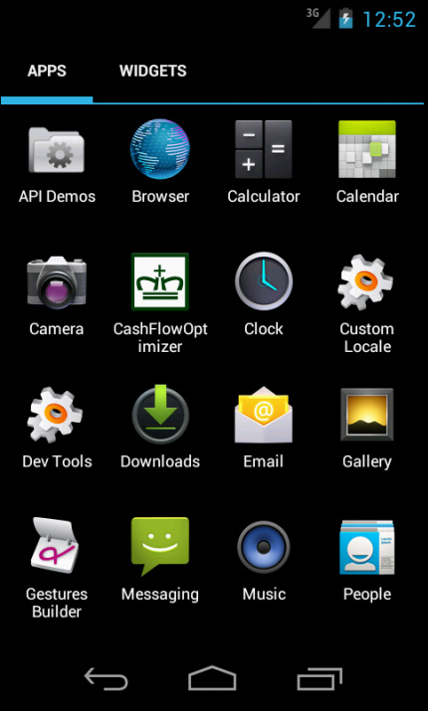
THE CASHFLOW OPTIMIZER APP

Slide 15
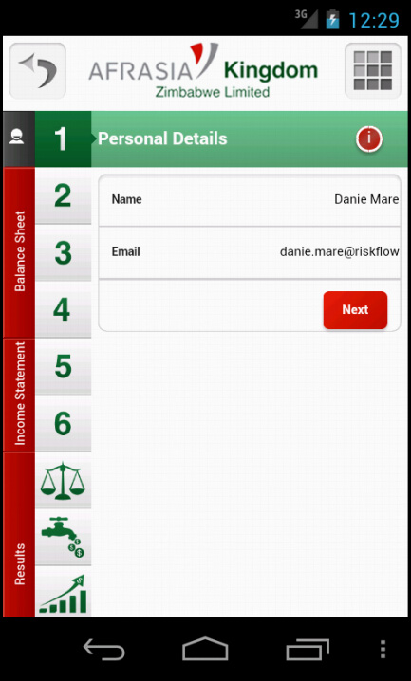
Personal Details
You detail will be used when creating output.
An email will be sent to your email address as you supply it here.

Slide 16
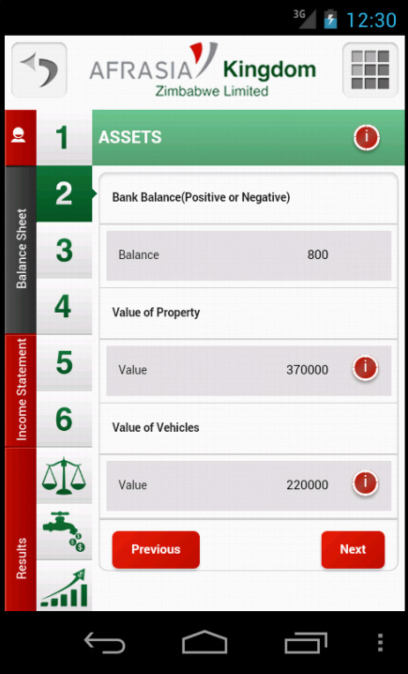
Assets
∇ Set_L1_ rarg;⎕IO;V1;V2;V3
:Access Public
:Signature Set_L1_ Double Properties, Double Vehicles, Double BankAccount
⍝⍝ Set_L1_ ....
⎕IO←1
⍝⍝
(V1 V2 V3)←3↑rarg
∆bs_a_property←V1
∆bs_a_vehicles←V2
∆bs_bank←V3
⍝⍝ End Function
∇

Slide 17
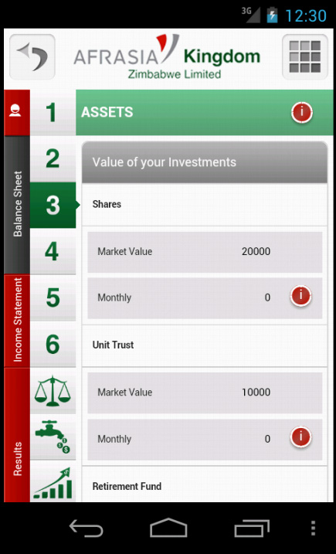
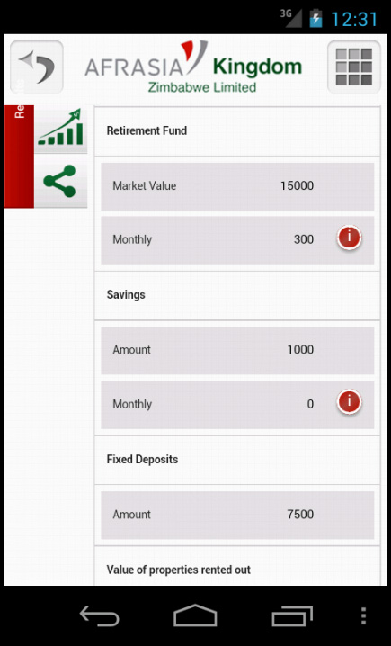
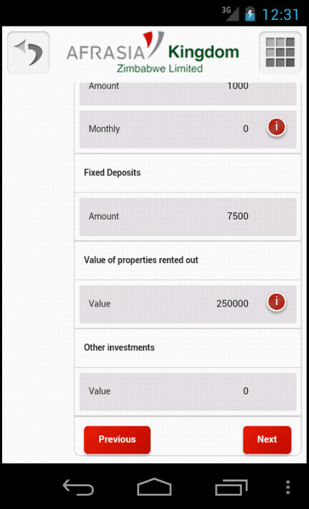
Investment Assets

Slide 18
Investment Assets
∇ Set_L2_ rarg;⎕IO;V1;V2;V3;V4;V5;V6;V7;V8;V9;V10;V11
:Access Public
:Signature Set_L2_ Double Shares, Double SharesCont,
Double UnitTrust, Double UnitTrustCont, Double Retirement,
Double RetirementCont, Double Savings, Double SavingsCont,
Double FixedDeposit, Double InvertProperties, Double Other
⍝⍝ Set_L2_ ....
⎕IO←1
(V1 V2 V3 V4 V5 V6 V7 V8 V9 V10 V11)←11↑rarg
∆bs_a_shares←V1
∆bs_a_sharescont←V2
∆bs_a_unit←V3
∆bs_a_unitcont←V4
∆bs_a_retfund←V5
∆bs_a_retfundcont←V6
∆bs_a_savings←V7
∆bs_a_savingscont←V8
∆bs_a_fixdep←V9
∆bs_a_invprop←V10
∆bs_a_other←V11
∇

Slide 19
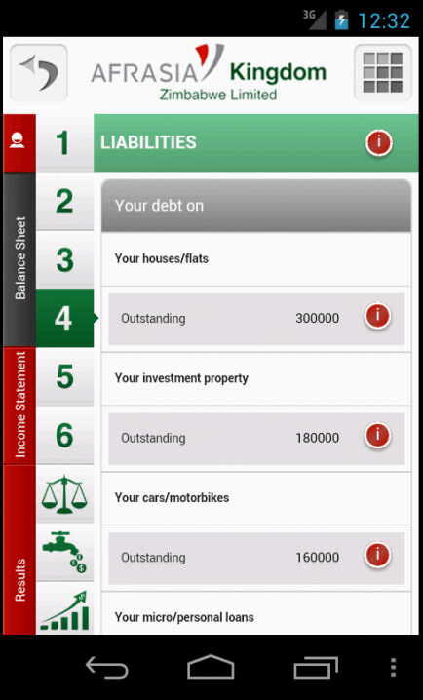
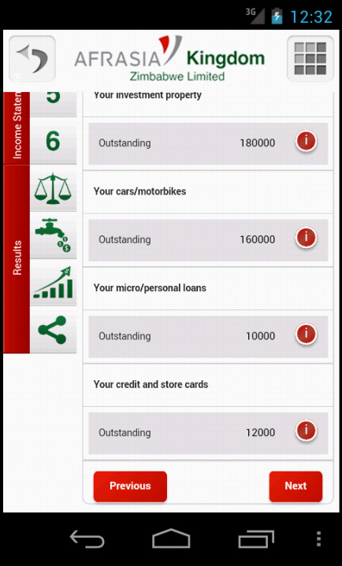
Liabilities

Slide 20
Liabilities
∇ Set_L3_ rarg;⎕IO;V1;V2;V3;V4;V5
:Access Public
:Signature Set_L3_ Double PropertyLoans,
Double InvestmentLoans, Double VehicleLoans,
Double OtherLoans, Double CreditCard
⍝⍝ Set_L3_ ....
⎕IO←1
⍝⍝
(V1 V2 V3 V4 V5)←5↑rarg
∆bs_l_property←V1
∆bs_l_invprop←V2
∆bs_l_vehicles←V3
∆bs_l_loans←V4
∆bs_l_credit←V5
⍝⍝ End Function
∇

Slide 21
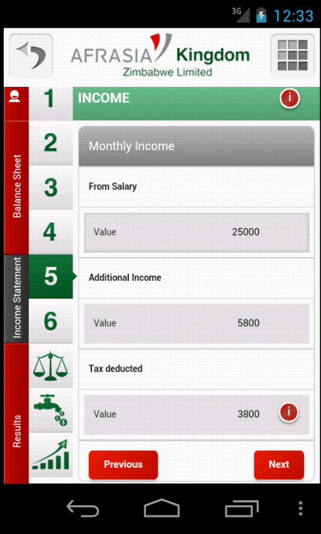
Income
∇ Set_L4_ rarg;⎕IO;V1;V2;V3
:Access Public
:Signature Set_L4_ Double Salary, Double OtherIncome, Double Tax
⍝⍝ Set_L4_ ....
⎕IO←1
⍝⍝
(V1 V2 V3)←3↑rarg
∆is_salary←V1
∆is_income←V2
∆is_tax←V3
⍝⍝ End Function
∇

Slide 22
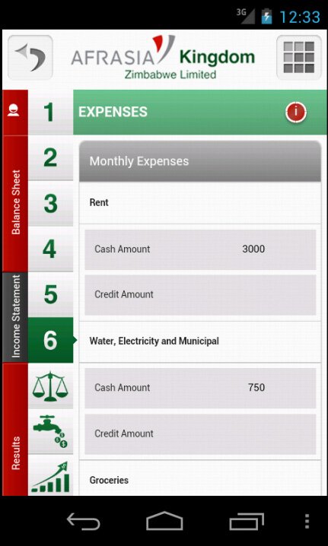
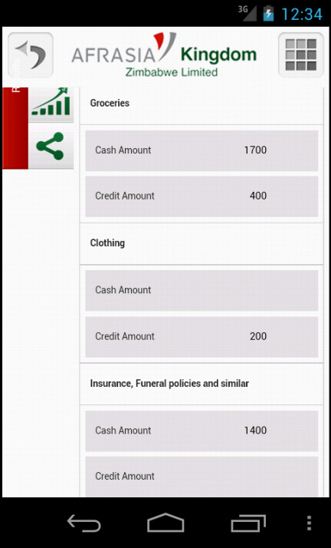
Expenses

Slide 23
Expenses
∇ Set_L5_ rarg;⎕IO;V1;V2;V3;V4;V5;V6;V7;V8;V9;V10;V11;V12;V13;V14;V15;V16;V17;
V18;V19;V20;V21;V22
:Access Public
:Signature Set_L5_ Double Rent_Bank, Double Rent_Credit,
Double WaterElec_Bank, Double WaterElec_Credit, Double Grosories_Bank,
Double Grosories_Credit, Double Cloths_Bank, Double Cloths_Credit,
Double Policies_Bank, Double Policies_Credit, Double Medical_Bank,
Double Medical_Credit, Double Transport_Bank, Double Transport_Credit,
Double Entertain_Bank, Double Entertain_Credit, Double Study_Bank,
Double Study_Credit, Double Phone_Bank, Double Phone_Credit,
Double Other_Bank, Double Other_Credit
⍝⍝ Set_L5_ ....
⎕IO←1
⍝⍝
(V1 V2 V3 V4 V5 V6 V7 V8 V9 V10 V11 V12 V13 V14 V15 V16 V17 V18 V19 V20 V21 V22)←22↑rarg
∆cf_rent←V1
∆is_rent←V2
∆cf_we←V3
∆is_we←V4
.....
∆cf_other←V21
∆is_other←V22
∇

Slide 24
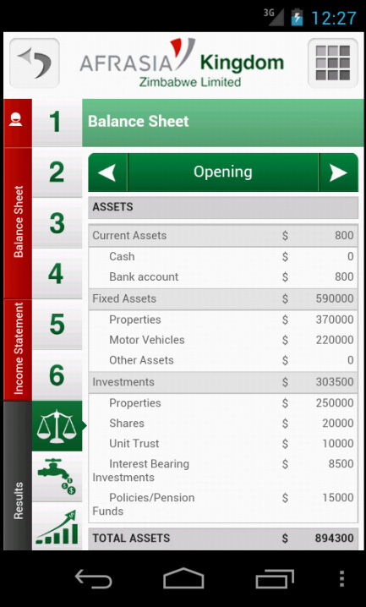
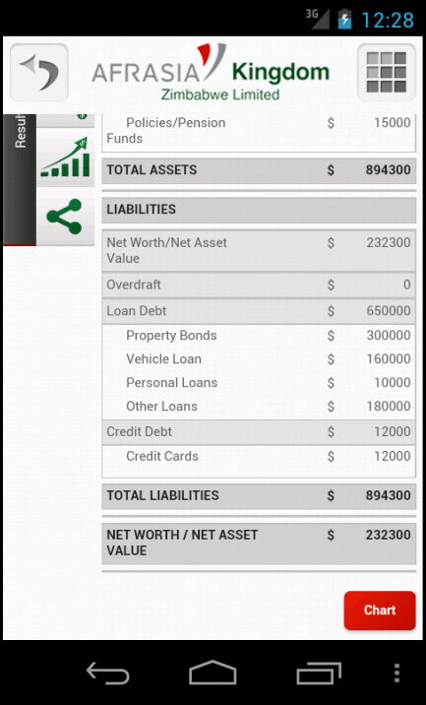
Balance Sheet

Slide 25
Balance Sheet
∇ Ret←Get_BS_All_;⎕IO;i
:Access Public
:Signature Double[,]←Get_BS_All_
⍝⍝
⎕IO←1
i←1 2 3 4 5 6 9 10 11 12 13 14 15 16 17 18 19 25 26 27 28 29 30 31 32 34 35 36
Ret←∆bs_values[∆bs_Line⍳100×i;(⍳12),1+12×⍳5]
∇
∇ Ret←Get_BS_Rows_;⎕IO;i
:Access Public
:Signature String[,]←Get_BS_Rows_
⎕IO←1
i←1 2 3 4 5 6 9 10 11 12 13 14 15 16 17 18 19 25 26 27 28 29 30 31 32 34 35 36
Ret←∆bs_Depth[∆bs_Line⍳100×i]
Ret←⍉Ret,[0.5]∆bs_Description[∆bs_Line⍳100×i]
∇

Slide 26
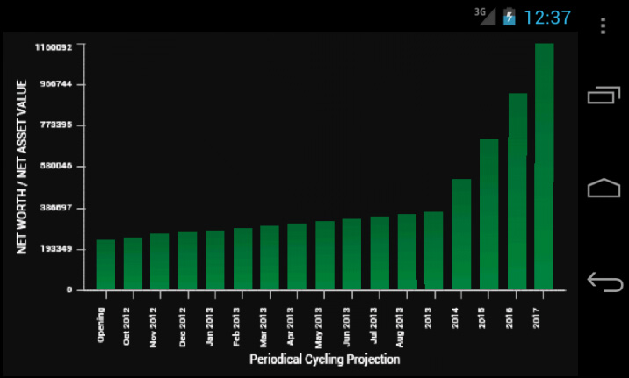
Balance Sheet Graph

Slide 27
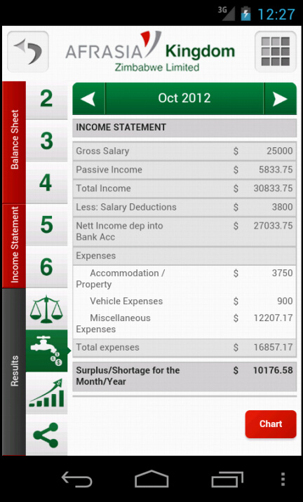
Income Statement

Slide 28
Income Statement
∇ Ret←Get_IS_All_;⎕IO;i;tmp
:Access Public
:Signature Double[,]←Get_IS_All_
⎕IO←1
i←1 2 4 5 7 8 9 10 10.02 10.07 11 11.01 11.02 12 12.03 12.04 12.05 12.12 12.13 12.14 12.16 12.19 12.18 13 14
tmp←↑(⊂1 1 60 0 1)YTD_¨↓∆is_values[∆is_Line⍳100×i;]
Ret←∆is_values[∆is_Line⍳100×i;(⍳12)],tmp[;12×⍳5]
∇
∇ Ret←Get_IS_Rows_;⎕IO;i
:Access Public
:Signature String[,]←Get_IS_Rows_
⎕IO←1
i←1 2 4 5 7 8 9 10 10.02 10.07 11 11.01 11.02 12 12.03 12.04 12.05 12.12 12.13 12.14 12.16 12.19 12.18 13 14
Ret←∆is_Depth2[∆is_Line⍳100×i]
Ret←⍉Ret,[0.5]∆is_Description[∆is_Line⍳100×i]
∇

Slide 29
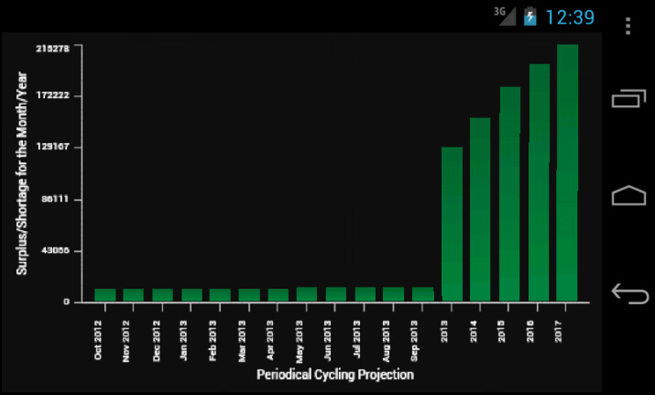
Income Statement Graph

Slide 30
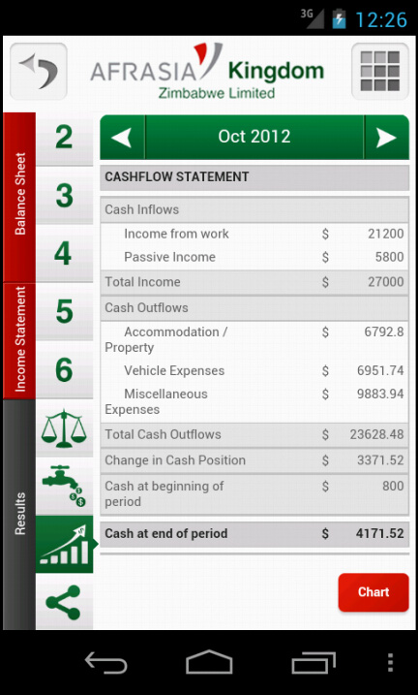
Cash flow Statement

Slide 31
Cash flow Statement
∇ Ret←Get_CF_Rows_;⎕IO;i
:Access Public
:Signature String[,]←Get_CF_Rows_
⎕IO←1
i←1 2 2.01 2.02 3 4 5 5.01 5.02 5.07 6 6.01 6.02 7 7.01 7.03 7.04 7.05 7.07 7.12 7.13 7.14 7.19 7.2 7.18 8 9 10 11
Ret←∆cf_Depth2[∆cf_Line⍳100×i]
Ret←⍉Ret,[0.5]∆cf_Description[∆cf_Line⍳100×i]
∇
∇ Ret←Get_CF_All_;⎕IO;i;j;k;tmp;res
:Access Public
:Signature Double[,]←Get_CF_All_
⎕IO←1
i←1 2 2.01 2.02 3 4 5 5.01 5.02 5.07 6 6.01 6.02 7 7.01 7.03 7.04 7.05 7.07 7.12 7.13 7.14 7.19 7.2 7.18 8 9 10 11
j←i~10 11 ⋄ k←10 11
tmp←↑(⊂1 1 60 0 1)YTD_¨↓∆cf_values[∆cf_Line⍳100×j;]
res←∆cf_values[∆cf_Line⍳100×k;]
res[1;12]←∆bs_bank
res[1;12×1+⍳4]←res[2;12×⍳4]
tmp←tmp ON_ res
Ret←∆cf_values[∆cf_Line⍳100×i;(⍳12)],tmp[;12×⍳5]
∇

Slide 32
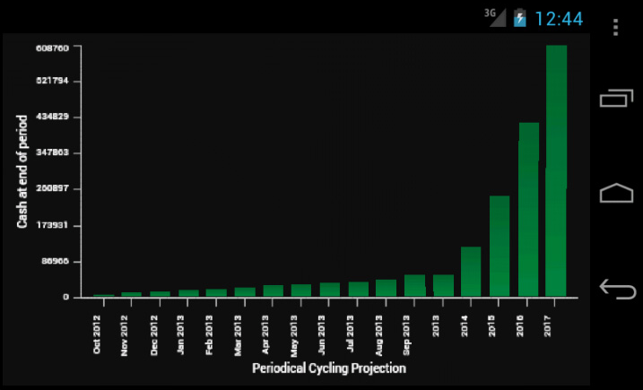
Cash flow Statement Graph

Slide 33
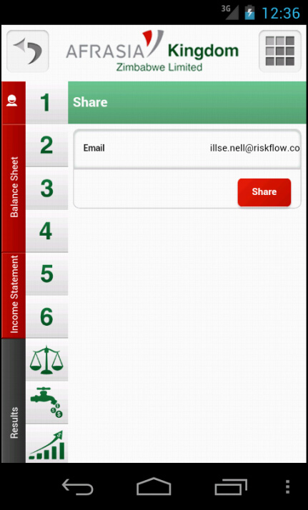
Share your details
Type in an email address and they will receive an Excel copy of your Balance Sheet.
This function is to help the bank gain value information to assist you.

Slide 34
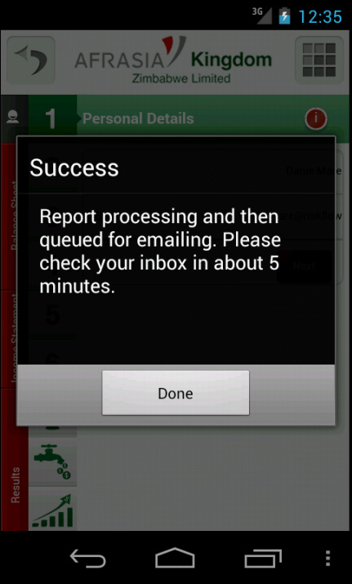
Sharing Confirmation
Confirmation message that indicates the status of the email sent.

Slide 35
Demo Code
I will now show you some examples including practical code of how the DLL has been implemented on multiple platforms.

Slide 36
Any Questions?
??

