Slide 1


Slide 2
Welcome to
To 78 delegates from:
United States | 23
United Kingdom | 21
Italy | 15
Sweden | 5
Denmark | 5
Canada | 4
Finland | 3
South Africa | 1
Russia | 1
Grand Total | 78

Slide 3
US Conference Delegates
 |  | 2013 | 2011 | 2009 | 2007
United States |  | 23 | 37 | 47 | 41
United Kingdom |  | 21 | 16 | 15 | 13
Italy |  | 15 | 21 | 7 | 7
Denmark |  | 5 | 4 | 5 | 5
Sweden |  | 5 |  |  | 6
Canada |  | 4 | 6 | 7 | 3
Finland |  | 3 | 2 | 1 | 3
Russia |  | 1 | 3 | 1 | 2
South Africa |  | 1
Germany |  |  | 1 | 1 | 2
Austria/Switzerland |  |  |  | 1 | 1
France |  |  |  | 1
Astralia/New Zealand |  |  |  | 2 | 1
Grand Total | 78 |  | 90 | 88 | 84

Slide 4
US Conference Delegates
 |  | 2013 | 2011 | 2009 | 2007
United States |  | 28 | 37 | 47 | 41
United Kingdom |  | 25 | 16 | 15 | 13
Italy |  | 15 | 21 | 7 | 7
Finland |  | 8 | 2 | 1 | 3
Denmark |  | 6 | 4 | 5 | 5
Sweden |  | 5 |  |  | 6
Canada |  | 4 | 6 | 7 | 3
Russia |  | 2 | 3 | 1 | 2
South Africa |  | 1
Germany |  |  | 1 | 1 | 2
Austria/Switzerland |  |  |  | 1 | 1
France |  |  |  | 1
Astralia/New Zealand |  |  |  | 2 | 1
Grand Total | 94 |  | 90 | 88 | 84

Slide 5
Agenda
...... I found the one-on-one interaction with the Dyalog developers extremely helpful
....... and the ability to interact with members of the community and from Dyalog is absolutely invaluable.
From last years questionaire:
It would be good to know who the Dyalog people are .....

Slide 6
Agenda
Dyalog
  Who we are
  What we do

Slide 7
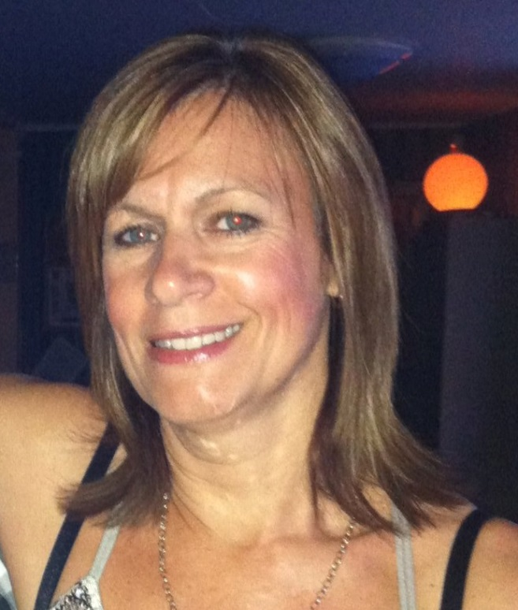
First things first
Karen is running this show
  and she is the one you
  want to ask about stuff ☺
She will make household announcements each morning
starting now:

Slide 8

Monday October 21st
Dyalog Dinner
6:30pm – meet on Oceanfront Patio to
        walk down together
7:00pm – dinner at JB’s on the Beach
        (next to Deerfield Beach Pier)

Slide 9
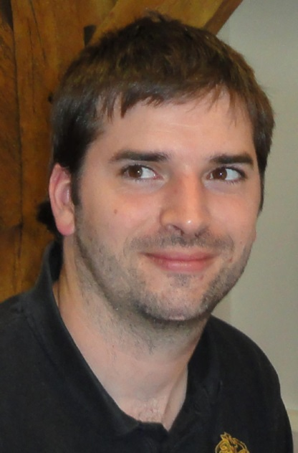
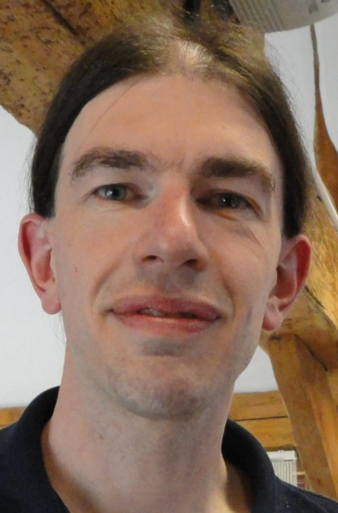
First things first
Jason and Jonathan are
managing the technical setup
  Those of you who are giving presentations please see
  them for any questions about
  wiring you up

Slide 10
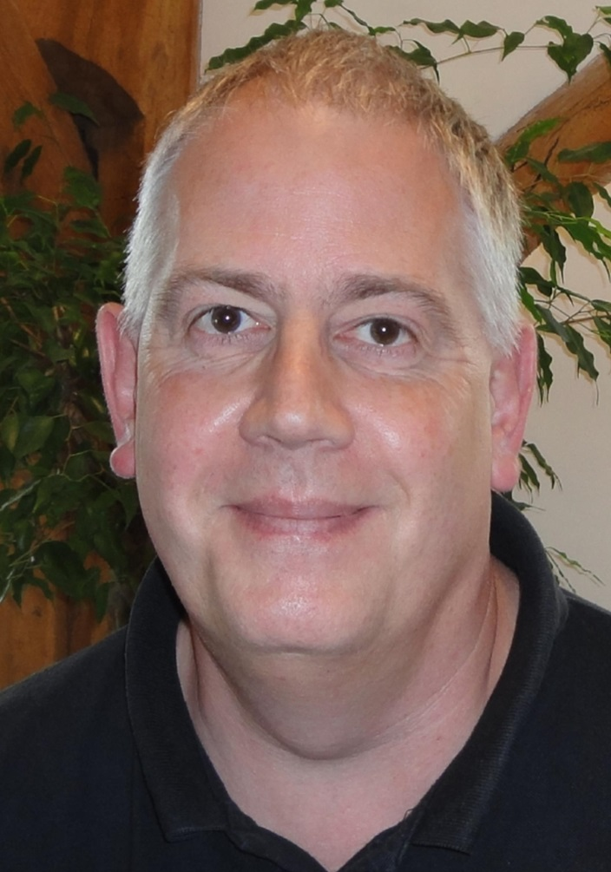
Secondly
Andy is our operations guy
in addition to being our
Unix guru.
  And of most importance to you:
  He is managing the DSS
  support and he is in control of
  our “incident lists” ☺

Slide 11
The Mission
To allow people with ”other skills than programming” to be key contributors to the Programming Process
To allow Software Engineers to feel comfortable with all aspects of the use of APL as a major or minor component of a Software Solution

Slide 12
The Customer
Today, 8 of our 10 biggest customers are software vendors themselves
They expect to be able to produce high-performance, scalable, secure multi-user applications which will fit into a corporate IT-infrastructure
They expect to be able to recruit new APL’ers

Slide 13
The Mission
To allow people with ”other skills than programming” to be key contributors to the Programming Process
To allow Software Engineers to feel comfortable with all aspects of the use of APL as a major or minor component of a Software Solution

Slide 14
Talk to the others
Object Orientation
  Better paradigm for talking to the environment
.NET support
  Consume vast library of resources
.NET assemblies
  Package APL code to be consumed by others
WPF
  The successor to Win32 and WinForms on Microsoft Windows

Slide 15
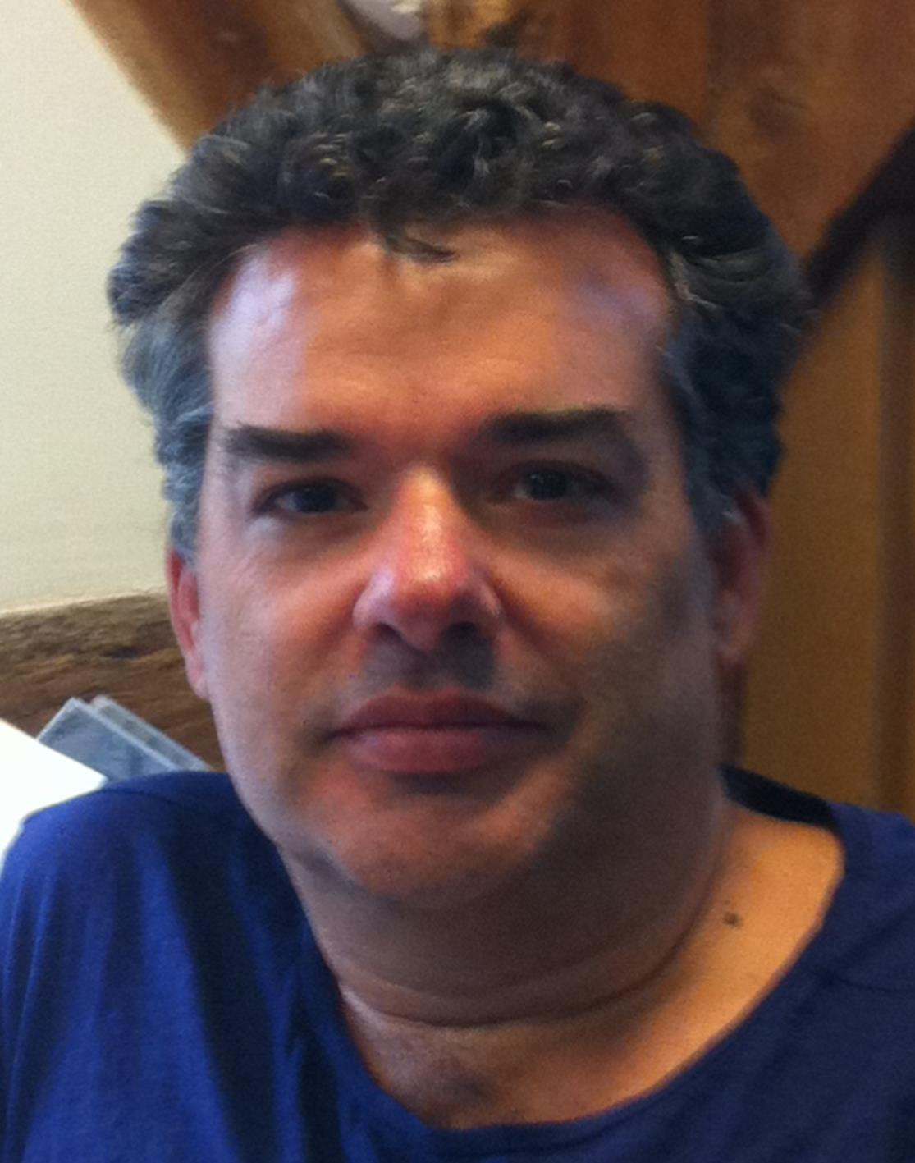
Talk to the others
  John Daintree
  Chief Architect and
  implementor of these
  interfaces

Slide 16
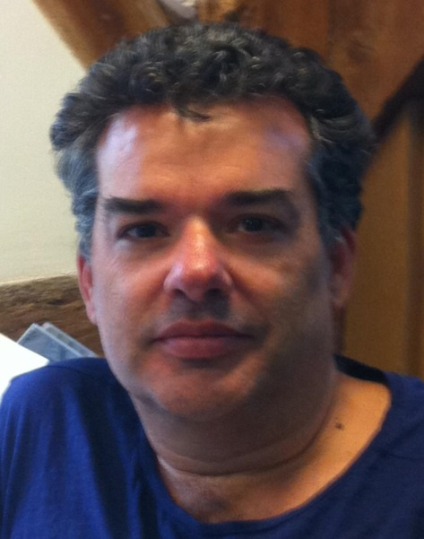

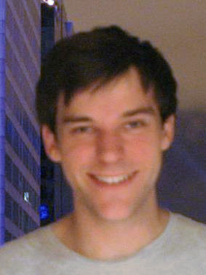
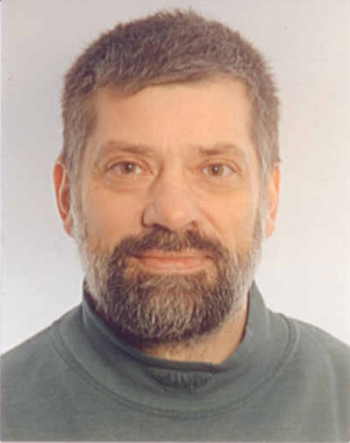
Talk to the others (yourself)
RIDE
  a long time underway
  Microsoft didn’t help
  We now have a ”big” team working on it:

Slide 17
Be like the others
Unicode
  APL-char problem solved
64-Bit
  Since 2005 – now becoming standard
Source Code Management

Slide 18
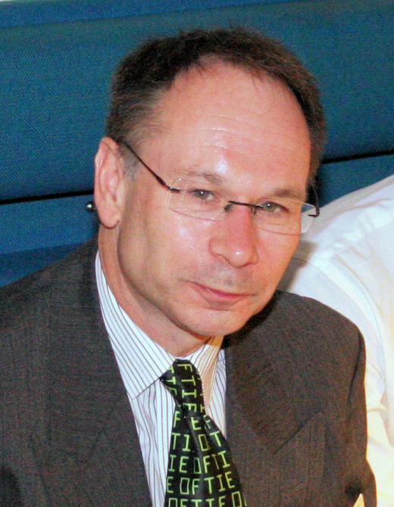
Be like the others
Journaling Component Files
  Coping with network deficiencies
Dyalog File Server (“ShareFiles” for Dyalog)
  High performance, secure Component Files

Slide 19
Be like the others
SQL interface - SQAPL
TCP/IP comm with SSL Support and Windows Single Signon (Conga v2.3)
  Security across open networks

Slide 20
Be fast and furious
  APL applications compete quite well with applications developed in other languages when it comes to speed.
  Growing amounts of data and requirements for new functionality require even more speed - and we cannot rely on the processors to provide that any more.

Slide 21
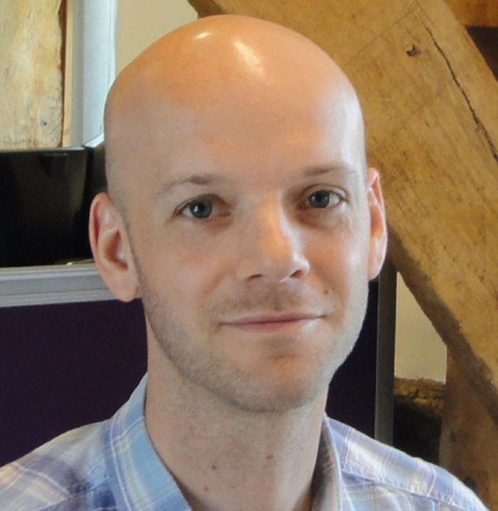
Be fast and furious
  Measuring speed is important
    “APLMON” and ⎕Profile
  Interpretative speed
    Reduce overhead on small functions
    Look at memory management
  Compilation of APL
    Working with Aaron Hsu

Slide 22
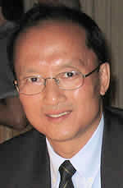
Be fast and furious
  Primitive function performance

Slide 23
The Mission
To allow people with ”other skills than programming” to be key contributors to the Programming Process
To allow Software Engineers to feel comfortable with all aspects of the use of APL as a major or minor component of a Software Solution

Slide 24
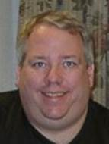
Tools
MiServer v. 3
  New OO Framework
SAWS
  StandAlone Web Service
DFS
  Dyalog File Server

Slide 25
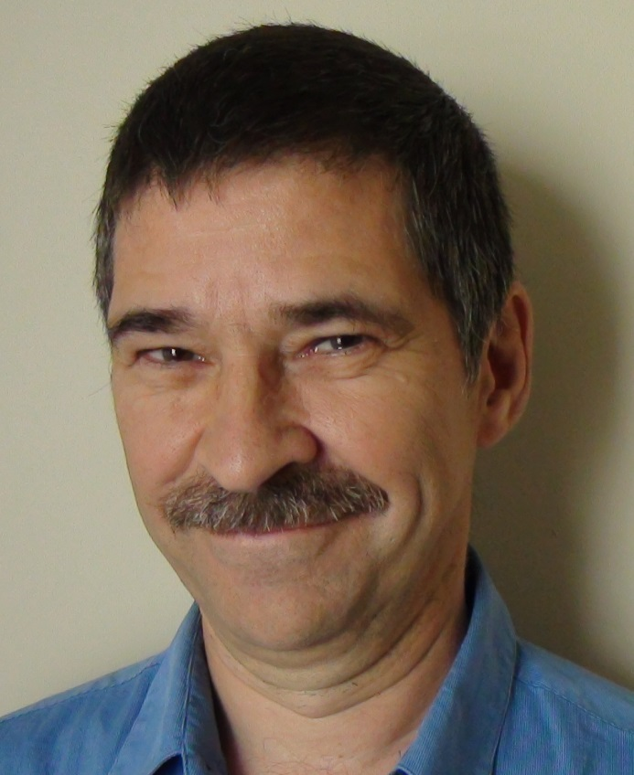
Tools
SALT
  Code Management
User Commands
  Utility Functions
Web Lectures

Slide 26
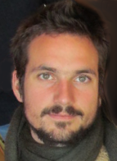
Tools
SharpPlot

Slide 27
APL the Language
Moving towards parallel computing with Dyalog v.14
Language constructs for expressing parallelism
Functional programming to facilitate compilation

Slide 28

APL the Language
Function
Trains
Rank
and Key

Slide 29
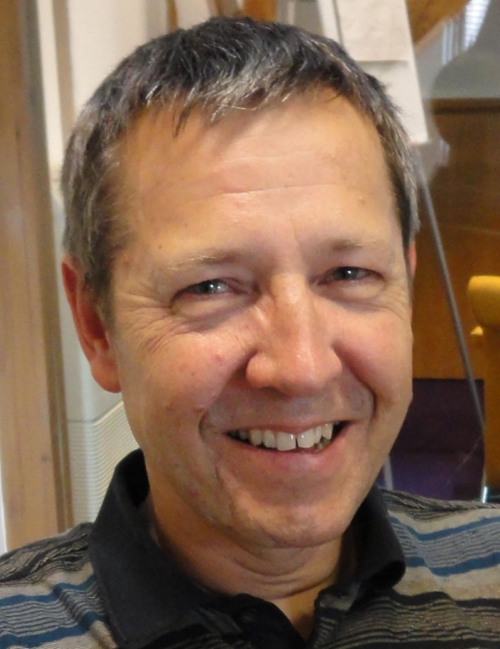

APL the Language
Futures and Isolates

Slide 30
The Customer
Today, 8 of our 10 biggest customers are software vendors themselves
They expect to be able to produce high-performance, scalable, secure multi-user applications which will fit into a corporate IT-infrastructure
They expect to be able to recruit new APL’ers

Slide 31
New APL’ers
Annual APL contest
  New format
  2 stages – introductory and problem set
  ~100 participated in stage 1
  13 completed stage 2
We believe that our customers could benefit from looking at the contestants when they recruit

Slide 32
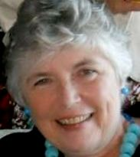
New APL’ers
Pat Buteux joined last year
as US Marketing and Sales
Pat has been following our
educational license holders
closely since she joined
She is also responsible for the Scavenger Hunt

Slide 33
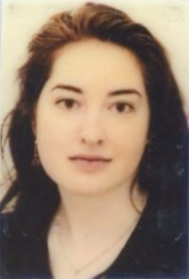
New APL’ers
Fiona Smith joined this year
as Documentation Manager
She now know what a new
APL programmer needs
The reference card is her initiative
  It is version 1 so please evaluate and give us feedback.
She cultivates our vocabularies

Slide 34
New APL’ers
Fiona Smith joined this year
as Documentation Manager
She now know what a new
APL programmer needs
The reference card is her initiative
  It is version 1 so please evaluate and give us feedback.
She cultivates our vocabularies
  Pre-prandial

Slide 35
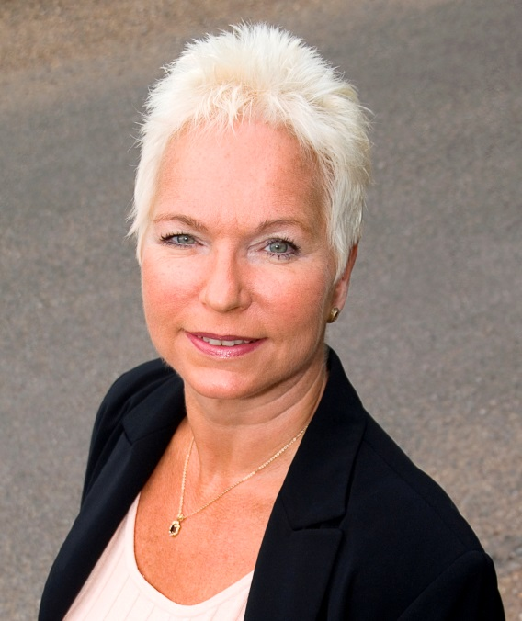
New APL’ers and Old
New website in the works
Targeted at
  better captivating newcomers
  providing platform for know-how sharing
  organising material better
Vibeke is in charge of the site and is always chasing good APL stories

Slide 36
Welcome to Dyalog’13
Enjoy the conference
Enjoy the Customer presentations
Enjoy the previews of Dyalog v.14

Slide 37
Welcome to Dyalog’13
Enjoy the conference
Enjoy the Customer presentations
Enjoy the previews of Dyalog v.14
Enjoy your network

