Slide 1

Towards
Industrial Strength
Web Applications
Brian Becker, Dyalog LTD.
APL Tools Group

Slide 2
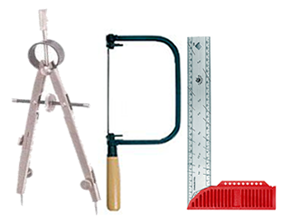
The APL Tools Group
Our job is to provide you tools that make it easier for you to do your job.

Slide 3
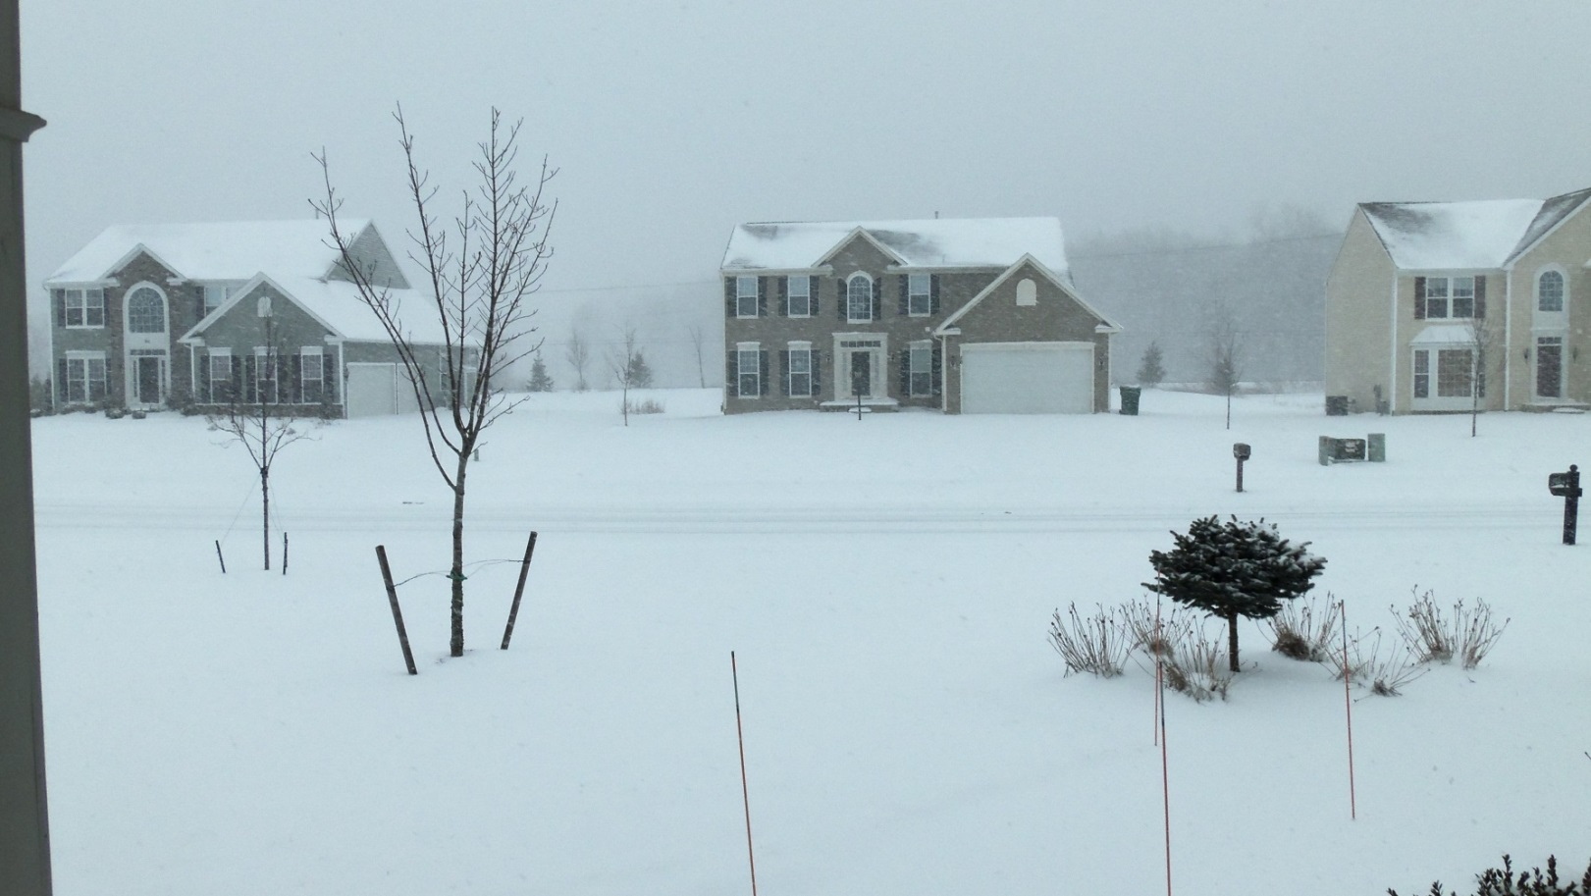
Before We Begin…
If you were at Elsinore last year…

Slide 4
Agenda
What is MiServer?
MiServer Features
MiServer Version 3

Slide 5
What is a Web Server?
A program that listens for HTTP requests for “resources” from clients, which are typically web browsers.
The server attempts to locate the resource (typically an HTML file) and send the contents to the client.
If the resource is a “script”, execute it and generate “dynamic” output.

Slide 6
MiServer - More Than Just a Web Server
Yes, it is a web server written in APL by APLers for APLers
It's also an extensible web server framework
  You can add your own features and extensions
And a web application server
  Provide a web interface to existing and new APL applications
And an ever-growing suite of tools to help APLers build web content.
Cross platform – currently: Windows, Linux, AIX;
future: OS X (Mac), Android
Open source - http://tools.dyalog.com and GitHub

Slide 7
MiServer’s Evolution
The “WildServer”
  Stefano Lanzavecchia – 2007
The “MildServer”
  Morten Kromberg
    Version 1.0 - 2009
MiServer
  APL Tools Group
    Version 2.0 - 2012
    Version 3.0 - 2014

Slide 8
MiServer Philosophy
"Anyone who can write an APL function should be able to host it on the Web"
Provide a suite of HTML generating tools that cover most common use cases
  Goal: Make it no more complex to develop rich user interfaces than using the native Dyalog GUI function ⎕WC
Provide interface(s) to the full functionality of the underlying technologies
  JavaScript, jQuery, jQueryUI, jQueryMobile, SyncFusion
Make the framework easy to modify and extend
  APL extensions
  Adding new plug-ins/widgets/libraries

Slide 9
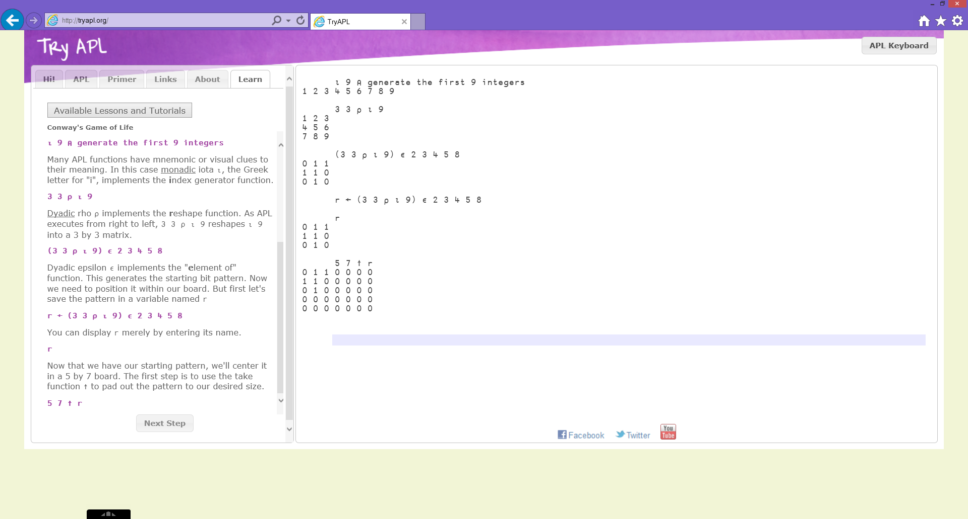
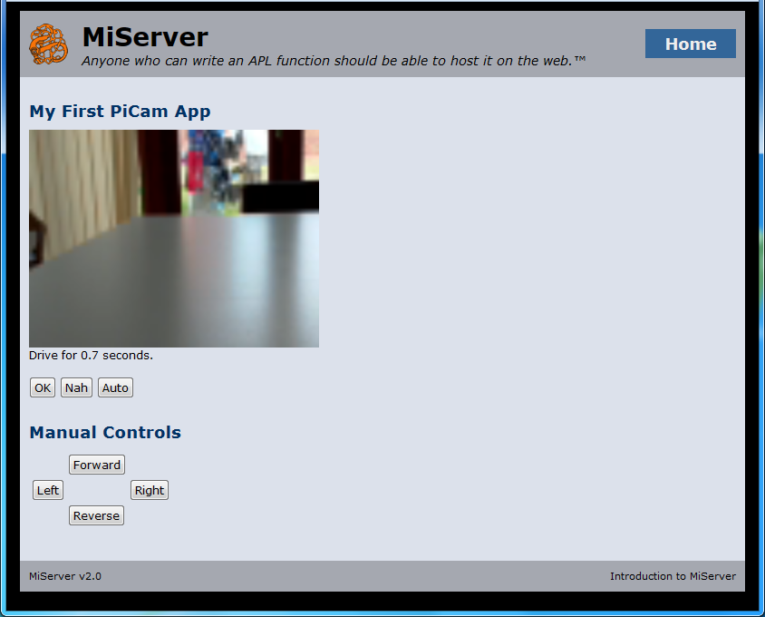
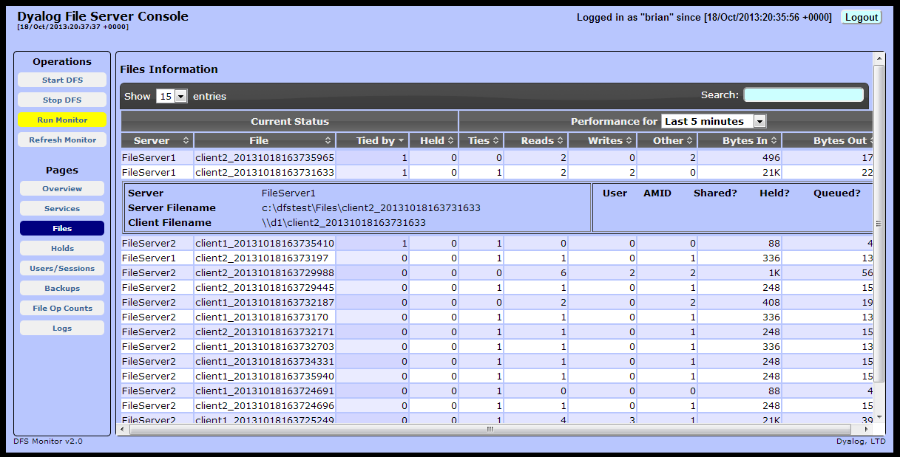
MiServer In Use…

Slide 10
MiServer Features
User Sessions/User State
  HTTP is a "stateless" protocol meaning that each request is treated as an independent transaction that is unrelated to any previous request.
  MiServer implements user sessions to maintain state across transactions.

Slide 11
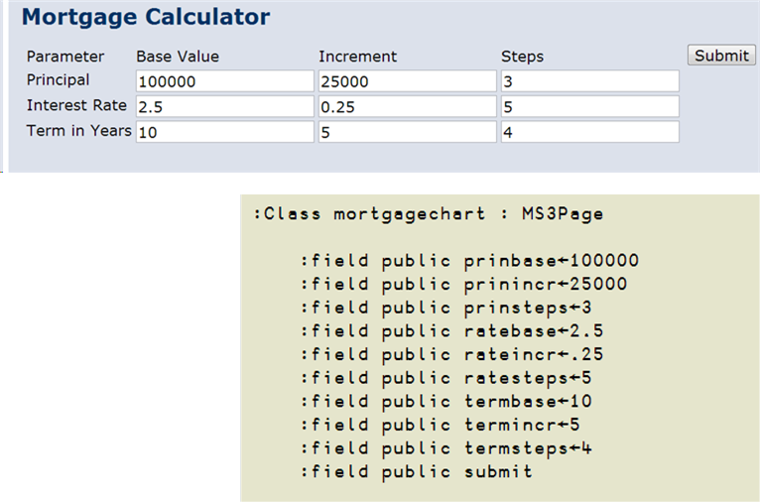
MiServer Features
Data Binding
  Input elements in the web page can be bound to like-named fields or properties on the server.
  MiServer v3 will extend this capability
    Knockout.js is a JavaScript library that implements data binding
    SyncFusion

Slide 12
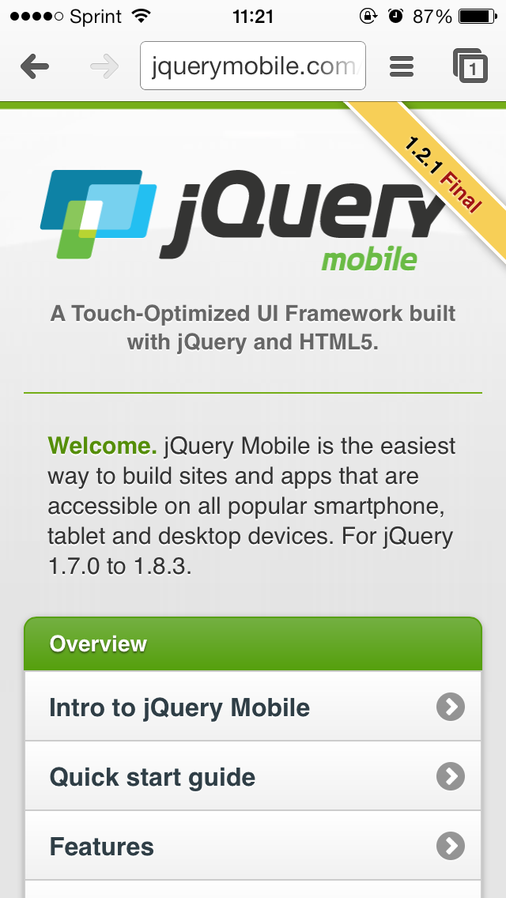
MiServer Features
JavaScript Plug-In Support
  jQuery is a JavaScript library that provides cross-browser web page Document Object Model (DOM) manipulation.
  In addition, there are many*2 tools and toolsets based on jQuery
    jQueryUI – Widgets, Interactions, Effects, Themes
    DataTables, and others
    MiServer 3 will add:
      jQueryMobile
      SyncFusion – 30+ widgets

Slide 13
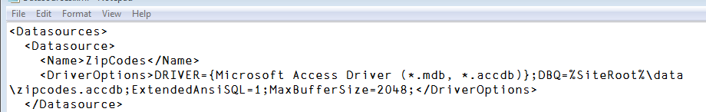
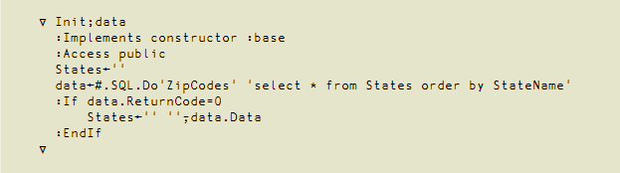
MiServer Features
SQAPL support
  "Named" datasources
  Of course, you can also use SQAPL natively

Slide 14
MiServer Features
Logging – 3 flavors
  HTTP Request logging
    Can be analyzed using standard log processing tools
  Error logging
    Using DrA – Dyalog's error logging utility
    Email notification
  Server and User Configurable logging
    Define your own events to log

Slide 15
MiServer Features
Security Features
  Secure communications available using Conga's SSL/TLS support
  Basic HTTP Authentication support
  Integrated Windows Authentication (Single sign-on in a Windows domain)

Slide 16
MiServer Features
Ability to run "behind" IIS or Apache server
  Using CGI via MiServerCGI.exe
  MiServer runs in background
  MiServerCGI is a thin layer that forwards request information to MiServer and waits for a response to send back to IIS/Apache

Slide 17
HTML Element anatomy
<div id="mydiv">some text</div>
Some tags have no content
<br/>
<meta charset="utf-8"/>
<link rel="icon" href="/i.png"/>
tag (element) name
attributes
opening tag
content
closing tag

Slide 18
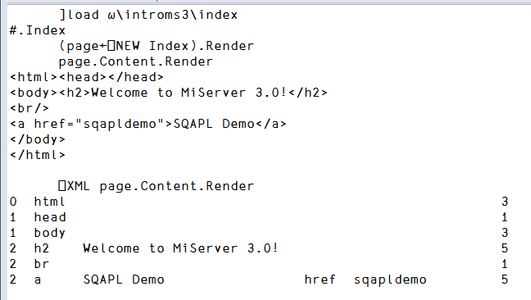
MiServer Features
MiServer generates XHTML
  XML-compliant HTML
  all attributes are quoted
  all elements are closed
Why is this significant?
  Content can be processed by XML tools
  ⎕XML can be used to build test and validation tools

Slide 19
MiServer Versions 2 and 3
MiServer 2
Builds page content by concatenating strings
AJAX support via APLJax method
Available now
MiServer 3
Builds page content by "Add"ing objects
AJAX support via APLJax and named callback functions
MiServer 2 pages can be built using MiServer 3
Available 2nd Quarter 2014

Slide 20
Make them say "Ooh" and "Aah"
Originally I'd thought of namespace names…
  OOH – Object Oriented HTML
  AAH – APL Augmented HTML
  Fortunately, saner minds prevailed and they are instead named HTML, and _HTML

Slide 21
Why Object Oriented?
Because you can more easily manipulate your page content.

Slide 22
HtmlElement class
Every HTML5 element is implemented using the class HtmlElement and contained in the HTML namespace
d←⎕NEW HTML.div
Constructor can accept content and attributes
d←⎕NEW HTML.div ('some test' 'id=1')
Render renders the element's HTML
d.Render
<div id="1">some test</div>

Slide 23
HtmlElement
Add adds to the element's content
d.Add 'some text'
SetAttr sets element attributes
d.SetAttr 'onclick' 'alert("hello")'

Slide 24
HtmlElement fields/props
Fields defined for common HTML element attributes:
id value name class
style title type
d.(title class)←'Hello' 'hdg'
Content contains the content for the element
Attr is a keyed property for attributes

Slide 25
HtmlElement Setting Attributes
Using Attr
d.Attr['id' 'class']←'foo' 'goo'
d.Attr[⊂'title']←⊂'Hello World'
Using SetAttr
d.SetAttr ('id' 'foo') ('class' 'goo')
d.SetAttr 'id' 'foo' 'class' 'goo'
d.SetAttr 'id=foo' 'class=goo'
d.SetAttr 'id=foo class=goo'

Slide 26
HtmlElement Function Chaining
If Add is passed an object, it returns a reference to the object that was added
SetAttr returns a reference to its object
tab←⎕NEW HTML.table
((tab.Add HTML.tr).SetAttr 'class=hdg').Add HTML.td 'cell content'

Slide 27
Some Examples…
A sampling of MiServer pages

Slide 28

In the words of Porky the Pig…
Please come to our Dyalog 2015 presentation entitled "Reflections on Industrial Strength Web Applications" ☺
Questions?

