Slide 1

October 20-24

Slide 2
Interfaces to NAG, R and Q
Morten Kromberg
Dyalog LTD
Dyalog’13

Slide 3
Agenda
Briefly discuss interfaces from Dyalog APL to three external software packages:
R – Free Statistical Package
NAG – Numerical Algorithms Group
Q – High Performance Database

Slide 4
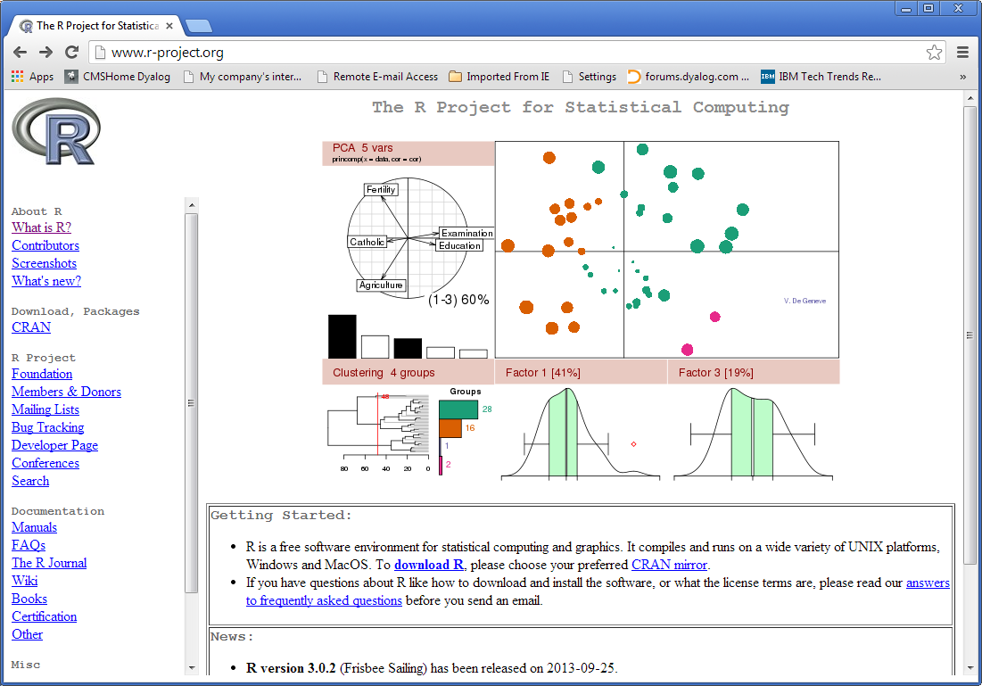

Slide 5
R
Free programming language for statistical computing
  (Open Source version of ”S”)
Extensive and growing libraries for statistics and graphics
Widely used by statisticians and ”data miners”
A rising star – lots of users
  http://www.sr.bham.ac.uk/~ajrs/R/r-gallery.html

Slide 6
Rconnect - Features
Encapsulates the R environment as an object within an APL workspace
R functions can be called ”as if the were in your workspace”
R arrays and simple lists are mapped direct to APL arrays
Other common R structures are mapped to objects:
  lists with named items
  tables, data.frame and ts
DEMO...

Slide 7
Rconnect - benefits
Leverage existing R skills
Tap into state-of-the-art statistics and graphics
Verify statistical routines written in APL

Slide 8
Rconnect Availability
Official release with documentation in Q1/2014 for Unicode editions of Dyalog APL for Windows or Linux
  Test versions available now
Requires with R v2.1 or later with rscproxy
  Note: Dyalog cannot distribute R
  (and you probably cannot either!)
Rconnect will be free a download from tools.dyalog.com

Slide 9
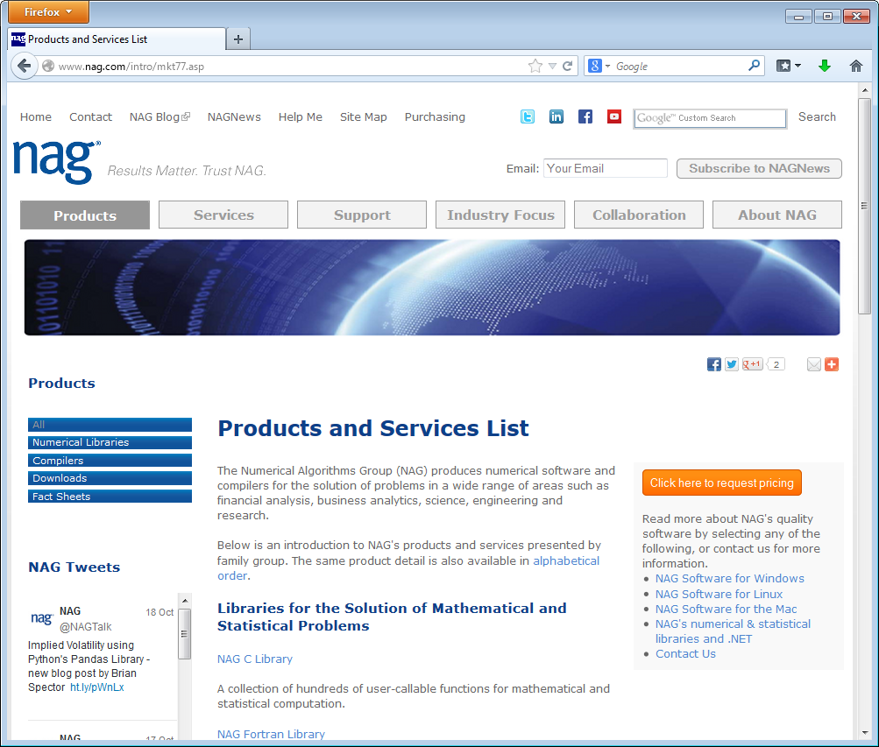

Slide 10
NAG (Numerical Algorithm Group)
“The largest collection of reliable and supported numerical algorithms commercially available”
  Library of over 1,700 functions
NAG is not free; the advantage is you can embed the libraries in your application
  NAG Libraries can be purchased through Dyalog or directly from NAG

Slide 11
NAG Numerical Facilities
Optimization, both Local and Global
Linear, quadratic, integer and nonlinear programming and least squares problems
Ordinary and partial differential equations, and mesh generation
Solution of dense, banded and sparse linear equations and eigenvalue problems
Solution of linear and nonlinear least squares problems
Curve and surface fitting and interpolation
Numerical integration and integral equations
Roots of nonlinear equations (including polynomials)
Option Pricing Formulae
Wavelet Transforms

Slide 12
NAG Statistical Facilities
Random number generation
Simple calculations on statistical data
Correlation and regression analysis
Multivariate methods
Analysis of variance and contingency table analysis
Time series analysis
Nonparametric statistics

Slide 13
Dyalog - NAG Interface
Will be available under Windows and Linux (32&64)
In v14: ⎕NA extended with support for callbacks
  Allows NAG optimization methods to use APL functions to compute values to be optimised
  May be ported to earlier versions depending on interest
Dyalog aims to provide a function-builder that will build a ”first cut” cover-function for any NAG function
Most functions will need, or benefit from manual ”tweaking” after auto-generation
Dyalog will participate in building an collecting / publishing libraries of APL cover-functions

Slide 14
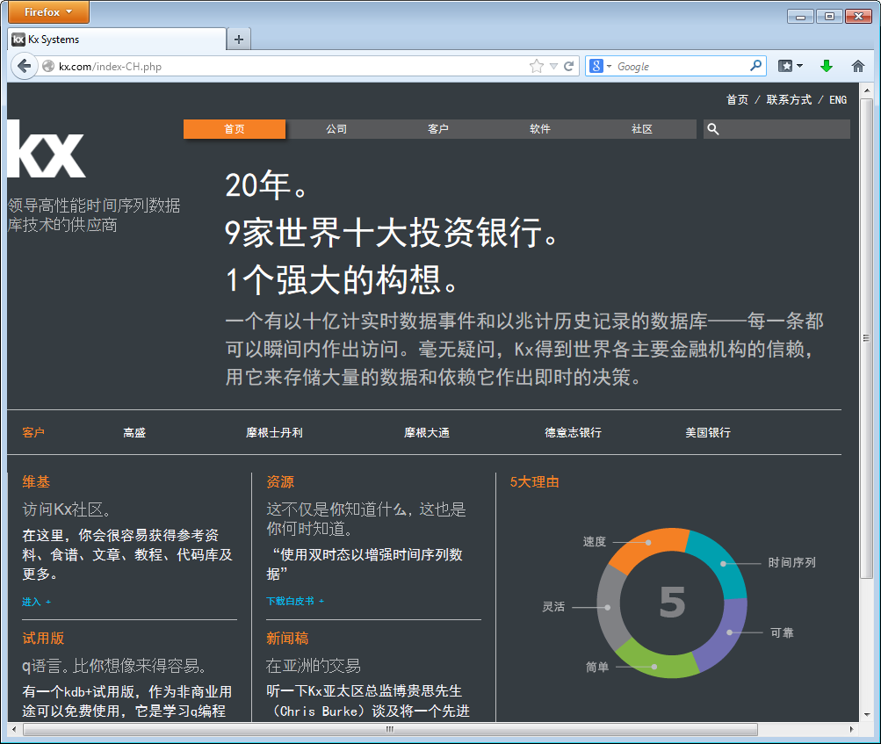
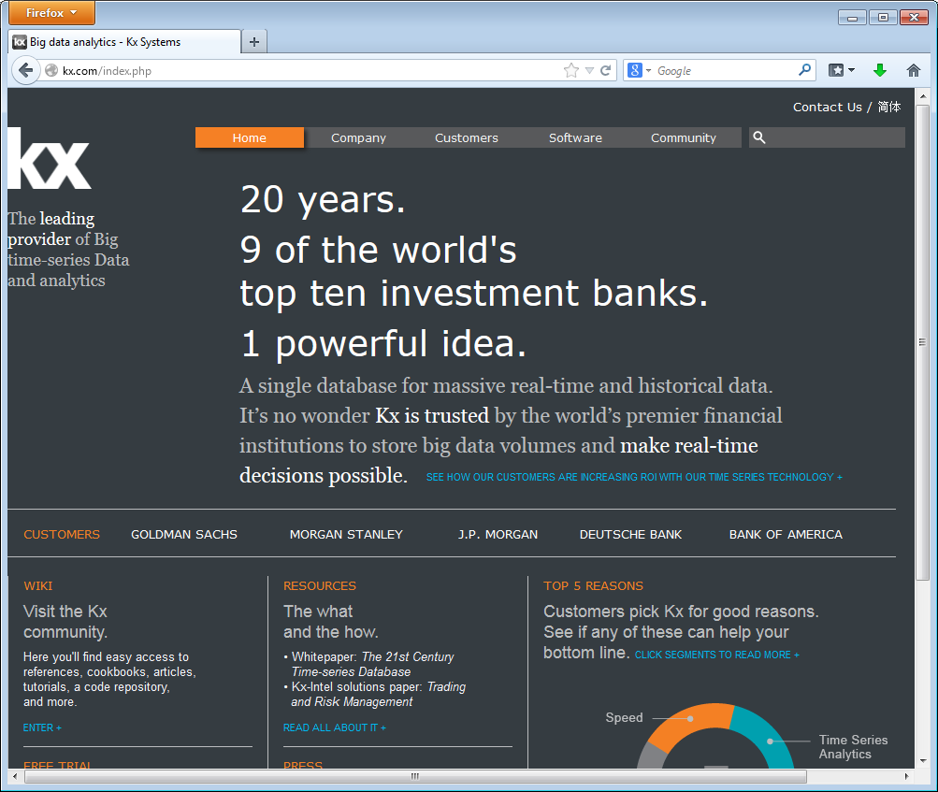

Slide 15
Qconnect
Capabilities
Execute Q statements from APL
Convert Q data structures to APL arrays
Implementation
Uses CONGA to connect to the Q ”IPC” interface (TCP Sockets)

Slide 16
Credits
Ronald Chan: Rconnect implementation
Sasha Skomorokhov (University of Obninsk): Documenting the R interface (& understanding R)
Fiona Smith: Rconnect documentation
Geoff Streeter: ⎕NA callback extensions and NAG samples
Chris Burke (kx and Jsoftware) and Simon Garland (kx): getting started with Q IPC.
Gilgamesh Athoraya (Optima) help with Q data conversions.

Slide 17
Demos
R
NAG
Q

Slide 18
Availability
Rconnect: Q1/2014
Qconnect: Under development, available to anyone who is interested
  Free 32-bit kdb+ trials at http://kx.com
NAG: Proof of Concept under way
  Contact Dyalog if you would like to participate

