Slide 1





@OptimaSystemsUK
Raspberry Pi Project
James Greeley – Private Pi – Robot
Samuel Gutsell – Pi in the Sky – Weather Station
Shaquil Sidiki – Racing Pi - Robot

Slide 2
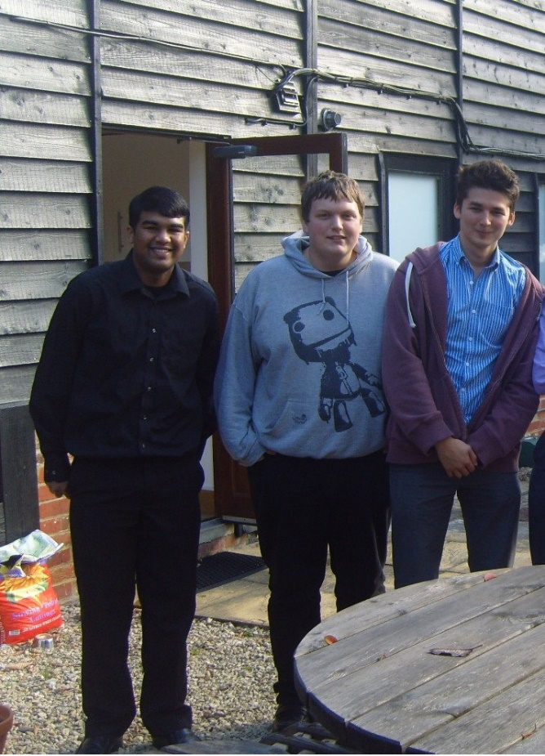
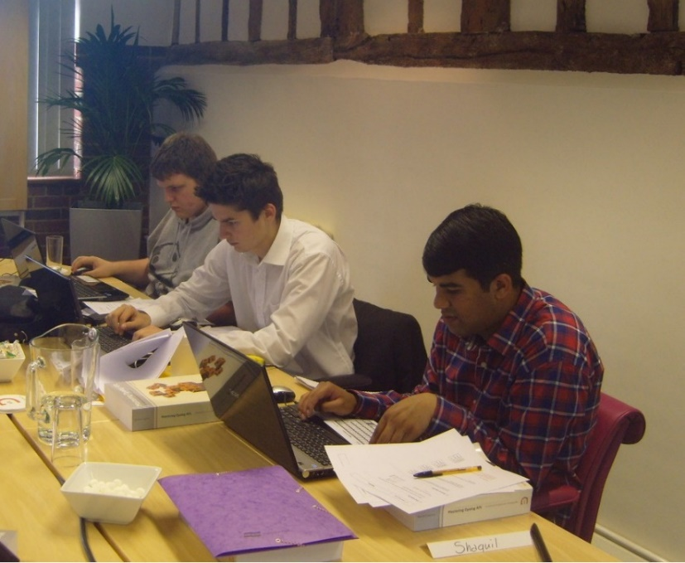
@OptimaSystemsUK
About Us
Former apprentices at Optima Systems Ltd (UK)
Trainee APL Programmers since August 2013
Have been using APL for just over 1 year
Blog: http://threeblindmiceapl.wordpress.com

Slide 3

@OptimaSystemsUK
Project Background
Last conference Dyalog discussed using APL on Raspberry Pi
Asked to investigate Raspberry Pi’s by Paul Grosvenor
In May he asked us to think of a project
Our budget was £150 (242.26 US Dollar) each
We had until August to finish it
We each chose individual projects to undertake
A Raspberry Pi that has Dyalog APL running MiServer, which is various hardware components

Slide 4
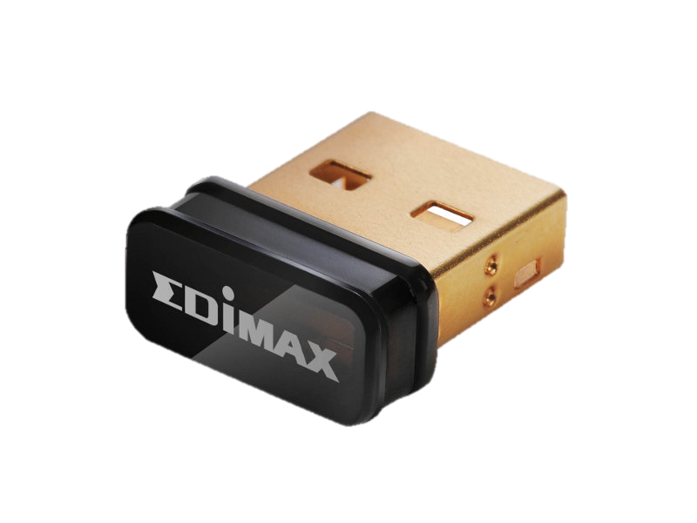
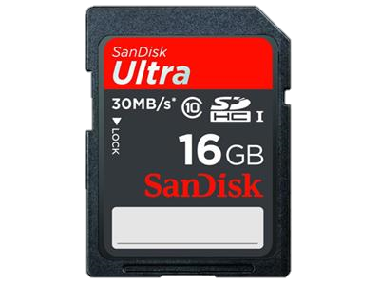
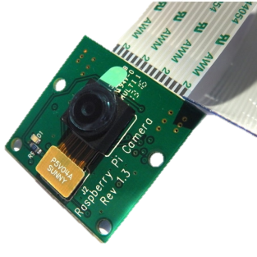
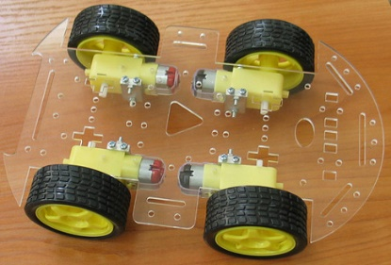
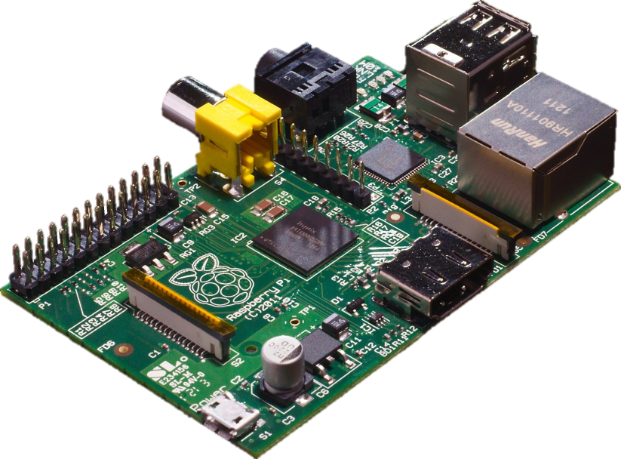
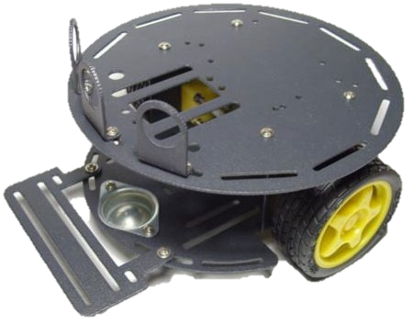
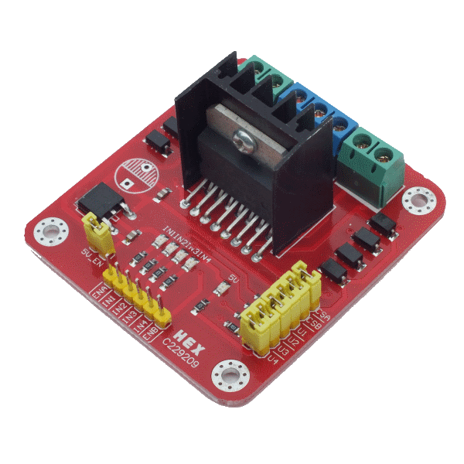
@OptimaSystemsUK
Hardware
Wi-Fi Dongle
£5
$8.07
Pi Camera
£15
$24.22
SD Card
£13
£20.99
Shaquil’s Chassis
£15
$24.22
Motor Controller
£20
$32.29
Raspberry Pi
£28
$45.21
James’ Chassis
£25
$40.37

Slide 5

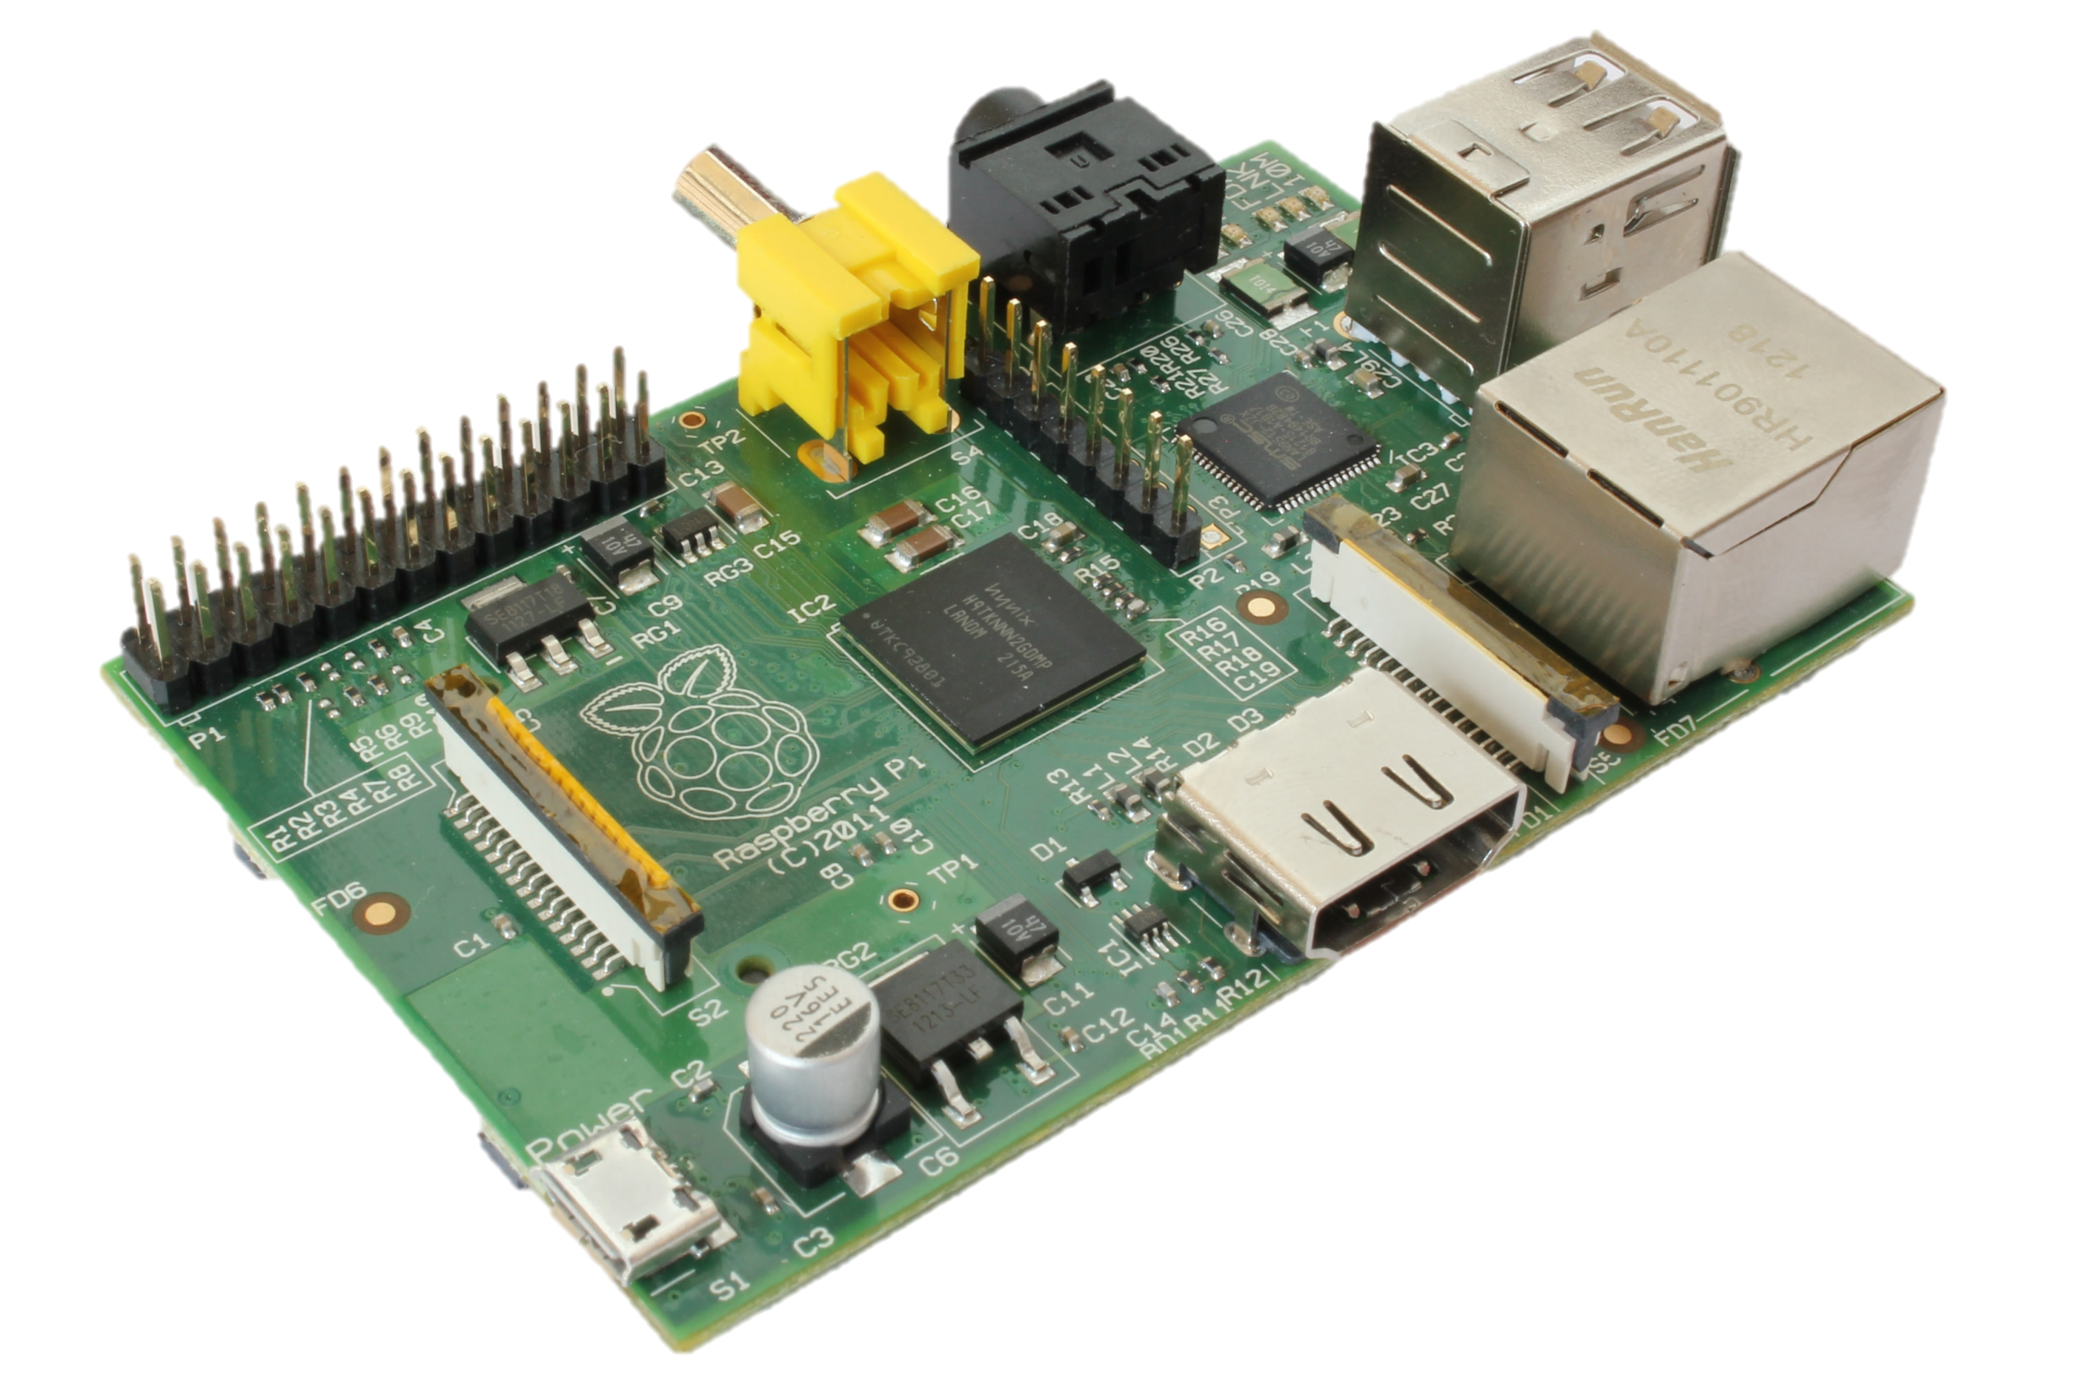
@OptimaSystemsUK
Raspberry PI
The brain of the project
Runs Linux distribution optimised for Raspberry Pi called Raspbian Wheezy
Runs Dyalog APL 13.2
5

Slide 6

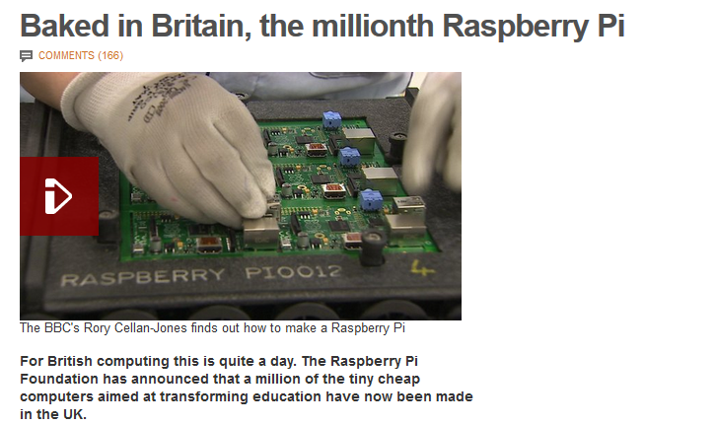

1 millionth Raspberry Pi Baked in Great Britain

Slide 7
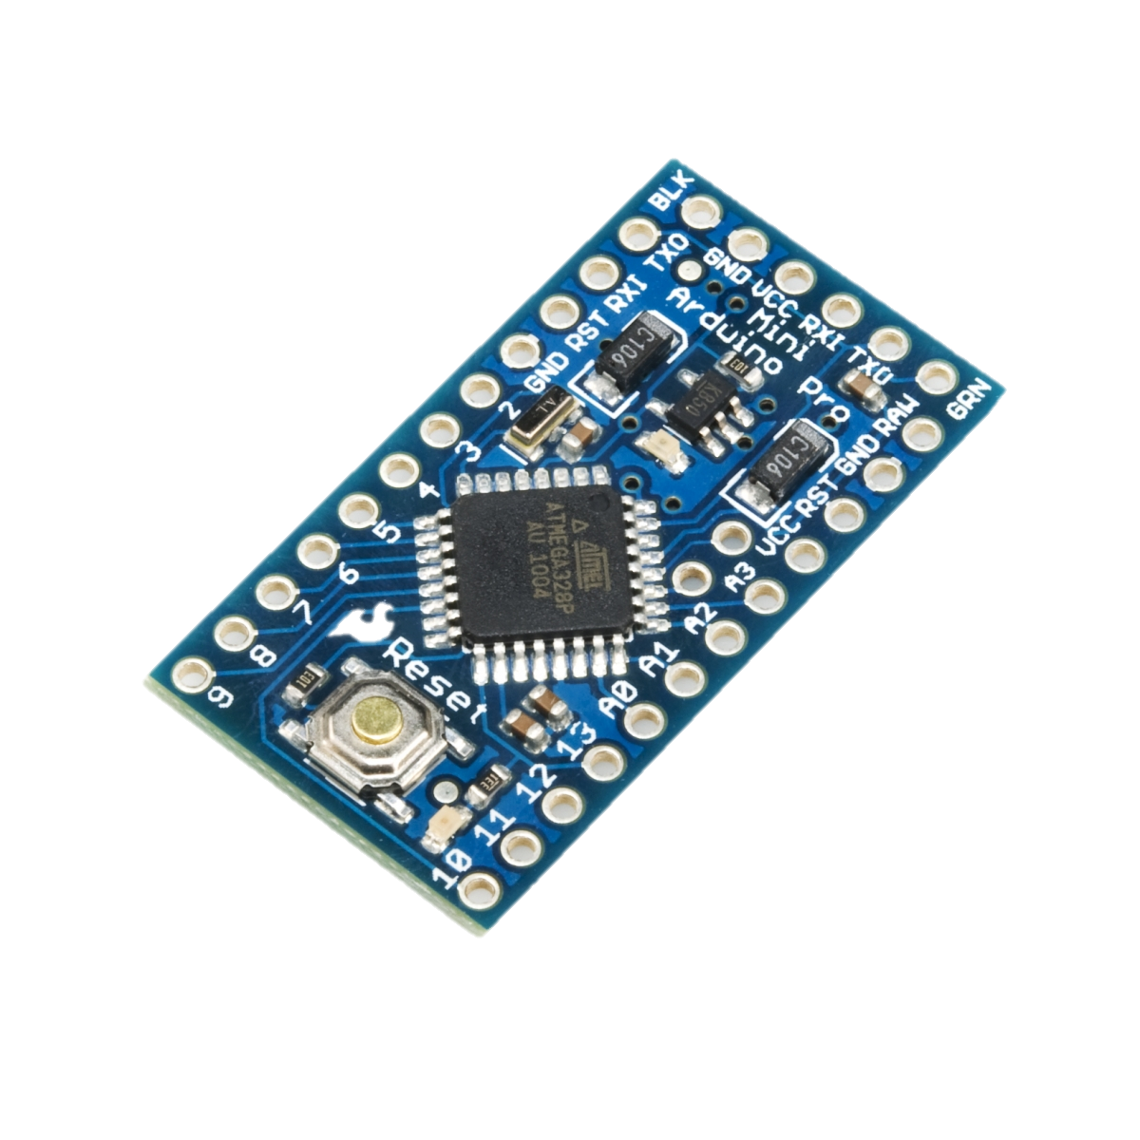
@OptimaSystemsUK
Arduino
Basic Input/output device
Uses I2C to interface with Raspberry Pi

Slide 8



@OptimaSystemsUK
Software
Raspbian –Linux based Raspberry Pi OS
Dyalog 13.2 Linux
Putty – A open source SSH client
Samba – Allow us to map the raspberry pi as a network drive
Arduino IDE – develop C code for Arduino communications

Slide 9
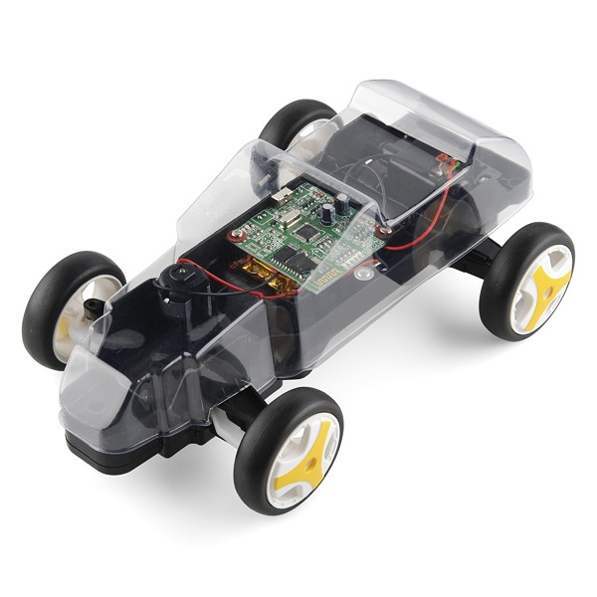
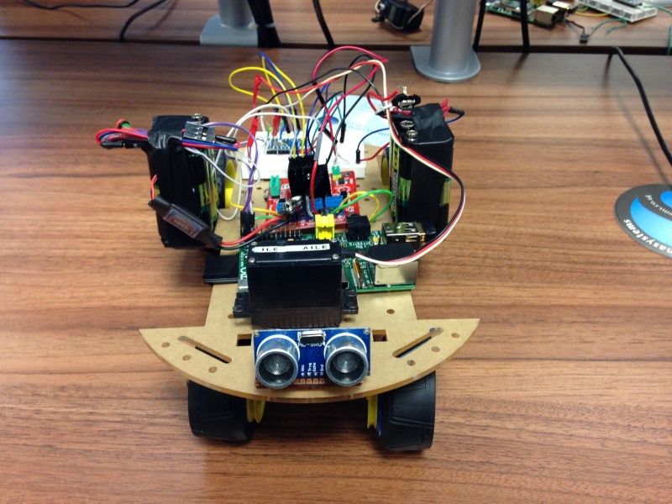

@OptimaSystemsUK
Problems
Soldering the Arduino
Re-programming the Arduino
Wiring. Trying to make things look neat
Big base to support the hardware
SD card corruption
Power problems

Slide 10
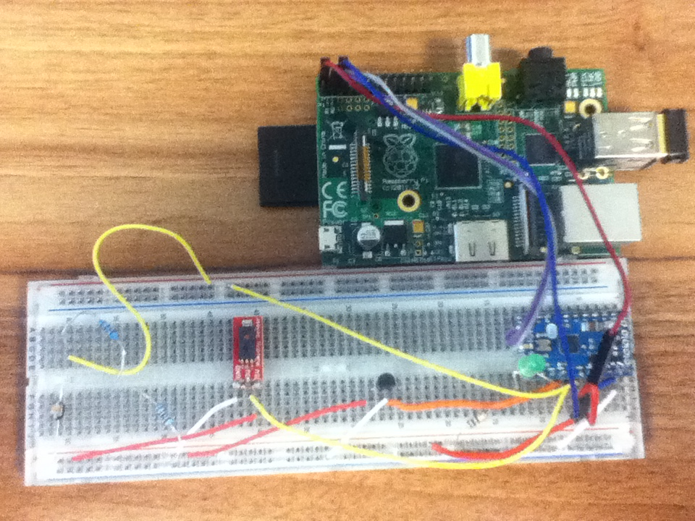
@OptimaSystemsUK
Pi in the Sky
Make something of interest to me
Make something that has a use
Have a temperature, humidity and light sensor working with the Raspberry Pi
Have a DCF with specific day to day data in it
Make a MiServer page with integrated RainPro graphs to show readings of the past 7 days

Slide 11
@OptimaSystemsUK
Pi in the Sky
Circuit Diagram
Raspberry Pi
+5V
+5V
GND
SDA
SCL
Humidity
Sensor
Temperature
Sensor
+5V
+5V
Out
0V
Out
0V
0V
+5V
GND
A4
A5
A0
Arduino
A1
A2
0V

Slide 12
@OptimaSystemsUK
Pi in the Sky
System Flow Diagram
Raspberry Pi
(Dyalog APL)
Arduino
APL, HTML
(MiServer)
Sensors
User Interface
USER
KEY
USER REQUEST
SYSTEM RESULT

Slide 13
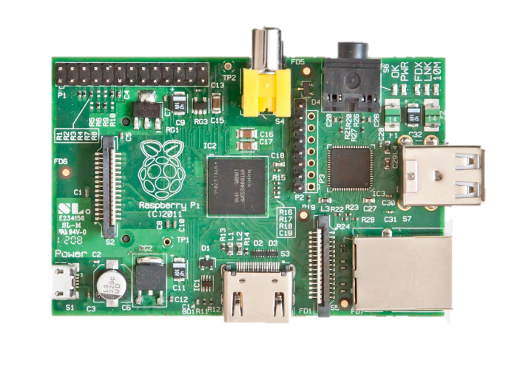
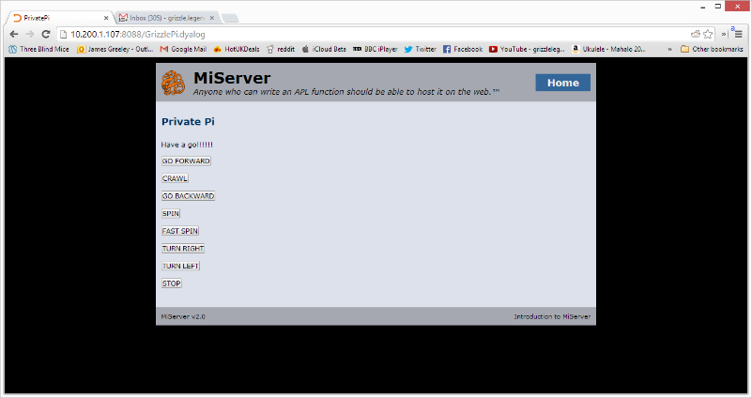
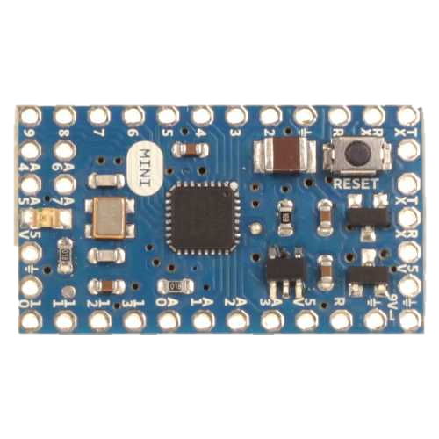
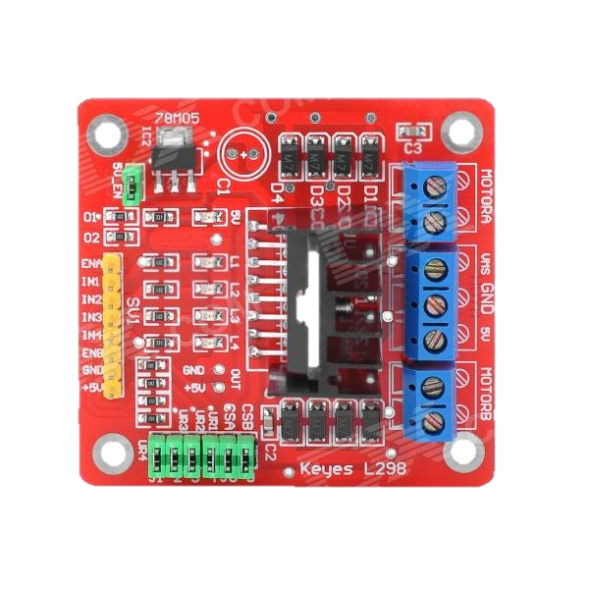

@OptimaSystemsUK
Private Pi

Slide 14
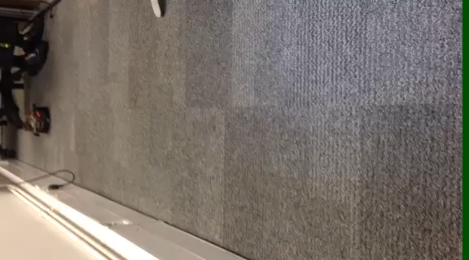
Maiden Voyage
@OptimaSystemsUK
Should have implemented a stop button…

Slide 15
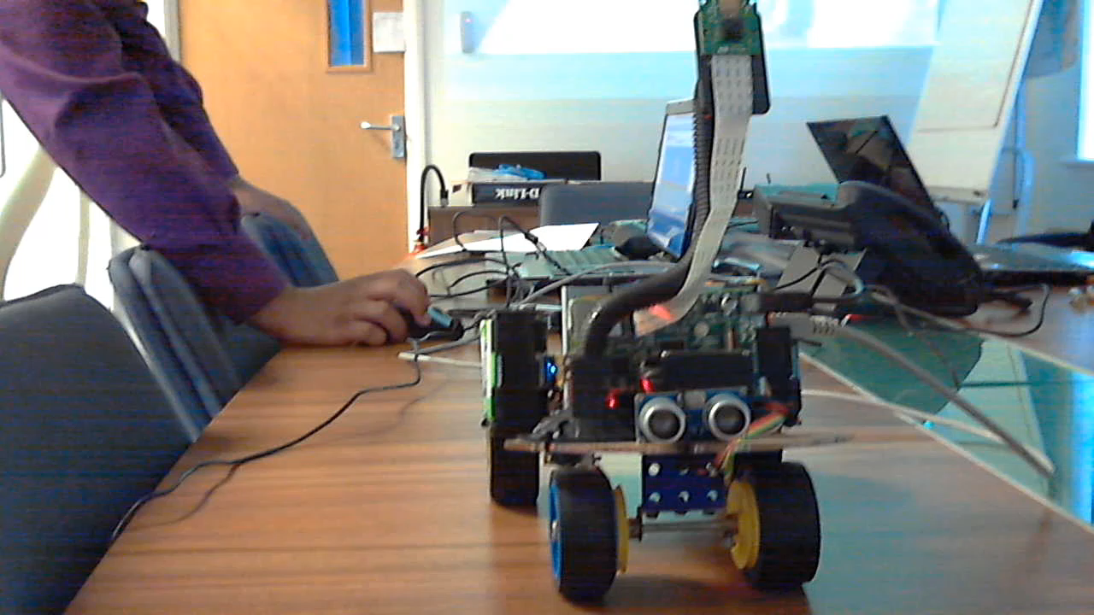
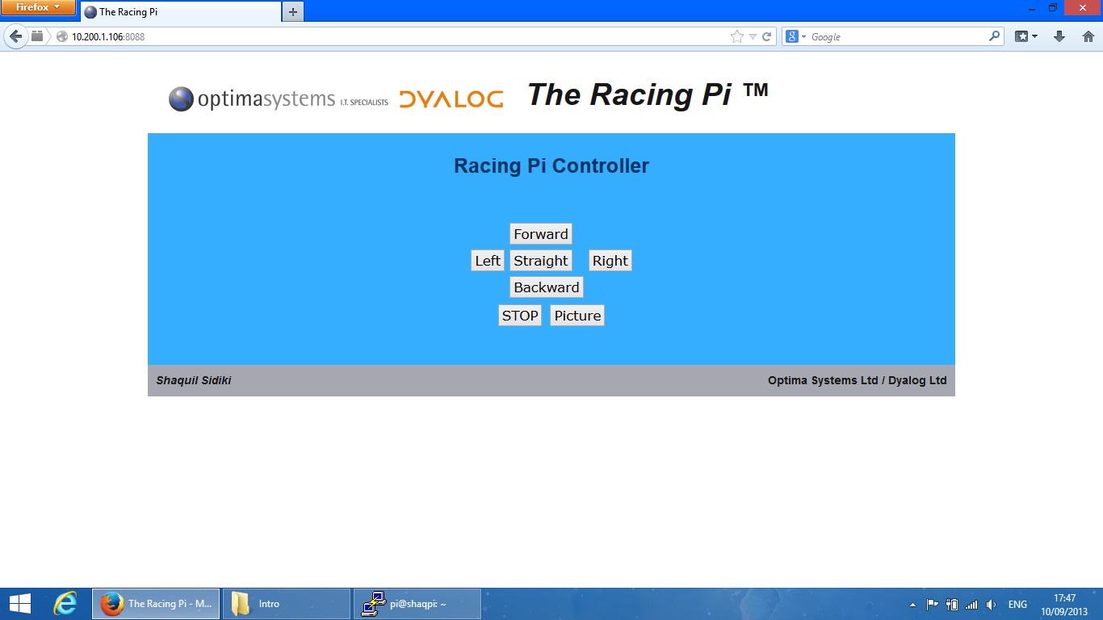
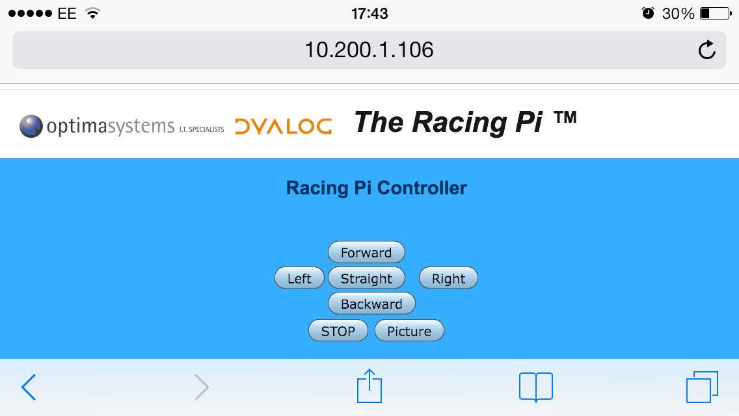
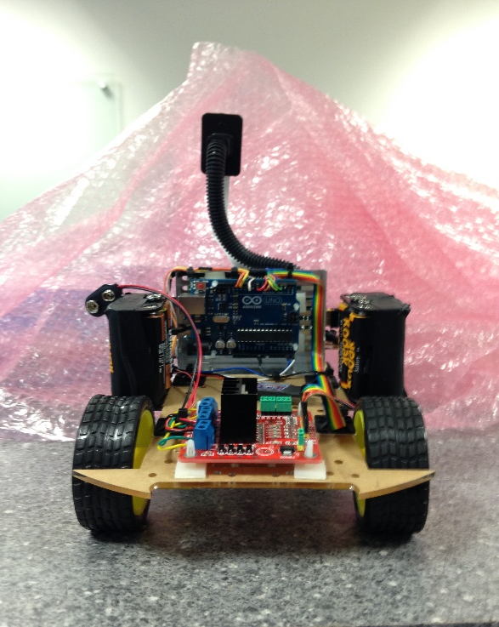
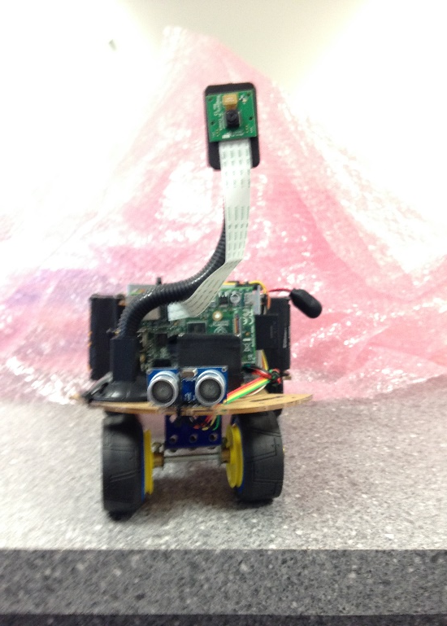
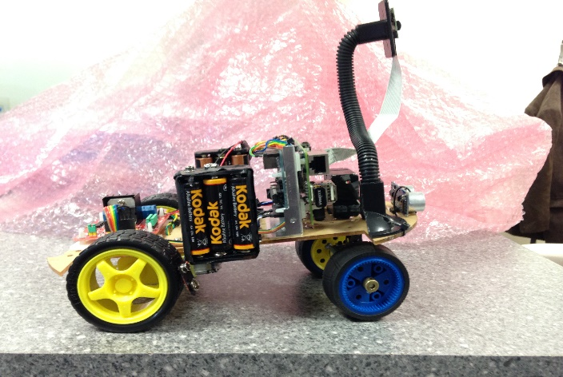
@OptimaSystemsUK
Racing Pi
Robot with 4 wheels.
Use a motor for speed and another motor for directions (servo).
Distance Sensor at the front of the robot.
Record where the robot goes. (PiCamera)
Control it via MiServer

Slide 16
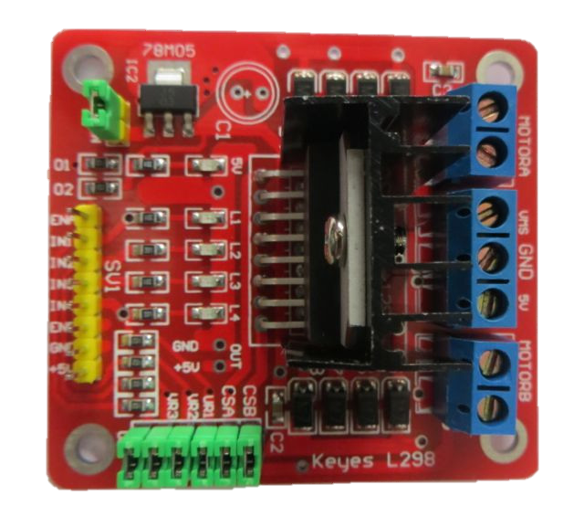
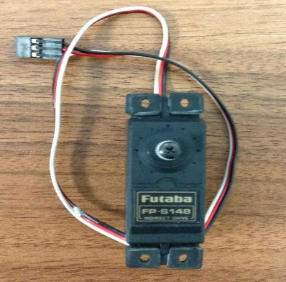
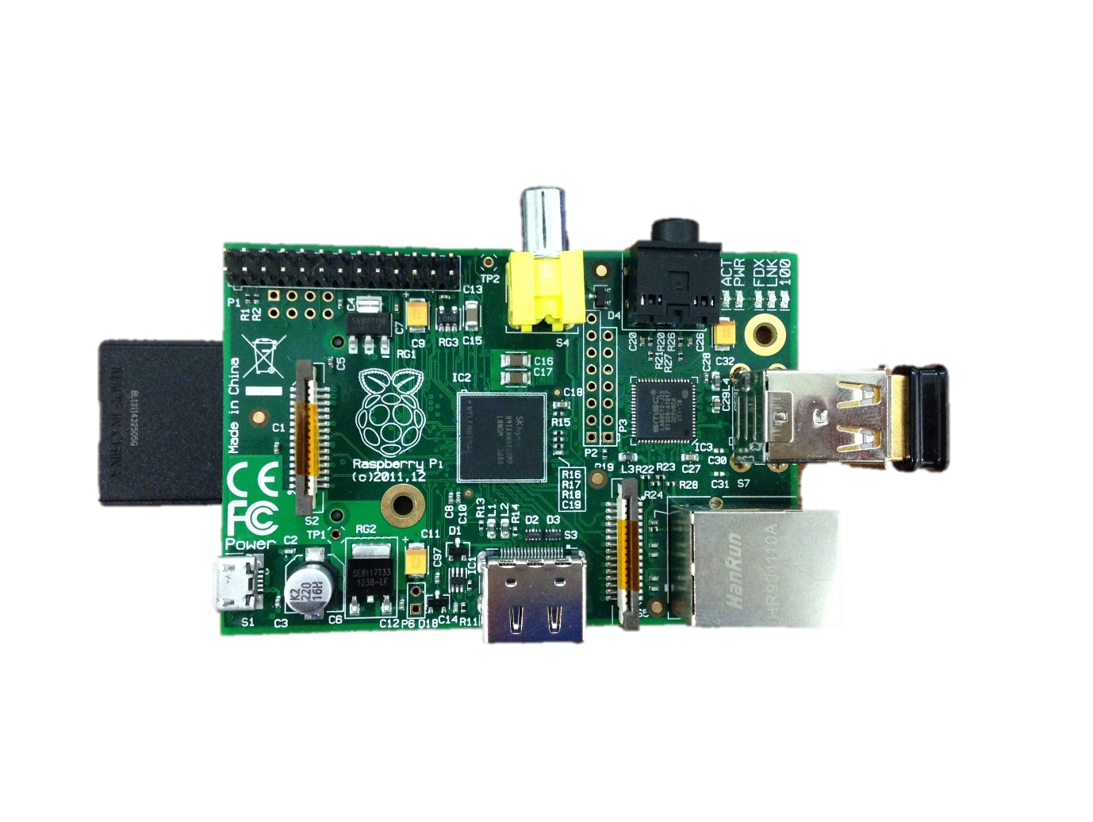
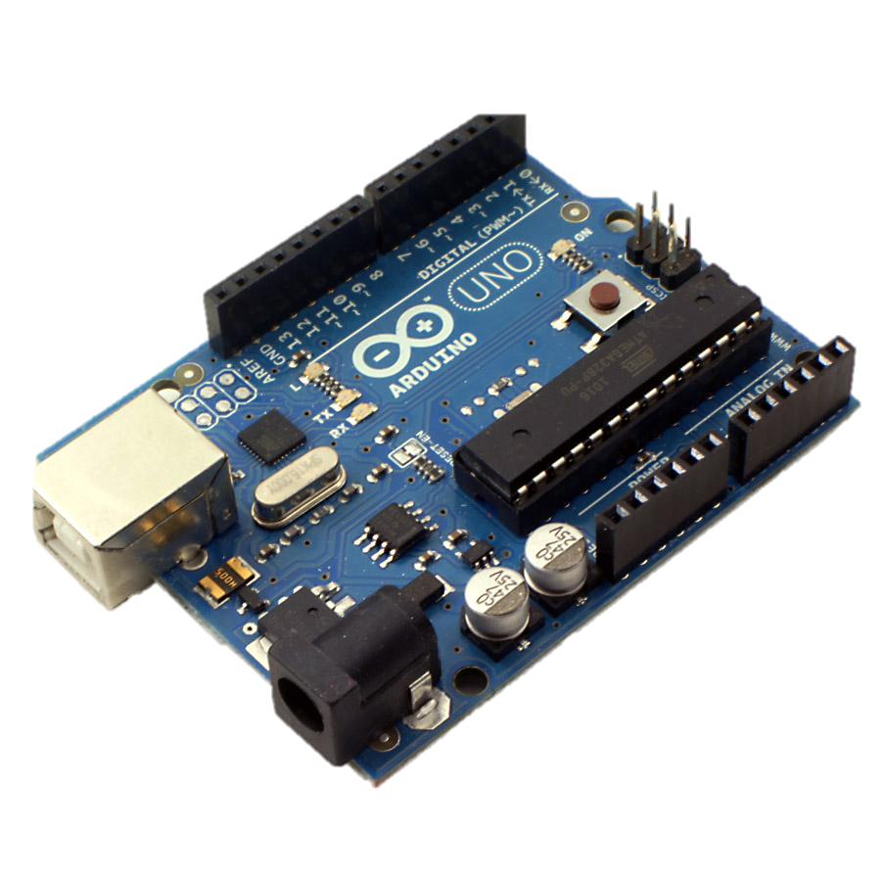
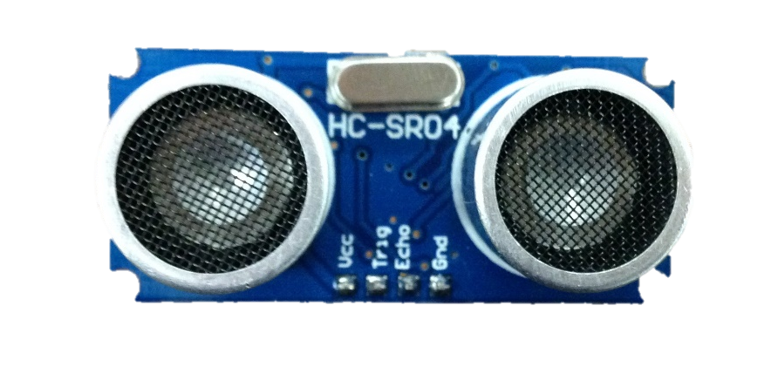
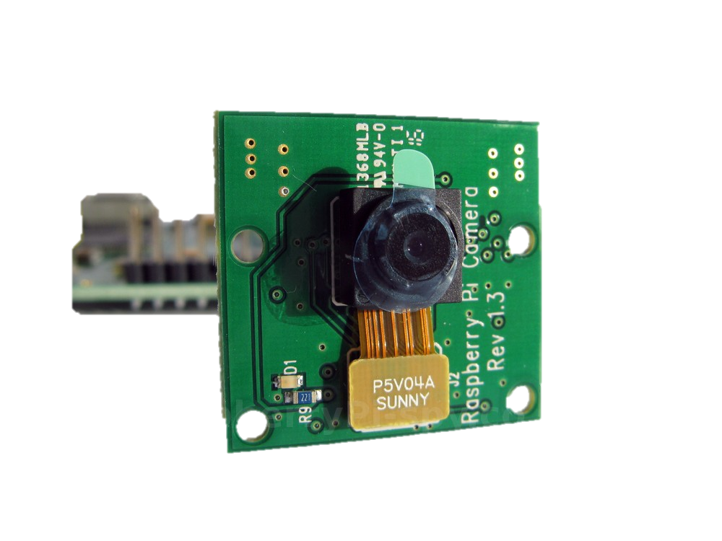
@OptimaSystemsUK
Racing Pi
Diagram
Motor Controller
Forwards and Backwards
APL
C Code
Servo
Turn right and left
To check if there is any “danger”
Ultrasonic
Distance Sensor
Records where the robot goes.
Pi Camera

Slide 17
@OptimaSystemsUK
DEMO TIME

Slide 18


@OptimaSystemsUK
Special Thanks to:
Jason Rivers
Morten Kromberg
Liam Flanagan
Dyalog team
Paul Grosvenor and Optima Systems

Slide 19

@OptimaSystemsUK
THANK YOU FOR LISTENING
James Greeley – Private Pi – Robot
Samuel Gutsell – Pi in the Sky– Weather Station
Shaquil Sidiki – Racing Pi - Robot
Contact Us:
Optima House, Mill Court, Spindle Way, Crawley, RH10 1TT
01293 562 700
www.optima-systems.co.uk
http://threeblindmiceapl.wordpress.com
Any Questions?

