Slide 1

WPF Third Party Controls
Syncfusion & APLGrid

Slide 2
WPF 3rd Party Controls
WPF = Windows Presentation Foundation
State of the art platform for Windows Desktop applications
Consists of Microsoft.Net classes that can be manipulated by Dyalog application code
It is an important goal for Dyalog to make WPF easy to use in applications.

Slide 3
WPF 3rd Party Controls
”Controls” are the elements that a user interface is composed of.
WPF comes with a set of common controls, like:
  Button, CheckBox, ComboBox, Image, Label, ListBox, RadioButton, TextBox
Plus ”layout” controls used to organise others:
  Canvas, StackPanel, DockPanel, WrapPanel, Gird, TabControl, Canvas
These are only sufficient for the most basic applications

Slide 4
WPF 3rd Party Controls
3rd Party: Not Microsoft and not You, but…
Mindscape
Component Art
Actipro
Syncfusion
Telerik
Infragistics
MJH Software
Xceed
DevExpress
Binary Mission
Ice Blue
Divelements

Slide 5

Libraries
Syncfusion is a leading vendor of ”enterprise class” components for many platforms
  ASP.NET, Mobile, Silverlight, WinForms, Windows Phone, WinRT, WPF, Javascript
  and Windows 8
Dyalog has acquired the rights to bundle the WPF and Javascript libraries with APL
WPF 110+ controls: grids, charts, guages, menus, calendars, editor plus file format library for Excel, Word and PDF
(Javascript 70 controls)

Slide 6
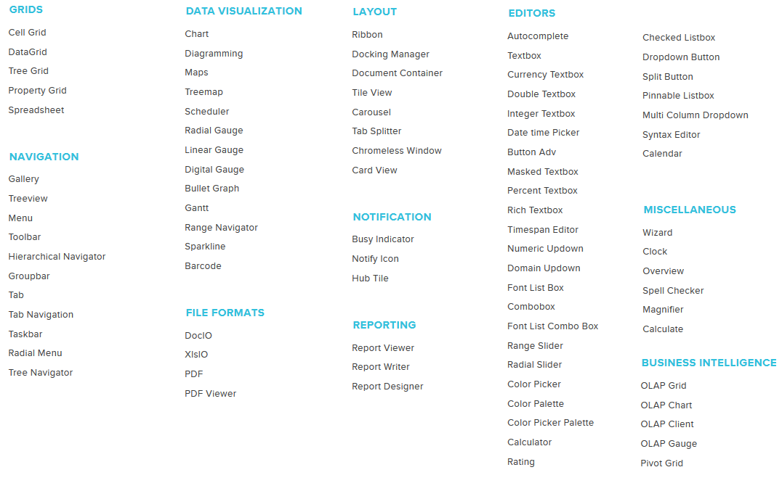
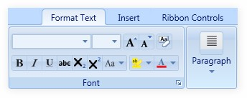
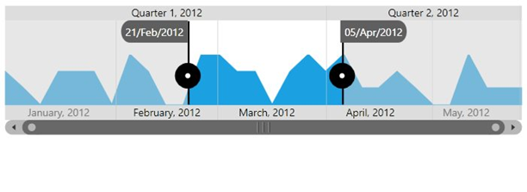
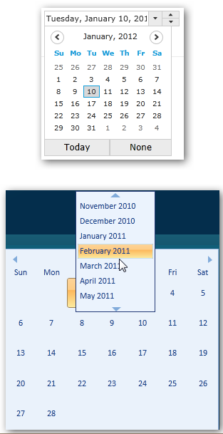
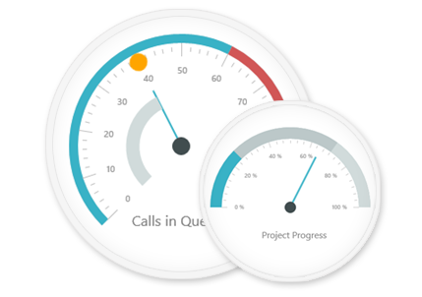
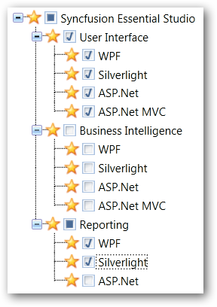
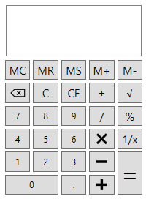
Syncfusion WPF Controls (September 2014)

Slide 7
Libraries
Dyalog users have the rights to distribute these controls as components of applications written in APL
  Under the same terms as the Dyalog Licence that is being used (including non-commercial and educational licences)

Slide 8

Grid Control
The most complex control provided by ⎕WC is the Grid object.
It is very widely used; migrating to WFP without an equivalent control would be hard work.
Michael Hughes has created a Grid control, built upon the Syncfusion Grid, which closely emulates (and extends) the ⎕WC Grid.
Michael will demonstrate this component in the last
part of this session.

Slide 9
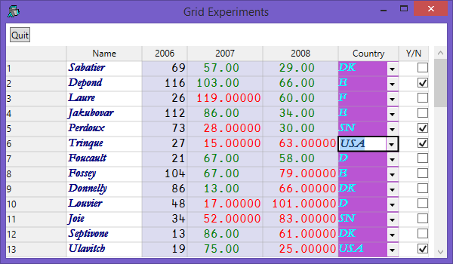
Grid Control

Slide 10
Examples

Slide 11
Worth mentioning about WPF
Controls can be defined directly from Dyalog:
  (b1←⎕NEW Button).Content←'Press Me!‘
… or declaratively using XAML documents
  <Button Content="Press Me!" />
XAML simplifies separation of UI design from code
Data Binding allows separation of data model from business logic
We can benefit from work done by other WPF users
  3rd party controls can be used from APL
  With XAML, no changes. C# samples ”easily” transliterated.

Slide 12
Available Now
Syncfusion v12.1 libraries were shipped with Dyalog v14.0 in June
Updates available (v12.3 in October)
For production use, Dyalog recommends that you become a direct customer of Syncfusion
Remember you can combine WPF and + ⎕WC
Tools and tutorials still ”work in progress”, but APL examples are starting to accumulate

