Slide 1

Data Data Everywhere
And Not a Byte to Eat
(With all due apologies to Samuel Taylor Coleridge)
Using Dyalog to
Read, Write, Manipulate and Visualise
Data From a Variety of Sources
Dan Baronet, Brian Becker
Application Tools Group, Dyalog LTD.

Slide 2
Hi and Welcome!
About Us...
About You...
Please...
  Ask Questions
  Contribute and Collaborate
  Experiment

Slide 3


Agenda and Goals
Data
Sources and Formats
Tools, Techniques, and Tips
  Many of the topics covered today could warrant a workshop of their own
  We want to make you aware of what's available
What Other Tools Do You Need?
Notes:
Portrayed by actor Brent Spiner, Lt Commander Data first appeared the pilot episode of Star Trek the Next Generatio... What? This isn't the Star Trek convention?
Talk with us through the week about your needs

Slide 4
Data Sources
Component Files
Flat (Native) Files
  Delimited
  Text
  XML
Databases
  Relational
  NoSQL
Application APIs
  MS Office
  Google
Web Services
  XML
  JSON
  HTML
Misc
  Compressed Files
Notes:
These are places to get or put data

Slide 5
Ad Hoc or Programmatic
Ad Hoc
  One time
  Interactive
  "Quick and Dirty"
Programmatic
  Automated
  Robust
  Standardized
  Efficient

Slide 6
Consumer, Provider or Both?
Consumer
  Where is the data?
  What format is it in?
  Tools to obtain and manipulate
Provider
  What formats do your clients expect?
  Tools to format and provide
  Are there security requirements?
Notes:
Stand alone – MS Access, MySQL, SQL Server

Slide 7
Native files
To read a native file we use ⎕NREAD:
Tie ←filename ⎕ntie 0
Size←⎕nsize Tie
Text←⎕nread Tie, 80, Size ,0
Notes:
This is for regular text only (AZ09.). For other (e.g. APL) we need something else.

Slide 8
Native files
To read a native file we use ⎕NREAD:
Tie ←filename ⎕ntie 0
Size←⎕nsize Tie
Text←⎕nread Tie, 80, Size ,0
Notes:
This is for regular text only (AZ09.). For other (e.g. APL) we need something else.

Slide 9
Native files
Native files can also contain Unicode text.
Various encoding formats exist for Unicode text:
UCS1, UCS2, UCS4
UTF8, UTF16, UTF32
Notes:
UCSx are represented in APL by 80 160 and 320 types ([]DR)

Slide 10
Native files
UCSn (Unicode Character Set) refers to the size (n=1, 2, 4) of each character written.
UTF-n (Unicode Transformation Format, n=8, 16, 32 bits) refers to the type of encoding for each character:
UTF-8 is the standard character encoding on the web.
UTF-8 is the default character encoding for HTML5, CSS, JavaScript, PHP, SQL, and XML.
Notes:
UCS4=UTF32; in theory max 6 for UTF-8

Slide 11
Native files
To write a native file containing UCS1, UCS2 or UCS4:
Text← 'APL⍺⍵' ⍝ type 160
Tie ← filename ⎕ncreate 0
Text ⎕nappend Tie, ⎕DR Text
(⍴Text),⎕nsize Tie
5 10
Notes:
No need to specify a BOM

Slide 12
Native files
To read a native file containing UCS1, UCS2 or UCS4 you need to know the size:
Tie← filename ⎕ntie 0
Size←⎕nsize Tie
⎕nread Tie,80,Size,0
A P Lz#u#
⎕nread Tie,160,(Size÷2),0
APL⍺⍵
Notes:
80 is not what we want, each character is turned into 2 (possibly unrelated) characters

Slide 13

Native files
To write a native file containing UTF-8 or UTF-16:
Text← '我愛APL' ⍝ UCS4 text
Tie←‘\tmp\t4.txt’ ⎕ncreate 0
¯1 ¯2 ⎕nappend Tie 83 ⍝ BOM
U← 83 ⎕DR 'UTF-16‘ ⎕ucs Text
U ⎕nappend Tie 83
Notes:
We need to specify a BOM (Bytes Order Mark) and encode Text into UTF-x. Editors can then read them.

Slide 14
Native files
An easier way to do this is to use already written utilities:
T←'我愛APL' ⋄ File←'\tmp\t5.txt'
fileUtilities.WriteFile File T
fileUtilities.ReadFile File
Notes:
fileUtilities is found in the LoadDATA workspace.

Slide 15
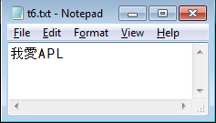
Native files
There are also tools in SALT:
T←'我愛APL'
File←'\tmp\t6.txt'
]load tools\code\fileutils
#.fileUtils
#.fileUtils.WriteFile File T
]open \tmp\t6.txt
\tmp\t6.txt
Notes:
Once opened in Notepad the file can be edited. It can also be edited IN APL using the ucmd ]file.edit

Slide 16
Native files
We can check the actual file contents:
⎕nsize tn←'\tmp\t6.txt' ⎕ntie 0
12
⎕NREAD tn 83 12 0
¯1 ¯2 17 98 27 97 65 0 80 0 76 0
⎕UCS T ⍝ 我愛APL
25105 24859 65 80 76

Slide 17
Component Files
Available since 1970's
  ⎕F functions - ⎕FREAD, ⎕FTIE
Advantages
  Extremely flexible
  Perhaps the best medium for storing APL data
Disadvantages
  Security
  "APL-centric"
Dyalog File Server (DFS)
  Client/Server for both component and native file
  Scalable, Backup/Restore, Administrative Console
  See Richard Smith's talk later this week
Notes:
Flexibility – Inverted database, full text, arbitrary data, offset/block, a blank canvas
Security – if the user can tie the file directly, he can also edit it with something like NotePad
APL-centric – difficult to share with non-APL environments

Slide 18
Component files
APL offers a way to store data in special files that can store APL data.
Those files can be manipulated using ⎕Functions whose names all start with an F.
tie←'\tmp\a1' ⎕Fcreate 0
cpt←(⍳100) ⎕Fappend tie
⍴⎕Fread tie cpt
100
Under Windows,
the extension .DCF is appended by default
Notes:
The extension of those files is DCF by default (only on Windows!)
Point out the issues of dealing with cross platform – it's best to be explicit with file extensions

Slide 19
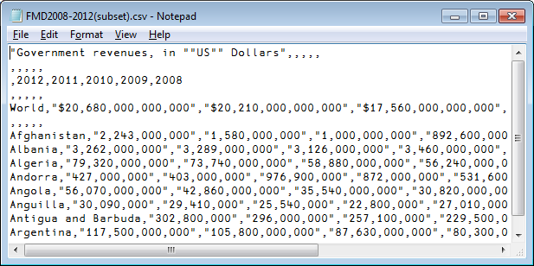
CSV
Comma separated values files are a common format and often handled by software like Excel.
They are regular text files that can be read and handled by APL too.
Notes:
The comma can be changed. The Swedes use ; instead.

Slide 20
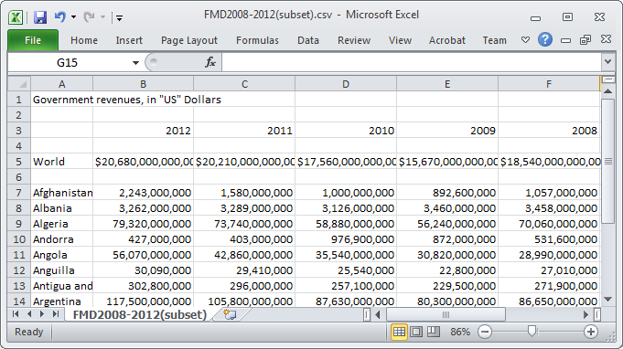
CSV

Slide 21
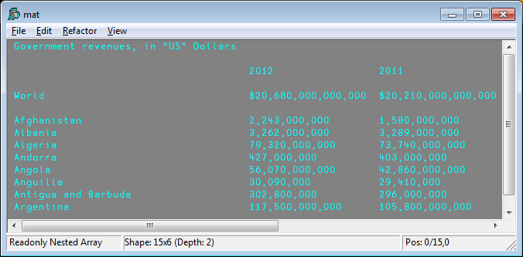
Read Delimited Data
In the LoadDATA workspace are found several programs to read text files and
Notes:
Each item is a string

Slide 22
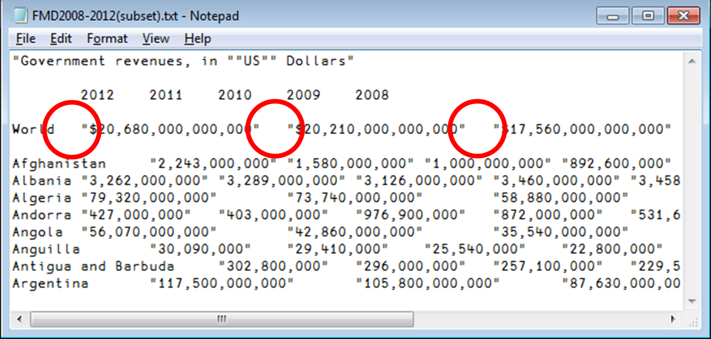
Delimited Data
Other characters than comma can be used.
This file uses TAB instead:

Slide 23
Excel Files
You can grab Excel data many ways:
Manually using the tools menu
Using .Net
Using the loaddata workspace

Slide 24
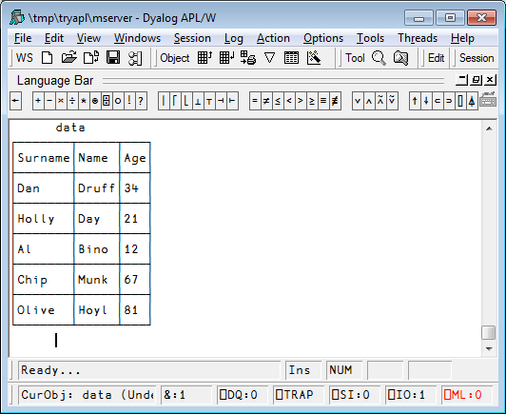
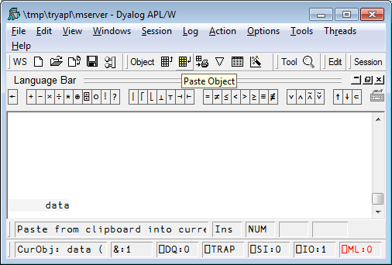
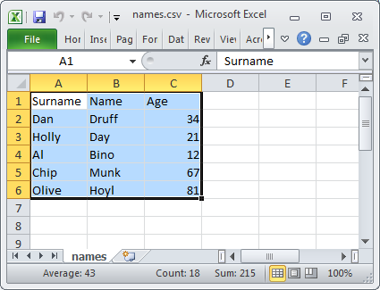
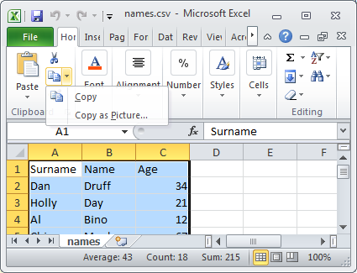
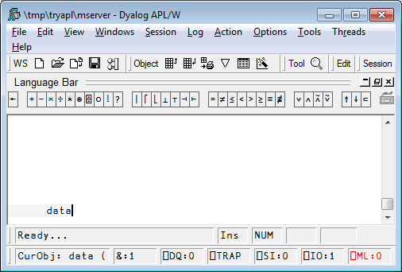
Excel
You can grab data many ways:
Manually using the tools menu
6 rows
6 rows
3
cols
3
cols
Notes:
6 rows, 3 columns

Slide 25
Other text formats - Excel
You can grab Excel data many ways:
Using .NET

Slide 26
Other text formats - Excel
You can grab Excel data many ways:
Using the loaddata workspace

Slide 27
The LOADDATA workspace
This workspace contains functions to read/write data to files in various formats
)load loaddata
)fns
LoadSQL LoadTEXT LoadXL LoadXML SaveSQL SaveTEXT SaveXL SaveXML TestSQL TestXML

Slide 28
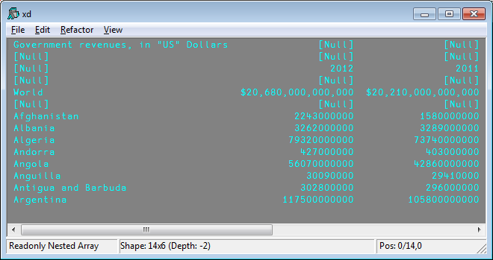
Reading Excel files
file←'\my\FMD2008-2012(subset).xlsx'
⍴xd←LoadXL file
14 6
)ED xd

Slide 29
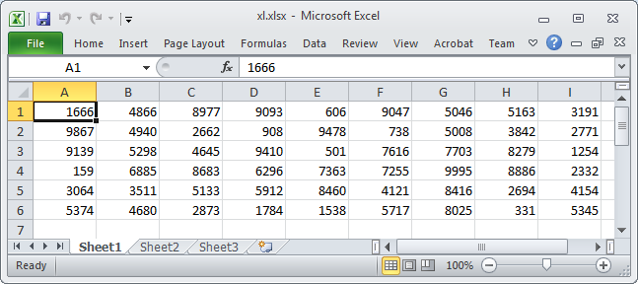
Saving Data to Excel files
SaveXL (?6 9⍴10000) '\tmp\xl.xlsx'

Slide 30
Reading CSV/Text files
Other characters than comma can be used.
This file uses TAB instead:
DEL←⎕UCS 9 ⍝ TAB character
⍴tab←LoadTEXT ‘fil.TXT’ DEL
15 6

Slide 31
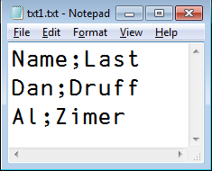
Other text formats – CSV/Text
Saving APL data in CSV format:
mat←'Name' 'Last' 'Dan' 'Druff'
⎕←mat←3 2⍴mat, ‘Al’ ‘Zimer‘
Name Last
Dan Druff
Al Zimer
SaveTEXT mat '\tmp\txt1.txt' ';'
0

Slide 32
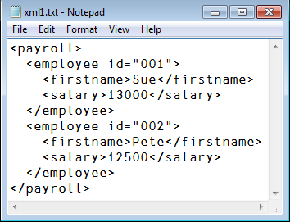
Reading XML files
XML files are text files where each element is surrounded by tags and may be nested.
Ex:
<payroll>
<employee id="001">
<firstname>Sue</firstname>
<salary>13000</salary>
</employee>
<employee id="002">
<firstname>Pete</firstname>
<salary>12500</salary>
</employee>
</payroll>

Slide 33
Reading XML files
)load LoadDATA
⎕← Data← LoadXML '\tmp\xml1.txt'
id firstname salary
001 Sue 13000
002 Pete 12500
⍴ Data
3 3
Notes:
Let's modify Data to write it out

Slide 34
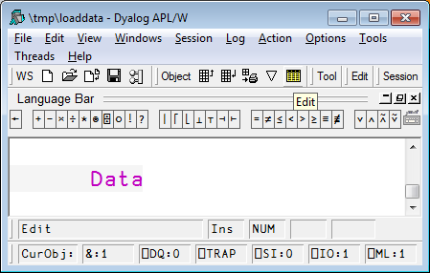
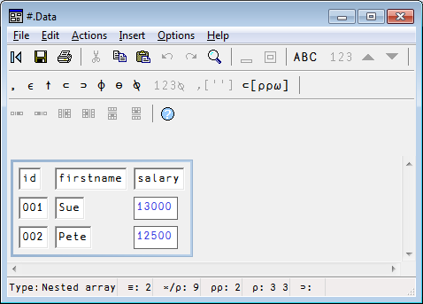
Editing Data
The APL editor is good for simple character data but not for complex or numeric data.
Dyalog comes with an APL object editor.
It can be called from the menu.
Data ⍝ put the cursor on the name to edit

Slide 35
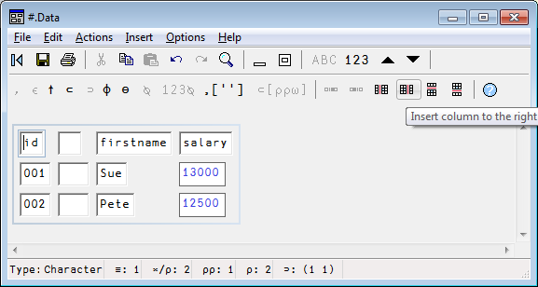
Editing Data
Inserting columns
Select a cell
Select the “Insert column to the right” button
Selected
cell

Slide 36
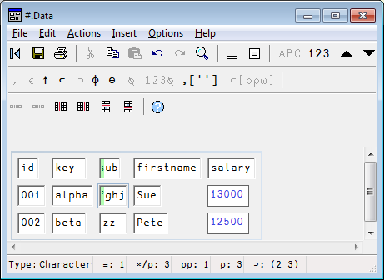
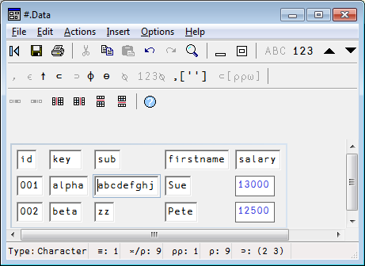
Editing Data
Enter data and Refresh the display – F5

Slide 37
Writing XML files
⍴ Data
3 5
Data
id key sub firstname salary
001 alpha abcdefghj Sue 13000
002 beta zz Pete 12500
Notes:
The green columns are new – let's write the whole thing out

Slide 38
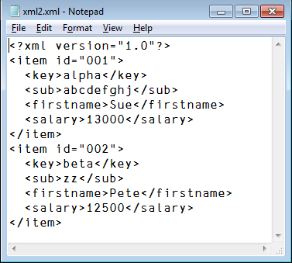
Writing XML files
SaveXML Data '\tmp\xml2.xml'
]open \tmp\xml2.xml -using=notepad
\tmp\xml2.xml

Slide 39
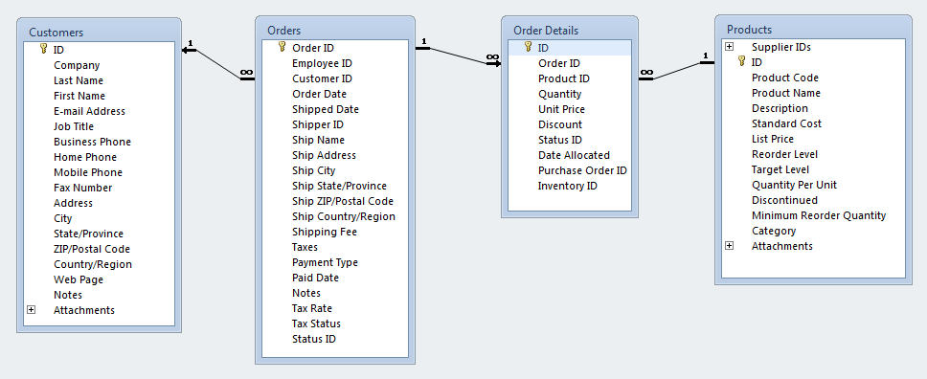
Databases
Databases
  Relational – tables using SQL
  NoSQL – Not Only SQL
    Document store
    Graph
    Key-Value

Slide 40
Relational Databases (RDBs)
There are several ways to access relational databases (e.g. MS Access, Oracle, MySQL, SQL Server and DB2) from Dyalog…
  LoadSQL/SaveSQL in the loaddata workspace provides a simple interface to read and write relational tables (Windows only)
  SQA in the sqapl workspace contains functions to read, write, and manipulate relational databases
  .NET components, in particular ADO.NET (Windows only)
Notes:
This isn't quite correct…
One way to access relational databases from APL is to use the SQA namespace in SQAPL
SQA interfaces with the ODBC (Open Data Base Connectivity) drivers for a number of databases including MS Access, Oracle, MySQL, SQL Server, and DB2
One common way to access a database is to set up a data source

Slide 41
RDBs – Data Sources
There are two ways to specify the connection to your relational database.
Create a Data Source Name (DSN)
Use a DSN-less connection string
Notes:
This isn't quite correct…
One way to access relational databases from APL is to use the SQA namespace in SQAPL
SQA interfaces with the ODBC (Open Data Base Connectivity) drivers for a number of databases including MS Access, Oracle, MySQL, SQL Server, and DB2
One common way to access a database is to set up a data source

Slide 42
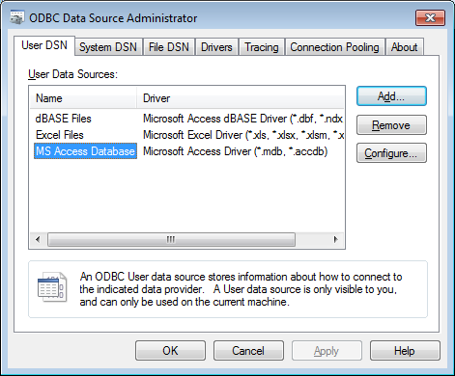
RDBs – Data Source Name

Slide 43
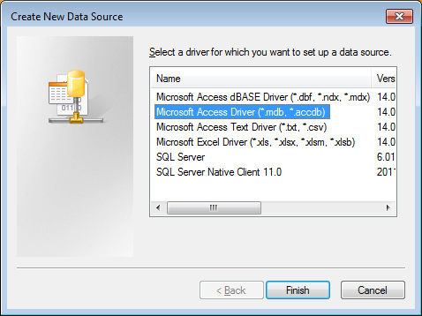
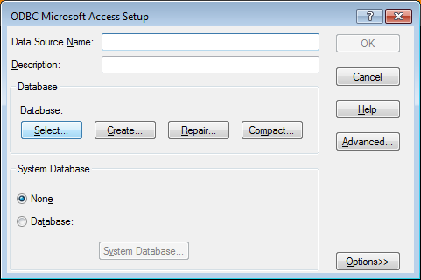
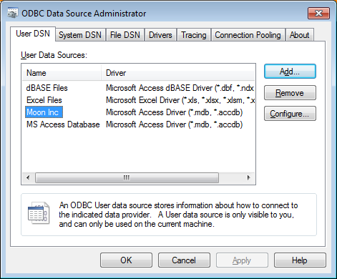
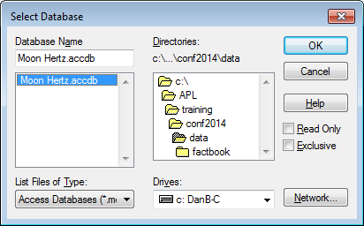
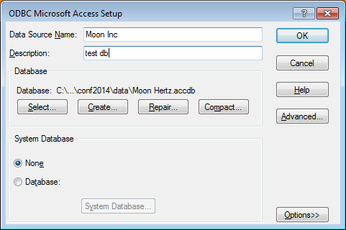
RDBs – Data Source Name

Slide 44
loaddata - LoadSQL
)load LoadDATA
Saved ...
LoadSQL 'Moon Inc' '' 'TABLE_NAME'
TABLE_NAME
MSysAccessStorage
MSysACEs
MSysComplexColumns
MSysNameMap
...

Slide 45
loaddata - LoadSQL
⍴table←LoadSQL 'Moon Inc' 'Products'
45 14
  3 4↑table
1 NWTB-1 Northwind Traders Chai 13.5
2 NWTCO-3 Northwind Traders Syrup 7.5
3 NWTCO-4 Northwind Traders Cajun Seasoning 16.5

Slide 46
DSN-less Connection
driver←'DRIVER={Microsoft Access Driver (*.mdb, *.accdb)};'
file←'DBQ=c:\Dyalog14\Data\Northwind.accdb;'
user←pwd←dsn←''
table←LoadSQL (user pwd dsn (driver,file))'products'
Connection Strings Reference: http://www.connectionstrings.com/
Notes:
]demo

Slide 47
RDBs – Table Search
In workspace
  Table lookup
  Inverted table lookup
Let the database driver do the heavy lifting

Slide 48
RDBs – Table Search
When a table contains fields of different data types, searching in memory can be CPU intensive.
Using an inverted structure can be much more efficient for searching.
┌─────┬───┐
│Name │Age│
├─────┼───┤
│Dick │30 │
├─────┼───┤
│Jane │28 │
├─────┼───┤
│Sally│5 │
└─────┴───┘
name
Dick
Jane
Sally
age
30 28 5

Slide 49

RDBs – Table Search
⍴table←LoadSQL 'MyDB' 'Parts'
45000 143
⎕size 'table' ⍝ 277M!
276720040
1 7↑table
Coleen J. Pérez F 19560922 141, 41st Av, App 33 Modena Italy
What if we were looking for someone named Sophy W. Johnston living in Alexandria, Egypt?
Notes:
BTW there is a program <genRecords> in tools\data\names to generate random data

Slide 50
RDBs – Table Search
lookfor←'Sophy W.' 'Johnston' lookfor,←'Alexandria' 'Egypt'
(table[;1 2 6 7]∧.≡lookfor)⍳1
12345
]runtime "(table[;1 2 6 7]∧.≡lookfor)⍳1" -repeat=100
* Benchmarking "(table[;1 2 6 7]∧.≡lookfor)⍳1", repeat=100
Exp
CPU (avg): 37.29
Elapsed: 37.3
Notes:
BTW there is a program <genRecords> in tools\data\names to generate random data

Slide 51
RDBs – Table Search
There is a faster way.
We need to work with an inverted file:
⍴¨ifields←↑¨ ↓[1] table
45000 22 45000 10 45000 45000 8
lookUp←8⌶
⍝↓↓ create 1 row matrices
what←,[.5]¨ lookfor
ifields[1 2 6 7] lookUp what
12345
Notes:
8⌶ is a special function written just for that

Slide 52
RDBs – Table Search
]runtime "fields[1 2 6 7]lookUp what" -r=100
* Benchmarking "fields[1 2 6 7]lookUp what", repeat=100
Exp
CPU (avg): 2.97
Elapsed: 2.94

Slide 53
RDBs – Table Search
Let the database driver do the work…
s1:{⍺,(≢⍵)}⌸⊃3⊃SQA.Do 'select stateabbr from
zipcodes'
s2:⊃3⊃ SQA.Do 'select stateabbr,count(*) from
zipcodes group by stateabbr'
s2 is 76% faster than s1
Notes:
This isn't quite correct…
One way to access relational databases from APL is to use the SQA namespace in SQAPL
SQA interfaces with the ODBC (Open Data Base Connectivity) drivers for a number of databases including MS Access, Oracle, MySQL, SQL Server, and DB2
One common way to access a database is to set up a data source

Slide 54
RDBs – Writing Data
Using loaddata SaveSQL
Create a new table
Data←2 2⍴'Fred' 10000 'Sue' 12000
SaveSQL Data 'MySource' 'Employees'
'create table employees
(firstname char(10),salary integer)'
Delete all records and overwrite
Data[;2]←10500 12500
SaveSQL Data 'MySource' 'Employees' 'overwrite'
Insert new records
Data←2 2⍴'Dan' 18000 'Brian' 16000
SaveSQL Data 'MySource' 'Employees' 'insert'
Update/Insert based on 1st column
Data←2 2⍴'Sue' 13000 'Pete' 15000
SaveSQL Data 'MySource' 'Employees'
'upsert where key=firstname'
firstname | salary
Fred | 10000
Sue | 12000
firstname | salary
Fred | 10500
Sue | 12500
Dan | 18000
Brian | 16000
firstname | salary
Fred | 10500
Sue | 13000
Dan | 18000
Brian | 16000
Pete | 15000
firstname | salary
Fred | 10500
Sue | 12500

Slide 55
RDBs – Writing Data
Using SQAPL
Creating tables
Inserting data
  Single records
  Bulk records
Updating data
Notes:
]demo sqapl

Slide 56
XML
XML = eXtensible Markup Language
A markup language much like HTML
Designed to describe data, not to display data
Tags are not predefined. You define your own tags
Designed to be self-descriptive
<message>
<from>Brian</from>
<to>Dan</to>
<subject>Is it time to panic yet?</subject>
</message>

Slide 57
XML Elements
have opening and closing tags
are strictly nested
can have attributes
there is a single root element
<name>Dan</name>
<person>
<name>Dan</person>
</name>
<person>
<name>Dan</person>
</name>
<person>
<name>Dan</name>
</person>
<person sex="male">
<name>Dan</name>
</person

Slide 58
⎕XML
xml←'<person sex="male"><name>Dan</name></person>'
⊢apl←⎕XML xml
┌─┬──────┬───┬──────────┬─┐
│0│person│ │┌───┬────┐│3│
│ │ │ ││sex│male││ │
│ │ │ │└───┴────┘│ │
├─┼──────┼───┼──────────┼─┤
│1│name │Dan│ │5│
└─┴──────┴───┴──────────┴─┘
⎕XML apl
<person sex="male">
<name>Dan</name>
</person>
⎕XML converts between XML and a 5 column array representation of the XML
[;1] level of nesting
[;2] element name
[;3] content
[;4] n×2 name/value pairs of attributes
[;5] indication of what the row contains⍺
Notes:
column [;5]
1 Element
2 Child element
4 Character data
8 Markup not otherwise defined
16 Comment markup
32 Processing instruction markup

Slide 59
XML vs HTML
XML was designed to describe data
HTML was designed to display data
XML follows rules strictly
HMTL not so much
  Browsers are "tolerant" of mis-nesting
  <b><i>Brian</b></i>
  Not all elements require closing tag
  <br>, <img>, <meta>, et al

Slide 60
XML Namespace
ToNS - convert XML into namespace format (limited to 3 levels)
ToNS_Deep – convert XML into namespace format, unlimited depth
ToXML – convert namespace into XML format
HTMLtoXHTML – attempt to convert HTML into XHTML format
Notes:
]demo xml
ToNS useful for configuration settings

Slide 61

XML
You know what this means...
There are a couple
of dumbbells at the
front of the room?
No!
Time for exercises!

Slide 62
JavaScript Object Notation - JSON
{
"name":{
"first":"Brian",
"last":"Becker"
},
"shoesize":11,
"coworkers":[
"Dan",
"Morten"
]
}
Lightweight data interchange format
Frequently used in
  AJAX to transport information between browser/server
  Web services
  jQuery-style parameters
APL serialization

Slide 63
JSON Class Methods
Convert APL to JSON (lossless when serialized)
json←{quote serial} JSON.fromAPL array|namespace
Convert JSON to APL
apl← {serialized} JSON.toAPL json
Convert XML to JSON
json←{quote} JSON.fromXML xml
Convert JSON to XML
xml← {root} JSON.toXML json
Convert invalid APL name
name← JSON.parseName invalidAPLname
Notes:
]demo JSON
show serialization

Slide 64
Different Ways to Represent the Same Data
Tabular
  RDB, Spreadsheet, Table (Word, HTML, etc), XML
Hierarchical
  XML, JSON
{"zips": [
{"MD": [
{"Montgomery": [
{"Gaithersburg": [
{"zip": 20842,"lat": 12,"long": 23},
{"zip": 20844,"lat": 14,"long": 26}]},
{"Germantown": [
{"zip": 20874,"lat": 12,"long": 23}]}
]}
]}
]}
Zipcode | Latitude | Longitude | City | StateAbbr | County | LocationText
62245 | 38.554515 | -89.563107 | GERMANTOWN | IL | CLINTON | Germantown, IL
41044 | 38.63785 | -83.966512 | GERMANTOWN | KY | BRACKEN | Germantown, KY
20874 | 39.169859 | -77.275645 | GERMANTOWN | MD | MONTGOMERY | Germantown, MD
20875 | 39.1791 | -77.273 | GERMANTOWN | MD | MONTGOMERY | Germantown, MD
20876 | 39.191769 | -77.243299 | GERMANTOWN | MD | MONTGOMERY | Germantown, MD
12526 | 42.123977 | -73.861999 | GERMANTOWN | NY | COLUMBIA | Germantown, NY
45327 | 39.628806 | -84.378734 | GERMANTOWN | OH | MONTGOMERY | Germantown, OH
38138 | 35.088885 | -89.806773 | GERMANTOWN | TN | SHELBY | Germantown, TN
38139 | 35.087468 | -89.761502 | GERMANTOWN | TN | SHELBY | Germantown, TN
38183 | 35.0962 | -89.804 | GERMANTOWN | TN | SHELBY | Germantown, TN
53022 | 43.219155 | -88.120435 | GERMANTOWN | WI | WASHINGTON | Germantown, WI
STATE COUNTY CITY ZIPCODE
┌ MD ─┬ MONTGOMERY ────┬ GAITHERSBURG ──┬ 20842
│ │ │ ├ 20844
│ │ │ └ 20846
│ │ └ GERMANTOWN ────┬ 20874
│ │ └ 20879
│ └ PRINCE GEORGES ┬ BELTSVILLE ────┬ 20704
│ │ └ 20705
│ └ OXON HILL ────── 20723
└ NY ─┬ MONROE ────────┬ HENRIETTA ────── 14467
│ └ ROCHESTER ─────┬ 14612
│ ├ 14623
│ └ 14624
└ WESTCHESTER ───┬ ARMONK ───────── 10504
├ BEDFORD ──────── 10506
└ VALHALLA ─────── 10595

Slide 65
Web Services
Application components that run on the web.
Use standard protocols and formats
  SOAP, HTTP, XML, JSON
Two predominant schools of thought
  SOAP – Simple Object Access Protocol
  REST – Representational State Transfer

Slide 66
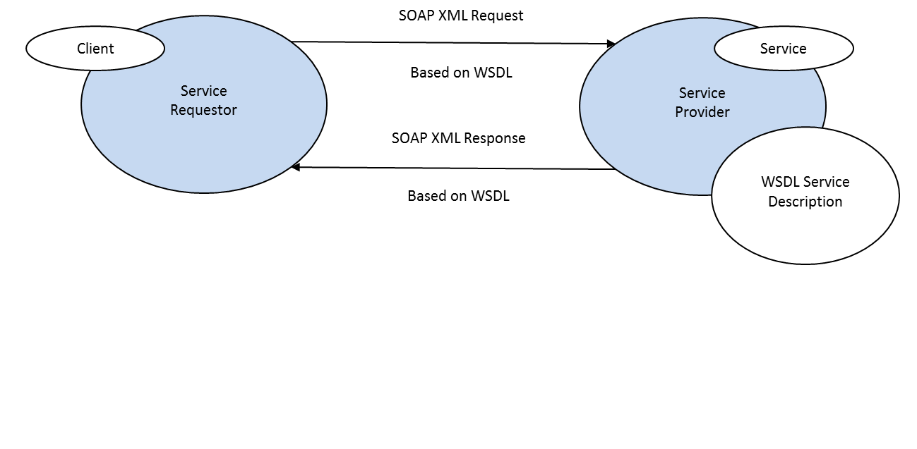
SOAP-based Web Services
Uses an XML dialect called SOAP over HTTP
Web Service Description Language (WSDL) used to describe the web service
  Operations that can be performed
  Input and output message format and content
  Binding information for how to call the web service
Sample SOAP Web Service
SAWS – Dyalog's Stand Alone Web Service framework can be used to both provide and consume SOAP-based web wervices
HTTP(S)

Slide 67
RESTful Web Services
Use standard HTTP methods (GET, POST, PUT, DELETE) to access and manipulate resources
Resources are represented by URIs
Parameters can be passed via URI (GET) or in message body (POST)
http://graphical.weather.gov/xml/sample_products/browser_interface/ndfdBrowserClientByDay.php?zipCodeList=14586&format=24+hourly&numDays=1
Provider: MiServer 3.0
Consumer: conga Samples.HTTPxxx
Notes:
show HTTPGet

Slide 68
RESTful Web Service
Has a base URI
Returns a standard MIME type JSON, XML, images,
Collection http://example.com/cds/
  GET list of URIs of the collection's elements
  PUT replace the entire collection
  POST create a new collection entry
  DELETE delete the entire collection
Element http://example.com/cds/cd23
  GET retrieve a representation of the element
  PUT replace or create an element
  POST update the element
  DELETE delete the element
Notes:
show HTTPGet

Slide 69
MS Office API
Office Desktop applications can be accessed directly from Dyalog using ⎕WC
'app' ⎕WC 'OLEClient' 'xxx.Application'
Uses:
  Collect information from email messages in Outlook
  Automate document production
  Search Outlook, OneNote, Word, PowerPoint documents
Notes:
Show outlook workspace

Slide 70
conga Samples.HTTPGet
The function HTTPGet in the Samples namespace in the conga workspace issues the HTTP GET command for the URI passed as its argument.
z←Samples.HTTPGet 'http://maps.googleapis.com/maps/api/staticmap?center=Eastbourne,UK&size=600x300&zoom=15'
  z[1] conga return code (0=success)
  z[2] HTTP headers
  z[3] message payload
The latest version of conga has a new operator, HTTPcmd, which can issue any HTTP command – making it possible to call any RESTful web service functions.

Slide 71
Google APIs
Google has APIs for 88 services
Many are REST APIs
Many have a free, courtesy usage limit
Some require an Application key to track usage
Some use OAuth for authentication to allow access to user data without the user having to share their credentials with your application.

Slide 72
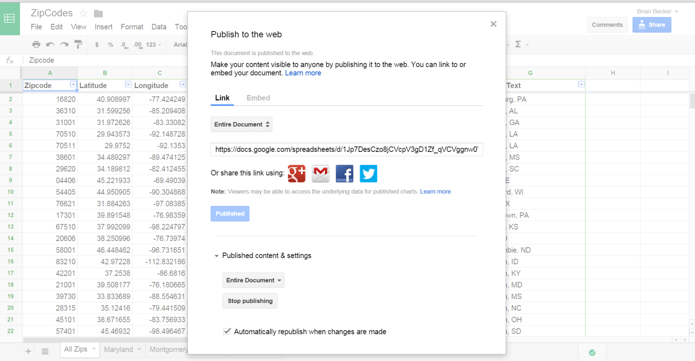
Google APIs
Google Drive can store many types of documents – documents, spreadsheets, presentations, etc.
Share documents with everyone or specific users, granting different levels of access
Publish documents for online use

Slide 73
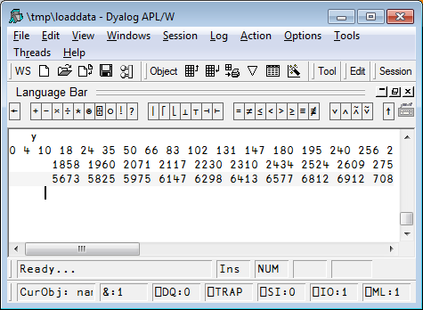
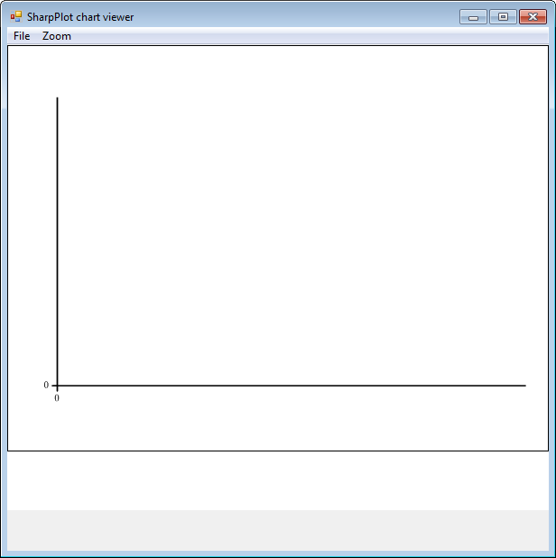
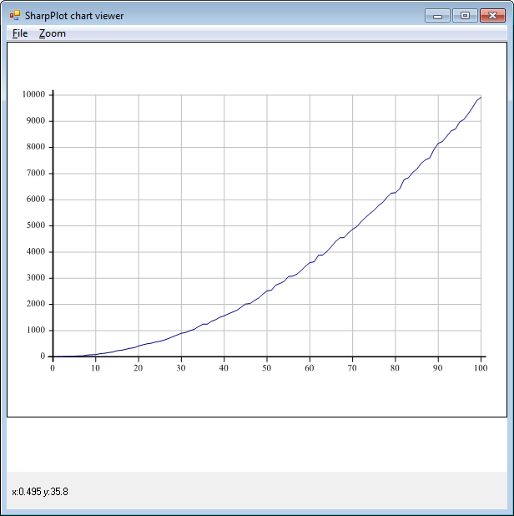
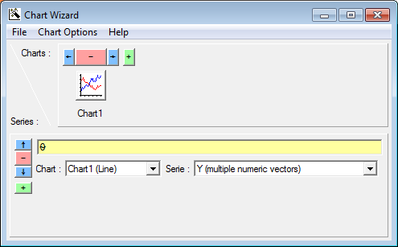
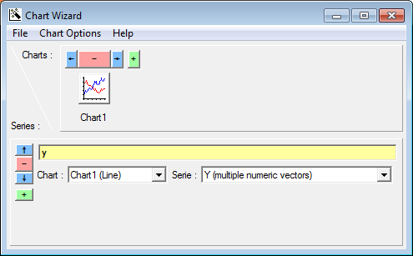
Visualising Data – Graphs
y
0 4 10 18 24 35 50… 8370 8473 8750 8838
⍴y
100

Slide 74
Visualising Data – R
)load rconnect
Saved…
r←⎕new R
r.init
RConnect initialized
⎕←r.x'2+3'
5

Slide 75
Visualising Data – R
d←r.x'read.csv("FMD2008-2012(subset).csv")'
d.Value
2012 2011
World $20,680,000,000,000 $20,210,000,000,000 ...
Afghanistan 2,243,000,000 1,580,000,000 ...
Albania 3,262,000,000 3,289,000,000 ...
Algeria 79,320,000,000 73,740,000,000
Andorra 427,000,000 403,000,000
Angola 56,070,000,000 42,860,000,000
Anguilla 30,090,000 29,410,000
Antigua and Barbuda 302,800 296,000,000
Argentina 117,500,000,000 105,800,000,000

Slide 76
Visualising Data – R
V
2.243E9 1.580E9 1.000E9 8.926E8 1.057E9
3.262E9 3.289E9 3.126E9 3.460E9 3.458E9
7.932E10 7.374E10 5.888E10 5.624E10 7.006E10
4.270E8 4.030E8 9.769E8 8.720E8 5.316E8
5.607E10 4.286E10 3.554E10 3.082E10 2.899E10
3.009E7 2.941E7 2.554E7 2.280E7 2.701E7
3.028E8 2.960E8 2.571E8 2.295E8 2.719E8
1.175E11 1.058E11 8.763E10 8.030E10 8.665E10
'val' r.p V ⍝ put in R's variable 'val'

Slide 77
Visualising Data – R
⎕←r.x'summary(val)'
[R table - 6 rows]
V1 V2 V3 V4 V5
Min. :3.009e+07 Min. :2.941e+07 Min. :2.554e+07 Min. :2.280e+07 Min. :2.701e+07
1st Qu.:3.960e+08 1st Qu.:3.762e+08 1st Qu.:7.969e+08 1st Qu.:7.114e+08 1st Qu.:4.667e+08
Median :2.752e+09 Median :2.434e+09 Median :2.063e+09 Median :2.176e+09 Median :2.257e+09
Mean :3.239e+10 Mean :2.850e+10 Mean :2.343e+10 Mean :2.160e+10 Mean :2.388e+10
3rd Qu.:6.188e+10 3rd Qu.:5.058e+10 3rd Qu.:4.138e+10 3rd Qu.:3.717e+10 3rd Qu.:3.926e+10
Max. :1.175e+11 Max. :1.058e+11 Max. :8.763e+10 Max. :8.030e+10 Max. :8.665e+10

Slide 78
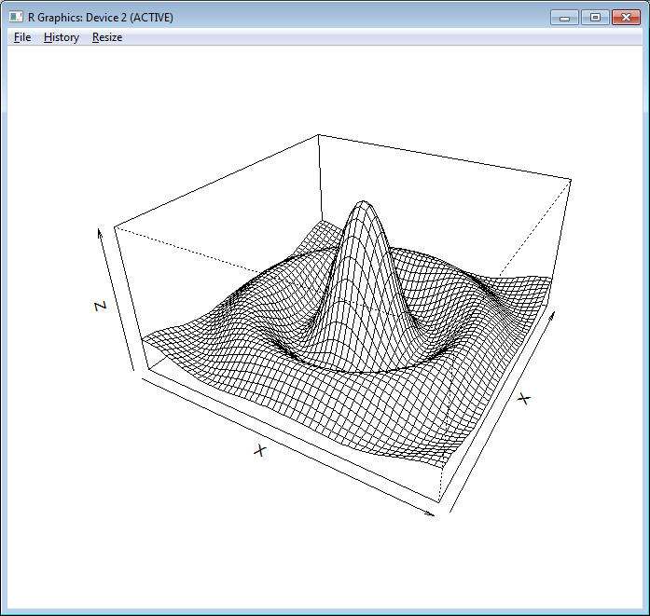
Visualising Data – R
x←¯10 10 {⍺[1]++\0,⍵⍴(|-/⍺)÷⍵} 50
z←x∘.{{10×(1○⍵)÷⍵}((⍺*2)+⍵*2)*.5}x
expr←'persp(⍵,⍵,⍵,theta=30,phi=30,expand=0.5,'
expr,←'xlab="X",ylab="X",zlab="Z")'
r.x expr x x z ⍝ Use x for both x and y co-ordinates

Slide 79
File transfers - FTP
z←⎕NEW FTPClient (host user pass)
z.List folder
z.Get 'file/name'
z.Put 'other/file'

