Slide 1
Technical Road Map
The User Experience
Morten Kromberg
CXO, Dyalog Ltd

Slide 2


Two Road Map Presentations
Morten Kromberg
Chief eXperience Officer (CXO)
Jay Foad
Chief Technology Officer (CTO)

Slide 3
CXO vs CTO (with thanks to Wikipedia)
  A Chief eXperience Officer (CXO) is the officer responsible for the overall user experience (UX) of an organization.
    The CXO ensures that the organization has good customer service and products that meet current and future requirements, so users are able to have a positive experience.
  A Chief Technology Officer (CTO) … is focused on scientific and technological issues within an organization.
    The CTO ensures that the organization is able to effectively make use of relevant technologies to deliver products and services.
  In a core technology company like Dyalog, there is significant overlap between these roles.
  The CEO, COO, Chief Architect and everyone else will dive in too ☺

Slide 4
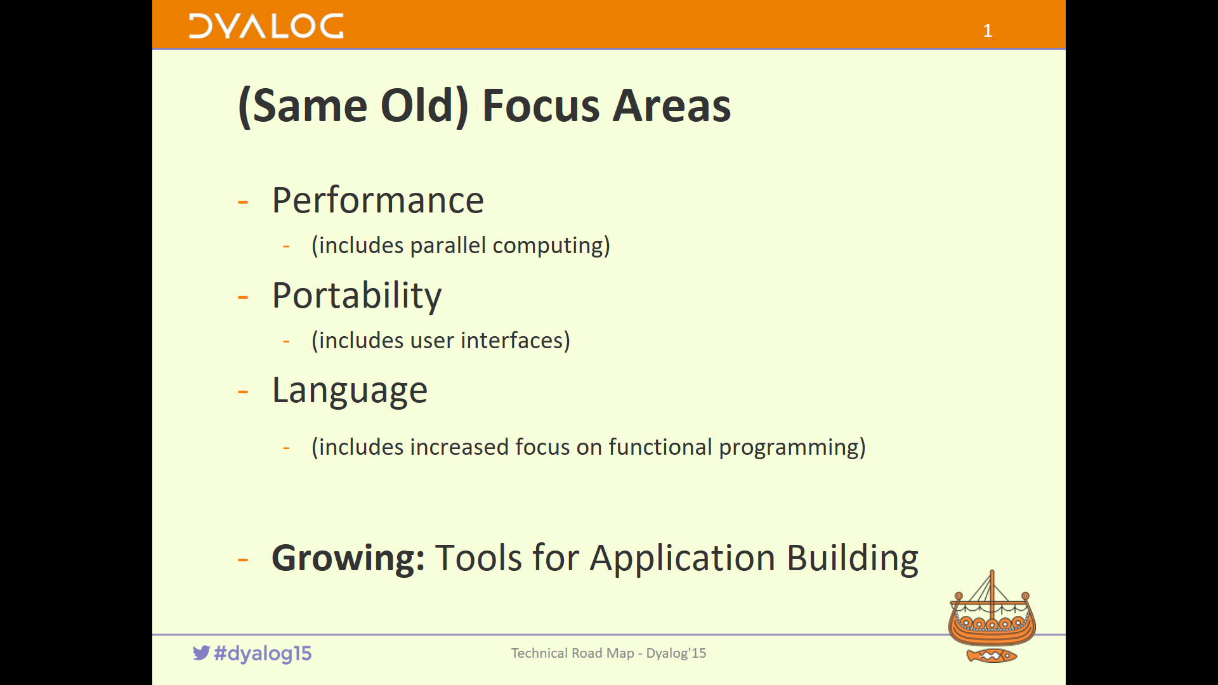
Primary CXO Focus

Slide 5
CXO Focus Areas
(as before):
Portability / Availability
Tools for Application Development
Plus:
More specific focus on Usability
Marketing – getting the word out

Slide 6

Portability - Platforms
We want Dyalog APL available on new platforms before you decide you must have it!
Supported platforms:
  Microsoft Windows, IBM AIX
  64 bit Unicode only: x64 Linux and macOS
  ... and the Raspberry Pi
Non-Commercial / Educational on all platforms except AIX
Rumours that prototypes have been observed running on mobile platforms...

Slide 7
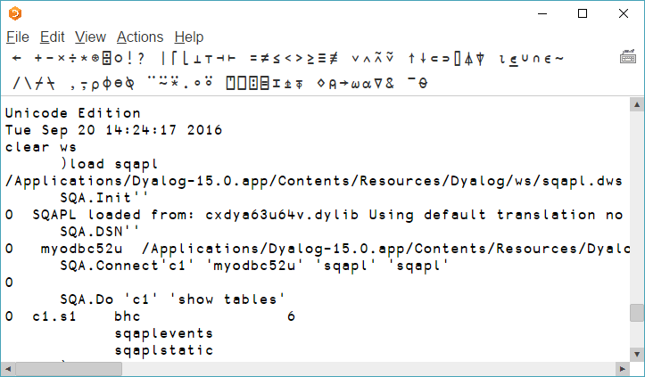
Portability – Development Environment
The RIDE significantly improves usability on non-Window platforms
NB: SQAPL
on a Mac!

Slide 8
RIDE Status
RIDE 3.0 was released with Dyalog v15.0
  Included workspace explorer and ability to launch APL processes using ssh
  Primary IDE on Mac
Plan for RIDE 4.0 (due out with v16.0)
  Address usability issues reported by first wave
  of ”production” users
  Primary IDE on Linux and RasPi
  Plus: Browser-based version (no install)
  Features to manage threads & stacks
  Protocol documented; first prototype of alternative IDE will soon be available (open source Eclipse Plugin)
  More tomorrow at 17:15 (”Open Front Ends”)

Slide 9




Tools for Application Development
The goal remains:
Develop on any Dyalog platform
  Using RIDE or the classical ODE under MS Windows
Deploy on any other platform
  Using tools which are cross-platform
Virtually all recently developed tools from Dyalog are designed to work on all supported platforms
A number of current client projects are developed under Windows or macOS, and deployed under
Linux on the cloud

Slide 10
Cross-Platform Tools
CONGA for TCP-based (Web) communications
  Web servers & -ices (and clients).
MiServer Web Server/Service Framework
  Version 3.0 finally available and in use for commercial devt
SQAPL for ODBC access on all platforms
RConnect integrates R statistics with APL
LoadData workspace for data import from SQL,CSV,XML,...
XML / JSON converters
Cryptographic Library
Graphics & Publication Production (SharpPlot/Leaf)
”Native File” tools added to interpreter in v15.0
  List contents of folders, read text files, etc - cross platform

Slide 11
Cross-Platform Tools, to come...
Conga: Many enhancements in v16.
SQAPL: ODBC interface bundled under macOS from v16.
Vecdb: column-oriented storage for large collections of data
Tools to Launch and Manage Processes from APL, either on the local machine or using ssh (secure shell) on remote machines
Dyalog File Server: Secure, high performance server for component files (now also supports native files)
  In production use for several years now at large installation; second installation in progress. Docn&packaging remains.
In the interpreter: ⎕JSON and ⎕CSV(!)
Longer term: V2.0 of Cryptographic Library to support increased support for crypto-features in most operating systems
Support for 2-way Data Binding to simplify development of HTML/JS applications

Slide 12

A word about Open Source...
It is wonderful to see a growing number of APLers contributing to open-source projects:
MiServer
vecdb
Synchronisation ToolBox (STB)
APLTree utilities
Both quality and quantity of tools available to us all will increase if you join in (write tests, if nothing else)!
Dyalog is committed to contributing to the growth – and management – of open source repositories containg APL code
We will open-source as many tools as we can in order to encourage participation

Slide 13
User Interfaces
50 Years of APL
  33 Years of Dyalog APL
    25 since John Daintree joined the team
24 years since Microsoft Windows 3.1 (1992)
  And ~23 years since JD gave us ⎕WC
  http://archive.vector.org.uk/art10000690
  Arguably the main reason why so many of us are here today
Now we must search for the successor to ⎕WC
  Fortunately, JD is still here to help
  And of course ⎕WC will continue to work until most of us have retired

Slide 14
Stand Alone or Integrate?
Should we provide cross-platform APL-centric solutions, or aim to integrate with (often platform specific) IT frameworks?
UI in APL vs C#/JS/Java Calling APL as a Service?
MiServer vs APL embedded in Microsoft IIS / Apache?
Dyalog Cryptographic Library vs OS Crypto Features
vecdb vs ODBC&SQL databases
  And what about ”OData”?
In favour of Integration:
big shops with specific integration requirements
software engineers with skills other than APL
Better off with stand-alone tools:
less sophisticated users needing to build complete applications in APL

Slide 15
Demo
Stand-Alone Cross Platform UI

Slide 16
Embedded Web Browser Engine
Allow APL application to generate HTML/Javascript
  Have it rendered in one or more windows
  Intercept *all* HTTP requests that would have gone to a web server, and respond to them (including POSTs and WebSocket requests)
Allows MiServer or other HTML/JS generators to power cross-platform ”desktop” applications
Can re-use the same code that is used to drive web apps
Initially under Windows, macOS and Linux

Slide 17

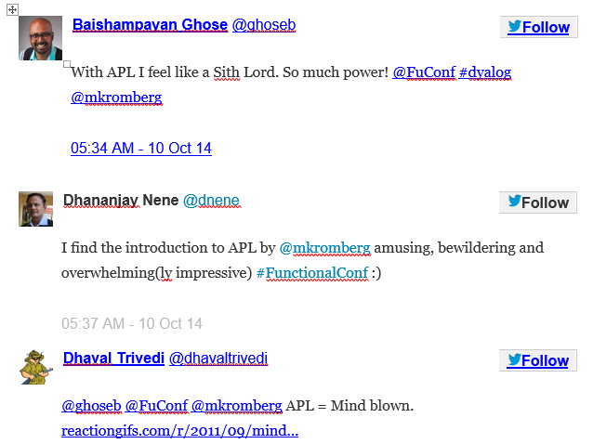
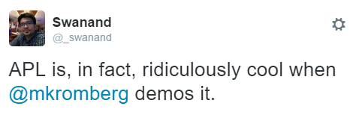
Marketing

Slide 18
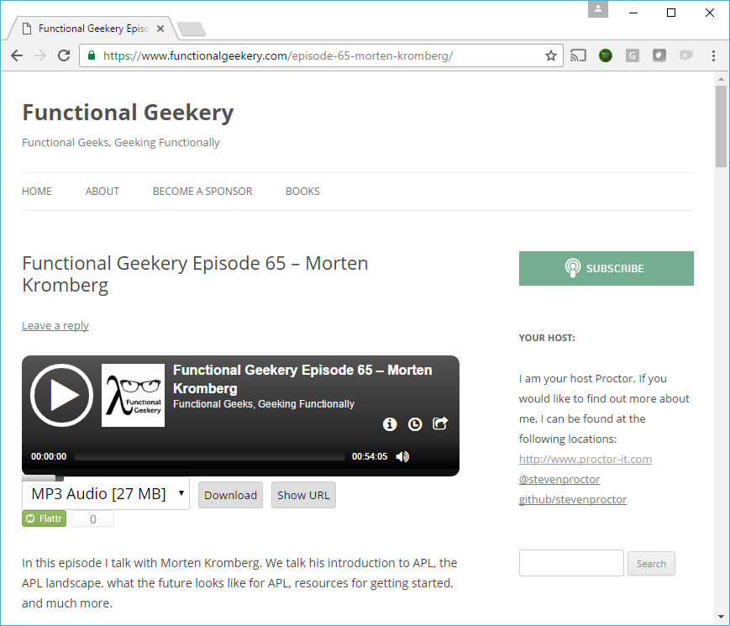

Slide 19
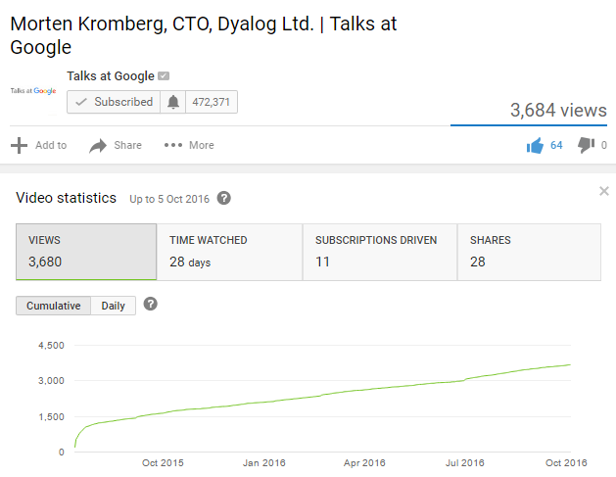

Marketing
2017 will be the year where we achieve regular publication of tutorials and training materials
!!!
Blog, tweet, etc – and play Code Golf
Increase presentations outside APL community
  2016: Array’16 Keynote, podcasts: FunctionalGeekery 65 and FlawCode (to come), two presentations + APL workshop at FnConf’16, colloquium at U of Portland OR
Google Talk (June 2015) ~3k views in 1st year, frequency increasing ☺

Slide 20

Usability: New Users
Dyalog has become the APL system of choice for professional application development in APL
Less sophisticated users – and new users – have not been prioritised
Without reducing our commitment to the Pro’s, we need new focus on understanding the needs of new users of APL
  Besides, the Pro shops also need to recruit new talent
Migrants to Dyalog APL also challenge our age-old ideas of what is good design ☺
Suki Tekverk, Intern

Slide 21


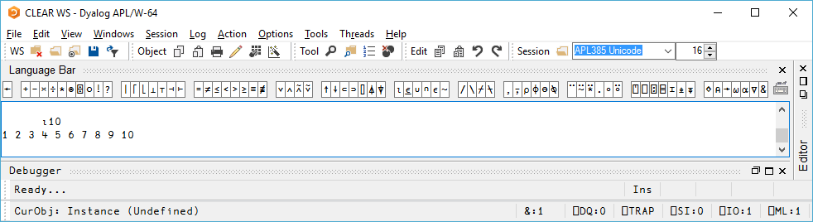
Look n’ Feel
A baby step in Dyalog’15
  Watch this space (standard disclaimer applies)

Slide 22
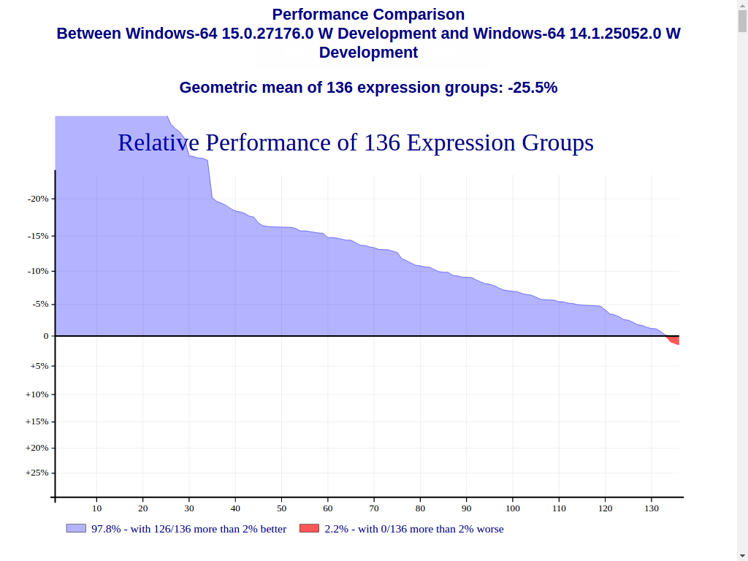
Conclusion
At 33, Dyalog is coming of age
Focus is shifting from ultra-rapid addition of features towards
  Thorough design and selection of new features
  Explaining how to use what is already there,
  Improving quality - and always performance!
  Understanding and satisfying the needs of new users
    Because there are a growing number of them
    Both ”Domain Experts” and ”Software Engineers”, which makes it more interesting
    Without reducing our commitment to ”old” users (we’re hiring more people)!
    ... and because old users need to find apprentices!!!
The goal of providing a modern set of tools on all important platforms, with high performance, is within reach – grab it!

Slide 23

“Dyalog is a modern, array-first,
multi-paradigm programming language,
which supports functional, object-oriented and imperative programming,
based on an APL language kernel.”

