Slide 1
vector database
Morten Kromberg
CXO, Dyalog Ltd

Slide 2
Goals
An efficient mechanism for storing ”large data”
  Some number of GigaBytes
  Parallel Queries & Sharding
  Open Source (github – 2 external contributors so far)
  Free (requires Dyalog APL)
Updates, but no ”transactions”
  Focus on bulk loading and analysis
Very simple query language
  No joins (at least not to begin with)
  Support for Group By (Sum Max Min Count)

Slide 3
Data Types
Each column is a memory-mapped vector:
B: Boolean
I1, I2, I4: Integers
F: Float – (645)
C: I2 pointer to up to 32,768 different strings
  I4 pointers and ”fixed width char” to come

Slide 4
Memory-Mapped Vectors
Can be much larger than the workspace
  Only query RESULTS need to fit in the WS
APL primitives including optimised ⍳ and ⌸ (key) apply directly without first reading data ”into” the workspace
Efficient I/O managed by the Operating System

Slide 5
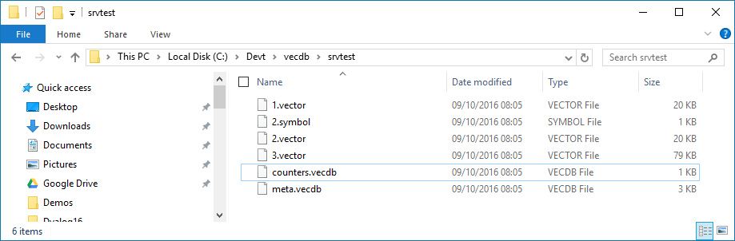

Creating a vecdb
columns←'Day' 'Sym' 'Price'
types←'I2' 'C' 'F'
options←⎕NS''
options.BlockSize←10000 ⍝ grow by 10,000
date←10000/⍳2×365
⍝ 10,000 records × 2 × 365 days = ~36M records
sym←(≢date)⍴'MSFT' 'IBM' 'AAPL' 'GOOG' 'DYLG'
price←100+0.1×⍳⍴date ⍝ It's a good market!
data←date sym price
params←name folder columns types options
db←⎕NEW #.vecdb (params,⊂5↑¨data)
assert 5=db.Count
db.Append columns(5↓¨data)

Slide 6
Query ”Language”
Extremely simple at this point:
db.Query Where [Cols [[GroupBy]]
All records for 2 days
db.Query ('Day'(200 201)) columns
Read DYLG records for 2 days
db.Query (('Day'(200 201))('Sym' 'DYLG')) columns
Select count Price, max Price, min Price group by Day Where Sym=”DYLG”
db.Query ('Sym' 'DYLG')
('count Price' 'max Price' 'min Price')'Day'

Slide 7
Record Indices / Updates
Indices of records for Day 200
ix←db.Query ('Day' 200) ⍬
Use them to Read
data←db.Read ix ('Day' 'Price')
Use for Update:
db.Update ix 'Price' (1.1×data[;2])

Slide 8
Calculated Columns
Virtual / computed columns can be defined:
db.AddCalc 'SquareI1' 'col_I1' 'I2' '{⍵*2}' ⍬ '{⍵*0.5}'
name base type expr map inverse
In addition to calculation formulae
  A map can be defined
  An inverse function can be specified so the base column can be searched directly

Slide 9
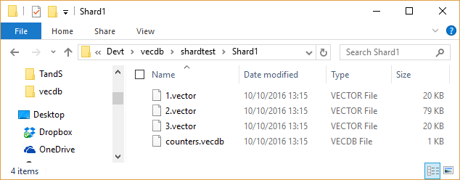
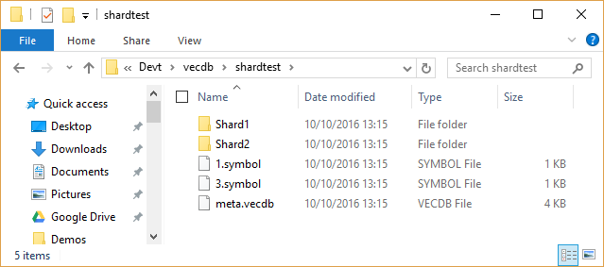
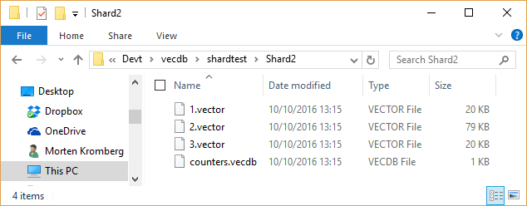
Sharding
Horizontal sharding can be defined using a lambda expression and a selection of columns
options.ShardCols←1 ⍝ Day
options.ShardFn←'{1+2|⊃⍵}'
⍝ Even in 1st shard, Odd days in 2nd
Location of Shards can be specified precisely
options.ShardFolders←
'c:\devt\vecdb\srvtest\shard1'
'//Mortens-Macbook-Air/vecdb/srvtest/shard2'
options.LocalFolders←
'c:\devt\vecdb\srvtest\shard1'
'//Users/mkrom/vecdb/srvtest/shard2'

Slide 10
Using Shards
Local use (typically during creation):
db←⎕NEW vecdb 'c:\devt\vecdb\srvtest' 2
  (now populate shard #2 – perhaps using process running on machine were shard is located)
Once created, via parallel server:
srvproc←#.vecdbsrv.Launch folder 8100
#.vecdbclt.Connect '127.0.0.1' 8100 'mkrom'
db←#.vecdbclt.Open folder
db.Query … etc …

Slide 11
Parallel Queries
Application
Client 1
Master Server
Slave serving
Shard 1
Slave serving
Shard 1
Shard 1
Data
Application
Client 2
Application
Client 3
Slave serving
Shard 2
Shard 2
Data
Queries are ”broadcast” to all slaves
Update data is ”pre-sharded” by Master

Slide 12
Test Driven Development
Let’s look at the source
https://github.com/Dyalog/vecdb/tree/Server

Slide 13
Conclusions - vecdb
Rudimentary but already useful
Heading for 3 ”commercial” users
Next steps:
  Optimise parallel queries
  Add more character types
  Extend query ”language” to allow relational functions < > etc
Please join in / tell us what you need!

