Slide 1
Web Stack of the Future
(Introducing Conga 3.0)
Bjørn Christensen
Morten Kromberg

Slide 2
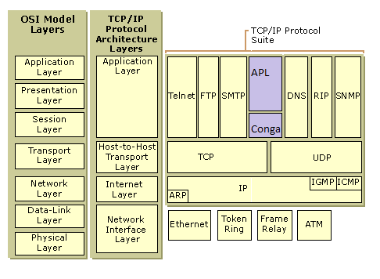
What Web Stack?

Slide 3

What Web Stack?
Current...
...of the Future
App.
HTML
SOAP
REST, etc
HTTP
App.
APL
HTML(CSS+JS)
SOAP
REST, etc
MiServer
(or similar)
HTTP
TCP
Conga
3.0
TCP

Slide 4
New CONGA Features
v3.0 adds more features than any recent release:
New Threading Model
Improved Scalability
Ability to run without secure features enabled
Transmit files
Built-in support for HTTP Protocol
  Including WebSockets for bi-directional
Object-Oriented Wrappers
Isolate multiple uses of Conga in the same APL process (e.g. Application vs Source Code Mgt)
Experimental support for User Datagrams (UDP)

Slide 5
New (Optional) Threading Model
Traditional approach is to run one APL thread which handles both Connect and Receive events
'OnlyConnections' property specifies that DRC.Wait on the server will only report new connections
  DRC.Wait on individual connections handle traffic on the connections
Assumption is you will run a separate thread for each connection
  Aimed at applications with long-running / stateful sessions, websockets etc

Slide 6
Improved Scalability
A new ”ReadyStrategy” uses an optimised FIFO queue for incoming messages.
Will not work for applications which might wait on connections in multiple threads
  (see previous slide)
Less flexible, but faster and fairer for high volume applications

Slide 7
Run Without Secure Features
The ssl library (~1.7Mb) is loaded when required
If it is not present, you cannot make secure connections
  In current Conga, if it is not present, Conga will not start

Slide 8
Transmit Files
You can now transmit the content of a file without first reading data into the workspace.
∇ e←SendFile(status hdr filename);Answer
:Access public
hdr←'Date: ',HttpDate,NL,hdr
:If 0≡status ⋄ status←'200 OK' ⋄ :EndIf
:If 0≠⍴hdr ⋄ hdr←(-+/∧\(⌽hdr)∊NL)↓hdr ⋄ :EndIf
Answer←(uc Version),' ', status,NL,hdr,NL,NL
e←Send (⊂Answer filename)
∇

Slide 9
HTTP Protcol Support
Direct support for the HTTP protocol simplifies application code and improves performance:
Incoming HTTP messages are broken up into separate messages:
  HTTPHeader
  HTTPBody
  HTTPChunk
  HTTPTrailer

Slide 10
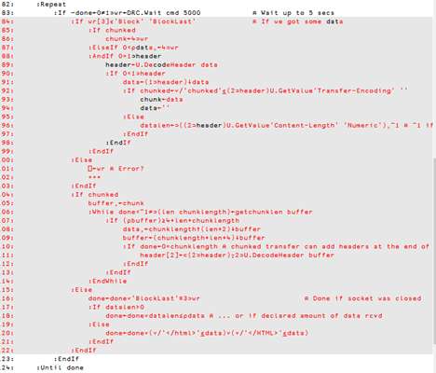
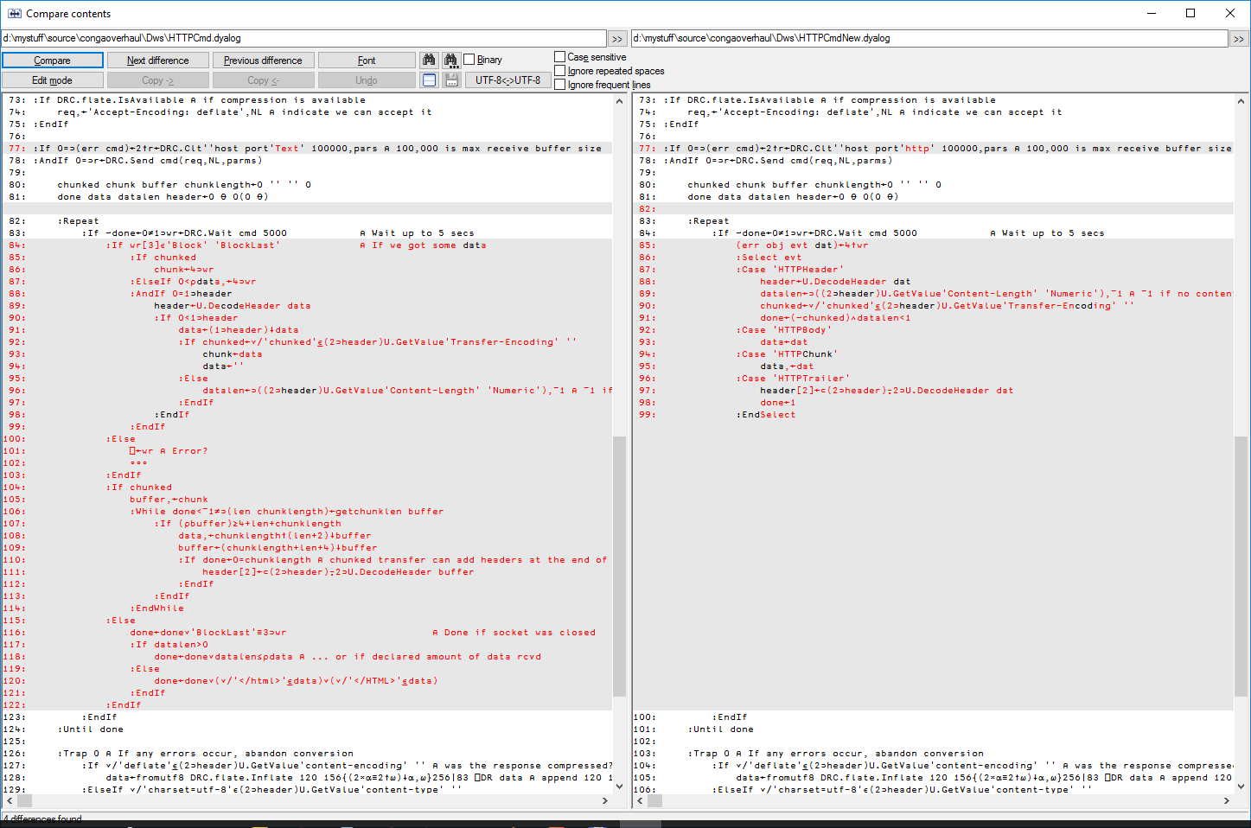

Slide 11
Object-Oriented Wrappers (experimental)
For example, an RPC server which reverses its argument:
:Class MyServiceHandler : #.DRCShared.Connection
∇ onReceive(obj data)
:Access public override
_←Respond obj (⌽data)
∇
:EndClass
srv←DRC.Srv 5001 MyServiceHandler
srv.Start
clt←DRC.Clt 'localhost' 5001
clt.SendRecv ‘Testing’

Slide 12
”Multi-Root”
Application use of Conga can conflict with tools also using Conga (e.g. Source code mgt)
Conga 3.0 allows tools to specify a separate ”root object”, giving an isolated instance
For example:
  Allows the writing of development tools using Web Protocols via Conga, without them conflicting with the application being developed

Slide 13
Multi-Root Example
DRC←DRCShared.Init '' ⍝ Use default root
srv←DRC.Srv 5000 #.MyCon
srv.Start
DRC.Names '.'
SRV00000000
CRD←DRCShared.Init '' 'CRD' ⍝ Use root 'CRD'
srv2←CRD.Srv 5001 #.MyCon
srv2.Start
DRC.Names '.'
SRV00000000
CRD.Names '.'
SRV00000000

Slide 14
Experimental UDP Support
DRC←DRCShared.Init ''
DRC.Srv 'US' '' 5000 'udp' 10000
0 US
DRC.Wait 'US' 100
0 US Timeout 100
DRC.Clt 'UC1' 'localhost' 5000 'udp' 10000
0 UC1.AAAAAAAAAAAAAAAAAAAAAQ==:1388
DRC.Send 'UC1.AAAAAAAAAAAAAAAAAAAAAQ==:1388' 'Testing 1 2 3'
0 UC1.AAAAAAAAAAAAAAAAAAAAAQ==:1388
DRC.Wait 'US' 1000
0 US.AAAAAAAAAAAAAAAAAAAAAQ==:e424 Block Testing 1 2 3
DRC.Send 'US.AAAAAAAAAAAAAAAAAAAAAQ==:e424' 'Testing 3 2 1'
0 US.AAAAAAAAAAAAAAAAAAAAAQ==:e424
DRC.Wait 'UC1' 100
0 UC1.AAAAAAAAAAAAAAAAAAAAAQ==:1388 Block Testing 3 2 1

Slide 15
Web Sockets
For highly responsive applications with bi-directional traffic (a la Google autocompletion)
Will allow two-way databinding
  (data can be pushed in both directions)
An HTTP connection can be upgraded to a WebSocket
  As a client, set the WsUpgrade property and receive event WSResponse as confirmation
  As a server, receive WSUpgradeReq and set WSAccept
  Or select Auto mode and just get a WsUpgraded event
Once upgraded:
  Data arrives via WSF events (binary or text data)
  DRC.Send is used to transmit data

Slide 16
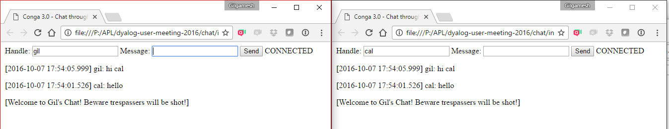
Interactive Chat Client

Slide 17
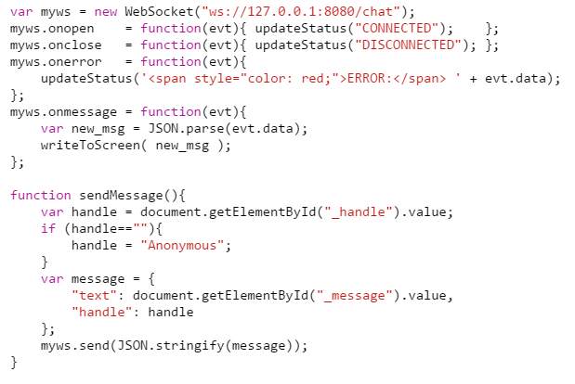
Chat Client (JavaScript)

Slide 18
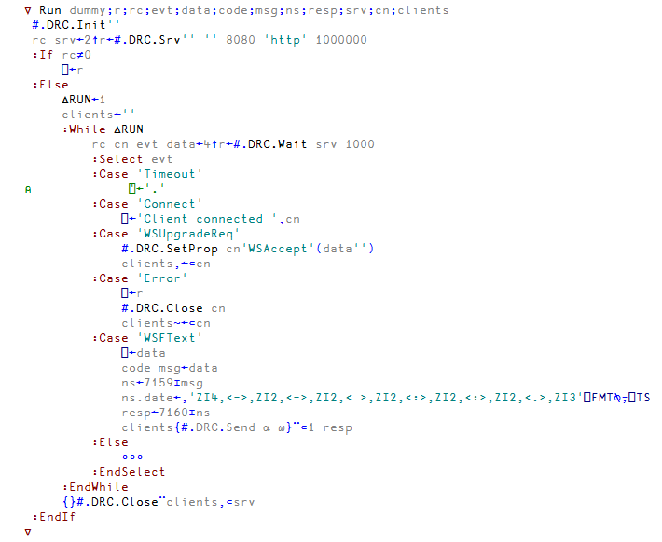
Chat Server (APL)

Slide 19
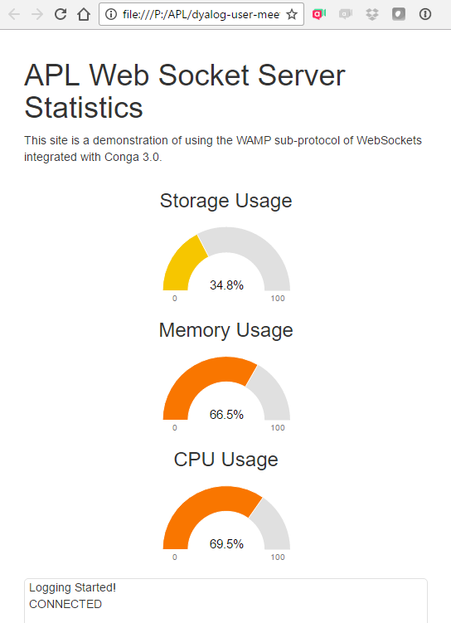
Publishing Stats via ”WAMP”

Slide 20
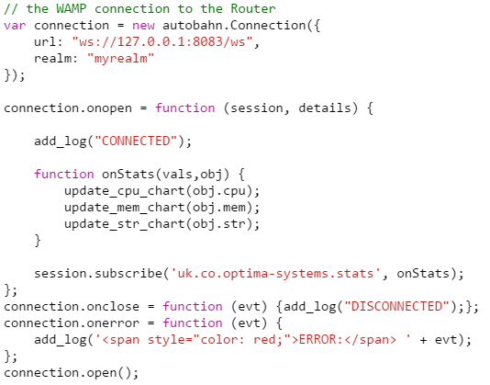
WAMP Client (JavaScript)

Slide 21
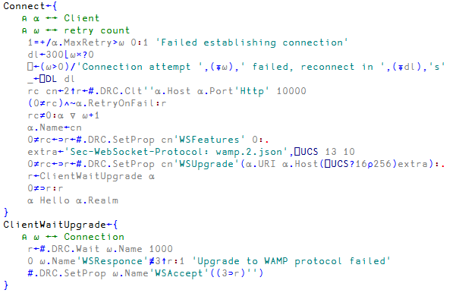
WAMP Client Connect (APL)

Slide 22
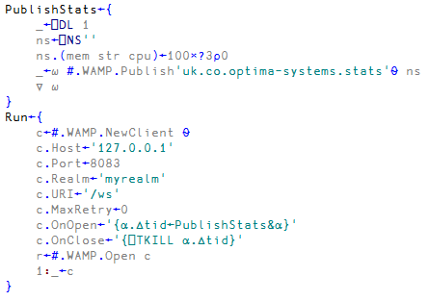
WAMP Client Publishing

