Slide 1
The wisdom of those who came before us, or, the price of freedom
Glasgow, October 2016

Slide 2
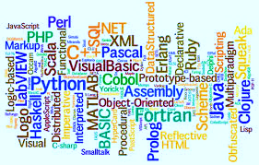
About Me
Stefano Lanzavecchia
CTO of APL Italiana
APL, the longest commitment in my life…
… and Music
Programming Languages Freak
Notes:
Exposed to APL when 13 years old
Assembler x86
Only one forced on me: Fortran’77 (in 1995…)
Some languages I’ve managed to learn: JavaScript, C#
Some still baffle me: Haskell

Slide 3

Sofia
Sofía: SOftware FInanziario APL…
…and the name of a woman
Portfolio Management System
20+ years young
Notes:
One of those financial applications APL is so renowned for

Slide 4
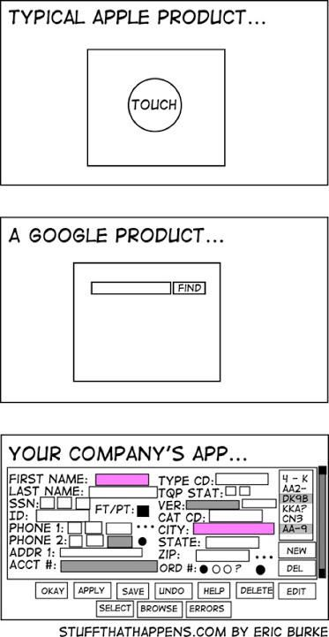
The Project
Bring your data to life
****® lets you create visualizations, dashboards, and apps that answer your company’s most important questions. Now you can see the whole story that lives within your data.
Sofia can produce loads of data
Interactive analysis of data
Do not want to compete with established (or budding) reporting tools
**** transforms your company's data into rich visuals for you to collect and organize so you can focus on what matters to you.
The **** Report Platform: Enterprise-grade reporting solution.
Meet ****. Your data, only hotter.
Award-winning features, with unmatched value and support. Become a Reporting Superhero. Inform and analyze with absolute ease.
Notes:
The market is not saturated with reporting products, but there are many, standalone, in the «cloud», embeddable. Some claims scrolling by in shiny colors.

Slide 5
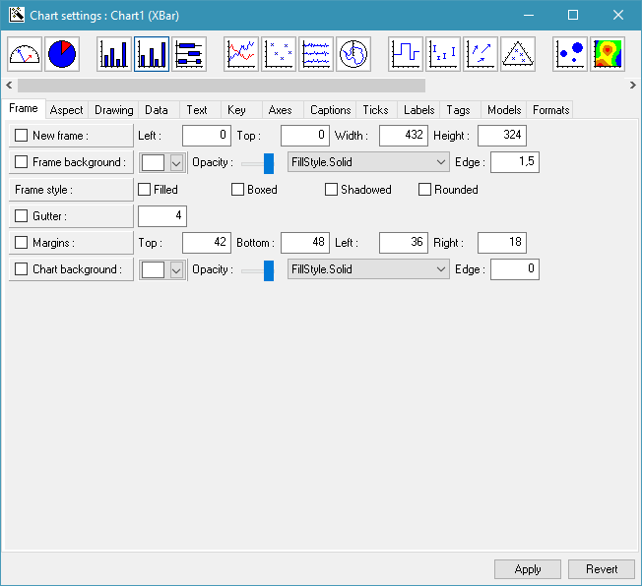
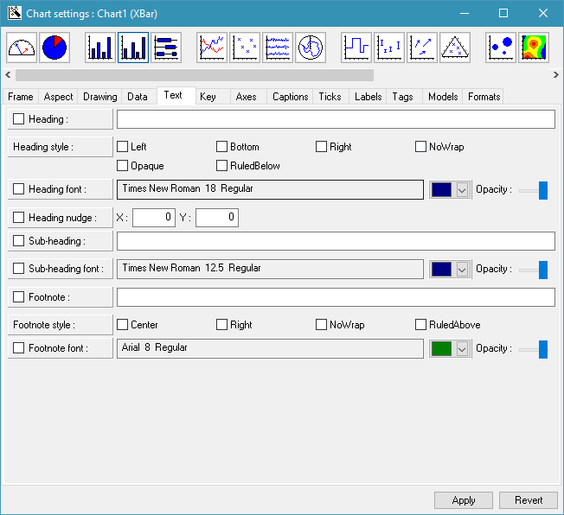
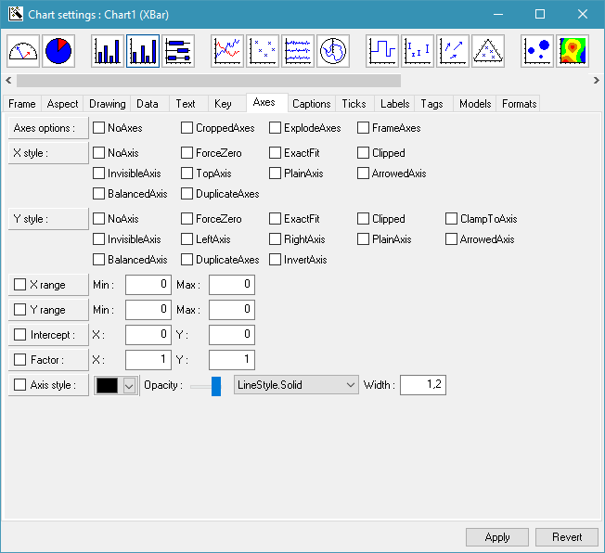
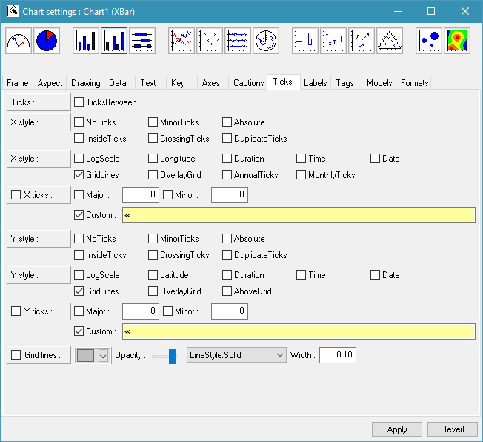
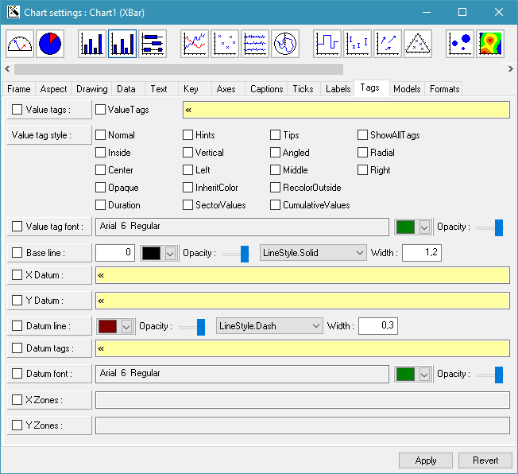
The Project
Interactive analysis of data
Do not want to compete with established (or budding) reporting tools
Do not want to design an editor
Notes:
Dyalog APL Chart’s editor. Thank you, but no thank you.

Slide 6
The Project
Interactive analysis of data
Do not want to compete with established (or budding) reporting tools
Do not want to design an editor

Slide 7
Demo

Slide 8
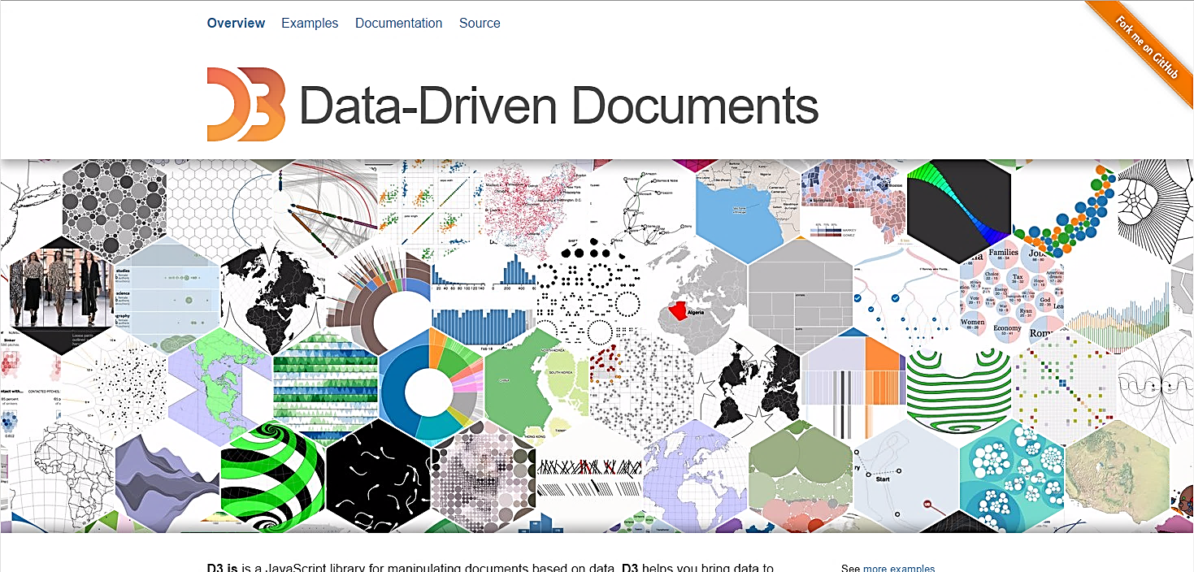
D3.js
“
Data–Driven Documents: Open Source JavaScript library for manipulating web documents based on data
”
Notes:
We went hunting for a tool to produce «colorful moving pixels».

Slide 9
D3.js
Why a framework instead of a library?
  Pro: Maximum freedom
  Cons: Steeper learning curve
Friendly community
Actively developed and supported
OSS: Open Source Software

Slide 10
Open Source Software
OSS means I can see how it works
  Many products too complex for source code to be useful
  D3.js is small enough for its source code to be helpful
OSS does not necessarily mean it’s free to use everywhere
  D3 is (right license for us)

Slide 11

Embed a Web Application
Ingredients:
A web server
A web client
Glue
Notes:
Given that we decided to use web tools, it seems like we need to find a way to embed a web application inside a 20+ years young APL application.

Slide 12
The Glue: .NET
Outstanding support in Dyalog APL…
… alas, sometimes a bit of a hit-or-miss
COM: tried, enough for a lifetime
Productivity boost:
  Huge community
  C#: good language
  Garbage Collection
  Visual Studio

Slide 13

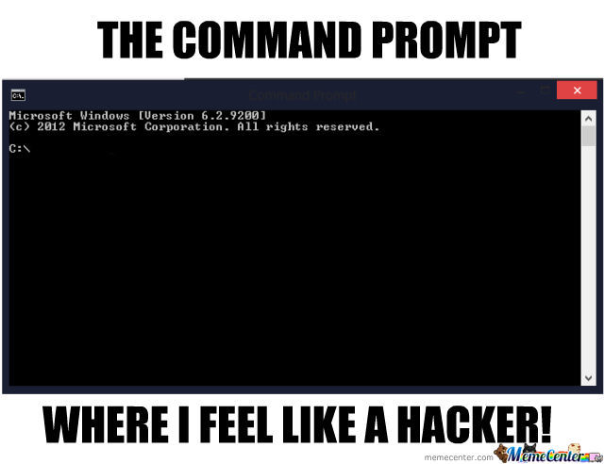
The Glue: .NET
Outstanding support in Dyalog APL’s…
… alas, sometimes a bit of a hit-or-miss
COM: tried, enough for a lifetime
Productivity boost:
  Huge community
  C#: good language
  Garbage Collection
  Visual Studio

Slide 14
The Web Server
An embeddable web server:
The 5th I write or borrow
This one’s not written in APL
Not based on http.sys
I picked: Nowin
What is OWIN?
Notes:
Somebody looking from the outside would think that I am obsessed by web servers. Probably I am.
5th: one was the source of inspiration of what then became Dyalog’s MildServer.
http.sys: the quintessence of an embedded server. Been available since XP SP2. .NET wrapper. Simple API. SuperUser for anything other than localhost.
Nowin: implementation of an OWIN server from raw sockets. Surprise: where http.sys crashed every now and then Dyalog APL, Nowin does not.
OWIN: Open Web Interface for .NET - OWIN defines a standard interface between .NET web servers and web applications. The goal of the OWIN interface is to decouple server and application, encourage the development of simple modules for .NET web development, and, by being an open standard, stimulate the open source ecosystem of .NET web development tools.

Slide 15
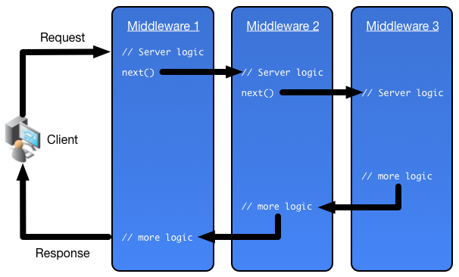
Request Pipeline
Notes:
OWIN introduces the concept of Middleware. Each Middleware is just a fancy function call and the pipeline is a chain of calls. Given that it’s the responsability of each piece of middleware to call down the chain, the graph can branch.

Slide 16
Request Pipeline
Typical middleware:
Logging
Authentication
Authorization
MVC Frameworks
Static Resources

Slide 17
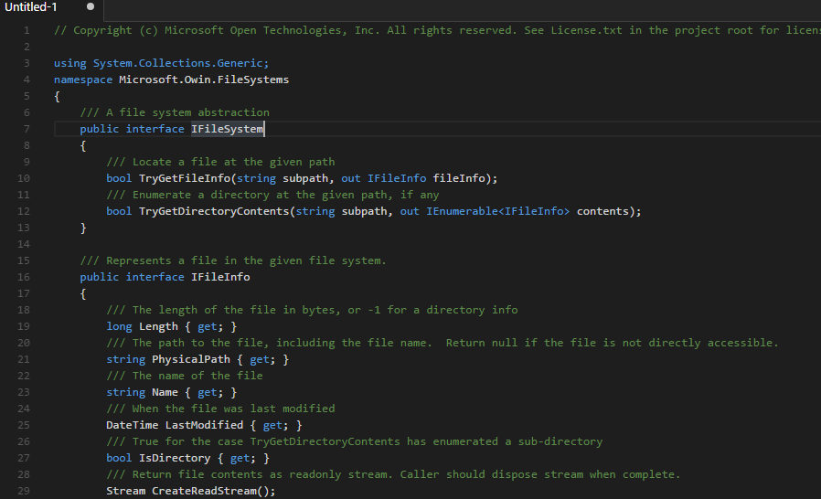
Virtual File System
IFileSystem
  GetDirectoryContents(string DirPath) → Collection of IFileInfo’s
  GetFileInfo(string FilePath) → IFileInfo
Notes:
«I» stands for «interface». It’s a contract that the implementation must respect.
These are not the exact definitions but are close

Slide 18
Virtual File System
IFileSystem
  GetDirectoryContents(string DirPath) → Collection of IFileInfo’s
  GetFileInfo(string FilePath) → IFileInfo
IFileInfo
  IsDirectory: boolean
  LastModified: DateTime
  Length: number
  Name: string
  CreateReadStream()
  → Stream

Slide 19
Virtual File System
IFileSystem
  GetDirectoryContents(string DirPath) → Collection of IFileInfo’s
  GetFileInfo(string FilePath) → IFileInfo
IFileInfo
  IsDirectory: boolean
  LastModified: DateTime
  Length: number
  Name: string
  CreateReadStream() → Stream
Stream
  Read
  …

Slide 20
File System
Possible implementations:
  Physical File System
  In-memory File System
  Zip File System:
    Physical Zip File
    In-memory Zip Blob
Composite File System
  Ordered array of IFileSystem implementations: the first to return wins
Notes:
… DB-backed storage
… HTTP pass-through

Slide 21
Layered File System
The File System
/path1/path_a/
/path1/path_b/
/path1/file1
…
/path1/filen
/path1
/path2
/path1/file3
/path1/file1

Slide 22
Layered File System
The File System
/path1/path_a/
/path1/path_b/
/path1/file1
…
/path1/filen
/path1
/path2
/path1/file1
/path1/file2
/path1
/path1/file3
/path1/file1
Notes:
This is the basis. It can be composed ad libitum.

Slide 23
Development vs. Deployment
Sofia built over an in-house source code management system based on APL component files
Easy to ship patches to the code
Not so to random files on disk
We develop the Web Application using a Physical File System
Before shipping we build a blob and put it in the code repository

Slide 24

The Web Client
Chromium
Gecko
Internet Explorer
The OCX?
The WinForms control?
Notes:
Chromium: huge runtime on disk, unstable unofficial .NET wrapper
Gecko: same issues as Chromium + even less polished .NET wrapper
Too bad, because they are better
OCX vs. WinForms, differences:
WinForms: can inject HTML without web server. We take for granted that a web app needs a web server, but modern browsers can intercept requests to URLs and delegate to callbacks the productions of the resources.
WinForms: DOM keypress events not fired. Deal breaker?
OCX: only with a web server

Slide 25
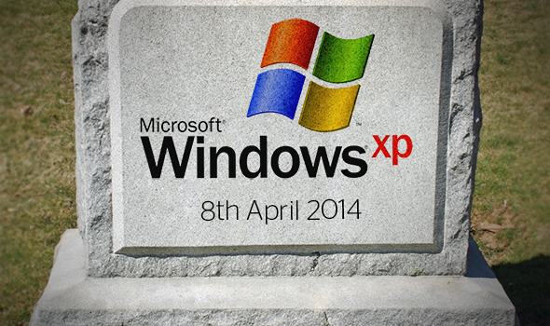
Versions
.NET: v4.5.x
  Old enough
  Complete enough
Internet Explorer: v11
  Fast engine
  Decent support of various Web standards
  Nothing to install
Notes:
We have customers complaining that we do not pay enough attention to Office 2016. Others who are secretly wishing they could still run Office 97.

Slide 26
Run
Instantiate Web Server
Instantiate client as a GUI control on a form
Make the client navigate to a URL
Client fires HTTP request to embedded server
Application downloaded
User interacts with the form:
  Click inside the browser control
  Click outside the browser control
  Print/Export

Slide 27
Architecture Diagram (I)
APL WS
GUI Form
Function 1
DO
OCX
Function 2
DOM
Print
HTML
SVG
Various
GUI
Controls
JS
Web Server
Function A
C#
Function B

Slide 28
Internet Explorer API (I)
Navigate:
  ocx.Navigate⊂URL
Refresh:
  REFRESH_NORMAL←0
  REFRESH_IFEXPIRED←1
  REFRESH_COMPLETELY←3
  ocx.Refresh2⍎'REFRESH_',mode
Notes:
Code not particularly exciting: such is the nature of the problem.

Slide 29
Interaction
Web Application talks to workspace hosting it:
  HTTP Get
  HTTP Post
APL to talks web application running in browser:
  JS code injection via IE’s «eval»

Slide 30
Architecture Diagram (I)
APL WS
GUI Form
Function 1
DO
OCX
Function 2
DOM
Print
HTML
SVG
Various
GUI
Controls
JS
Web Server
Function A
C#
Function B
Notes:
Let’s look again at the diagram. When the user clicks on the «DO» button, we want something to happen inside the DOM.

Slide 31
Internet Explorer API (II)
Inject JS:
  ocx.Document.parentWindow.eval jsCode
jsCode can be any JavaScript program:
a (global) variable assignment
a subroutine call
a function call…

Slide 32
.NET callbacks
When .NET calls home, it can do so on any thread, within any Dyalog APL’s thread, including brand new threads without stack.
How about local variables?
Re-enqueue all requests in a FIFO queue with known stack.

Slide 33
Development and Debugging
Development:
External editors
Resources on physical filesystem
Static data
External Web Server
Random Web browser (modern devtools are good!)
Debugging in context:
tricky because IE as OCX does not expose devtools!
welcome back «Print» debugging
Notes:
Some things can only be debugged in context:
CSS
Real Data
Host/Guest interaction

Slide 34
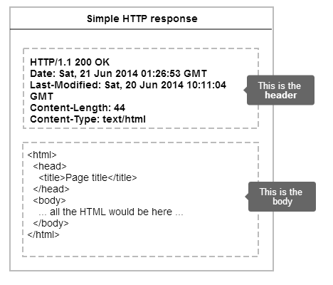
Trick
X-UA-Compatible
Notes:
By default an embedded Internet Explorer thinks we are still in 200x.

Slide 35
Print/Export
PhantomJS
Notes:
Remember that «Print» button on the Diagram? Let’s see how it works.
We need to introduce yet another player.

Slide 36
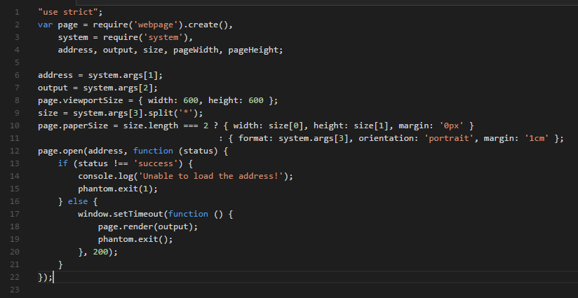
PhantomJS
“
PhantomJS is a headless WebKit scriptable with a JavaScript API. It has fast and native support for various web standards: DOM handling, CSS selector, JSON, Canvas, and SVG.
”
Notes:
WebKit is the engine behind Safari, and used to be the one behind Chrome, before the big fork, when Google parted ways.
Scripts can do all sort of things. A typical usage case is automated testing of websites.

Slide 37
Print/Export
PhantomJS + server side trick
  read the current content of the web page…
  … hold on to it.
  execute PhantomJS to rasterize the scraped web page
Tricky points:
  External resources (CSS) re-rooted
  No client-side Javascript
  Paper size/orientation/resolution
  Mix of vector and raster graphics
Notes:
The APL program reads via the OCX’s COM API the current (dynamically generated by D3.js) content of the web page…
… and saves it in a safe place.
Then executes PhantomJS pointing it to a URL of the web app.
PhantomJS rasterizes the virtual web page built from the stash…
… making sure not to execute any client-side JavaScript that would destroy all the dynamically generated content (because the app would re-init!)

Slide 38
Architecture Diagram (II)
APL WS
GUI Form
Function 1
OCX
DO
DOM
Function 2
Print
HTML
SVG
Web Server
Various
GUI
Controls
JS
C#
Function A
Function B
PhantomJS
WebKit
Function α
DOM
JS
Function β
HTML
SVG
Fn A
Fn B

Slide 39
JavaScript: the Origins
In 1995, Netscape Communications recruited Brendan Eich with the goal of embedding the Scheme programming language into its Netscape Navigator.
The company later decided that the scripting language they wanted to create would complement Java and should have a similar syntax.
To defend the idea of JavaScript against competing proposals, the company needed a prototype.
Eich wrote one in 10 days, in May 1995.
Although it was developed under the name Mocha, it was renamed JavaScript before the final release.
[Source: Wikipedia]
Notes:
The final choice of name caused confusion, giving the impression that the language was a spin-off of the Java programming language.

Slide 40
JavaScript ECMAScript
No, really!
Nice language
Relatively straightforward internal adoption
Developers can do the same kind of horrible things they do in APL…
WWW as an amazing resource trove:
  Tutorials
  Libraries
  StackOverflow
…and I wish they did not…

Slide 41
Learning
HTML
CSS
JavaScript
D3.js
… a bit of other libraries
… external tools (editors, debuggers)
Notes:
Two different development groups, with hardly any previous experience with Web technologies, learnt on their own.

Slide 42
Summary
Freedom to:
Substitute the Web Server
Not depend on pre-baked charts
Develop/Deploy/Send Patches
Print/Export

Slide 43

Future
Infrastructure:
  D3.js: from v3 to v4
  Web server: move to Kestrel
  Web client: Microsoft Edge? No can do.
  Dyalog’s integrated browser + fake server (?)
Sofia:
  Enhance existing charts
  Implement new charts for other areas of Sofia

Slide 44


Questions?

