Slide 1
Try
APL
Online
Adám Brudzewsky
Brian Becker

Slide 2
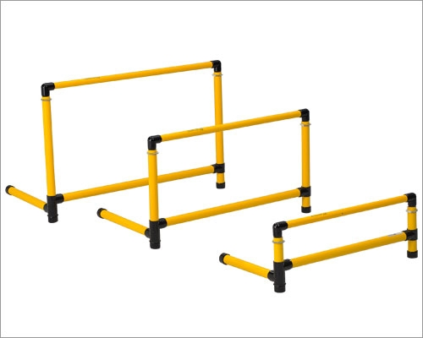
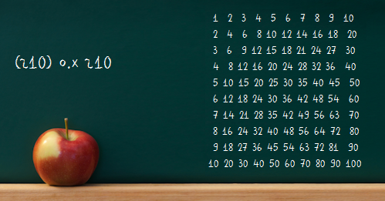
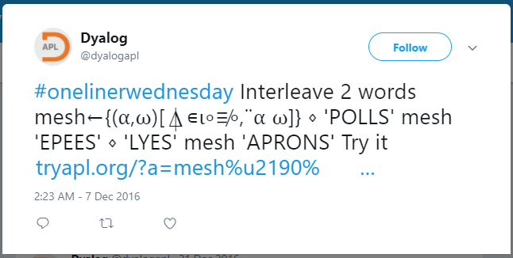
Why Try?
Low/zero cost introduction to APL
Facilitate learning APL
Facilitate idea exchange
Everyone else does it
(Haskell, Scheme, Ruby, Python, JavaScript, et al)

Slide 3
Two Approaches to Try
TryAPL.org
Introduced in January 2012
Running MiServer 2.1 (3.0 soon)
Dyalog v14.0 (16.0 soon)
"Pseudo" APL session
Single line input
Not a complete APL environment
Provides an introduction to APL
tio.run/#apl-dyalog
Introduced January 2017
Uses the Try It Online framework
Dyalog 16.0
Predetermined run
"Scripted" code and session
Almost everything included
Shows how code runs

Slide 4

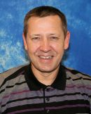
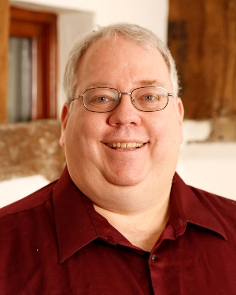
The Genesis of TryAPL
Boston, MA USA on 4 Oct 2011 at ~16:45PM
Joel Hough, APL Competition Winner
Morten to Brian via Instant Message
Brian to self
3 months later TryAPL.org released in January 2012
June 2012 - The Reddit Effect
Oh crap!
(16:49:05) Morten Kromberg: We need to build TryAPL.org
(16:49:27) brian@dyalog.com/X220: yeah, I think so too

Slide 5
TryAPL Today
Averaging 1200 users/month
Input Methods
A Little Fib
Windows IME
Floating Keyboard
Primer
Backtick Input
Copy/Paste
Click on Examples
Notes:
Input methods
Copy and Paste
Windows IME
Popup keyboard
Primer
Backtick
Click on Examples
Permalinks
Session recall
Tutorials

Slide 6
TryAPL Future
Upgrade to MiServer 3.0 and Dyalog v16.0
More Tutorials (please contribute!)
Save your work locally
Responsive layout for tablets and phones
RIDE-style input

Slide 7


Try It Online (tio.run)
32
({}≤()≥)
(≤()≥)
99
({}≤()≥)
((<>[≤()≥]))
⋮
add 72
put
fwd 1
add 101
put
⋮
Dennis
  ShapeScript – stack-based
  M – golfed J
  Jelly – THE golfed J
  Sesos – concise BrainF*** assembler language
  Sad-Flak – an unholy fusion of Woefully and Brain-Flak
TIO
  334 338 347 programming languages, ALGOL – Zsh
  All languages together see over ¼ million uses/month
``Hello, World!˝
“3ḅaė;œ»
“Hello, World!
'Hello, World!'
Notes:
safe playground

Slide 8


The path to Dyalog APL on TIO
Judaism Stack Exchange
Programming Puzzles & Code Golf Stack Exchange
Used TryAPL to show how solutions work
"Everyone" uses TIO
January 25, 2017 at 5:28 PM, Adám to Dennis in TIO chat room:
I'd really like to see Dyalog APL on TIO. Any way to achieve that?
2 (two) sleepless nights…
January 27, 2017 at 1:14 PM, Morten to Adám by email:
I think this is VERY COOL INDEED!

Slide 9
Why Dyalog APL on TIO?
APL in a format more familiar to the non-APL world
Demonstrate an entire sequence of inputs at once
Can do things that TryAPL cannot (for good reason):
  Demonstrate utilities and using unsafe primitives like ⍎
  Teach about Dyalog APL's Object Orientation
  Use automated "interactivity" and I/O streams

Slide 10
FAQ
TryAPL.org since January 2012
Basic info "No-cost" way to become introduced to APL
MiServer 2.1 on Dyalog 14.0 (changing soon!)
Closed source (for now)
Written by the APL Tools Group
Interaction Optional floating APL keyboard
Backtick keyboard input
Defaults ]Rows (truncate output) and ]Boxing
Primer (categorised language bar)
Scroll through history of inputs
Teaching Traditional interactivity
Perma-link to one expression
Plain URL perma-link
Primer and tutorials
Limitations White-listed operations, dfns, dops, tacit fns only
10 second time limit for each input
64 MB workspace
Results limited to 25 rows and 215 columns
Session Emulated traditional APL session
Saved session (3 days)
Uses cookie determine server-side session file
User code is executed in separate "safe" process
tio.run#apl-dyalog since January 2017
Full Dyalog APL interpreter online
Dyalog 16.0 Unicode/Classic in an SELinux sandbox on 4 load-balanced arenas
Free Open Source Software (MIT licence)
Written by Stack Exchange user Dennis
No native way to enter APL characters
Needs OS input method, copy-paste, or perma-link
User must manually enable SALT to access user commands
Gives performance info (⎕AI and exit code)
Separate I/O streams (STDIN, STDOUT, STDERR)
Non-interactive
Perma-link to entire session
Plain URL, HTML, Wiki markup, Markdown, code golf, BBCode perma-links
Loads any default install workspace (e.g. dfns)
Almost everything allowed (files, APL/OS threads, etc. – no graphics or network)
1 min execution timeout for entire session
128 MB workspace by default (increasable to 2.5 GB)
Limits ⎕ and ⍞ to 128 kB each for entire session
Scripted workspace and predetermined "typed" input
Clean environment for every session (⎕SE is empty)
Does not use tracking cookies
Every session in separate thread with tight security context

