Slide 1
A Tale of Two Web-Apps
Brian Becker
Michael Baas

Slide 2
Agenda
Facets of a production web application
  Security
  Session management (state maintenance)
  Database access
  Scalability
  N-Tiered architecture/API
  Continuous integration
  Availability/Robustness
  3rd Party Services
  Logging
  User Experience

Slide 3

Security
Authentication
  Are users authenticated?
Authority
  Do users have access to the appropriate resources?
  Role-based access
Are communications encrypted?
  Using https?

Slide 4
Security
Authentication guidelines
  Never transmit passwords unencrypted
    Use HTTPS or
    Use "salting" to hash passwords
  Never store passwords unencrypted
    Store salt and salted password

Slide 5
Session Management
How do you differentiate one user's session from another user's?
Persisting session data
  How long?
  Permanent storage vs. In memory
Notes:
Shopping cart

Slide 6
Database Access
Do you need a database?
Database connection management
  Per server? Per client session?
SQL Injection Risk
  https://www.w3schools.com/sql/sql_injection.asp
  Use SQAPL bind variables!

Slide 7
Scalability
What happens when you have
  1, 10, 100, 1000 simultaneous users?
Use APLProcess to distribute and isolate work

Slide 8
N-Tiered Architecture/API
N-Tiered design separates
  Business logic
  Database
  User interface
These should communicate with one another through well-designed interfaces

Slide 9
Continuous Integration
How are changes to the application tested and pushed into production?
  Manual process
  Automated process
  Hybrid process

Slide 10
Availability/Robustness
Error handling
Monitoring
Restartability

Slide 11
3rd Party Integration
What 3rd party services will you interact with?
How do you interact with them?
  HttpCommand
  Integrated JavaScript

Slide 12
Logging
Different Levels of Logging
  Error (DrA)
  Server (MiServer.Log)
  HTTP (Lumberjack)
  Application

Slide 13
User Experience
What platforms will your users use?
  Desktop/laptop
  Tablet
  Phone
  Watch
Giving your application a common look and feel with templates

Slide 14
Two MiServer-based Web Applications
TryAPL
  Online since 2012
  Running MiServer 2.1, Planned upgraded to MiServer 3 in 2017
  Developed on Windows, Running on Linux
EvReg
  Based on Dyalog Conference Registration System
  Using MiServer since 2014, Rewritten with MiServer 3 in 2017
  Developed on Windows, Running on Linux

Slide 15
TryAPL Demo
http://tryapl.org

Slide 16
TryAPL - Security
TryAPL does not use HTTPS nor have any user authentication.
Cookies are used to "remember" the user

Slide 17
TryAPL - Session Management
Uses cookies to identify user
Uses MiServer session for timeout
  /Config/Server.xml
  _Request.Session
Uses TryAPLSession to save user's "APL session" in component file
  /TryAPL/Code/TryAPLServer.dyalog
Notes:
Shopping cart

Slide 18
TryAPL - Database Access
TryAPL does not use a database

Slide 19
Scalability
TryAPL uses "slave" processes to execute user inputs
  The number is configurable in
  /TryAPL/Config/TryAPL.xml
The slave processes are initiated using APLProcess
  APLProcess is a cross-platform utility to start and control APL processes on your local machine or remote machines

Slide 20
TryAPL - N-Tiered Architecture/API
TryAPL implements its business logic in two classes
  /TryAPL/Code/TryAPLServer
  /TryAPL/Code/TryAPLSlave.dyalog
In general you will build a class based on the MiServer class
  The MiServer class has a number of overridable methods
User interface is implemented in /TryAPL/index.dyalog

Slide 21
TryAPL - Continuous Integration
TryAPL does not currently use any of the continuous integration framework
  It is planned for the upcoming rewrite

Slide 22
TryAPL - Availability/Robustness
Error handling
  Untrapped errors in the slave processes are logged and a new slave is started
  Untrapped errors in the master process cause TryAPL to stop
Monitoring
  A separate task queries TryAPL every 60 seconds
Restartability
  If the monitor does not get a response TryAPL is restarted

Slide 23
TryAPL - 3rd Party Integration
TryAPL uses Google Analytics
  Requires registering for Google Analytics
  Include some JavaScript

Slide 24
TryAPL - Logging
Error – we use DrA (built into MiServer)
Server – level of logging is settable
HTTP – logs all HTTP requests to /var/log/tryapl
Application – log all user inputs

Slide 25
TryAPL - User Experience
Single page
Geared for Desktop
The native keyboard dilemma

Slide 26
EvReg
Demo
as and where appropriate
VPN -> http://confreg.dyalog.bramley/index.mipage

Slide 27
What does EvReg demonstrate?
Security
Database-Access
Availability / Continous Integration
Integrating 3d Party services
N-tiered architecture/API
User Experience

Slide 28
Setup
MiServer3
  get it from https://github.com/Dyalog/MiServer/tree/bootstrap
\MyMS3Sites\EvRegLite
  get it from https://github.com/Dyalog/MiSites
  ...soon!
no database, sry!

Slide 29
Intro: EvReg
„Old system“
MiServer2
used hacks
needed code-updates every year
„New“ system
MiServer3
no hacks
„a user-meeting is an n-tuple“ -> data-driven
„events“, not just „the meeting“

Slide 30





Overview EvReg
EvReg
MySQL

Slide 31
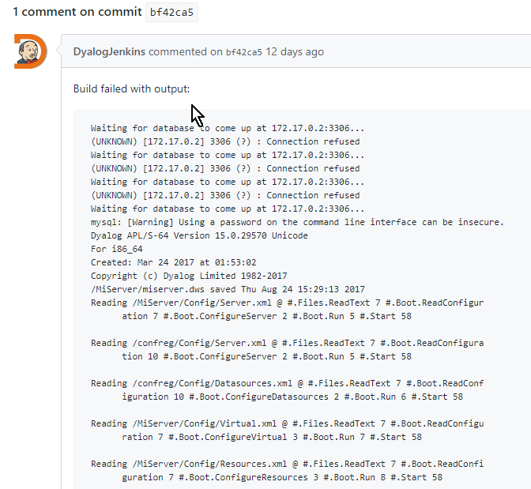

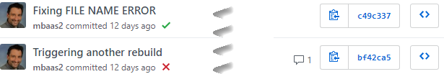

Continous Integration in EvReg
Repository
Commit
Returns Status of test, err-msg
CI
(Jenkins)
CI checks for updates of repo and builds new instance if req‘d.
Docker
Runs new instance and performs test
Test ok: use this updated build for future sessions

Slide 32
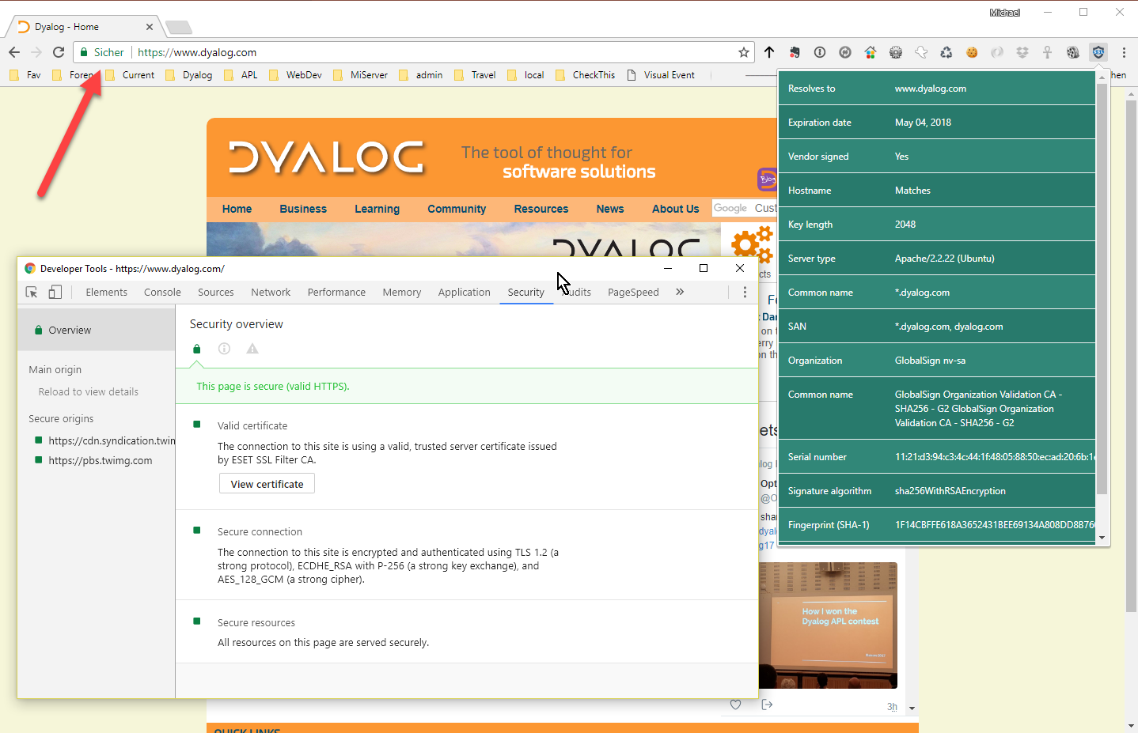
Security in EvReg
https:
  handled by Load Balancer
Credit Card Info is handled on Worldpay‘s site

Slide 33
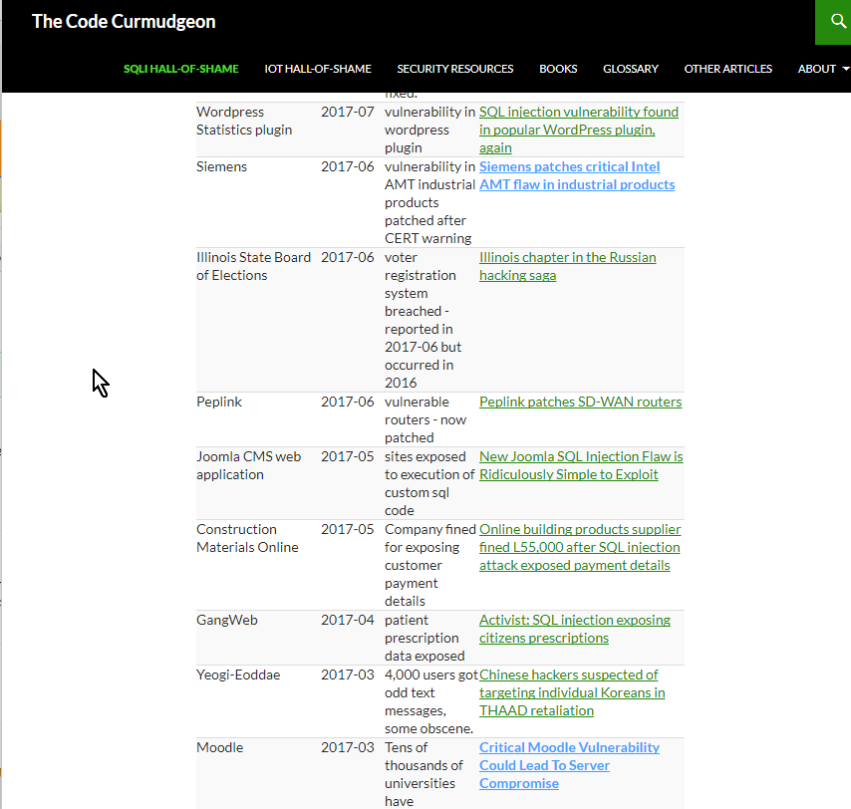
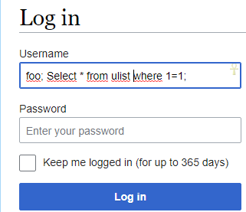
Database-Access in EvReg
Avoid SQL-Injections by using SQAPL‘s Bind-Mechanism

Slide 34
Continous Integration in EvReg
Repository
Commit
Returns Status of test, err-msg
CI
(Jenkins)
CI checks for updates of repo and builds new instance if req‘d.
Docker
Runs new instance and performs test
Test ok: use this updated build for future sessions

Slide 35
High Availability in EvReg
Repository
CI
(Jenkins)
Docker
Load Balancer
http:
https:

Slide 36
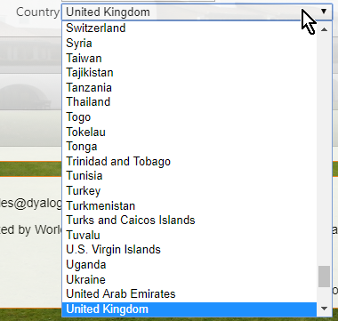
3d-party services in EvReg
Country.io
Worldpay
later: Validation of EU VAT-Ids

Slide 37
EvReg
Demo
]demo countries

Slide 38
country.io → Code\Countries.dyalog
∇ R←getem
...
z←(1(7159⌶)(#.HttpCommand.Get'http://country.io/names.json').Data)[;2 3]
...
∇
R←#.Countries.List
R←{what}#.Countries.FromIP ip
R←#.Countries.GetNameFromCode code
Quite standalone, might be released on its own one day
⎕JSON

Slide 39
WorldPay-Integration: initiate payment
PARAMS←⎕NS''
PARAMS.amount←(2⍕InvoiceAmount)~' '
PARAMS.cartId←'Conf',⍕TransactionId
PARAMS.currency←'EUR'
PARAMS.desc←'Dyalog Usermeeting 2017' ⍝ default
PARAMS.desc←(confIdx⊃confs.Title)
PARAMS.desc,←' / ',SelectedPackage.Title
PARAMS.email←EMail
PARAMS.instId←‘******‘ ⍝ top secret!
PARAMS.hideCurrency←'true'
PARAMS.name←DelegateName
PARAMS.address1←Address
...
PARAMS.MC_callback←#.Boot.ms.Config.Application.('https://',OurDomain,'/',CallbackURL)
PARAMS.MC_pack←⍕SelectedPackage.id
PARAMS.MC_items←¯1↓∊(⍕¨∊TheItems.(Picked/id)),¨','
:If 1=#.Strings.tonum #.Boot.ms.Config.Application.testMode
PARAMS.testMode←'100'
:EndIf
f←Add _.Form #.Boot.ms.Config.Application.PaymentURL
:For n :In PARAMS.⎕NL-2
f.Add _.input''('type=hidden name=',n,' value="',(PARAMS.⍎n),'"')
:EndFor
OnLoad←'$("form").submit();'

Slide 40
WorldPay-Integration: processing completed payment-transaction
WP calls MC_callback (=paymentresponse.mipage)
Get¨'transStatus' 'authAmount' 'authCurrency‘

Slide 41
EvReg
Demo
http://confreg.dyalog.bramley/index.mipage

Slide 42
N-tiered architecture in EvReg
EvReg
API
Load Balancer
EvReg

Slide 43
API-Integration
Configured in Application.xml
Implemented through API-Link/API.dyalog and API-Link.dws as well as...:
API: ConfApp.dyalog
  :access public
  (RetCode Msg res)←{larg}APIfn rarg
    RetCode:
      0=ok
      anything else is an error-code
    Msg: only relevant if RetCode≠0
    res:Result

Slide 44
Using the API
Page-Class:
∇ {R}←APIdo rarg
:Access public
R←CatchAPIErrors(SessionGet'APIref').CallAPI rarg
∇
∇ R←CatchAPIErrors S
:Access public
⍝ simplistic mechanism to handle API-Errors and Warning:
⍝ any return-code ≠0 will ⎕SIGNAL and get out of the stack,
⍝ so the result returned in case of successfull operations
⍝ will be the 3d element of the calls result.
:If 0=⊃S
R←3⊃S
:Else
('API-Warning/Error-Msg: ',2⊃S)⎕SIGNAL 2
:EndIf
∇
confs←APIdo('GetConfs' 1)

Slide 45
The custom Server-Class: Code/CFR_Server
onServerStart:
  process Config/application.xml
onSessionStart:
  create new instance of API & link it to session (req.Session.APIref)
  assign req.Session.Country ('country_code'#.Countries.FromIP{(¯1+⍵⍳':')↑⍵}2⊃req.PeerAddr would have been nice, but we do not have IP of „end-client“)
onSessionEnd:
  close API-Connection

Slide 46
Responsive Design
„Responsive web design (RWD) is an approach to web design aimed at allowing desktop webpages to be viewed in response to the size of the screen or web browser one is viewing with.”
https://en.wikipedia.org/wiki/Responsive_web_design

Slide 47
Health-Warning: RD in EvReg lite
„Lite“ implementation for demo-purposes
You will need to get some understanding of BS-Concepts yourself, we can‘t „hide“ it in MS-Widgets
Current BS-Integration still evolving, please download seperate Bootstrap-branch and be aware that it still might be subject to breaking changes
Based on BS3. BS4 dev started in 2014, it entered beta-stage in Aug17. Our final implementation will be based on BS4.

Slide 48
Bootstrap‘s Grid-Model
Everything has 12 columns
Sizes and classes
'.col-xs-6'Add _.div
 | Extra small | Small | Medium | Large
Width (px) | <768 | ≥ 768 | ≥ 992 | ≥ 1200
Prefix | xs | sm | md | lg

