Slide 1
The "P" Words
Projects and Packages
Morten Kromberg

Slide 2
Agenda
Packages
  Why do we need packages?
  Getting started with Tatin
  Using a Tatin Package
Projects
  Why do we need project managers?
  Acre & Dado
  Cider

Slide 3
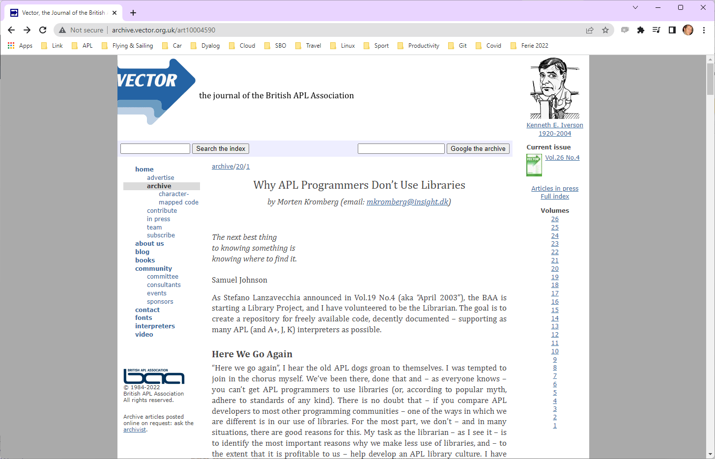
(July 2003)

Slide 4
Most Importantly
In addition to be valuable educational resources…
Packages are critical to keeping APL competitive as a tool for building modern applications
Support web protocols and components, data formats, operating system APIs, security requirements

Slide 5
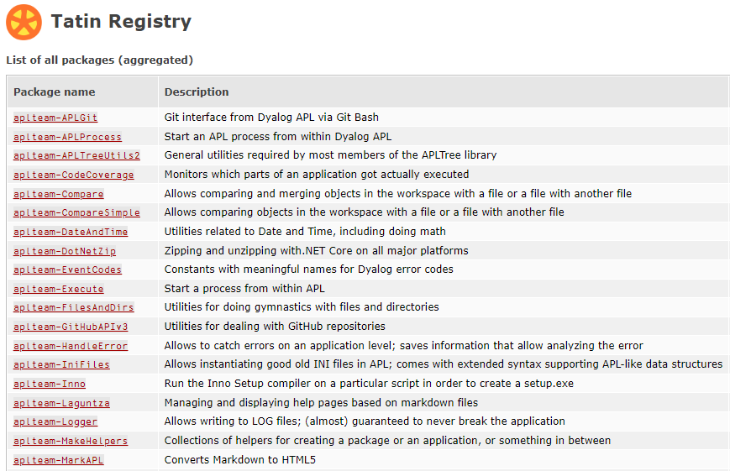

Slide 6
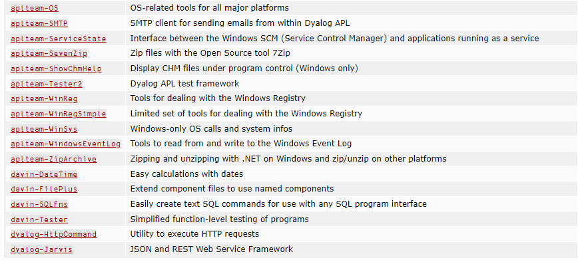
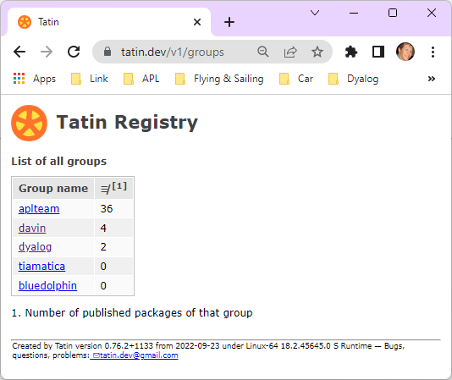
🍾 Finally, the first Dyalog Packages are published!

Slide 7

Introducing Tatin
Developed by Kai Jäger (first lines of code written in 2020)
Funded by Dyalog
Designed by Kai and Gilgamesh Athoraya
Input from various people at Dyalog
Logo by Adam Brudzewsky
Many thanks to Davin Church, the first real user of the system other than Kai himself
Paul Mansour is not to blame for the current design of Tatin, but has been an important inspiration

Slide 8
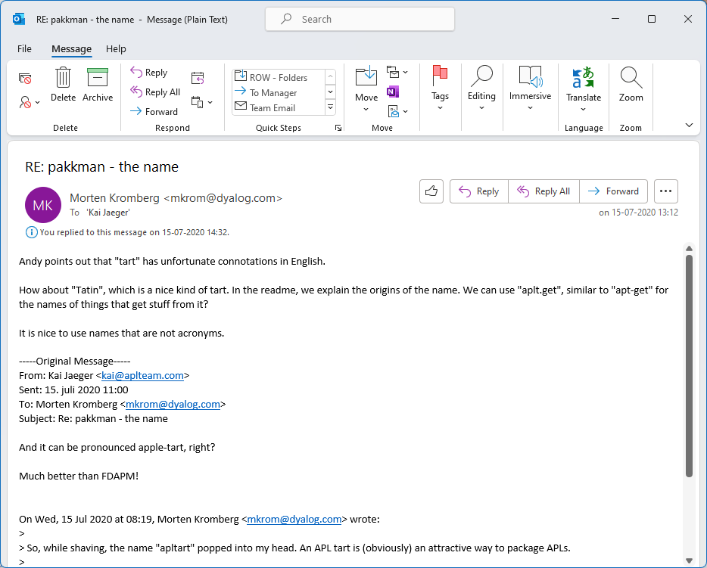
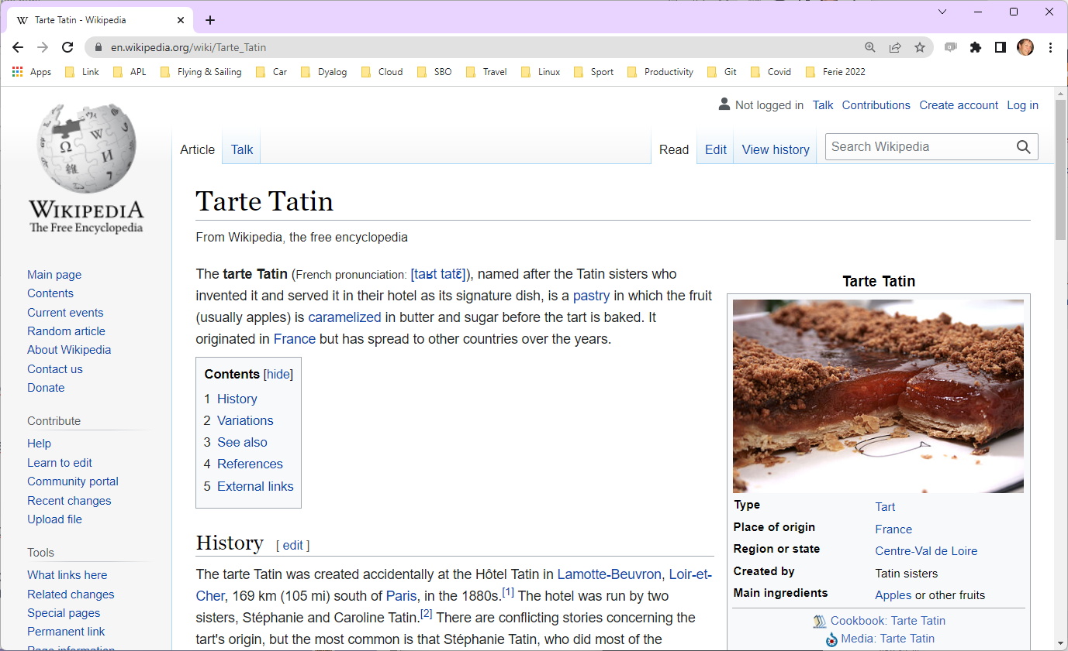

Slide 9
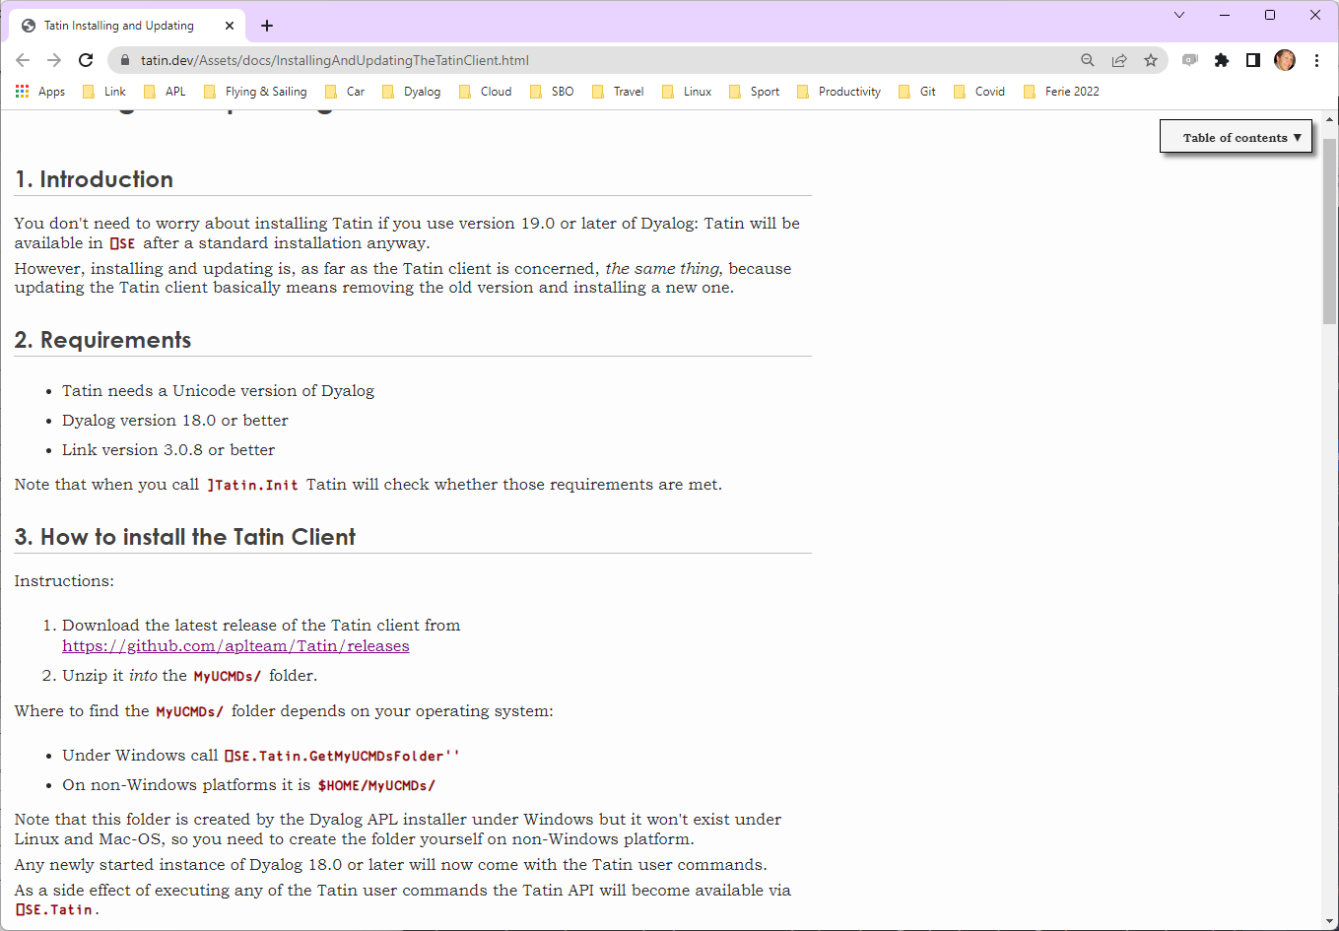

Slide 10
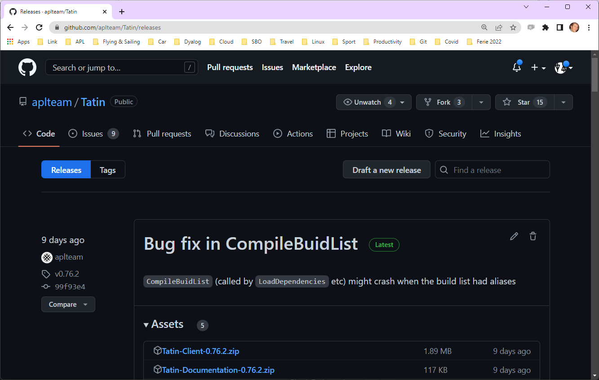

Slide 11
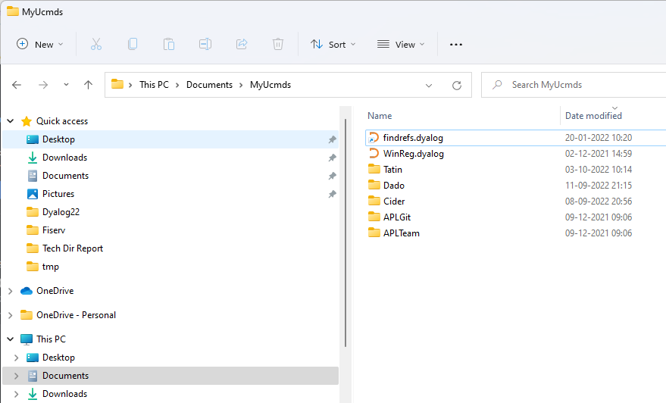
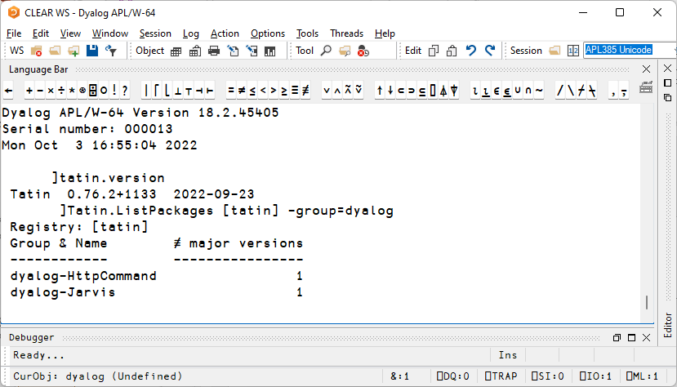

Slide 12
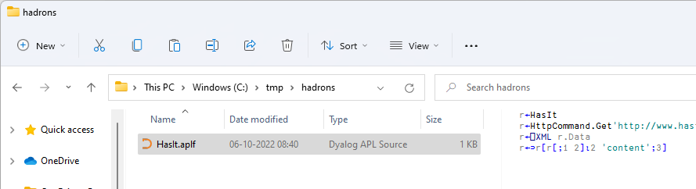
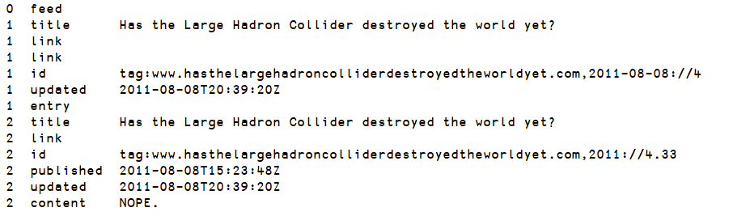
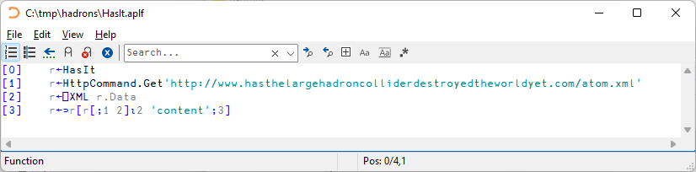
A Small APL Application

Slide 13
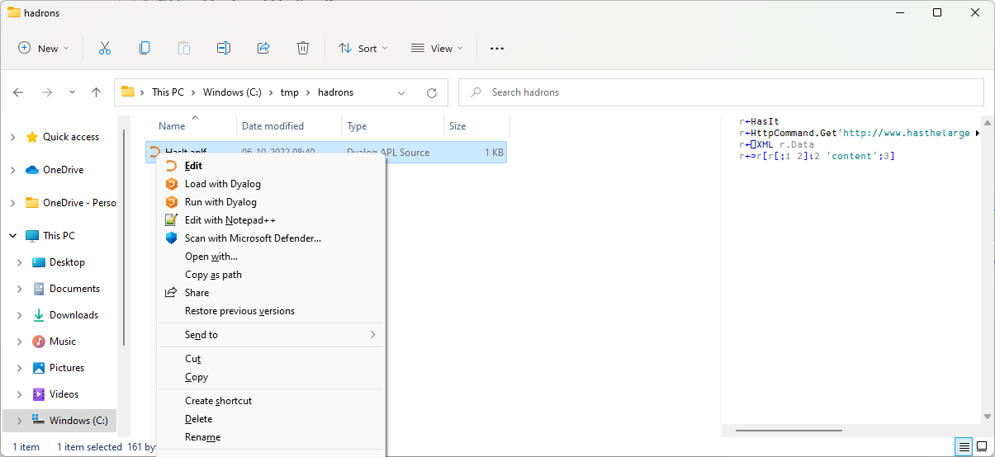

A Small APL Application
Proposed Link Logo

Slide 14
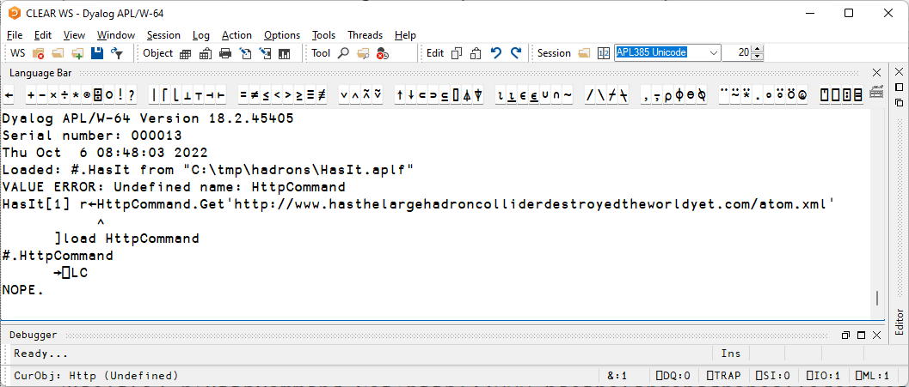

Slide 15
A bit more structure
Load our source with ]Link.Create
Load HttpCommand with ]Tatin.LoadPackages
Proposed Link Logo

Slide 16
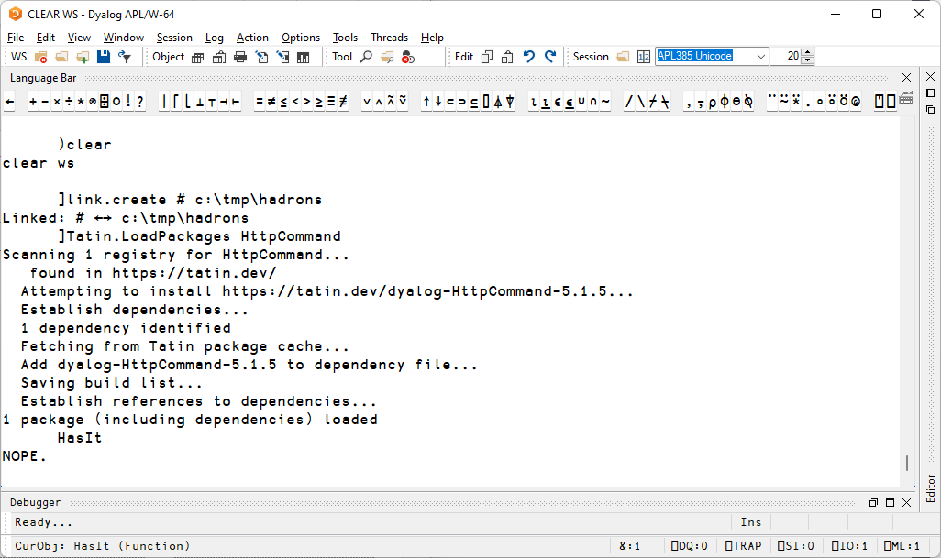
Loading a Package

Slide 17
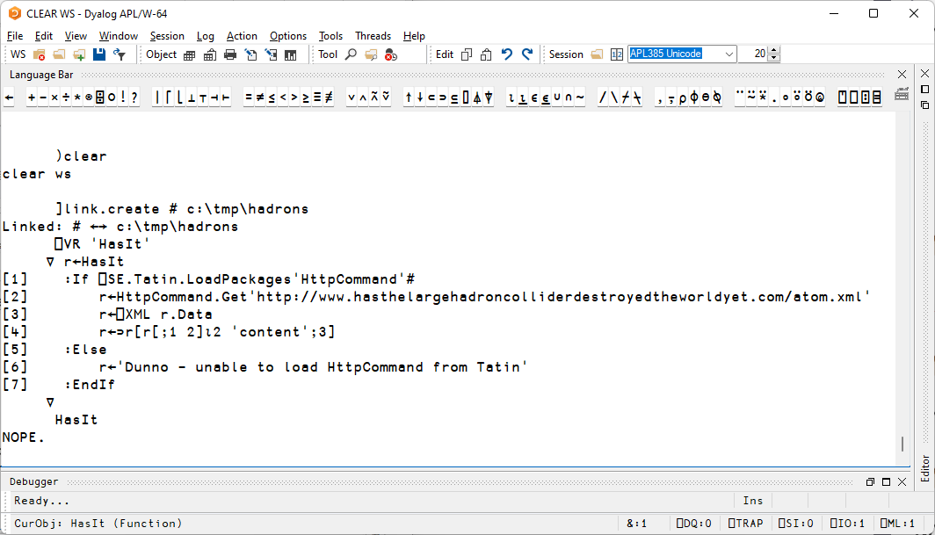
You should NEVER dynamically load from
a package manager in a production system

Slide 18
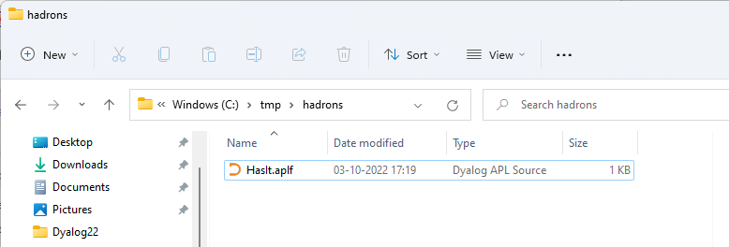
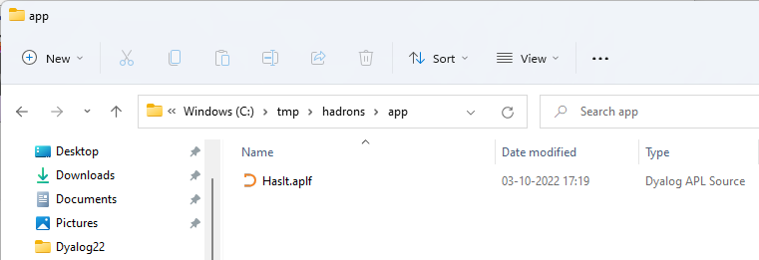
More Structure Needed

Slide 19
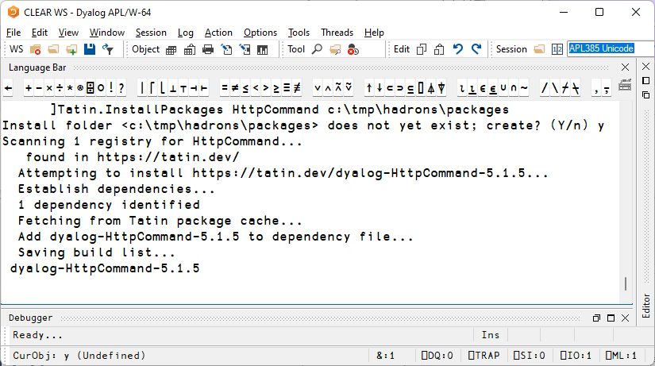
Install Package into sibling folder

Slide 20
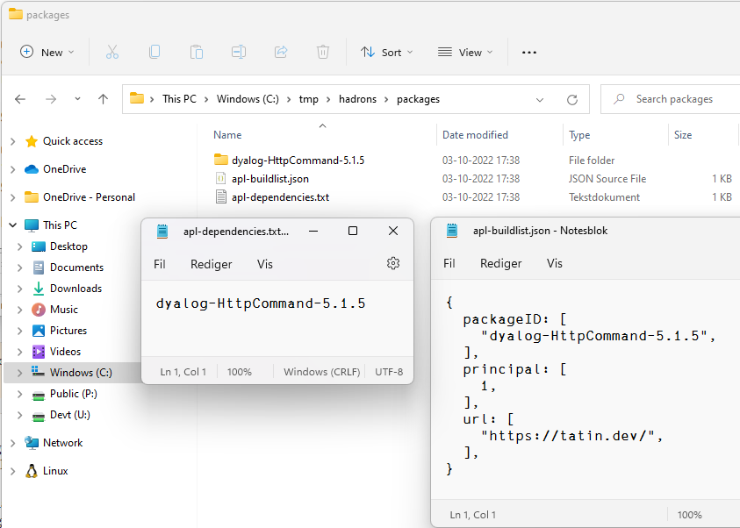

Slide 21
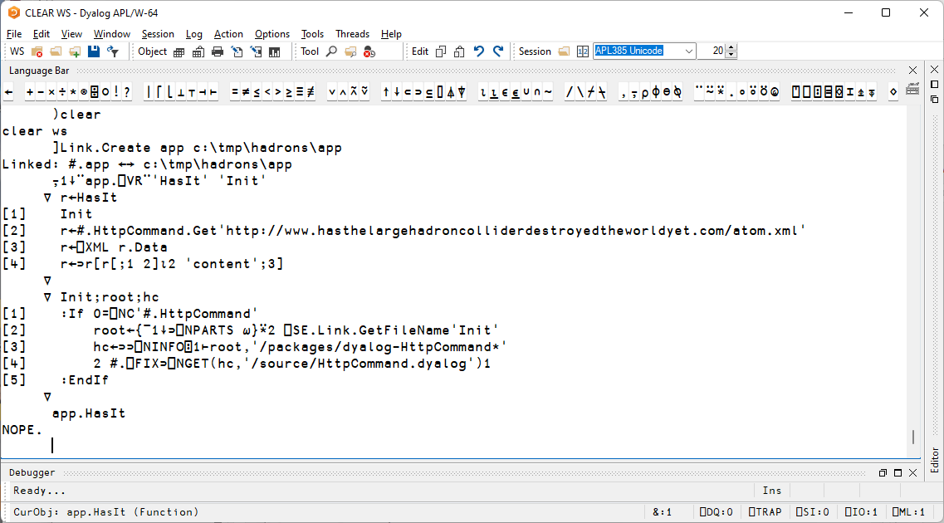
Now all we need to do is materialise
#HttpCommand from
installed package folder
☺
☹

Slide 22
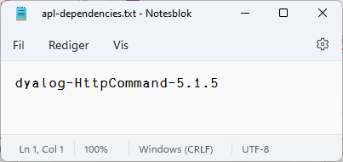
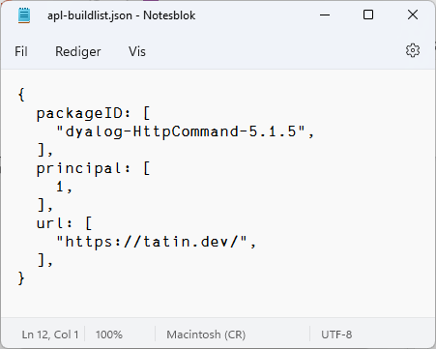
And really…
… we should inspect
apl-dependencies.txt
And loop through apl-buildlist
This is what a "Project Manager" does
Time for some Cider with that Tart

Slide 23
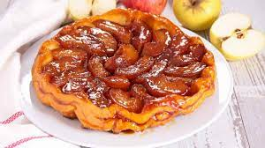

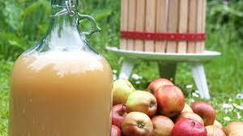
Another way to enjoy apples
Tatin
Cider

Slide 24


Another way to enjoy apples
Tatin
Cider

Slide 25
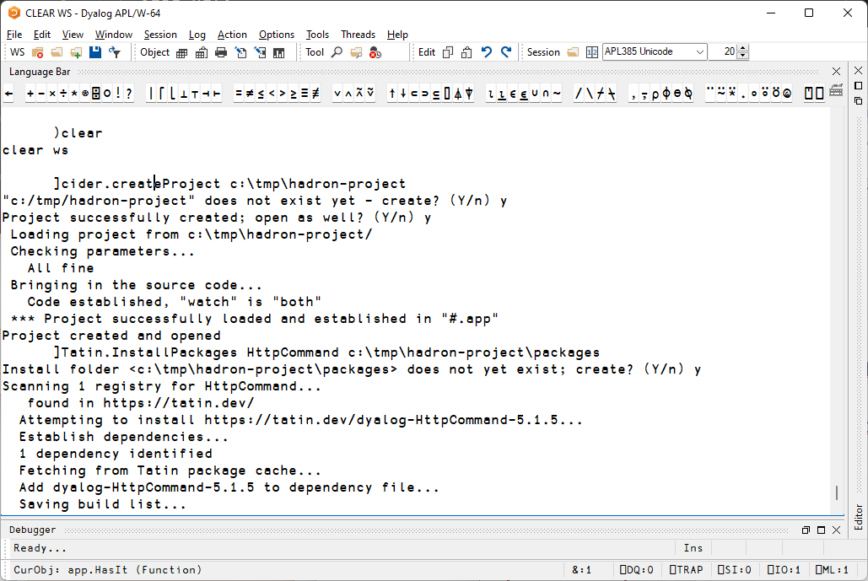
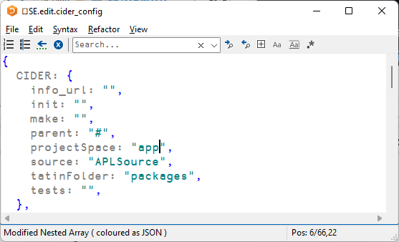
Default was "hadron_project"

Slide 27
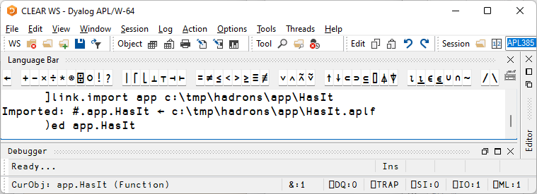
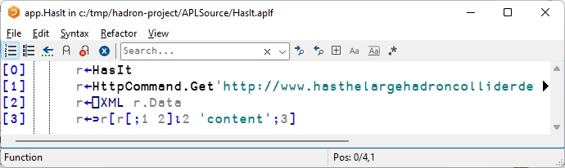
Remove call to Init
Remove #. From #.HttpCommand

Slide 28
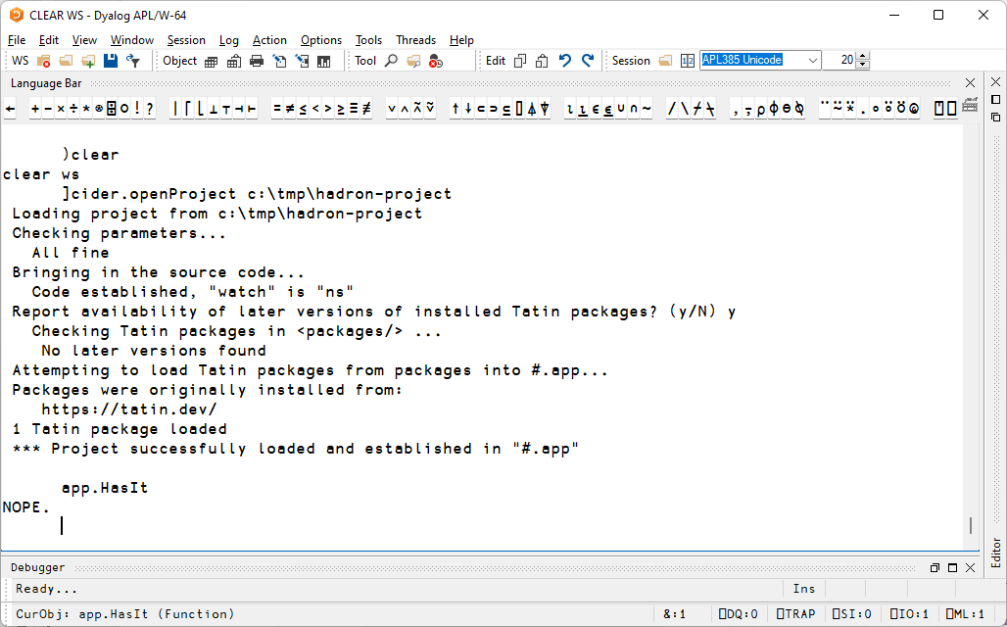

Slide 29
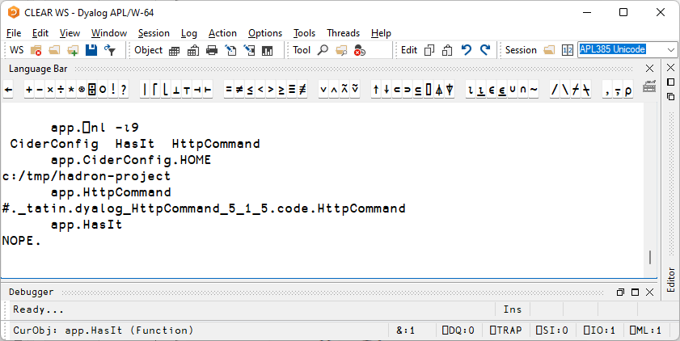

Slide 30
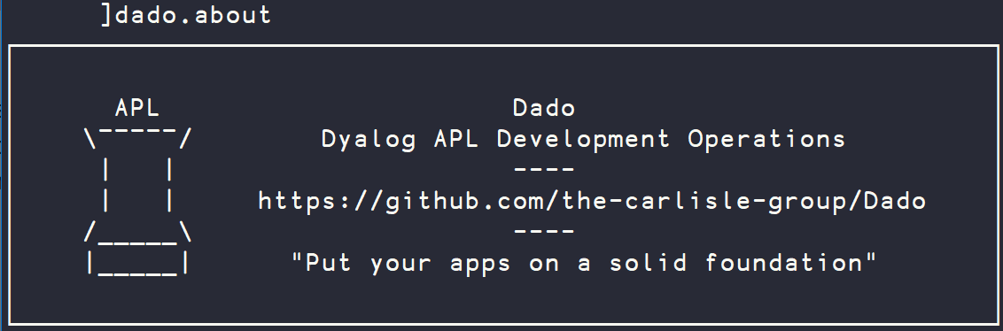
Acre and Dado
Acre: In use for >10 years
  Originally used component files
  Recent versions based on text source
  Stable foundation for Dado
Dado: Adds Git workflow to Acre
  Manages dependencies between Dado projects
  Previously presented by Josh David in Dyalog'21 talk
  Foundations of workflow presented by Paul Mansour at Dyalog'19

Slide 31
Benefits of Dado
]Dado.DependencyReport
┌───────────────────────────────────────────────────────────────────────┐
│ FlipDBDesktop Dependency Report │
├───────────────────────────────────────────────────────────────────────┤
│ Specified Loaded Current New Unreleased │
│ Dependency Version Version Branch Version Commits │
│ ------------------------------------------------------------------- │
│ FlipDB 2.0.21 ← n/a Yes (2.0.22) ? │
│ Rumba 0.1.6 ← n/a ? │
│ XL2APL 0.0.13 ← n/a ? │
│ CashFlow 2.0.5 ← n/a ? │
├───────────────────────────────────────────────────────────────────────┤
│ Current workspace state is safe for testing for release. │
└───────────────────────────────────────────────────────────────────────┘
Direct support for Git[Hub]
  No need to chose a Git workflow,
  Dado already chose one
Dependency management
Automatic Release generation
  Dado will automatically create and format release notes
  based on commit history
Accessible from the APL Session
  No need to download other software
  to do git operations.

Slide 32
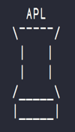
Downsides of Dado
Dado is "opinionated": Perfect if the choices are right for you, but:
Dado requires Git[Hub/Lab]
Only supports one Git workflow
  Not ideal for teams maintaining multiple versions of a project
Only supports other Dado projects as dependencies
Dyalog recommends Dado, but is designing Cider as a more agnostic, extendable tool to complement Dado

Slide 33
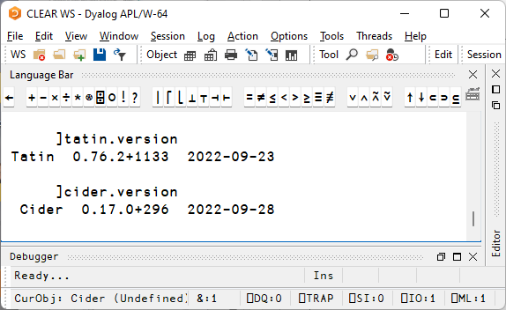
Current Status of Tatin and Cider
Tatin is maturing
  Has seen significant testing (thanks, Davin!)
  A useful number of packages exist
  We hope to ship Tatin v1.0 with v19.0
Cider is in it's infancy
  Developed by Kai for own use during Tatin project
  Already useful, but needs a few more cycles
  We plan to make rapid progress on Cider this winter
    Dyalog will participate in development

Slide 34
Things I'd like to see in Cider v1.0
Support for many dependency types, for example
]cider.add-dependency tatin HttpCommand
]cider.add-dependency dado https://github.com/user/dado-pkg
]cider.add-dependency folder \devt\tools\some-internal-tool
]cider.add-dependency nuget System.Drawing.Common
Support for ]dbuild and other build and/or deployment tools
  Including very easy deployment to Tatin
Support for ]dtest and other test frameworks
Support for "Assets", supporting multiple target platforms
Management of configuration files for the interpreter and application
An extensible architecture, so users / the community / can add new types of
dependencies, build tools, new test frameworks, etc

Slide 35

Further ideas to support Projects
"Open With Dyalog" should be able to identify whether a folder is
  A Cider project
  A Dado or Acre project
  A collection of source files to be opened with Link (in the future, directly from the interpreter without using Link)
An alternative definition of "Workspace" could be a configuration file which defines…
  A collection of projects to be opened
  Tools to be loaded for use during development
  IDE configuration settings for the workspace (session captions, etc)

Slide 36
Dyalog:
Making APL more enjoyable
Tatin
Cider

Slide 37

Dyalog:
Making APL more enjoyable
Tatin
Cider

Slide 38

Dyalog:
Making APL more enjoyable
Tatin
Cider

