Slide 1
Automating Application Builds
Norbert Jurkiewicz

Slide 2




The Architecture
Interpreter and Libraries -Distributables
Dyalog 14.1
Dyalog 18.2
Unicode 32Bit and 64Bit
.NET
HTML5/CSS/JS
Build Tools
Dyalog APL 18.0
Git, Github, & Github Actions
Node
  The purist can and will do this in APL but I choose the path of least resistance.
  Also runs everywhere - Local, Server, Github Action, Serverless, Lamda etc..
AWS Environment
WiX Toolset

Slide 3
The Architecture…
Third-Party Components
Closed Source - OCX, MSM, Printer Drivers, .NET libraries, JS Libraries and Executables
Open Source - JS Libraries, Dyalog provided redistributables, APL packages
Release
Help published online
Windows Desktop MSI
Code Signing
  This was easy before “Extended Validation” became a thing
  Gets around that little browser warning that really wants to make sure you trust the source.

Slide 4
The Architecture…
Source Code Management
Text only!
Git
Github
Dado - Package and Application Structure
  Built on top of Acre (we may change to Link in the future)
  Package Management via Git/Github
  Versioning
  Release building

Slide 5
Why automate?
Clean and Trusted Environment
Consistent Build Environment
Consistent Development Environment
Anyone can Build the Application
Scalable & Performance

Slide 6
Workflow
Code
Test
Push
Build Help Github Action
Build Application
  Version
  Release Notes
  Publish Packages
  Powershell Magic
Sign Installer (manual)
Release (manual)

Slide 7
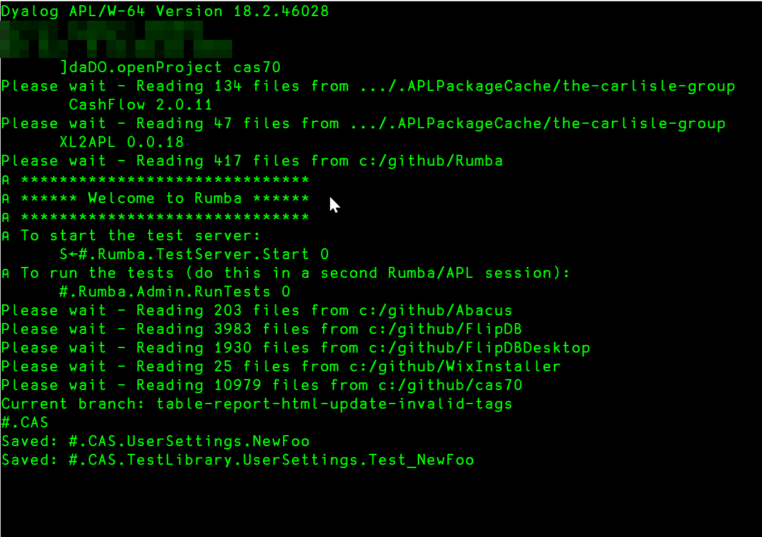
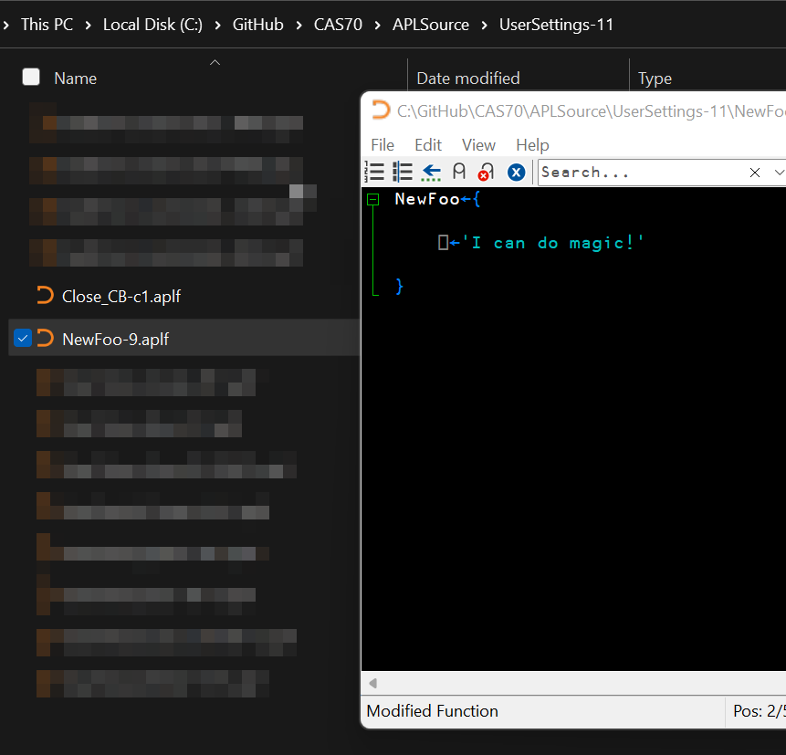
…code

Slide 8
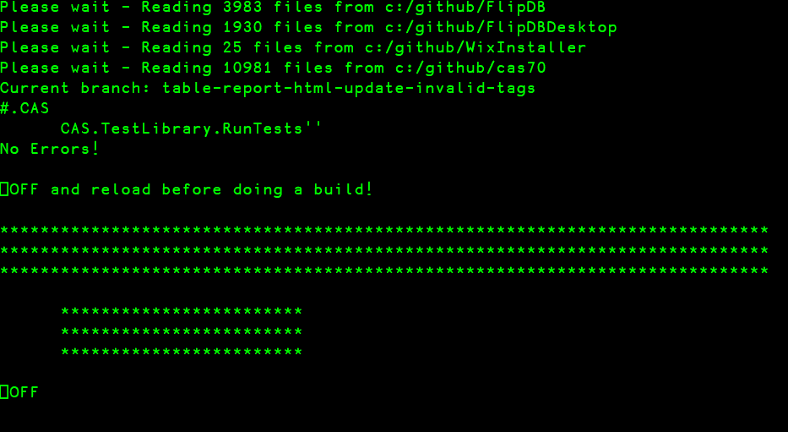
…test

Slide 9
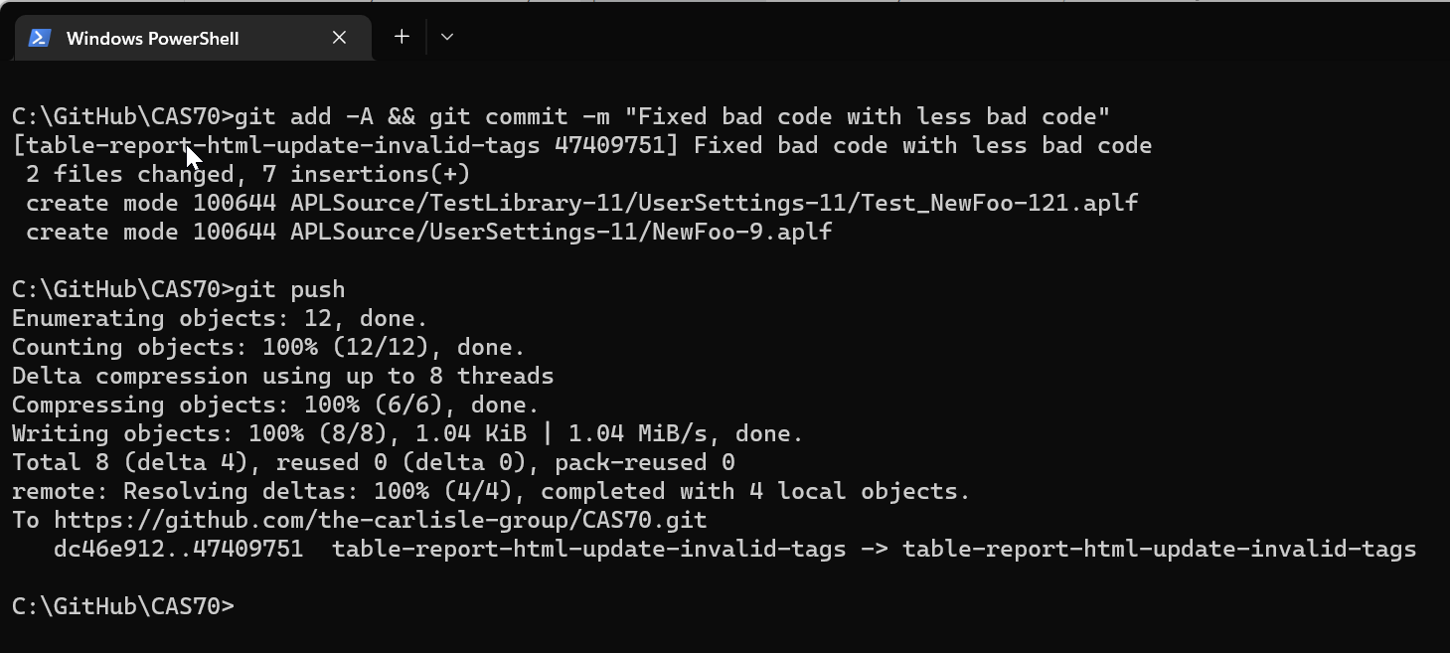
...push

Slide 10
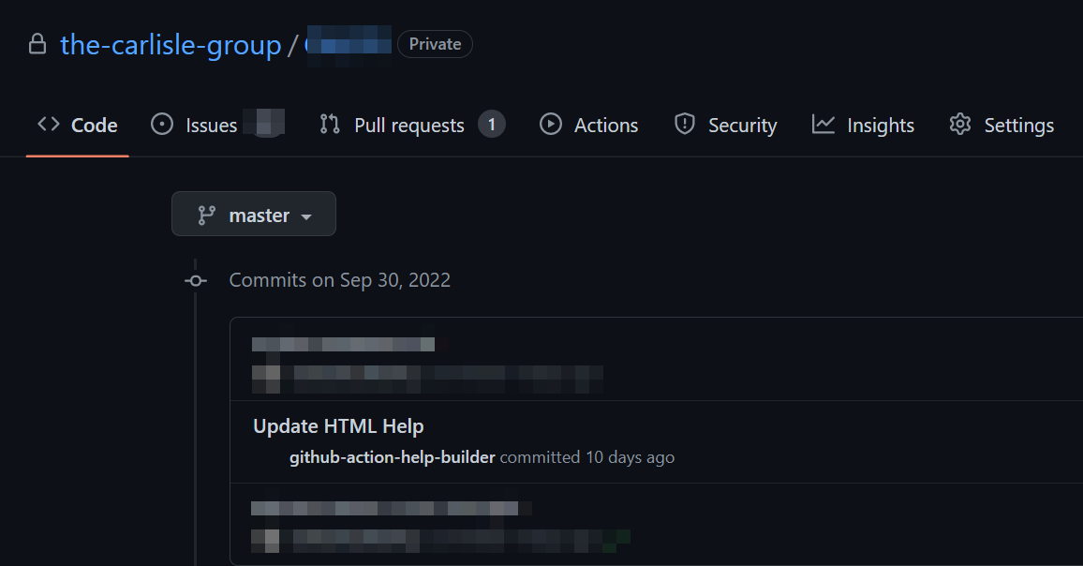
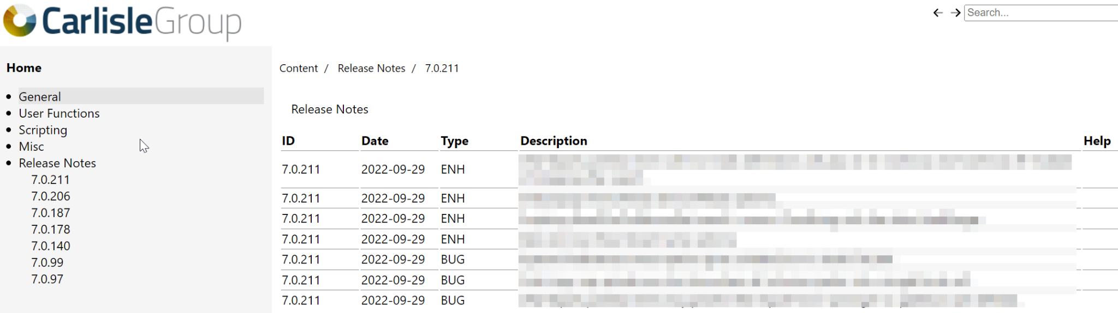
…generate help

Slide 11
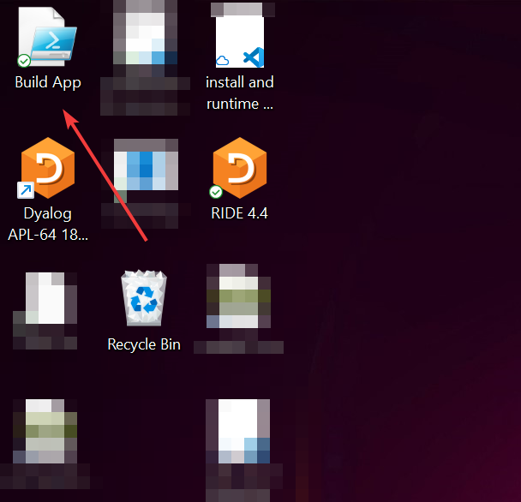
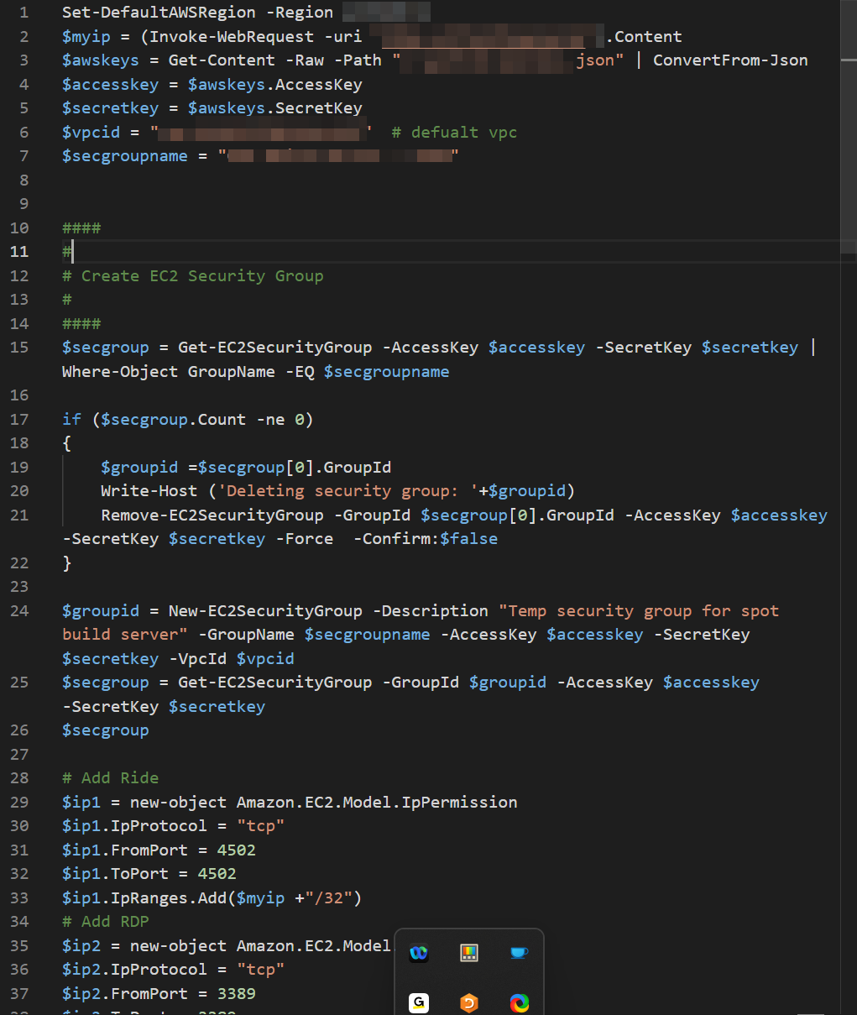
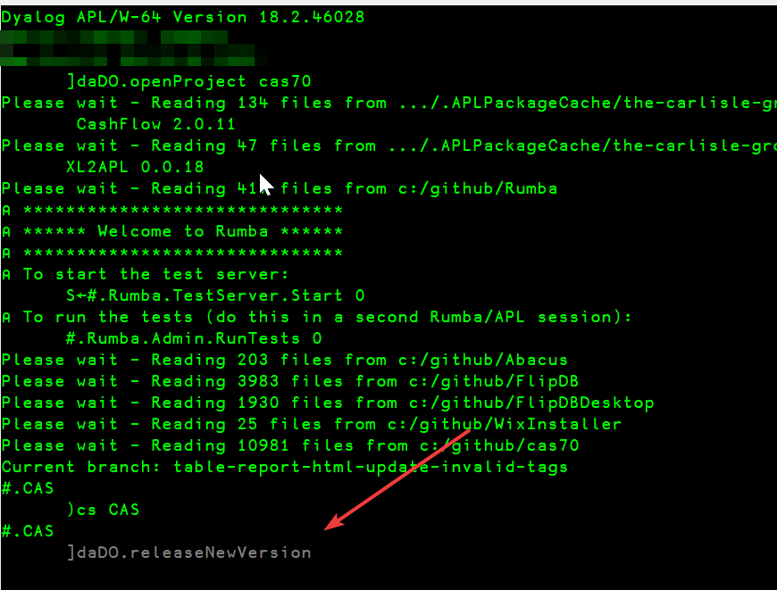
…create / build / upload / destroy
(PS) Create AWS Infrastructure
  IAM
  EC2
  S3 Objects
  Secrets Manager
(PS) Download Credentials
(PS) Download Repositories from Github
(PS) Install Dylaog, Git, AWS, Node, Dado, etc…
(PS ) Start Dyalog, load Dado project
(Dado) LX initialize build routine
(Dado) Upload to Box, S3, Dropbox,... etc.
(Dado) Email notification of success or failure.
(PS) Take down VM, VPC, Security Groups…

Slide 12
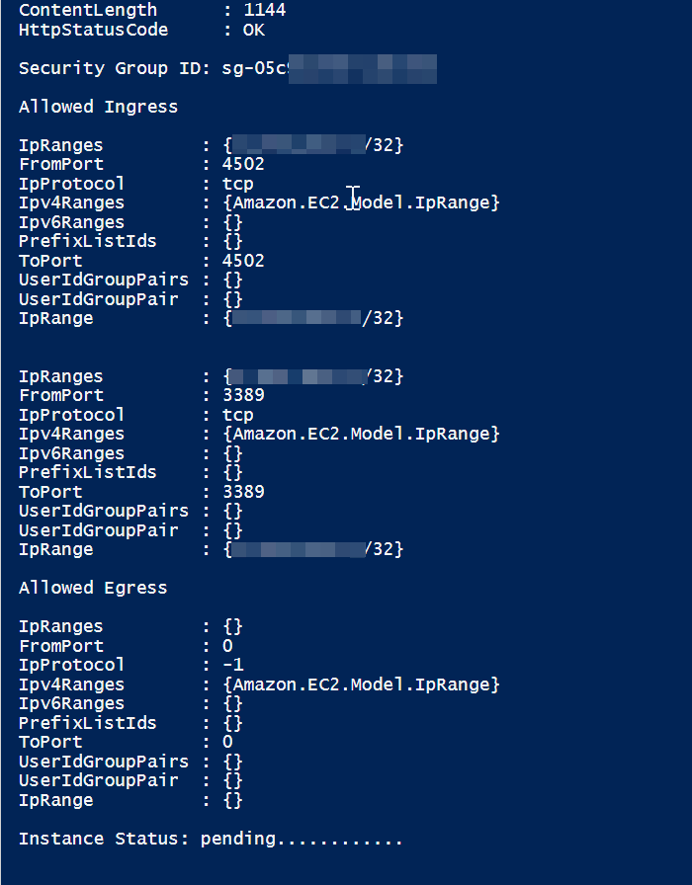
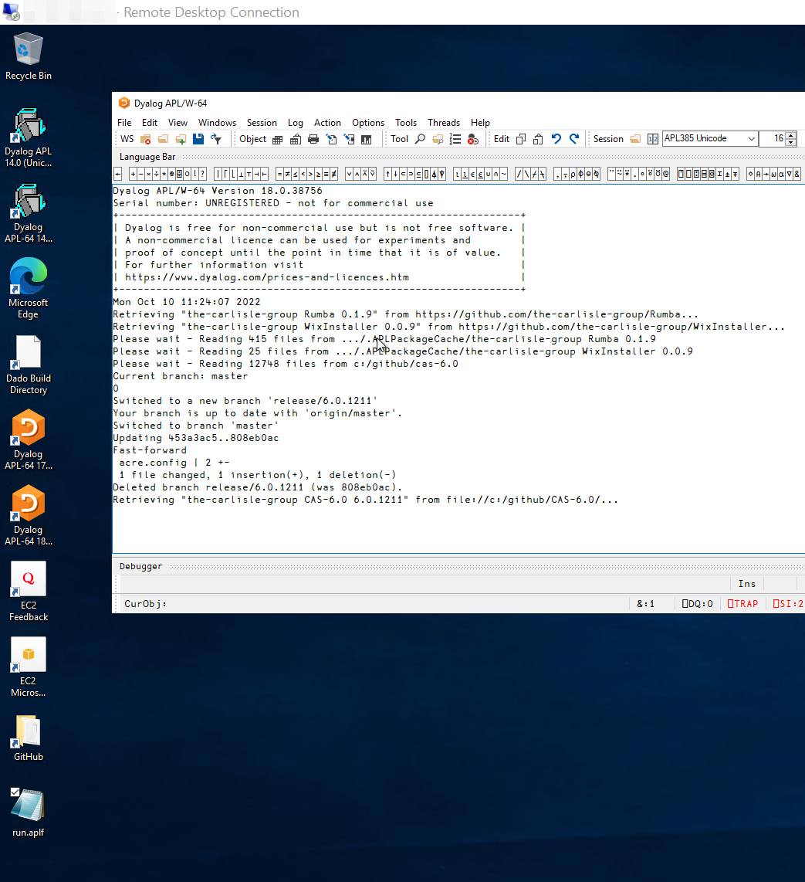
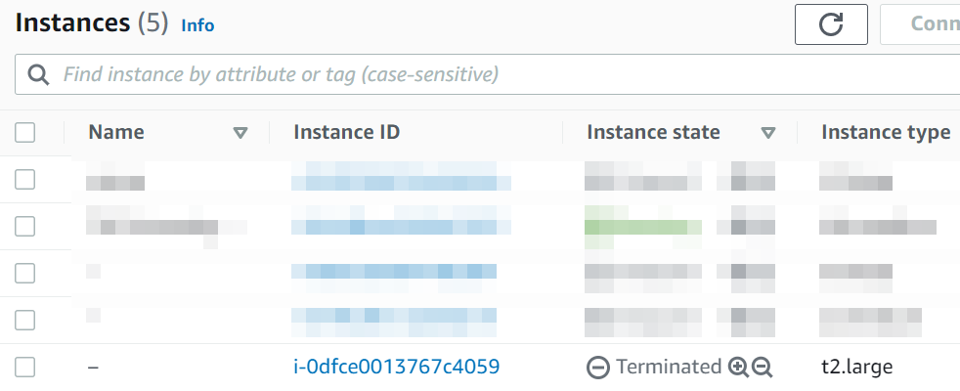
…aws automation (manual mode?)
Powershell builds the AWS environment | Build | Teardown

Slide 13
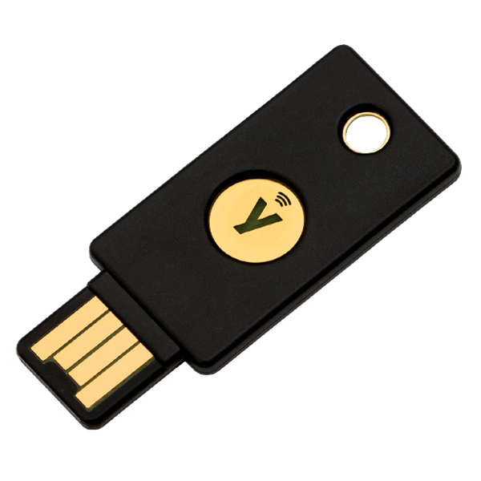
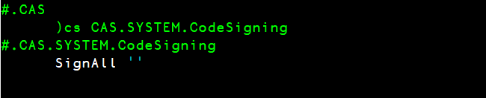
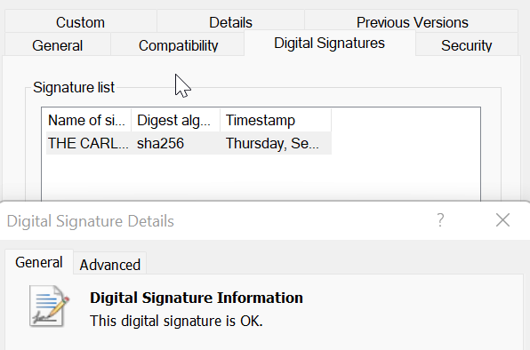
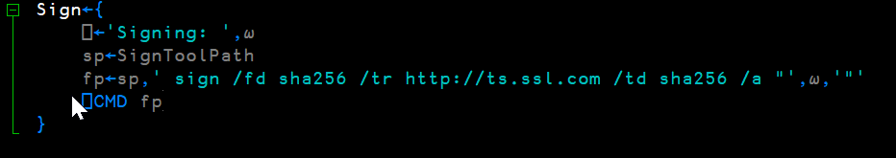
…sign
EV Code Signing Certificate (Extended Validation)

Slide 14
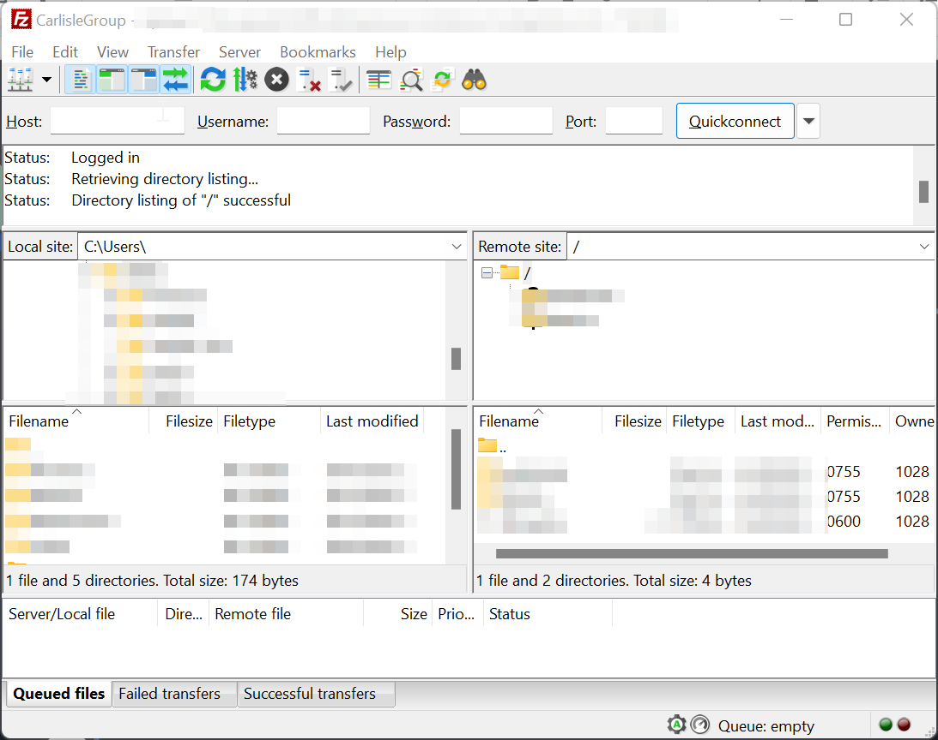
…release
Website Upload
- FTP
- Admin Backend
- Distributables
- Release Notes

Slide 15
The End
(o fim)

