Slide 1
D02 - The Road Ahead
Morten Kromberg, CTO

Slide 2
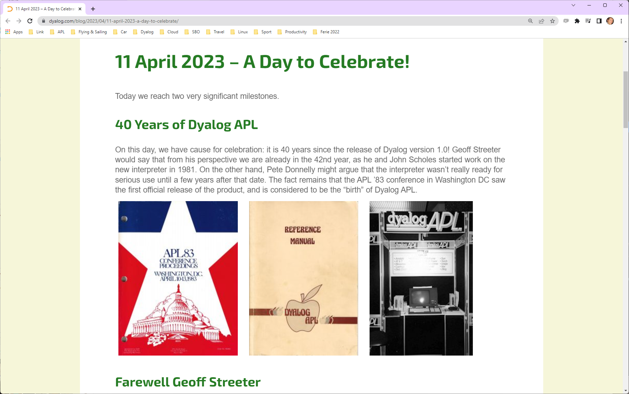

Slide 3
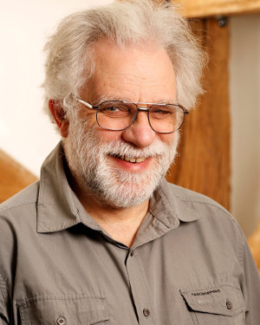
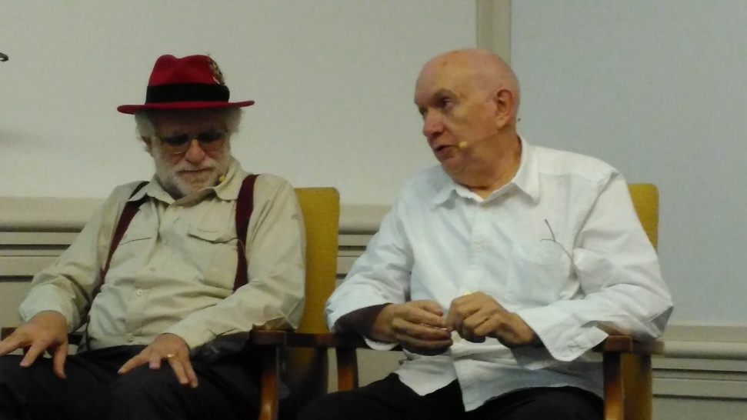
Geoff has Retired (!)
With John Scholes, Geoff Streeter implemented Dyalog APL v1.0 in 1981-1983
We hope to welcome Geoff back for a retrospective talk at Dyalog'24 in (September 15-19, Glasgow)

Slide 4
40 years in pursuit of excellence
Decade | Leaders in…
1980's | The best APL for Workstations (X-Windows, ⎕SM)
1990's | The best APL for Microsoft Windows (⎕WC)
2000's | The best APL for Microsoft .NET (⎕USING)
2010's | The most complete Array Language (+⌿÷≢) ⍤⌸@⍸⌺
2020's | The best APL for Cloud Computing (☁️)

Slide 5
Major Milestones in 1st 30 years
1983: APL2 Nested Arrays + SHARP APL Component Files, Error Trapping, etc
1990: Namespaces, Windows GUI
1995: Control structures (If/Then/Else, Repeat/Until, exception handling, and so on)
1996: Functional programming: dfns provide lexical scope and lambda-style expressions
2006: Object oriented programming, tighter integration with .NET & OO frameworks
2013: Rank (⍤) and Key (⌸) operators
2014: Point-free or "tacit" syntax similar to that in the J programming language
2014: Futures and isolates for parallel programming
More highlights of the last decade
2015: macOS, RIDE, JSON, Secure Sockets
2016: Cross Platform File Functions, load & edit Unicode Test Files using editor
2017: CSV, HTTP Support in Conga, HTMLRenderer, Where (⍸), At (@), Stencil (⌺) and Nest/Partition (⊆)
2018: aplssh & pynapl, APL as a DLL, Total Array Ordering, JSONServer
2019: Link, Unregistered non-Commercial Version, Headless mode, Containers
2020: ⎕C, ⎕DT, constant (⍨) over (⍥) and atop (⍤), unique mask (≠), .NET Core Bridge, LOAD text files, text config files
2022: Basic Licence, Shell Scripts, ⎕ATX
Performance increased consistently during
most of this decade.

Slide 6
More highlights of the last decade
2015: macOS, RIDE, JSON, Secure Sockets
2016: Cross Platform File Functions, load & edit Unicode Test Files using editor
2017: CSV, HTTP Support in Conga, HTMLRenderer, Where (⍸), At (@), Stencil (⌺) and Nest/Partition (⊆)
2018: aplssh & pynapl, APL as a DLL, Total Array Ordering, JSONServer
2019: Link, Unregistered non-Commercial Version, Headless mode, Containers
2020: ⎕C, ⎕DT, constant (⍨) over (⍥) and atop (⍤), unique mask (≠), .NET Core Bridge, LOAD text files, text config files
2022: Basic Licence, Shell Scripts, ⎕ATX
Performance increased consistently during
most of this decade.
Major Milestones in 1st Half of the Fifth Decade
2024 / Tool Projects
  Tatin & Cider become "mainstream"
  Jarvis & WebSocket integration
  One secret project, come to Glasgow ☺!
2025 / v20:
  Literal Array Notation
  .NET Generics
  HTMLRenderer (& Conga?) as Open-Source extensions
  Android version?
2026 / v21:
  Co-dfns compiler integrated with Dyalog APL
  All asynchronous operations return futures
  Dual / Under, Differentiation
2027 / v22:
  Multiple Numeric Towers: 64-bit integers, Rationals, Unlimited-precision integers
(NB Mortens dreams, NOT promises!)

Slide 7
Major Milestones in 1st Half of the Fifth Decade
2024 / Tool Projects
  Tatin & Cider become "mainstream"
  Jarvis & WebSocket integration
  One secret project, come to Glasgow ☺!
2025 / v20:
  Literal Array Notation
  .NET Generics
  HTMLRenderer (& Conga?) as Open-Source extensions
  Android version?
2026 / v21:
  Co-dfns compiler integrated with Dyalog APL
  All asynchronous operations return futures
  Dual / Under, Differentiation
2027 / v22:
  Multiple Numeric Towers: 64-bit integers, Rationals, Unlimited-precision integers
(NB Mortens dreams, NOT promises!)
And… without dates attached
Universities start offering APL courses
  Not as part of a "comparative" course
APL recognised as a respectable tool for modeling machine learning and quantum computing
First commercially significant APL application created by someone who learned APL in this millennium
"Full Stack" Web development in APL

Slide 8
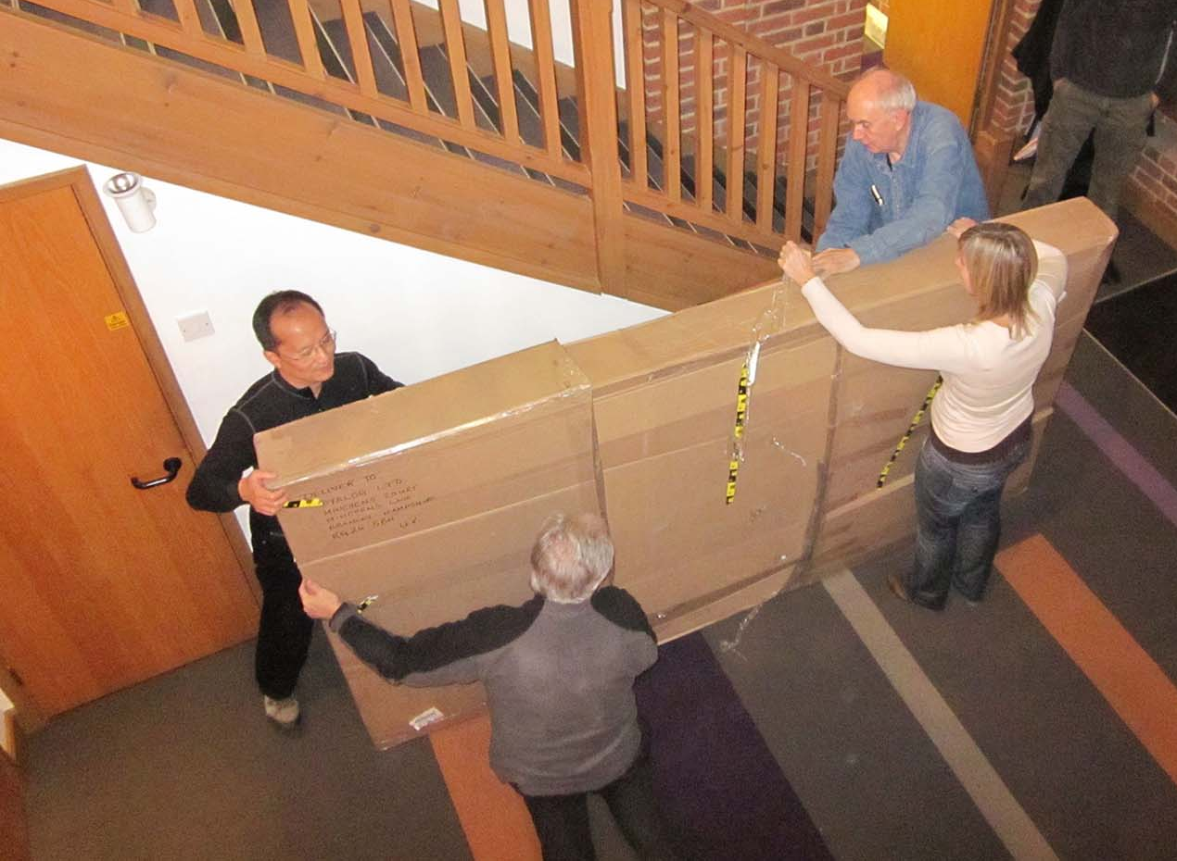
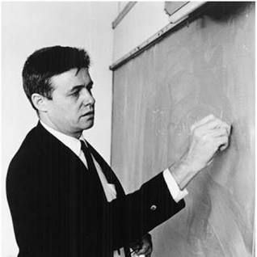
Ken Iverson's Blackboard
arrives in Bramley (2010)

Slide 9







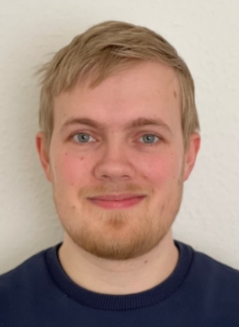


Dyalog … The Next Generation
Legend:
A = APLer
C = C developer
D = Admin
E = Doc/Evangelism
Aaron (ACE)
Adam (AE)
Rich (AE)
Josh (A)
Stine (D)
Karta (C)
2022
Silas (C)
Peter (C)
Jesus (E)

Slide 10
Dyalog … The Next Generation
Legend:
A = APLer
C = C developer
D = Admin
E = Doc/Evangelism
Aaron (ACE)
Adam (AE)
Rich (AE)
Josh (A)
Stine (D)
Karta (C)
2022
Silas (C)
Peter (C)
Jesus (E)

Slide 11
Dyalog … The Next Generation
Legend:
A = APLer
C = C developer
D = Admin
E = Doc/Evangelism
2022
Silas (C)
Peter (C)
Jesus (E)

Slide 12
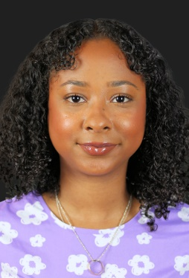




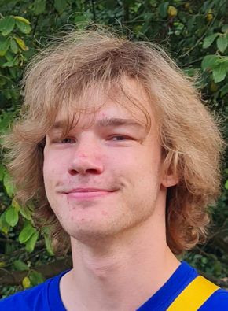
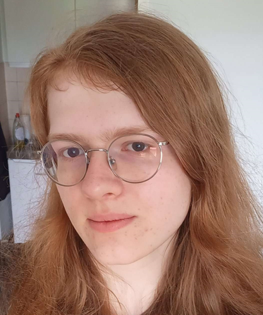


Dyalog … The Next Generation
Legend:
A = APLer
C = C developer
D = Admin
E = Doc/Evangelism
I = IT
2022
2023
Silas (C)
Peter (C)
Jesus (E)
(Summer Interns)
+
Jada (D)
Stefan (AE)
Aarush (AC)
Abs (I)
Mike (DE)
Asher (ACE)
Kamila (ACE)

Slide 13
Academic Collaboration
Santiago Núñez-Corrales PhD, Markos Frenkel, Bruno de Abreu
National Center for Supercomputing Applications
  A Quantum Computing Library for APL
Jesús Galán López (Ghent University)
  Metallurgy with APL
Asher Harvey-Smith (University of Warwick)
  (and Summer Intern at Dyalog)
Tuesday 13:00 quAPL
(Markos Frenkel, NCSA/U.Illinois)
Tuesday 13:30 APL and Metallurgy
(Jesús Galán López, Ghent U.)
Wednesday 11:00 Grain Growth and Array Programming
(Jesús Galán López, Ghent U.)
Tuesday 14:00 Teaching Algebra with APL
(Asher Harvey-Smith, U. Warwick)

Slide 14
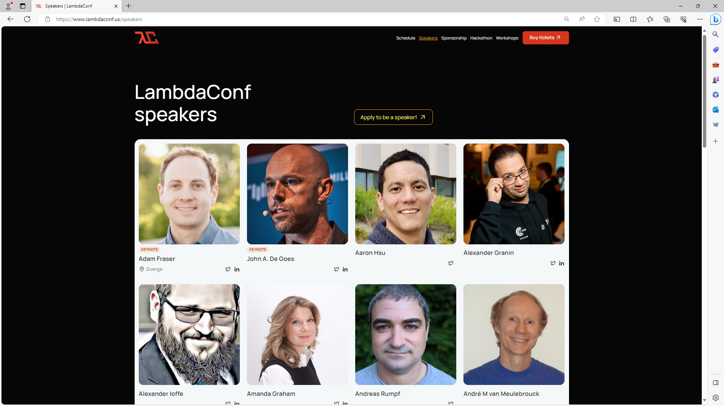

Slide 15

Can you host a young(er) member of our team for 3-5 days?
Or perhaps even run a small consulting project with 1 senior + 1 junior Dyalogger?

Slide 16
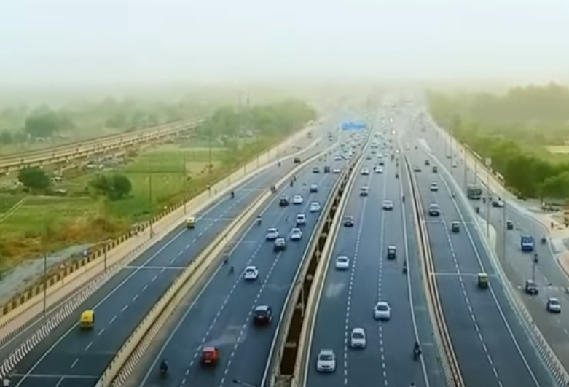

2022 Road Map
2023…

Slide 17
Why v19.0 is Late…
(January 2024)
Hired lots of new people
Adjusted Created processes to manage growth
Summer interns (Wonderful!)
Two .NET bridges
Two macOS variants to build & sign
ARM64 version for the Macs, Pi and AWS Graviton
Cumulative 3-4 month delay caused collision with Dyalog'23
New Long Term Support version of .NET (8.0) on November 8th
Want to test with 8.0 before General Availability
Official Beta Testing to start mid-November
Excuses
Excuses
Excuses

Slide 18
Highlights Version 19.0
Platform Support / Distribution
  64-bit ARM support
    Mx Macs, Pi 4&5, AWS Graviton
  Enhanced .NET Bridge
    Framework vs new .NET versions
  Bound executables on all platforms
Building Production Systems
  Token range reservation
  WS FULL handling
  NCOPY/NMOVE callbacks
Developer Productivity / IDE
  Source "as typed" by default
  Multi-line input on by default
  HTMLRenderer updates
  Link 4.0: Support for text data
  HttpCommand client, Jarvis web service
Installing & Managing APL
  Multiple session files
  Health Monitor

Slide 19
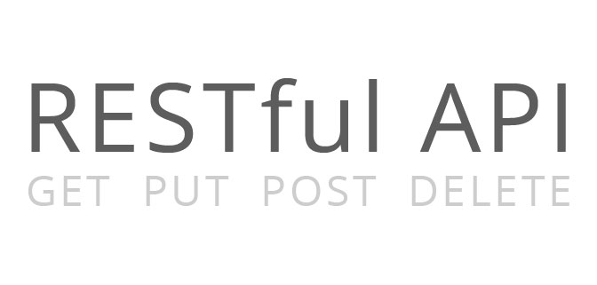

Service Orientation
A rapidly increasing proportion of new APL code is delivered as services
Jarvis wraps APL code as HTTP/JSON or RESTful services on any platform
  https://github.com/dyalog/jarvis
Off-the-shelf docker containers containing Dyalog APL (optionally with Jarvis)
HttpCommand is our HTTP client
HTTP(s) / JSON

Slide 20
Service Orientation
Monday 14:45 APL Worker Bees
(Stig Nielsen, SimCorp)
Monday 15:15 Transforming and Streamlining a Complex Process
(Mark Wolfson, BIG)
HTTP(s) / JSON
Tuesday 09:00 Dyalog Tools Update
(Brian Becker)
Tuesday 09:30 Converting from COM to a Jarvis Web Service
(Finn Flug, DPC Consulting)
Tuesday 11:00 Dyalog, AWS, Jarvis, Docker…What's Not to Like?
(Claus Madsen, FinE Analytics)
Tuesday 16:45 Dyalog + Kafka = True?
(Stefan Kruger)

Slide 21
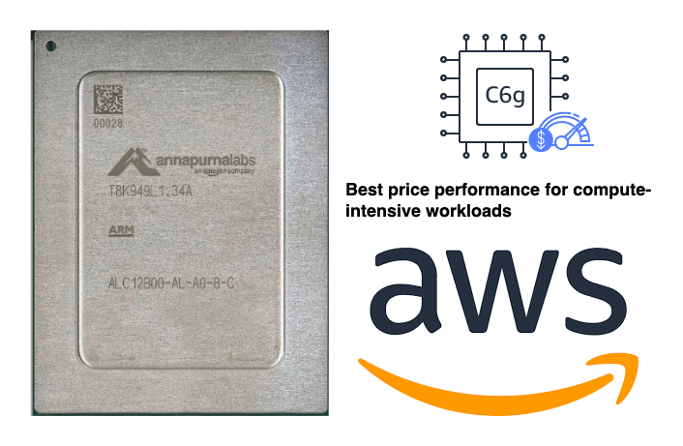
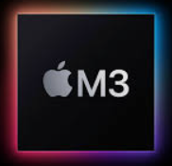

Arm64
64-bit ARM chips appearing in many places
M1, M2 & M3 Macs
Raspberry Pi – 64 Bit
Amazon Web Services "Graviton"
ARM64
Tuesday 10:00 Dyalog on ARM64
(Ron Murray)

Slide 22
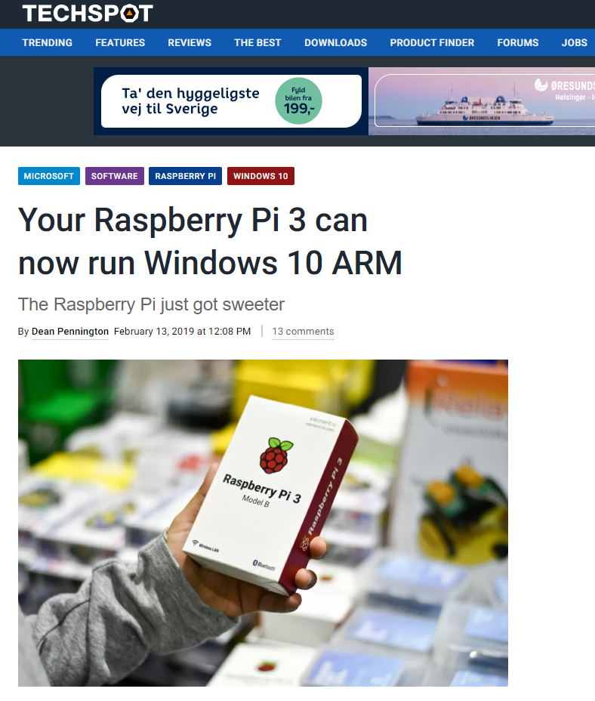

Slide 23
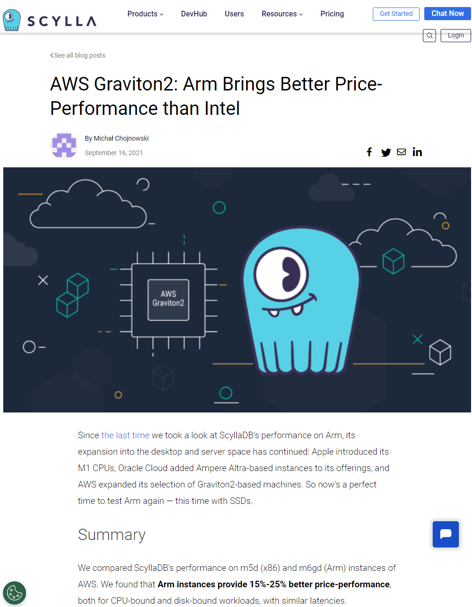

Slide 24
Dyalog APL for ARM-based Macs
Version 19.0 will be available in two versions for macOS:
  ARM64: M1, M2 and soon M3 based Macs
  Intel x64: For older Macs
64 bit, Unicode only
NB: Version 19.0 will be the last version to support Intel-based Macs.
Apple Hardware
1979: 68000
1994: POWER
2005: Intel x64
2021: ARM64

Slide 25
Sun is Setting on Classic & 32 Bit
Classic
Down to no more than half a dozen significant clients
More than half of these actively planning - or working on - moving to Unicode
May soon decide to offer Classic on IBM AIX only
32 Bit
Rapidly dwindling user base
Difficult to test due to lack of support from operating systems and other frameworks
Discounted price will be removed next year; 32 will cost the same as 64.
Neither are for sale to new users or supported on new platforms
Tuesday 16:45 Return of Uncle Andy's Fireside Chat
(Uncle Andy)

Slide 26
[Microsoft].NET History
.NET has been around for 20+ years. The old "Framework" is being replaced by an open source, cross-platform .NET, initially known as ".NET Core".
Dyalog v18.0 added a bridge to .NET Core 3, to complement the 20 year old bridge to the .NET Framework.
v18.2 officilly supported "Core" 3.1 but works with 5.0 and later
v19.0 targets 8.0 (Long Term Support version due on Nov 8th 2023)
Name | Platforms | Version Numbers
Microsoft.NET Framework | Windows | 1 2 3 4.0 4.8.1
".NET Core" | Windows Linux macOS | 1 2 3
".NET" | Windows Linux macOS | 5.0 6.0 7.0 8.0

Slide 27

v19.0 .NET Bridge
Adds support for .NET 6, 7, 8 …
  Tested with 6.0 & 8.0 - and 4.8 (aka ".NET Framework")
  Will be shipped configured for 8.0
Can export APL code as .NET assemblies
  Will allow embedding APL code in .NET frameworks like ASP.NET Core, etc
.NET 8.0 will be the
Long Term Support
version on Nov 8th

Slide 28
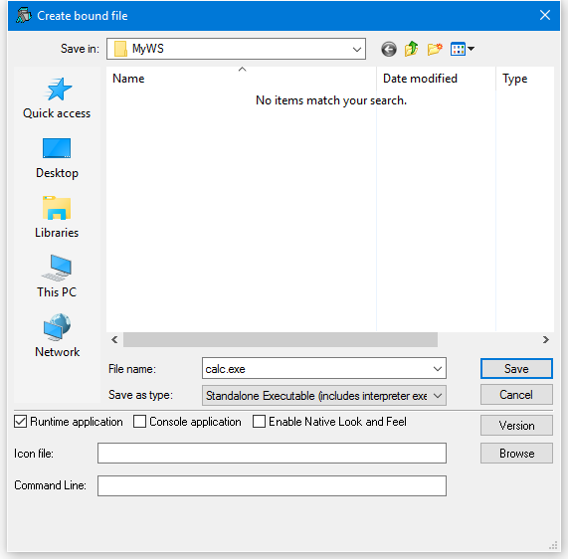
Bound Executables
A bound executable is a file which combines an interpreter and a workspace into a single .exe file
"Always" been available under Windows
In v19.0 also available for Linux
  Maybe MacOS soon
  (but you will need to sign the result)
In the longer term, I expect we will look at encrypting and signing application code

Slide 29
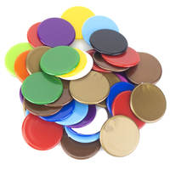
  Token Range Reservation
System functions ⎕TGET and ⎕TPUT allow threads to synchronise execution, and pass values to each other using numbered "tokens".
New system function ⎕TALLOC allocates token ranges, allowing independent components to avoid using the same tokens.
⎕TALLOC returns a single integer n, granting the right to use floating-point token ids in the range < n , n+1 >
NB not including the (integer) end points
  This allows old-style integer tokens to be used by existing applications without conflicting with new modules

Slide 30

WS FULL Handling
IF a WS FULL leaves VERY little free space,
THEN the interpreter and IDE can malfunction
  For example, a runaway recursion can leave only a few bytes of free workspace
  Error trapping may not be possible (system might just stop)
Version 19.0 allocates 1% of MAXWS as a buffer which is released on WS FULL
  Allows WS FULL traps to be safely processed
    (the reservation size is configurable)
    After successful trap handling, space is re-acquired

Slide 31
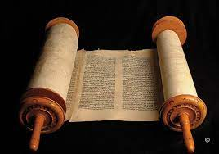
  Source "as typed" by default
Historically, Dyalog APL has re-generated source code from tokenised code when an editor is opened.
  This does not preserve white space and constants exactly as typed by the user.
For several releases, Dyalog APL has preserved source "as typed" when a function or operator was created using ⎕FIX
  2 ⎕FIX 'file://myapp/foo.aplf'
From version 19.0, the default is to preserve source
as typed within the workspace for *all* fns and ops
  NB: Old behaviour can be selected if desired.

Slide 32
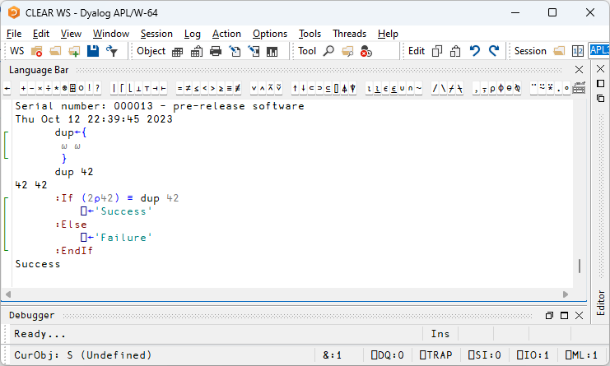
  Multi-line input On by Default

Slide 33

  HTMLRenderer updates
Use of the HTMLRenderer continues to grow.
New features include:
ExecuteJavaScript (asynchronous)
AllowContextMenu
Get/SetZoomLevel
IsLoading + LoadEnd event

Slide 34
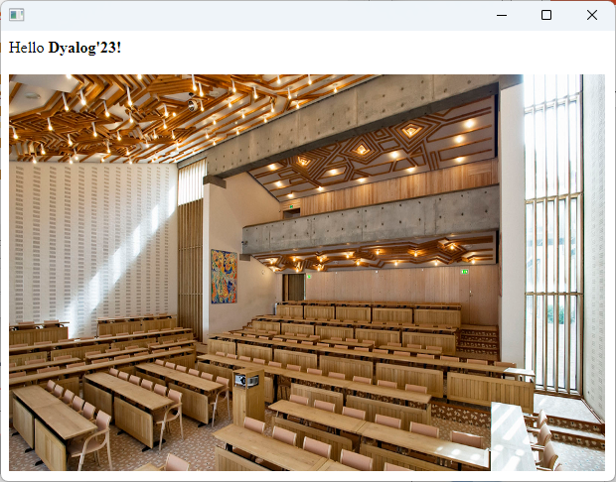
HTMLRenderer – what's that?
pic←'https://www.konventum.dk/media/jjcjop23/carousel_damgaard_1135x604.png'
'MyForm' ⎕WC 'HTMLRenderer' ('Hello <b>Dyalog''23!</b><br/>
<img src="',pic,'" height=400 width=600>')
Chromium
Embedded
Framework
(CEF)

Slide 35



Source Code Management
Productivity
& IDE
Bundled with v19.0:
Link v4.0, with support for simple text vectors, vectors of text vectors, and character matrices in simple text files, configuration files, many small features & fixes
Prototypes of the Cider project manager and the Tatin package manager client will be bundled with v19.0
Link
(source)
Cider
(projects)
Monday 16:15 Evolution of APLTree and APL-cation
(Kai Jaeger)
Tatin
(packages)
Monday 16:45 Using Packages
(Morten Kromberg)

Slide 36

(… many more of Kai's packages skipped …)

Slide 37
Packages Coming in 2024?
(Potentially, at least)
Tuesday 16:45 Dyalog + Kafka = True?
(Stefan Kruger)
Wednesday 09:30 A YAML Parser in APL
(Brandon Wilson, Effective Altruism)
Wednesday 10:00 Statistical Libraries for Dyalog
(Josh David)
Thursday 11:00 Vega Charts with Dyalog
(Rich Park)

Slide 38
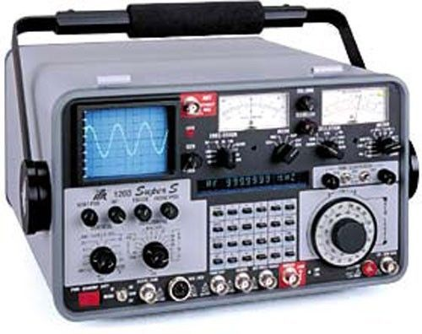
Health Monitor
Experimental TCP-based monitor:
Regular updates on (for example) :
  CPU consumption
  Memory statistics
  Are any threads suspended?
  )SI stack and Error information
Notification on
  untrapped error
  ws compaction
Exact execution location if "breadcrumbs" enabled
Information about whether a RIDE connection is possible

Slide 39
Health Monitor Example
["PollFacts",{"Facts":["AccountInformation","Workspace","ThreadCount"],"Interval":5000,"UID":"1 1"}]
["Facts",
{"Facts": [ {
"ID": 2, "Name": "AccountInformation",
"Value": {
"ComputeTime": 438,
"ConnectTime": 46973,
"KeyingTime": 0,
"UserIdentification": 0
}},{
"ID": 3, "Name": "Workspace",
"Value": {
"Allocation": 33882064,
"AllocationHWM": 33882064,
"Available": 2144207480,
"Compactions": 2,
"FreePockets": 186682,
"GarbageCollections": 0,
"GarbagePockets": 0,
"Sediment": 2120,
"Used": 3276168,
"UsedPockets": 23209,
"WSID": "CLEAR WS"
}},{
"ID": 6, "Name": "ThreadCount",
"Value": {
"Suspended": 1,
"Total": 2
}}
],
"Interval": 5000,
"UID": "1 1"
}]

Slide 40
Highlights of v19.0
Not to be forgotten:
We closed a LOT of "issues"
  Tricky dfn scoping issues were fixed \☺/
  Significant contribution from new team members
Unfortunately the list of open issues is growing
  …mostly because we're doing more, better testing
  New users with new usage patterns
  New employees finding bugs & logging "WIBNIs*"
*
Wouldn't
It
Be
Nice
If …

Slide 41
Sketch of Version 20.0 (Q2/2024)
Transferred from v19.0
Resume Optimisation Work
.NET Bridge "enhancements"
  Support "Generic" methods & classes
More HTMLRenderer improvements
  Work on open-sourcing it
Health Monitor
Script Engine Support
⎕NATTRIBUTES
Next Set of Projects
Array Notation
Token-by-token Debugging
Probably some New Operators
Query Platform Features
New "Shell" System Command
Virtual "Execution Environments"
Design / Prototyping of Async

Slide 42
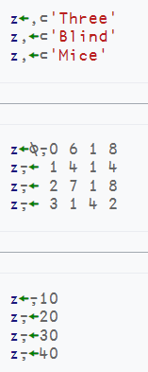
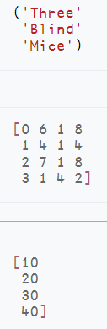
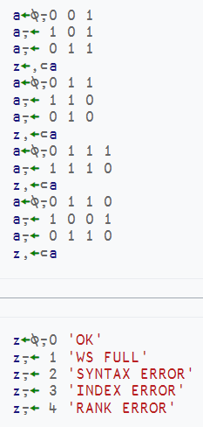
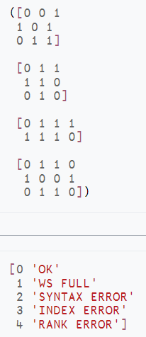
Array Notation
https://aplwiki.com/wiki/Array_notation

Slide 43
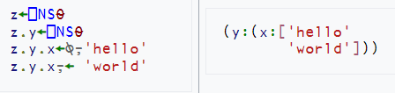
Array Notation
Proposal published – awaiting community feedback
  https://aplwiki.com/wiki/Array_notation
APL model exists in Link and
⎕SE.Dyalog.Array.Serialise|Deserialise
Hope to start C implementation in v20.0
Thursday 10:00 An Implementation of APL Array Notation
(Kamila Szewczyk, Saarland University - Dyalog Summer Intern)

Slide 44
Source Code Management
Critical for adoption of APL by new generation of users
Independent from v20.0 projects, but in same timeframe:
  Project Management - Cider
  Package Management - Tatin
  Link 5.0 with a "Crawler" as backup / alternative to File System Watcher
Voice opinions to Gilgamesh Athoraya, Kai Jaeger, Rich Park, Stefan Kruger, or myself.

Slide 45
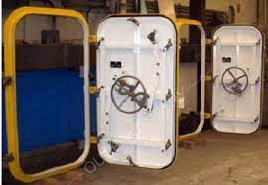
Virtual Environments
Closely related to Projects & Packages
A virtual environment defines
  A specific version of Dyalog APL
  With a set of installed packages
  And a set of environment variables
Allows development or maintenence of applications in controlled / static settings

Slide 46
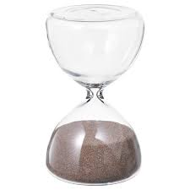
Optimisation Work
Initial focus on performance of ∊ and ⍳
Instrumented interpreter can collect data about calls made by running applications
In version 20.0, we hope to implement the first improved algorithms
Monday 14:00 Performance of Set Functions
(Karta Kooner)

Slide 47
HTMLRenderer Enhancements
Medium term: Separate HTMLRenderer from APL and make it a separate, open source component
  Not sure this will make it to v20.0
Until then, we may release regular updates to the HTMLRenderer to pick up new versions of CEF
  When there are critical security patches to Chromium
These releases may contain feature tweaks
  File Upload, Multiple Modal instances

Slide 48
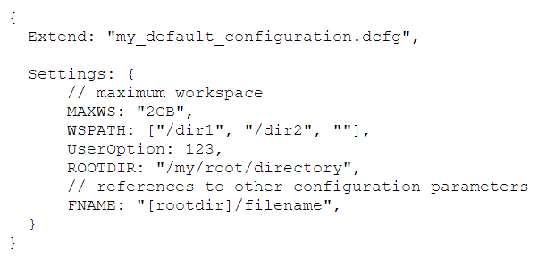
Configuration Files
Continue the move towards portable configuration files
Currently require a startup script on non-Windows platforms
  Implement Good defaults for all settings under Linux, macOS, …
  All settings configurable via text config files
  Eliminate the need for the script
Remove need for the Windows Registry
  Windows interpreter already has good defaults if no config found
  Move all "interpreter settings" to text (JSON5) config files
  Leave IDE settings in the Registry (as RIDE settings are in a JSON repository)
This might not make 19.0 20.0, but remains an important medium term goal.

Slide 49
.NET Bridge Enhancements
The v19.0 bridge to "New .NET" is roughly on par with the Framework bridge
Potential new features in v20.0
  Generics
  Delegates
  (Tools to load/manage .NET dependencies)
NB: New features will probably NOT be back-ported to the Framework bridge
Tuesday 15:15 Dyalog Version 20.0 – Part 2
(John Daintree)

Slide 50

Token-by-token Debugging
Not saying any more, John is up next
Monday 10:15 Dyalog Version 20.0 – Part 1
(John Daintree)

Slide 51
New Primitives / System Functions
A small set of APL primitives is still missing
See Adam's presentation at Dyalog'22
  D15: Filling the Core Language Gaps
And later today:
Monday 11:15 Setting and Getting Variable Values
(Adám Brudzewsky)
Tuesday 16:15 Giving Key a Vocabulary
(Adám Brudzewsky)

Slide 52
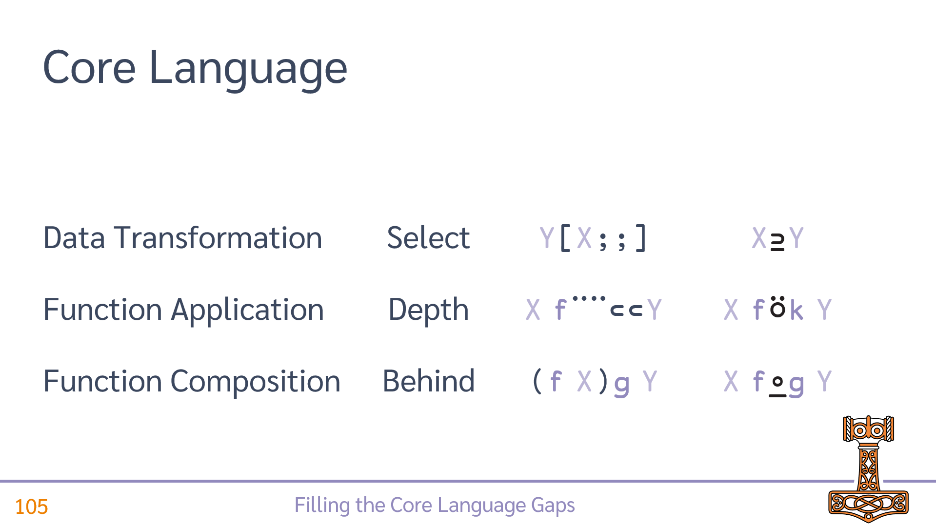
Possible New Primitives

Slide 53
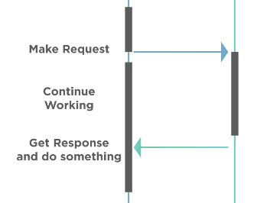
Design / Prototyping of "Async"
Work on the .NET bridge makes it clear to us that modern APIs are often asynchronous
A future .NET Bridge needs to support this elegantly – see John Daintree's "2022 Conference Edition Part 3" talk from Dyalog'22
  Async … Await
  And/or Futures

Slide 54
Grand Unified Theory of Async?
A dyadic parallel operator could invoke a function
in a variety of asynchronous ways, all of which would
immediately return a future:
Invoke foo in…
ns∥foo ←→ an "in process" fork of the ns
isolates∥foo ←→ a "separate process" (isolate)
⍬∥foo ←→ an empty isolate (current APL model)
0∥foo ←→ a green thread in current ws (like current foo&)
¯1∥foo ←→ current ws, but lazily (when value is required)

Slide 55
Health Monitor
Version 19.0 contains a prototype. Ideas for v20.0 include:
Complete implementation of "breadcrumbs" so it is possible to understand where an interpreter is hanging
Sending signals to interrupt or terminate tasks
Discoverability: allow APL process to broadcast services that it provides
Switch PROFILE on and off; collect data

Slide 56
I/O Project
I/O routines significantly refactored in v19.0
  Goal is to properly manage redirection in the future
  Changes should be invisible to users
In v20.0, we aim to add
  The ability to change redirection under program control
  Ability to attach RIDE to a "script engine" and manage where programme and user input come from during debugging

Slide 57
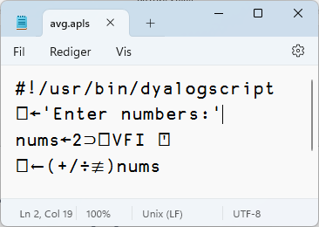
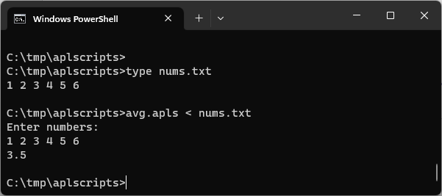
Script-Engine Support
#! (hash bang) scripting
We think the script engine will
be critical for attracting new users
Still a bit of a prototype
  Needs to be debug-able via RIDE
  (awaiting next phase of I/O project)

Slide 58
Other Small but Important Things
⎕SHELL to replace existing ⎕SH
  Interruptible
  Manage stdin, stdout & stderr
⎕PROFILE enhancements
  Ideas: capture thread id, non-aggregating mode, memory allocations, binary export format
Monday 11:45 Revisiting ⎕SH and ⎕CMD
(Peter Mikkelsen)

Slide 59
Sketch of Version 20.0 (Q2/2024)
Transferred from v19.0
Resume Optimisation Work
.NET Bridge "enhancements"
  Support "Generic" methods & classes
More HTMLRenderer improvements
  Work on open-sourcing it
Health Monitor
Script Engine Support
⎕NATTRIBUTES
Next Set of Projects
Array Notation
Token-by-token Debugging
Probably some New Operators
Query Platform Features
New "Shell" System Command
Virtual "Execution Environments"
Design / Prototyping of Async

Slide 60
Major Milestones in 1st Half of the Fifth Decade
2024 / Tool Projects
  Tatin & Cider become "mainstream"
  Jarvis & WebSocket integration
  One secret project, come to Glasgow ☺!
2025 / v20:
  Literal Array Notation
  .NET Generics
  HTMLRenderer (& Conga?) as Open-Source extensions
  Android version?
2026 / v21:
  Co-dfns compiler integrated with Dyalog APL
  All asynchronous operations return futures
  Dual / Under, Differentiation
2027 / v22:
  Multiple Numeric Towers: 64-bit integers, Rationals, Unlimited-precision integers
(NB Mortens dreams, NOT promises!)
And… without dates attached
Universities start offering APL courses
  Not as part of a "comparative" course
APL recognised as a respectable tool for modeling machine learning and quantum computing
First commercially significant APL application created by someone who learned APL in this millennium
"Full Stack" Web development in APL
And… not forgotten
VS Code Integration (Debug Adapter Protocol)
Inverted Tables (aka "Magic Arrays")
WASM?

Slide 61
Hope that was all clear!

