Slide 1
Tacit Techniques
APL Wiki
Adám Brudzewsky
Rich Park asst. Peter Mikkelsen

Slide 2
These
Tacit Techniques
Will Blow Your Mind!
APL Wiki apl.wiki/tacit#Tutorials
Adám Brudzewsky xpqz.github.io/cultivations/Trains
Rich Park youtu.be/Enlh5qwwDuY “Train Spotting”

Slide 3
What is the essence of tacit programming? Find out here!
Explicit code mentions arguments:
Expression (⌈/N)-⌊/N←3 1 4 1 5
Tradfn ∇ R←Range Y …
Dfn {(⌈/⍵)-(⌊/⍵)}
Tacit code implies arguments:
Tacit ⌈/-⌊/
Notes:
Guy Steele said one of the disadvantages of APL is that user-defined functions don't look like the core language (some would say that is an advantage).
Tacit programming allows writing more complex functions using just primitives, which gives those functions mnemonic value as set phrases you can learn to do specific things

Slide 4
Shocking Revelation:
You’ve been unknowingly using tacit constructs all along!
f/ f¨ ∘.g f\ A∘g f⌸ f⍠B
APL old-timers don’t want you to know this one fact:
Operator application is actually just tacit programming!

Slide 5
Function composition
f⍥g f⍤g f⍨ fgh f∘g
Discover the mind-blowing secret:
Function composition is actually just plumbing!

Slide 6
Experts rave about tacit!
Arguments in operands
Memorable (like ≠⊆⊢ and +⌿÷≢)
Adjacency (like ×- and ∨/⍷)
Brevity (like F⍥⎕C)
DRY (Don’t Repeat Yourself; like ≡⍥⍴)
Just a general feeling of superiority and awesomeness

Slide 7
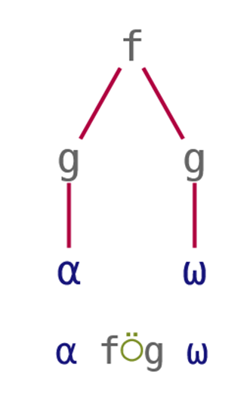
Over
The shape of an outer product ⍺ ∘.f ⍵ is
(⍴⍺) , (⍴⍵)
We can write this as
⍺ ,⍥⍴ ⍵
“pre-process both”

Slide 8
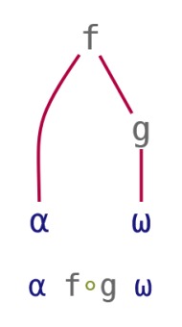
Beside
Location of ⍺^{th} 1 in each element of ⍵ is
⍺ ⊃¨ ⍸¨ ⍵
We can write this as
⍺ ⊃∘⍸¨ ⍵
“pre-process right”

Slide 9
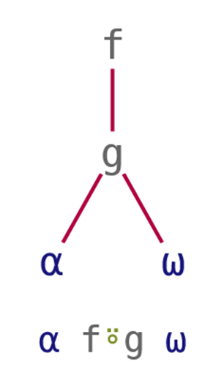
Atop
Any-presence of ⍺ in ⍵ is
∨/ ⍺ ⍷ ⍵
We can write this as
⍺ ∨/⍤⍷ ⍵
“post-processing result”

Slide 10
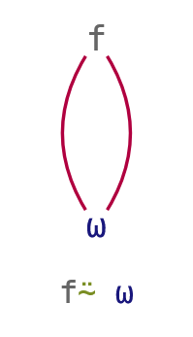
Commute
A multiplication table of N is
(⍳⍵) ∘.× (⍳⍵)
We can write this as
∘.×⍨ ⍳⍵
“selfie”
Notes:
After this slide, handout "function compositions" cheat sheet

Slide 11
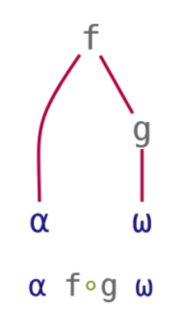
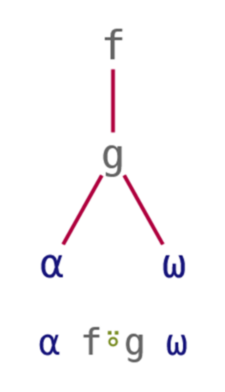
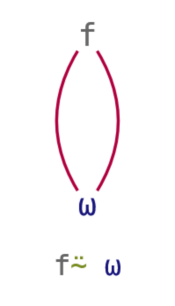
Tacit Techniques
Function Compositions
Over | Beside | Atop | Commute
pre-process both | pre-process right | post-process result | selfie

Slide 12
Tasks: Tacify!
'Hello' {(⎕C ⍺)≡(⎕C ⍵)} 'HELLO'
'ab' 'cd' {∧/⍺∊⍵}¨ 'abba' 'dad'
64 1000 0 {⍺*÷⍵} 3
10 4 1 0 {⍺××⍵} ¯3 2 0 ¯1
1
1 0
4 10 0
¯10 4 0 0
Notes:
≡⍥⎕C
∧/⍤∊¨
*∘÷
×∘×

Slide 13
Train Introduction
Also a type of composition
Sequence of functions in isolation:
Parenthesised:
(+⌿÷≢) 3 1 4 1 5
Assigned
Avg←+⌿÷≢
Avg 3 1 4 1 5

Slide 14
Discussion: Writing Trains
(f Y) + (h Y) → (f + h) Y
Notes:
Spotting patterns, like function composition

Slide 15
Discussion: Writing Trains
(f Y) + (h Y) → (f + h) Y
(f Y) + ( Y) → (f + ⊢) Y

Slide 16
Discussion: Writing Trains
(f Y) + (h Y) → (f + h) Y
(f Y) + ( Y) → (f + ⊢) Y
(X f Y) + (X h Y) → X (f + h) Y
Notes:
Everyone OK with left and right tacks?

Slide 17
Discussion: Writing Trains
(f Y) + (h Y) → (f + h) Y
(f Y) + ( Y) → (f + ⊢) Y
(X f Y) + (X h Y) → X (f + h) Y
(X ) + (X h Y) → X (⊣ + h) Y

Slide 18
Discussion: Writing Trains
(f Y) + (h Y) → (f + h) Y
(f Y) + ( Y) → (f + ⊢) Y
(X f Y) + (X h Y) → X (f + h) Y
(X ) + (X h Y) → X (⊣ + h) Y

Slide 19
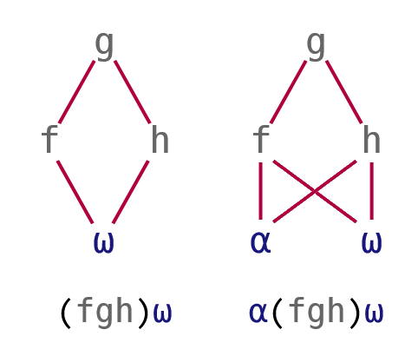
Discussion: Writing Trains
(f Y) g (h Y) → (f g h) Y
(f Y) g ( Y) → (f g ⊢) Y
g (h Y) → ( g h) Y
(X f Y) g (X h Y) → X (f g h) Y
(X ) g (X h Y) → X (⊣ g h) Y

Slide 20
Discussion: Writing Trains
(f Y) g (h Y) → (f g h) Y
(f Y) g ( Y) → (f g ⊢) Y
g (h Y) → ( g h) Y
(X f Y) g (X h Y) → X (f g h) Y
(X ) g (X h Y) → X (⊣ g h) Y
g (X h Y) → X ( g h) Y

Slide 21
Discussion: Writing Trains
(f Y) g (h Y) → (f g h) Y
(f Y) g ( Y) → (f g ⊢) Y
g (h Y) → ( g h) Y
(X f Y) g (X h Y) → X (f g h) Y
(X ) g (X h Y) → X (⊣ g h) Y
g (X h Y) → X ( g h) Y

Slide 22
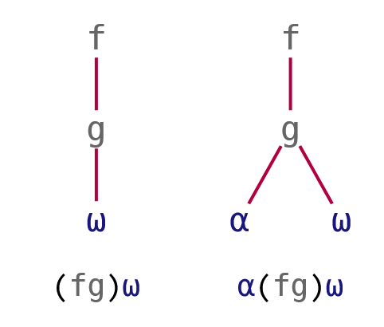
Discussion: Writing Trains
(f Y) g (h Y) → (f g h) Y
(f Y) g ( Y) → (f g ⊢) Y
f (g Y) → ( f g) Y
(X f Y) g (X h Y) → X (f g h) Y
(X ) g (X h Y) → X (⊣ g h) Y
f (X g Y) → X ( f g) Y

Slide 23
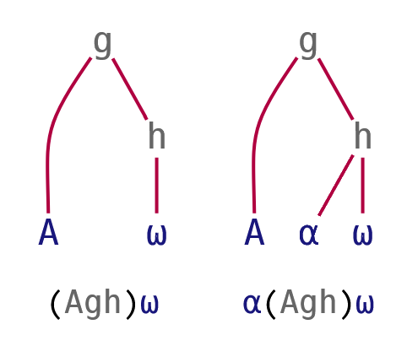
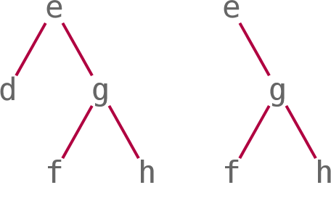
Train Details
Some parts can actually be arrays:
A g h is {A} g h
Two sub-types of trains:
Fork: f g h and A g h
Atop: f g
Longer trains:
(d e f g h) is (d e (f g h))
(e f g h) is (e (f g h))
Notes:
After this slide, handout "trains" cheat sheet

Slide 24
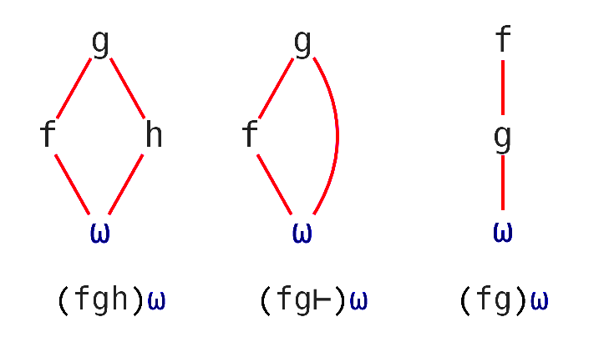
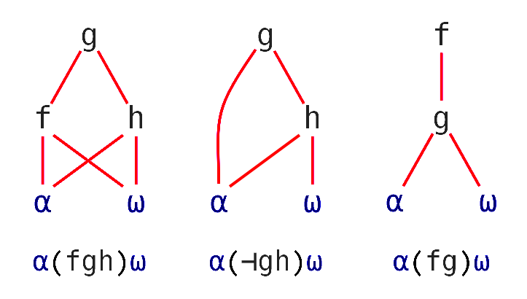
Tacit Techniques
Trains
Monadic
(f Y) g (h Y) ↔ (f g h) Y
(f Y) g ( Y) ↔ (f g ⊢) Y
g (h Y) ↔ ( g h) Y
Dyadic
(X f Y) g (X h Y) ↔ X (f g h) Y
(X ) g (X h Y) ↔ X (⊣ g h) Y
g (X h Y) ↔ X ( g h) Y

Slide 25
Example: Writing a Train
{∧/ (⌈\⍵) = ⍵} 1 3 5 6 7
1
{∧/ (⌈\⍵) = (⊢⍵)} 1 3 5 6 7
1
{∧/ (⌈\ = ⊢) ⍵} 1 3 5 6 7
1
{(∧/ ⌈\ = ⊢) ⍵} 1 3 5 6 7
1
(∧/ ⌈\ = ⊢) 1 3 5 6 7
1

Slide 26
Tasks: Tacify!
{2×⍵} 2 7 1 8
3 1 4 {(⍺∪⍵)~(⍺∩⍵)} 1 6 1
{∪⍵∨⍳⍵} 10
2 {(⍺⊃⍒⍵)⊃⍵} 3 1 4 1 5
4 14 2 16
3 4 6
1 2 5 10
4
Notes:
+⍨ 2×⊢ 2∘× ←discuss
∪~∩
∪⊢∨⍳ ∪⍤∨∘⍳⍨
⊃∘⍒⊃⊢ ⊃⍨∘⊃∘⍒⍨

Slide 27
Amazing tool: ]box on

Slide 28
]box on |⊢÷+/⍣≡
┌─┬─────────────────┐ │|│┌─┬─┬───────────┐│ │ ││⊢│÷│┌─────┬─┬─┐││ │ ││ │ ││┌─┬─┐│⍣│≡│││ │ ││ │ │││+│/││ │ │││ │ ││ │ ││└─┴─┘│ │ │││ │ ││ │ │└─────┴─┴─┘││ │ │└─┴─┴───────────┘│ └─┴─────────────────┘

Slide 29
]box on –t=… |⊢÷+/⍣≡
-t=box
┌─┬─────────────────┐ │|│┌─┬─┬───────────┐│ │ ││⊢│÷│┌─────┬─┬─┐││ │ ││ │ ││┌─┬─┐│⍣│≡│││ │ ││ │ │││+│/││ │ │││ │ ││ │ ││└─┴─┘│ │ │││ │ ││ │ │└─────┴─┴─┘││ │ │└─┴─┴───────────┘│ └─┴─────────────────┘

Slide 30
]box on –t=… |⊢÷+/⍣≡
-t=box | -t=tree
┌─┬─────────────────┐ │|│┌─┬─┬───────────┐│ │ ││⊢│÷│┌─────┬─┬─┐││ │ ││ │ ││┌─┬─┐│⍣│≡│││ │ ││ │ │││+│/││ │ │││ │ ││ │ ││└─┴─┘│ │ │││ │ ││ │ │└─────┴─┴─┘││ │ │└─┴─┴───────────┘│ └─┴─────────────────┘ | ┌─┴─┐ . | ┌─┼─┐ . ⊢ ÷ ⍣ . ┌┴┐. / ≡. ┌─┘ . + .

Slide 31
]box on –t=… |⊢÷+/⍣≡
-t=box | -t=tree | -t=parens
┌─┬─────────────────┐ │|│┌─┬─┬───────────┐│ │ ││⊢│÷│┌─────┬─┬─┐││ │ ││ │ ││┌─┬─┐│⍣│≡│││ │ ││ │ │││+│/││ │ │││ │ ││ │ ││└─┴─┘│ │ │││ │ ││ │ │└─────┴─┴─┘││ │ │└─┴─┴───────────┘│ └─┴─────────────────┘ | ┌─┴─┐ . | ┌─┼─┐ . ⊢ ÷ ⍣ . ┌┴┐. / ≡. ┌─┘ . + . | |(⊢÷((+/)⍣≡))

Slide 32
Tasks: Tacify!
{(⊖⍵)⊥(⊖⍵)} 1 1 1 0 1 1 0 0
',;' {(~⍵∊⍺)⊆⍵} 'ab,de;fgh'
nums←3 1 4 1 5
4 {(⍺+⌿⍵)÷⍺} nums
{(+⌿⍵)÷≢⍵} nums
Bonus task: Combine 3 & 4 into an ambivalent function.
3
ab de fgh
2.25 2.75
2.8
Notes:
⊥⍨⍤⊖ ⊥⍥⊖⍨ +⌿∧⍀
~⍤∊⍨⊆⊢
and 4. +⌿÷⊣∘≢

Slide 33
4 aspects of tacit that could ruin your life – #4 will blow your mind!
Arguments in operands
Monadic functions
Recursion, Assignment, Dotting
Selection (but 20.0…)

Slide 34
The ultimate paradox revealed:
Arguments in operands
10 {x←⍺ ⋄ ⌽@{x<⍵}⍵} 1 2 13 14 5 16 7 18
1 2 18 16 5 14 7 13
10 { ⌽@(⍺<⊢)⍵} 1 2 13 14 5 16 7 18
1 2 18 16 5 14 7 13
2 {(⌽⍤⍉⍣⍺)⍵} 3 3⍴⍳9
9 8 7
6 5 4
3 2 1

Slide 35
Inappropriate tacit discovered: Lots of monadic functions
{⌽+⌿↑⌽¨⍵}
⌽⍤(+⌿)⍤↑⍤(⌽¨)
⌽(+⌿(↑⌽¨))
⌽+⌿⍤↑⍤(⌽¨)
⌽(+⌿⍤↑⌽¨)

Slide 36
3 things tacit code just cannot do
Assignment
Namespace “dotting”
Recursion
{n⍪⍉↑⍺⍎¨n←⍺.⎕NL¯2}
┘ │
│
┘
┐
{1≥⍵:1 ⋄ (⍵-1)+⍥∇(⍵-2)}

Slide 37
The ugly truth about selection, and what we plan to do about it
{(3>⍵)⌿⍵} 3 1 4 1 5
4 5
(3∘>⌿⊢) 3 1 4 1 5
SYNTAX ERROR
(3∘>⌿ ⊢) 3 1 4 1 5
SYNTAX ERROR
(3∘> ⊢⍤⌿ ⊢)3 1 4 1 5
4 5
3∘>⍛⌿ 3 1 4 1 5

Slide 38
The ugly truth about selection, and what we plan to do about it
'aeiou' {⍵[⍺⍋⍵]} 'hello world'
eoohll wrld
'aeiou' {⍵⌷⍨⍺⍋⍵} 'hello world'
LENGTH ERROR
'aeiou' {⍵⌷⍨⊂⍺⍋⍵} 'hello world'
eoohll wrld
'aeiou' (⊂⍤⍋⌷⊢) 'hello world'
eoohll wrld
'aeiou' (⍋⊇⊢) 'hello world'

Slide 39
Tasks: Convert tacit to dfn
Monadic ××⌊⍤|
Dyadic ⌊∘≢↑⊢
Monadic ≡⍥(⎕C~∘' ')
Monadic +⌿⊢>+⌿÷≢
Bonus tasks:
Monadic ⌽≡⊢⊢≡⌽
Notes:
{(×⍵)×⌊|⍵}
{(⍺⌊≢⍵)↑⍵}
{F←{⎕C⍺~' '} ⋄ (F⍺)≡(F⍵)}
{+⌿⍵>(+⌿⍵)÷≢⍵}
{⍵≡⌽⍵}

Slide 40


Amazing tool: tacit.help

Slide 41
7 hash tables that won’t go away
P ⍋ s
P ⍒ s
P ⍳ s
P ∪ s
s ∊ P
s ~ P
s ∩ P
P∘⍋ s
P∘⍒ s
P∘⍳ s
P∘∪ s
(∊∘P) s
(~∘P) s
(∩∘P) s

Slide 42
7 hash tables that won’t go away
s←'Hello, World!'
AVi←⎕AV∘⍳ ⋄ {}AVi s
cmpx '⎕AV⍳s' 'AVi s'
⎕AV⍳s → 6.0E¯7 | 0% ⎕⎕⎕⎕⎕⎕⎕⎕⎕⎕⎕⎕⎕⎕⎕⎕⎕⎕⎕⎕
AVi s → 3.7E¯7 | -39% ⎕⎕⎕⎕⎕⎕⎕⎕⎕⎕⎕⎕
AVg←⎕AV∘⍋ ⋄ {}AVg s
cmpx '⎕AV⍋s' 'AVg s'
⎕AV⍋s → 2.3E¯6 | 0% ⎕⎕⎕⎕⎕⎕⎕⎕⎕⎕⎕⎕⎕⎕⎕⎕⎕⎕⎕⎕
AVg s → 5.5E¯7 | -77% ⎕⎕⎕⎕⎕

Slide 43
7 hash tables that won’t go away
s←'Hello, World!'
cmpx '⎕AV⍳s' '⎕AV∘⍳ s'
⎕AV⍳s → 6.5E¯7 | 0% ⎕⎕⎕⎕⎕⎕⎕⎕⎕⎕⎕⎕⎕⎕⎕⎕⎕⎕⎕
⎕AV∘⍳ s → 7.0E¯7 | +7% ⎕⎕⎕⎕⎕⎕⎕⎕⎕⎕⎕⎕⎕⎕⎕⎕⎕⎕⎕⎕
cmpx '⎕AV⍋s' '⎕AV∘⍋ s'
⎕AV⍋s → 2.0E¯6 | 0% ⎕
⎕AV∘⍋ s → 6.7E¯5 | +3242% ⎕⎕⎕⎕⎕⎕⎕⎕⎕⎕⎕⎕⎕⎕⎕⎕⎕⎕⎕⎕

Slide 44
Showdown: Memory vs CPU
⍪e
┌─────────────┐
│a (∧/¨∊¨) b │
├─────────────┤
│a {∧/¨⍺∊¨⍵} b│
├─────────────┤
│a ∧/⍤∊¨ b │
├─────────────┤
│a {∧/⍺∊⍵}¨ b │
└─────────────┘
a←(2e4⍴¨'ab' 'cd')[?5e4⍴2]
b← 'aba' 'cad'[?5e4⍴2]
∇ hwm←mem expr
{}⎕WA
{}0(2000⌶)14
hwm←2000⌶14
{}⍎expr
hwm-⍨←2000⌶14
∇

Slide 45
Showdown: Memory vs CPU
(⍕⍪,mem¨) e
a (∧/¨∊¨) b 125835728
a {∧/¨⍺∊¨⍵} b 125835792
a ∧/⍤∊¨ b 4194304
a {∧/⍺∊⍵}¨ b 4194304
(⍕⍪,1∘cmpx¨) e
a (∧/¨∊¨) b 0.45675
a {∧/¨⍺∊¨⍵} b 0.4145
a ∧/⍤∊¨ b 0.4245
a {∧/⍺∊⍵}¨ b 0.42275
Notes:
High memory cost of loop fission

Slide 46
Showdown: Memory vs CPU
(⍕⍪,mem¨) e
a (∧/¨∊¨) b 0
a {∧/¨⍺∊¨⍵} b 0
a ∧/⍤∊¨ b 4194304
a {∧/⍺∊⍵}¨ b 4194304
(⍕⍪,1∘cmpx¨) e
a (∧/¨∊¨) b 0.0080625
a {∧/¨⍺∊¨⍵} b 0.0078359375
a ∧/⍤∊¨ b 0.019703125
a {∧/⍺∊⍵}¨ b 0.021765625
a←2↑¨a
Notes:
High cost of loop fusion
A tacit function has less overhead which you can feel when repeatedly calling a single function
Constant expressions are evaluated only once in tacit

Slide 47
Check out this cool summary
— you won’t regret it!
Function composition:
⍥ Pre-process both
∘ Pre-process right
⍤ Post-process
⍨ Selfie
Operators: long left scope
Trains: odd-even from right
Tools: ]box on -t=…
tacit.help
Watch out for these:
Arguments in operands
Lots of monadic functions
Just don’t try:
  Assignment
  Namespace “dotting”
  Recursion
Selection issues:
  Compress: ⊢⍤⌿
  Index: ⊂⍤… ⌷ …

