Slide 1

Array Notation:
A Journey of Discovery
John Daintree

Slide 2
Array Notation (again)
John Daintree

Slide 3
2015 (Phil Last)

Slide 4
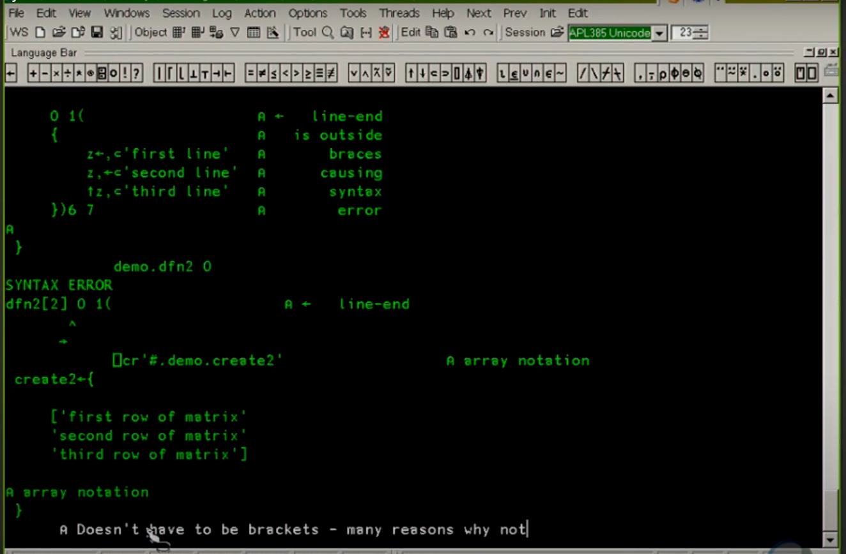

Slide 5
2017 (Adam Brudzewsky)

Slide 6
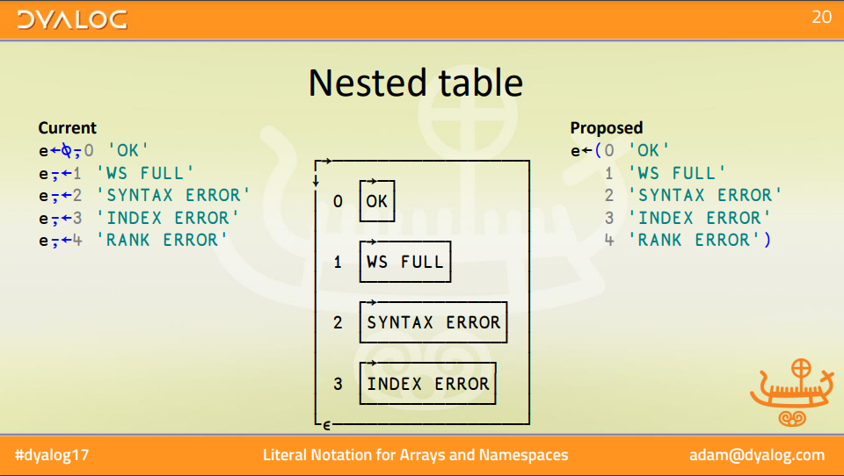

Slide 7
Array Notation
(A retrospective)
John Daintree

Slide 8
2018 (Adam Brudzewsky)

Slide 9
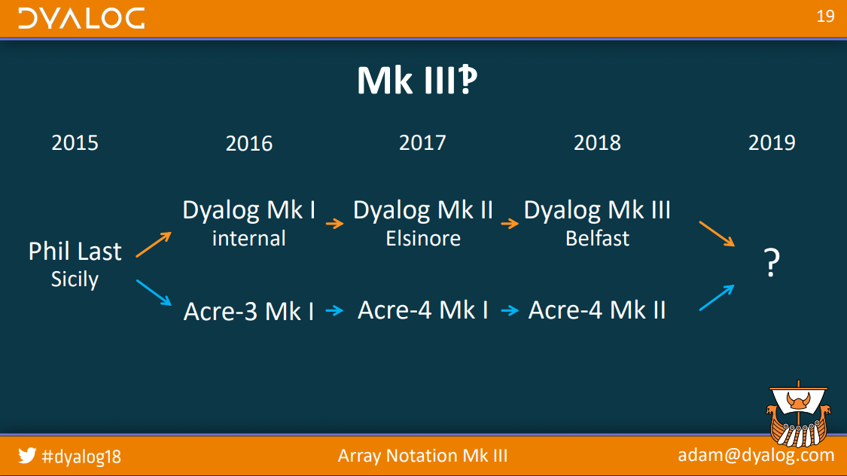

Slide 10
Array Notation:
A Journey of Discovery
John Daintree

Slide 11
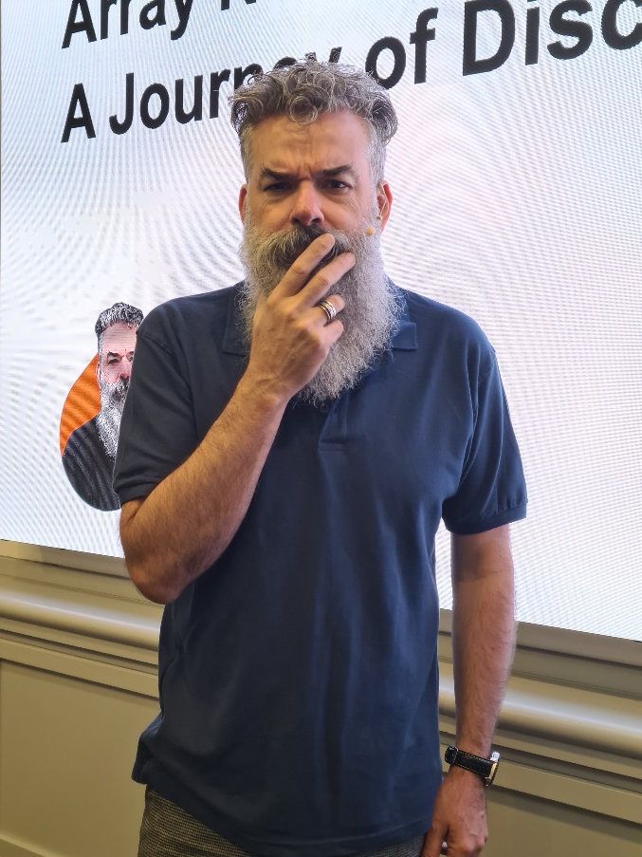
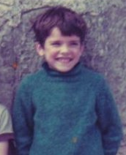

Time to be a grown up

Slide 12
2024 (Me)
Today
Now

Slide 13
We will NOT cover
vector←(1 2 3
4 5 6
7 8 9)
matrix←[1 2 3
4 5 6
7 8 9]
space←(a:1 2 3
b:4 5 6
c:7 8 9)

Slide 14
Array Notation on the Wiki
https://aplwiki.com/wiki/Array_notation

Slide 15
We will cover
Array Notation as a serialized form
Array Notation and code
Array Notation and variables

Slide 16
It's all demo from here

Slide 17
Demo 1

Slide 18
We will cover
Array Notation as a serialized form
  Allows arrays (and namespaces) to be read from and saved to text files
    Usually with no APL symbols
  Restricted set of allowed primitives
    ⌿ (and a few others)
  Using i-beam(s) for deserialization
  And APL code for serialization

Slide 19
We will cover
Array Notation and code

Slide 20
Demo 2

Slide 21
We will cover
Array Notation and code
  No restrictions on functions allowed
  Easy to edit
  No conflict with other uses of ( and [
  But…
    There are some limits
    D16: Interpreter Limits (Wednesday 11.55)

Slide 22
We will cover
Array Notation and variables

Slide 23
We will cover
Array Notation and variables

Slide 24
Demo 3

Slide 25
We will cover
Array Notation and variables
  Retirement of David Liebtag's Array Editor, because …
  Significant extensions to the Dyalog editor
  Gloriously easy to edit many (most?) variables
  Multiline array/namespace creation in the session

Slide 26
And finally
(and probably not in 20.0)

Slide 27
Demo 4

Slide 28
A Journey of Discovery?

Slide 29
In summary
Array Notation as a serialized form
Array Notation and code
Array Notation and variables

Slide 30
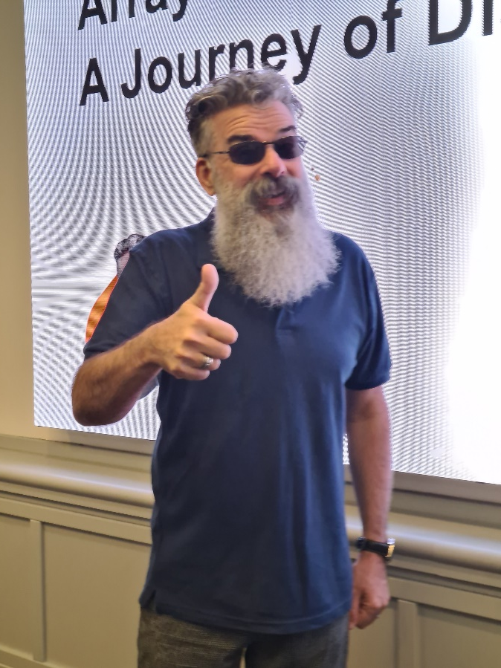
In summary
Array Notation as a serialized form
Array Notation and code
Array Notation and variables

Slide 31
I hope you've learnt a least a couple of things today.
Glasgow 126.98
Southampton 108.42

