Slide 1

ullu: Tests for Dyalog APL
Aarush Bhat
Dyalog Ltd.
Notes:
Aarush Bhat
1.5 years at Dyalog
First time presenting

Slide 2
Coming up…
What is ullu?
How has Dyalog been tested so far?
Why and How ullu was created?
What is the future of ullu?

Slide 3

What is ullu
Notes:
New Test framework which helps to have comprehensive coverage for all new and old features for dyalog apl

Slide 4
Pre-ullu
Standard QAs
Shuffle QAs
Unit Tests
Fuzz tests
Code Coverage tests
Notes:
Shuffle- 50k times longer, parallel qas- upto 10 days- everytime ROS pockets are restricted, it shuffles
Fuzz- Americal fuzzy loop - test huge numbers of expressions

Slide 5
Versions and Platforms
6½ platforms – Windows, Mac, Mac/Arm, AIX, Pi, Linux, Linux/Arm(under dev)
4 versions × 6½ platforms × 32/64 × Classic/Unicode
That is… 63 interpreters of Dyalog APL

Slide 6
With ullu
Notes:
New Test framework which helps to have comprehensive coverage for all new and old features for dyalog apl
Structed approach to qas
Fresh eyes
New, independent, 40 years ago

Slide 7
What does it do?
Verify correct results using fundamental scenarios
Test edge cases
Test all the data types possible, being reproducible and truly randomised
Finally, inspect code coverage to find missing test cases
Notes:
What does ullu really do?
- Explain that we pick up a primitive and grill it until all cases are covered
- Find Bugs, Irregularities, Edge cases, Code Coverage

Slide 8

Battle testing
Image generated by GPT-4o
Notes:
Explain why was ullu needed: to test the functionality other than focusing on testing mostly the code
Getting tests to be on a global level covering all the interactions that the code has with the users
Battle Testing
All primitives
All data types
Lots of data

Slide 9
Primitives Covered – as of 1/9/24 - 11
add (dyadic +)
divide (dyadic ÷)
floor (monadic ⌊)
magnitude (monadic |)
residue (dyadic |)
subtract (dyadic -)
unique (monadic ∪)
unique mask (monadic ≠)
index of (dyadic ⍳)
membership (dyadic ∊)
multiply (dyadic ×)
Notes:
- Explain the variety of primitives that have been covered

Slide 10
Next up
greater (dyadic >)
less (dyadic <)
exponential (dyadic *)
grade (⍋⍒)
not equal (dyadic ≠)
not (monadic ~)
union (dyadic ∪)
Notes:
- Explain the variety of primitives that have been covered

Slide 11
Process
Define fundamental scenarios
Explore the codebase
Check code coverage
Check user issues
Verify interpreter limits
Check displayed errors
Remove dead code
Notes:
Explain the framework
Point to jds presentation
Point out fundamental in next slide

Slide 12
Model functions
Unique R←∪Y
  {0=≢⍵:⍵ ⋄ ↑,⊃{⍺,(∧/⍺≢¨⍵)/⍵}⍨/⌽⊂¨⊂⍤¯1⊢⍵}
Add R←X+Y
  {⍺--⍵}
Magnitude R←|Y
  {⍵×(¯1@(∊∘0)(⍵>0))}
Notes:
What model functions are
What we think about before writing them

Slide 13
Tests
Unique R←∪Y
  Assert (≢data)≥≢∪data
Add R←X+Y
  RunVariations (2×data) data data
Magnitude R←|Y
  RunVariations (modelMag data) data
Notes:
Explain what the tests generally look like
properties of the primitive
Logical tests
Model tests
Correct Error tests
Cross datatype tests

Slide 14
RunVariations
Normal array (one or two datatypes mixed)
Scalar
Empty array
Differently shaped array
Testing with model
Testing with completely randomised data with model
Notes:
Explain what are the variations

Slide 15
Data, more data and results
84,274 tests
Lots of numbers, arrays and data elements
Good news, ullu is now integrated with the standard and coverage QAs
Notes:
data for the amount and variety of data tested, number of tests in total
Todo: need to add tests for multiply here
83,184

Slide 16
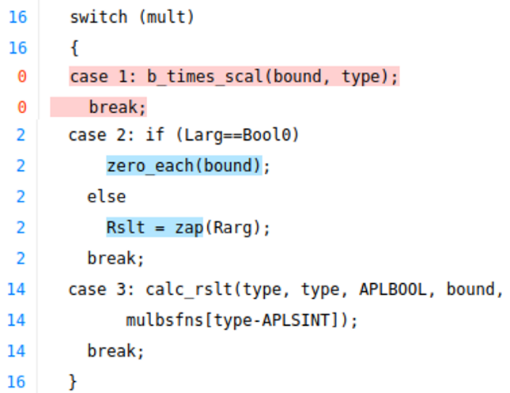
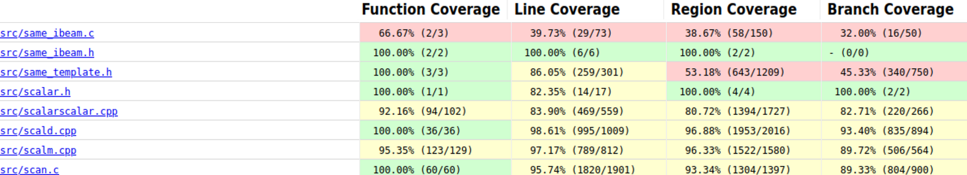
Code coverage
Notes:
After code and variations we look at code coverage
Explain what code coverage is
Data about code coverage
Avg Jump in codecoverage of the features currently covered:

Slide 17
Future plans
Cover all primitives
Work with more data
Find cases that people might not hit in a 100 years
Make Dyalog APL more reliable
Notes:
More data- 20 mins, can be increased to hours

Slide 18
Find ullu at: github.com/Dyalog/ullu
Reach out: aarush@dyalog.com
Notes:
Summary
Not for finding flaws right now, but for making changes
Different kind of problem solving

Slide 19
In short, ullu is…
New
Structured
Independent
A 2nd coat of paint
Notes:
Reinforcing

Slide 20
It is not just about finding things wrong about Dyalog APL but making us more confident when making enhancements
Notes:
Ullu does not only finds bugs in Dyalog APL but makes the developers confident to explore
Logical and actual coverage

