Slide 1

Planely winning the APL Forge
Holden Hoover
holdenhoover@bkaw.ca

Slide 2
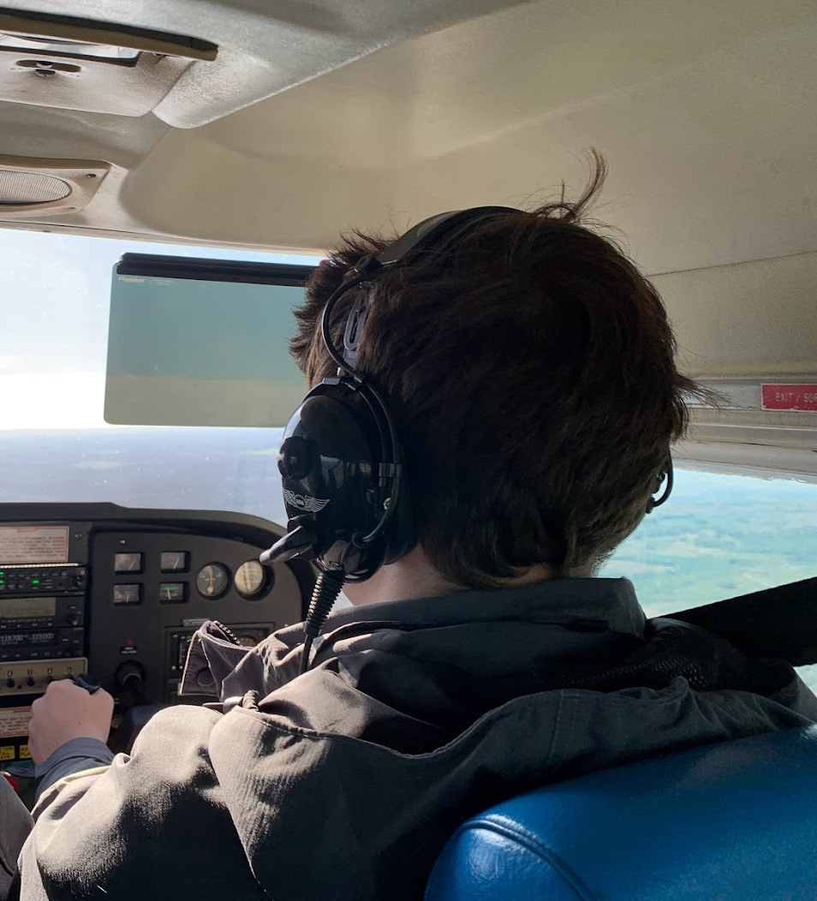
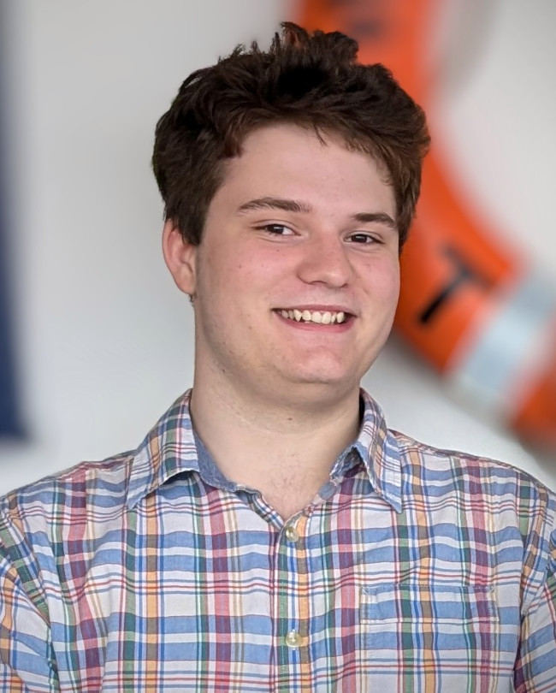
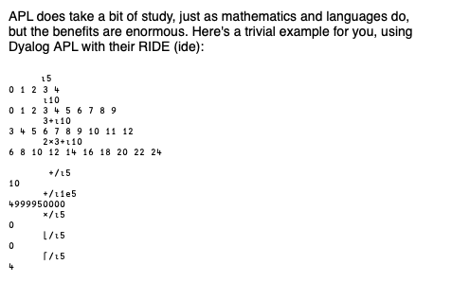
Who am i?
High School Student
Using APL since 2020
Summer of 2021, worked on APEX
Aviation Enthusiast

Slide 3
My Project
Radar Ingest System is an application that aggregates, processes, and stores ADS-B messages from a network of individual and independent feeder antennas, creating a unified database of real-time data from multiple aircraft across the network.

Slide 4
ADS-B?

Slide 5
What is ADS-B?
Automatic Dependent Surveillance-Broadcast
Automatic - No request is made
Dependent - Systems are on the plane
Surveillance - For surveillance of planes
Broadcast - Available to all

Slide 6
How does ADS-B work?
In a nutshell
Plane has a computer
Computer broadcasts a message
Message is received by an antenna

Slide 7
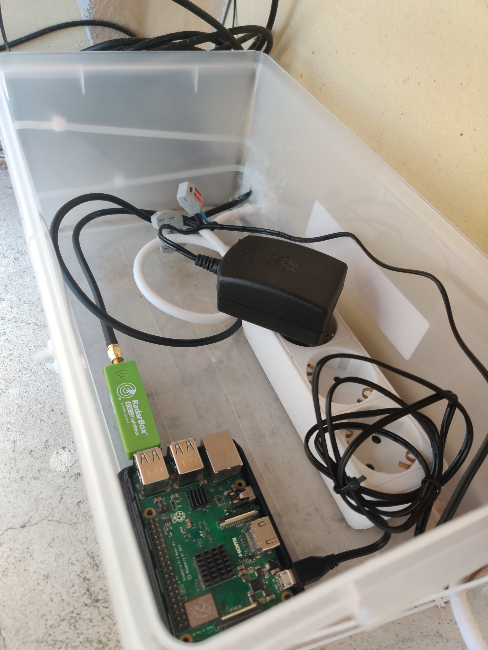
How does Radar Ingest System work?
Radar (antenna) connects to RIS
Radar receives message
Radar sends the message to RIS
RIS ingests the message
RIS appends (or modifies) a plane entry into the database

Slide 8

RIS DEMO

Slide 11
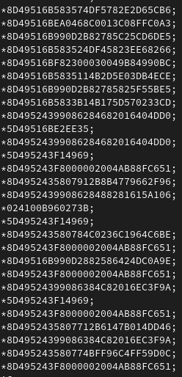
What exactly is “Ingestion”
Message gets sent to RIS from Radar
The message gets cleaned up
The message is sent to adsbProcess
The aircraft record is returned to the RIS instance
The record is added to the database

Slide 12
What exactly is “Ingestion”
Continued

Slide 13
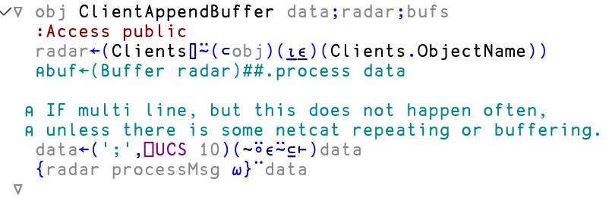
What exactly is “Ingestion”
Continued

Slide 14
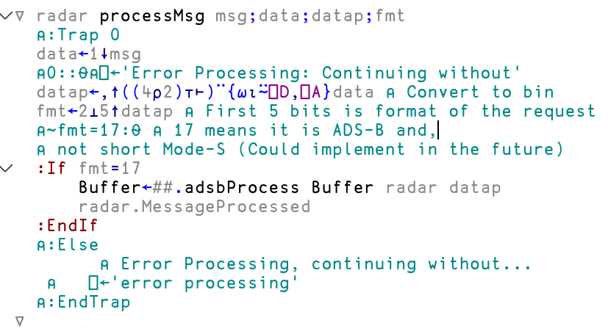
What exactly is “Ingestion”
Continued

Slide 15
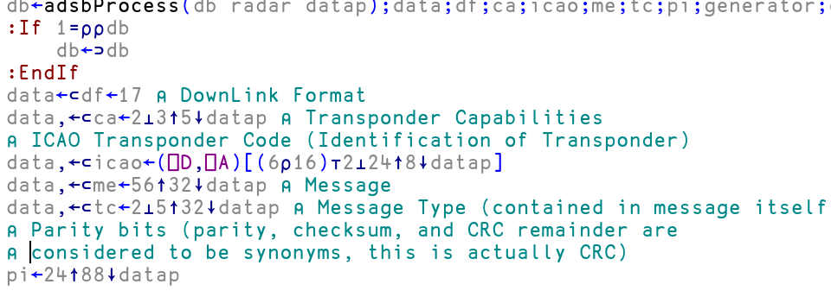
What exactly is “Ingestion”
Continued

Slide 16
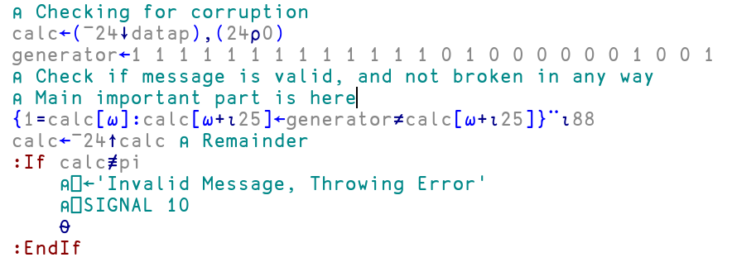
What exactly is “Ingestion”
Continued

Slide 17
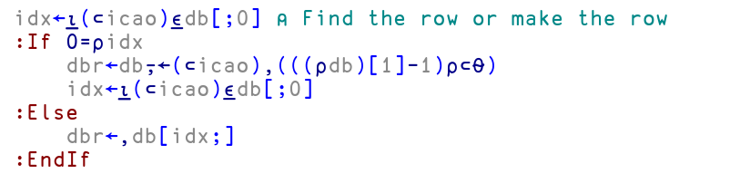
What exactly is “Ingestion”
Continued

Slide 18
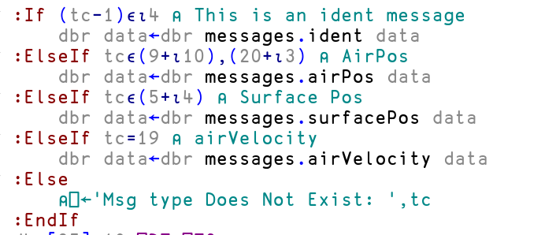
What exactly is “Ingestion”
Continued

Slide 19
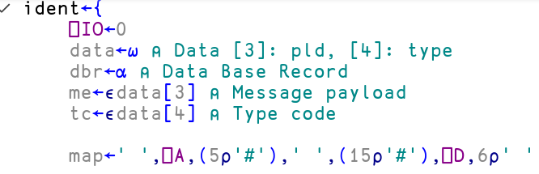
What exactly is “Ingestion”
Continued

Slide 20

What exactly is “Ingestion”
Continued

Slide 21

What exactly is “Ingestion”
Continued

Slide 22
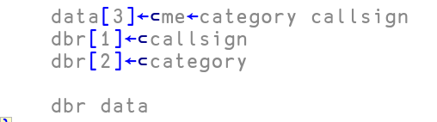
What exactly is “Ingestion”
Continued

Slide 23
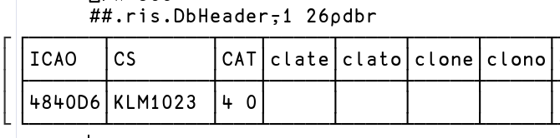
What exactly is “Ingestion”
Continued

Slide 24
RIS ARchitecture
Cider
Tatin
Dyalog Class
Dyalog Conga
Dyalog Jarvis

Slide 25
Future
Proper UI
Needs some major optimisation
Needs to be made more robust
New radar communication protocol?

Slide 26
Thank you

