Slide 1
Deployment of the Dyalog Interpreter as
OLE-Server for interactive Use
(Microsoft Windows only)
Jürgen Wiedemann Dyalog ´24
DPC 17. September 2024

Slide 2
Agenda
Introducing DPC and myself
Starting point and Requirements
Implementation
Demo

Slide 3
About DPC (Dittrich & Partner Consulting)
Founded in 1981
Acquired from HBA Consulting in 2023
10 employees, together with HBA 50
Located in Germany, customers in Germany, Austria and Switzerland
Providing consulting services
mainly for life insurance companies
Distributing APL Software licences

Slide 4
About me
Working for DPC since 1998
Consultant with focus on APL
Done a lot of APL migrations
Managing director since 2019
(second job)

Slide 5
Starting point and Requirements
Migration of several APL+Win applications (with all the typical challenges)
Requirement:
  special functionality referred to as
  “APL+Win as an ActiveX server”
Possibility to
  create an instance of APL
  to use any workspace in it without special preparation

Slide 6
Use cases
Regression test for lots of calculations in parallel on several local instances
Integration of APL in other environments,
e.g. in Excel (VBA)
Operation in “Developer mode”:
  fully functional IDE
  visible
  debugging and tracing

Slide 7
Challenge
Dyalog does not offer an out-of-the-box solution for these requirements.
You can
  export workspaces as Runtime, in- and out-of-process server, .Net assembly
  provide namespaces via Jarvis.
  But this is more or less tied to a fixed code base.
Full IDE with editor and debugger ?!?
However, this was an important requirement.

Slide 8
Solution
OLEServer object
  allows visibility and full access to the session
  but deploys a specific namespace and only certain functions from it
  an OLEServer object is generated from a namespace and the entry points to be provided are defined with its ExportedFns property
Emulation for most of the APL+-Features

Slide 9
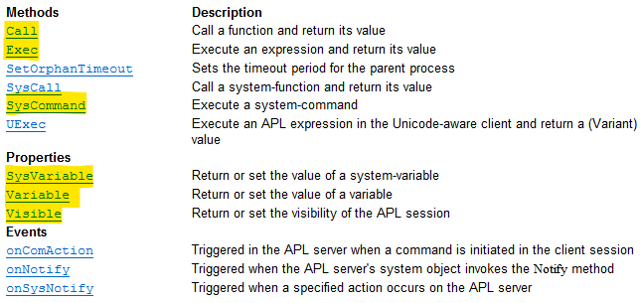
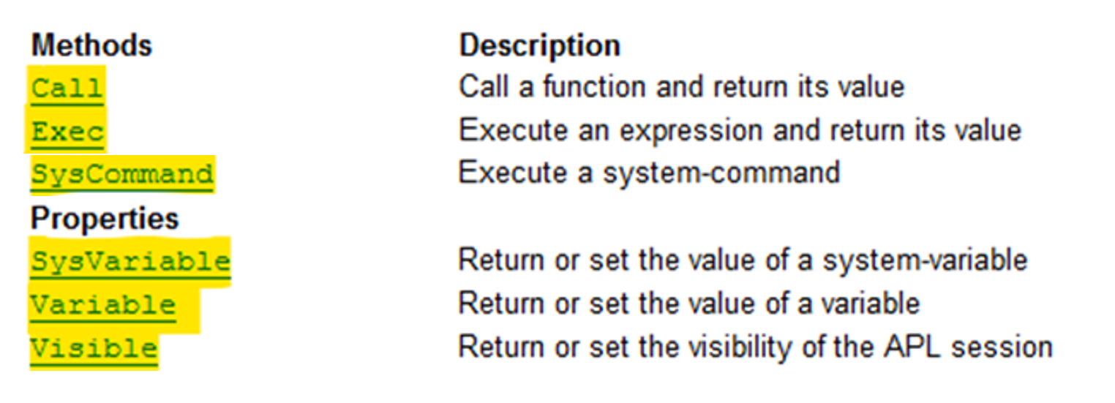
Solution - Template
Overview “APL+Win as an ActiveX server”

Slide 10
dyalog.WSEngine - Essentials
Tiny namespace as an OLEServer
Very few and general methods
To overcome some limitations that apply to an OLEServer
The OLEServer namespace only acts as an intermediate layer for dynamic use of any APL resources.

Slide 11

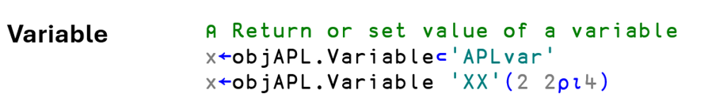
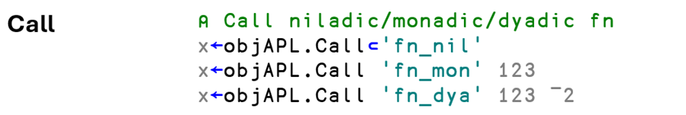
dyalog.WSEngine - Details

Slide 12
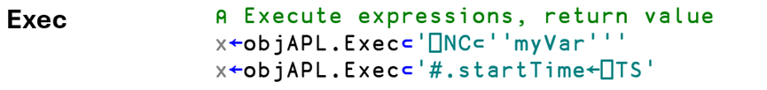
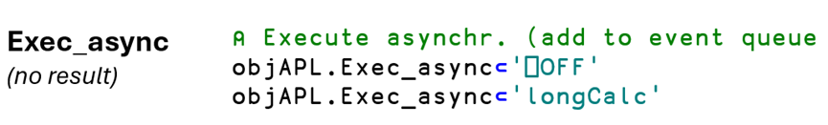


dyalog.WSEngine - Details

Slide 13
Deployment
Registration
  with the OLERegister method invoked in ⎕LX
  called with a special switch /RegWSEngine
  dyalog.exe WSEngine.dws -MAXWS=256M RegWSEngine=1 DYALOG_NOPOPUPS=1
Invocation
  VBA
  Dim objAPL As Object
  Set objAPL = CreateObject(“dyalog.WSEngine”)
  Dyalog
  'objAPL‘ ⎕WC 'OLEClient' 'dyalog.WSEngine'

Slide 14
Examples
From APL
'APL'⎕WC'OLEClient' 'dyalog.WSEngine'
APL.setVisible 1
x←APL.SysCommand⊂'LOAD ',ws
x←APL.Call⊂'init_appl'
x←APL.Call 'do_calc' 123
x←APL.Exec_async⊂'⎕OFF'
⎕EX'APL'
From Excel (VBA)
Set APL = CreateObject("dyalog.WSEngine")
rc = APL.SysCommand(")LOAD " & DWSfile)
rc = APL.SysVariable("PATH", "#.UTILS")
rc = APL.Call("init_appl")
rc = APL.Call("do_calc",123)
APL.Exec_async (apl_quad & "OFF")
Set APL = Nothing

Slide 15
Demo
Excel/VBA
  CreateObject("dyalog.WSEngine")

Slide 16
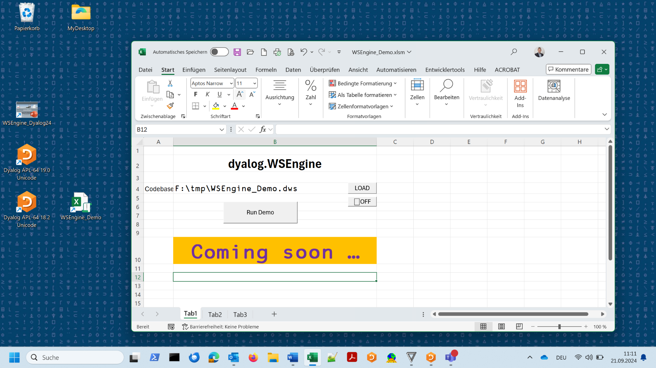
Demo: Excel/VBA ←→ dyalog.WSEngine

Slide 17
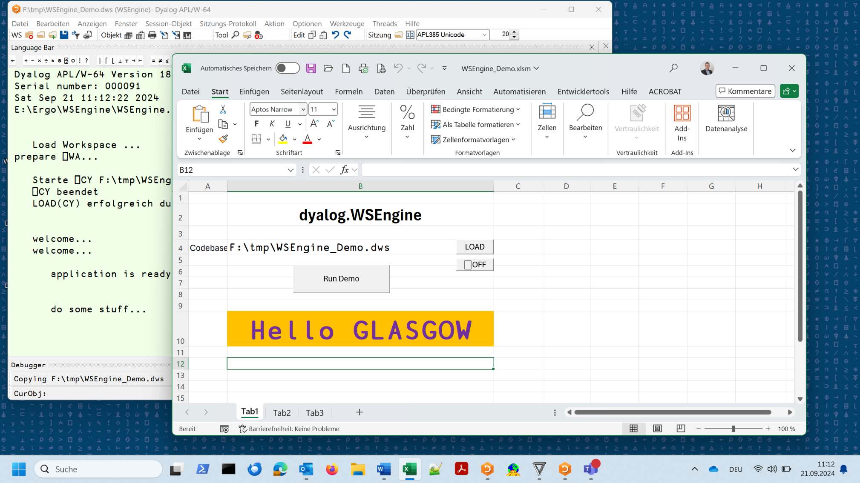
Demo: Excel/VBA ←→ dyalog.WSEngine

Slide 18
Demo
Dyalog v19 using WSEngine v18.2:
  ]demo F:\tmp\WSE

Slide 19
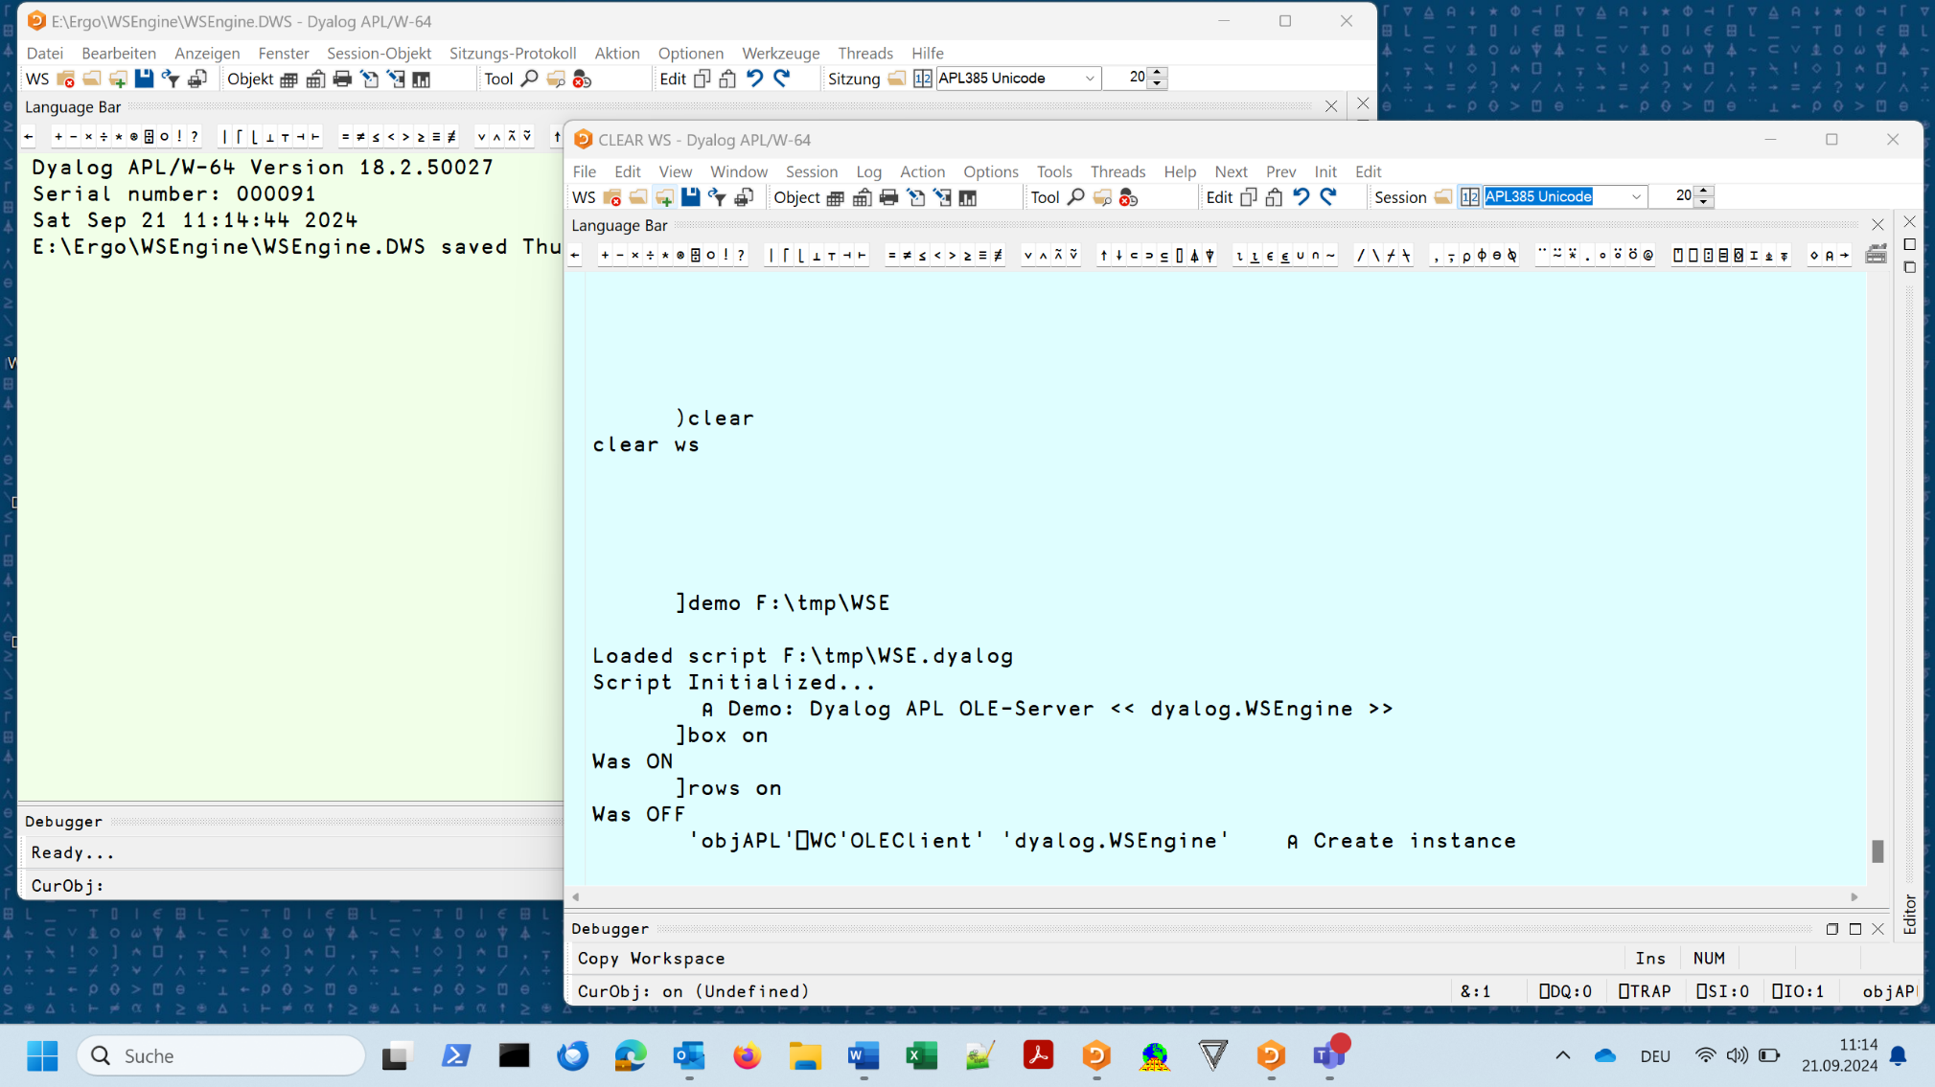
Demo: APL ←→ dyalog.WSEngine

Slide 20
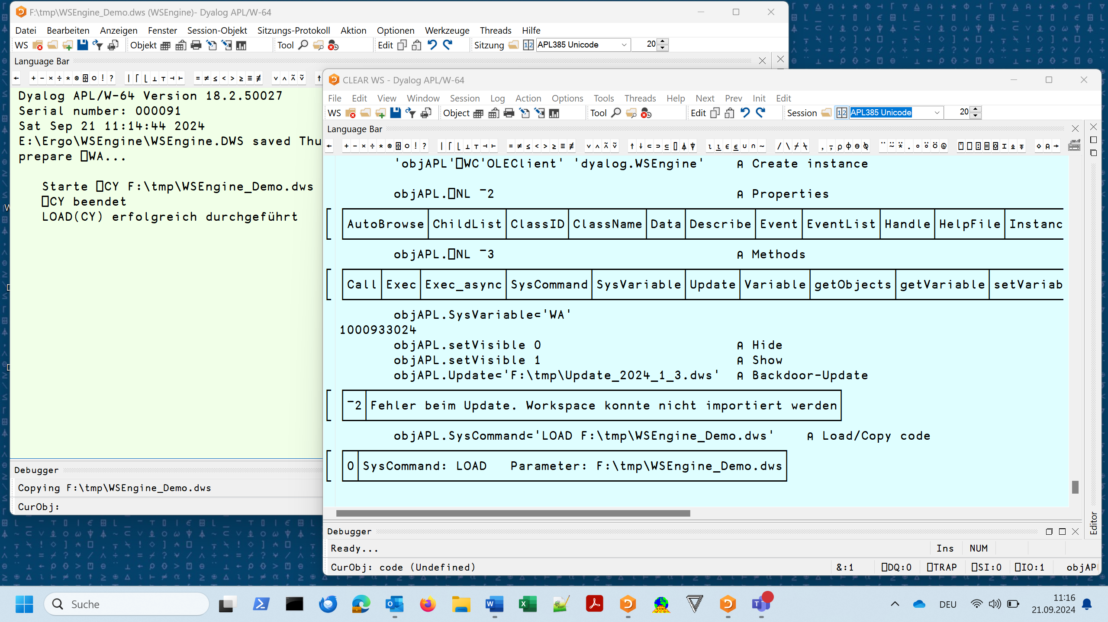
Demo: APL ←→ dyalog.WSEngine

Slide 21
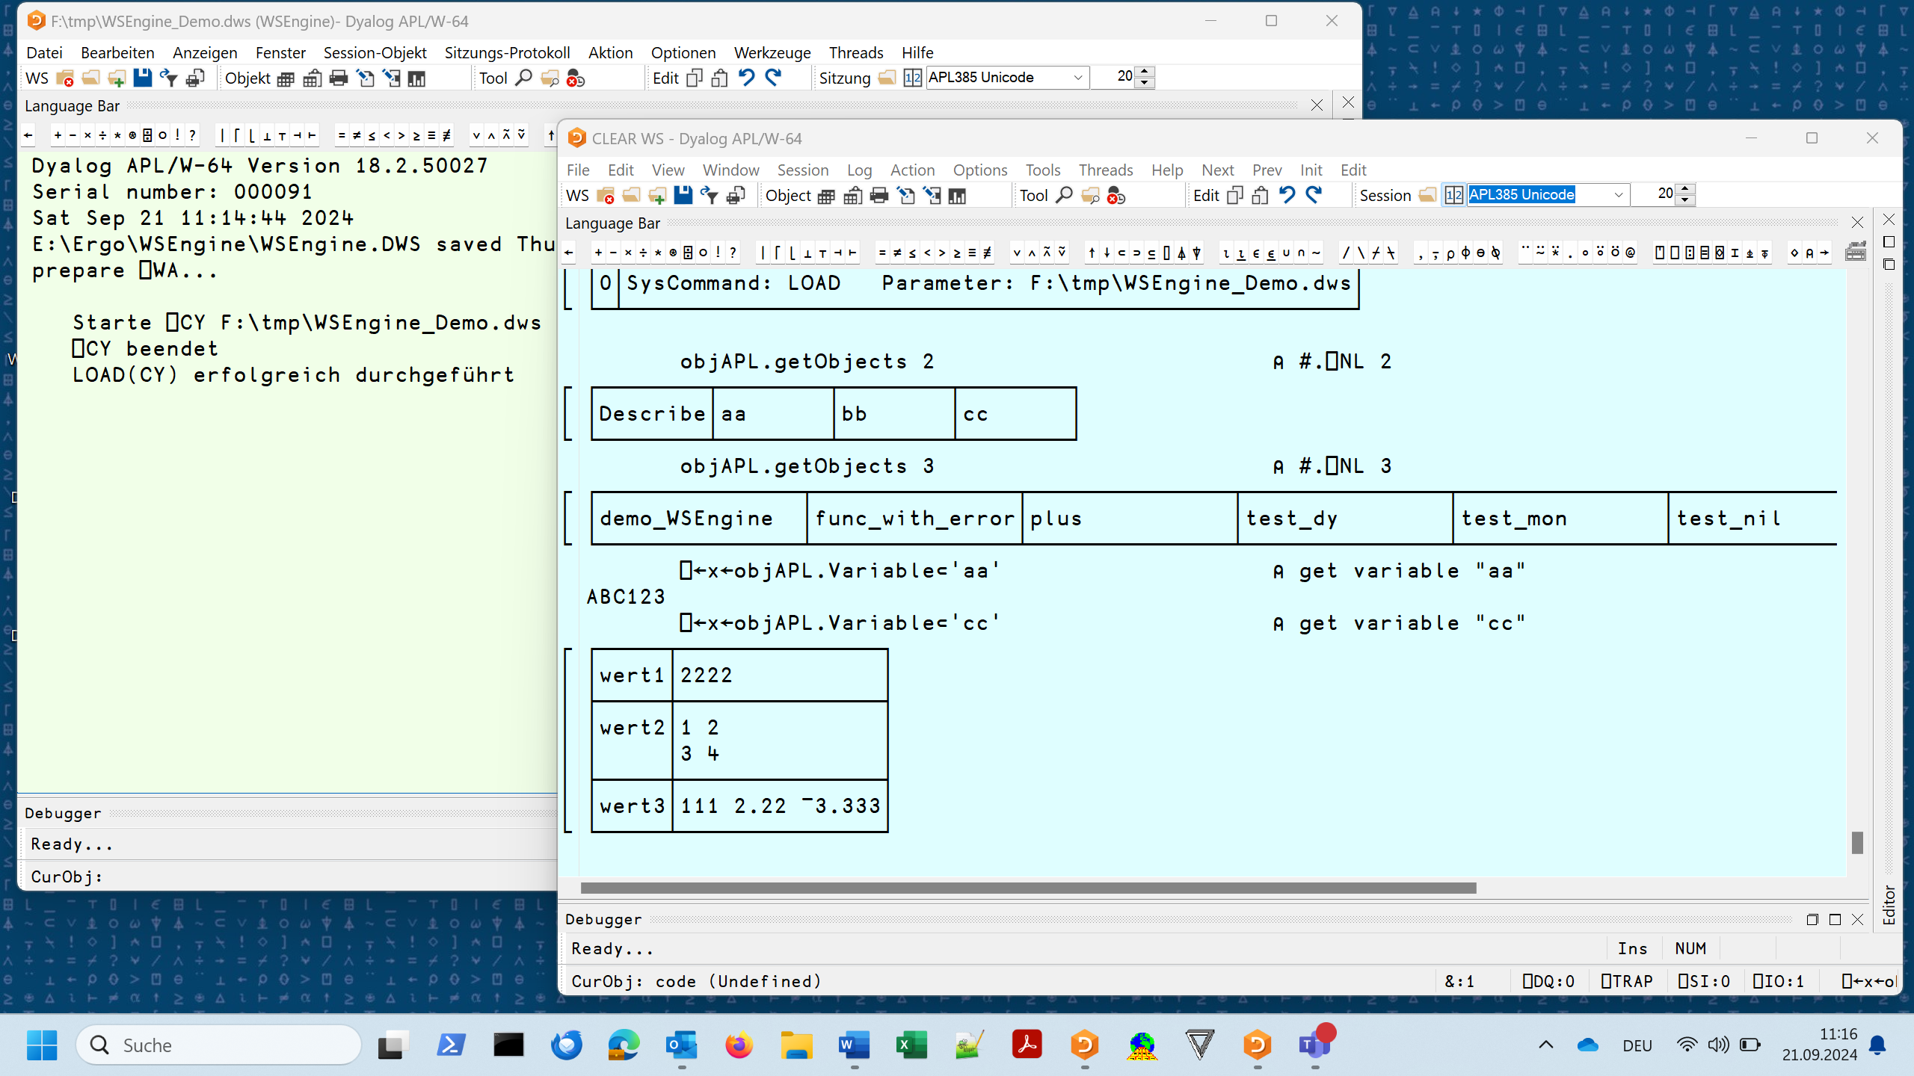
Demo: APL ←→ dyalog.WSEngine

Slide 22
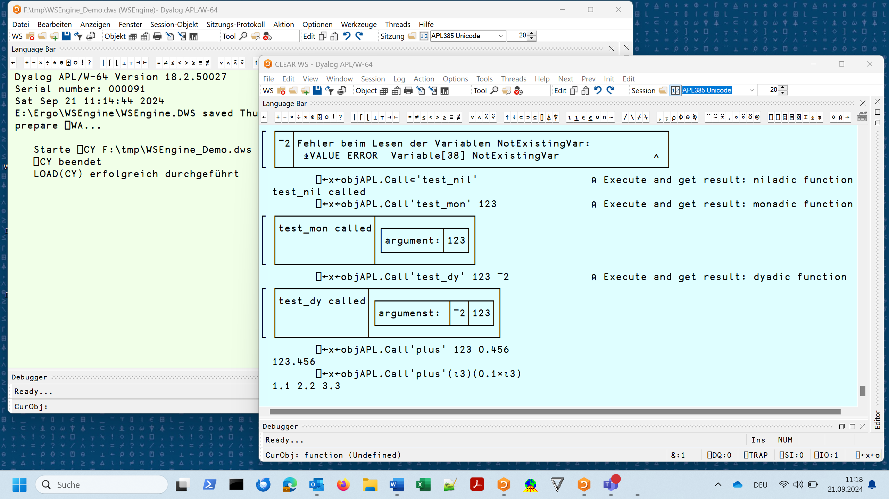
Demo: APL ←→ dyalog.WSEngine

Slide 23
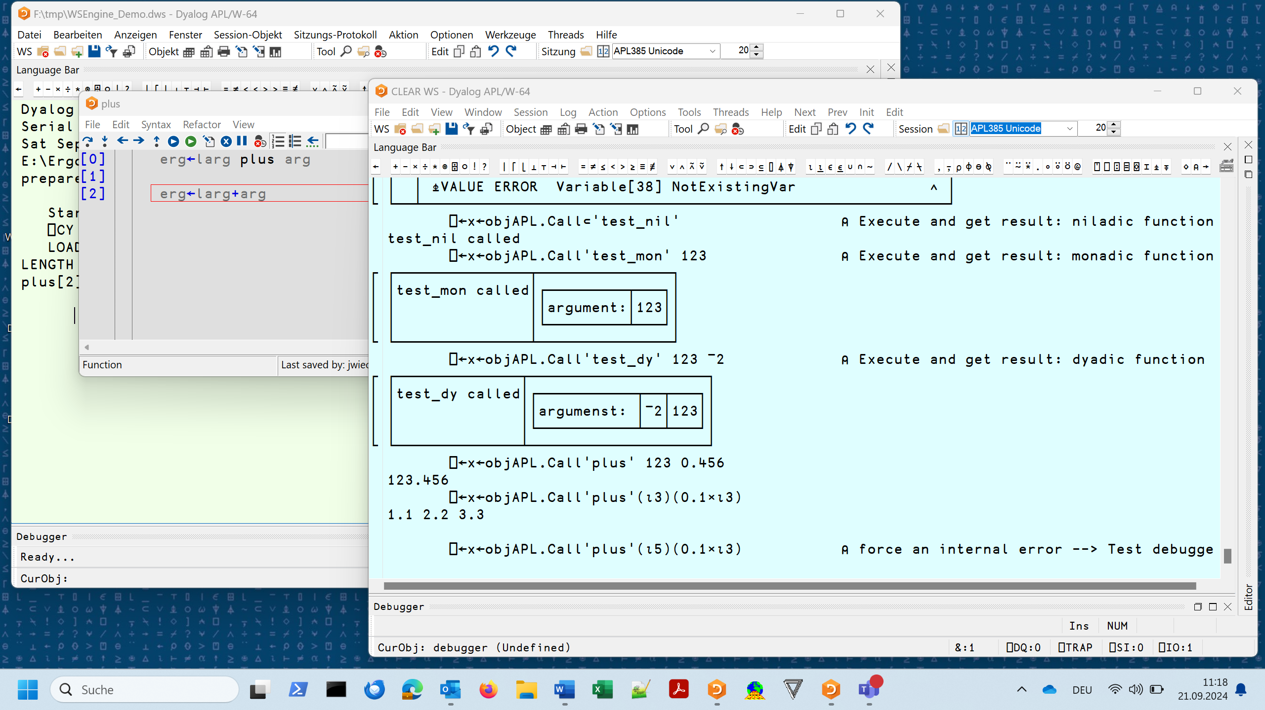
Demo: APL ←→ dyalog.WSEngine

Slide 24
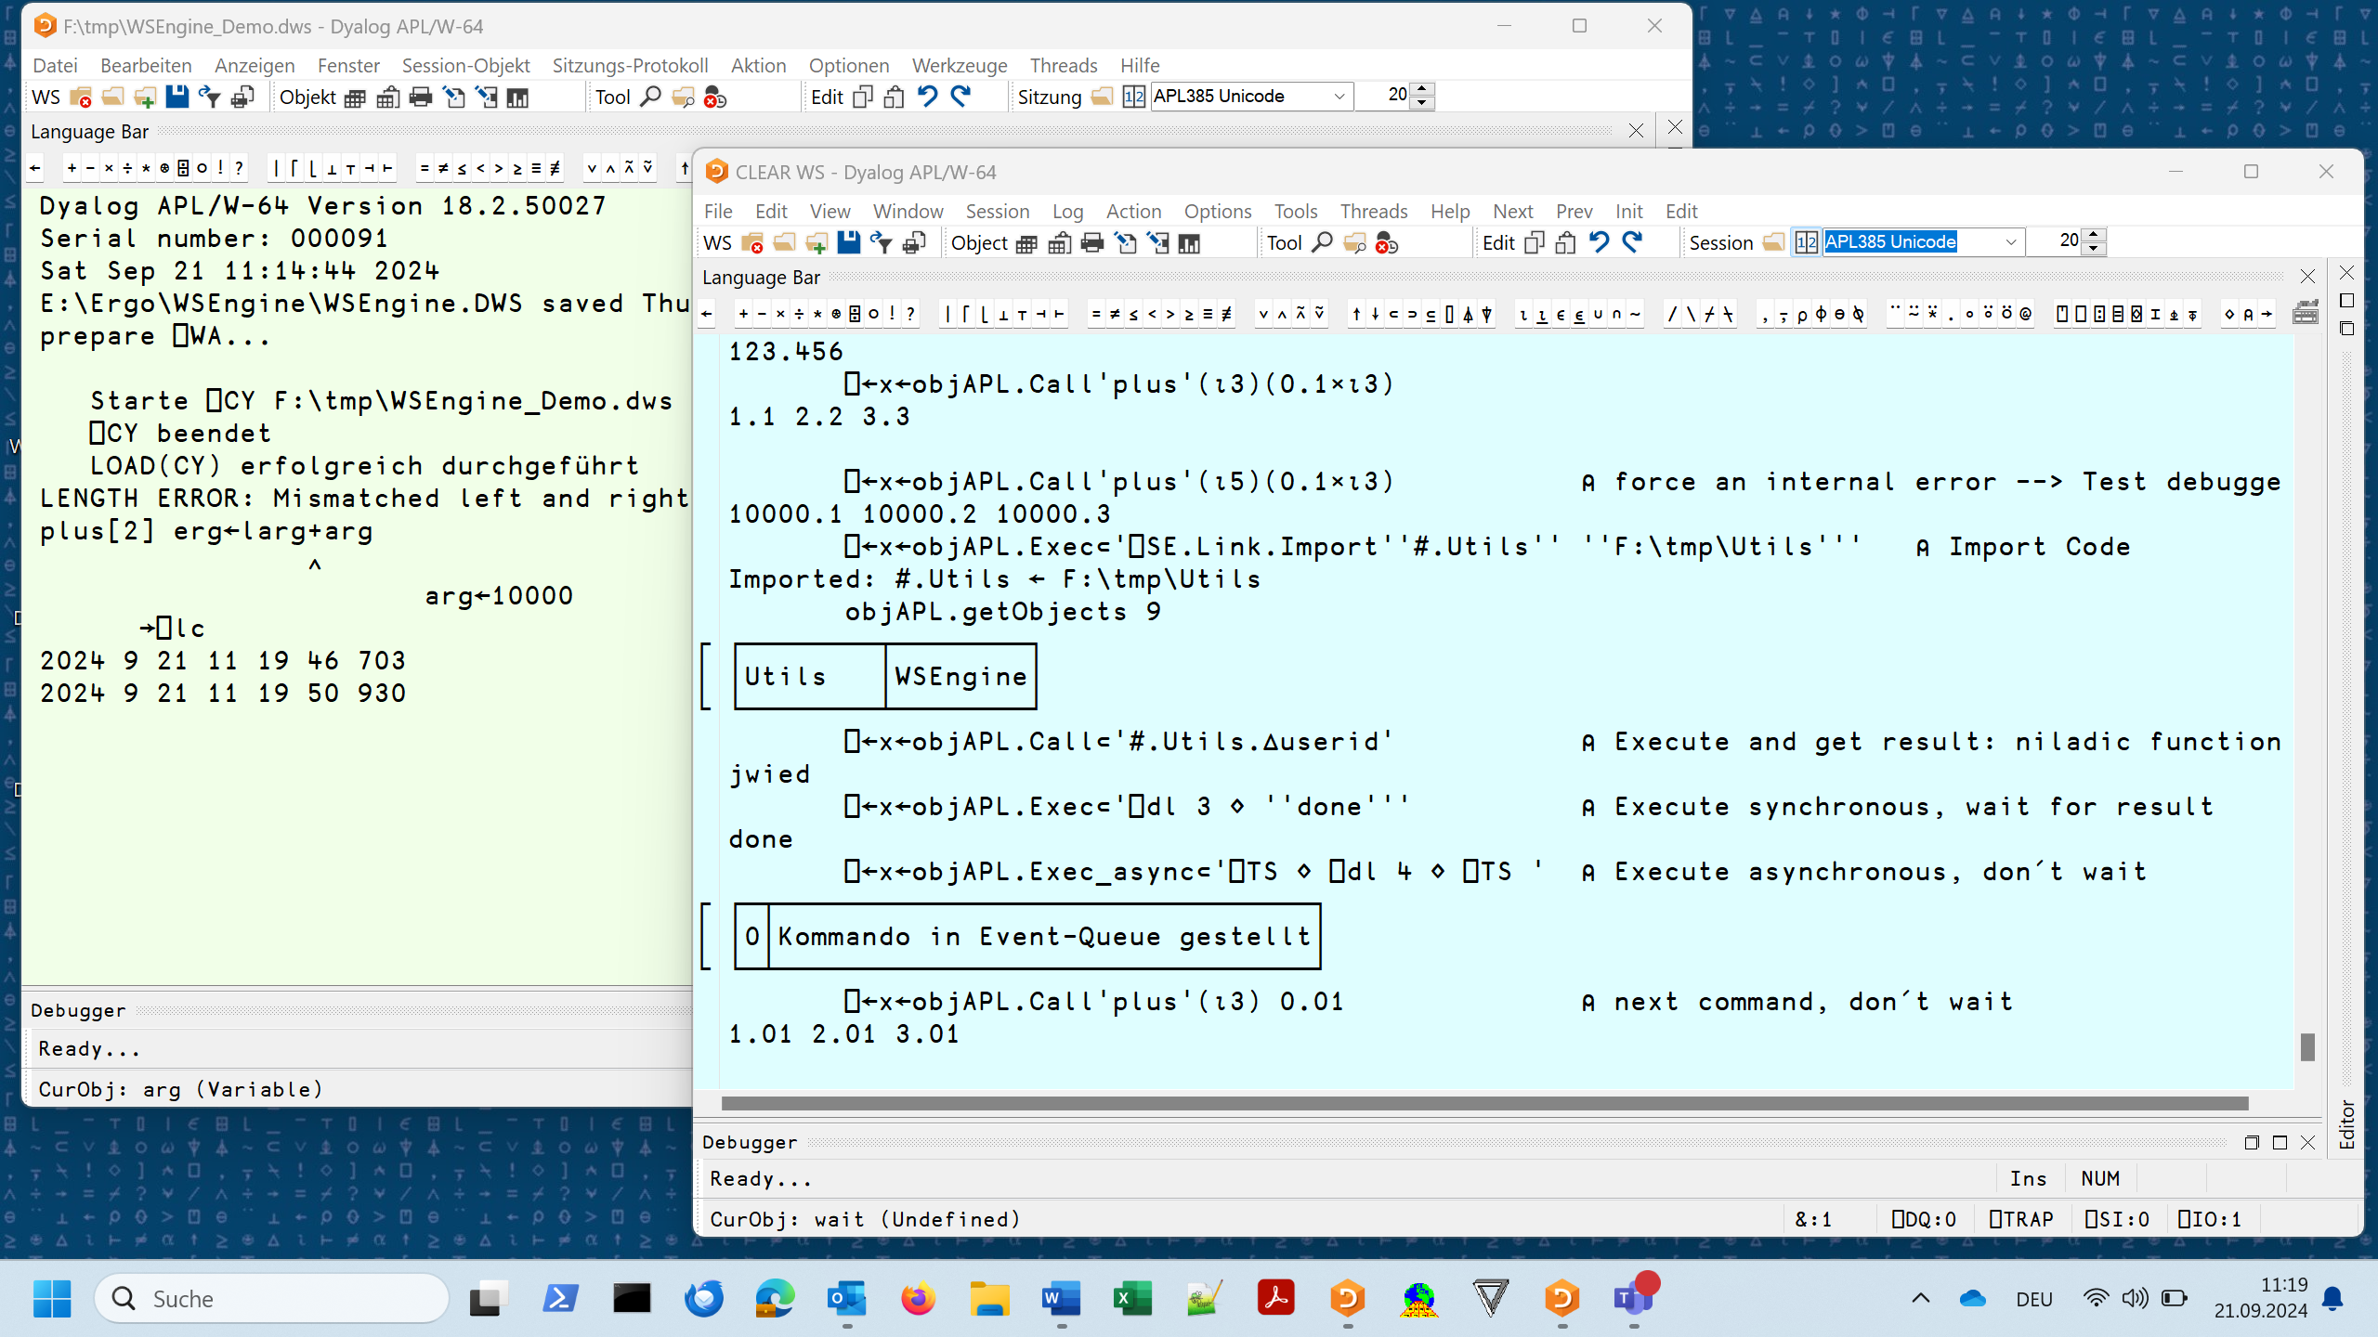
Demo: APL ←→ dyalog.WSEngine

Slide 25
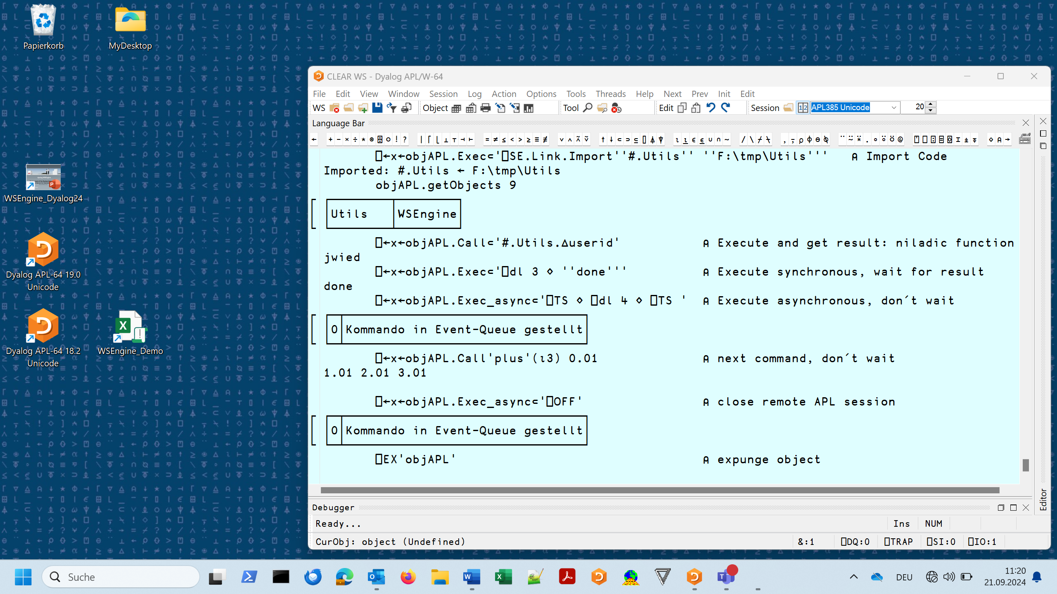
Demo: APL ←→ dyalog.WSEngine

Slide 26
Thank you for listening
Jürgen Wiedemann Dyalog ´24
DPC 17. September 2024

