Slide 1

Building Web-Enabled, Cross-Platform Applications with
MiServer 3.0
Brian Becker, Applications Tools Group Manager
Morten Kromberg, CTO

Slide 2
Agenda
Session 1
Intro and Overview
  Motivation
  Demo
  Install/Config
  Objects

Slide 3
Agenda
Session 2
Building Pages
  Widgets/APIs
  Events
  Data Binding
  Sample Page

Slide 4
Agenda
Session 3
Web Apps and Services
  Web Applications
    Session Data
  RESTful Web Services
    Sample Service
  Questions

Slide 5
To Build Web Applications...
Develop expertise in some combination of
  HTML
  CSS
  JavaScript
  jQuery
  HTTP
Host the web application
  Learn to install, configure and manage IIS or Apache
  or
  Find someone else to host your web application

Slide 6

To Build Web Applications...
Develop expertise in some combination of
  HTML
  CSS
  JavaScript
  jQuery
  HTTP
Host the web application
  Learn to install, configure and manage IIS or Apache
  or
  Find someone else to host your web application

Slide 7
To Build Web Applications...
Download and unzip MiServer
Learn a basic set of APL tools to manipulate web content
Our goal is to make it easy and natural for someone familiar with Dyalog APL to build rich, browser-based user interactions.

Slide 8
MiServer 3.0 – Why?
Because it's easy...
  To provide your users access to your application
    All they need is a browser
    Run from any operating system (that has a browser)
    Run from any platform (that has a browser)
      Desktop, Laptop, Tablet, Phablet, Phone...
    No software or updates to distribute, download, or install
    Customers are always running the latest software
  To build and deploy applications
    "Easy as ⎕WC"
    Run server on any platform where Dyalog and Conga run
      Windows, Linux, AIX, Mac OS!, (watch this space)

Slide 9
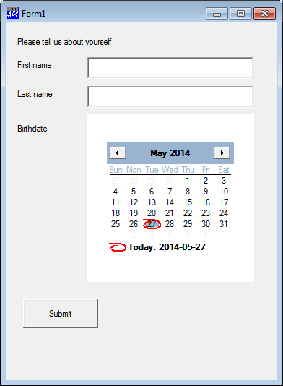
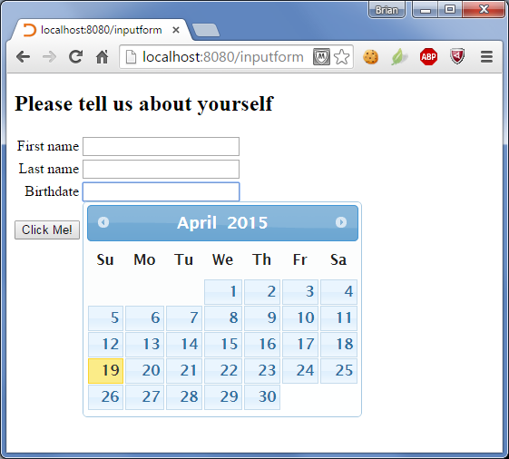

Easy as ⎕WC? Let's see...
Disclaimer:
I love ⎕WC
⎕WC

Slide 10
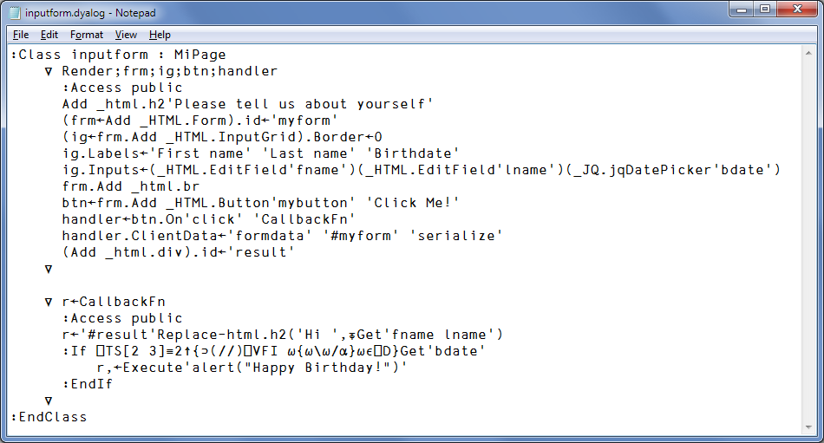
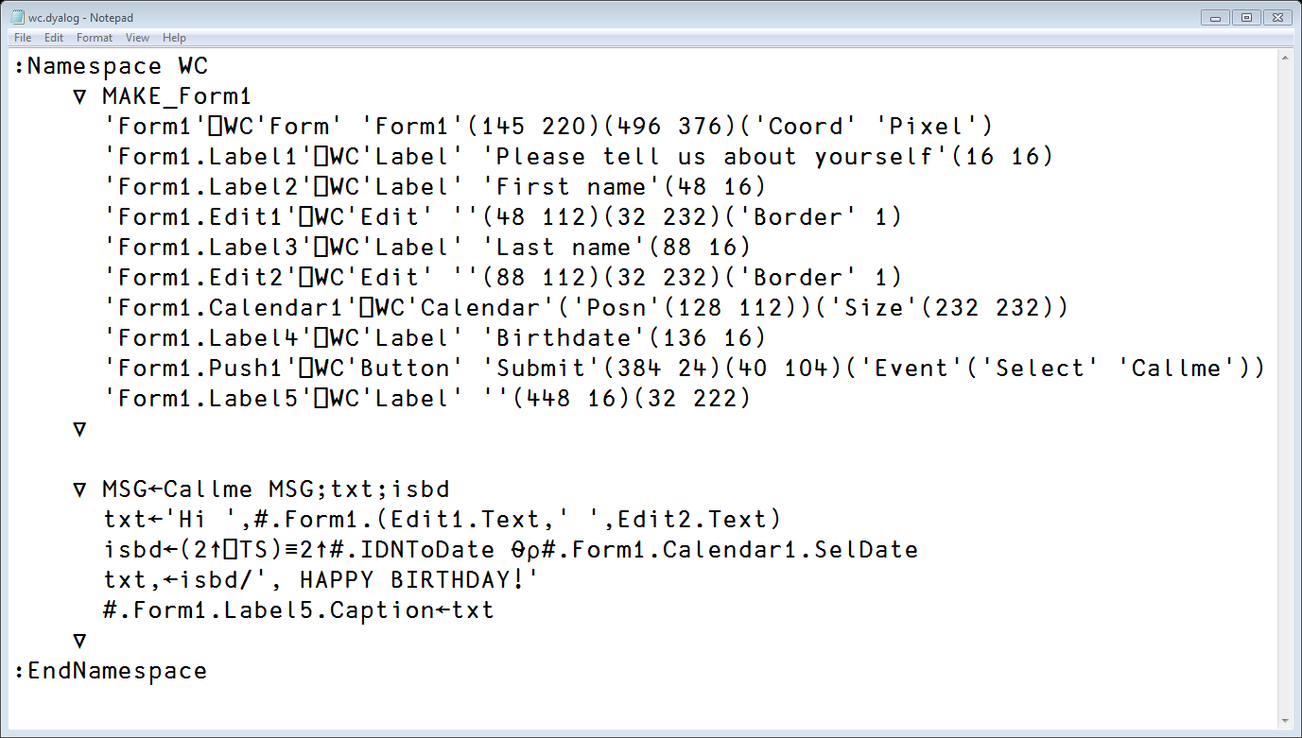
Easy as ⎕WC? Let's see...

Slide 11
Controls...
Notes:
With ⎕WC you need to know about the set of available Win32 GUI controls and objects
With MiServer, you need to know about the set of available HTML5 and Javascript controls and widgets

Slide 12
Callbacks
Notes:
With both ⎕WC and MiServer, you can set up event handlers and callback functions

Slide 13
Layout of Controls
Notes:
With ⎕WC you need specify the size and position of controls
With MiServer, the browser handles layout, but you can exercise more control using CSS if you care to
Mention position support as well

Slide 14
MiServer
Stand-alone APL-based Web Server
Tools to Generate Web Content
Integrates Dyalog and Web Environment

Slide 15
APL-based Web Server
Can serve both web pages and web services
All you need is a TCP/IP port
Any platform where Dyalog APL runs
Client – any platform with a browser
Run locally, intranet, internet
Extensible – open architecture

Slide 16
Tools to Easily Generate Web Content
Web pages consist of a combination of:
  HTML
  JavaScript
    Raw JavaScript
    JavaScript Libraries like jQuery, Syncfusion, et al
    JSON
  CSS

Slide 17
Integrates Dyalog with the Web
Event handling
Data binding (watch this space)
Relational Database Interface (SQAPL)

Slide 18
Hands On – Install MiServer
Either:
  Download from:
    https://github.com/Dyalog/MiServer
  Copy from available flash drives
Unzip the zip
)load miserver
1 Start 'DyNA'
Let's explore...
http://localhost:8080/

Slide 19

A Few Terms...
MiSite a MiServer web site
MiPage a MiServer web page
also the name of the base class for pages
EAWC Easy As WC (⎕WC)
HTTPRequest object representing a request from the client (browser)
Widget a small progam you can embed in your web page
API Application Programming Interface (how you talk to a widget)

Slide 20
Anatomy of a MiPage
]load [ws]\DyNA\inputform
:class inputform : MiPage
∇Render
∇r ← CallbackFn
http://localhost:8080/inputform
Notes:
Hands on
:access public
What is MiPage?
Go through

Slide 21
We've Got a Lot of Class(es)
:class HtmlElement
:field public Tag←''
:field public Content←⍬
:Class DyNApage : #.EAWC
⍝ This is a template that "wraps" the page content by
⍝ - adding a header and footer
⍝ - adding a handler that will toggle the display of the web page and its APL source code
∇ Wrap;lang
:Access Public
...
:Class EAWC : MiPage
:field public shared a←#._html.a
:field public shared abbr←#._html.abbr
:field public shared acronym←#._html.acronym
:field public shared address←#._html.address
:field public shared area←#._html.area
:field public shared article←#._html.article
:field public shared aside←#._html.aside
:field public shared audio←#._html.audio
:field public shared b←#._html.b
:field public shared base←#._html.base
:field public shared bdi←#._html.bdi
:field public shared bdo←#._html.bdo
:field public shared big←#._html.big
:field public shared blockquote←#._html.blockquote
:field public shared body←#._html.body
:field public shared br←#._html.br
:field public shared button←#._html.button
:field public shared canvas←#._html.canvas
:field public shared caption←#._html.caption
:field public shared circle←#._html.circle
:field public shared cite←#._html.cite
:field public shared code←#._html.code
:field public shared col←#._html.col
:field public shared colgroup←#._html.colgroup
:field public shared command←#._html.command
:field public shared datalist←#._html.datalist
:field public shared dd←#._html.dd
:field public shared del←#._html.del
:field public shared details←#._html.details
:field public shared dfn←#._html.dfn
:field public shared div←#._html.div
:field public shared dl←#._html.dl
:field public shared dt←#._html.dt
:field public shared ellipse←#._html.ellipse
:field public shared em←#._html.em
:field public shared embed←#._html.embed
:field public shared fieldset←#._html.fieldset
:field public shared figcaption←#._html.figcaption
:field public shared figure←#._html.figure
:field public shared footer←#._html.footer
:field public shared form←#._html.form
:field public shared g←#._html.g
:field public shared h1←#._html.h1
:field public shared h2←#._html.h2
:field public shared h3←#._html.h3
:field public shared h4←#._html.h4
:field public shared h5←#._html.h5
:field public shared h6←#._html.h6
:field public shared head←#._html.head
:field public shared header←#._html.header
:field public shared hgroup←#._html.hgroup
:field public shared hr←#._html.hr
:field public shared html←#._html.html
:field public shared i←#._html.i
:field public shared iframe←#._html.iframe
:field public shared img←#._html.img
:field public shared input←#._html.input
:field public shared ins←#._html.ins
:field public shared kbd←#._html.kbd
:field public shared keygen←#._html.keygen
:field public shared label←#._html.label
:field public shared legend←#._html.legend
:field public shared li←#._html.li
:field public shared line←#._html.line
:field public shared link←#._html.link
:field public shared map←#._html.map
:field public shared mark←#._html.mark
:field public shared menu←#._html.menu
:field public shared meta←#._html.meta
:field public shared meter←#._html.meter
:field public shared nav←#._html.nav
:field public shared noscript←#._html.noscript
:field public shared object←#._html.object
:field public shared ol←#._html.ol
:field public shared optgroup←#._html.optgroup
:field public shared option←#._html.option
:field public shared output←#._html.output
:field public shared p←#._html.p
:field public shared param←#._html.param
:field public shared path←#._html.path
:field public shared polygon←#._html.polygon
:field public shared polyline←#._html.polyline
:field public shared pre←#._html.pre
:field public shared progress←#._html.progress
:field public shared q←#._html.q
:field public shared rect←#._html.rect
:field public shared rp←#._html.rp
:field public shared rt←#._html.rt
:field public shared ruby←#._html.ruby
:field public shared s←#._html.s
:field public shared samp←#._html.samp
:field public shared script←#._html.script
:field public shared section←#._html.section
:field public shared select←#._html.select
:field public shared small←#._html.small
:field public shared source←#._html.source
:field public shared span←#._html.span
:field public shared strong←#._html.strong
:field public shared style←#._html.style
:field public shared sub←#._html.sub
:field public shared summary←#._html.summary
:field public shared sup←#._html.sup
:field public shared svg←#._html.svg
:field public shared table←#._html.table
:field public shared tbody←#._html.tbody
:field public shared td←#._html.td
:field public shared textarea←#._html.textarea
:field public shared tfoot←#._html.tfoot
:field public shared th←#._html.th
:field public shared thead←#._html.thead
:field public shared time←#._html.time
:field public shared title←#._html.title
:field public shared tr←#._html.tr
:field public shared track←#._html.track
:field public shared tt←#._html.tt
:field public shared u←#._html.u
:field public shared ul←#._html.ul
:field public shared var←#._html.var
:field public shared video←#._html.video
:field public shared wbr←#._html.wbr
:field public shared Button←#._HTML.Button
:field public shared Datalist←#._HTML.Datalist
:field public shared EditField←#._HTML.EditField
:field public shared Form←#._HTML.Form
:field public shared Input←#._HTML.Input
:field public shared InputGrid←#._HTML.InputGrid
:field public shared InputSubmit←#._HTML.InputSubmit
:field public shared Script←#._HTML.Script
:field public shared Select←#._HTML.Select
:field public shared Style←#._HTML.Style
:field public shared StyleSheet←#._HTML.StyleSheet
:field public shared Table←#._HTML.Table
:field public shared _ejWidget←#._SF._ejWidget
:field public shared ejAccordion←#._SF.ejAccordion
:field public shared ejAutocomplete←#._SF.ejAutocomplete
:field public shared ejBarcode←#._SF.ejBarcode
:field public shared ejBulletGraph←#._SF.ejBulletGraph
:field public shared ejButton←#._SF.ejButton
:field public shared ejCaptcha←#._SF.ejCaptcha
:field public shared ejChart←#._SF.ejChart
:field public shared ejCheckBox←#._SF.ejCheckBox
:field public shared ejCircularGauge←#._SF.ejCircularGauge
:field public shared ejCurrencyTextbox←#._SF.ejCurrencyTextbox
:field public shared ejDatePicker←#._SF.ejDatePicker
:field public shared ejDateTimePicker←#._SF.ejDateTimePicker
:field public shared ejDiagram←#._SF.ejDiagram
:field public shared ejDialog←#._SF.ejDialog
:field public shared ejDigitalGauge←#._SF.ejDigitalGauge
:field public shared ejDraggable←#._SF.ejDraggable
:field public shared ejDropDownList←#._SF.ejDropDownList
:field public shared ejDroppable←#._SF.ejDroppable
:field public shared ejGantt←#._SF.ejGantt
:field public shared ejGrid←#._SF.ejGrid
:field public shared ejLinearGauge←#._SF.ejLinearGauge
:field public shared ejListBox←#._SF.ejListBox
:field public shared ejListView←#._SF.ejListView
:field public shared ejMap←#._SF.ejMap
:field public shared ejMaskEdit←#._SF.ejMaskEdit
:field public shared ejMenu←#._SF.ejMenu
:field public shared ejNumericTextbox←#._SF.ejNumericTextbox
:field public shared ejPercentageTextbox←#._SF.ejPercentageTextbox
:field public shared ejProgressBar←#._SF.ejProgressBar
:field public shared ejRTE←#._SF.ejRTE
:field public shared ejRadioButton←#._SF.ejRadioButton
:field public shared ejRangeNavigator←#._SF.ejRangeNavigator
:field public shared ejRating←#._SF.ejRating
:field public shared ejResizable←#._SF.ejResizable
:field public shared ejRotator←#._SF.ejRotator
:field public shared ejSchedule←#._SF.ejSchedule
:field public shared ejScroller←#._SF.ejScroller
:field public shared ejSlider←#._SF.ejSlider
:field public shared ejSplitButton←#._SF.ejSplitButton
:field public shared ejSplitter←#._SF.ejSplitter
:field public shared ejSymbolPalette←#._SF.ejSymbolPalette
:field public shared ejTab←#._SF.ejTab
:field public shared ejTagCloud←#._SF.ejTagCloud
:field public shared ejTextBoxes←#._SF.ejTextBoxes
:field public shared ejTile←#._SF.ejTile
:field public shared ejTimePicker←#._SF.ejTimePicker
:field public shared ejToggleButton←#._SF.ejToggleButton
:field public shared ejToolbar←#._SF.ejToolbar
:field public shared ejTreeMap←#._SF.ejTreeMap
:field public shared ejTreeView←#._SF.ejTreeView
:field public shared ejUploadBox←#._SF.ejUploadBox
:field public shared ejWaitingPopup←#._SF.ejWaitingPopup
:field public shared ejmAccordion←#._SF.ejmAccordion
:field public shared ejmAutocomplete←#._SF.ejmAutocomplete
:field public shared ejmButton←#._SF.ejmButton
:field public shared ejmCheckBox←#._SF.ejmCheckBox
:field public shared ejmDatePicker←#._SF.ejmDatePicker
:field public shared ejmDialog←#._SF.ejmDialog
:field public shared ejmFooter←#._SF.ejmFooter
:field public shared ejmGrid←#._SF.ejmGrid
:field public shared ejmGroupButton←#._SF.ejmGroupButton
:field public shared ejmHeader←#._SF.ejmHeader
:field public shared ejmListbox←#._SF.ejmListbox
:field public shared ejmMenu←#._SF.ejmMenu
:field public shared ejmNumeric←#._SF.ejmNumeric
:field public shared ejmProgess←#._SF.ejmProgess
:field public shared ejmRadioButton←#._SF.ejmRadioButton
:field public shared ejmRating←#._SF.ejmRating
:field public shared ejmRotator←#._SF.ejmRotator
:field public shared ejmScrollPanel←#._SF.ejmScrollPanel
:field public shared ejmSlider←#._SF.ejmSlider
:field public shared ejmSplitPane←#._SF.ejmSplitPane
:field public shared ejmTab←#._SF.ejmTab
:field public shared ejmTextBox←#._SF.ejmTextBox
:field public shared ejmTile←#._SF.ejmTile
:field public shared ejmTimePicker←#._SF.ejmTimePicker
:field public shared ejmToggleButton←#._SF.ejmToggleButton
:field public shared ejmToolbar←#._SF.ejmToolbar
:field public shared DataTable←#._JQ.DataTable
:field public shared Handler←#._JQ.Handler
:field public shared Position←#._JQ.Position
:field public shared _jqObject←#._JQ._jqObject
:field public shared _jqUITabbedWidget←#._JQ._jqUITabbedWidget
:field public shared _jqUIWidget←#._JQ._jqUIWidget
:field public shared _jqWidget←#._JQ._jqWidget
:field public shared jqAccordion←#._JQ.jqAccordion
:field public shared jqAutocomplete←#._JQ.jqAutocomplete
:field public shared jqButton←#._JQ.jqButton
:field public shared jqButtonset←#._JQ.jqButtonset
:field public shared jqDatePicker←#._JQ.jqDatePicker
:field public shared jqDialog←#._JQ.jqDialog
:field public shared jqDraggable←#._JQ.jqDraggable
:field public shared jqDroppable←#._JQ.jqDroppable
:field public shared jqMenu←#._JQ.jqMenu
:field public shared jqProgressbar←#._JQ.jqProgressbar
:field public shared jqResizable←#._JQ.jqResizable
:field public shared jqSelectable←#._JQ.jqSelectable
:field public shared jqSlider←#._JQ.jqSlider
:field public shared jqSortable←#._JQ.jqSortable
:field public shared jqSpinner←#._JQ.jqSpinner
:field public shared jqTabs←#._JQ.jqTabs
:field public shared jqTooltip←#._JQ.jqTooltip
:field public shared Gyro←#._DC.Gyro
:field public shared StackPanel←#._DC.StackPanel
:field public shared Timer←#._DC.Timer
:EndClass
]load [ws]\dyna\index
DyNApage page template for this conference
adds "look and feel"
EAWC Easy As WC template
adds shortcuts for direct access to widgets
MiPage base class for all MiPages
adds MiServer "cognizance", events, etc.
HtmlPage base class for all HTML pages
adds page "wrapper"
HtmlElement core class for all HTML elements
Pay No Attention to the Classes Behind the Curtain
:class HtmlPage : #.HtmlElement
:field public Head
:field public Body
:field public Scripts
:field public Styles
:Class MiPage : #.HtmlPage
:Field Public _PageName←'' ⍝ Page file name
:Field Public _PageDate←'' ⍝ Page saved date
:field Public _Request ⍝ HTTPRequest
:field public _Serialized←1 ⍝ serialized forms to return in _PageData
:field Public _event ⍝ set be APLJAX callback - event that was triggered
:field Public _what ⍝ set be APLJAX callback - id of the triggering element
:field public _PageData
:field public OnLoad←'' ⍝ page equivalent to ⎕LX
:field public _html ⍝ base HTML elements
:field public _HTML ⍝ "Enhanced" HTML elements
:field public _JQ ⍝ JQuery/JQueryUI
:field public _SF ⍝ SyncFusion
:field public _JQM ⍝ JQueryMobile
:field public _JSS ⍝ JavaScript Snippets
:field public _DC ⍝ Dyalog Controls
Notes:
Talk about templates
Hands on drill down
That's all you really need to know about

Slide 22
HTTPRequest
Break inputform.dyalog
http://localhost:8080/inputform
Examine _Request

Slide 23
Data Binding
The challenge is synchronizing (at least) two copies of the data, one in the browser and one on the server.
Yesterday :public fields
Today _PageData and ∇Get
Tomorrow Server Sent Events/AJAX
WebSockets

Slide 24
Working with Content
To add things to a page or object, use the Add method.
For raw HTML elements
Add element {content} {attributes}
Add h2 'Hello World' 'class=blue'
For all widgets
Add widget {selector}
Add ejDatePicker 'myPicker'

Slide 25
Working with Content
Add returns a reference to the added object
d←Add div 'This is a div element'
d.Add p 'This is an added p element'
Seven common HTML attributes are directly available – id, name, class, value, title, type, style
Example: 4 ways to set the class for an h2 element
Add h2 'Hello' 'class=blue'
(Add h2 'Hello').class←'blue'
(Add h2 'Hello').Set 'class' 'blue'
(Add h2 'Hello').Attr[⊂'class']←⊂'blue'
Experiment in immediate execution:
h←⎕NEW _html.h2
h.Render

Slide 26
Event Handling
There are 2 basic ways to specify event handling
Use the element's On method
myDiv.On 'click' 'myCallback'
Add a Handler to the page
Add Handler '#mydiv' 'click' 'myCallback'

Slide 27
Event Handling
Sending a response back to the client
There are 4 basic responses that can be sent back by a callback function

Slide 28
Wonderful World of Widgets
MiServer 3 has over 100 widgets between Syncfusion, jQueryUI, third party, and Dyalog-built
  Charts, Grids, Input Elements, Content Formatters...
Where it makes sense, we are in the process of implementing APL "friendly" APIs for widgets.
Mobile widget libraries will follow this summer.

Slide 29
Exercise – Book a Stay
Build a page with
2 Datepickers
  one for check-in
  one for check-out
A drop down selection of room types and costs
A button which will execute a callback to calculate the number of nights and total cost
The callback function should display something like: "King-size room for 4 nights @ $150 = $600" on the page

Slide 30
Web Services
What is a web service?
  SAWS – SOAP-based
  MiServer – "RESTful"
  http://localhost:8080/pv?FV=10000&r=.08&n=10

Slide 31
Exercise - Mortgage Web Service
Copy the mortgage web page and convert it to be a web service
Use the PV web service as a guideline

Slide 32

QUESTIONS?

