Slide 1
APL and Web Services
Brian Becker
APL Tools Architect
Dyalog, LTD

Slide 2
Web Services
What
Consuming using HttpCommand
Providing using Jarvis
Ask questions!

Slide 3
What is a Web Service?
Let's ask a web service what a web service is…

Slide 4
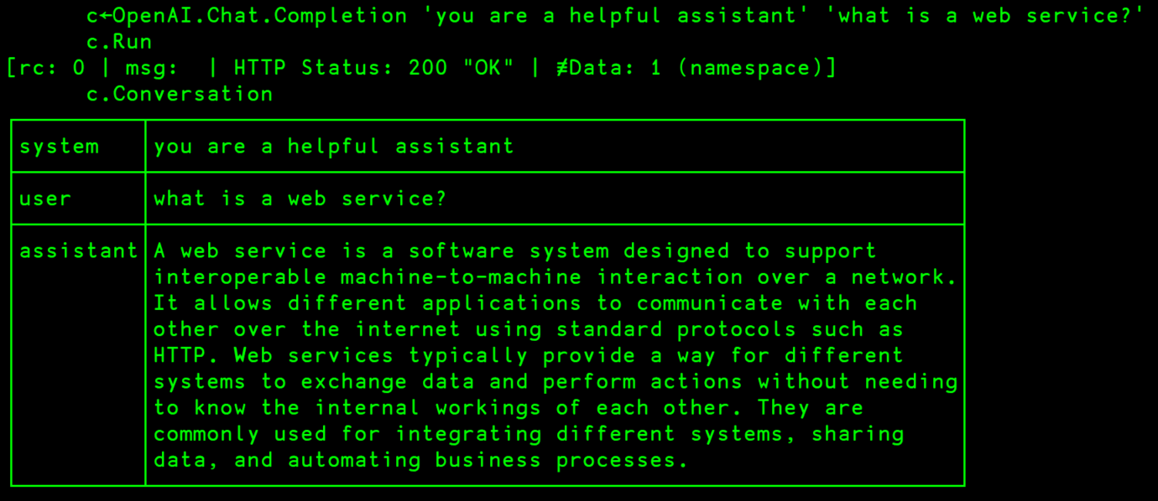
What is a Web Service?

Slide 5
What is a Web Service?

Slide 6
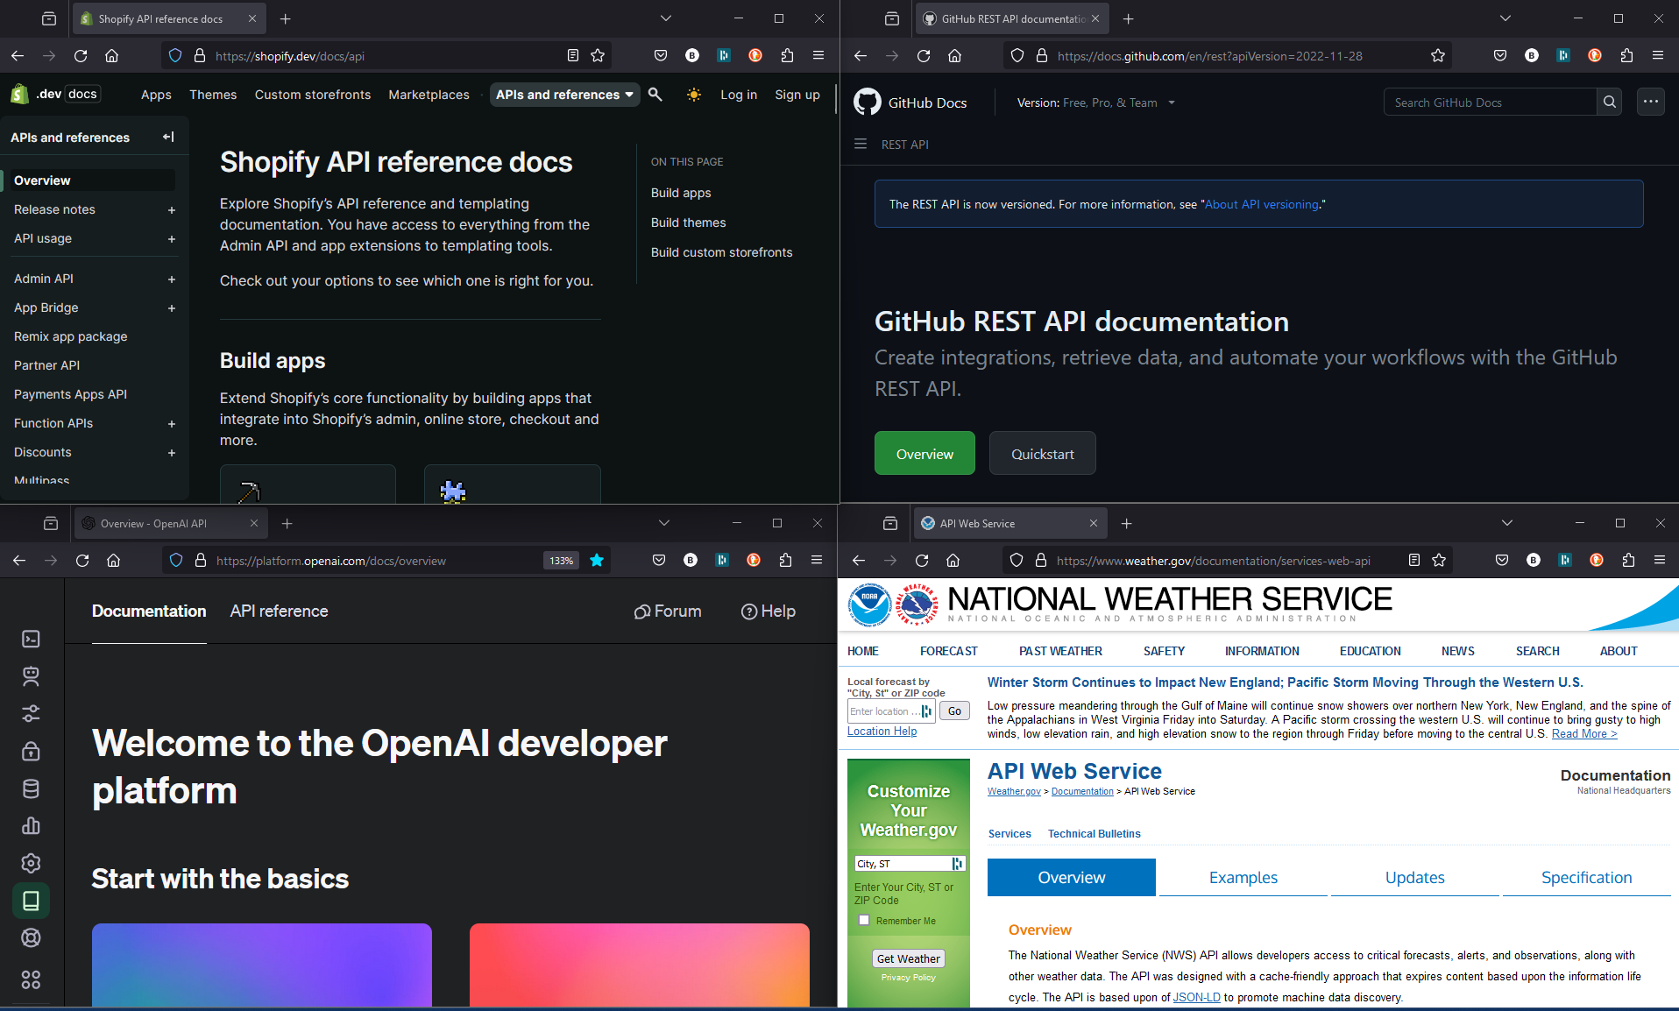
Web Services
Machine to machine
Use a standard protocol (HTTP, HTTPS)
Expose an Application Programming Interface (API)
  Server doesn't necessarily know what the client is
    Web page/JavaScript, Phone App, C#, .NET, APL
  Client doesn't know the server's internal workings

Slide 7
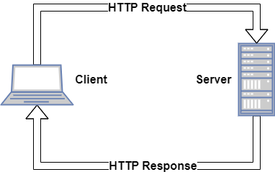
HTTP Communications 101
HTTP is a request-response protocol
A client sends a request to a server
The server receives the request
The server runs an application to process the request
The server sends a response back to the client
The client receives the response
Client Examples:
A web browser, HttpCommand, cURL, JavaScript, Python
Server Examples:
IIS, Apache, Nginx, Jarvis, DUI/MiServer
Notes:
HTTPS requires a bit of up-front handshaking
With HTTP, all requests originate from the client

Slide 8
Web Service API Usage Patterns
  Find the documentation
  Determine if you need authentication credentials
    Register and obtain an API key
    Many web services provide a free, rate-limited, level of access
  Construct and send your request
  Process the service's response

Slide 9
HttpCommand
HttpCommand is a utility that is well-suited to enable the APLer to interact with web services because it:
Allows you to specify an HTTP request in a manner that is conducive to an APLer
Sends a properly formatted HTTP request to the server
Receives the server's response
Decomposes the response in a manner that is conducive to an APLer
Minimizes the need for you to learn a lot about HTTP

Slide 10
Typical HttpCommand Usage
  Create a new HttpCommand
  Specify:
    HTTP Method (GET, PUT, POST, etc)
    URL (https://api.github.com/repos)
    Any additional necessary headers (Content-Type, Authorization, etc)
    Any payload
  Send the request
  Examine and process the response

Slide 11
Example
h ← HttpCommand.New ''
h.URL ← 'dyalog.com'
h.Command ← 'get'
⊢ r ← h.Run
[rc: 0 | msg: | HTTP Status: 200 "OK" | ≢Data: 24139]

Slide 12
Shortened Example
h ← HttpCommand.New 'get' 'dyalog.com'
⊢ r ← h.Run
[rc: 0 | msg: | HTTP Status: 200 "OK" | ≢Data: 24139]

Slide 13
Demo Time…
Grabbing a web page
Using a REST web service (GitHub)
Using a non-REST web service (OpenAI)

Slide 14
J
SON
A
ND
R
EST
SER
VICE

Slide 15
J
A
R
VICE

Slide 16
J
A
R
VIS

Slide 17
Jarvis
Much like HttpCommand, Jarvis is designed with the APLer in mind:
Client requests are POST requests with JSON payloads
Web Service Endpoints are APL functions
They take an APL array as a right argument
They return an APL array as their result
Jarvis handles all the rest

Slide 18
More Demos
Web service in 5 Minutes
Limit endpoints
Authentication
Sessioning/State maintenance

Slide 19
Think about it…
Anything that can "speak" HTTP can talk to your web service
  Web page
  Phone app
  Another process
  Even HttpCommand ☺

Slide 20
Security
If you are sending sensitive content - use HTTPS
Jarvis supports HTTP Basic authentication out of the box
You can implement whatever authentication makes sense
Sessions are independent and cannot see one another, unless you do so in your application code.

Slide 21
Performance
Jarvis itself has very little overhead
Performance may be impacted by
  Number of requests
  Size of requests
  Application code
  How much "state" is maintained on the server and for how long

Slide 22
Scalability
At Dyalog'22, Morten and Brian ran a half-day workshop. We:
took an application
made it a Jarvis web service
ran it in a Docker container
moved it to the cloud (AWS)
scaled it
load-balanced it
ran it securely using HTTPS

Slide 23
The Plan Visualized… (from Dyalog'22)

Slide 24
The Plan Visualized…
In the beginning, there was an Application…
Database
App

Slide 25
Run the app as a service
Database
Jarvis
App

Slide 26
Run it in a container
Database
Docker Container
Jarvis
App

Slide 27
Split into Front and Back Ends
We'll call this "Two-Tier"
Database
Front End
Docker Container
Jarvis
Read Operations
App
Write Operations
Docker Container
Jarvis
App
Back End

Slide 28
Try it in the cloud
"The Cloud" (AWS)
Database
Docker Container
Jarvis
Read Operations
App
Write Operations
Docker Container
Jarvis
App

Slide 29
Scale it up
"The Cloud" (AWS)
Database
Docker Container
Jarvis
Read Operations
App
Docker Container
Write Operations
Jarvis
App
Docker Container
Jarvis
Docker Container
App
Jarvis
App

Slide 30
Load balance it
"The Cloud" (AWS)
Database
Docker Container
Jarvis
Read Operations
Load Balancer
App
Docker Container
Write Operations
Jarvis
App
Docker Container
Jarvis
Docker Container
App
Jarvis
App

Slide 31

Secure it
"The Cloud" (AWS)
Database
Docker Container
Jarvis
Read Operations
Load Balancer
App
Docker Container
Write Operations
Jarvis
App
Docker Container
Jarvis
Docker Container
App
Jarvis
App

Slide 32
Jarvis and REST
Jarvis can serve REST web services
  Instead of "functional" endpoints, you write a function for each HTTP method your service will support
  Each function will parse the requested resource and take appropriate action
To me as an APLer, the JSON paradigm seems more natural
If you have an interest in the REST paradigm, ask me

Slide 33
In the Jarvis Pipeline
Finish the documentation!
Add more logging and management capability
JAWS – Jarvis And Web Sockets

Slide 34
Questions?
?
?
?

