Slide 1
Leveraging Community Packages
Josh David

Slide 2
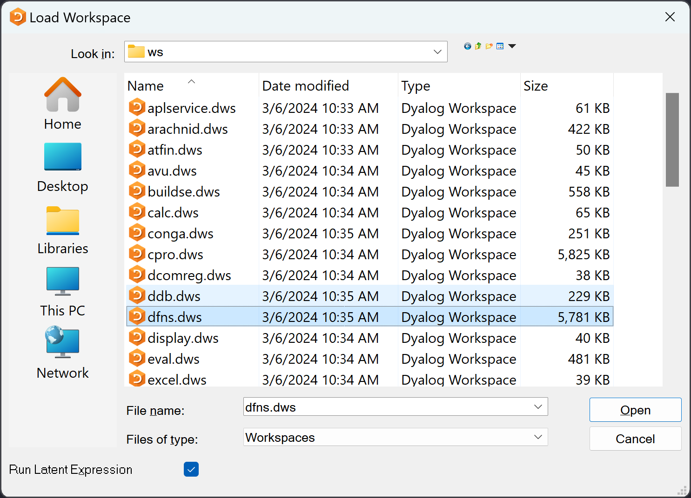
The Workspace
)LOAD
)XLOAD
)SAVE/⎕SAVE
)WSID/⎕WSID
⎕LOCK

Slide 3
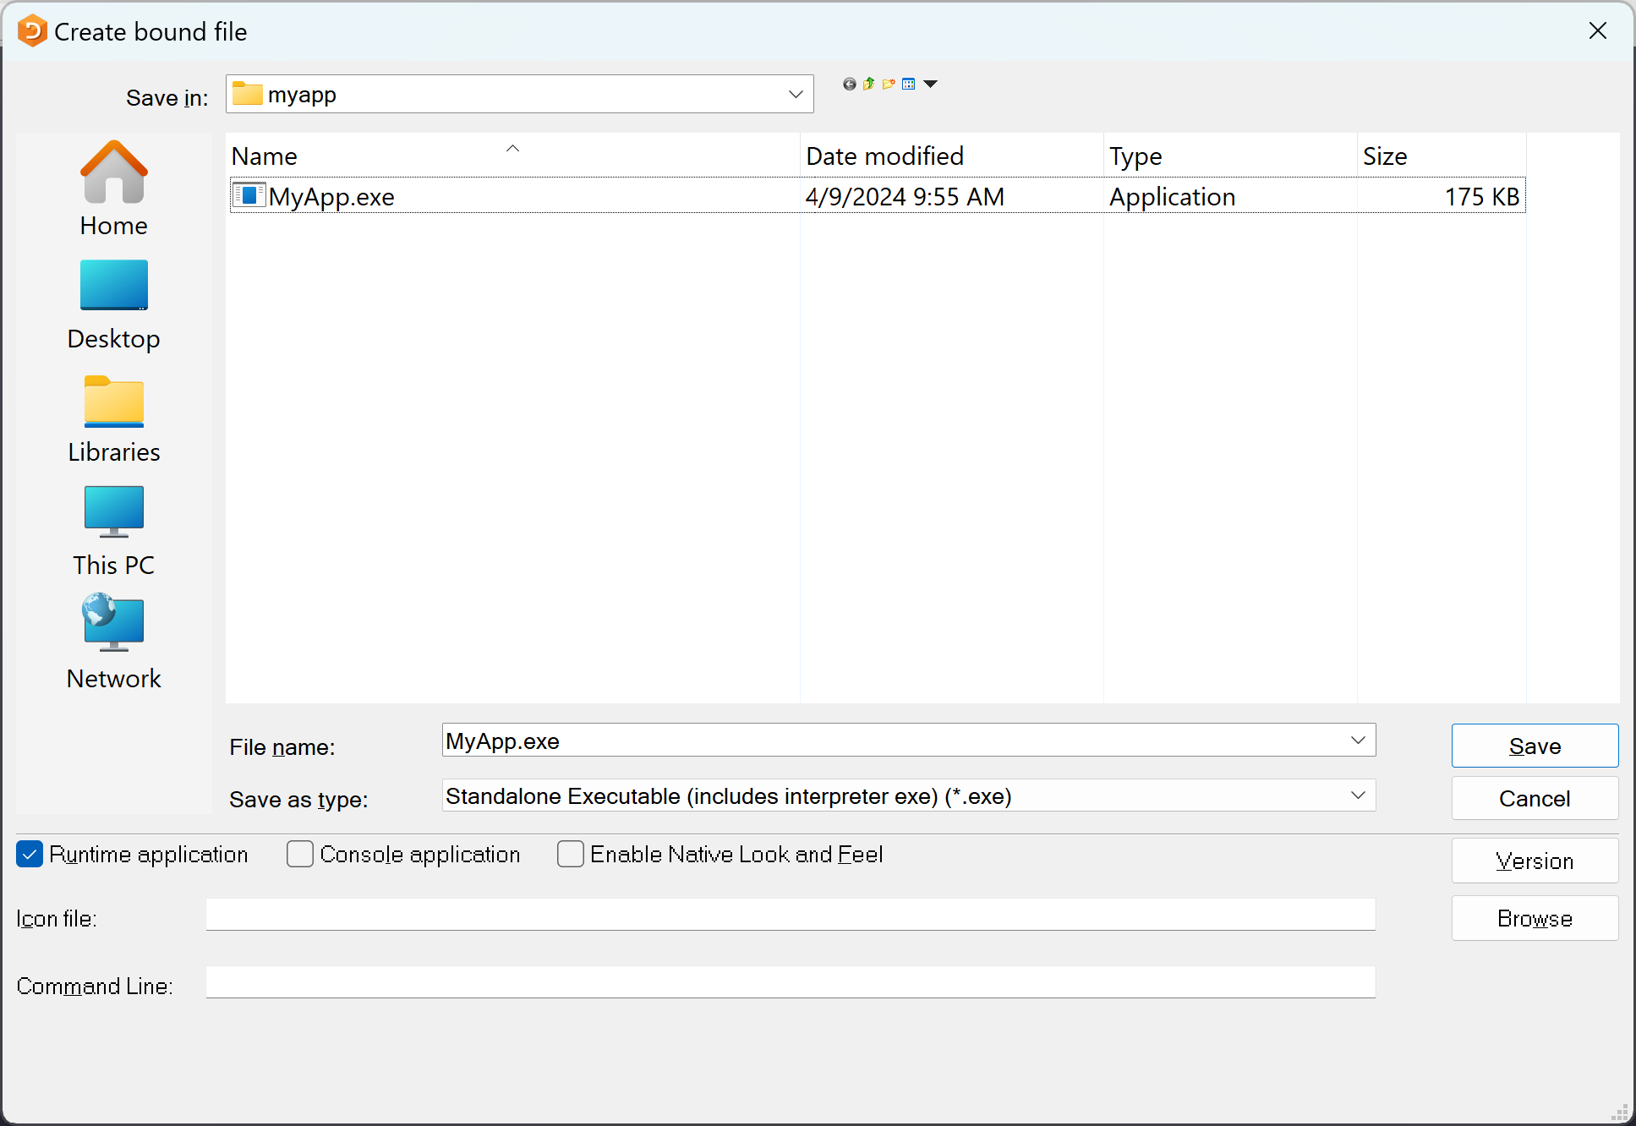
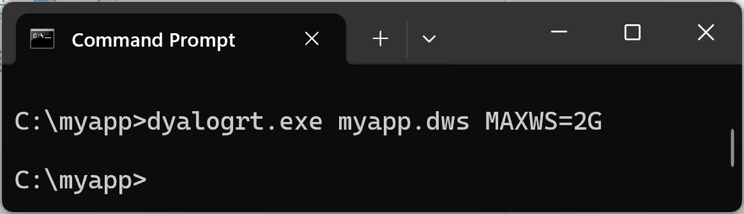
Distribution Mechanism
⎕LX
⎕LOCK

Slide 4
Prefix explanations
)
  System command
⎕
  System function
]
  User command
)WSID
⎕WSID
]runtime

Slide 5
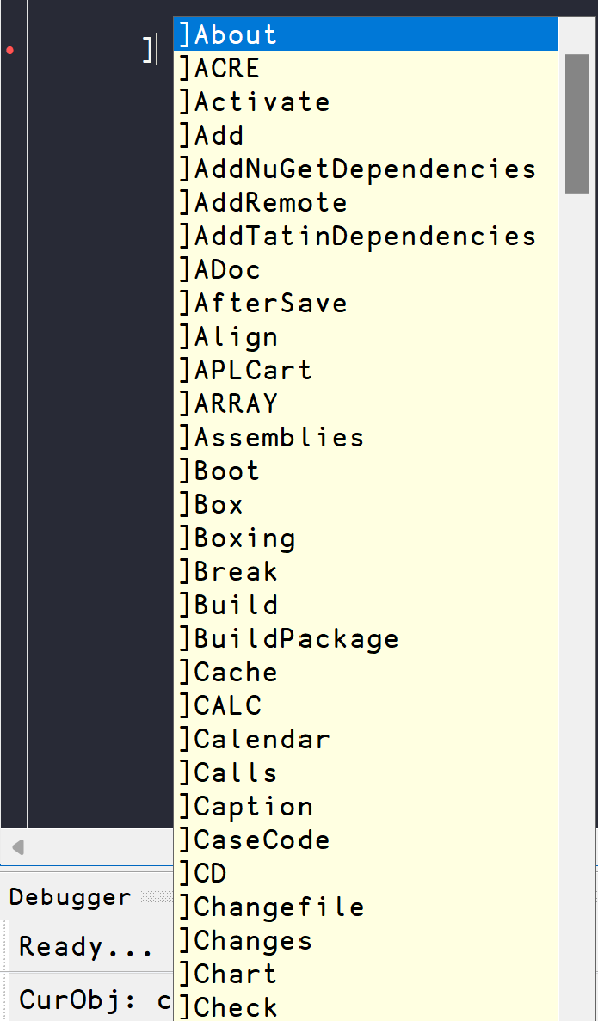
User Commands
“Add-ons” for your APL environment

Slide 6
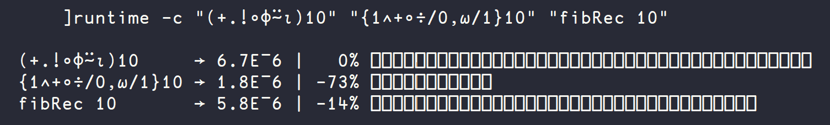
UCMD for runtime comparison
fibRec←{ ⍝ Tail-recursive Fibonacci.
⍺←0 1
⍵=0:⍬⍴⍺
(1↓⍺,+/⍺)∇ ⍵-1
}
The following function illustrates the relationship between the Fibonacci sequence and rational approximations to the "golden mean" (Phi).
fib←{1∧+∘÷/0,⍵/1}
│ │ └───── continued fraction: 0 1 1 1 ...
│ └───────── approximation to Phi-1: 0 1 0.5 0.666 ...
└─────────── numerator of rational: 0 1 1 2 3 5 8 13 21 34 ...
fib ← (+.!∘⌽⍨⍳) ⍝ Sum of binomial coefficients (Jay Foad)
dfns.dyalog.com

Slide 7
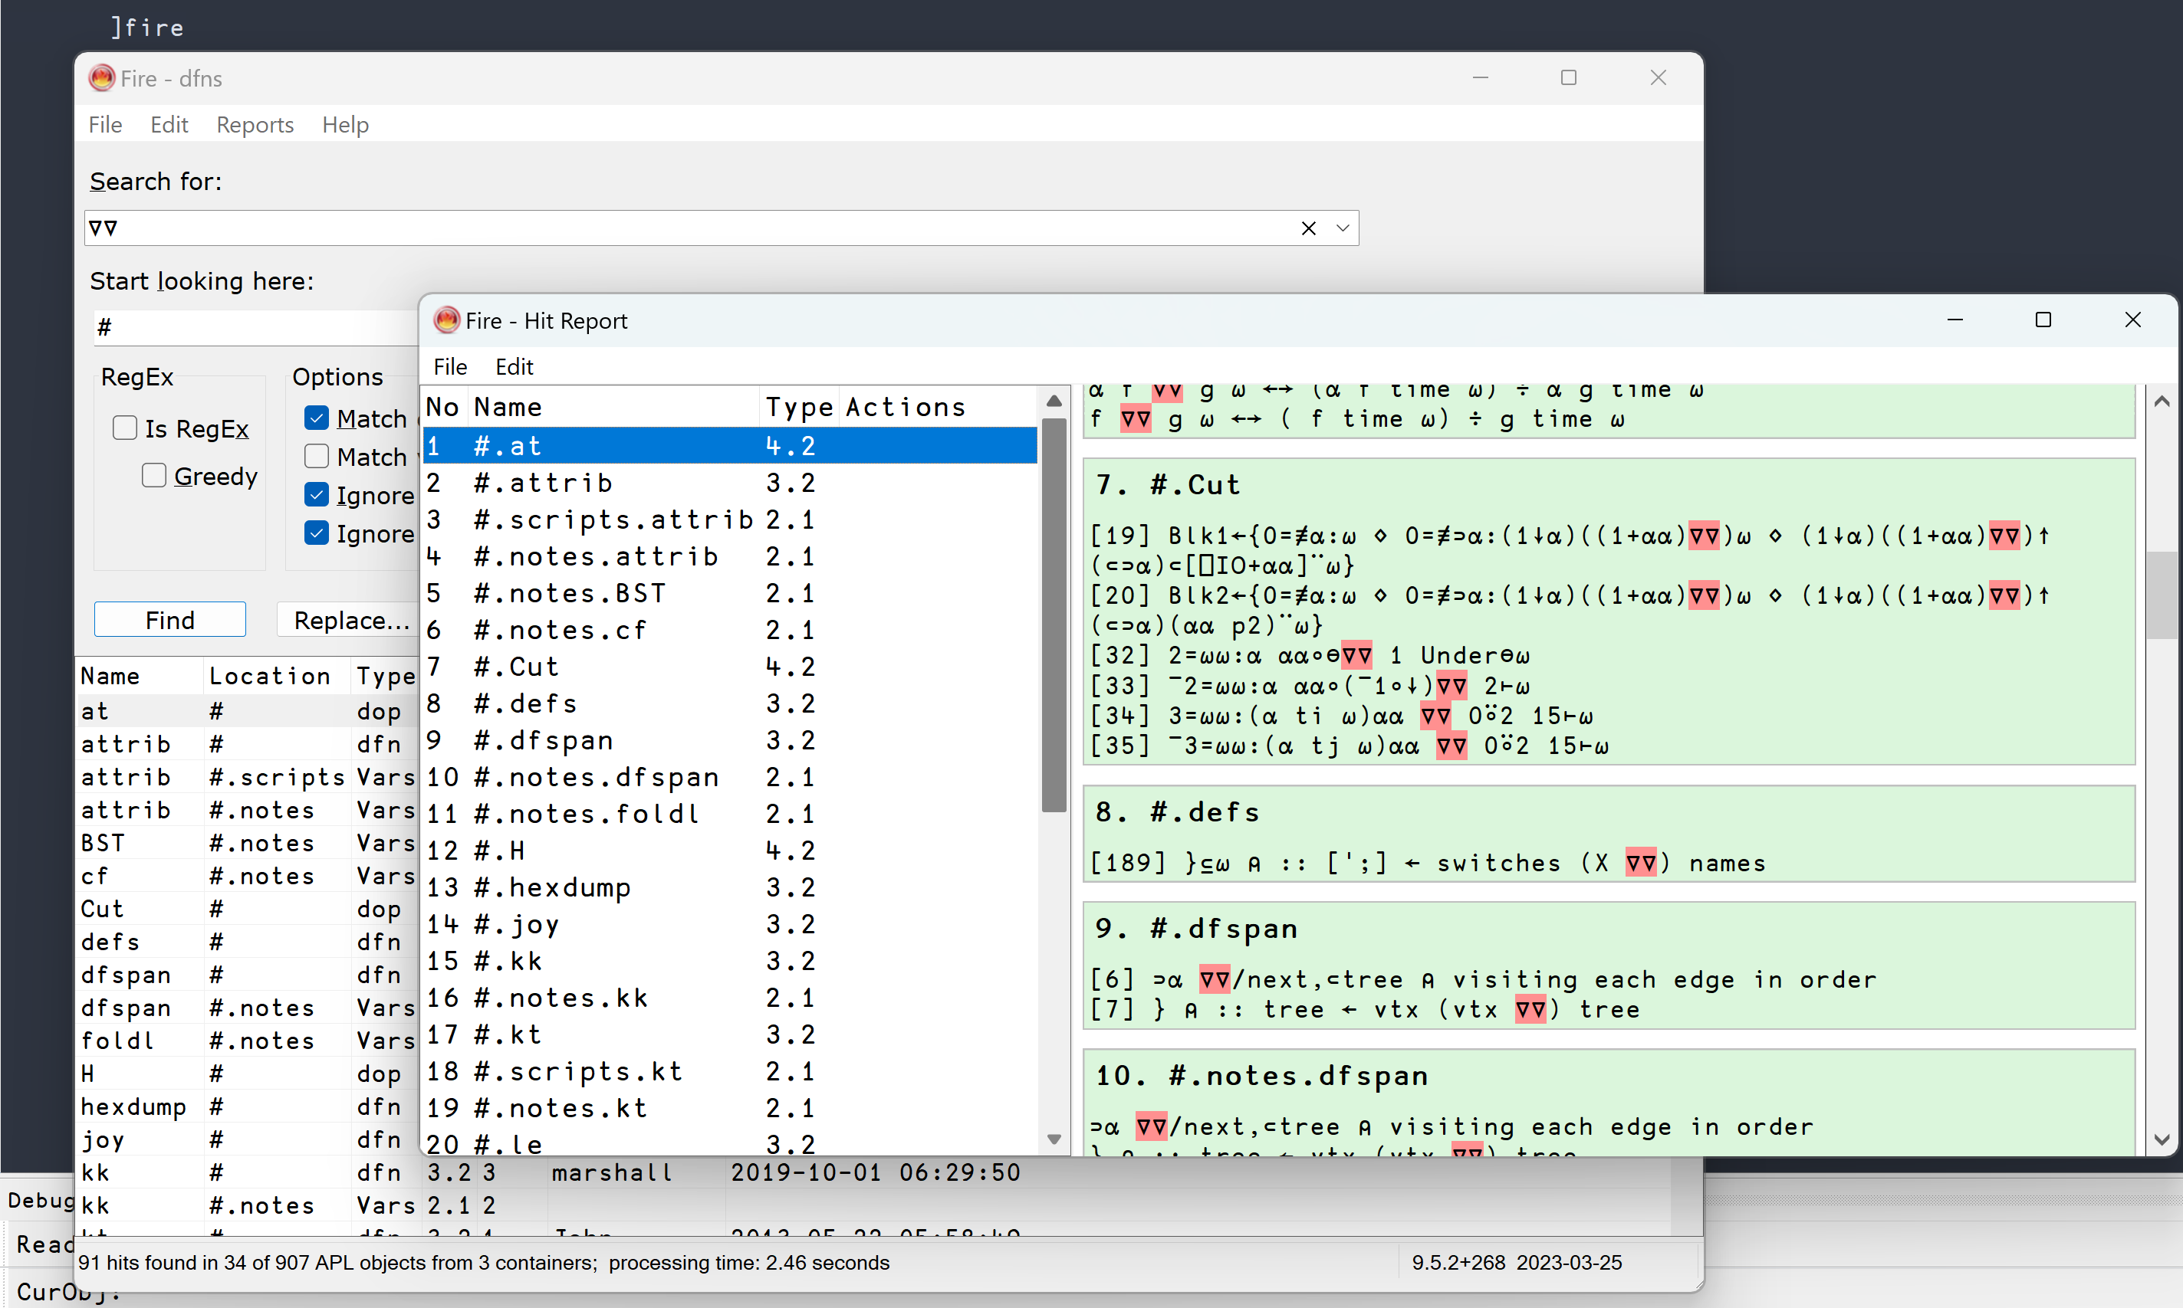
UCMD Example - FIRE
https://github.com/aplteam/fire

Slide 8
Importing different types of files
)LOAD
  Workspaces (.dws)
⎕FIX
  Namespaces (.apln)
  Classes (.aplc)
  Functions (.aplf)
Fetch data/code in many formats from local or remote sources
]Get <source>[:<ext>] [-only=<names>] [-target=<ns>] [-sync] [-unpack]
Examples:
]Get "C:\tmp\testme.apln"
]Get 'file://C:\tmp\Take.aplf' -sync
]Get C:\tmp\linktest
]Get /tmp/myapp -sync
]Get /tmp/ima.zip
]Get github.com/mkromberg/apldemo/blob/master/Units.csv
]Get github.com/Dyalog/Jarvis/blob/master/Distribution/Jarvis.dws
]Get http://github.com/json5/json5/blob/master/test/test.json5
]Get http://github.com/json5/json5/blob/master/test/test.json5:v
]Get https://github.com/mkromberg/d18demo/tree/master/perfected
]Get https://github.com/abrudz/Kbd
]Get raw.githubusercontent.com/Dyalog/MiServer/master/Config/Logger.xml
]Get ftp://speedtest.tele2.net/512KB.zip
]Get '"C:\tmp\myarray.apla"'
]Get HttpCommand -target=⎕SE
]Get dfns
]Get display -only=DISPLAY -unpack
]Get ]box
]Get ]box:vtv

Slide 9
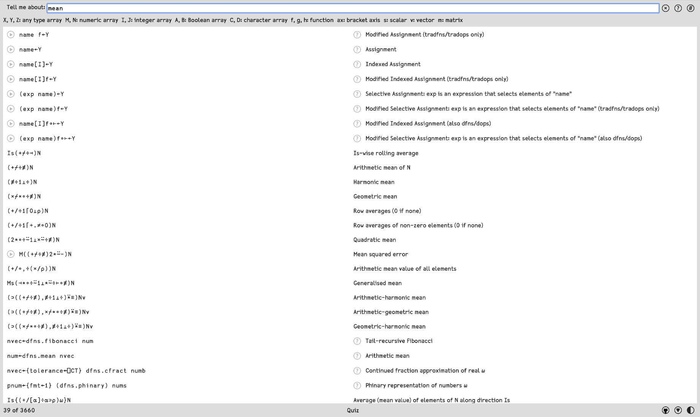
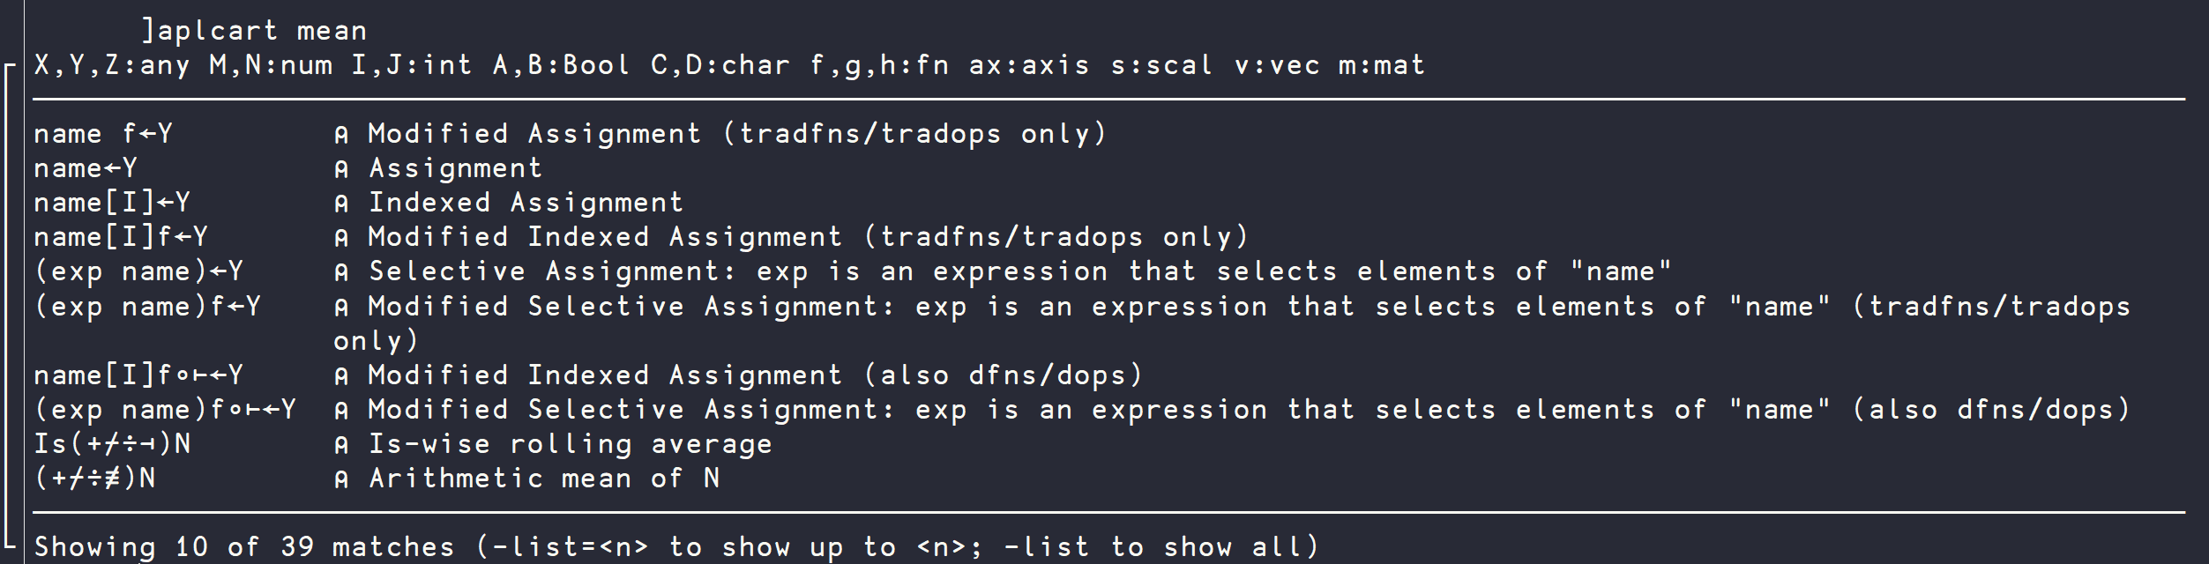
aplcart.info

Slide 10
First There Was The Workspace
APL
Workspace

Slide 11

Then There was Link
APL
Workspace
Source Code
in Text Files
Link

Slide 12

Then There was Link (and git/svn etc)
APL
Workspace
Source
History
Source
History
Source Code
in Text Files
Source
History
Link

Slide 13
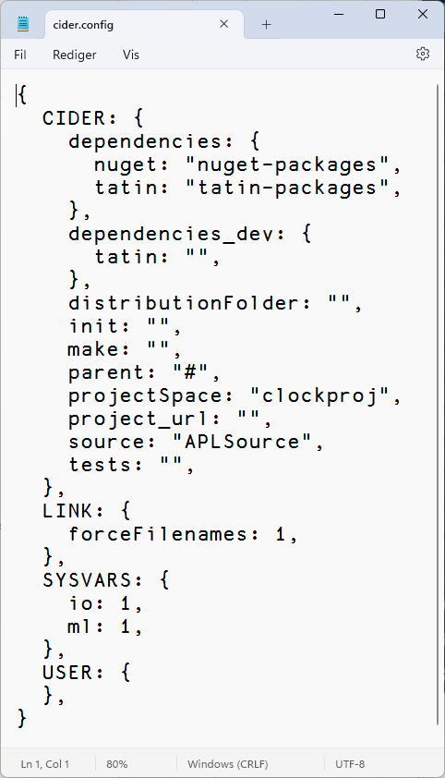
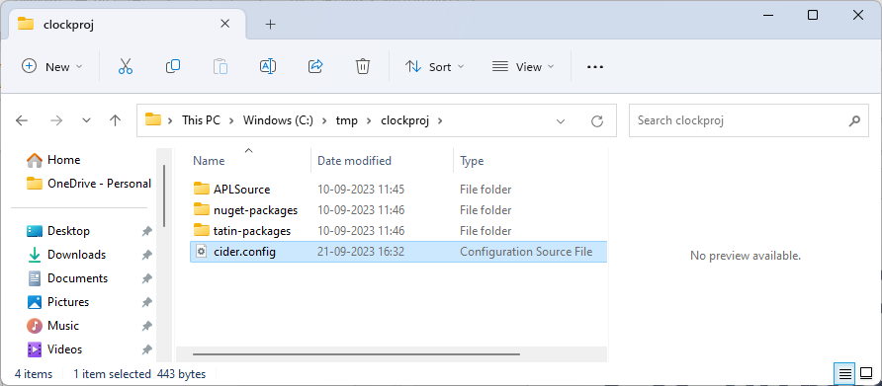
A Cider Project

Slide 14
Projects: Cider
Load other code that we depend on
Run some code on opening the project
Run a build function
Decide where to load the code
Run tests
Set Link options to be used when loading the source code
Set ⎕IO, ⎕ML

Slide 15
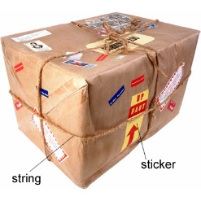
A Project is…
Source Code +
Dependencies (packages) loaded from a package manager
Environment configuration
Development tools and processes
Can be opened and "set up" by a Project Manager (Cider)
A Package is…
A "build" of a project...
In a standard format
Can be found, downloaded and installed by a
"Package Manager"
Cider supports the development of Tatin Packages
Cider can load Tatin + NuGet Packages

Slide 16
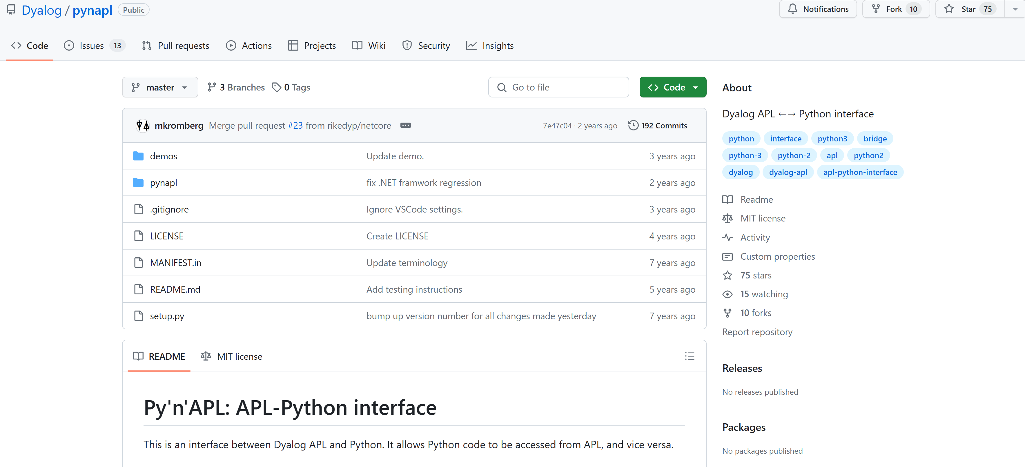
Python Bridge

Slide 17
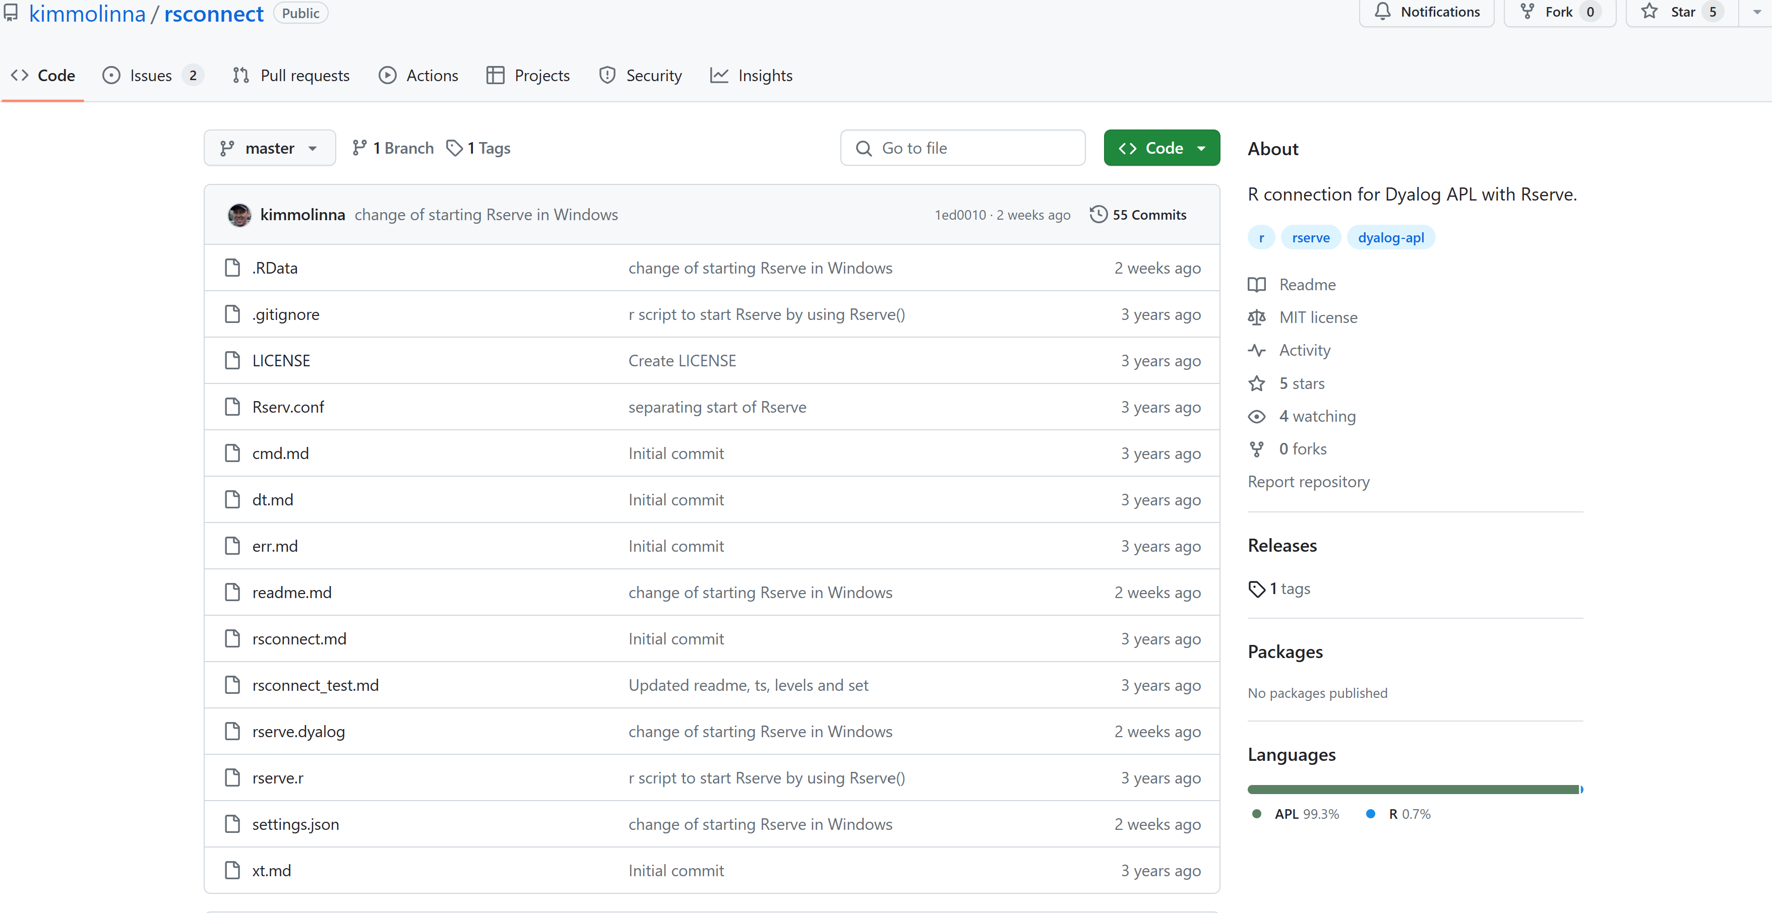
R Interface

Slide 18



Tatin
Package manager for Dyalog APL
A tasty way to package APLs
50 Packages
NuGet
Package manager for .NET
Related to "Chocolatey"
361,905 372,765 Packages
]z←tatin.listPackages
{⍺,≢⍵}⌸{(¯1+⍵⍳'-')↑⍵}¨3↓z[;1]
aplteam 43
davin 4
dyalog 3
¯2↑z
dyalog-Jarvis 1
dyalog-NuGet 1

Slide 19
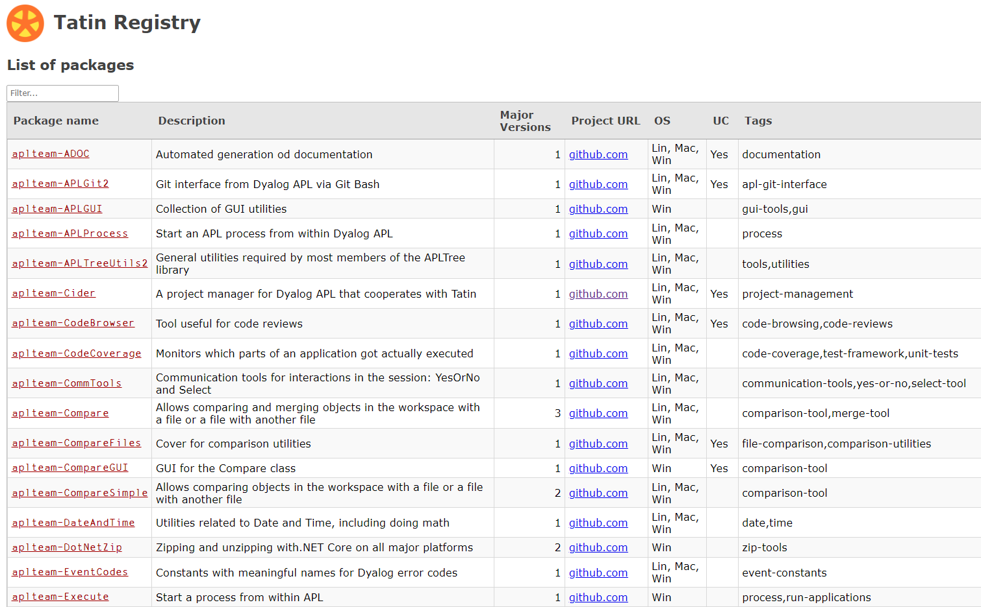
Finding Packages – www.tatin.dev

Slide 20
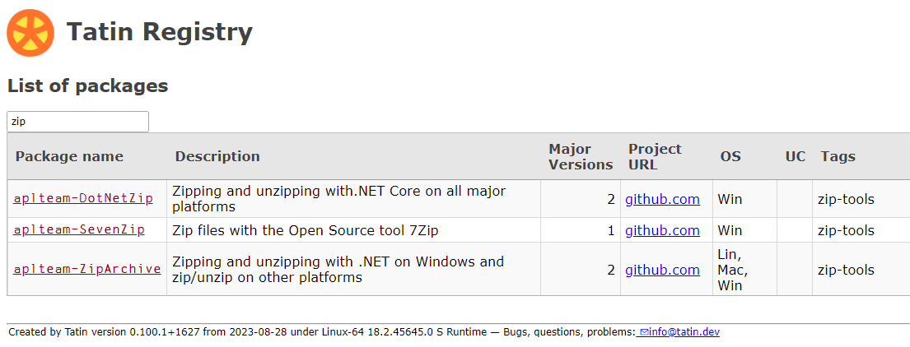
Finding Packages

Slide 21
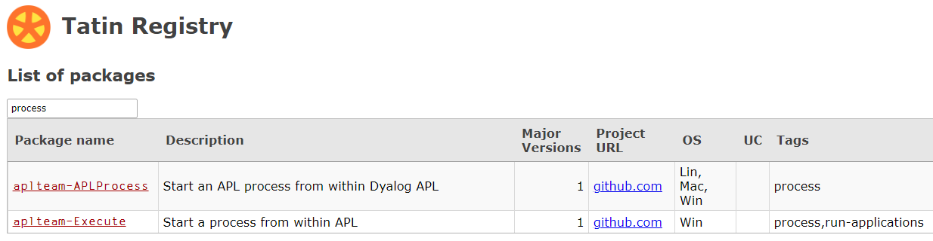
Finding Packages
50 packages is enough to (sometimes) make it difficult
to decide which one to use (and "dyalog-APLProcess" is yet to come ☺)

Slide 22
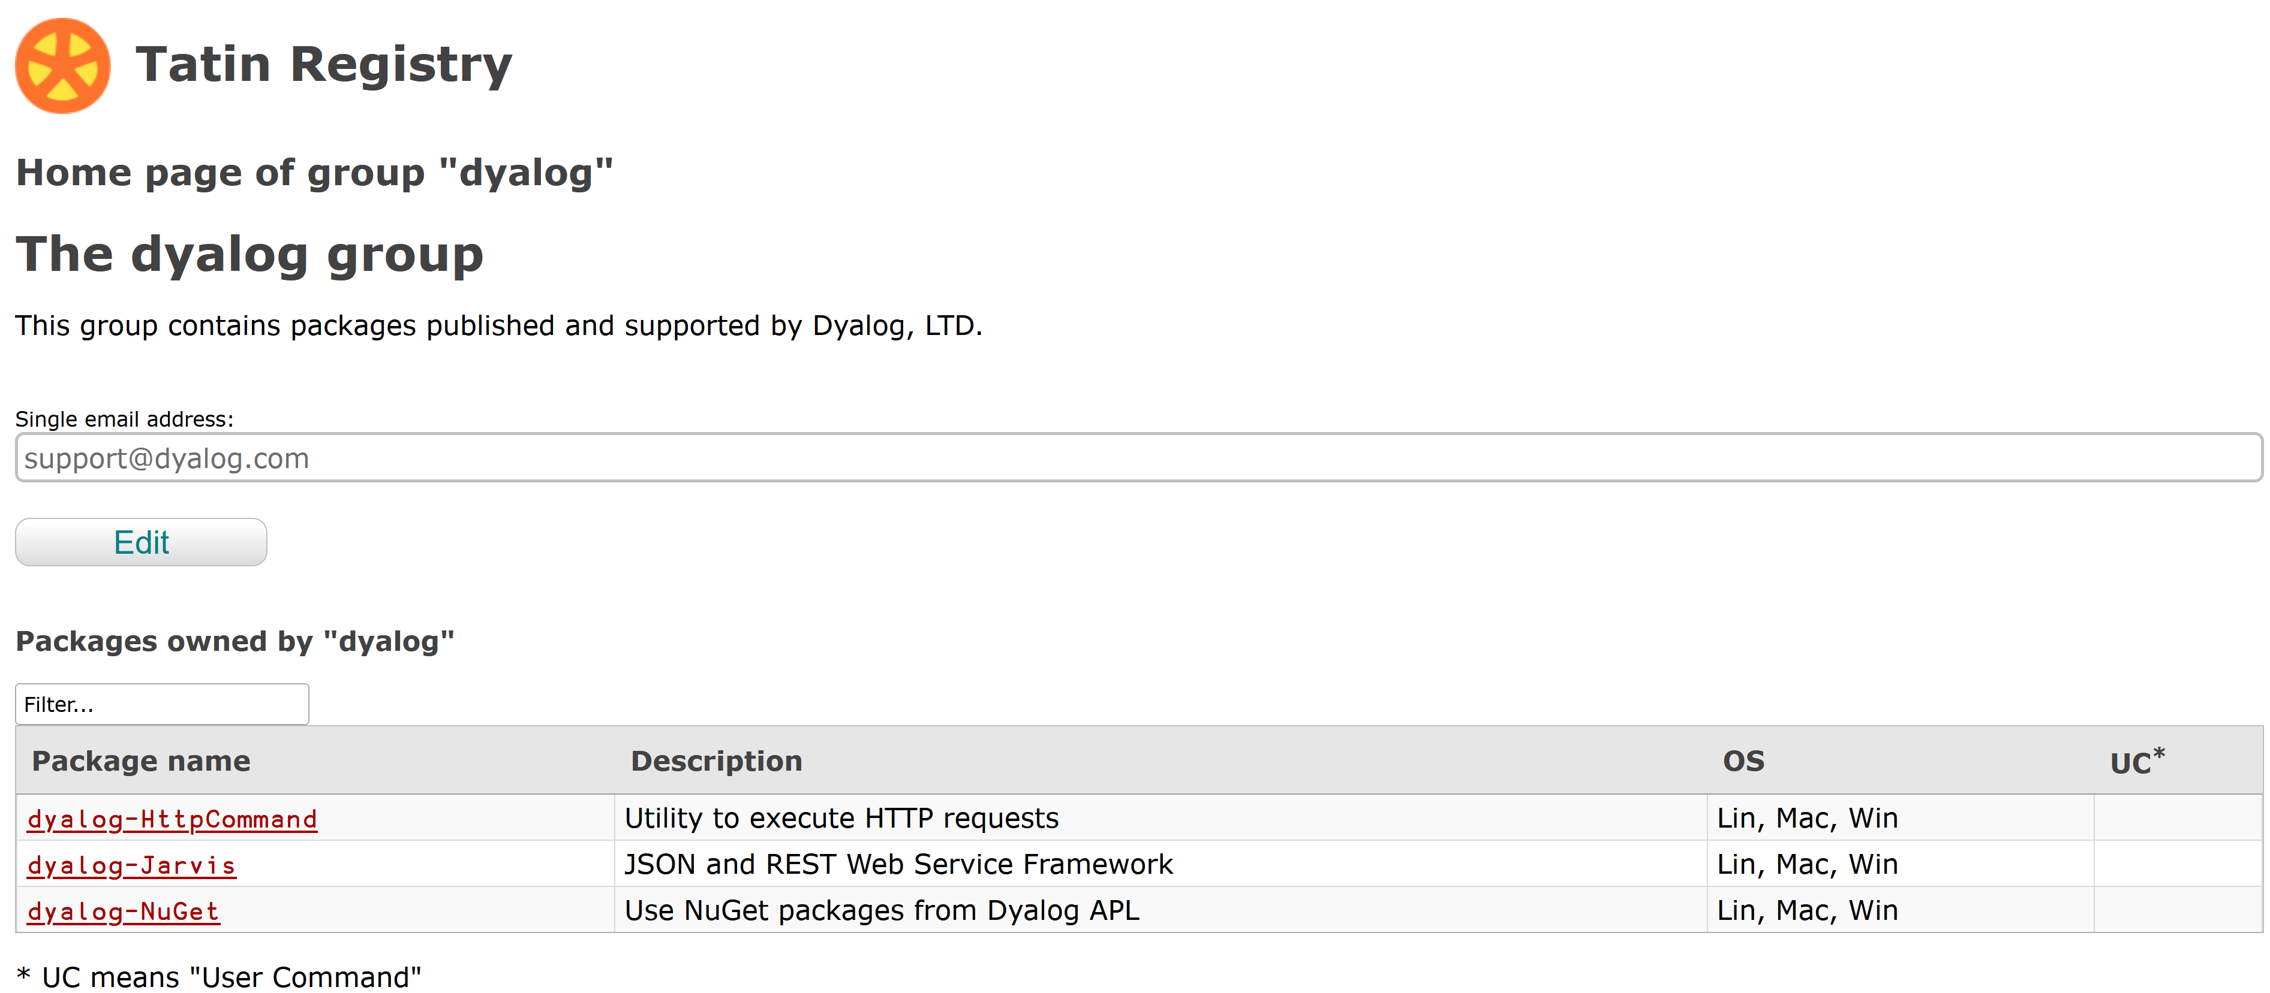

Slide 23
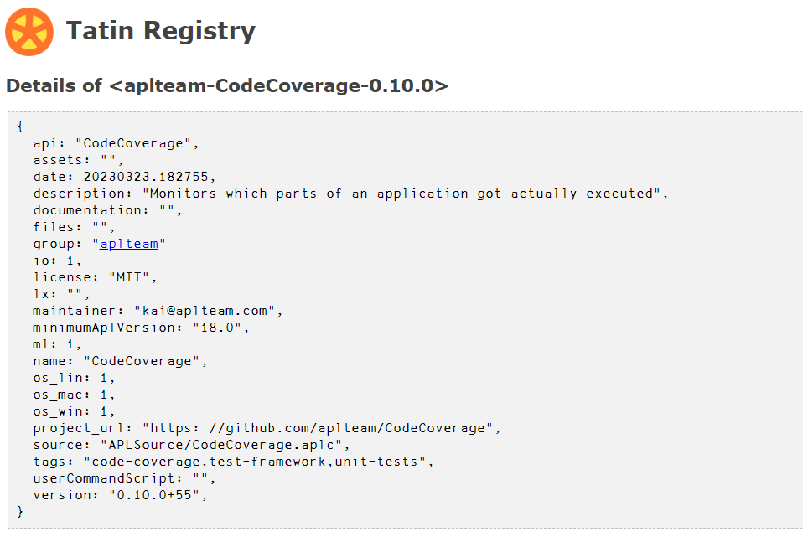
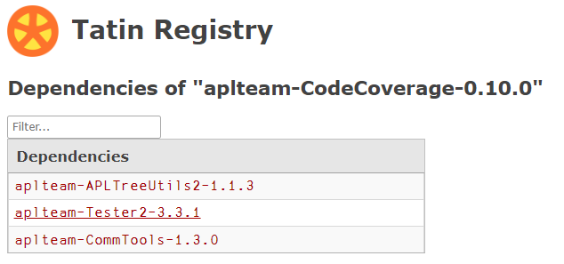

Slide 24
]Tatin.ListPackages
]tatin.listtags
tags from https://tatin.dev
--------------------------
apl-git-interface
build
calculations
chm
code-browsing
code-coverage
code-reviews
command-generation
communication-tools
comparison-tool
comparison-utilities
components
config-files
converter
copy
cryptography
date
dates
…
…
utilities
validation
webservice
windows-event-log
windows-registry
winscp-interface
write
yes-or-no
zip-tools
]Tatin.ListPackages -group=dyalog
Registry: https://tatin.dev
Group & Name # major versions
------------ ----------------
dyalog-HttpCommand 1
dyalog-Jarvis 1
dyalog-NuGet 1
]Tatin.ListPackages -tag=crypto
Registry: https://tatin.dev
Group & Name # major versions
------------ ----------------
aplteam-HashPasswords 1
aplteam-IniFiles 1

Slide 25
Adding a Tatin Dependency
Example: I use HttpCommand in just about every new project
To add it to our Cider project:
]Cider.AddTatinDependencies HttpCommand
1 Tatin dependency added:
dyalog-HttpCommand-5.2.0
Since we did not specify a version, we get the latest.
A reference is created to the loaded package within our project space:
D08.HttpCommand.Get 'www.dyalog.com'
[rc: 0 | msg: | HTTP Status: 200 "OK" | ≢Data: 22580]

Slide 26
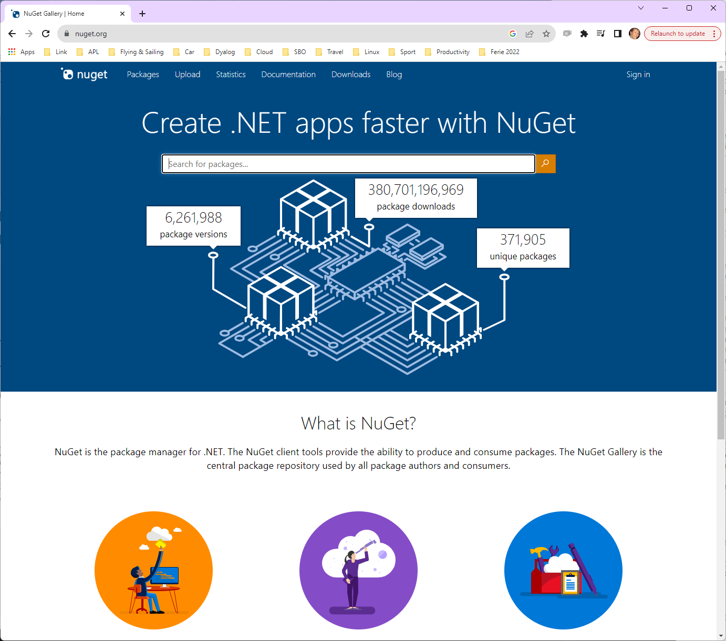
NuGet
NuGet is the .NET
package manager
You can use NuGet packages from Dyalog APL,
with .NET 6.0 or later

Slide 27
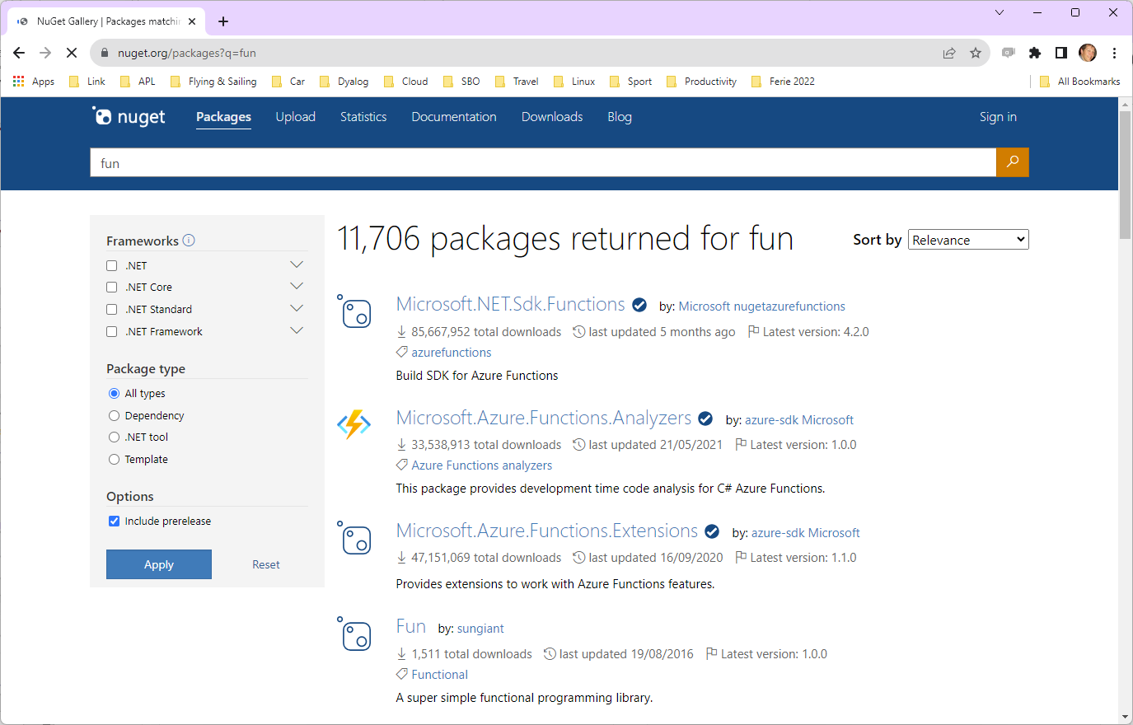
Finding NuGet Packages (HARD!!!)

Slide 28
Adding a NuGet Package
NuGet support currently requires .NET 6.0, 7.0 or 8.0
Support for "Framework" packages MAY follow
Example: NuGet contains a very simple package called "Clock".
We can add it to our Cider project (by default, we get the latest version):
]Cider.AddNuGetDependencies Clock
Clock 1.0.3
A reference to a namespace hosting the .NET package is created:
#.clockproj.Clock.UtcNow.(Hour Minute)
14 43
In fact, the namespace is empty except for ⎕USING:
clockproj.Clock.⎕USING
,c:/tmp/clockproj/nuget-packages/published/Clock.dll

Slide 29
Dependencies
]Cider.OpenProject C:\tmp\fleatest
Project successfully loaded and established in "#.fleatest"
)cs fleatest
#.fleatest
⎕NL -9
CiderConfig CompareFiles ZipArchive
CompareFiles
#._tatin.aplteam_CompareFiles_4_0_1.API
⍪#._tatin.⎕nl -9
aplteam_APLTreeUtils2_1_2_0
aplteam_CommTools_1_5_0
aplteam_CompareFiles_4_0_1
aplteam_DotNetZip_2_0_2
aplteam_FilesAndDirs_5_5_0
aplteam_OS_3_0_1
aplteam_ZipArchive_0_1_1
#._tatin.aplteam_CompareFiles_4_0_1.⎕NL -9
API APLTreeUtils2 Admin CommTools ComparisonTools FilesAndDirs TatinVars
Our Dependencies
Dependencies of Dependencies

Slide 30
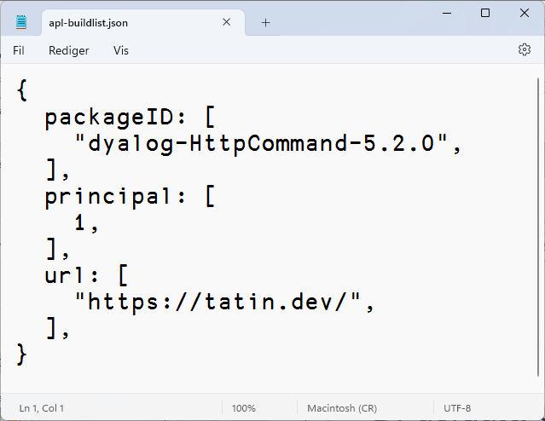
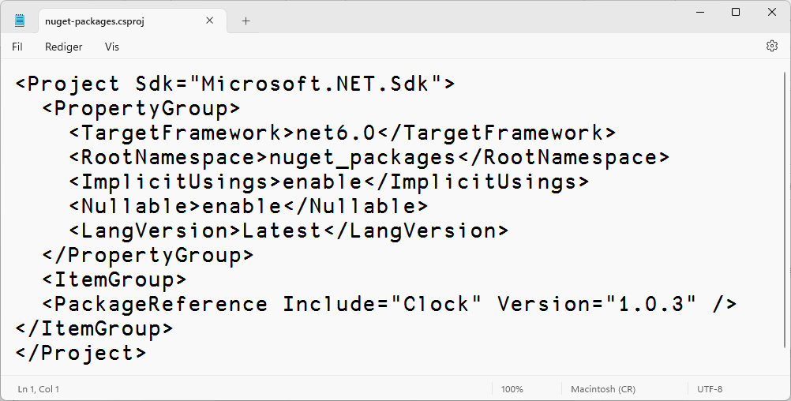
Similar but different
Tatin
NuGet
#.projectSpace.HttpCommand
#.projectSpace.Clock

Slide 31




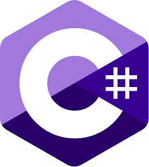
Tools Mentioned
Link Synchronises Source Files and Workspace
The workspace and source files are "Linked"
Cider is a Project Manager
A Project is a linked source folder,
a config file, plus optional dependencies
Tatin is the APL Package Manager
A Package is a project wrapped up for consumption by others
NuGet is the .NET Package Manager
The Dyalog.NET Bridge allows APL to use .NET libraries

Slide 32
Tools to Develop/Manage APL Packages
Tatin – https://github.com/aplteam/Tatin
  The Tatin client allows you to incorporate APL packages and any dependencies they may have into your APL application.
  Additionally, the client enables you to maintain and publish packages
  A Tatin server exposes and hosts a registry where packages may be imported from or published to
  You may run your own Tatin server, which exposes a or use the publicly available ones:
    Production server: https://tatin.dev
    Test server: https://test.tatin.dev
Dado - https://github.com/the-carlisle-group/Dado/
  A framework for helping manage and deploy APL projects
  Centered around a GitHub-based workflow

Slide 33
Demo:
Use community tools to analyze this file of eclipse data

