Slide 1

Parsing User Input for Database Normalization
DYNA ’26 – 04/27/2026
Mark Wolfson and Kori Smith

Slide 2
Who is BIG?
Who is BIG and why is it a perfect use-case for APL
Service consultancy in the jewelry industry
  Customers:
    Retail Jewelers
    Jewelry Manufacturers (vendors)
    Jewelry industry service companies
  Services:
    Inventory analysis & merchandising consulting
    Jewelry sales/inventory data aggregation
  We provide these services by collecting accurate, timely data from 1600 retail jewelry stores using 40 different software systems, and 120 vendors.
Notes:
Prequel: What we’re doing with APL and how it has helped us disrupt our industry, increasing collaboration, creating efficiencies and improving overall performance.

Slide 3
Retailer Data – A HOT MESS
Integration with dozens of systems
  Varying number of files even for the same system
  Different formats
    Flavors of CSV
    Text files
    Excel
    XML
    JSON
  Different content
    Variations in content between retailers using the same system
    Variations within a retailer depending on who’s entering the data
    Changes over time

Slide 4
Retailer
APL Process
Upload Service
Retailer
APL Process
MS SQL Database
Retailer
APL Process
Balance to Buy
Integrations
Vendor
APL Process
Notes:
STOP after this slide to explain how the system is complicated and
LOT of Moving parts
EVERYTHING IS C# except Black Boxes

Slide 5
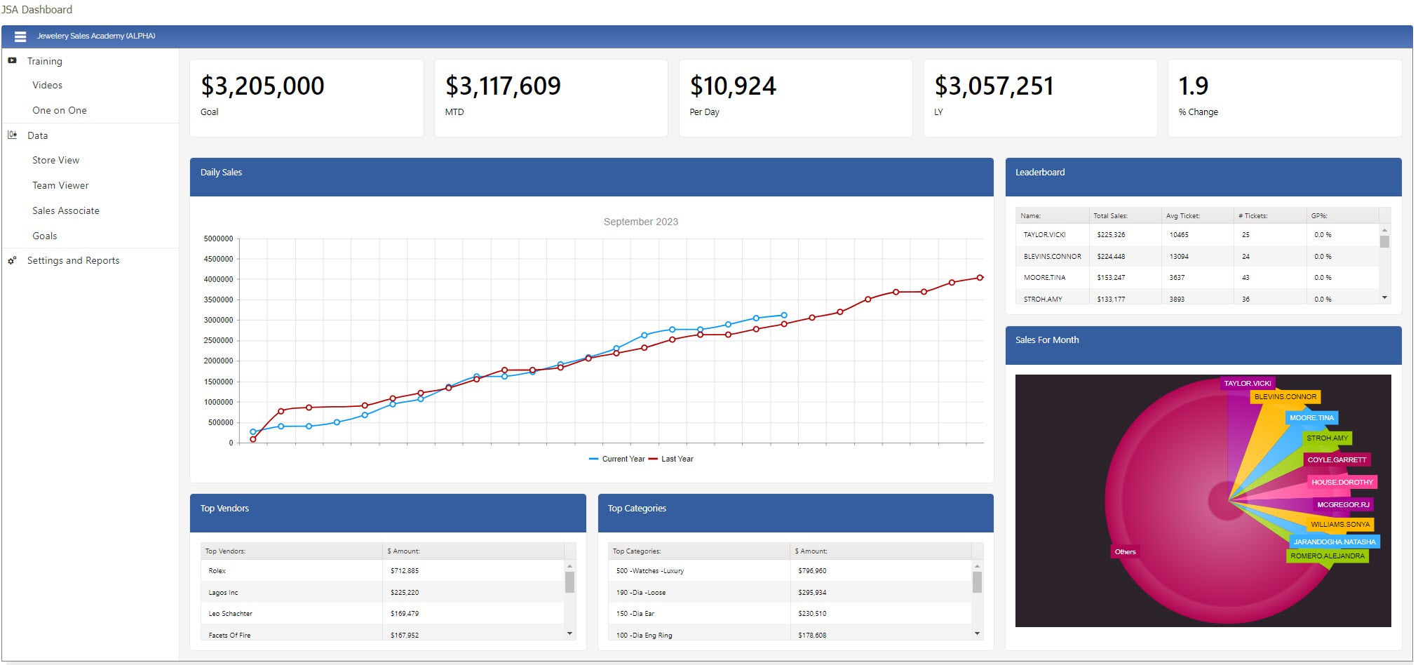
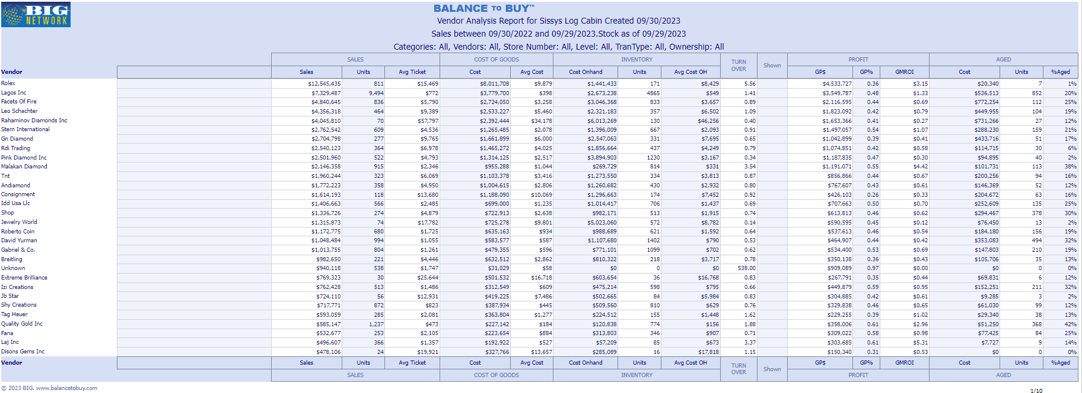
Retailer
.CSV
Black Box Process
MS SQL DB
Retailer
Retailer
Applet
15 POS Systems
Retailer
Black Box Process
Retailer
Retailer
Black Box Process
Retailer
.csv
API
Black Box Process
.txt
Retailer
API
Black Box Process
.xls
Raw Data Store
Retailer
API
Black Box Process
.xlsx
Custom Reporting
Retailer
API
Black Box Process
Vendor
.xml
API
Black Box Process
.json
Black Box Process
Vendor
API
Outbound Integrations
Black Box Process
Retailer
FTP
Black Box Process
Retailer
Vendor
Black Box Process
Outbound Datafeeds
Vendor
Retailer
Black Box Process
Retailer
Notes:
STOP before to explain APL is just tranche in the middle – application is all C#
STOP after to explain using Dyalog with standard tools – APL=GLUE
2 60-somethings doing black boxes, now 2 20-somethings

Slide 6
Example descriptions
3.08Ct E VS1 Princess Lab Grown Diamond Cert Name Cert Number GCAL LG340810249 Cut Grade IDEAL/EX/EX | 191 -Loose Lab Grown Dia
3.04Ct Round Brilliant E VS1 Lab Grown Diamond Cert Number IGI Lg662424955 Cut Grade Ex/Ex/Ex | 191 -Loose Lab Grown Dia
0.71 ct Round Brilliant Cut Diamond D SI1 | 190 -Dia -Loose
2.00 Ct Oval Brilliant Cut Diamond H SI1 GIA Certifcate and laser inscription 5406232622 | 190 -Dia -Loose
Roberto Coin 18 Karat Yellow Gold Navarra Bangle Bracelet With 60=0.72Tw Round Diamonds | 170 -Dia Brac
Roberto Coin Rose Gold 18 Karat Love In Verona Bracelet With 1.87Tw Round Black & White Diamonds | 170 -Dia Brac
Marco Bicego 18K Yellow Gold Marrakech Twisted Coil Bracelet With Diamonds Diamonds total carat weight 0.15ctw Length 7 Inch | 170 -Dia Brac
Forevermark 18 Karat Yellow Gold Cuff Bracelet With One 0.20Ct Forevermark Round Diamond And One 0.14Ct Forevermark Round Diamond FM 7816757 / 2261013 | 170 -Dia Brac
14 Karat Yellow Gold Tennis Bracelet With 5=0.53Tw Baguette Stations Diamonds And 74=1.78Tw Round Diamonds Length/Size 6.75" | 170 -Dia Brac
Hearts On Fire 18 Karat White Gold Vela Twisted Diamond Pendant 1.17 Total Diamond Weight 18 Inch | 165 -Dia Neck
18/14 Karat White Gold One diamond Necklace With One 0.19Ct Round Diamond Length 16/18" | 165 -Dia Neck
18 Karat Rose Gold Circle Pendant With 109=0.42Tw Round Diamonds And 20=0.72Tw Round Brown Diamonds on 18 inch yellow gold box chain | 160 -Dia Pd
14 Karat Yellow Gold Polished Scattered Diamonds Medium HoopEarrings With 0.49Tw Round H/I Si1-2 Diamonds | 150 -Dia Ear
Verragio 14 Karat White Gold Renaissance Semi-Mount Engagement Ring With Round Diamonds 0.59 Total Diamond Weight | 140 -Dia Semi-Mt Ring
Forevermark 18 Karat White Gold Ring With One 0.31Ct Forevermark Pear I Vs2 Diamond And 104=0.61Tw Non Forevermark Round Diamonds FM 2267032 | 100 -Dia Bridal Ring (complete)
Notes:
Prequel: What we’re doing with APL and how it has helped us disrupt our industry, increasing collaboration, creating efficiencies and improving overall performance.

Slide 7
Problem: We have a freeform text field that we can naively assume…
Contains all relevant information in one place
Is written differently from client to client
Often includes shorthand, abbreviations, and misspellings
Often overly verbose or not verbose enough
May lack specific information that can be instead inferred using context clues
Notes:
Prequel: What we’re doing with APL and how it has helped us disrupt our industry, increasing collaboration, creating efficiencies and improving overall performance.

Slide 8
Objective
Create a parsing solution that operates quickly
Solution must handle a wide range of written behaviors
Output must be consistent and predictable
Can be customized quickly case by case, as needed
Easy to teach other developers how to use
Notes:
Prequel: What we’re doing with APL and how it has helped us disrupt our industry, increasing collaboration, creating efficiencies and improving overall performance.

Slide 9

Immediate concerns
Who has ever worked with freeform data?
Who is having flashbacks already?
We are working with millions of product descriptions written in this manner on any given day
str←'what if we want to find every word between three and five letters in this sentence'
'\b\p{L}{3,5}\b'⎕S'\l0'⊢str
Notes:
Prequel: What we’re doing with APL and how it has helped us disrupt our industry, increasing collaboration, creating efficiencies and improving overall performance.

Slide 10
What sets BIG apart
Data parsing services require customer to do a lot of the legwork
  Registering each product as separate item
  Inputting many specific details into separate fields, for each product
Jewelry is specific enough that we can do the work for them
Useful internally for future data science projects/plans
Notes:
Prequel: What we’re doing with APL and how it has helped us disrupt our industry, increasing collaboration, creating efficiencies and improving overall performance.

Slide 11
Poor use-case for AI
Equivalent of trying to hammer a nail with a sledgehammer
  Outsized tool for the job
Unpredictable results
Fails when given complex instructions such as parsing many different items from text
Difficult to customize output client-to-client
Notes:
Prequel: What we’re doing with APL and how it has helped us disrupt our industry, increasing collaboration, creating efficiencies and improving overall performance.

Slide 12
General strategy to parse anything
Build data dictionaries per item to parse for a given field
  Column 1: Type
  Column 2: Variant alias
  Column 3: Output format (regex)
  Column 4: Match regex
Pre/post processing to make stuff look pretty
Two lines of code
Notes:
Prequel: What we’re doing with APL and how it has helped us disrupt our industry, increasing collaboration, creating efficiencies and improving overall performance.

Slide 13
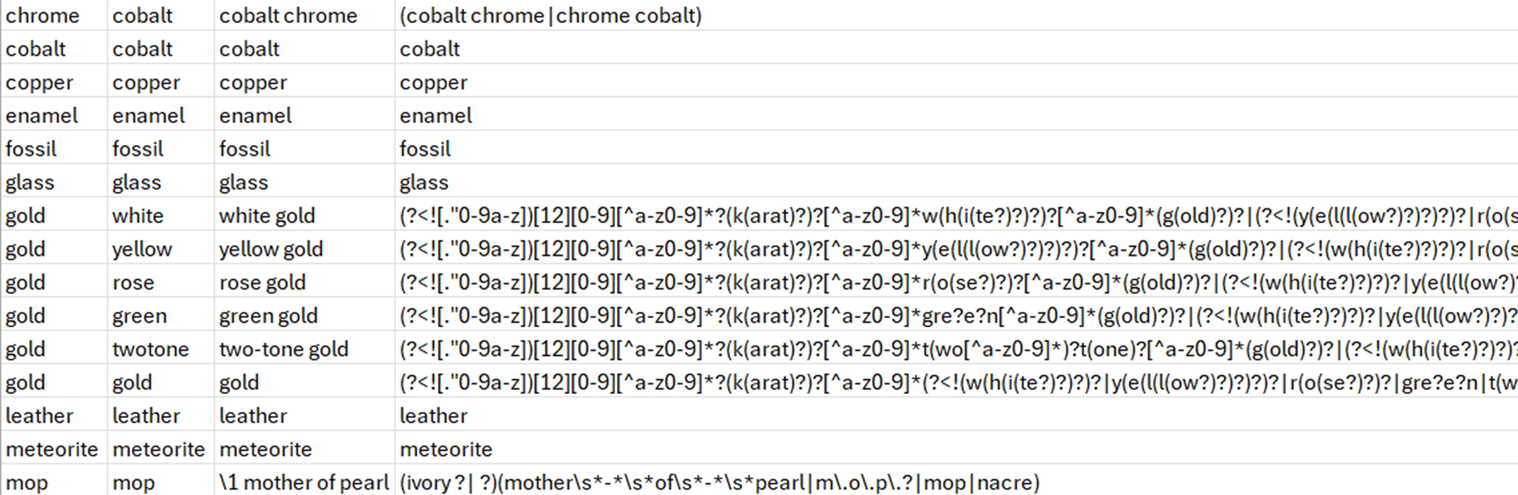
Regex dictionary example: Materials
Notes:
Prequel: What we’re doing with APL and how it has helped us disrupt our industry, increasing collaboration, creating efficiencies and improving overall performance.

Slide 14
The association problem
What if we have a single product description that
  Contains multiple gemstones
  Each gemstone has specific associated attributes
  Attributes associated with gemstones have varying conditions
    One carat max per gemstone group
    One count per gemstone group
    Some gemstones might not be gemstones (emerald)
    Sometimes gemstones not explicitly mentioned
How do we associate certain qualities to certain gemstones?
Notes:
Prequel: What we’re doing with APL and how it has helped us disrupt our industry, increasing collaboration, creating efficiencies and improving overall performance.

Slide 15
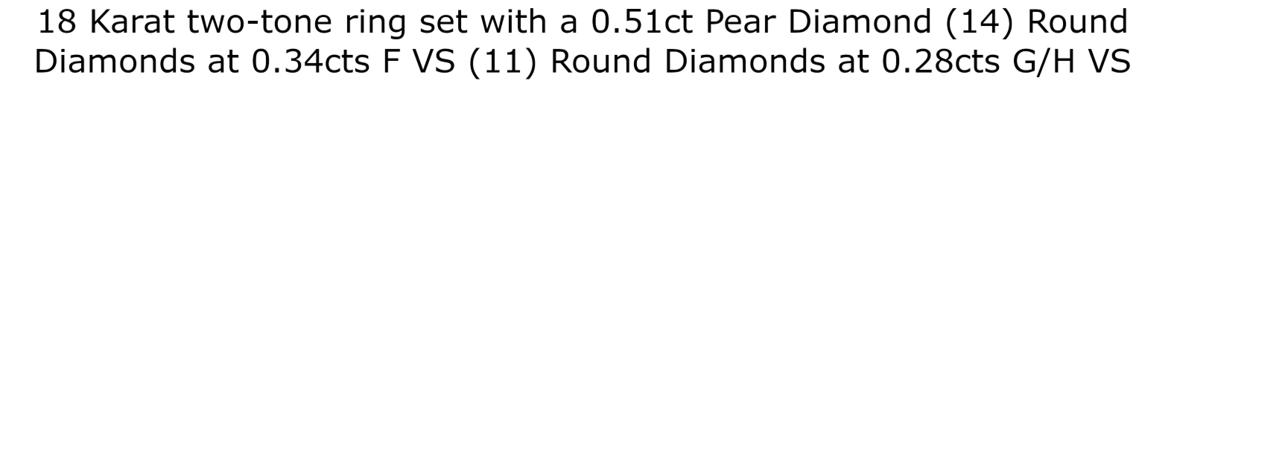
Building a stone string – Ex 1
Notes:
Prequel: What we’re doing with APL and how it has helped us disrupt our industry, increasing collaboration, creating efficiencies and improving overall performance.

Slide 16
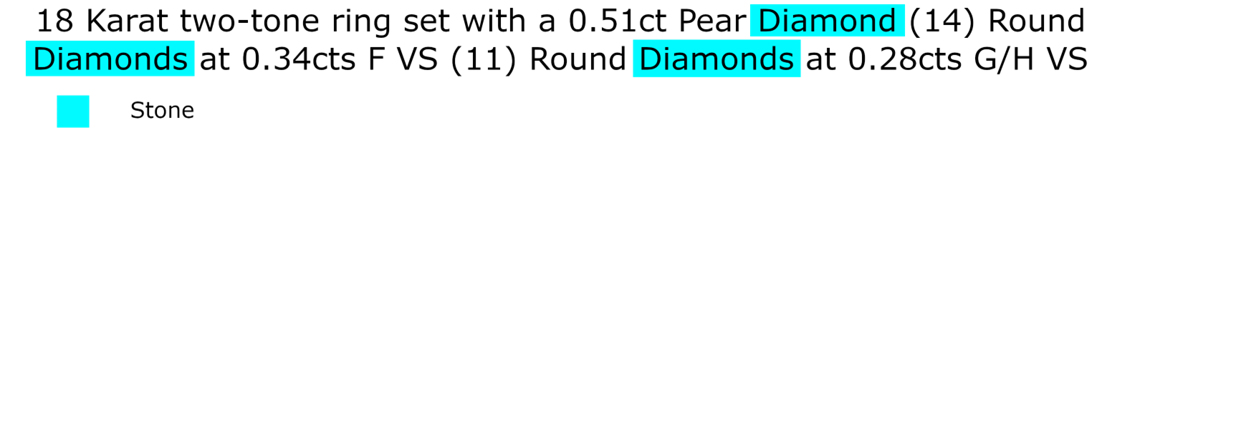
Building a stone string – Ex 1
Notes:
Prequel: What we’re doing with APL and how it has helped us disrupt our industry, increasing collaboration, creating efficiencies and improving overall performance.

Slide 17
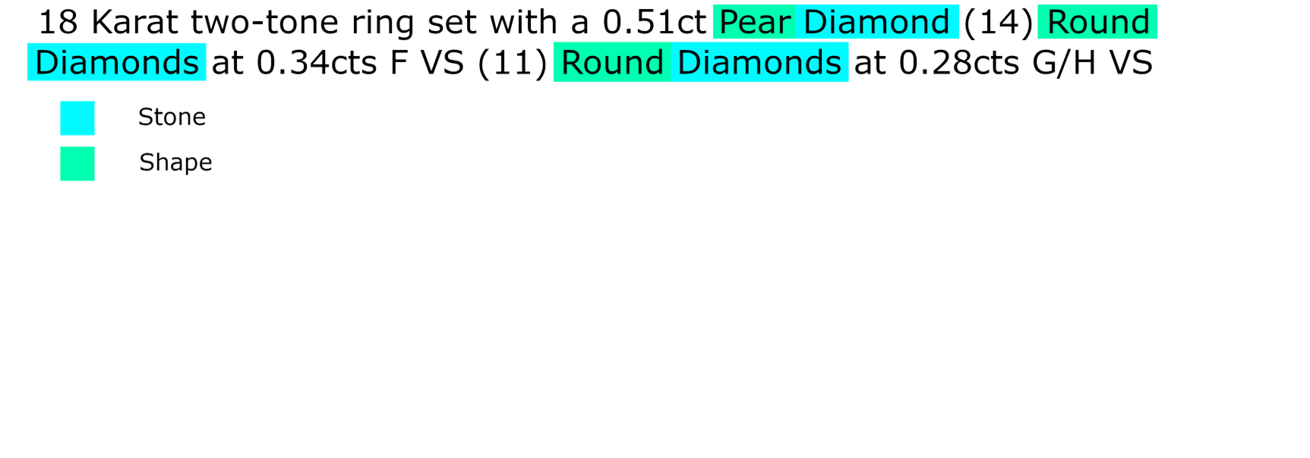
Building a stone string – Ex 1
Notes:
Prequel: What we’re doing with APL and how it has helped us disrupt our industry, increasing collaboration, creating efficiencies and improving overall performance.

Slide 18
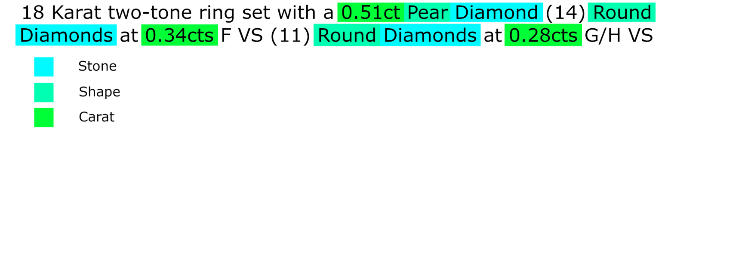
Building a stone string – Ex 1
Notes:
Prequel: What we’re doing with APL and how it has helped us disrupt our industry, increasing collaboration, creating efficiencies and improving overall performance.

Slide 19
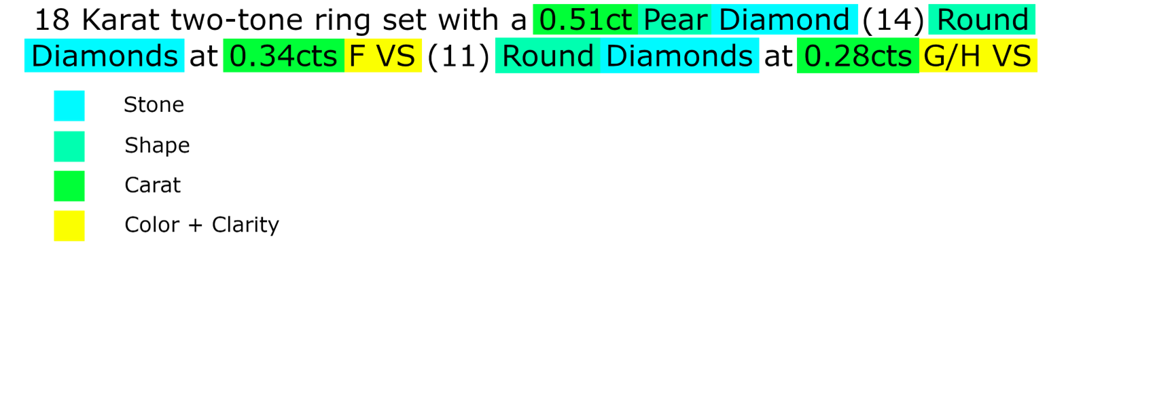
Building a stone string – Ex 1
Notes:
Prequel: What we’re doing with APL and how it has helped us disrupt our industry, increasing collaboration, creating efficiencies and improving overall performance.

Slide 20
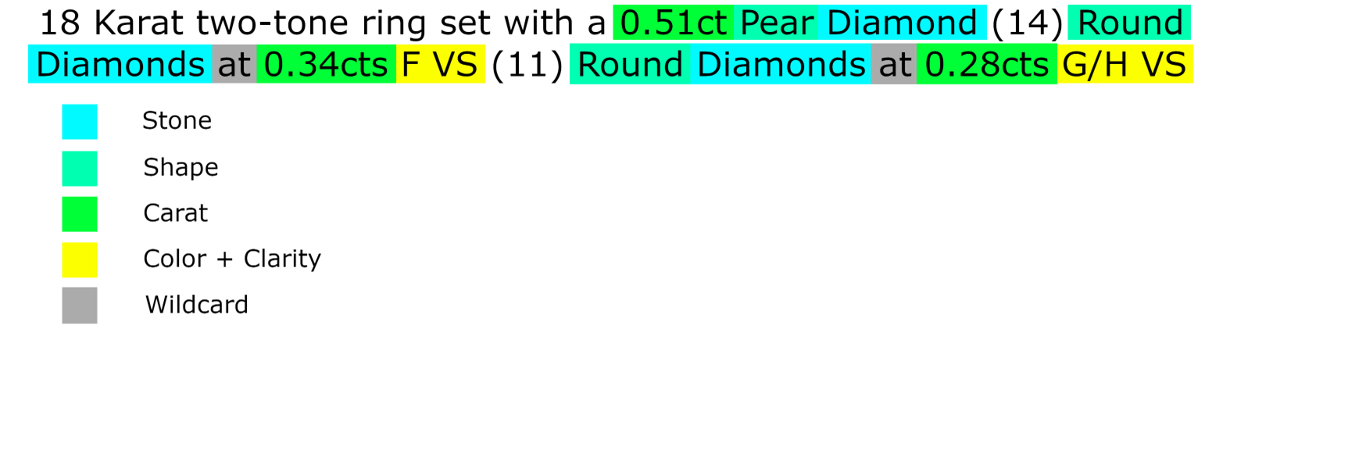
Building a stone string – Ex 1
Notes:
Prequel: What we’re doing with APL and how it has helped us disrupt our industry, increasing collaboration, creating efficiencies and improving overall performance.

Slide 21
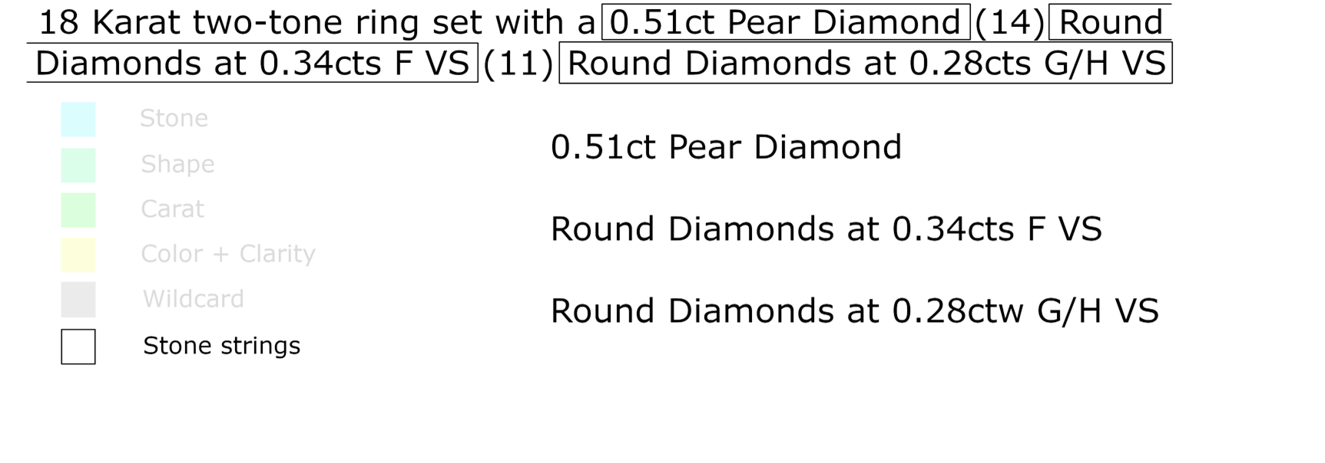
Building a stone string – Ex 1
Notes:
Prequel: What we’re doing with APL and how it has helped us disrupt our industry, increasing collaboration, creating efficiencies and improving overall performance.

Slide 22
Building a superpattern
Previous example was ideal
  All parsed items close together
  Everything properly spelled
Parse each item separately
  Stone size (1/2/3D in mm)
  Stone qualities (‘pink’ in pink diamond’
  Stone shape (round, pear, etc)
  Stone cut
  Stone color/clarity
  Carat weights
Turn each group of matches into regex ‘capture group’
Prefix modifier (with carat)
  PC
Prefix modifier (without carat)
  P
Stone type
  X
Suffix modifier (with carat)
  SC
Suffix modifier (without carat)
  S
Wildcard and Optional
  + and ?
Notes:
Prequel: What we’re doing with APL and how it has helped us disrupt our industry, increasing collaboration, creating efficiencies and improving overall performance.

Slide 23
Building a superpattern
Prefix modifier (with carat)
  PC
Prefix modifier (without carat)
  P
Stone type
  X
Suffix modifier (with carat)
  SC
Suffix modifier (without carat)
  S
Wildcard and Optional
  + and ?
In order of priority:
1) PC + X + S
2) PC + X
3) P + X + SC
4) X + SC
5) P? + X + S?
Notes:
Prequel: What we’re doing with APL and how it has helped us disrupt our industry, increasing collaboration, creating efficiencies and improving overall performance.

Slide 24
Revisiting Ex 1
PC
X
P
X
+
SC
P
X
+
SC
Notes:
Prequel: What we’re doing with APL and how it has helped us disrupt our industry, increasing collaboration, creating efficiencies and improving overall performance.

Slide 25
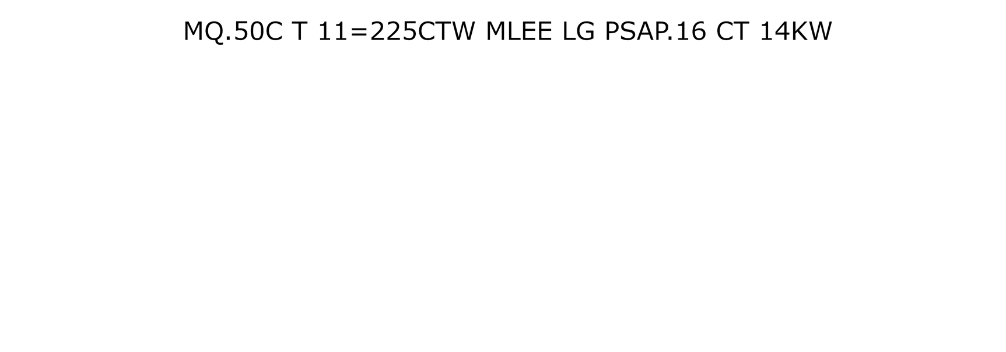
Messy descriptions – Ex 2
Notes:
Prequel: What we’re doing with APL and how it has helped us disrupt our industry, increasing collaboration, creating efficiencies and improving overall performance.

Slide 26
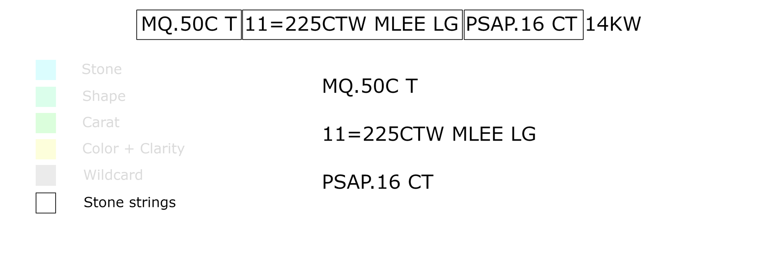
Messy descriptions – Ex 2
P
X/C
X/C
S
P
X
SC
Notes:
Prequel: What we’re doing with APL and how it has helped us disrupt our industry, increasing collaboration, creating efficiencies and improving overall performance.

Slide 27
How it works
Each step, we use regex dictionaries to reduce problem scope
  Find all matches
  Create regular expression from matches
  Used reduced scope capture groups to build super patterns
  Feed superpatterns back in, get new matches
Superpattern matches aren’t the final step
  Create new ordered regex capture group using ALL superpatterns
  Get final matches, using single sweep
Last step necessary to prevent overlapping stone string
Notes:
Prequel: What we’re doing with APL and how it has helped us disrupt our industry, increasing collaboration, creating efficiencies and improving overall performance.

Slide 28
How it works
Scope of the problem is massive and leads to impossibly complex regex
Dynamically build regular expressions piece by piece
  Cons: Many more regex operations
  Pros: Code is easy to diagnose when running into issues
Notes:
Prequel: What we’re doing with APL and how it has helped us disrupt our industry, increasing collaboration, creating efficiencies and improving overall performance.

Slide 29
Down the rabbit hole
What if nucleation point can be multiple categories?
  Example: ‘Diamond’ may be expressed as ‘G/H VS1-VS2’
  Decode dictionary may be different description to description
What if nucleation point can be abbreviated?
  Example: ‘RD SA DI 0.25CTW’
  Potentially captured in wildcard, blurring boundaries of stone strings
Notes:
Prequel: What we’re doing with APL and how it has helped us disrupt our industry, increasing collaboration, creating efficiencies and improving overall performance.

Slide 30
Down the rabbit hole
What if description written with unnatural English?
  Example ‘0.25 CTW DIA PINK
What if we capture multiple stones but there is only one stone?
  Example ‘LOOSE DIAMOND RING WITH 0.25CTW DIA’
Notes:
Prequel: What we’re doing with APL and how it has helped us disrupt our industry, increasing collaboration, creating efficiencies and improving overall performance.

Slide 31
Built in Dyalog
No :For loops outside of customization file
Inner products
  ,.{}
Reduction and outer products
  ,⌿∘.{}
Dfns to quickly handle :If, very useful for regex construction
  {×≢⍵: ⍵ ⋄ ‘’}¨
  Transparent
Key operator
  {}⌸
Notes:
Prequel: What we’re doing with APL and how it has helped us disrupt our industry, increasing collaboration, creating efficiencies and improving overall performance.

Slide 32
Thank you!
DYNA ’26 – 04/27/2026
Mark Wolfson and Kori Smith

