Slide 1
Consuming REST APIs in APL with OpenAPI
Holden Hoover
holden@dyalog.com

Slide 2


About Me
New APLer
Forge
UWaterloo Computer Engineering
Co-Op Student/Intern @ Dyalog Ltd

Slide 3
Web Services
Expose service to web

Slide 4
REST Services
Expose service to web
REST mechanism
“Design style”
Standard HTTP methods
“Stateless”
Other
Representational State Transfer (REST) architectural style

Slide 5
Why should I care?

Slide 6
Why should I care?

Slide 7
Why should I care?

Slide 8
Why should I care?

Slide 9
Why should I care?

Slide 10
Why should I care?

Slide 11
REST Interfaces: Now
We have some
But…
A lot of manual labour
Changes are hard
We want more!

Slide 12
What can we do?

Slide 13
Introducing: OpenAPI*
Standardised description of REST API
(Machine ∧ Human) readable
Automation
Collaboration (Frontend+Backend)
Iteration
* Formerly known as Swagger

Slide 14
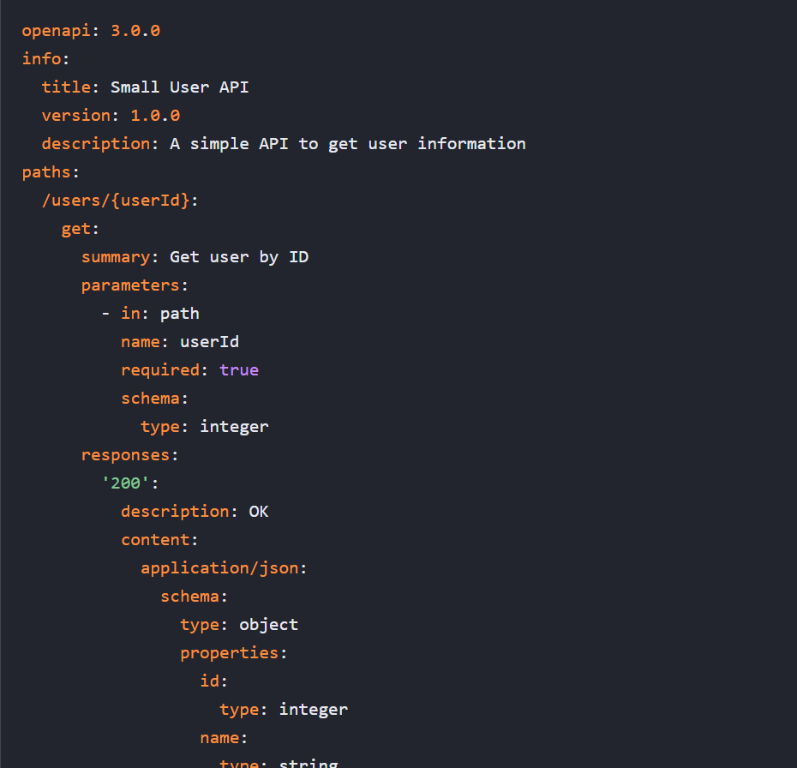
OpenAPI… What?
Big long YAML/JSON file
Defines every API “operation”
Inputs and Outputs
Documentation
Much more…

Slide 15
Why should I care?

Slide 16

+
?

Slide 17
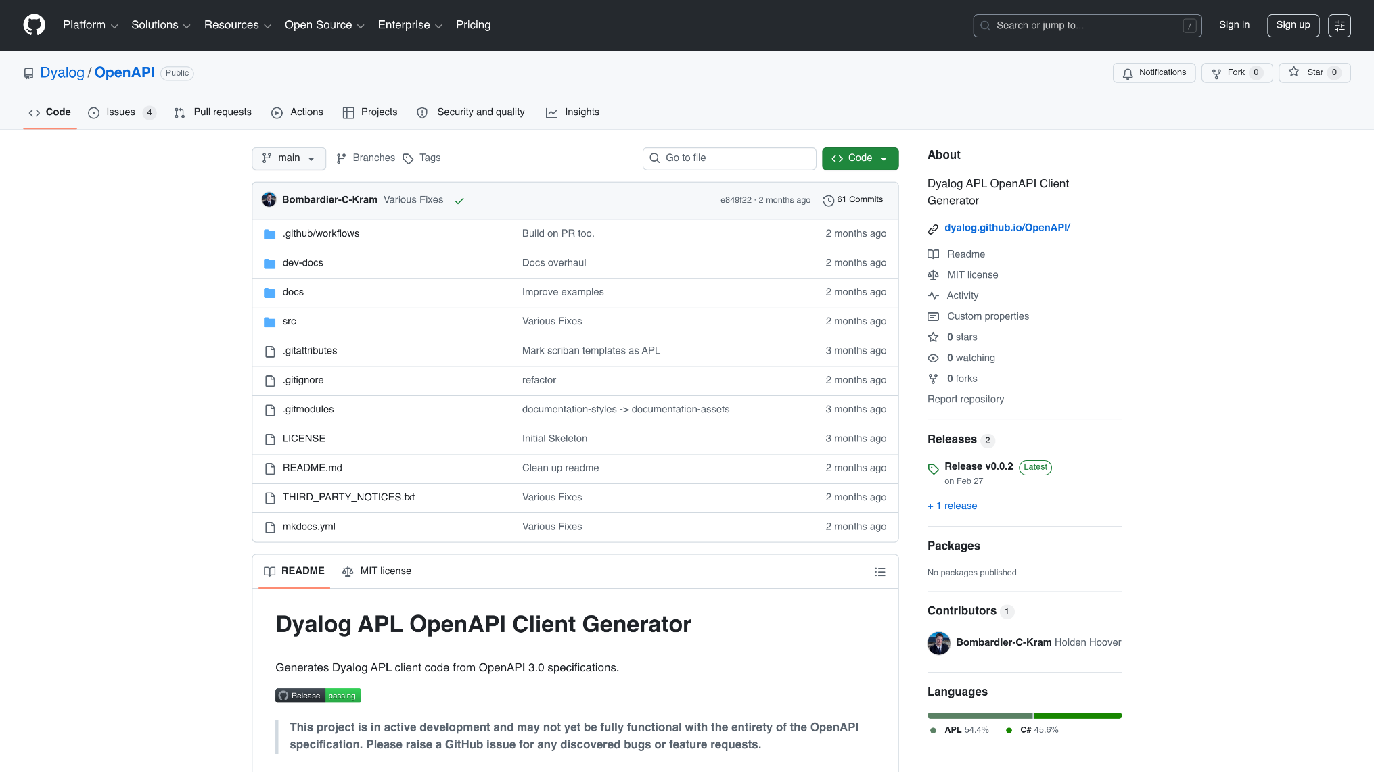

Slide 18
OpenAPI APL Client Generation
Take JSON/YAML description as input
APL code as output
Use HttpCommand internally
Hide “API Stuff”

Slide 19
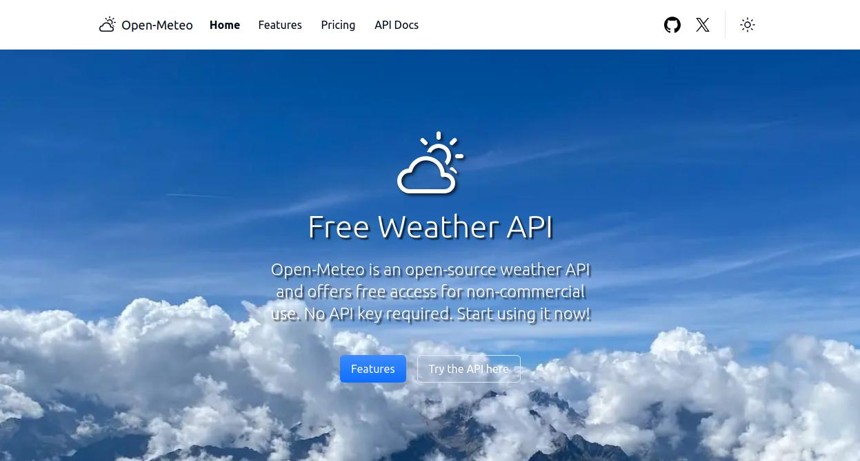
Demo 1

Slide 20
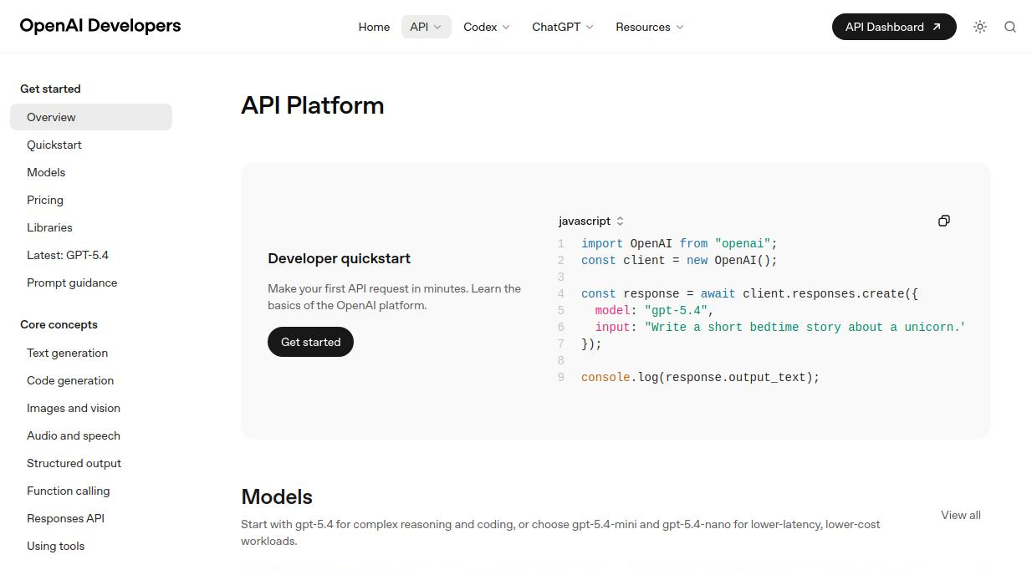
Demo 2

Slide 21
What Else?

Slide 22
OpenAPI REST Servers
Write spec first
Force to think about design of API
Tool ecosystem available
Generation
Documentation
Testing
LLMs work well with OpenAPI

Slide 23
Why should I care?
YOUR APP

Slide 24
Why should I care?
YOUR APP

Slide 25
APL OpenAPI Services
Stark
Experimental Project
Jarvis
“Register Routes”
Autogenerates OpenAPI JSON

Slide 26
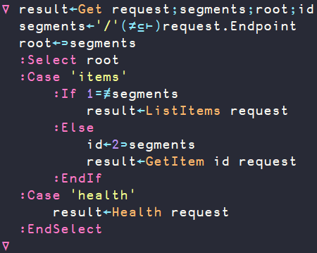
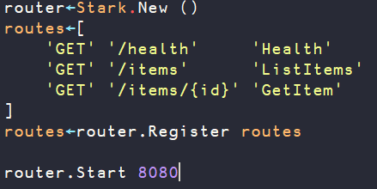
What about APL Servers?

Slide 27
What about APL Servers?

Slide 28
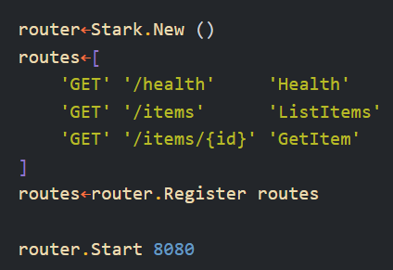
What about APL Servers?

Slide 29
What about APL Servers?

Slide 30
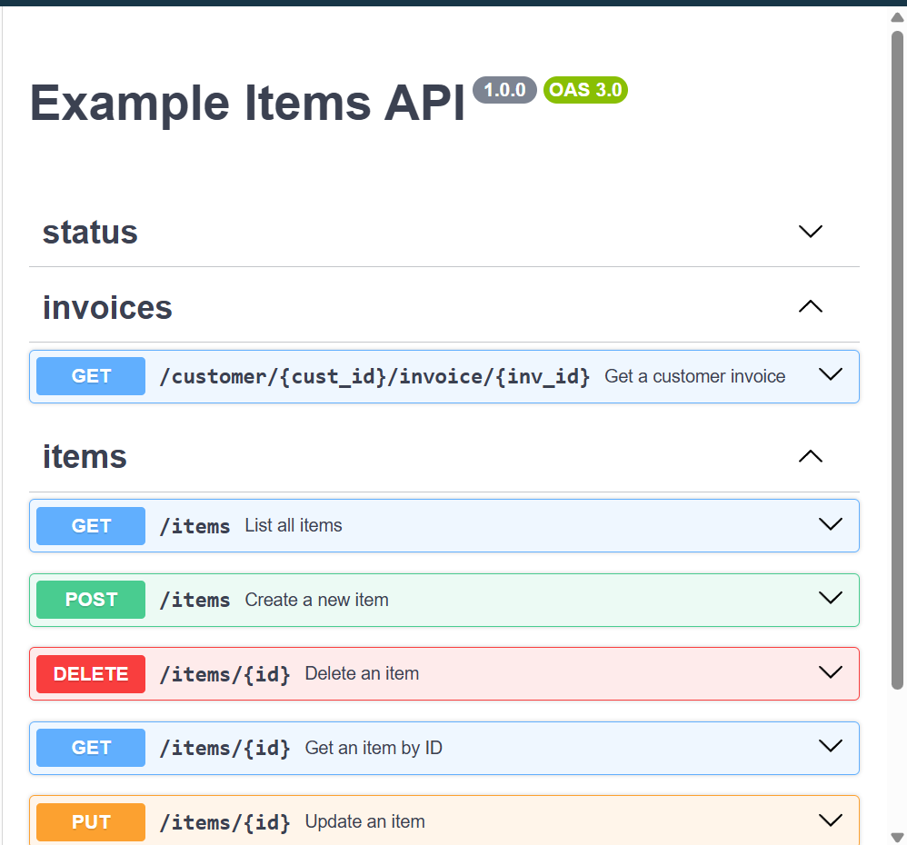
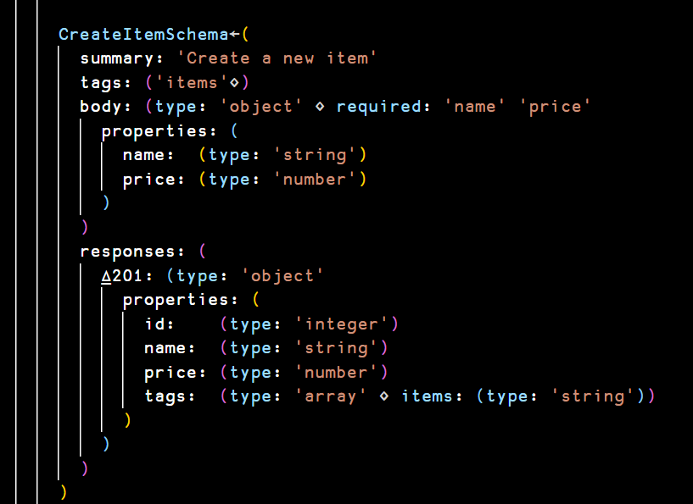
What about APL Servers?

Slide 31
Future?

