Slide 1
An interface to Kafka
Martina Crippa

Slide 2
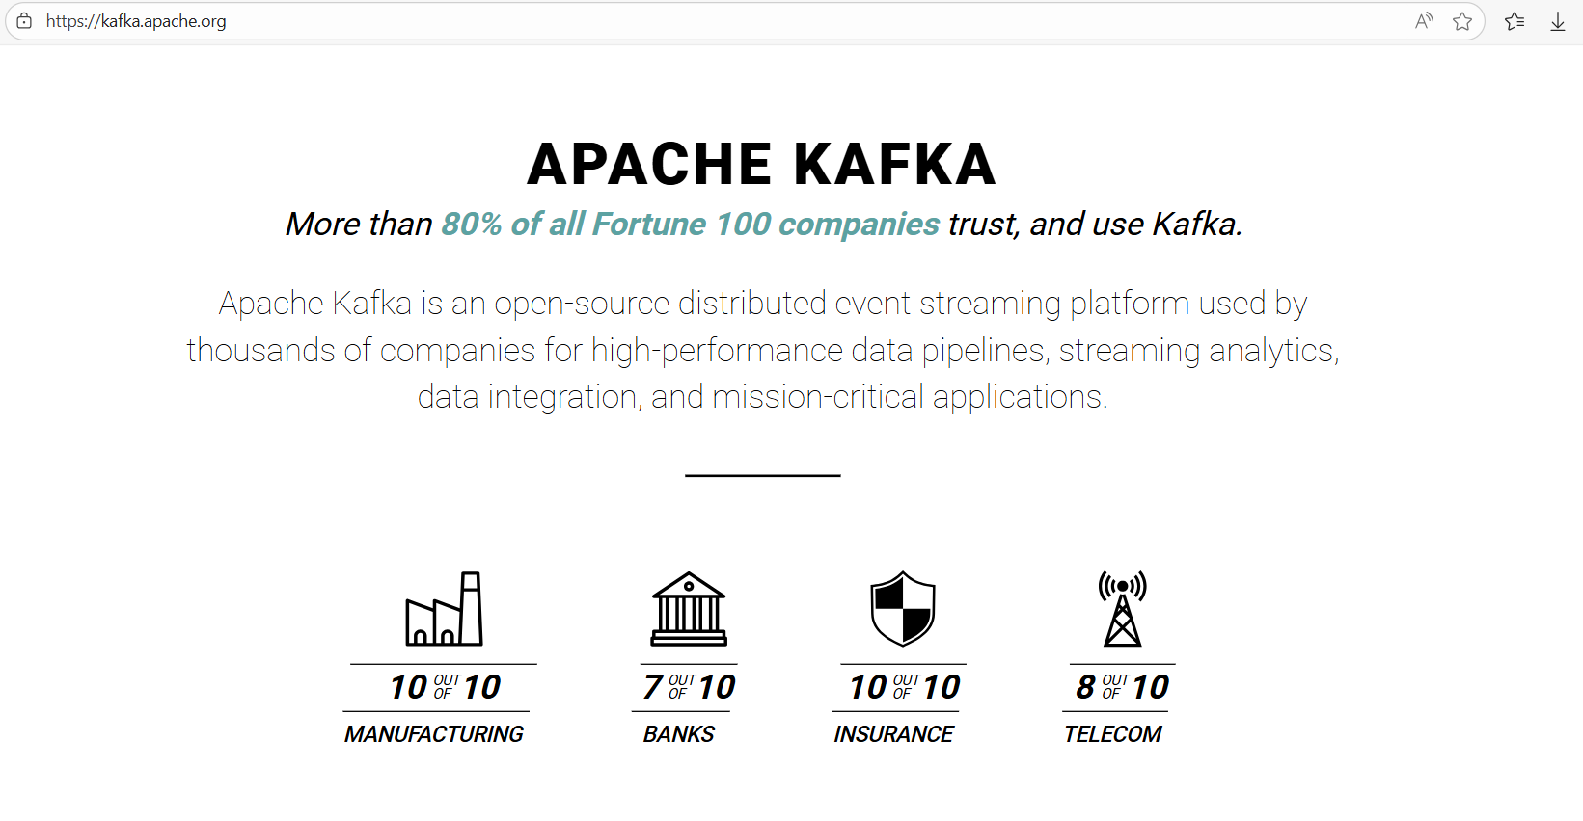
Why Kafka?

Slide 3






Distributed applications
“..distributed event streaming platform…”
  Applications can send and receive data in real time.
One (or more) applications write and read into/from multiple topics.
Producer
Topic (log):
Temperatures
T1
T2
…
Consumer
Consumer
Producer
Consumer
f1
…
f2
…
Topic: Forecast

Slide 4
Topics
Ordered sequence (log) of events stored as messages (key-payload pair), on a Kafka server.
Events are related
Durable
(Almost) no limit in size
Event
Topic A
Message1
Message2
Message3
Message4
…
Time

Slide 5
Partitions
Divide a topic into different logs.
Live on different “nodes” of a Kafka cluster.
    Distributed system
Order guaranteed inside each partition.
Topic A
Partition 1
…
Partition 2
...
Partition 3
...
…

Slide 6
Producers
Write messages on topic(s) and set the key. Partition assigned by the server as hash of the key.
Topic A
Key
Partition 1
…
Producer
Partition 2
...
Partition 3
...
…

Slide 7
Consumer & Groups
Subscribe to topic(s) and read the messages (key value pair).
A consumer subscribed to a topic, reads from all partitions.
  Consumers in the same group cooperate to read the messages from all the partitions.
  If there are different groups, each group reads all the messages.
  Consumers don’t destroy messages.
Topic A
Group 1
Group 1
Consumer 1
Partition 1
…
Consumer 1
Consumer 2
Partition 2
...
…
Group 2
Partition 3
...
Consumer 2
Consumer 1
…
…

Slide 8
Consumer groups
Producer
Topic (log): Temperatures
T1
T2
…
Group 2
Group 1
Consumer
Consumer
Producer
Consumer
f1
…
f2
…
Topic: Forecast

Slide 9


APL Kafka Interface
  C interface (based on Confluent librdkafka) and APL API built on top of it.
  Open Source! https://github.com/Dyalog/kafka
Kafka object: int InitKafka(void** kafka);
Configuration: int SetKafkaConf(void* kafka, char* key, …);
Produce: int Produce(void* prod, char* topic, char* payload, …);
Delivery report: int DeliveryReport(void* prod, unsigned long long* msgid, …);
Subscribe Topic: int SubscribeConsumerTPList(void* kafka, void* subscr,…);
Consume: int Consume(void* cons, char* topic,uint32_t *topiclen,…);
Manual commit: int Commit(void* cons, void* subscr);
typedef struct {
rd_kafka_conf_t* conf;
rd_kafka_t* rk;
rd_kafka_message_t* msg;
} kafka_struct;
kafka.dll accessible from APL (⎕NA): Producer and Consumer API.

Slide 10
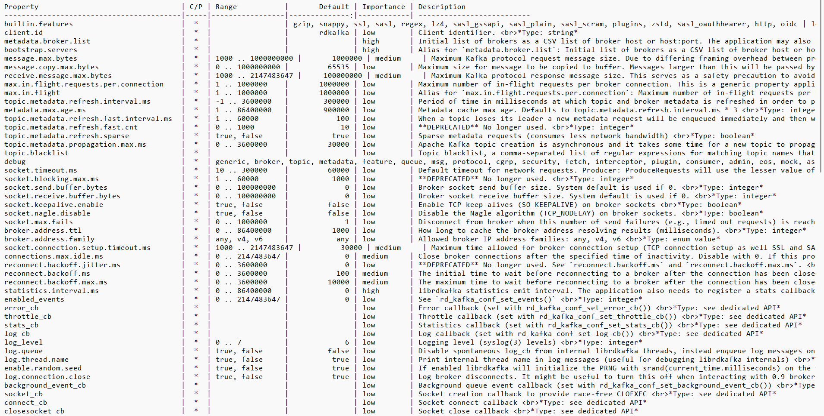

Producer API
librdkafka CONFIGURATION.md
⍝ Import libraries
Init 'path/to/dir/kafka/shared/lib'
⍝ Set configs
config← [
'bootstrap.servers' 'localhost:9092'
'client.id' 'martina']
⍝ Create producer
producer←⎕NEW Producer config
⍝ Produce messages
producer.produce 'animals' 'tiger' 'cats'
producer.produce 'invoces' (1⎕JSON inv) 'uid'
producer.produce_record ⎕NEW #.Record(
'animals' 'blackbird' 'birds')
⍝ Ask for delivery reports
producer.update_outstanding
⍝ Clean up
⎕EX 'producer'

Slide 11

Producer API
Python logo © Python Software Foundation. Used under CC BY-SA 3.0.
# Import libraries
from confluent_kafka import Producer
# Set configs
conf={'bootstrap.servers':'localhost:9092','client.id': 'martina'}
# Create producer
producer=Producer(conf)
# Produce messages
producer.produce('animals',
key='cats', value='tiger', callback=acked)
# Ask for delivery reports
producer.poll(1)

Slide 12
Consumer API
⍝ Consume messages
consumer.consume
:While running ⍝ Consume in a loop
cr←consumer.consume_record
:If 1=⊃cr
:Continue
:ElseIf 0=⊃cr
(2⊃cr).(Topic Payload Key Partition)
:EndIf
:EndWhile
⍝ Commit config⍪← 'enable.auto.commit' 'false'
consumer.commit
⍝ Clean up
⎕EX 'consumer'
⍝ Import libraries
Init 'path/to/dir/kafka/shared/lib'
⍝ Set configs
config←[
'bootstrap.servers' 'localhost:9092'
'client.id' 'martina'
'group.id' 'dyalog']
⍝ Create consumer with config and
⍝ subscribe to topics
consumer←⎕NEW Consumer config
consumer.subscribe 'animals' 'plants'

Slide 13
Consumer API
Python logo © Python Software Foundation. Used under CC BY-SA 3.0.
# Import libraries
from confluent_kafka import Consumer
# Set configs
conf = {
'bootstrap.servers':'localhost:9092',
'client.id': 'martina'
'group.id': 'dyalog'}
# Create consumer with config and
# subscribe to topics
consumer=Consumer(conf)
consumer.subscribe(['animals', 'plants'])
# Consume messages
while running:
msg = consumer.poll(timeout=1.0)
if msg is None:
continue
else: msg_process(msg)
# Commit
consumer.commit(False)

Slide 14
Kafka server admin
No “Admin API”: admin operations handled outside our interface, by kafka-cli:
  Create topics:
  Inspect groups status on the server:
  …
kafka-topics.sh --bootstrap-server localhost:9092 \
--create --topic "cars“ \
--partitions 3
kafka-consumer-groups.sh --bootstrap-server localhost:9092
--all-groups --describe --offsets
GROUP TOPIC PARTITION CURRENT-OFFSET LOG-END-OFFSET LAG CONSUMER-ID HOST CLIENT-ID
cl tp1 0 5 8 3 cl1-088dsd… /localhost cl1
cl tp1 1 16 20 4 cl1—088dsd… /localhost cl1
cl tp1 2 1 2 1 cl2—134a8f… /localhost cl2

Slide 15
Demo!

Slide 16



Group “accounting”
Topic “musical-instruments”
sales
Partition 0
…
accountant1

Slide 17




Topic “musical-instruments”
Partition 0
…
Topic “plants”
Group “accounting”
Partition 0
…
accountant1
sales
Partition 1
...
Partition 2
...
accountant2
…

Slide 18
Group “accounting”
accountant1
Topic “musical-instruments”
accountant2
sales
Partition 0
…
Group “marketing”
repr

Slide 19
Thank you!

