Slide 1
What can Vectorised Trees Do for You?
Asher Harvey-Smith

Slide 2
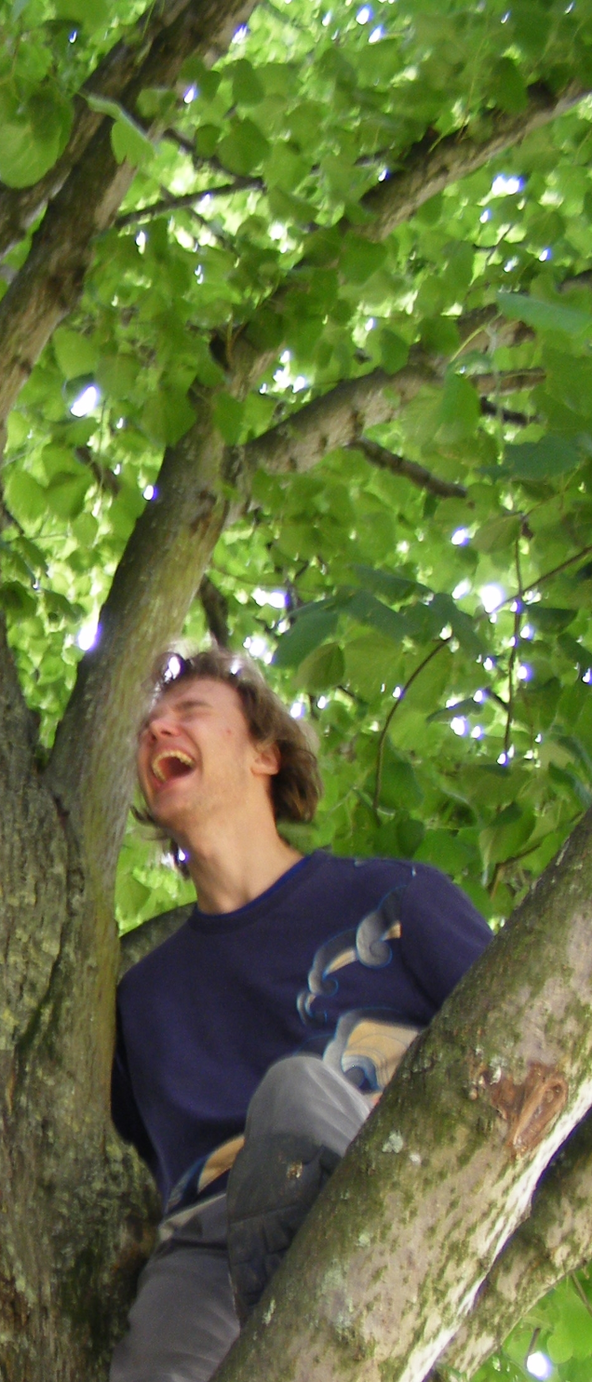
Me
Freshly graduated 🎉
(Computer Science MEng, University of Warwick)

Slide 3
Me
Freshly graduated 🎉
(Computer Science MEng, University of Warwick)
Intern

Slide 4
Me
Freshly graduated 🎉
(Computer Science MEng, University of Warwick)
Intern
Senior Intern

Slide 5
Me
Freshly graduated 🎉
(Computer Science MEng, University of Warwick)
Intern
Senior Intern
Proper employee 🎉

Slide 6
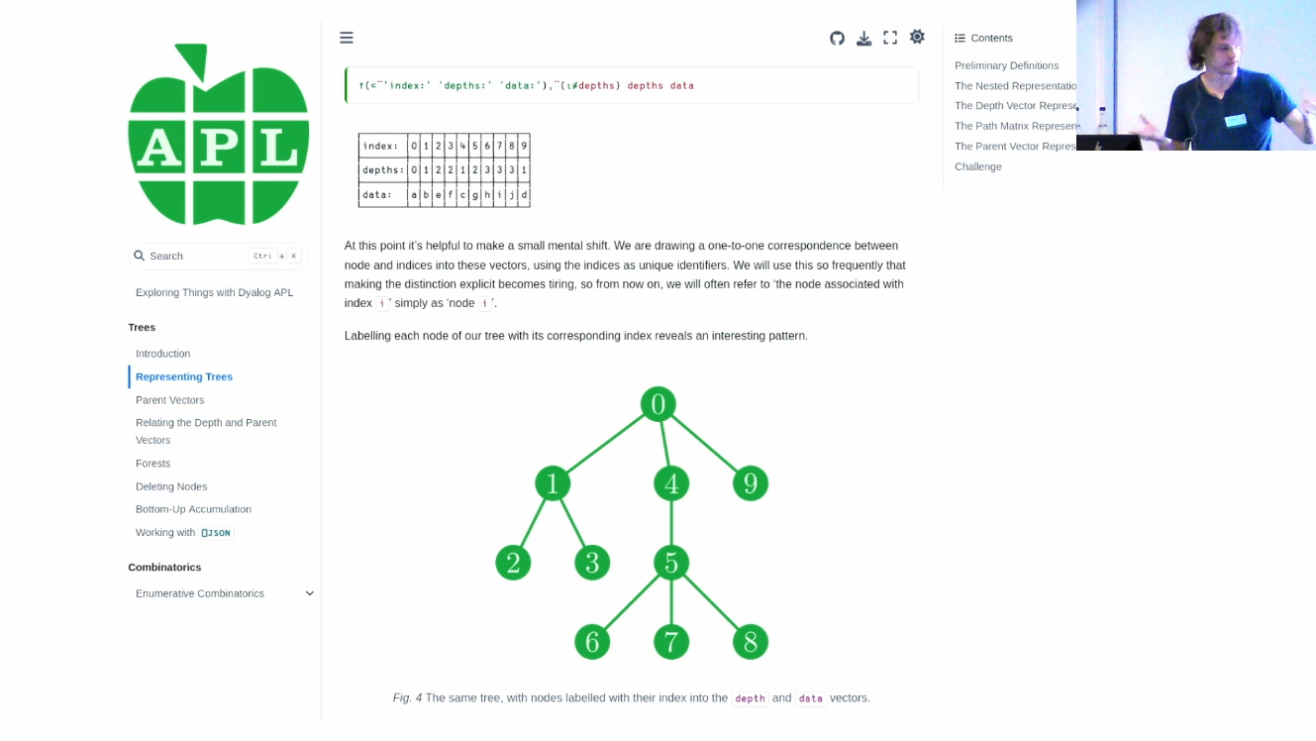

Slide 8
Parent

Slide 9
Parent
Child

Slide 10
Root
Parent
Child

Slide 11
Root
Parent
Leaf
Child

Slide 15
0
1
2
3
4
5
6
7
8
9

Slide 16
0
1
1
0
4
5
5
5
0
0
1
2
3
4
5
6
7
8
9

Slide 17
0
0
1
1
0
4
5
5
5
0
0
1
2
3
4
5
6
7
8
9

Slide 18
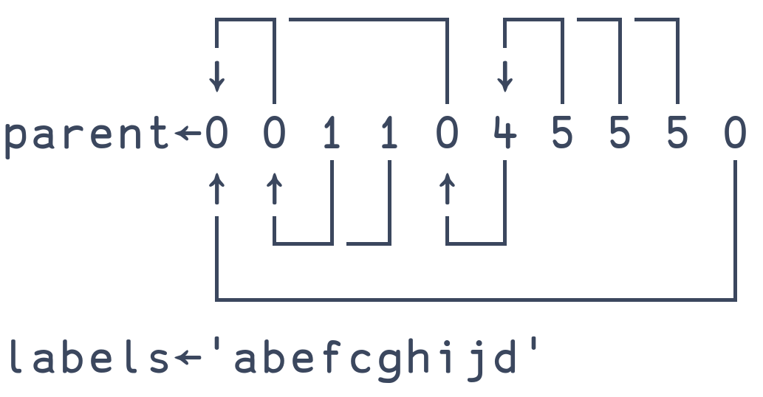
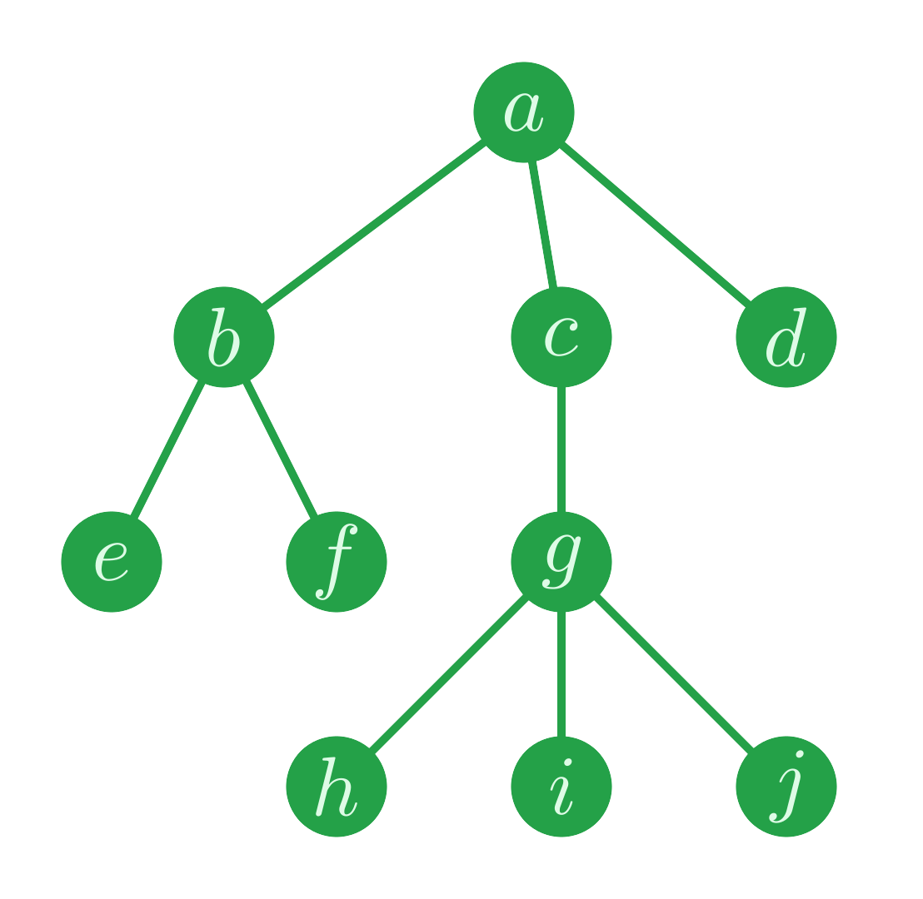
Parent Vectors

Slide 19
Parent Vectors

Slide 20
Parent Vectors
Let’s see some code

Slide 21
When Are Parent Vectors Useful?
Large ✔
  Larger trees have more performance gains from vectorisation.

Slide 22
When Are Parent Vectors Useful?
Large ✔
  Larger trees have more performance gains from vectorisation.
Irregular ✔
  For trees with a predictable shape, you can get away with ad-hoc approaches.

Slide 23
When Are Parent Vectors Useful?
Large ✔
  Larger trees have more performance gains from vectorisation.
Irregular ✔
  For trees with a predictable shape, you can get away with ad-hoc approaches.
Traversing bottom-up ✔
  Parent pointers take us up the tree.
  You can go bottom-up more often than you think!

Slide 24
Case Study: Co-dfns & Static Analysis
Syntax tree is represented by a parent vector
  Large ✔
  Irregular ✔
  Bottom-up traversals ✔
Largest serious projects using the technique (that I know of)

Slide 25
Case Study: File System Queries
File systems are* trees
  *pedants will bring up file system links, we will ignore the pedants
They can be large ✔ and irregular ✔
You can do all sorts of queries very easily on a parent vector
  Using bottom-up traversals ✔

Slide 26
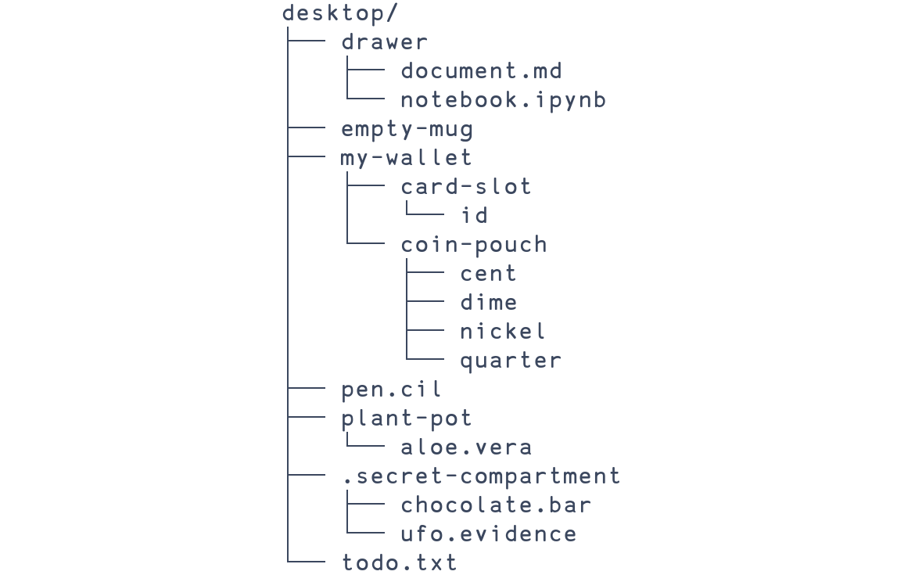

Slide 27
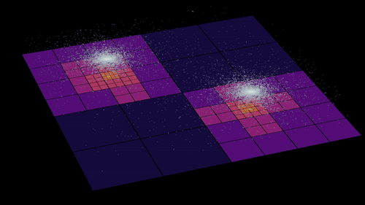
Case Study: Barnes-Hut Simulation
By Perossello - Own work, CC BY-SA 4.0, https://commons.wikimedia.org/w/index.php?curid=147365688

Slide 31


Slide 32


Slide 33
Case Study: Barnes-Hut Simulation
Possibility 1: I did it wrong

Slide 34
Case Study: Barnes-Hut Simulation
Possibility 1: I did it wrong
Possibility 2: Interpreter overhead is overwhelming the speedup
  Top down traversal for each particle, without any sharing

Slide 35
Case Study: Barnes-Hut Simulation
Possibility 1: I did it wrong
Possibility 2: Interpreter overhead is overwhelming the speedup
  Top down traversal for each particle, without any sharing
Maybe with more particles it is faster
  My laptop is not strong enough to try

Slide 36
Case Study: Barnes-Hut Simulation
Possibility 1: I did it wrong
Possibility 2: Interpreter overhead is overwhelming the speedup
  Top down traversal for each particle, without any sharing
Maybe with more particles it is faster
  My laptop is not strong enough to try
The point: parent vectors don’t help us with top-down traversal!

Slide 37
Case Study: Disjoint Set Data Structure

Slide 38
Case Study: Disjoint Set Data Structure

Slide 39
Case Study: Disjoint Set Data Structure

Slide 40
Case Study: Disjoint Set Data Structure

Slide 41
Case Study: Disjoint Set Data Structure

Slide 42
Case Study: Disjoint Set Data Structure

Slide 43
Case Study: Disjoint Set Data Structure

Slide 44
Case Study: Disjoint Set Data Structure

Slide 45
Case Study: Disjoint Set Data Structure
Finding contiguous regions of an image
  I used it for this
Finding connected components
Finding minimum spanning trees
Solving symbolic expressions by unification
Probably more!

Slide 46
The Root of It
Data
  Syntax trees ✔
  File systems ✔
  …
Algorithms
  Barnes-Hut simulation ✘
  Disjoint sets ✔
  …

Slide 47
The Root of It
You can do trees the APL way!
Consider using parent vectors if you have trees which
  Are large
  Are irregular
  Are often traversed bottom-up
You could* speed up your program and/or make it easier to understand
  *your mileage may vary, always profile

Slide 48
Read My Tutorial!
asherbhs.github.io/apl-site/trees/intro.html

Slide 49
Case Study: Disjoint Set Data Structure

Slide 50
Case Study: Disjoint Set Data Structure

Slide 51
Case Study: Disjoint Set Data Structure

Slide 52
Case Study: Disjoint Set Data Structure

Slide 53
Case Study: Disjoint Set Data Structure

Slide 54
Case Study: Disjoint Set Data Structure

Slide 55
Case Study: Disjoint Set Data Structure

Slide 56
Case Study: Disjoint Set Data Structure

Slide 57
Case Study: Disjoint Set Data Structure

Slide 58
Case Study: Disjoint Set Data Structure

Slide 59
Case Study: Disjoint Set Data Structure

Slide 60
Case Study: Disjoint Set Data Structure

Slide 61
Case Study: Disjoint Set Data Structure

Slide 62
Case Study: Disjoint Set Data Structure

Slide 63
Case Study: Disjoint Set Data Structure

Slide 64
Case Study: Disjoint Set Data Structure

Slide 65
Case Study: Disjoint Set Data Structure

Slide 66
Case Study: Disjoint Set Data Structure

Slide 67
Case Study: Disjoint Set Data Structure

Slide 68
Case Study: Disjoint Set Data Structure

Slide 69
Case Study: Disjoint Set Data Structure

Slide 70
Case Study: Disjoint Set Data Structure

Slide 71
Case Study: Disjoint Set Data Structure

Slide 72
Case Study: Disjoint Set Data Structure

Slide 73
Case Study: Disjoint Set Data Structure

Slide 74
Case Study: Disjoint Set Data Structure

Slide 75
Case Study: Disjoint Set Data Structure

Slide 76
Case Study: Disjoint Set Data Structure

Slide 77
Case Study: Disjoint Set Data Structure

Slide 78
Case Study: Disjoint Set Data Structure

Slide 79
Case Study: Disjoint Set Data Structure

Slide 80
Case Study: Disjoint Set Data Structure

Slide 81
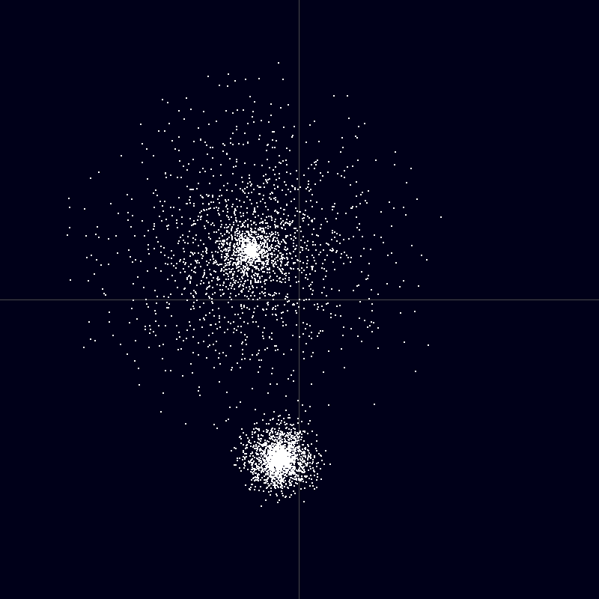
By Eclipse.sx - Own work, CC BY-SA 3.0, https://commons.wikimedia.org/w/index.php?curid=7388664

Slide 82
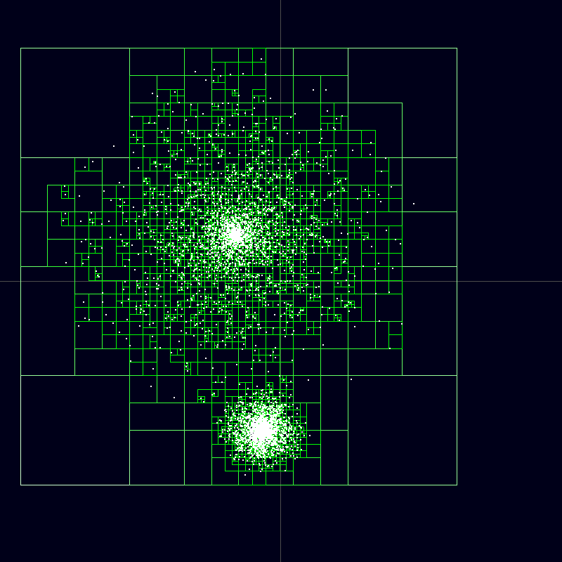
By Eclipse.sx - Own work by uploader; created with: http://www.beltoforion.de/barnes_hut/barnes_hut_de.html, CC BY-SA 3.0, https://commons.wikimedia.org/w/index.php?curid=7388668

Slide 83
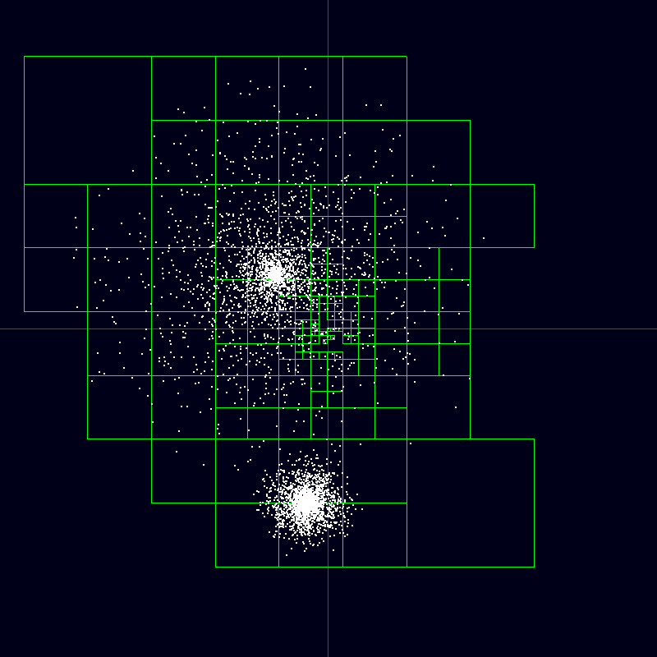
By Eclipse.sx - Own work by uploader; created with: http://www.beltoforion.de/barnes_hut/barnes_hut_de.html, CC BY-SA 3.0, https://commons.wikimedia.org/w/index.php?curid=7388671

