Slide 1
ArrayLab: Building a 3D APL Game with raylibAPL
Holden R. Hoover (holdenhoover@bkaw.ca)
DYNA Fall 2025

Slide 2

Who am I?
First year Computer Engineering Student @ UWaterloo
Using APL since 2020
  Summer of 2021, worked on APEX compiler
  2024 APL Forge winner
  Many other various projects…
Summer work with Dyalog

Slide 3
Overview
Intro
Intro to project
What is raylibAPL
Getting Started: in 2D
ArrayLab: the 3D game
The 3D game making process: APL edition (Challenges)
Conclusion

Slide 4
So, what is this year's project?
Testing raylibAPL
Making a game in APL
  Planning the game
  Being an artist
  Writing the game in APL

Slide 5
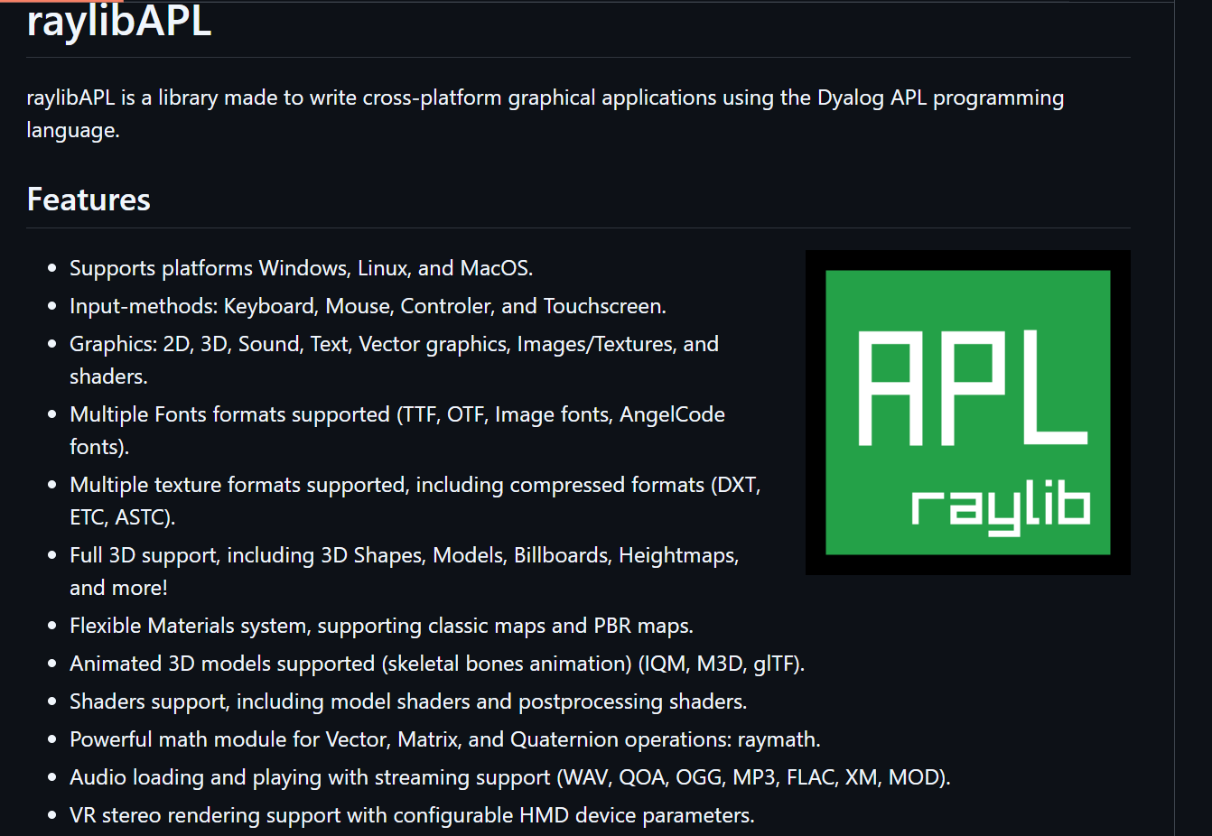
What is raylibAPL?
Raylib is a barebones C library for 2D/3D graphics, input, audio and more
raylibAPL provides the bindings to raylib, and uses ⎕NA
Written by Brian Ellingsgaard
Brians presentation last year goes over the “how it works”
For purposes of this presentation, it is a library that provides all of the required components to build a game

Slide 6
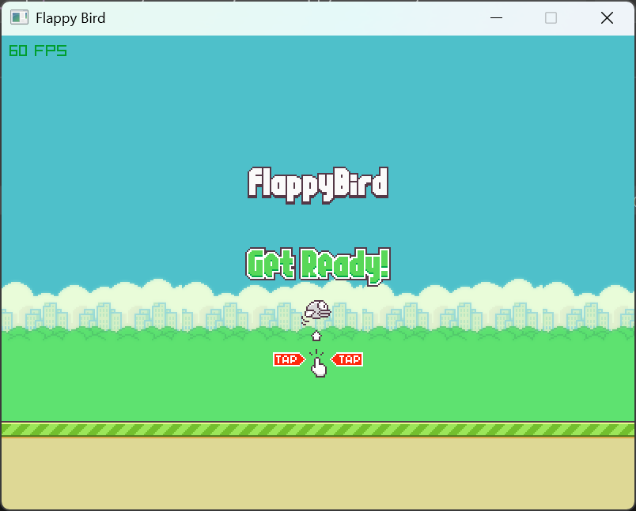
Getting Started (2D)
Started with a 2D game
Took around 6 hours
Quick demo

Slide 7
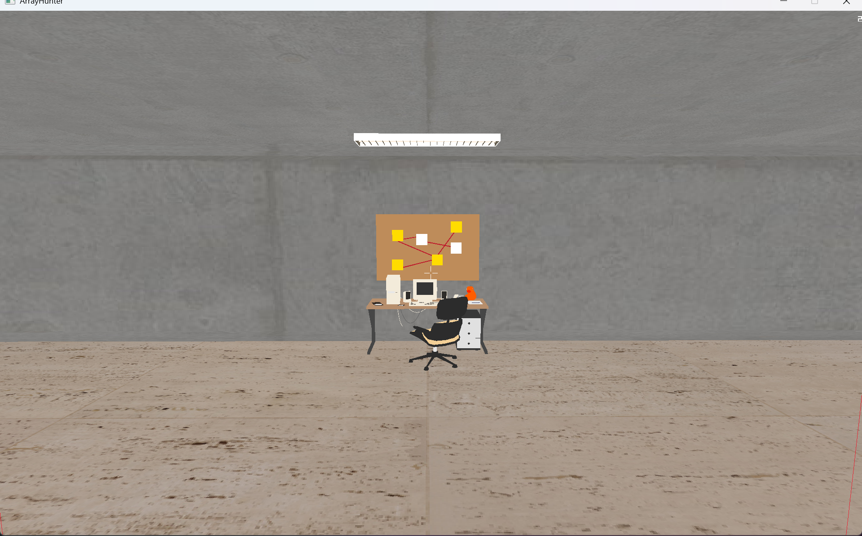
ArrayLab
Project: Create a fully fledged game in APL
Idea: “The story of APL, but funny”
Reality: Bugs
Modules implemented
Demo

Slide 8
My 3D Game Process (in APL)
Planning
Making art
Loading art
Physics
I/O

Slide 9
Loading…
GPU Thread
Split up the task
Primary thread issues
Mac

Slide 10
Physics
Collisions:
  Where?
  Colliding?
  What to do?
Gravity
Many models

Slide 11
I/O
APL Dialogue (Unicode)
Input lag

Slide 12
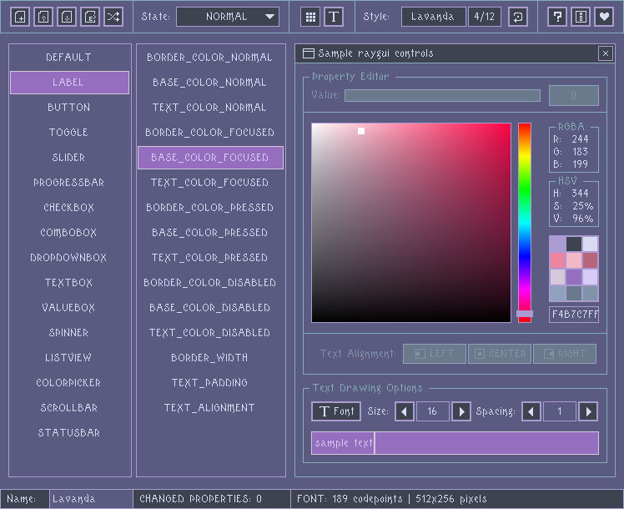
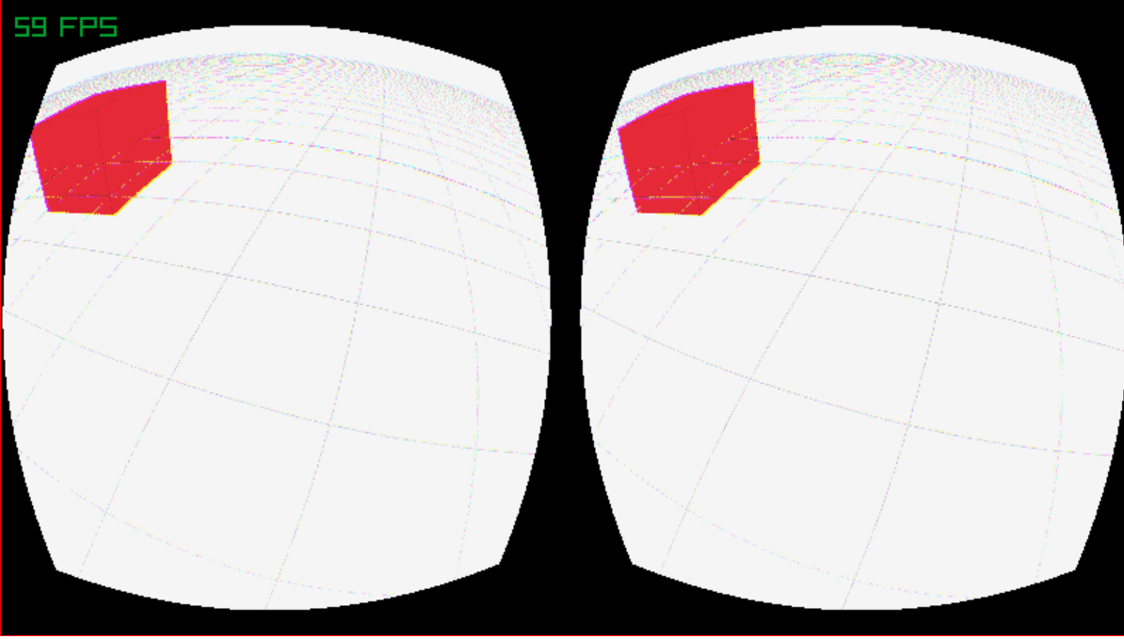
Why should I care?
Not just games
GUI possible
VR possible
Cross platform games

Slide 13
Conclusion
raylibAPL can deliver 2D/3D
Built this summer
What we learned
Bugs Squashed
Whats next?
Acknowledgements

Slide 14
Questions?
ArrayLab: Building a 3D APL Game with raylibAPL
Holden R. Hoover (holdenhoover@bkaw.ca)
DYNA Fall 2025

