Slide 1
APL Ecosystem
Brian Becker
APL Tools Architect
Dyalog, LTD

Slide 2
Premise
There are more resources today to
  Learn APL
  Participate in the APL community
  Contribute to the APL community
  Entertain yourself with APL
than at any time in history.
But most APLers don't know about them.

Slide 3
My goal
Make people aware of (some of) the resources available
Encourage people to explore those resources
Encourage people to share those resources
Encourage people to contribute to those resources

Slide 4
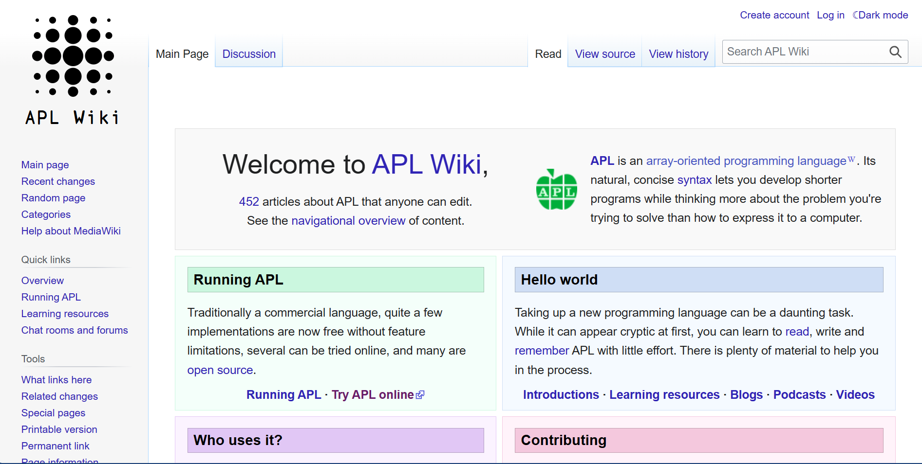
APLWiki

Slide 5
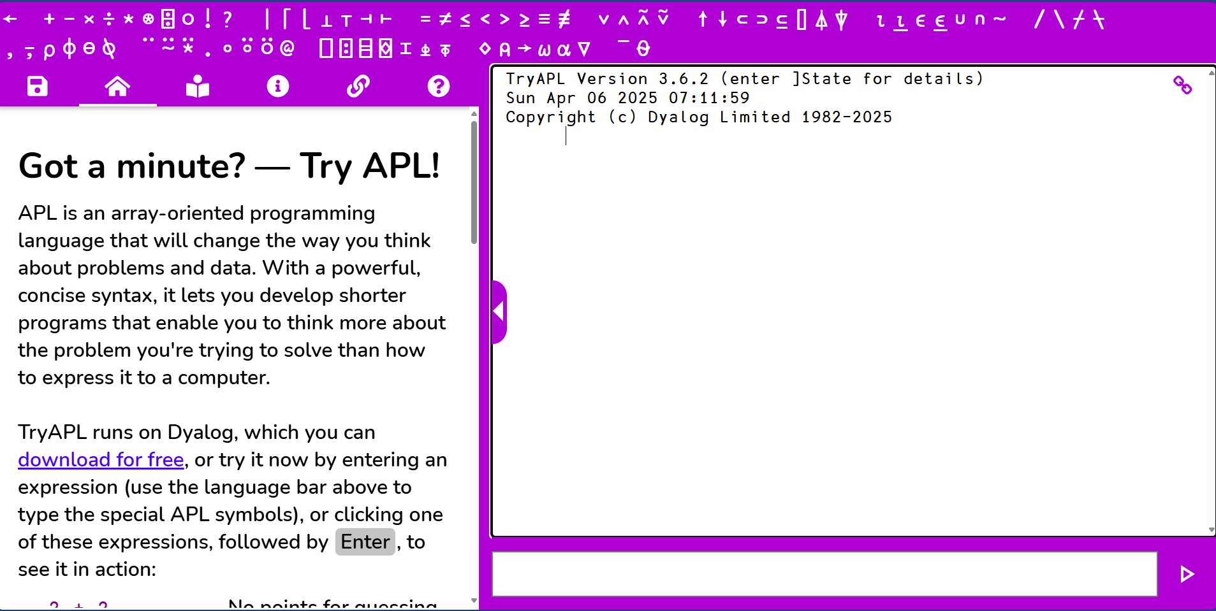
TryAPL

Slide 6
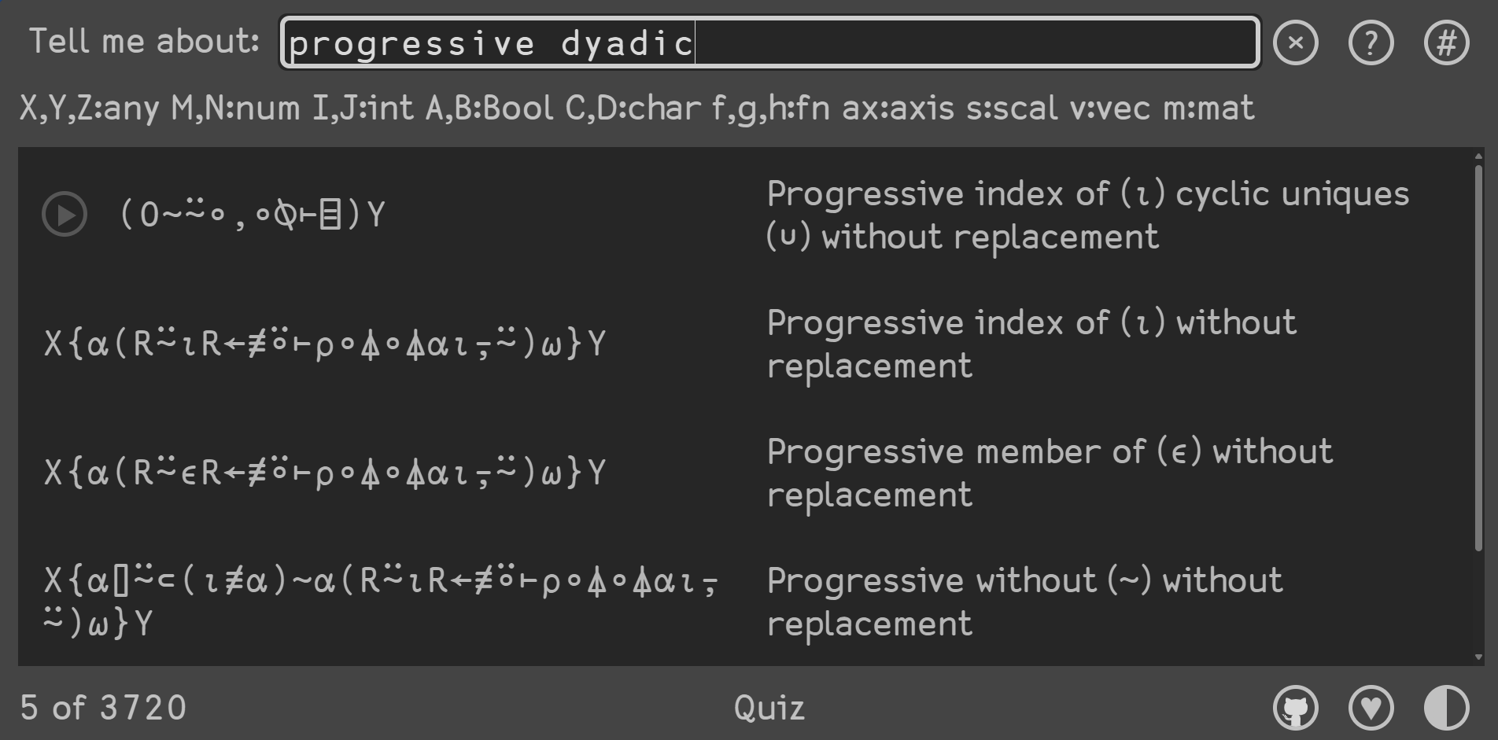
APLCart

Slide 7
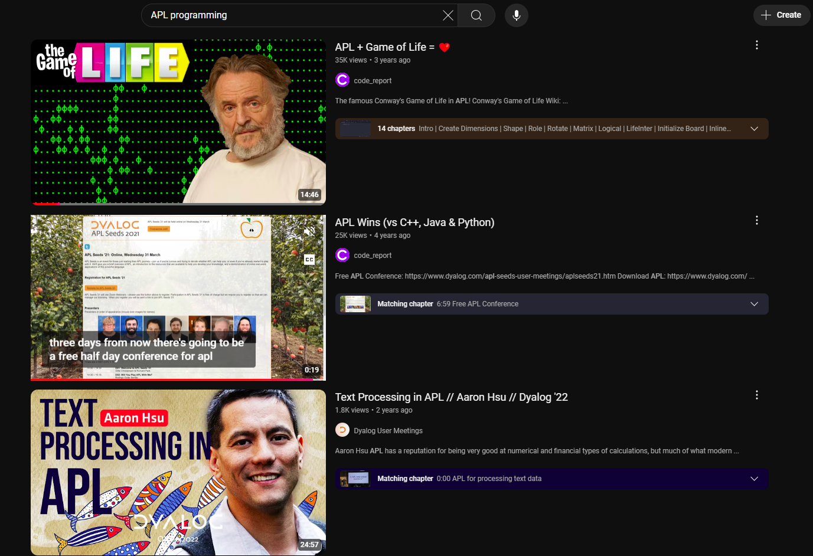
YouTube

Slide 8
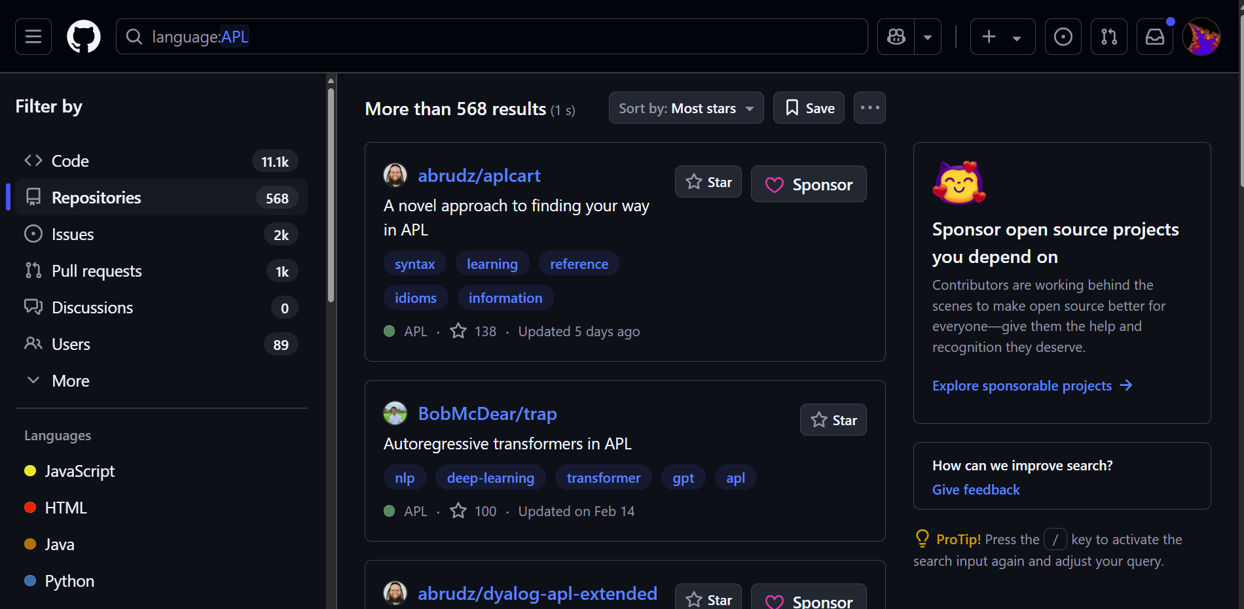
GitHub

Slide 9
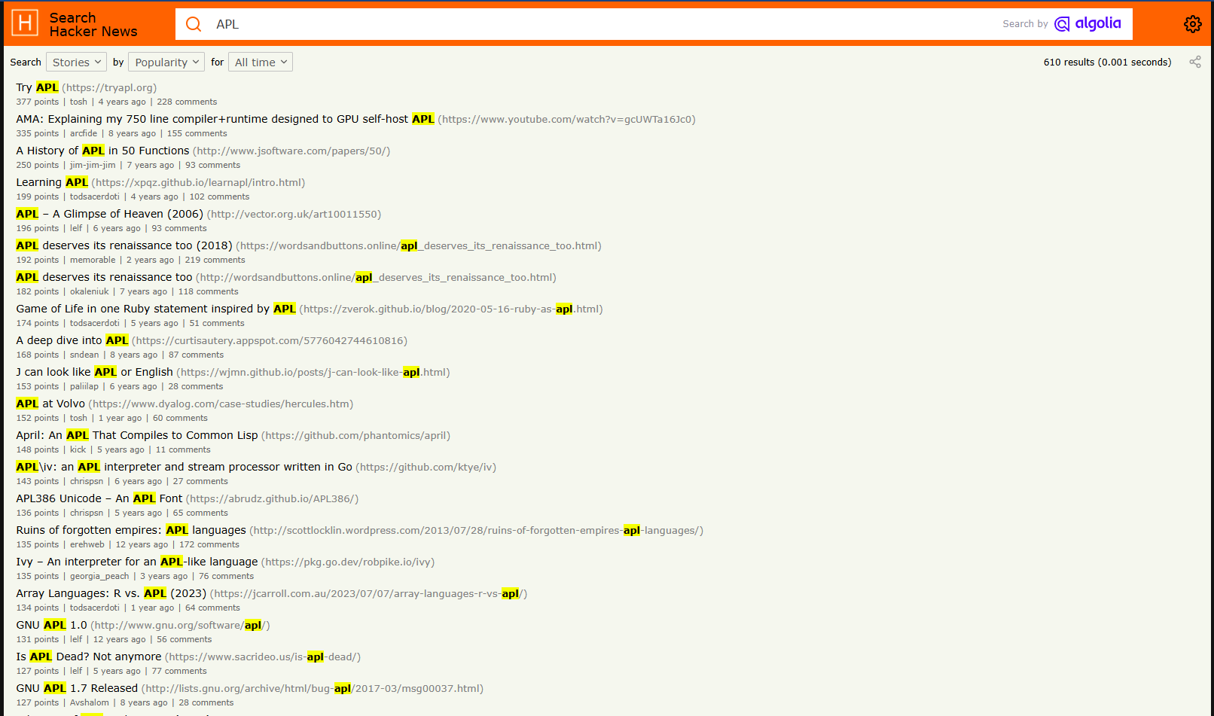
Hacker News

Slide 10
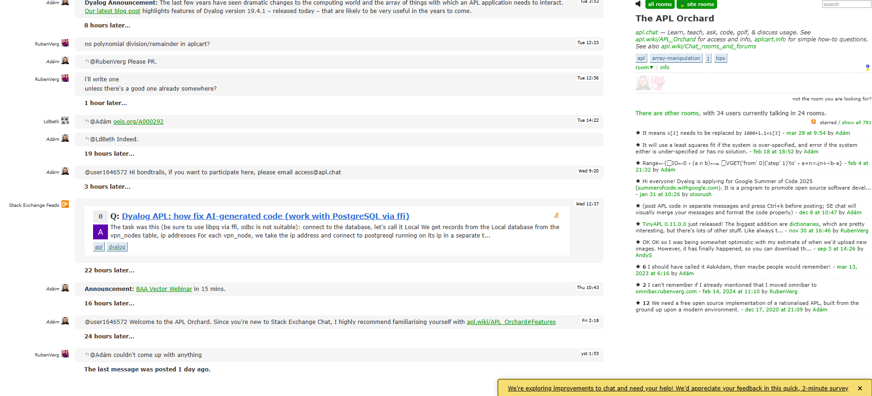
The APL Orchard (StackExchange)

Slide 11
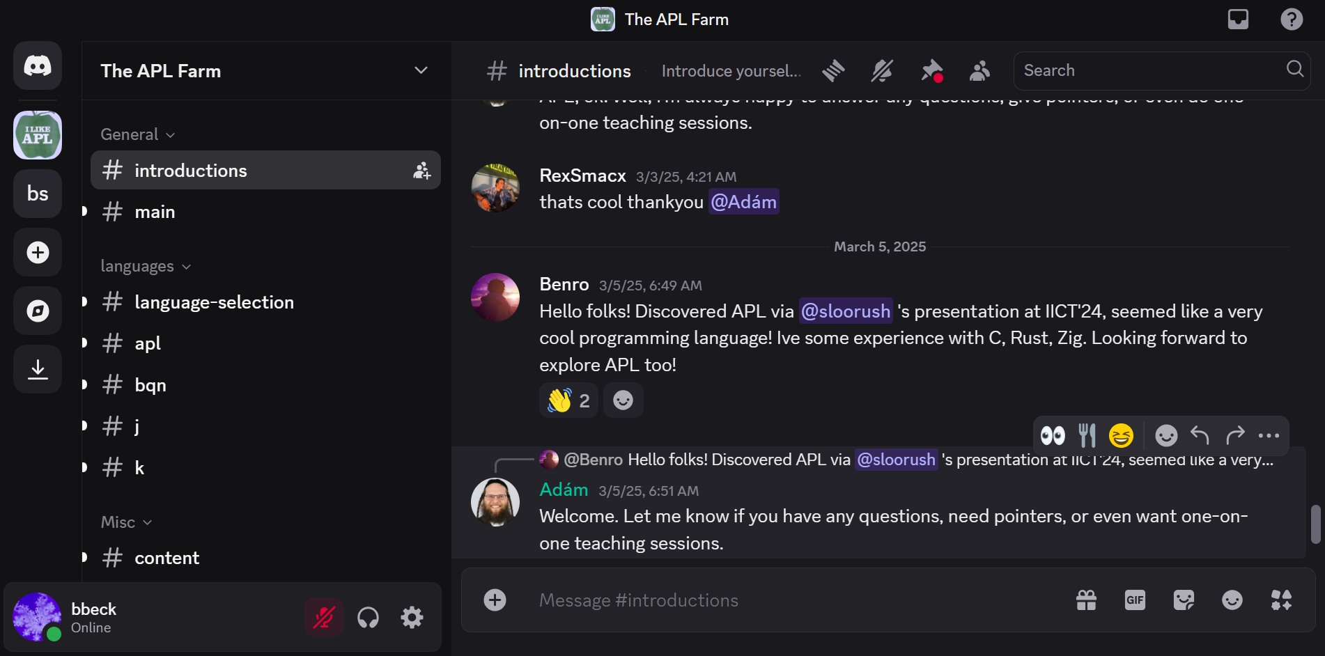
The APL Farm (Discord)

Slide 12
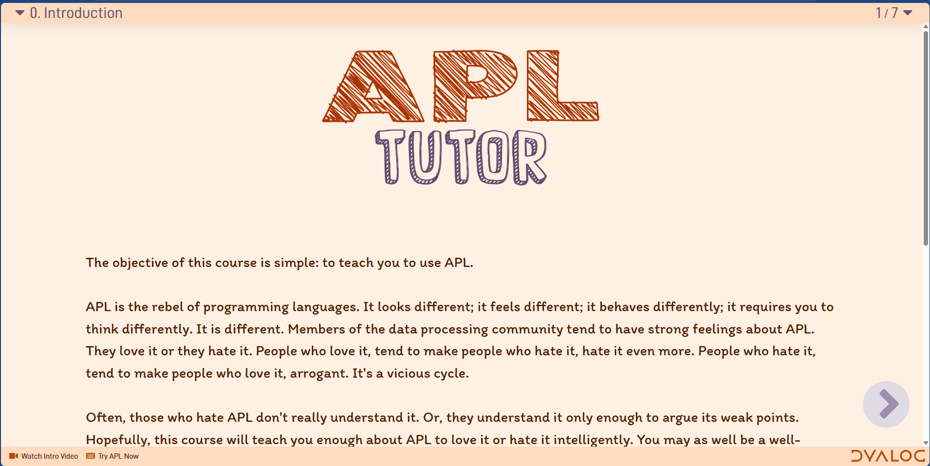
APL Tutor

Slide 13
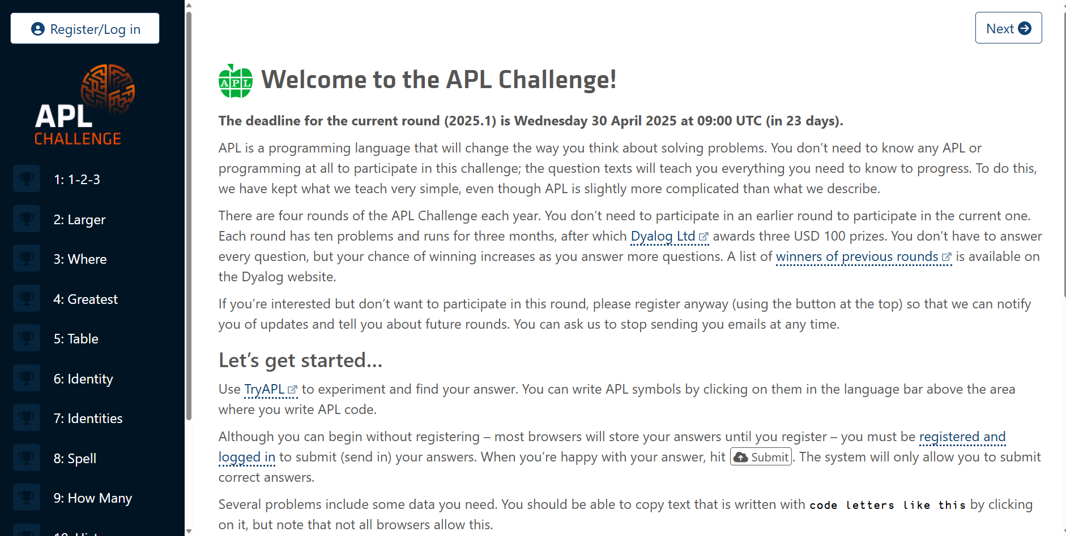
APL Challenge

Slide 14
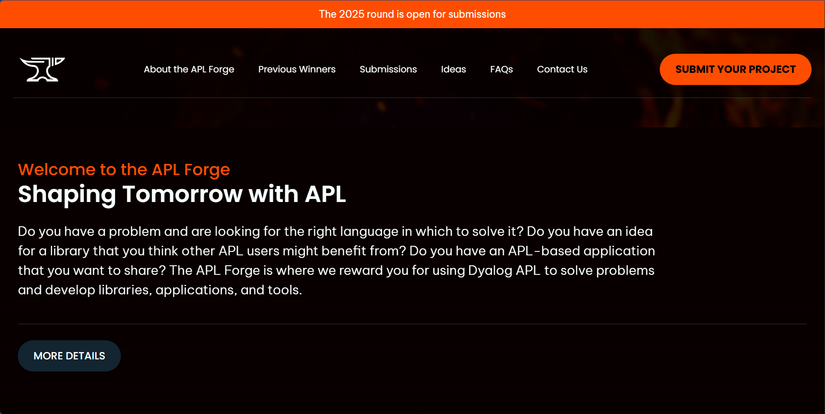
APL Forge

Slide 15
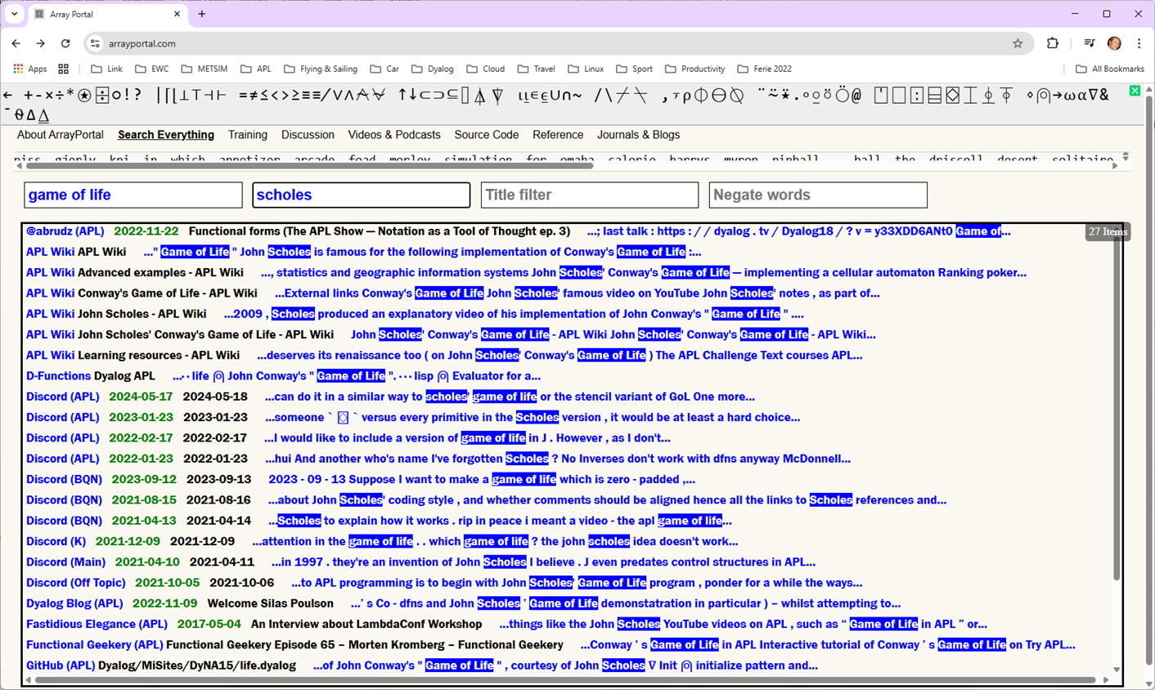
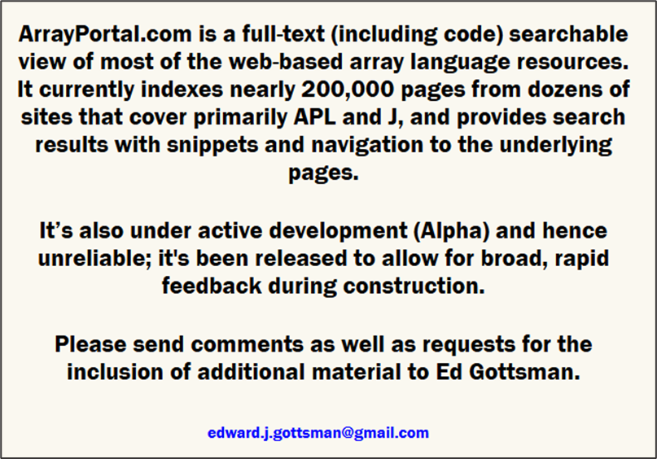
ArrayPortal.com

Slide 16
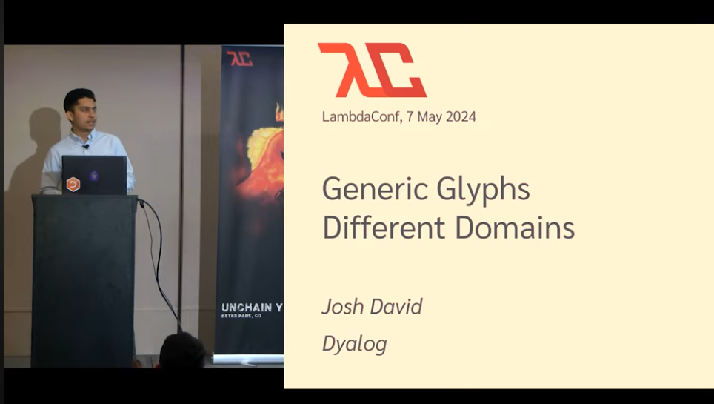
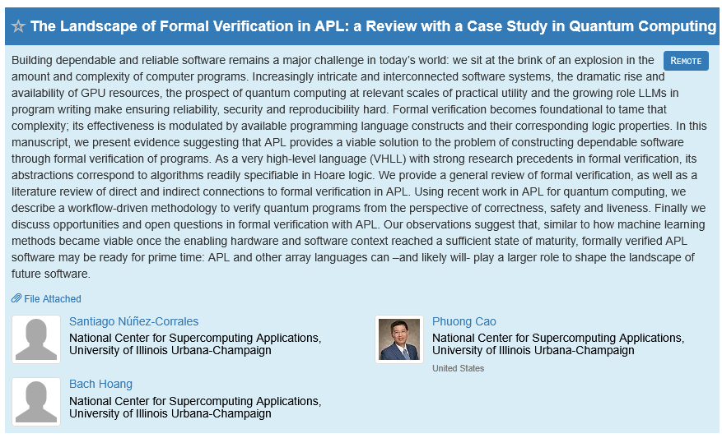
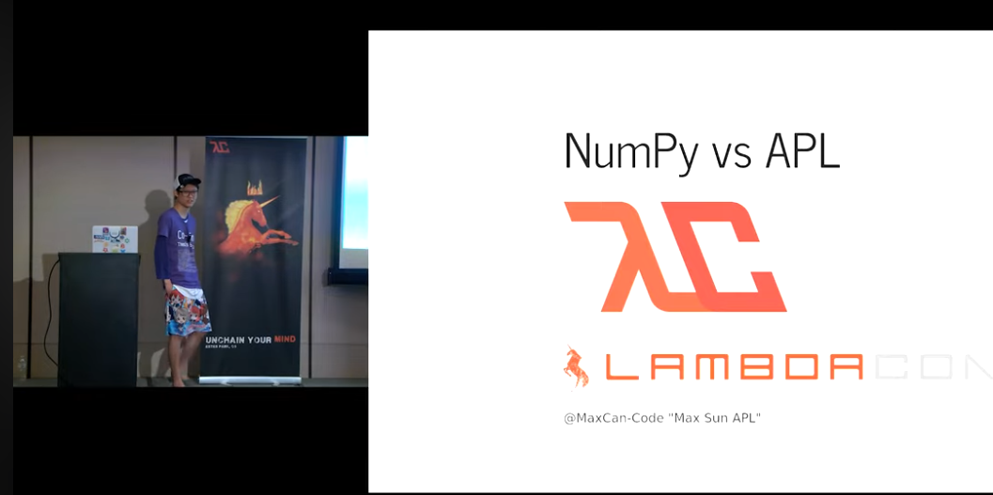
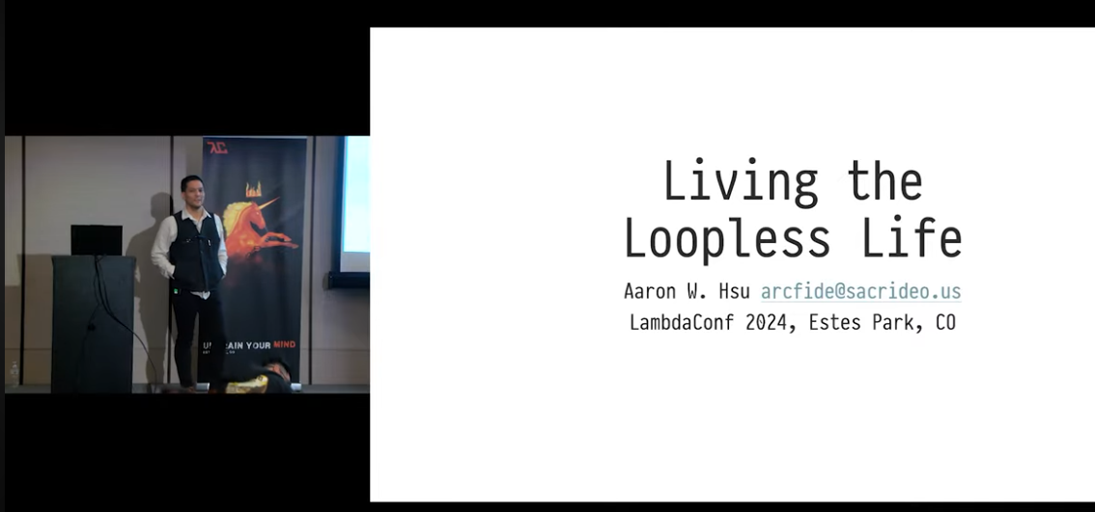
Evangelism
LambdaConf
Functional Conf
PLDI

Slide 17
URLS in this Presentation
The APL Wiki | https://aplwiki.com
APLCart | https://aplcart.info
YouTube | https://www.youtube.com/results?search_query=apl+language
GitHub | https://github.com/search?q=apl%20language&type=repositories
Hacker News | https://hn.algolia.com/?q=APL
The APL Orchard | https://chat.stackexchange.com/rooms/52405/the-apl-orchard
The APL Farm | https://discord.com/channels/821509511977762827/821509990287540285
APL Tutor | https://tutorial.dyalog.com/ (updated version coming)
APL Challenge | https://challenge.dyalog.com/
APL Forge | https://forge.dyalog.com/
Array Portal | https://www.arrayportal.com/

Slide 18
You can help…
Contribute to the APLWiki
Publish code
Like and comment on videos and presentations
Speak, Talk, Ask

Slide 19
Save the dates!
Fall DYNA will be a 2-day event on September 29th & 30th
Venue to be determined

Slide 20
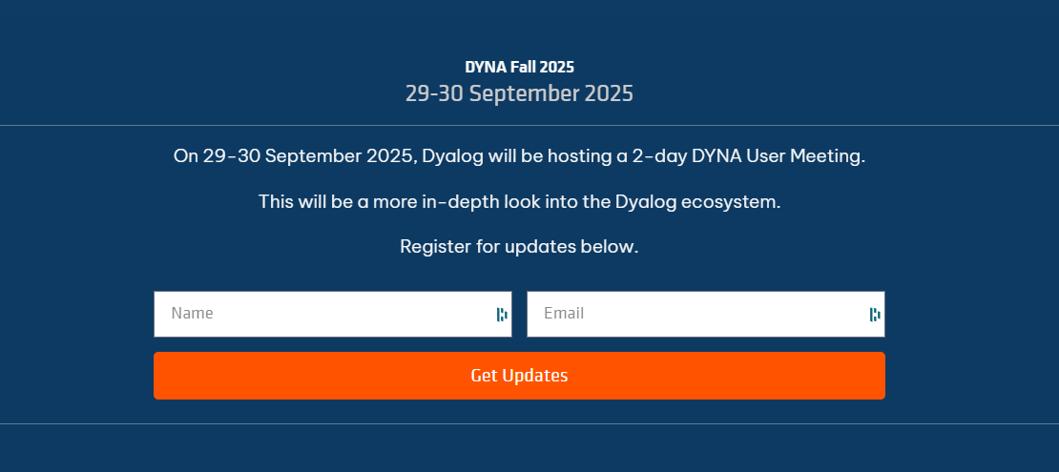
https://dyna.dyalog.com

